Slide 1
https://docs.google.com/presentation/d/1VJZWpoijQB7FS3HdH0G8qGJo0NB2PoRx-0gi0vmYD-g/edit?usp=sharing
https://docs.google.com/presentation/d/13DKhTlD6U1DwPYT7q8lTwOYk10-W7Mpm/edit?rtpof=true&sd=true

Slide 2
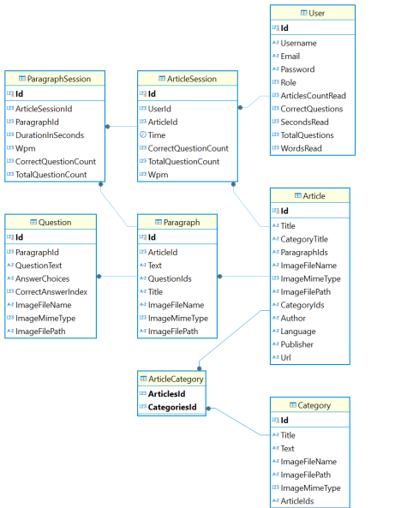

Slide 3


Slide 4
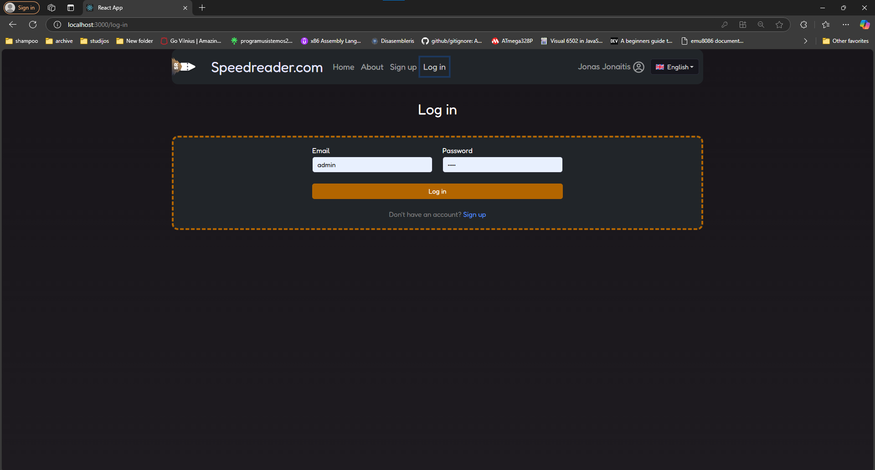

Slide 5
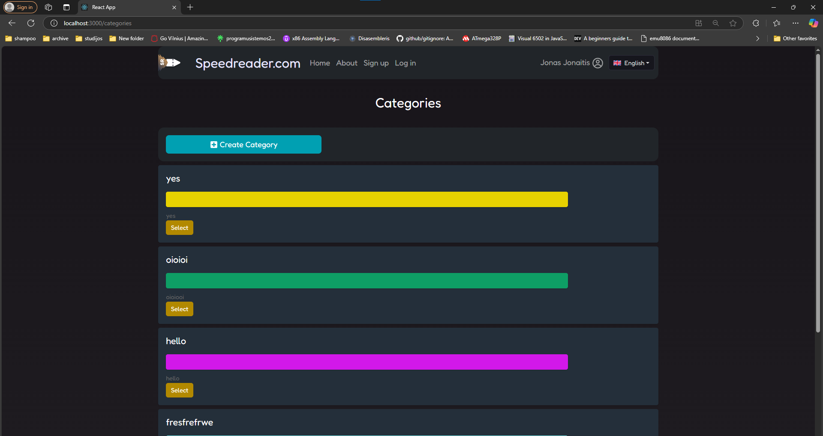

Slide 6
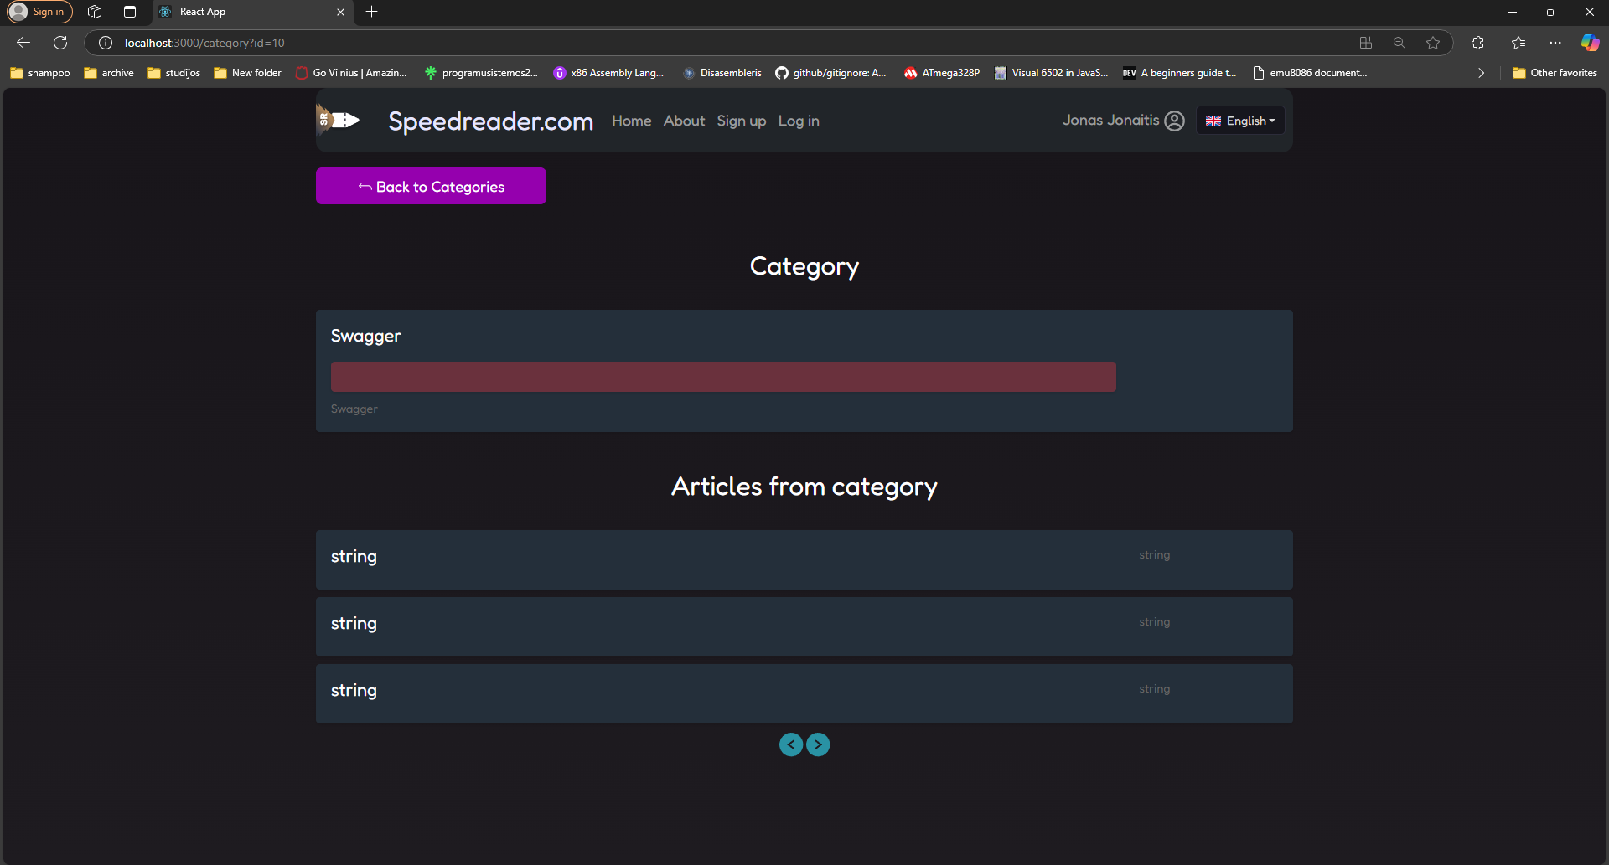

Slide 7
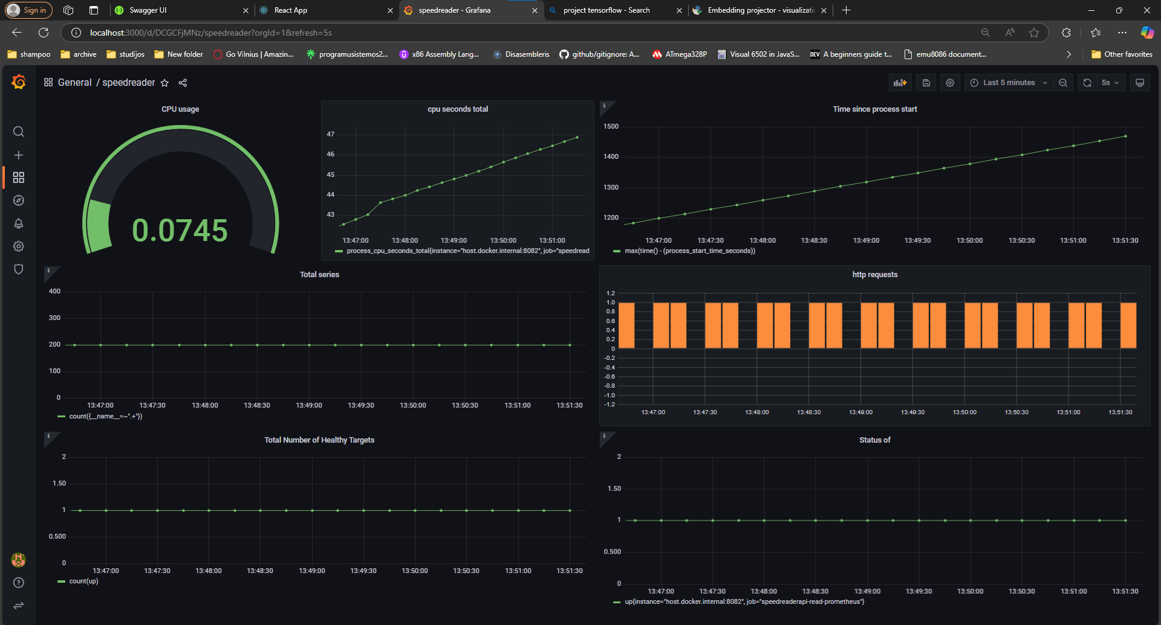

Slide 8
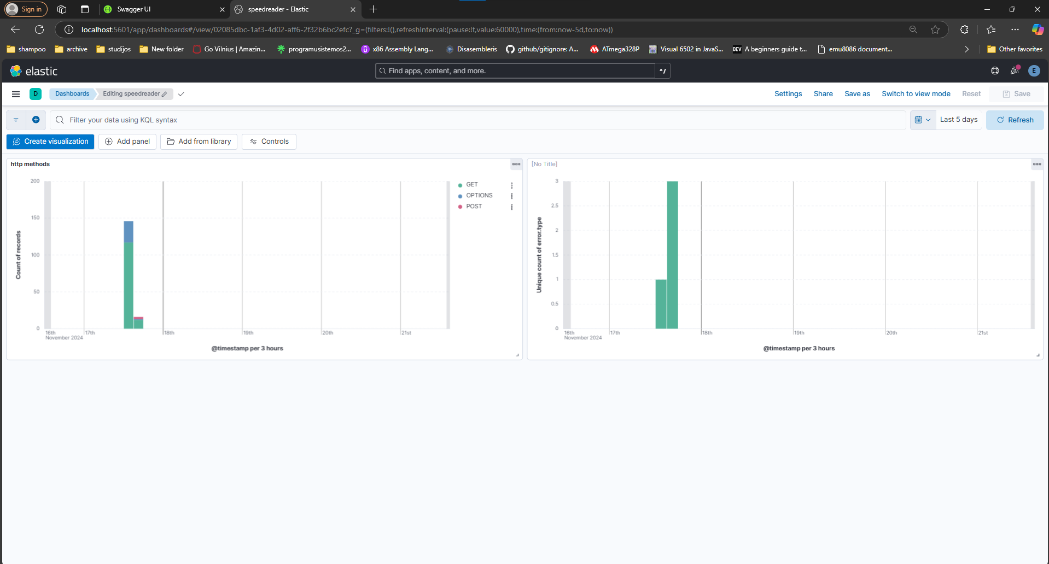

Slide 9
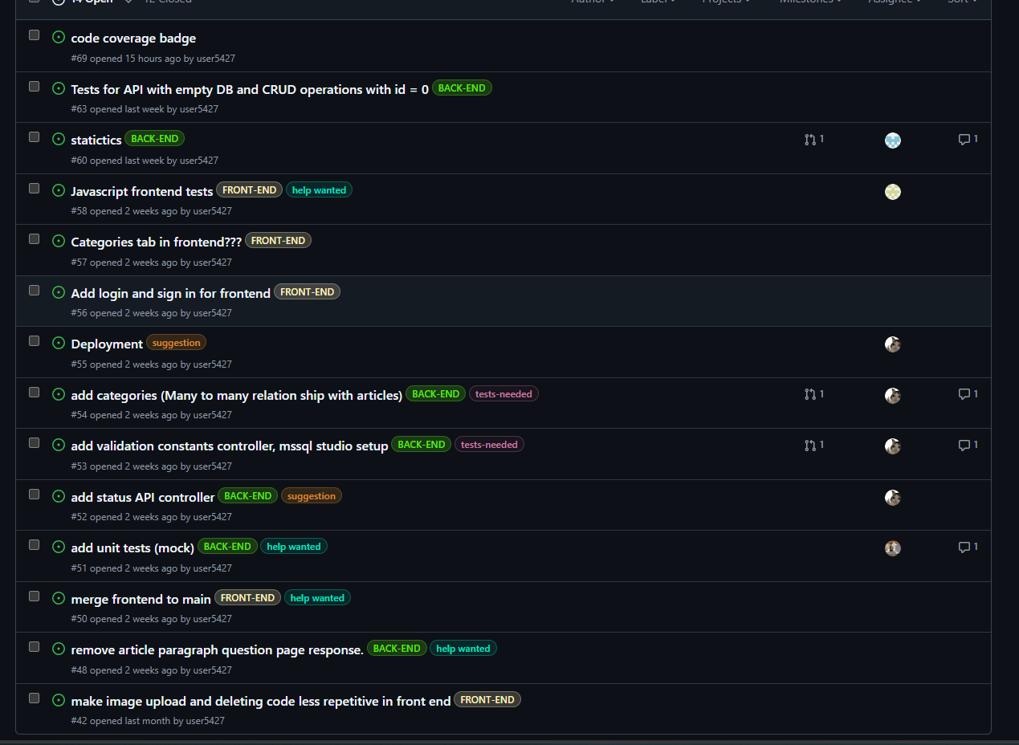

Slide 10
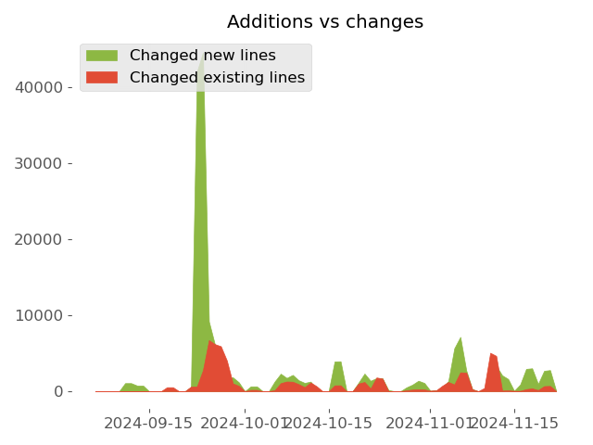

Slide 11
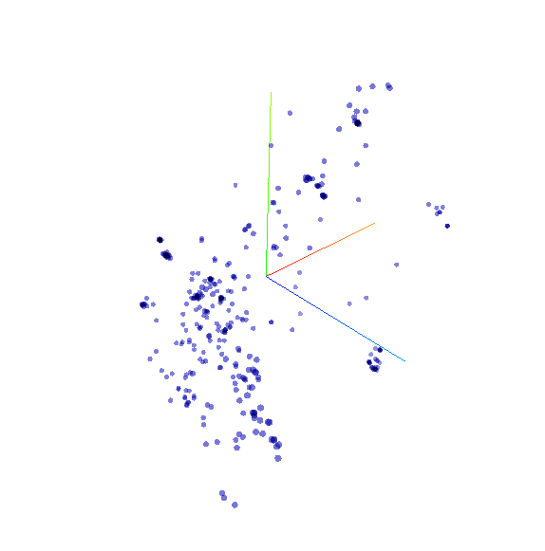
Embedding projector - visualization of high-dimensional data

Slide 12
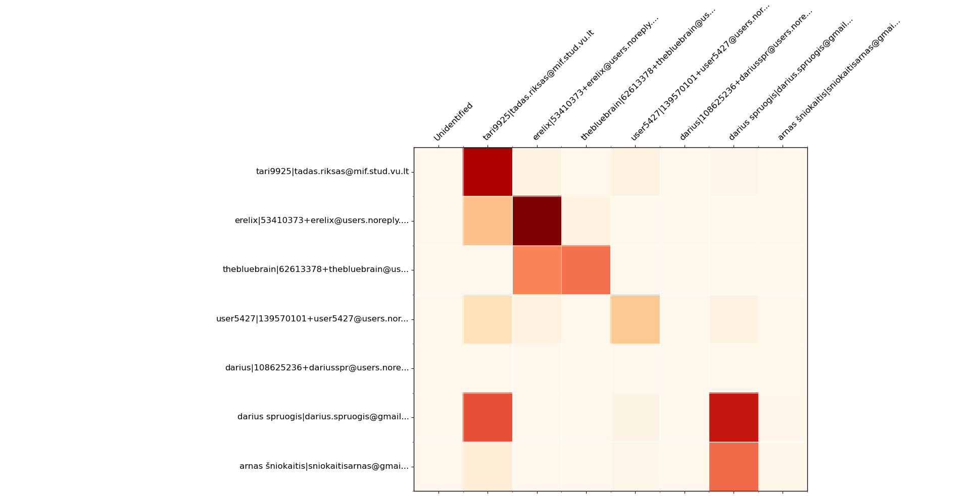

Slide 13
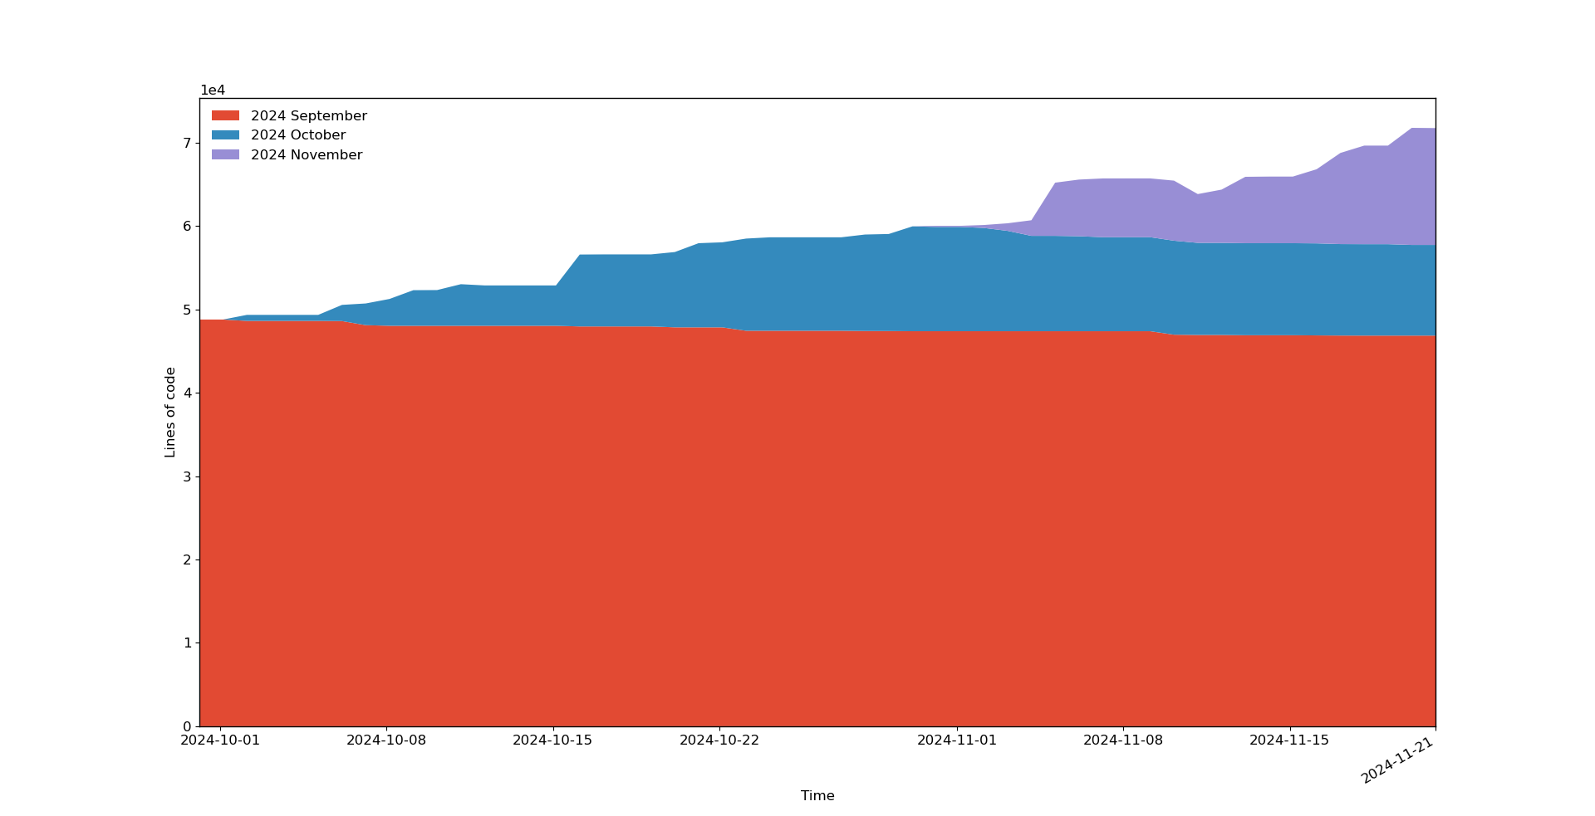

Slide 14
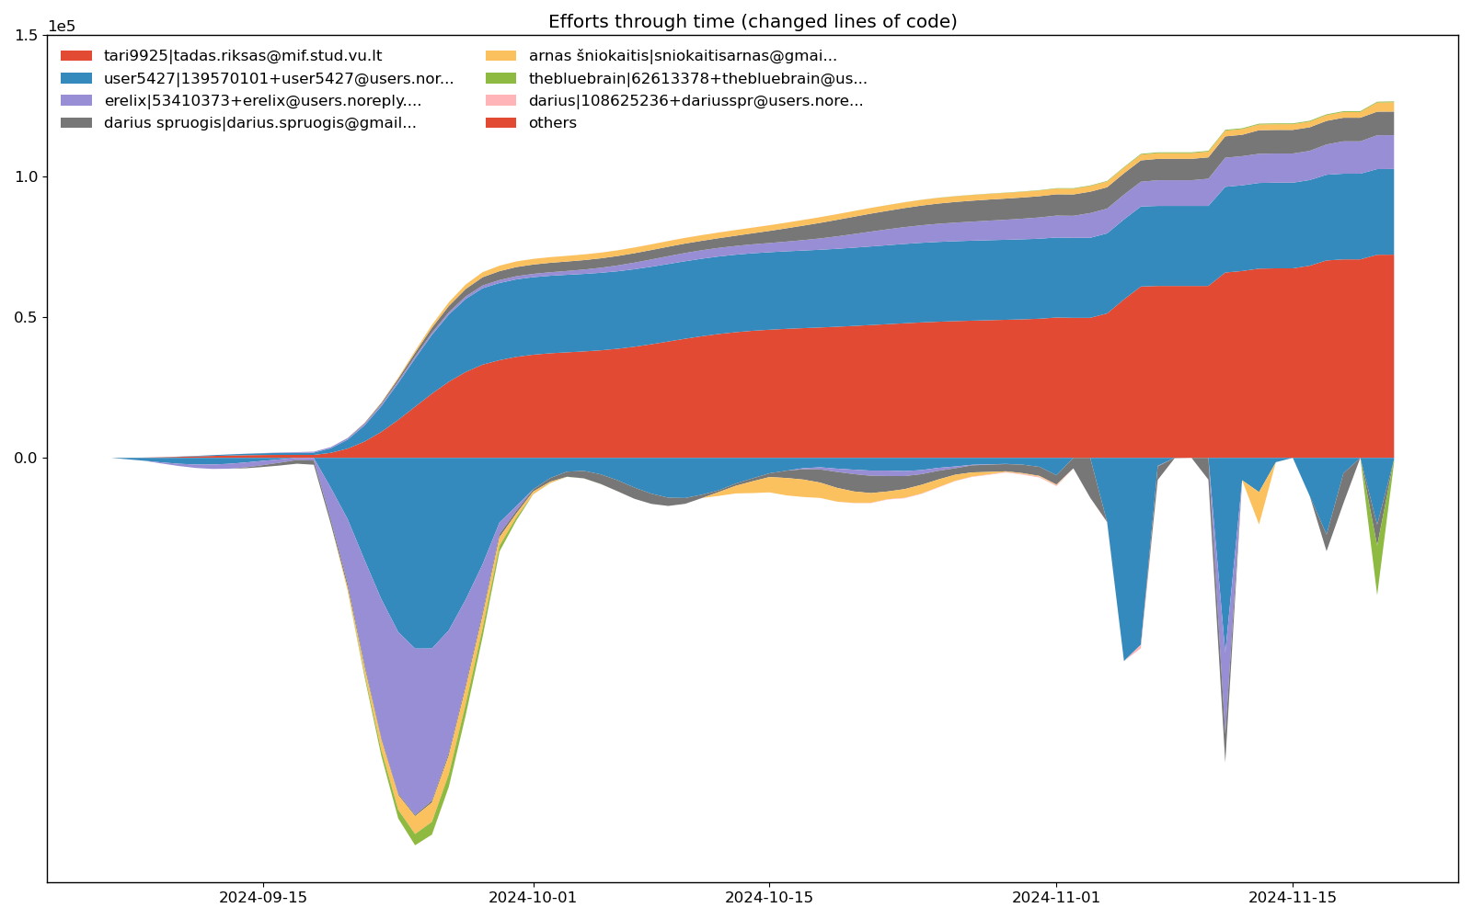

Slide 15
