Slide 1
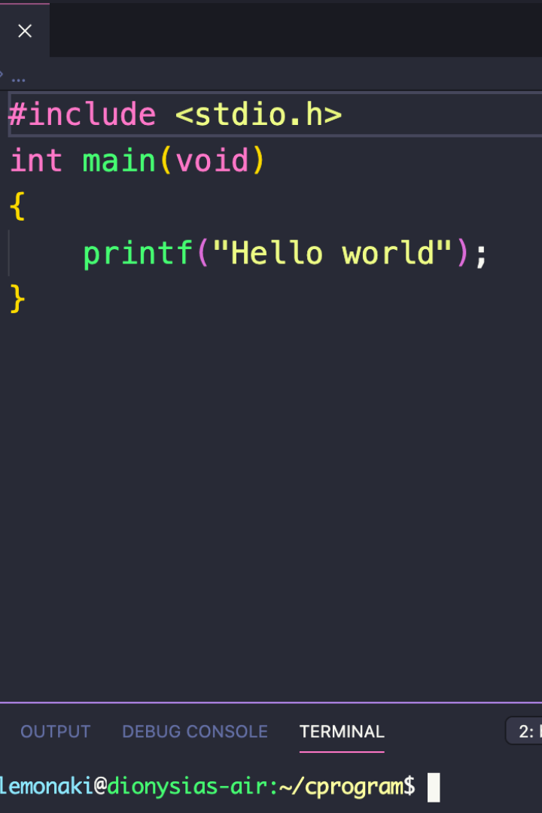
Introduction to Inline Functions and Function Pointers in C
Are you ready to take your C programming skills to the next level? In this presentation, we will explore two important concepts: inline functions and function pointers. By the end, you'll have a deeper understanding of these powerful tools and how to use them to optimize your code.

Slide 2

Inline Functions
If your code includes small, frequently used functions, inline functions can be a powerful optimization tool. Instead of calling a separate function, inline functions automatically insert the function code directly into the calling code, reducing overhead and improving performance.
1
Advantages:
Faster execution due to reduced branching and memory access. These functions are suitable for small, frequently called functions that require fast, repeated execution.
2
Syntax:
Use the "inline" keyword before the function declaration, and include the function code in the parentheses.
inline returnType functionName(parameters) { // Function code}

Slide 3

Function Pointers
Function pointers are variables that store the memory addresses of C functions. They allow you to dynamically call functions, add flexibility to your code, and enable callback functions.
1
Declaration:
An example of a function pointer declaration is:
returnType (*functionPointerName)(parameters);

Slide 4
Using Inline Functions
Example:
Usage:
int square(int x) { return x * x; } inline int inlineSquare(int x) { return x * x; }
int num = 5; int result_normal = square(num); int result_inline = inlineSquare(num);
The example above shows how to use inline functions in your code. By using the inline keyword, we tell the compiler to insert the code directly into the calling code, thereby reducing function call overhead.

Slide 5

Pros and Cons of Inline Functions
1
Pros:
Reduced function call overhead. Potential performance improvement for small functions. No separate function call/return.
2
Cons:
Increased code size. The compiler decides whether or not to inline the function.

Slide 6
Using Function Pointers
Example:
Usage:
int add(int a, int b){ return a + b; } int subtract(int a, int b){ return a - b; } int (*operation)(int, int);
operation = add; int sum = operation(3, 5); operation = subtract; int difference = operation(8, 4);
This example shows how to use function pointers to point to the memory address of a function. By doing so, you can dynamically choose which function to call. Function pointers are useful for event handling and callbacks.

Slide 7
Pros and Cons of Function Pointers
1
Pros:
Enable dynamic function calls. Useful for callbacks and event handling. Enhances flexibility.
2
Cons:
Slightly slower than direct function calls. Complex syntax.

Slide 8

Combining Inline Functions and Function Pointers
By combining inline functions and function pointers, you can optimize your code even further. Not only can you dynamically call functions, but you can also reduce the overhead of function calls.

Slide 9
Summary
Inline functions and function pointers are two important concepts in C programming. By using inline functions, you can optimize your code by inserting function code directly into the calling code, thereby reducing overhead and performance problems. Function pointers enable you to store and dynamically call functions, which can greatly enhance flexibility in your code.

Slide 10
Qsort()
Used to sort and array
Syntax:
void qsort(base, nitems, size, int (*compar)(const void *, const void*))
base − This is the pointer to the first element of the array to be sorted.
nitems − This is the number of elements in the array pointed by base.
size − This is the size in bytes of each element in the array.
compar − This is the function that compares two elements.

Slide 11
Qsort()
Example:
int cmpfunc (const void * a, const void * b) {
return ( *(int*)a - *(int*)b );
}
qsort(values, 5, sizeof(int), cmpfunc);

