Slide 1
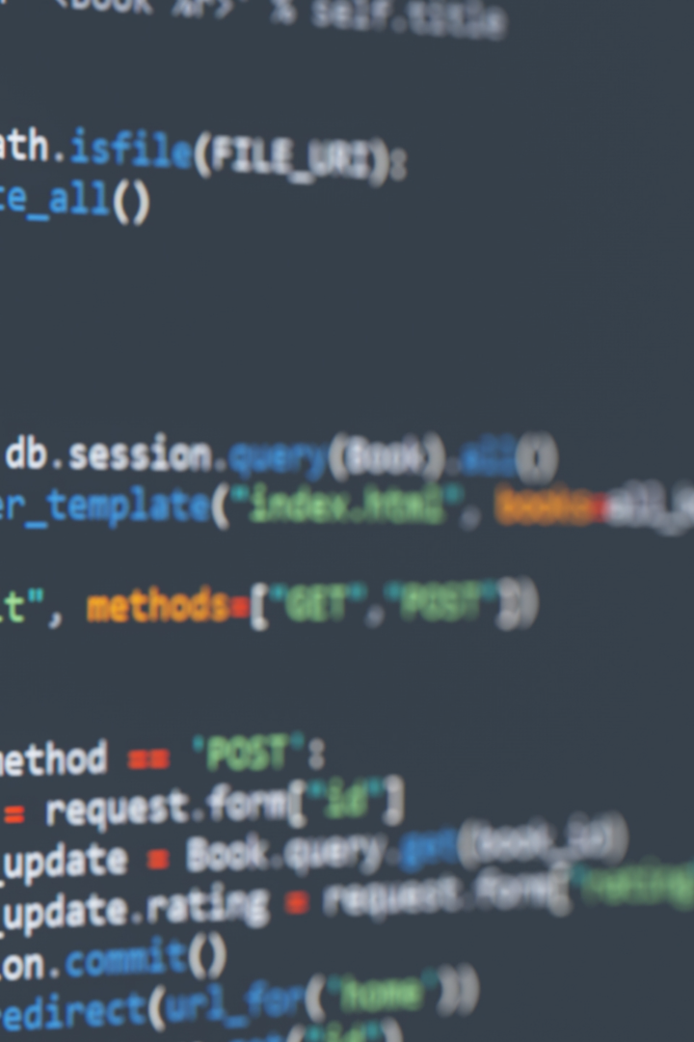
Exploring Advanced Concepts in C Programming
Expand your knowledge of C programming with advanced topics that include the qsort function, variadic functions, and the const keyword with pointers.

Slide 2
The qsort Function
The qsort function is a powerful tool for sorting arrays in C. It takes an array, the number of elements, the size of each element, and a comparison function as inputs. The comparison function is used to determine the correct order of the elements in the array. In practical applications, it can be used to sort an array of custom data types, such as structures, based on specific criteria.
Parameter
Description
base
Pointer to the array to be sorted
nitems
Number of elements in the array
size
Size (in bytes) of each element
compar
Comparison function that returns -ve, zero, +ve based on element comparison
Provide a suitable comparison function based on the data type to ensure accurate sorting. Remember that qsort can handle various data types.

Slide 3
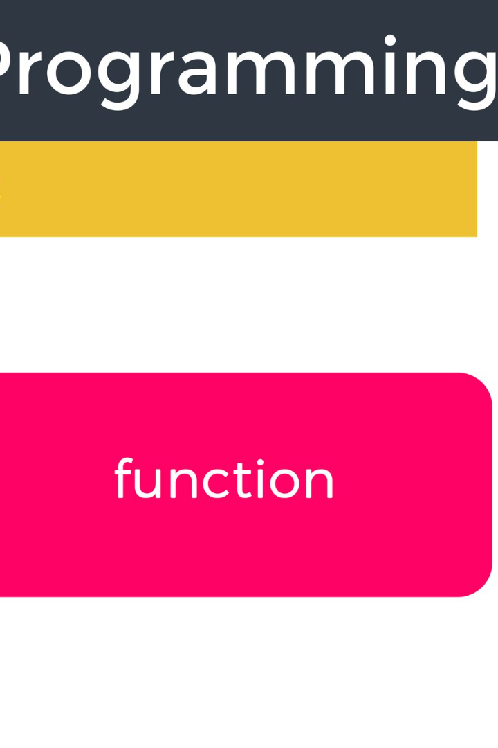
Variadic Functions
With variadic functions, you can handle an arbitrary number of arguments. This flexibility enables you to write dynamic and versatile code. An example of a variadic function is the `printf` function. In this function, you can pass a variable number of arguments to specify the format and the content of the output.
1
va_list
2
va_start
Argument list
Initialize the argument list
3
va_arg
4
va_end
Access each argument
Clean up the argument list
Make sure to access and clean up the arguments correctly using `va_start` and `va_end`.

Slide 4
The const Keyword with Pointers
The const keyword creates constant variables that are immutable and declared at compile time. When used with pointers, it enforces immutability for the value they point to. A const pointer is a pointer that is immutable, while a pointer to const is a pointer where the value is immutable.
const int
const int *
The value is constant.
The value pointed to is constant.
int *const
const int *const
The pointer itself is constant.
Both the pointer and the value are constant.
Remember that using const with pointers can help enforce immutability and data safety in function arguments.

Slide 5

qsort, Variadic Functions, and const with Pointers - Practical Applications
In practical applications, you can use qsort to efficiently sort arrays of custom data types, such as structures or linked lists. Variadic functions can be used to format output with flexible arguments like logs or user messages with varying data. Using const with pointers can safeguard data integrity and ensure immutability in function arguments. It protects the function parameters from modification.

Slide 6
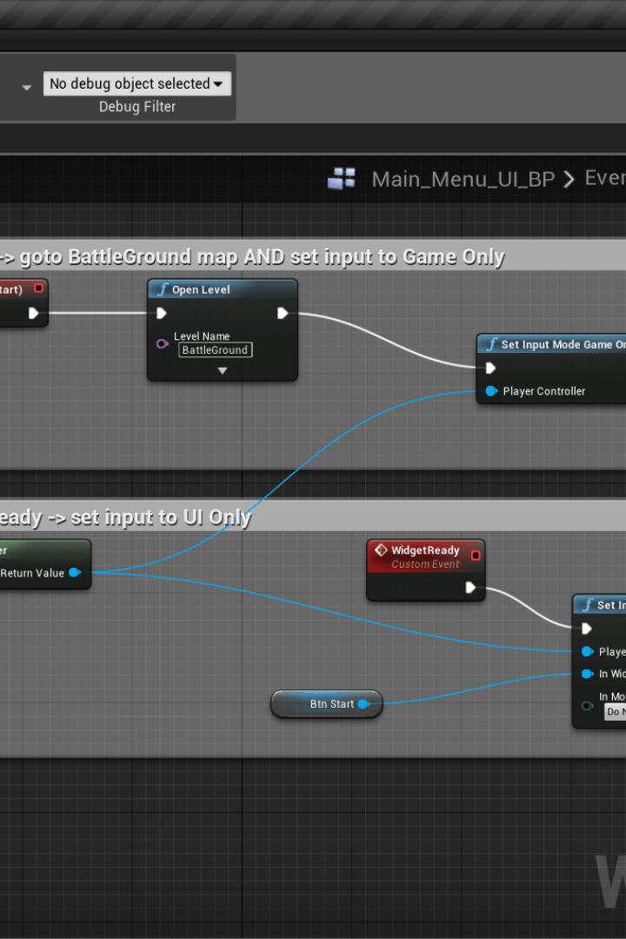
Considerations and Best Practices
Variadic functions require careful memory management. Ensure that arguments are accessed correctly and cleaned up using `va_end`. The const keyword with pointers is a powerful tool but it requires balance. Overuse can impact readability and debugging. When using qsort, provide an accurate comparison function to ensure correct sorting.

Slide 7
Summary
qsort: A powerful sorting tool for arrays of various data types.
Variadic Functions: Flexibly handle functions with variable arguments.
`const` with Pointers: Safeguard data integrity by enforcing immutability.

Slide 8

Conclusion
Mastering advanced C concepts, like qsort, variadic functions, and const with pointers, empowers you to write efficient and robust code. Experiment with these concepts to refine your programming skills and achieve success.

