Slide 1

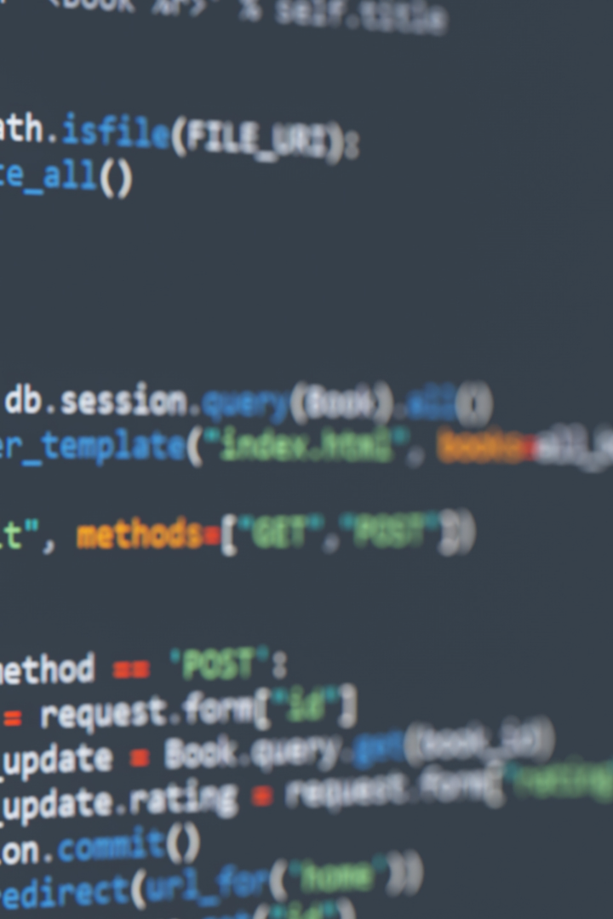
Introduction to Object-Oriented Programming (OOP) and C++
Welcome to the world of Object-Oriented Programming! In this presentation, we'll explore how OOP can help structure your code and make it easier to develop software.

Slide 2
Introduction to OOP
1
Objects and Classes
OOP uses objects, which are instances of classes, to represent real-world entities and their interactions. Classes define the properties and behaviors of an object.
2
Encapsulation
Encapsulation is the idea of "hiding" class data from outside access. This promotes data integrity, security, and helps prevent errors from occurring.
3
Inheritance
Inheritance allows classes to inherit properties and behaviors from a parent class. It promotes code reusability and saves development time.
4
Polymorphism and Abstraction
Polymorphism allows objects to take on multiple forms, while abstraction simplifies complex systems by hiding unnecessary details. Both promote modularity and make programs more scalable.

Slide 3
Procedural vs. OOP Paradigm
Procedural Programming
OOP
Advantages of OOP
Allows for code reusability
Focuses on procedures and functions.
Data and functions are separate.
Code is harder to maintain for large systems.
Focuses on objects and classes.
Combines data and functions into objects.
Code is modular and promotes reusability.
Enables modularity and maintainability
Promotes scalability and development efficiency

Slide 4
Structures vs. Classes
Structures
Classes
Encapsulation
Group related data members together.
Used in C for grouping related data members. No member functions. Data members are public by default.
Group data members and member functions together. Also promote encapsulation, which promotes data security.
Data members can be private, protected, or public.
Keeps data hidden away from outside access. It protects the data from any outside interference which may cause havoc and result in programs crashing.
Classes offer encapsulation, meaning that the internal details of an object are hidden from the outside world, promoting data integrity and security.

Slide 5

Variables and Data Types in C++
1
Data Types
2
Variable Declaration
3
Initialization
Determine the type of data a variable can store. Examples of data types include:
int, float, char, and double.
Variables can be initialized to a value during declaration. For example:
int age = 25;
Variables must be declared before use. For example:
int age;

Slide 6
Console Input/Output
cout
cin
Used for console output in C++. Displays messages and data to the user.
Used for console input in C++. Accepts user input during program execution.

Slide 7
GO TO Statement
A rarely used control statement in modern programming.
Allows transferring control to a labeled statement.
Can lead to unstructured code and is generally discouraged.t
Example:
goto label;
// ...
label:
// Code to execute

Slide 8
Preprocessor Directives
#include
Used to include libraries in C++
#define
Used to define macros in C++

Slide 9
Decision Making
if-else statement
switch statement
Provides branching based on a single condition. Enables the execution of different code based on whether a condition is true or false.
Used for multi-way branching based on the value of an expression. Offers a concise and readable way of writing code involving multiple selections.
1
2
3
4
if statement
else-if ladder
Used for conditional execution. Allows us to execute a block of code if a certain condition is met.
Allows multiple conditions to be tested in sequence. Offers greater flexibility than a simple if-else statement.

Slide 10
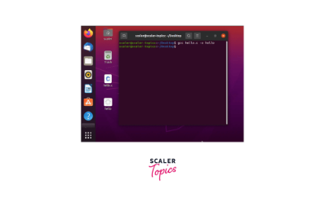
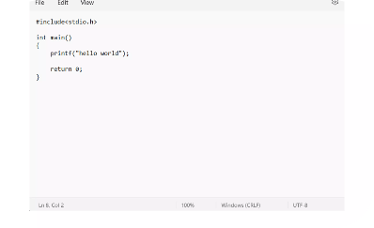
Repetitive Constructs
For Loop
While Loop
Do-While Loop
Used to repeat a block of code a specific number of times.
Used to repeat a block of code while a certain condition is true.
Similar to the while loop but executes the loop at least once.

Slide 11
Break and Continue
Break Statement
Continue Statement
Used to exit a loop prematurely.
Used to skip the current iteration of a loop. Execution resumes at the beginning of the next iteration.

