Slide 1
Launchpad Lecture -22
Data Structures
Graphs
Notes:
File Handling
Linked list code

Slide 2
Graphs

Slide 3
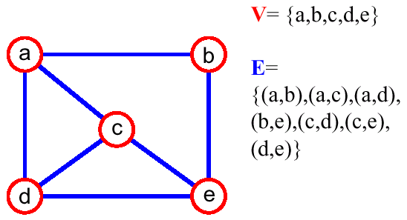
Graphs
Graph is a data structure that can be represented as a finite set of nodes and edges. Nodes are called as vertices and edges are used to connect two vertices.
Examples : Used in Google Maps, Social Networking sites, sending packets through various servers.
Notes:
Flight network road network

Slide 4
Terminology
Adjacent Vertices
Degree
Path
Connected Graph
Subgraph
Connected Components
Tree
Forest
Spanning Tree

Slide 5
Un-Weighted Graphs?
Each edge may or may not carry some weight.
Types of Edges :
Undirected Edges
Directed Edges
Notes:
Flight network road network

Slide 6
Weighted Graphs?
Each edge carry some weight.
Types of Edges :
Undirected Weighted edges
-A simple network of friends or bidirectional roads.
Directed Weighted edges
- One way road.
Bi-directional Weighted edges
- Flight Fares, Two way trips with different costs.
Notes:
Flight network road network

Slide 7
Number of edges
Complete Graph O(n^2)
Connected Graph
Tree

Slide 8
How to implement Graph?
Edge List
Adjacency matrix
Adjacency list

Slide 9


Edge List?
List of edges and vertices.
Generally used when we need sorted list of edges.
Can be created using Linked List.
list < pair<T,T>>
Takes more time to find neighbours O(E).

Slide 10
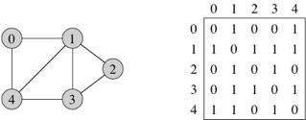
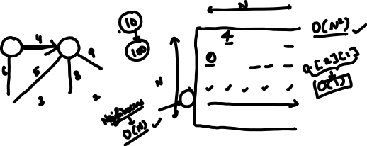
Adjacency Matrix?
Stored as VxV matrix, where V : number of vertices.
Not memory efficient, useful for complete graph.
Takes linear O(V) time to find neigbours of a given node.
Useful when we directly want to look presence of edge/ look up for edge weight between two nodes.

Slide 11
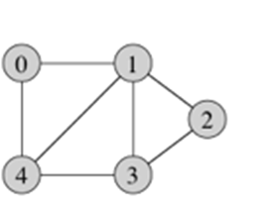
Adjacency List?
Most widely used and useful.
Efficiently computes neighbours of a given node.
Memory Efficient.
All neighbours are stored in a linked list.
Can be created using array of linked list (for integer keys only) or hash map.
Keys Values
0 -> 1,4
1 -> 2,3,4,0
2 -> 1,3
3 -> 2,1,4
4 -> 0,1,3

Slide 12
Adjacency List?
Implementation using array of linked list?
For Integer Nodes :
int * a=new int[V]; // this will give array of integers
list <int>* l=new list<int>[V]; // array of Linkedlist

Slide 13
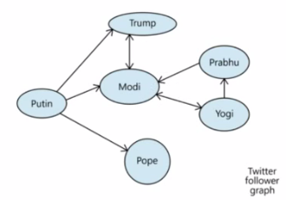
Adjacency List?
Implementation using Hash map?
For Generic Data :
Hash_map <key(T), value(list<T>)>
Key (String) Value(LinkedList<String>)
Modi -> Yogi, Trump
Prabhu -> Modi
Trump -> Modi
Yogi -> Modi, Prabhu
Putin -> Trump, Modi, Pope
Pope ->
Notes:
g.addEdge("Putin","Trump",false);
g.addEdge("Putin","Modi",false);
g.addEdge("Trump","Modi",true);
g.addEdge("Yogi","Modi",true);
g.addEdge("Yogi","Prabhu",false);
g.addEdge("Prabhu","Modi",false);
g.addEdge("Putin","Pope",false);

Slide 14
Searching in a Graph

Slide 15
How to Search through a Graph?
Breadth First Search
Depth First Search

Slide 16
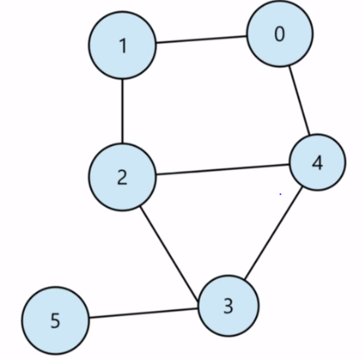
BFS?
It traverses graph, starting from a source vertex, then moving on to the neighbours of the source, then moving on to the next layer and so on.
Iterative approach like level order tree traversal.
Uses a Queue to maintain FIFO ordering, another data-structure (like array/map) is used to maintain the list of vertices visited so far.
Time Complexity: O(V+E)

Slide 17
Single Source Shortest Path?
An application of BFS, to find the minimum distance of all the nodes from a source node.

Slide 18
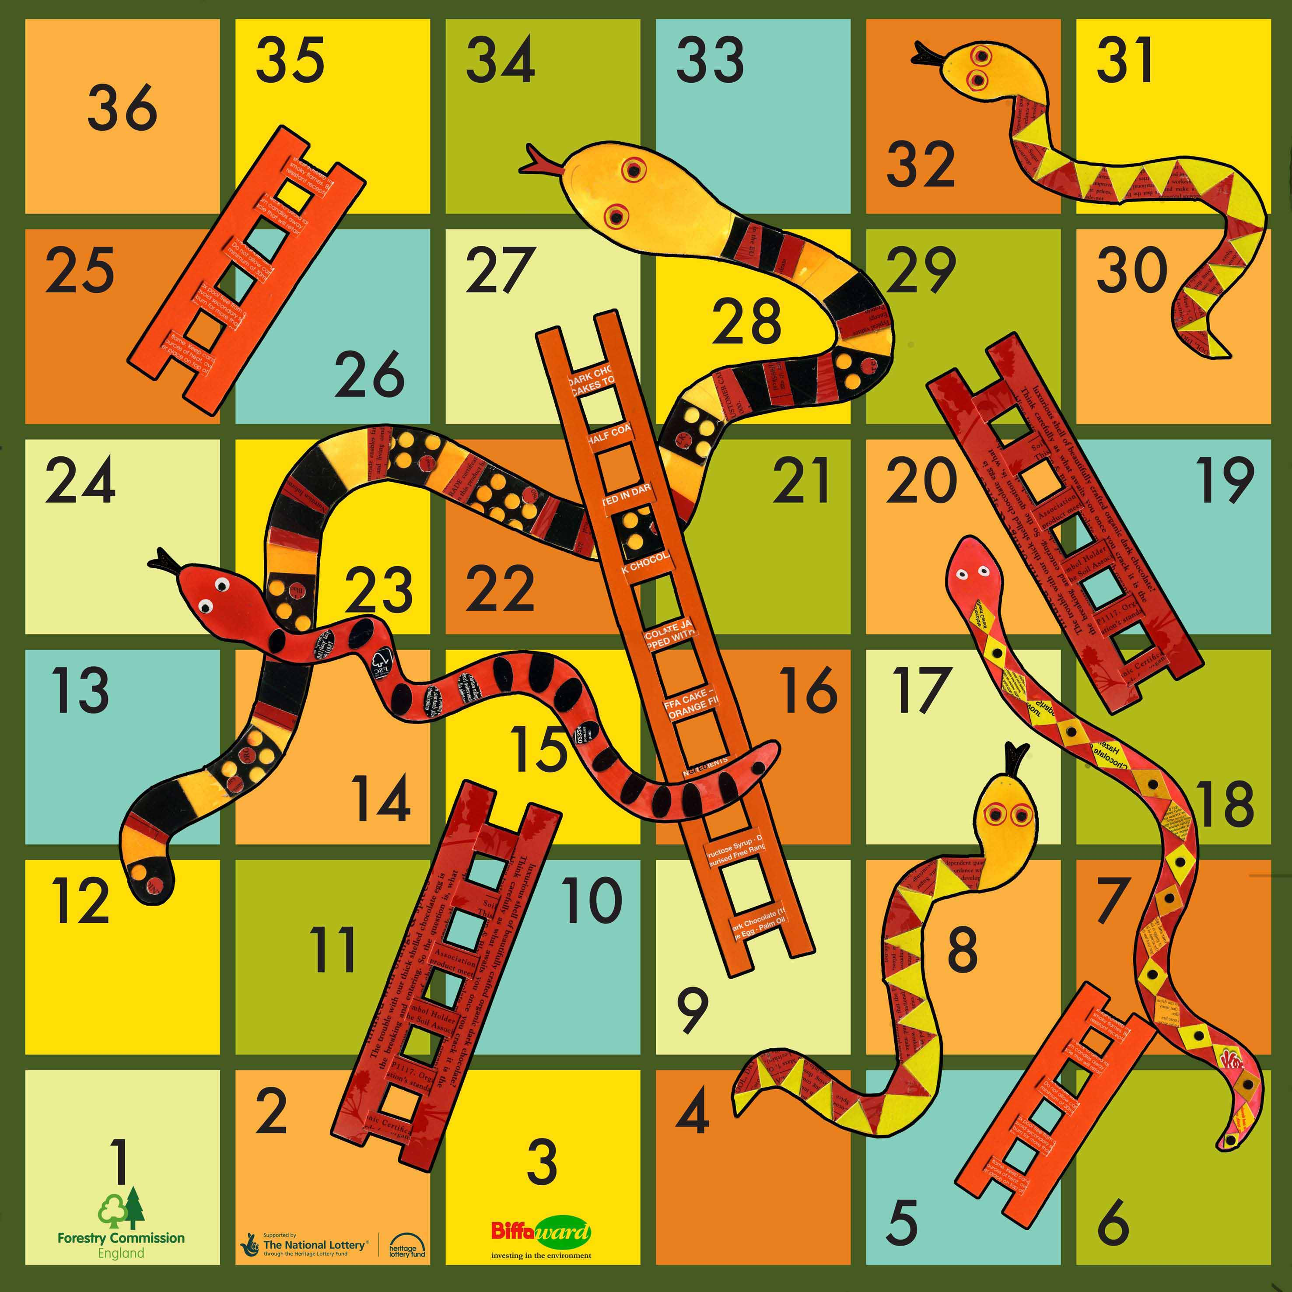
We are
standing
at ‘0’

Slide 19
Sample Output :
Min moves: 4
One Possible Shortest Path :
1->15->29->30->36
int board[50] = {0};
board[2] = 13;
board[5] = 2;
board[9] = 18;
board[18] = 11;
board[17]=-13;
board[20] = -14;
board[24] = -8;
board[25] = -10;
board[32] = -2;
board[34] = -22;

Slide 20
DEPTH FIRST SEARCH?
In this we pick one of the neighbors and visits it, and then we traverse further till we reach the vertex from we can’t go any further. After that we visits the next unvisited neighbor.
Thus to implement it we need :
- Hash map to maintain visited nodes.
- Recursive call on unvisited nodes.

Slide 21
Problems
Return all the connected components of the graph
Snakes and Ladders Problem.

Slide 22
Dijkstra’s Algorithm?
- To find Shortest Path on Weighted Graph.
Amritsar
1
Agra
4
Delhi
1
2
Jaipur
2
Bhopal
8
3
Mumbai
Notes:
g.addEdge("Amritsar",”Delhi”,1);
g.addEdge("Amritsar",”Jaipur",4);
g.addEdge("Delhi","Jaipur",2);
g.addEdge("Delhi","Agra",1);
g.addEdge("Bhopal","Agra",2);
g.addEdge("Bhopal","Mumbai",3);
g.addEdge("Jaipur","Mumbai",8);

Slide 23
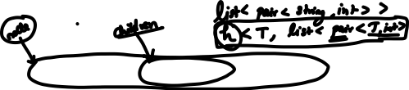
Dijkstra’s Algorithm?
Adjacency List
Keys Values
Amritsar -> (Delhi,1) (Jaipur,1)
Jaipur -> (Delhi,2) (Mumbai,8)
Mumbai -> (Bhopal,3) (Jaipur, 8)
Keys -> string
Values -> list of pair(String, distance)
Notes:
g.addEdge("Amritsar","Agra",1);
g.addEdge("Amritsar","Jaipur",4);
g.addEdge("Delhi","Jaipur",2);
g.addEdge("Delhi","Agra",1);
g.addEdge("Bhopal","Agra",2);
g.addEdge("Bhopal","Mumbai",3);
g.addEdge("Jaipur","Mumbai",8);

Slide 24

Thank You!
Kartik Mathur

