Slide 1



Lecture-1
FUNDAMENTALS
Basics of Problem Solving
Flowcharts, PseudoCode
1
Kartik Mathur

Slide 2


BT-1 Hour Glass
 You have two hourglasses: a 7 minute one and a 11 minute one. Using just two hourglass, accurately measure time 15 minutes.

Slide 3
Course Structure
 Basics of Problem Solving
 Programming Fundamentals
 Object Oriented Programming
 Data Structures

Slide 4
Course Administration
 Slack – Communication Channel
 Codes Repository – Github
 Regular Assignments (www.hackerblocks.com)
 Laptops

Slide 5

What does a computer do?
Input
Output
Computer

Slide 6
Tool for solving problems with data
 To communicate the solution we create
Programs.

Slide 7
Tool for solving problems with data
 To communicate the solution we create
Programs.
 So a program is a sequence of instructions that tells a computer how to perform a task.

Slide 8
Tool for solving problems with data
 To communicate the solution we create
Programs.
 So a program is a sequence of instructions that tells a computer how to perform a task.
 When computer follows the instructions we say it executes the program.
Notes:
Example : Making Tea.

Slide 9
It’s a machine!
 Computers are a machine, and at the most basic level, they are collection of switches – where 1 represents “on” and 0 represents “off”.

Slide 10
It’s a machine!
 Computers are a machine, and at the most basic level, they are collection of switches – where 1 represents “on” and 0 represents “off”.
 Everything that a computer does is implemented in this most basic of all numbering systems – binary

Slide 11
It’s a machine!
 Computers are a machine, and at the most basic level, they are collection of switches – where 1 represents “on” and 0 represents “off”.
 Everything that a computer does is implemented in this most basic of all numbering systems – binary

Slide 12
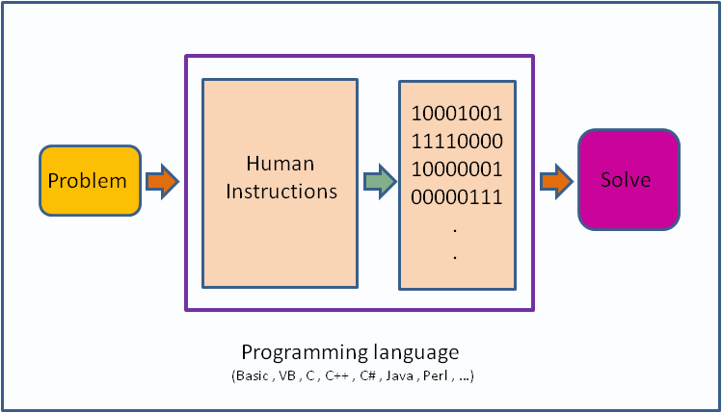

Slide 13
Its nearly impossible to write in Binary!

Slide 14
So we use programming language with Flowcharts & Algorithms for solving a Problem

Slide 15
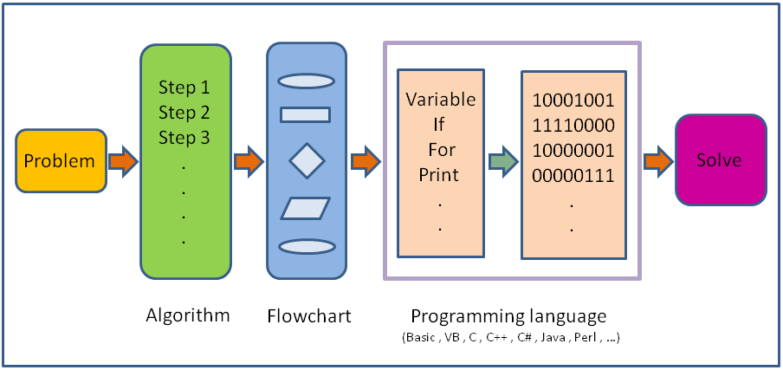

Slide 16
What is programming language?

Slide 17
What is programming language?
 A programming language is a set of rules that provides a way of telling a computer what operations to perform

Slide 18
What is programming language?
 A programming language is a set of rules that provides a way of telling a computer what operations to perform
 It provides a linguistic framework for
describing computations.

Slide 19
What is programming language?
 A programming language is a set of rules that provides a way of telling a computer what operations to perform
 It provides a linguistic framework for
describing computations.
 A programming language also has w o r d s, symbols and rules of grammar.

Slide 20
What is programming language?
 A programming language is a set of rules that provides a way of telling a computer what operations to perform
 It provides a linguistic framework for
describing computations.
 A programming language also has w o r d s, symbols and rules of grammar.
 The grammatical rules are called syntax

Slide 21
High/Low Level Languages!
C++/ Java/ Python
Assembly language
Machine Code

Slide 22

High/Low Level Languages!
C++/ Java/ Python
Assembly language
Machine Code

Slide 23

High/Low Level Languages!
C++/ Java/ Python
Assembly language
Machine Code

Slide 24

High/Low Level Languages!
C++/ Java/ Python
Assembly language
Machine Code

Slide 25

High/Low Level Languages!
C++/ Java/ Python
Assembly language
Machine Code
ARM/MIPS/IBM

Slide 26





How do we work with High Level?
Magic Box
Compiler
000000 00001
00010 00110
00000 100000
sum = I + j;
Linker
In High level
In Machine Code

Slide 27
Before we write a program for a
solution we need an Algorithm.

Slide 28
So what is an algorithm?

Slide 29
So what is an algorithm?
 An algorithm is a self-contained step by step set of operations to be performed in order to solve a problem.

Slide 30
So what is an algorithm?
 An algorithm is a self-contained step by step set of operations to be performed in order to solve a problem.
 Its an effective method that can be expressed within a finite amount of space and time and in well-defined formal language for solving a problem.

Slide 31
So what is an algorithm?
 An algorithm is a self-contained step by step set of operations to be performed in order to solve a problem.
 Its an effective method that can be expressed within a finite amount of space and time and in well-defined formal language for solving a problem.
 Another way to describe an algorithm is a sequence of unambiguous instructions.

Slide 32
Expressing Algorithms?
 Algorithms can be expressed in many kind of notations, including natural languages, pseudocode, flowcharts, etc.
 Natural Language expressions of algorithms tend to be verbose and ambiguous, and are rarely used for complex or technical algorithms.
 Programming languages are primarily intended for expressing algorithms in a form that can be executed by a computer.

Slide 33
Two basic aspects of programming
 Data
 Instructions

Slide 34
To understand data we need to
understand Variables!

Slide 35
What are Variables?
 Variables in a computer program are analogous to Buckets or Envelopes where information can be maintained and referenced.
 On the outside of the bucket is a name.
 When referring to the bucket, we use the name of the bucket, not the data stored in the bucket.

Slide 36
Variable Actions!
 Create one (with a nice name). A variable should be named to represent all possible values that it might contain. Some examples are: midterm_score, midterm_scores, data_points, course_name, etc.
 Put some information into it (destroying whatever was there before). We "put" information into a variable using the assignment operator, e.g., midterm_score = 93;
 Get a copy of the information out of it (leaving a copy inside). We "get" the information out by simply writing the name of the variable, the computer does the rest for us, e.g., average = (grade_1 + grade_2) / 2.

Slide 37
Now lets talk about Instructions!

Slide 38
What are instructions?
 Its an order given to computer.
 At lowest level each of these is a s e q u e n c e of 0s and 1s.
 In assembly language, each statement is one instruction but in high level each statement can be further broken into multiple steps.

Slide 39
Six basic computer instructions
 Reading/Receiving some information
 Outputting/Printing some information
 Performing arithmetic operation
 Assigning a value to a variable or memory location
 Conditional Execution
 Repeat a group of actions

Slide 40
Time for Flowcharts!

Slide 41
What is a flowchart?
 Diagrammatic representation illustrating a
solution to a given problem.
 Allows you to break down any process into smaller steps and display them in a visually pleasing way
 It shows steps as boxes of various kinds, and their order by connecting them with arrows.
 It helps your audience to see the logical flow and relationship between steps.

Slide 42

Flowchart components
Start
Initializer / Terminator
Read N
Let Sum =0, I = 1
Is I greater than N ?
A

Slide 43

Flowchart components
Start
Initializer / Terminator
Read N
Input / Output
Let Sum =0, I = 1

Slide 44

Flowchart components
Start
Initializer / Terminator
Read N
Input / Output
Let Sum =0, I = 1
Process
Is I greater than N ?
A

Slide 45

Flowchart components
Start
Initializer / Terminator
Read N
Input / Output
Let Sum =0, I = 1
Process
Is I greater than N ?
Decision

Slide 46
Flowchart components
Start
Initializer / Terminator
Read N
Input / Output
Let Sum =0, I = 1
Process
Is I greater than N ?
Decision
Arrow
A

Slide 47

Flowchart components
Start
Initializer / Terminator
Read N
Input / Output
Let Sum =0, I = 1
Process
Is I greater than N ?
Decision
Arrow
A
Connector

Slide 48
Lets look at few problems and their
flowcharts!

Slide 49

Read Principal, Rate & Time and Print SI
Start

Slide 50

Read Principal, Rate & Time and Print SI
Start
Read P, R, T

Slide 51

Read Principal, Rate & Time and Print SI
Start
Read P, R, T SI = (P*R*T)/100

Slide 52
Read Principal, Rate & Time and Print SI
Start
Read P, R, T SI = (P*R*T)/100
Output SI

Slide 53

Read Principal, Rate & Time and Print SI
Start
Read P, R, T SI = (P*R*T)/100
Output SI End

Slide 54
Find largest of three numbers
Start
Print A
Print B
Print C
End

Slide 55
Find largest of three numbers
Start
Read A,B,C
Is A > B
and A > C
Is B > A
and B
> C
Print A
Print B
Print C
End

Slide 56

Find largest of three numbers
Start
Read A,B,C
Is A > B
and A > C
Is B > A
and B
> C
Print A
Print B
Print C
End

Slide 57


Find largest of three numbers
Start
Read A,B,C
Is A > B
and A > C
Is B > A
and B
> C
Yes
Print A
Print B
Print C
End

Slide 58
Find largest of three numbers
Start
Read A,B,C
Is A > B
and A > C
No
Is B > A
and B
> C
Yes
Print A
Print B
Print C
End

Slide 59

Find largest of three numbers
Start
Read A,B,C
Is A > B
and A > C
No
Is B > A
and B
> C
Yes
Print A
Yes
Print B
Print C
End

Slide 60
Find largest of three numbers
Start
Read A,B,C
Is A > B
and A > C
No
Is B > A
and B
> C
Yes
Print A
Yes
Print B
No
Print C
End

Slide 61
Read a & d, print 10 numbers of form a+d, a+2d, a+3d…
Start
I = I + 1
Is I <= 10
Output term
End
term = a + I * d

Slide 62


Read a & d, print 10 numbers of form a+d, a+2d, a+3d…
Start
Read a, d Let I = 1
Yes
I = I + 1
Is I <= 10
Output term
No
End
term = a + I * d

Slide 63
Given N, print all numbers from 1 to N
Start
Add 1 to I

Slide 64
Given N, print all numbers from 1 to N
Start
Read N Let I = 1
Add 1 to I
Yes
Is I <= N ?
Output I
No
End

Slide 65
Time to try?
 Read five numbers and print their average
 Given N, find sum of even numbers from 1 to N
 Given N, check if its prime or not

Slide 66



Check if a number is prime or not?
Start
Read N
I = 2
Is I < N ?
No
Print
“IS PRIME”
Add 1 to I
Yes
No
Is N divisible by I?
Yes
Print
“NOT PRIME”
End

Slide 67
Some more examples!

Slide 68
Find largest of N numbers
Start
Let I = 1, L = -1000000
Is I <= N ?
Output L
Add 1 to I
Read Num
End
Is Num > L ?

Slide 69

Find largest of N numbers
Start
Read N
Let I = 1, L = -1000000
Is I <= N ?
No
Output L
Add 1 to I
Yes
Read Num
End
No
Is Num > L ?
L = Num
Yes

Slide 70
Print the below pattern
*
* *
* * *
* * * *
* * * * *
Start
I = I + 1
Read N
Print ‘\n’
Let I = 1
J = J + 1
Let J = 1
Is J <= I ?
End

Slide 71


Print the below pattern
*
**
***
****
*****
Start
I = I + 1
Read N
Print ‘\n’
Let I = 1
J = J + 1
No
Is I <= N ?
Print ‘*’
Yes
Yes
No
Let J = 1
Is J <= I ?
End

Slide 72
Time to try?
 Given a list of N integers, find mean, maximum and minimum value. You would be given first N, and then N integers of the list.
 Given a number check if it is a member of
Fibonacci sequence or not
 Read N, and print the following pattern
1
2 3
4 5 6
7 8 9 10
11 12 13 14 15

Slide 73
Time for Brain Teasers!

Slide 74
BT – 2: Apples and Oranges
There are three closed and opaque cardboard boxes. One is labeled "APPLES", another is labeled "ORANGES", and the last is labeled "APPLES AND ORANGES". You know that the labels are currently misarranged, such that no box is correctly labeled. You would like to correctly rearrange these labels. To accomplish this, you may draw only one fruit from one of the boxes. Which box do you choose, and how do you then proceed to rearrange the labels?

Slide 75
BT – 3: Average Salary
Three coworkers would like to know their average salary. However, they are self- conscious and don't want to tell each other their own salaries, for fear of either being ridiculed or getting their houses robbed. How can they find their average salary, without disclosing their own salaries?

Slide 76
Pseudocode!

Slide 77
What is pseudocode?
 A notation resembling a simplified programming language, used in program design
 It allows designers or lead programmers to express the design in great detail and provides programmers a detailed template for the next step of writing code in a specific programming language

Slide 78
Notation for those basic six!
 Reading/Receiving [ read N ]

Slide 79
Notation for those basic six!
 Reading/Receiving [ read N ]
 Outputting/Printing [ print Sum, print “Coding Blocks”, print 1, print ‘\n’ ]

Slide 80
Notation for those basic six!
 Reading/Receiving [ read N ]
 Outputting/Printing [ print Sum, print “Coding Blocks”, print 1, print ‘\n’ ]
 Assignment [Sum ← 5]

Slide 81
Notation for those basic six!
 Reading/Receiving [ read N ]
 Outputting/Printing [ print Sum, print “Coding Blocks”, print 1, print ‘\n’ ]
 Assignment [Sum ← 5]
 Arithmetic operators [ a+b, a * 5, sum + i ]

Slide 82
Notation for those basic six!
 Reading/Receiving [ read N ]
 Outputting/Printing [ print Sum, print “Coding Blocks”, print 1, print ‘\n’ ]
 Assignment [Sum ← 5]
 Arithmetic operators [ a+b, a * 5, sum + i ]
 If Else [ if I < N then … else then … endif ]

Slide 83
Notation for those basic six!
 Reading/Receiving [ read N ]
 Outputting/Printing [ print Sum, print “Coding Blocks”, print 1, print ‘\n’ ]
 Assignment [Sum ← 5]
 Arithmetic operators [ a+b, a * 5, sum + i ]
 If Else [ if I < N then … else then … endif ]
 While Loop [ while I < N do … endwhile ]

Slide 84
Lets convert some flowcharts into
pseudocode!

Slide 85
Check if a number is prime or not?
Start
Read N
I = 2
Is I < N ?
No
Print
“IS PRIME”
Add 1 to I
Yes
No
Is N is divisible by I ?
Yes
Print
“NOT PRIME”
End

Slide 86
Pseudocode- Check if N is prime?
read N
I ← 2
While I < N do
if N is divisible by I then
print “NOT PRIME”
exit
endif
I ← I + 1
endwhile
print “IS PRIME”
exit

Slide 87
Find largest of N numbers
Start
Read N
Let I = 1, L = -1000000
Is I < N ?
No
Output L
Add 1 to I
Yes
Read Num
End
No
Is Num > L ?
L = Num
Yes

Slide 88
Pseudocode –Largest of N numbers
read N
I ← 1, L ← -100000
while I < N do
read num
if num > L then
L ← num
endif
I ← I + 1
endwhile print L exit

Slide 89
Lets try one more pattern!
1
123
12345
1234567
123456789

Slide 90
Lets try one more pattern!
1
123
12345
1234567
123456789
read N
i ← 1
while i <= N do
j ← 1
while j <= n-i do
print ‘ ‘
j ← j + 1
endwhile
j ← 1, value ← 1 while j <= 2*i - 1 do
print value
j ← j + 1
value ← value + 1
endwhile print ‘\n’ i ← i + 1
endwhile exit

Slide 91
Time to try?
 Convert your flowcharts into pseudocode
 Read N and print the below pattern
1
232
34543
4567654
567898765
III. Given a number N, find sum of its digits

Slide 92
BT – 4: Criminal Cupbearers
An evil king has 1000 bottles of wine. A neighboring queen plots to kill the bad king, and sends a servant to poison the wine. The king's guards catch the servant after he has only poisoned one bottle.
The guards don't know which bottle was poisoned, but they do know that the poison is so potent that even if it was diluted 1,000,000 times, it would still be fatal. Furthermore, the effects of the poison take one month to surface. The king decides he will get some of his prisoners in his vast dungeons to drink the wine. Rather than using 1000 prisoners
each assigned to a particular bottle, this king knows that he needs to murder no more than 10 prisoners to figure out what bottle is poisoned, and will still be able to drink the rest of the wine in 5 weeks time. How does he pull this off?

Slide 93
What is next class about?

Slide 94
Programming Fundamentals - 1
 Basic syntax of C++
 Datatypes/Variables
 Constants
 If else
 while

Slide 95
Thank You!
Kartik Mathur

