Slide 1
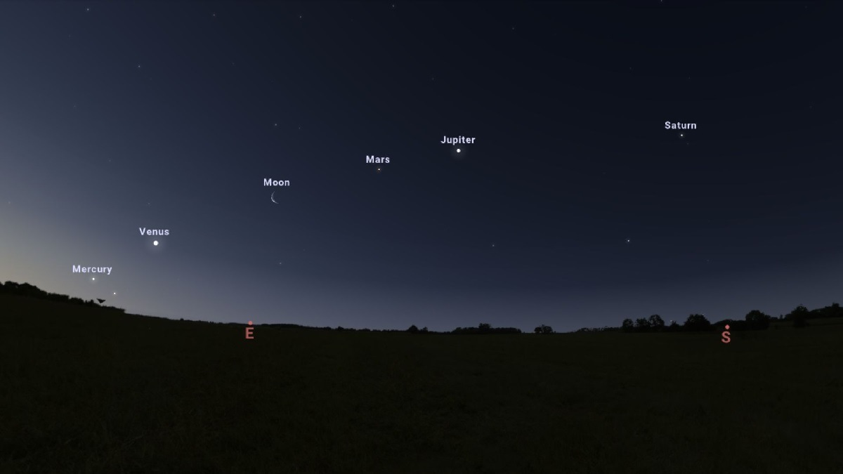
Down to Earth
Do our neighbors in the Solar System influence the timing or strength of earthquakes?
by Christopher Galloway
Image credit: Stellarium

Slide 2
Data Collection - Earthquakes
Core events:
Magnitude 7+
Worldwide
01/01/1980 – 23/02/2023
Precursors:
Magnitude < 7
Within 100 km of core event
Occurring 6 months or less before core event
Earthquake data collected with use of USGS Earthquake API: https://earthquake.usgs.gov/fdsnws/event/1/

Slide 3

Data Collection - Control
Control dataset:
Time, date, and coordinates randomly generated
Worldwide
01/01/1980 – 23/02/2023
Image source: https://clipartix.com/globe-clipart-image-329/

Slide 4
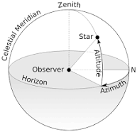
Data Collection - Astronomy
Sun, Moon, and 9 planets
Altitude and Azimuth
As seen at earthquake or control event
Image source: https://en.wikipedia.org/wiki/Horizontal_coordinate_system
Astronomy data collected with use of Astronomy API:
https://docs.astronomyapi.com/v/v2/

Slide 5
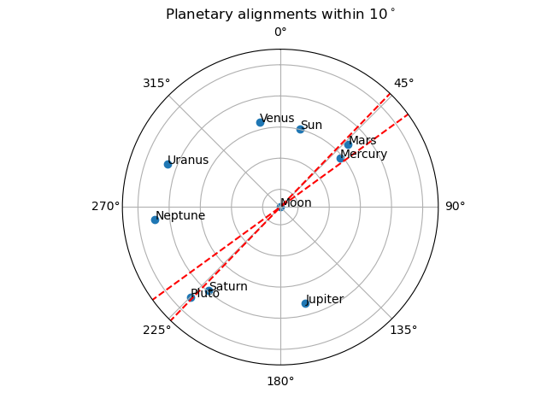
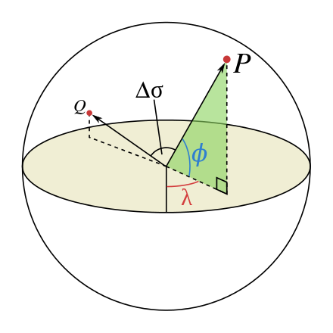
Alignments and Clusters
Central angle
Image source: https://en.wikipedia.org/wiki/Great-circle_distance

Slide 6
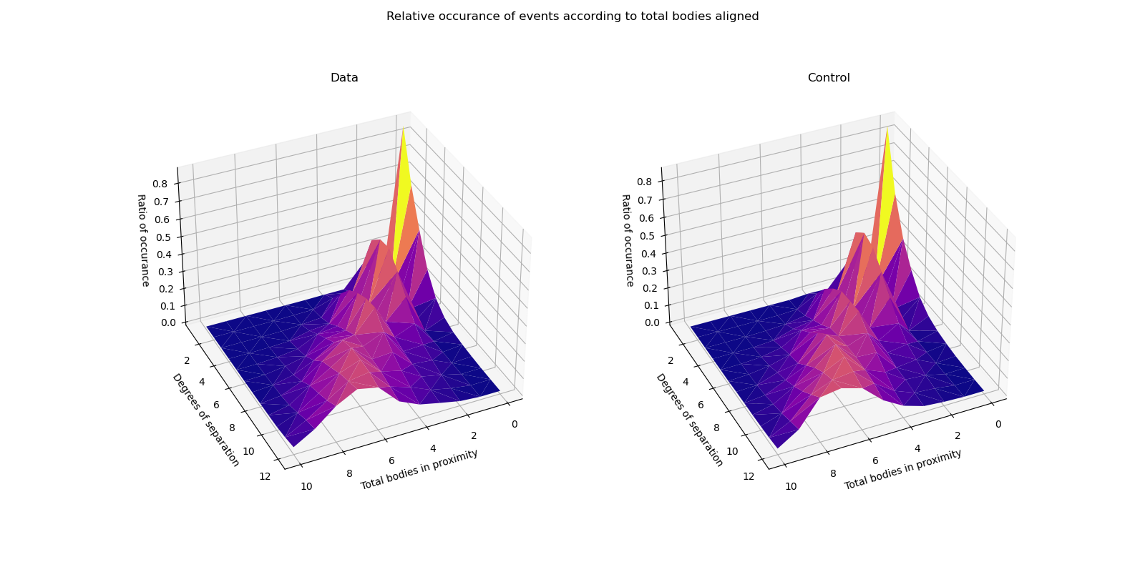
Effects of Alignments
No discernible difference to control set

Slide 7
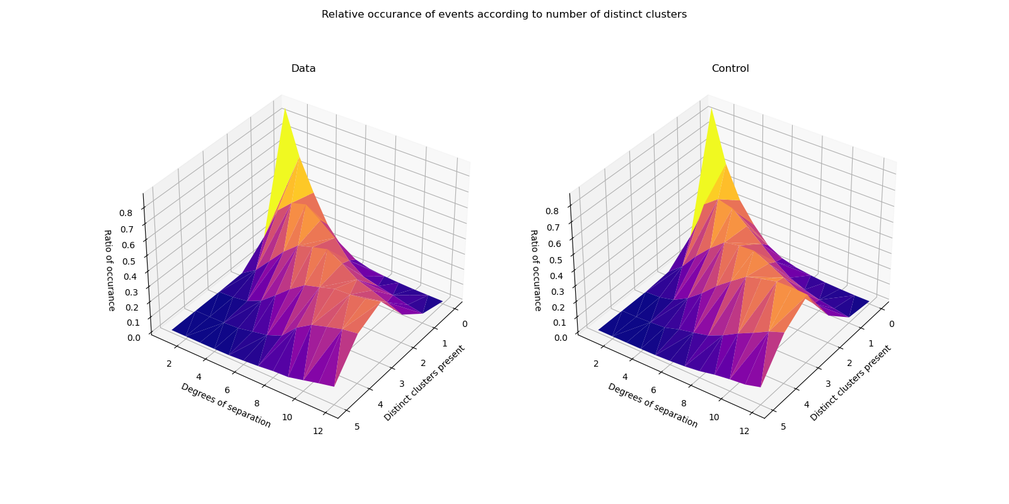
Effects of Clusters
No discernible difference to control set

Slide 8
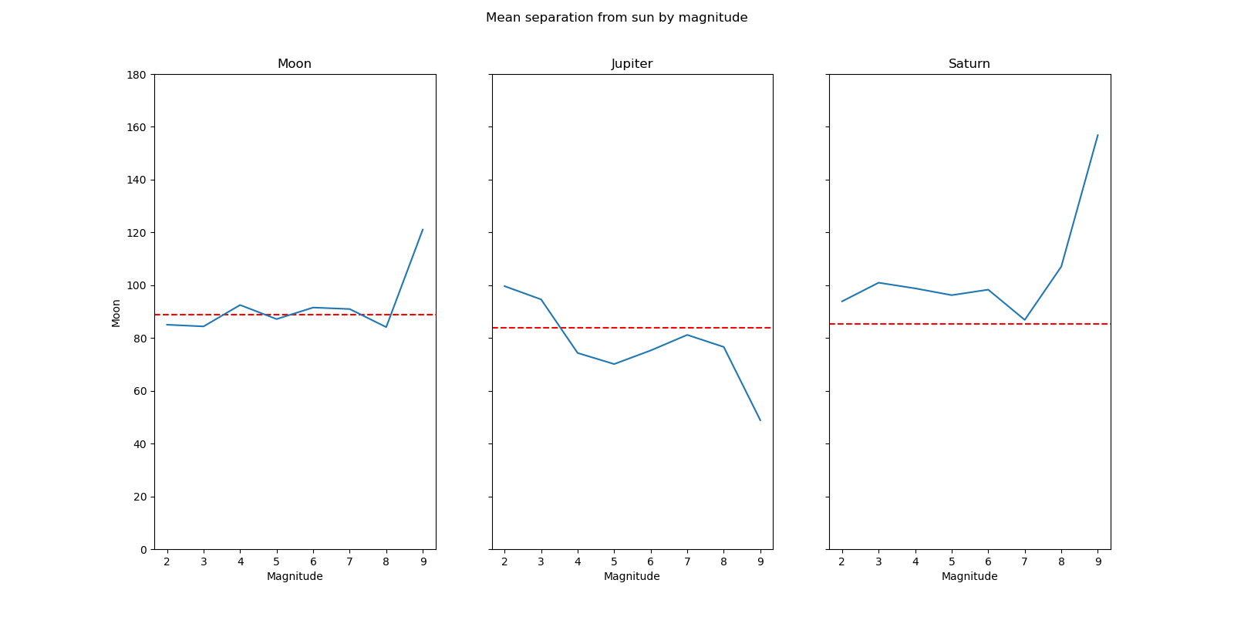
Effects on Magnitude

Slide 9
Effects on Magnitude

Slide 10
Effects on Magnitude
Statistically Insignificant

Slide 11
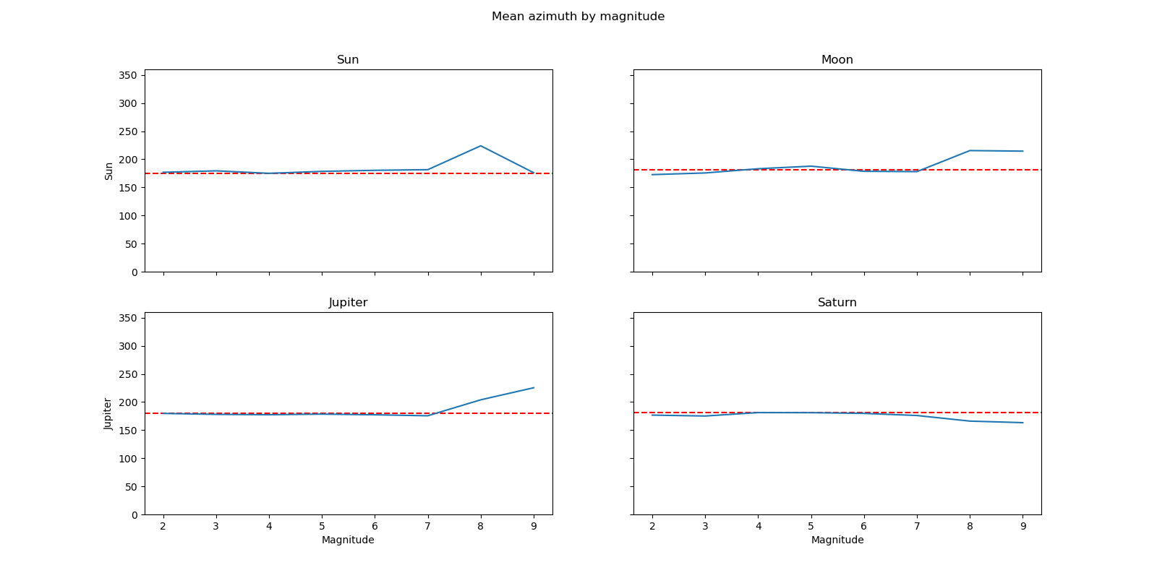
Effects on Magnitude

Slide 12
Effects on Magnitude

Slide 13
Effects on Magnitude

Slide 14
Effects on Magnitude
X
α = 0.03
X
X

Slide 15
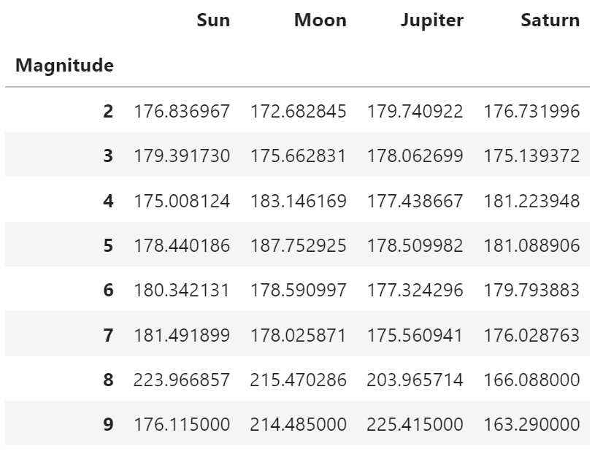
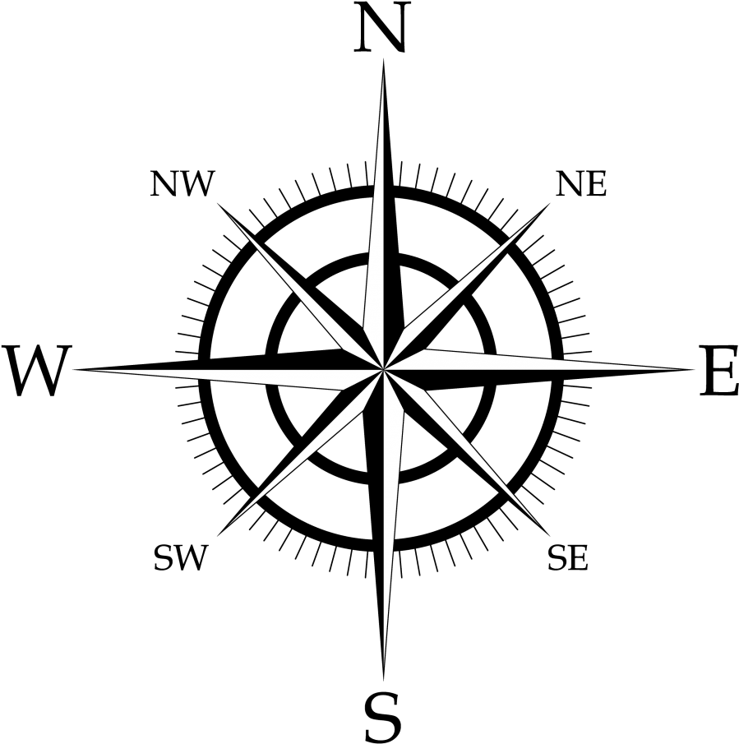
Conclusion
Image source: https://www.pngfind.com/mpng/imhmxh_compass-rose-png-transparent-background-compass-rose-png/

