Slide 1

Project:- Loan Data
Practice assignment for power Bi

Slide 2
Business Context: A financial corporation, Fincorp Lending, provides various types of loans such as personal, auto, home, education, and business loans. The corporation operates across multiple regions and caters to a diverse clientele. With a competitive market and regulatory challenges, efficient loan processing and risk management are crucial.
Business understanding: known as a business context which has mentioned just above.

Slide 3
Data Understanding & Data Preparation:
Handling missing value, duplicate removal
Checking Data Type, Use Delimiter
Using function DAX query for New Measure and New Column
What-If-Analysis
Business Objective:
Three Primary objectives:
Reduce the rate of loan defaults by improving the credit risk assessment model.
Enhance customer satisfaction by streamlining the loan approval process.
Identify key factors influencing loan outcomes and customer payment behavior to adjust policies and practices accordingly.

Slide 4
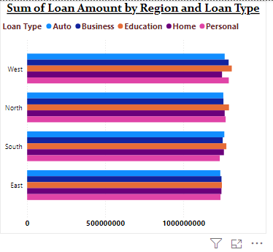
Chart Preparation:
Region | Loan Type | Sum of Loan Amount
West | Education | 1309048846
North | Education | 1291165910
West | Personal | 1289852705
West | Business | 1288958824
South | Education | 1274393552
North | Personal | 1269957191
North | Home | 1263748151
West | Auto | 1263726831
South | Auto | 1261347633
South | Home | 1258740333
North | Business | 1255752623
South | Business | 1251211181
West | Home | 1246749625
East | Education | 1245981897
East | Business | 1243401548
East | Home | 1243000442
East | Personal | 1236856184
East | Auto | 1235800298
South | Personal | 1232342974
Beginner Level Task:
1. Exploratory Data Analysis and Basic Reporting
Here, Distribution of loans across different region and categories.
The highest loan amount is : Education = 5120590205
Region is West = 6398336831

Slide 5
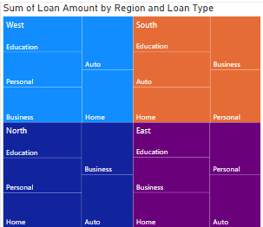
Beginner Level Task:
Loan Status | Avg interest rate | Total Loans
Pending | 8.47 | 8473021891
Rejected | 8.48 | 8357964056
Approved | 8.53 | 8386003146
2. Data Cleansing and Simple Calculations.
Avg Interest rate
8.49
Total loans
25bn
Total Customers
100000
Loan Type | Avg interest rate | Total Loans
Home | 8.47 | 5012238551
Business | 8.49 | 5039324176
Education | 8.49 | 5120590205
Auto | 8.50 | 5015827107
Personal | 8.50 | 5029009054
Using DAX function to get some aggregate value with the card chart.
The highest loan amount is for :
Education = 5120590205

Slide 6
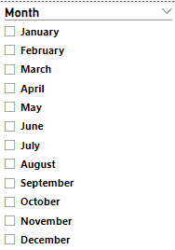
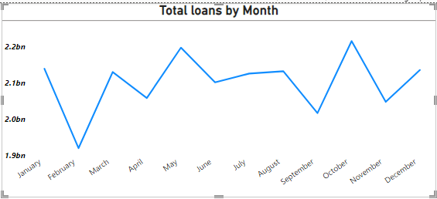
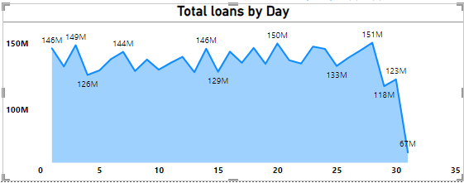

Beginner Level Task:
3. Dynamic Date Slicers
Objective: Implement a report with dynamic date slicers to allow viewing data within specified time frames.
We have line chart to visualize the total loans by months and 2nd chart is showing the total loans by days.
Enable the Slicer to visualize the loan data of specific month and days.
In October month loan is highest : 2215146439

Slide 7
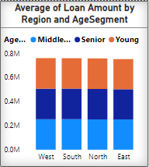
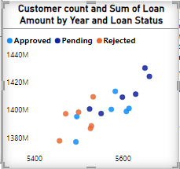
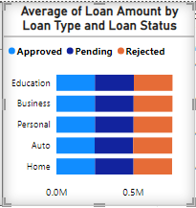
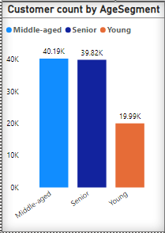
Intermediate Level Task:
1. Customer Segmentation and Performance Analysis
MonthName | Count of Loan ID | Average of Monthly Payment | Avg intrest rate | Average of MonthlyIncome
April | 8156 | 9511.710082 | 8.547869053 | 9192.68796
August | 8413 | 9788.322928 | 8.485045763 | 9173.118804
December | 8456 | 9550.837996 | 8.514939688 | 9130.467262
February | 7580 | 9611.262011 | 8.463970976 | 9204.621405
January | 8537 | 9539.987683 | 8.450459178 | 9158.868289
July | 8442 | 9440.925783 | 8.479437337 | 9101.410349
June | 8245 | 9573.308281 | 8.459831413 | 9167.779755
March | 8456 | 9597.398801 | 8.497018685 | 9210.3818
May | 8678 | 9694.934102 | 8.456002535 | 9111.099985
November | 8247 | 9445.832104 | 8.535103674 | 9093.575017
October | 8788 | 9557.459302 | 8.489544834 | 9138.66734
September | 8002 | 9639.215017 | 8.503485379 | 9160.56186
Analysis loan performance by customer segmentation through the insights where loan with different demographics.

Slide 8
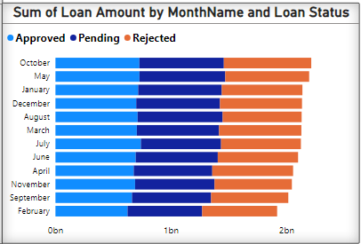
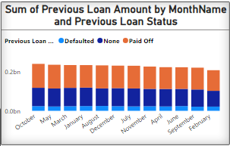
1. Customer Segmentation and Performance Analysis
Housing Status | Count of customers | Avg of Credit score | Sum of Loan Amount
Living with Parents | 33238 | 573.52 | 8342031113
Own Home | 33215 | 574.94 | 8406162805
Renting | 33547 | 573.92 | 8468795175
Analysis loan performance based on Customer segmentation.
Avg monthly income = 9152.96
Avg monthly payment = 9579.29
Avg interest rate = 8.49
Avg credit score = 574.13
Maximum customer’s house status is renting and their avg score is 574.
In march month customer income is high calculated as avg is : 9210.

Slide 9
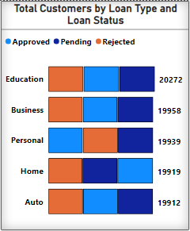
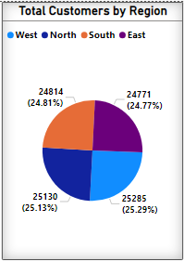
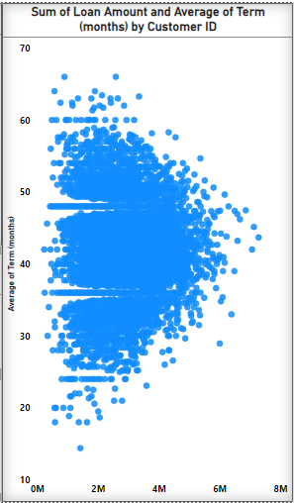
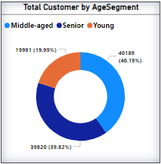
Intermediate Level Task:
2. Segmentation Analysis Using DAX
Objective: Categorize customers based on loan amount and term; visualize the segments with complex charts.

Slide 10
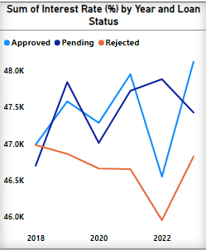
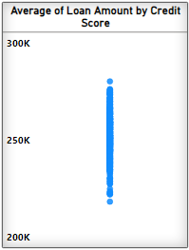
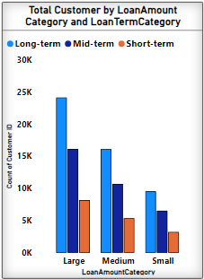
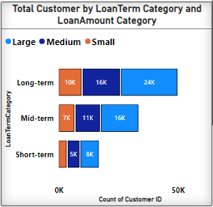
2. Segmentation Analysis Using DAX
Customer segmentation based on aggregation calculation using DAX query.
Nearabout 50000 persons get loan amounts in large term(month) category.
Highest avg loan amount by credit score :
Credit Score: 602
Avg loan Amount: 280254
25.29% customer in west region is highest count.
Total 40.19% customer is in middle-age(36-55).

Slide 11
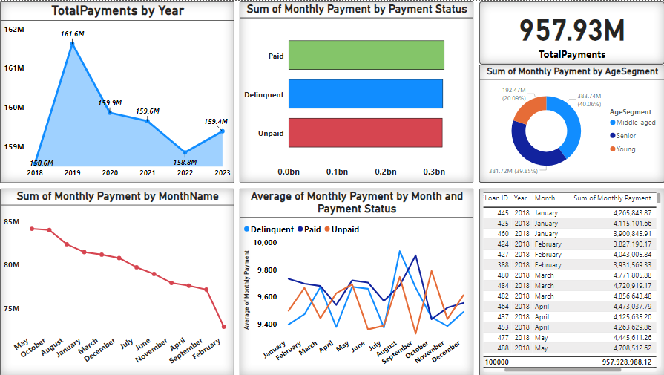
Intermediate Level Task:
3. Time-Series Analysis for Loan Payments
Analyze payment patterns and identify seasonal trends.
Monthly payment by age segment is the highest for middle–age(36-55) = 40.06%.
Monthly payment calculation by month is unstable.
Monthly payment by year through line chart is continuously down after 2019

Slide 12
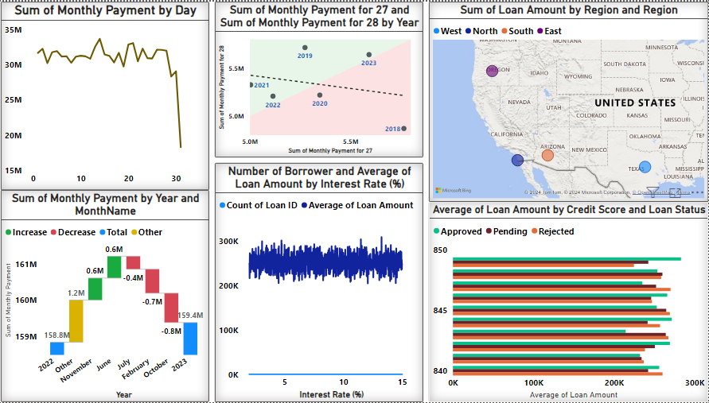
Advance Level Task:
1. Advanced Analytics for Forecasting and Anomaly Detection
Anomaly detection through line chart showing unexpected spikes in loan payment rates.
Forecasting Analysis of the 11.66% increase in average of loan amount between 14.31% and 14.32%.
Geographical analysis through the map visualizing loan distribution and region.
Forecasting analysis : sum of monthly payment for day 27 and day 28 by year is continuously decreasing.

Slide 13
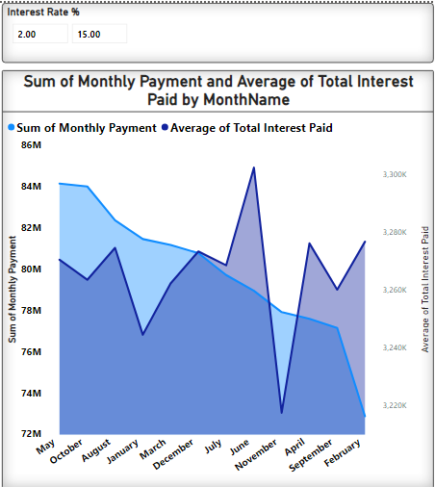

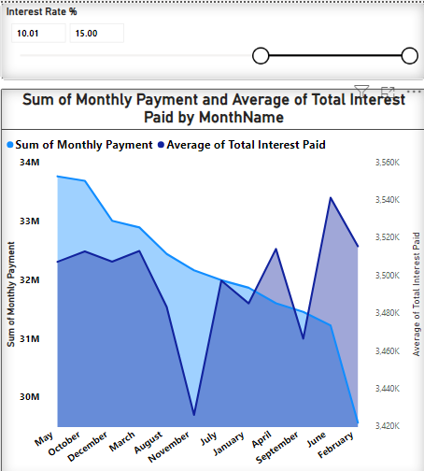

Advance Level Task:
2. What-If Analysis for Interest Rate Changes
What-if-analysis : Using what-if parameter creates as interest rates % to find in between value where happens ups and downs by sliding the cursor.
After do some analysis like interest rates 10% to 15% the value is : High+
Sum of monthly payments in May month : 33760138.23
Avg of total interest paid: 3514042.87

Slide 14
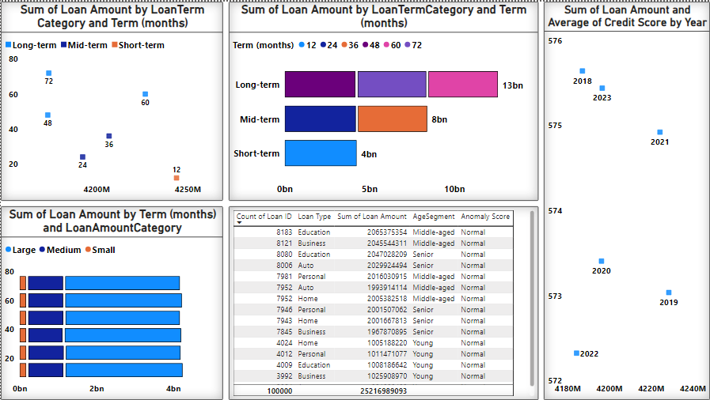
Advance Level Task:
Objective: Identify and visualize anomalies in loan applications, such as unusual loan amounts or terms.
3. Anomaly Detection in Loan Applications
Anomaly detection, such as usually high loan amounts, suspiciously frequent application.
Std deviation loan amount
143.08k
In this loan data have no outliers means anomaly score is normal as that the same analysis in the table chart.
Anomaly score retrieve using DAX query and calculate with std deviation.

Slide 15
Conclusion:
Followed by: CRISP-DM(Cross-Industry standard process and DATA Mining)
Identified seasonal patterns and a general growth/decline in loan payments over time.
Detected significant spikes and dips correlated with external events like economic policies and crises.
Found strong links between loan payments and economic indicators such as unemployment rates and interest rates.
Predictive models suggest a potential increase/decrease in future loan payments, allowing for proactive planning.
Improve borrower engagement through targeted communication and incentives.
Thank you!
Name = Atul Prajapati
Batch = ABADS 12
Email = user.atul@yahoo.com

