Slide 1


Thiruvarulnathan K
College Name : Bharathiar University, Coimbatore.
Degree : M.Sc Cyber Security
Pass Out Year : 2024
Branch : Computer science/ cyber security
Area of Interest: Cyber Security

Slide 2
Ethical hacking

Slide 3
Ethical hacking
As part of my MSc in Cyber Security, I have gained foundational knowledge of ethical hacking, which involves authorized testing and securing computer systems against cyber threats. Ethical hacking allows organizations to identify and fix vulnerabilities before they are exploited by malicious actors.

Slide 4
Techniques & Tools Used:
Techniques & Tools Used:
Kali Linux: A popular Linux distribution loaded with tools for penetration testing.
Nmap: Used for network discovery and vulnerability scanning.
Metasploit Framework: A tool to exploit security holes in a system and test its defenses.
Burp Suite: A comprehensive platform used for web application security testing.
Wireshark: A network protocol analyzer that helps in capturing and analyzing packets.

Slide 5
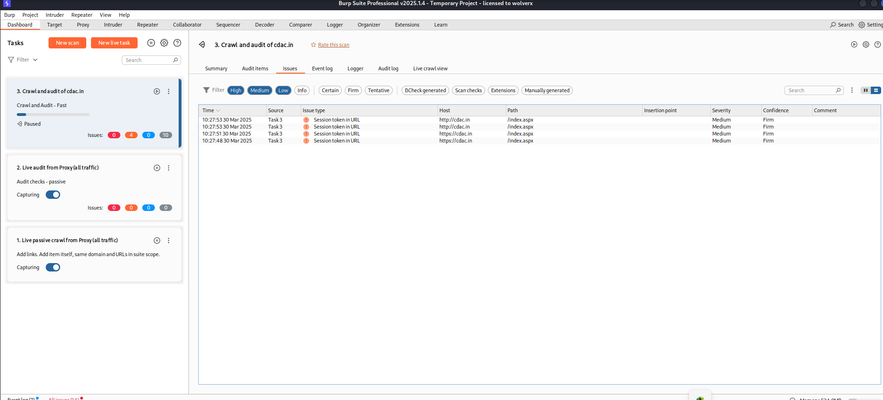
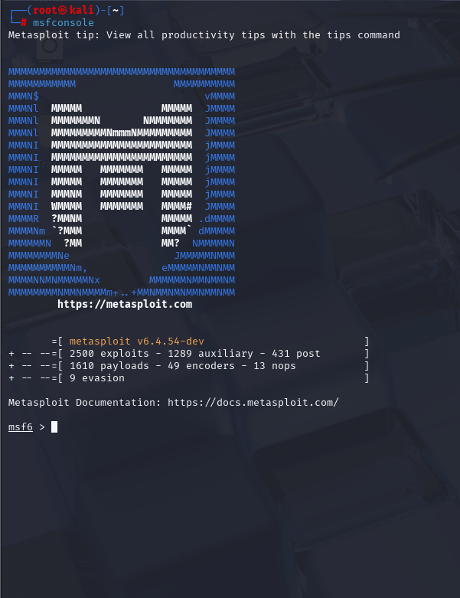
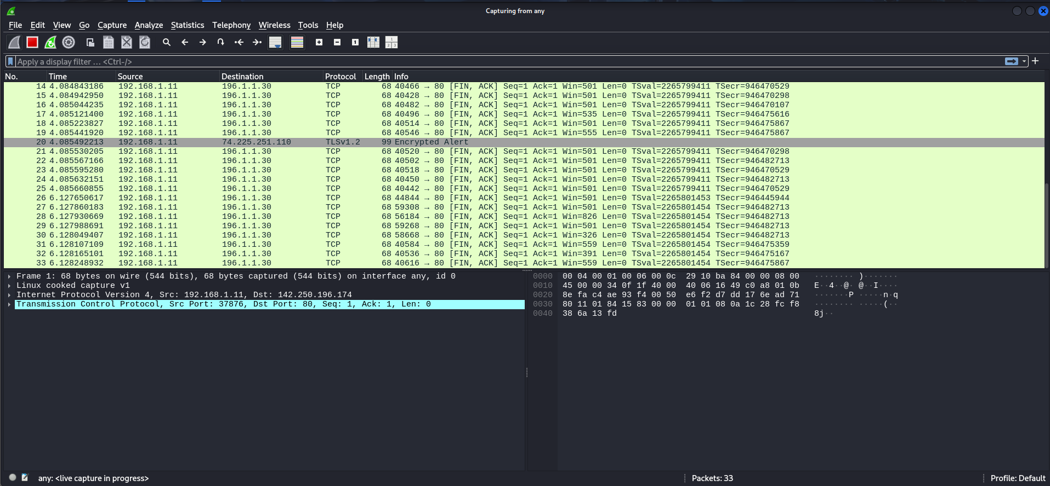
tools
Burpsuite pro scanner
Metasploit framework
(for exploiting Vulnerability)
Wireshark
(For capturing the packets)

Slide 6
Platforms
TryHackMe: A beginner-friendly platform for practicing ethical hacking techniques.
Hack The Box: A platform designed for penetration testing with real-world scenarios.
PicoCTF: A platform for test our skills in cyber world scenario.

Slide 7
Security Operations Center (SOC)

Slide 8
Security Operations Center (SOC)
A Security Operations Center (SOC) is a dedicated team or facility within an organization to monitor, detect, and respond to cyber threats. During my training, I gained insight into the importance of 24/7 monitoring to protect sensitive data from threats.

Slide 9
Techniques & Tools Used:
SIEM (Security Information and Event Management) Tools: Used for aggregating and analyzing logs.
Wazuh: A comprehensive, open-source SIEM tool for threat detection, integrity monitoring, and security analytics. Wazuh helps to collect, analyze, and correlate security data from various sources to improve an organization’s security posture.

Slide 10
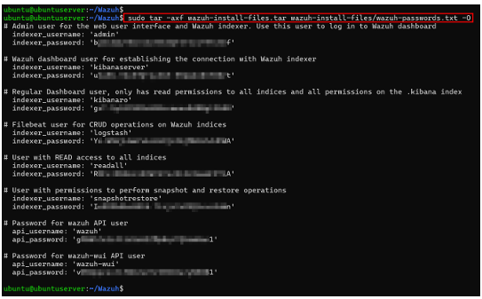
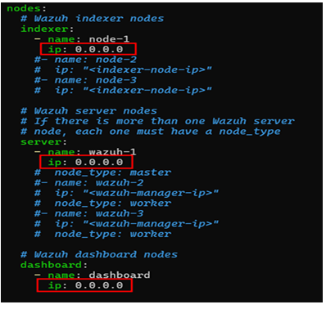
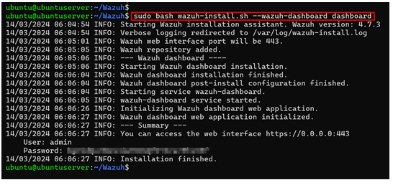
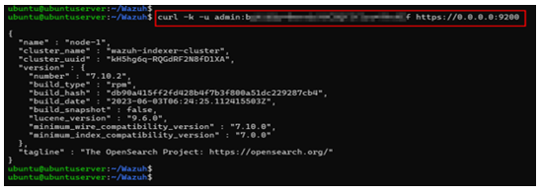


Wazuh Installing method
Password manager
Ip assign
Final Install
Config files
Admin dashboard conifig

Slide 11

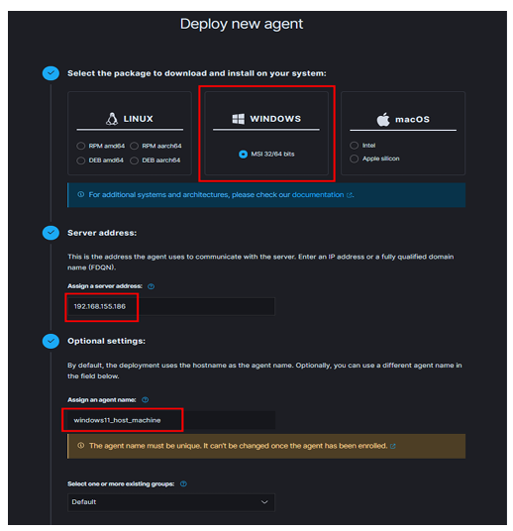
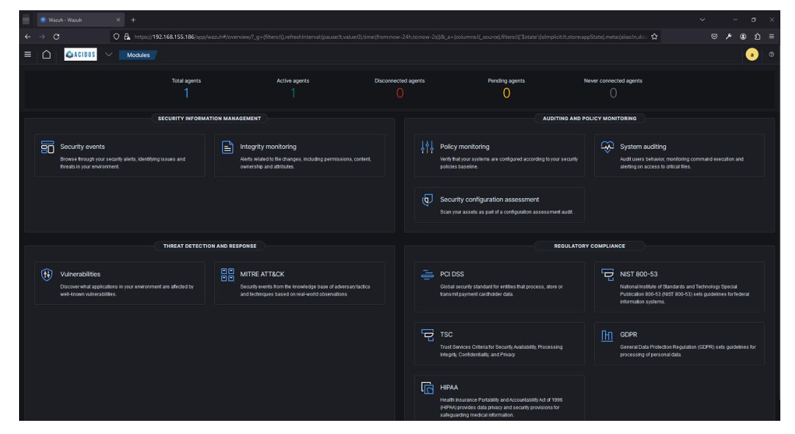
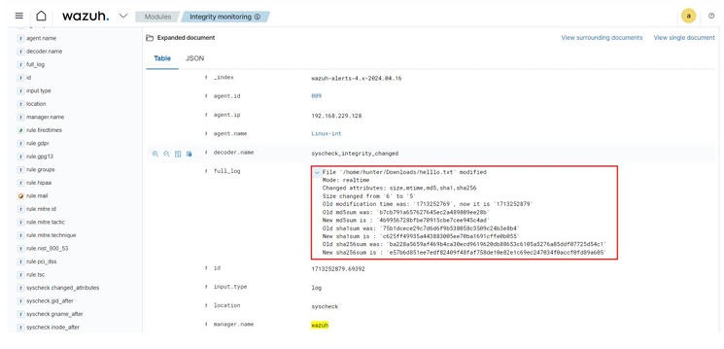
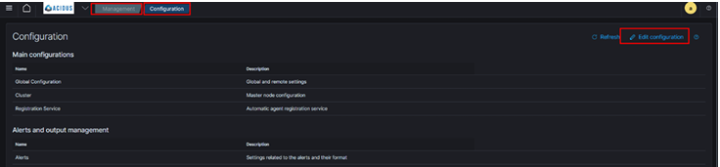
Wazuh
Agent Deploy tab
Wazuh dashboard
Rule config page
File integration

Slide 12
Vulnerability Assessment and Penetration Testing (VAPT)

Slide 13
Vulnerability Assessment and Penetration Testing (VAPT)
VAPT involves identifying vulnerabilities in a system through a systematic process of scanning, analyzing, and testing. The goal is to evaluate the security of IT infrastructure and prevent possible exploits.

Slide 14
Techniques & Tools Used:
Nessus: A vulnerability scanner that identifies weaknesses in the system, such as missing patches or configurations.
OWASP ZAP (Zed Attack Proxy): An open-source tool used for finding security vulnerabilities in web applications.

Slide 15
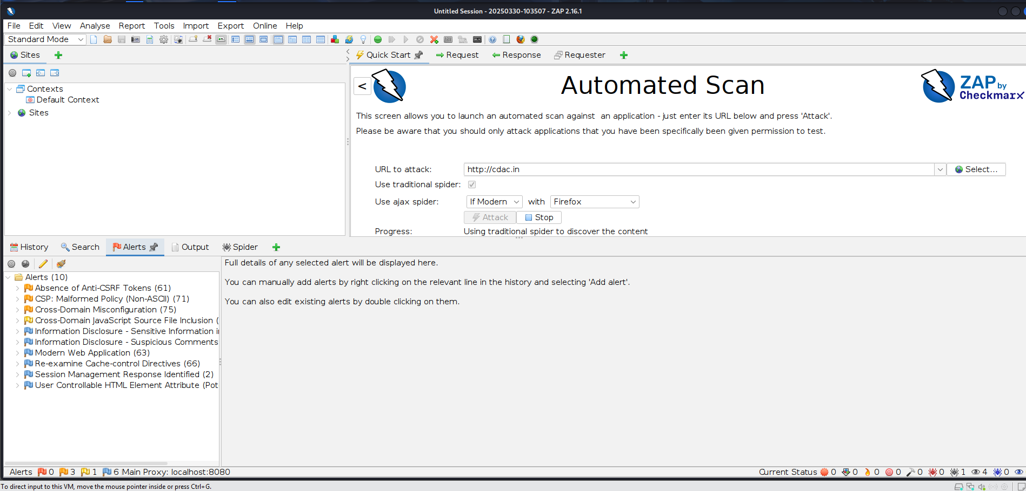
tools
Owasp zap
(for automatic scan)
Burpsuite pro

Slide 16

Cli based tools:
S.No | Tool Name | Description
1 | Nmap | A network scanning tool used for discovering hosts, services, and vulnerabilities on a network. It is one of the most popular tools for network reconnaissance.
2 | Hydra | A fast and flexible password-cracking tool used to brute-force passwords for various network protocols, including FTP, HTTP, SSH, and more.
3 | John the Ripper | A password cracking tool designed to break various password hashes through brute-force, dictionary attacks, or other techniques.
4 | Netcat | Often referred to as the "Swiss Army Knife" of networking, Netcat is a tool for reading and writing data across network connections, used in debugging and network analysis.
5 | Aircrack-ng | A suite of tools for wireless network auditing, including packet capture, WPA/WPA2 cracking, and network monitoring for Wi-Fi security testing.
6 | Gobuster | A directory and DNS busting tool that brute-forces URLs, subdomains, and directories to identify hidden resources and vulnerabilities.
7 | Enum4linux | A Linux-based tool for gathering information from Windows machines using SMB. It allows the collection of data such as usernames, shares, and password policies.
8 | SQLmap | A powerful tool for automating the process of detecting and exploiting SQL injection vulnerabilities in web applications.
9 | dirb | A web content scanner that brute-forces directories and file names on a web server to identify hidden content that may have security vulnerabilities.
10 | dnsrecon | A DNS enumeration tool used to gather and analyze information from DNS servers, including zone transfers, subdomains, and other DNS-related data.

