Slide 1
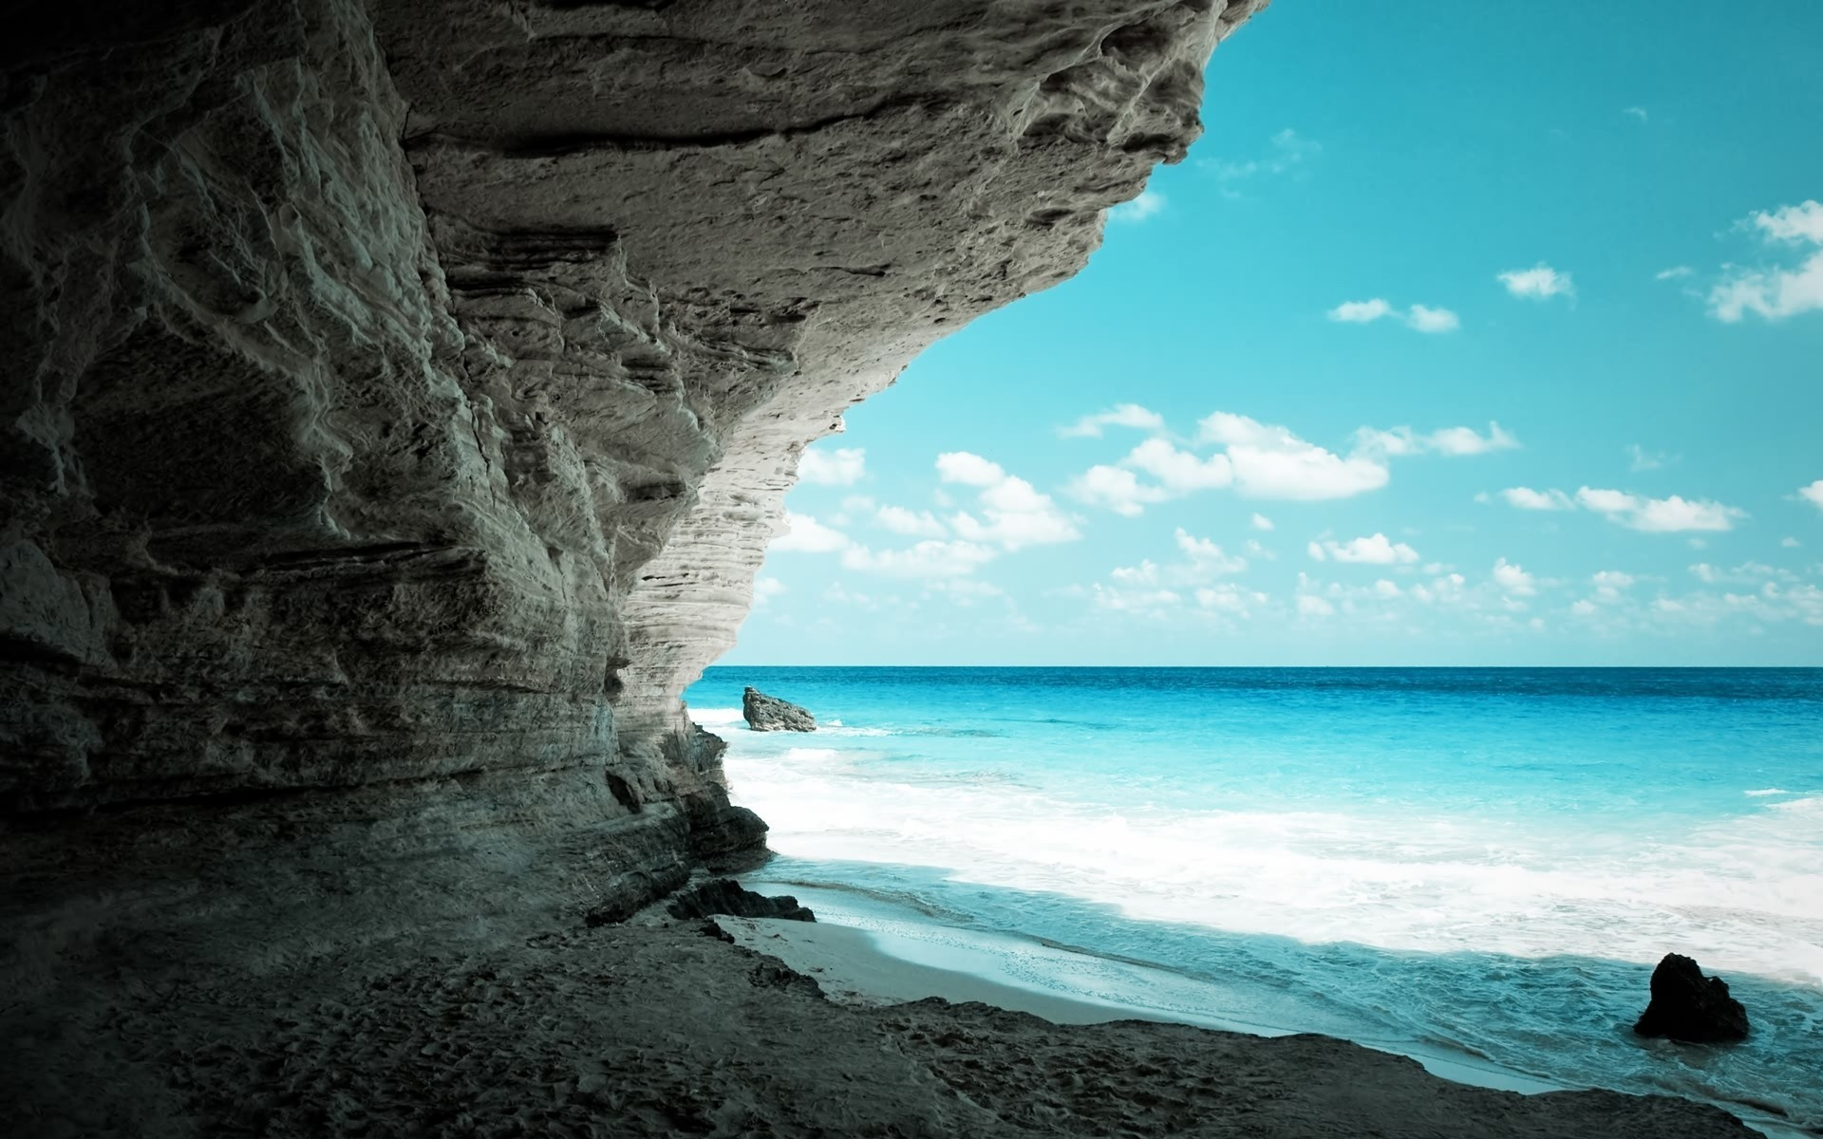
Slide 7
Slide 7
Slide 6
Slide 5
Slide 4
Slide 3
Slide 2
Slide 7
Famous World Landmarks and Their History
Exploring Ancient, Modern, and Symbolic Wonders of the World
Slide 7
Slide 7
Slide 7

Slide 2
Introduction
Landmarks are iconic structures that represent the essence of human history, culture, and progress.
Ancient & Historical Landmarks: Feats from early civilizations that showcase their architectural brilliance.
Modern Landmarks: Symbols of technological and architectural innovations of the contemporary world.
Cultural & Symbolic Landmarks: Representations of identity, faith, and freedom, holding deep cultural and religious meaning.

Slide 3
Why We Chose This Topic
Landmarks are a powerful reflection of human history, culture, and achievement. They offer us a window into the past, present, and future, helping us understand how societies have shaped the world we live in today.

Slide 4
Ancient and Historical Landmarks

Slide 5
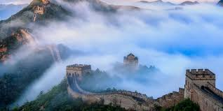
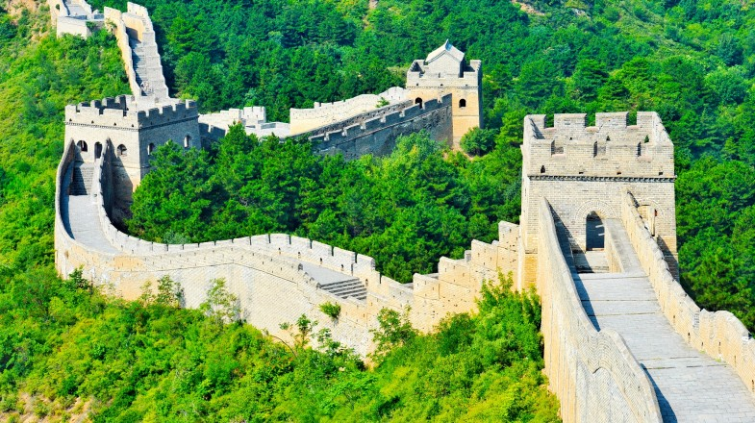
Great Wall of China (China)
History: Began construction in the 7th century BC, expanded during the Ming Dynasty (14th-17th century).
Fame: The longest structure ever built by humans, spanning over 13,000 miles
Interesting Fact: Contrary to popular belief, it is not visible from the moon.

Slide 6
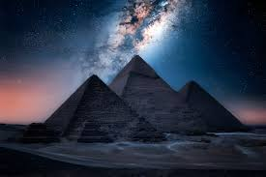
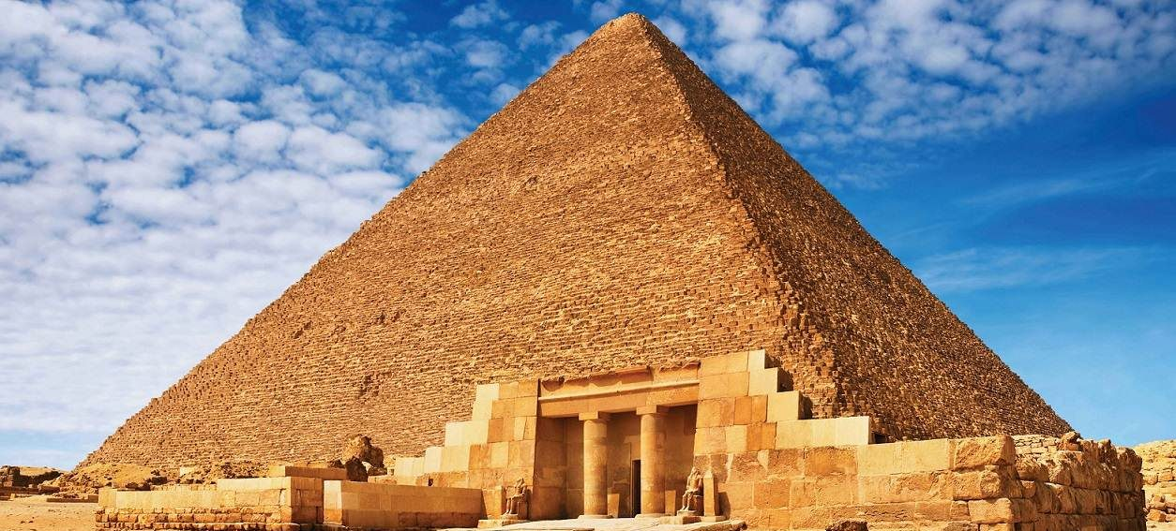
Great Pyramid of Giza (Egypt)
History
Built around 2560 BC during Egypt’s Old Kingdom.
Fame
The only surviving Wonder of the Ancient World.
Interesting Fact
It remained the tallest man made structure for over 3,800 years.

Slide 7
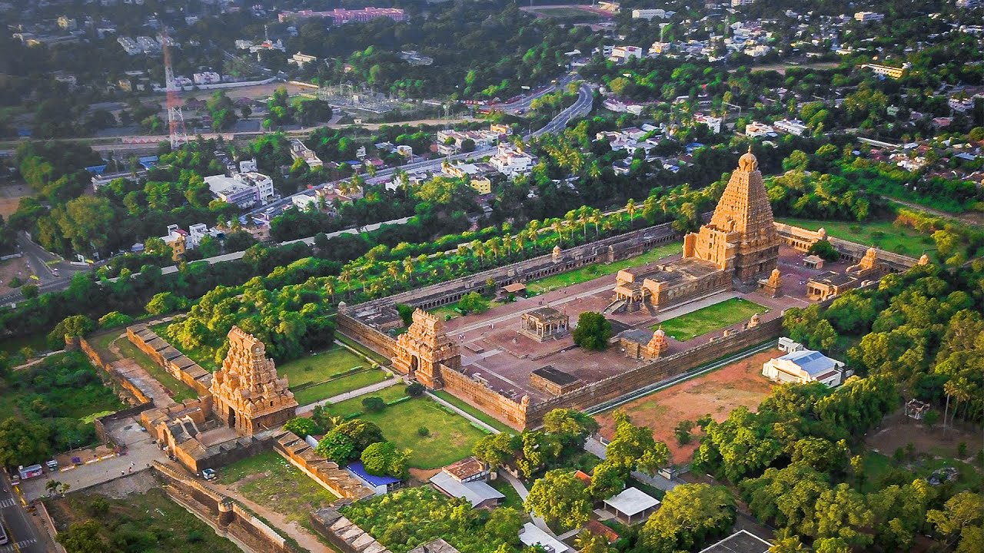
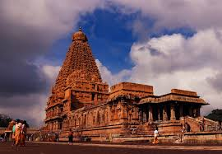
Brihadeeswarar Temple
History
Built by Raja Raja Chola I in 1010 AD during the Chola Dynasty.
Fame
A UNESCO World Heritage Site and an epitome of Dravidian architecture.
Interesting Fact
The temple’s Vimana (tower) is 216 feet tall, and the topmost stone weighs around 80 tons.

Slide 8
Introduction
Landmarks are iconic structures that represent the essence of human history, culture, and progress.
Ancient & Historical Landmarks: Feats from early civilizations that showcase their architectural brilliance.
Modern Landmarks: Symbols of technological and architectural innovations of the contemporary world.
Cultural & Symbolic Landmarks: Representations of identity, faith, and freedom, holding deep cultural and religious meaning.

