Slide 1
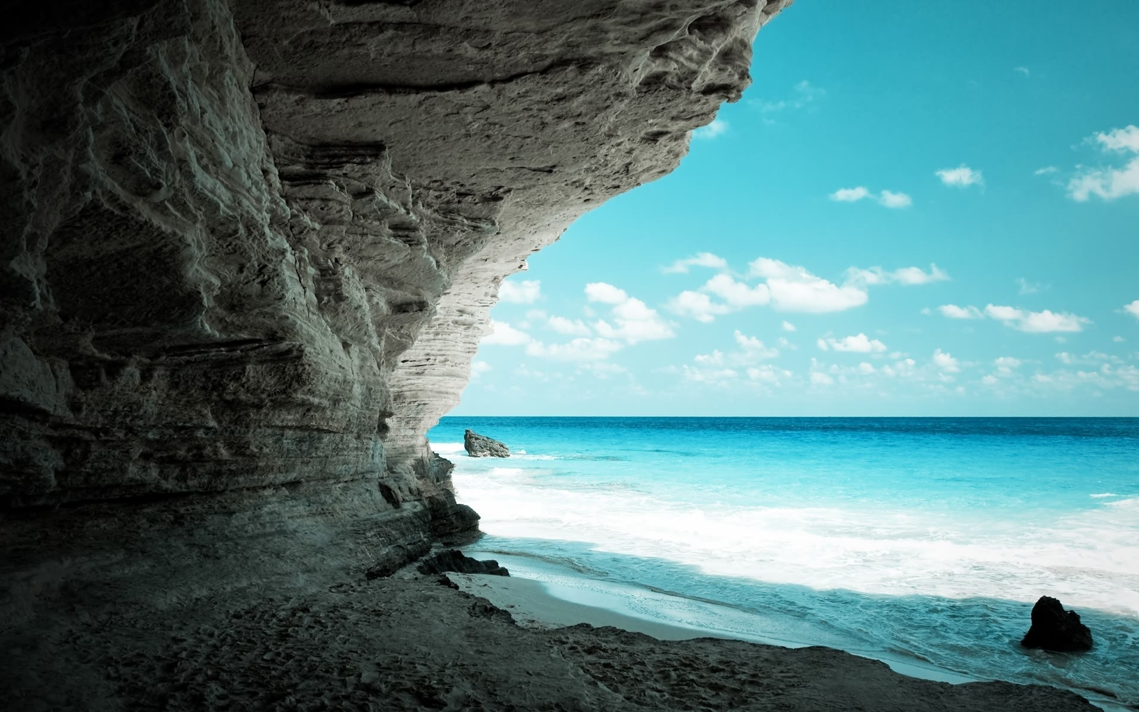
Slide 7
Slide 6
Slide 5
Famous World Landmarks and Their History
Slide 4
Exploring Ancient, Modern, and Symbolic Wonders of the World
Slide 3
Slide 2
Slide 1

Slide 2






Slide 7
Introduction
Add Your Text
Here you need to add some brief about the service that your company is providing currently
Slide 6
Add Your Text
Slide 5
Here you need to add some brief about the service that your company is providing currently
Slide 4
Add Your Text
Add Your Text
Here you need to add some brief about the service that your company is providing currently
Here you need to add some brief about the service that your company is providing currently
Slide 3
Slide 2
Add Your Text
Add Your Text
Here you need to add some brief about the service that your company is providing currently
Here you need to add some brief about the service that your company is providing currently
Slide 1

