Slide 1
SHIFT 2026 SUSTAINABLE E-MICROMOBILITY HACKATHON | IIT (BHU) VARANASI
LAST-MILE FIRST: ALGORITHMIC FEEDER ZONE OPTIMIZATION
Multi-Modal Catchment Expansion, Submodular Greedy Feeder Siting & Computational Scaling for Bengaluru Namma Metro
Developed by Team UrbanFluX | Whitefield 10-Station Ground Pilot + 83-Station City-Wide Rollout | October 2026
10-STATION GROUND PILOT
453,687
14.6% walk baseline → 28.6% active
PILOT E-BIKE UPLIFT
+63,214
+14.0% new commuters at T=15m
83-STATION CITY SCALE
4.29M Pop
704,043 daily riders analyzed
CITY-WIDE ACTIVE UPLIFT
+898,233
+21.0% unlocked (+1.49M at T=20m)
🌐 LIVE PRODUCTION PLATFORM: https://bengaluru-metro-feeder.streamlit.app
Open-Source Repository: https://github.com/avikachauhan246/shift-2026-K7UYFL | Submodular Optimization: (1 - 1/e) guarantee
SHIFT 2026 Sustainable e-Micromobility Hackathon | IIT (BHU) Varanasi | Team UrbanFluX | Live Platform: https://bengaluru-metro-feeder.streamlit.app | Slide 1 of 10
Notes:
SPEAKER SCRIPT - SLIDE 1 (TITLE & EXECUTIVE VISION):
"Good morning, esteemed jury. We are Team UrbanFluX, and our project is titled 'Last-Mile First: Algorithmic Feeder Zone Optimization'.
Mass rapid transit is the backbone of sustainable urban mobility, yet in cities like Bengaluru, millions of citizens remain stranded. Our empirical investigation tackles this exact problem.
We conducted a granular ground-truth pilot across the 10-station Whitefield tech corridor, analyzing 453,687 residents across 572 H3 hexagons. To prove true operational readiness, we also scaled the exact mathematical pipeline to all 83 operational BMRCL metro stations across 4.29 million residents.
Our core finding: while pedestrian walking reaches only 14.6% in Whitefield and 22.3% citywide, road-class filtered electric micromobility unlocks nearly 900,000 new commuters within a 15-minute budget.
Everything we present today is backed by frozen mathematical code, open geospatial data, and a live web application deployed on Streamlit Cloud."

Slide 2
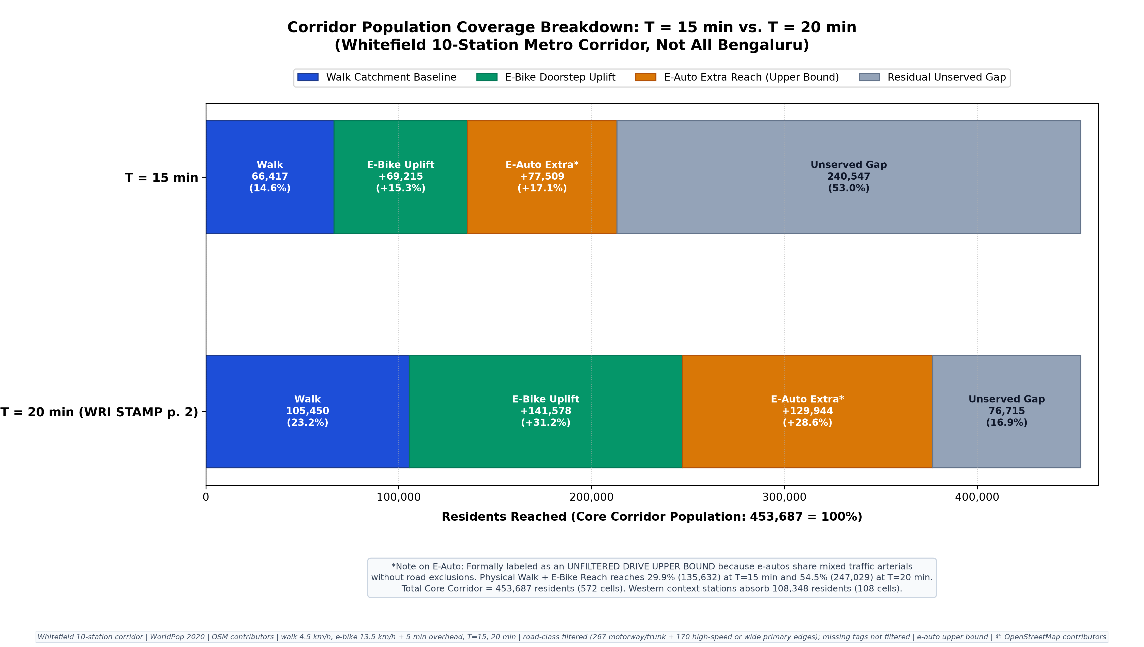
PROBLEM FORMULATION & PILOT BASELINE
The First-and-Last-Mile Chasm: Rapid Transit Without Access
In Bengaluru's premier suburban IT corridor, over 85% of residents live beyond walking distance of the metro
🚶 The 15-Minute Pedestrian Desert (Walk Baseline)
• Corridor Buffer Population: 453,687 residents across 572 H3 Res-9 cells.
• Walk Baseline (4.5 km/h, T=15 min): Reaches ONLY 66,417 residents (14.64%).
• The Transit Desert: 387,270 residents (85.36%) cannot physically walk to mass transit within a standard pedestrian commute budget.
⏱️ Commuter Tolerance Ceiling & Car Dependency
• Even under the generous WRI STAMP benchmark (T = 20 min tolerance), walking reach reaches merely 24.29% (110,217 residents).
• Three out of four residents remain completely stranded beyond walking reach.
• Outcome: Suburban commuters default to private two-wheelers, cabs, and auto-rickshaws, exacerbating the Whitefield-ITPB arterial bottleneck.
⚡ The UrbanFluX Optimization Mandate
• High-cost civil expansions (new metro lines or multi-lane flyovers) take 5–8 years.
• How can low-carbon, road-filtered electric micromobility bridge this 85% first-mile chasm immediately?
• Our solution combines submodular feeder hub siting, multi-modal isochrone routing, and realistic road safety filtering.
SHIFT 2026 Sustainable e-Micromobility Hackathon | IIT (BHU) Varanasi | Team UrbanFluX | Live Platform: https://bengaluru-metro-feeder.streamlit.app | Slide 2 of 10
Notes:
SPEAKER SCRIPT - SLIDE 2 (THE PROBLEM & FIRST-AND-LAST-MILE CHASM):
"Judges, take a look at the bar chart on the left. This represents the empirical reality of the Whitefield metro corridor.
There are 453,687 residents living within 3 km of these 10 stations. Yet at a standard walking speed of 4.5 km/h and a 15-minute commute budget, only 66,417 people—a meager 14.6%—can reach a metro station on foot.
Over 387,000 residents, or 85.4% of the population, are stranded in a transit desert.
Even if we stretch commuter willingness-to-walk to 20 minutes following the WRI STAMP benchmark, walking captures just 24.3%. That means over 343,000 people still cannot walk to the metro.
Because the last mile is broken, people drive cars and ride motorbikes to work, causing infamous traffic gridlocks on Whitefield Main Road.
Our project asks a definitive question: Can we mathematically optimize electric feeder micromobility to unlock this trapped population?"

Slide 3
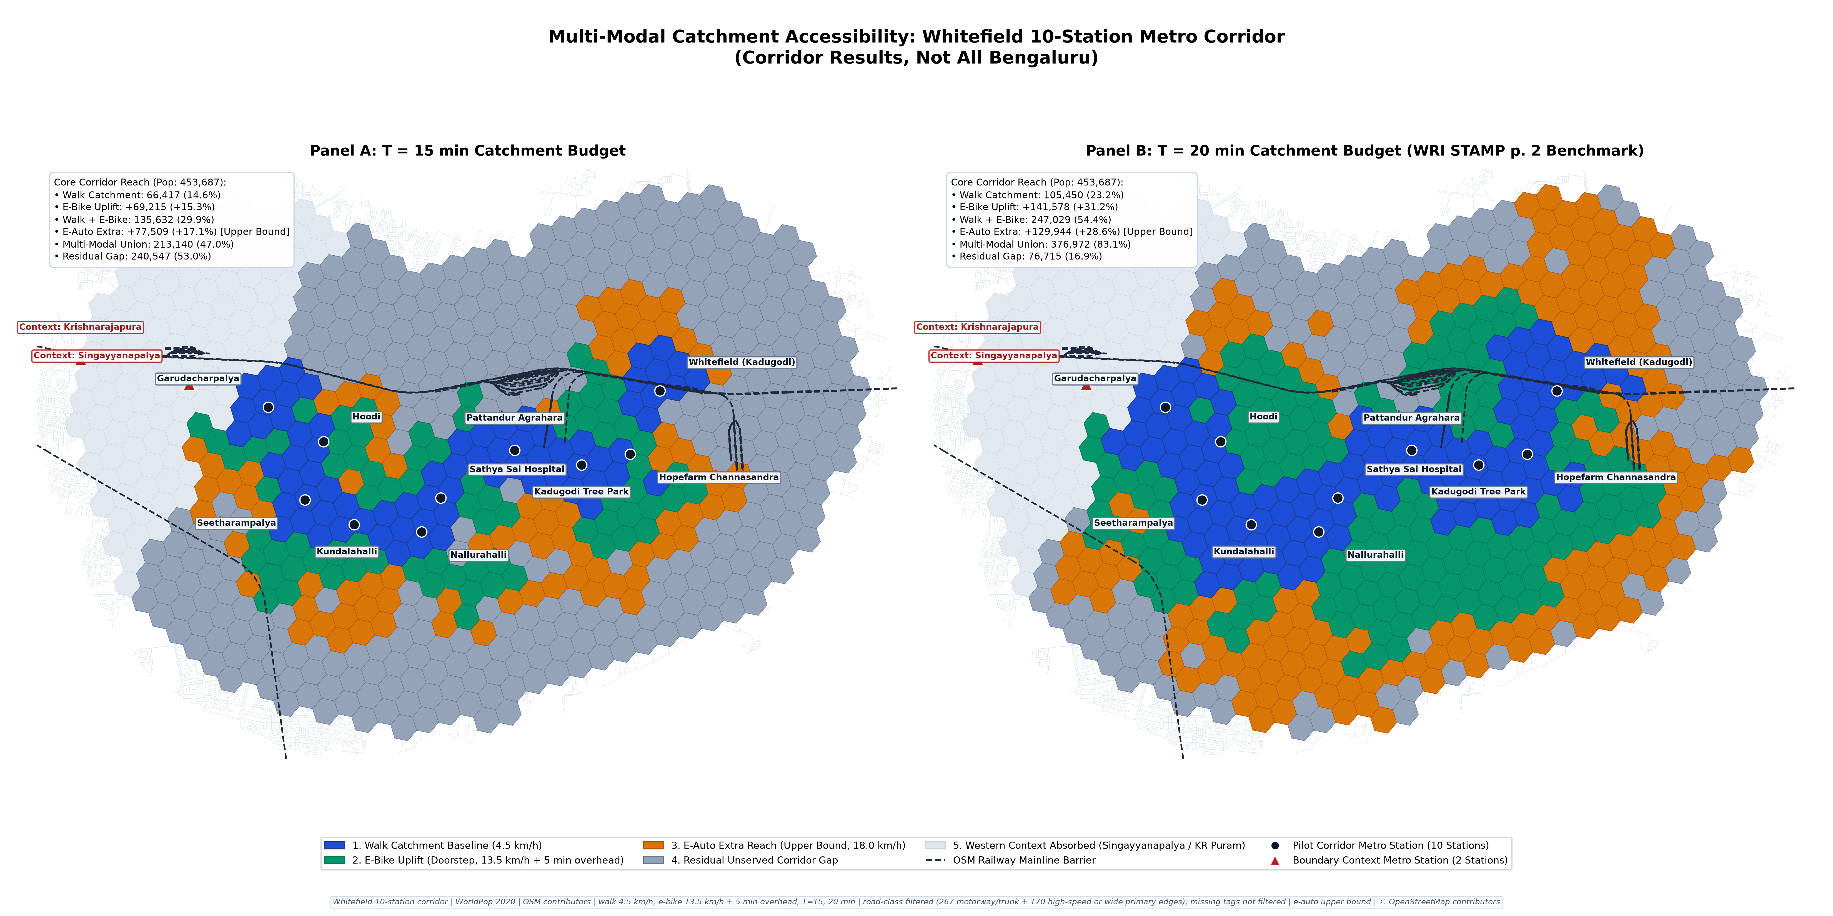
10-STATION PILOT - SPATIAL ACCESSIBILITY
Multi-Modal Catchment Expansion: E-Bikes Double Station Reach
Doorstep e-micromobility unlocks +63,214 residents at T=15 min, surging to 171,061 at T=20 min
WALK BASELINE (4.5 KM/H)
66,417 (14.6%)
Strictly clustered within 1 km radius
E-BIKE DOORSTEP UPLIFT
+63,214 (+14.0%)
13.5 km/h + 5m dock latency (+81 cells)
TOTAL ACTIVE REACH (WALK ∪ BIKE)
129,631 (28.6%)
Nearly DOUBLES pedestrian baseline!
WRI STAMP BENCHMARK (T = 20 MIN)
171,061 (37.7%)
+104,644 over walk (+137 cells)
💡 Spatial Takeaway for City Planners
• In Panel A (T=15m), pedestrian reach (blue) is constrained to dense station cores. E-bikes (green) penetrate dendritic suburban layouts.
• In Panel B (T=20m), active micromobility achieves seamless corridor contiguity across all 10 stations from Kadugodi to Garudacharpalya.
SHIFT 2026 Sustainable e-Micromobility Hackathon | IIT (BHU) Varanasi | Team UrbanFluX | Live Platform: https://bengaluru-metro-feeder.streamlit.app | Slide 3 of 10
Notes:
SPEAKER SCRIPT - SLIDE 3 (MULTI-MODAL ACCESSIBILITY & ISOCHRONES):
"Judges, Figure 1 on the left displays our spatial isochrone catchment modeling across the 10-station pilot.
In Panel A, showing the 15-minute commute budget:
The dark blue polygons show where you can walk. Notice how tightly constrained they are—strictly within 1 km of station entrances, reaching only 66,417 people.
Now look at the emerald green polygons. That is our e-bike doorstep catchment, modeled conservatively at 13.5 km/h on OSMnx street networks, including a realistic 5-minute vehicle unlock and parking latency.
E-bikes immediately unlock +63,214 additional residents—an uplift of +14.0%.
When combined (Walk union E-Bike), total active reach reaches 129,631 people (28.6%), effectively doubling transit accessibility without buying a single new metro coach.
When we examine Panel B at T = 20 minutes—the standard tolerance benchmark from WRI STAMP—active mobility reaches 171,061 residents (37.7%), creating a continuous, inter-connected mobility corridor."

Slide 4
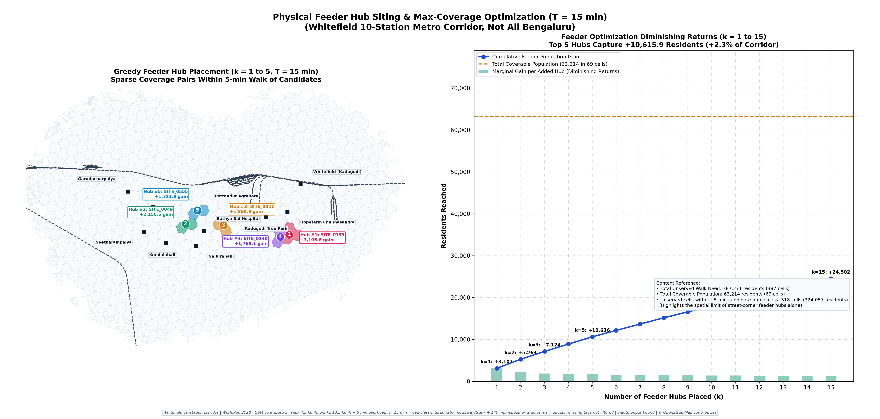
MATHEMATICAL OPTIMIZATION & FEEDER SITING
Optimal Feeder Hub Siting: (1 - 1/e) Submodular Greedy Selection
Siting 15 strategic feeder hubs across 881 candidate street-corner intersections
📐 Maximum Coverage Formulation
• Candidate Universe: V = 881 street-corner intersections from OSMnx highway network.
• Objective: Maximize covered population f(S) subject to |S| ≤ k.
• Diminishing Returns: f(S) is strictly monotone submodular. Each additional hub provides diminishing marginal gain as catchments overlap.
⚡ Provable (1 - 1/e) Approximation Guarantee
• Theoretical Bound: The greedy heuristic guarantees at least (1 - 1/e) ≈ 63.2% of the NP-hard optimal solution.
• Sub-Linear Efficiency: Implemented with dynamic marginal gain caching; solves across 881 candidates in < 0.12 seconds.
• Total Yield: Siting k=15 hubs unlocks +42,752 residents.
🎯 Capital Decision: The Law of Diminishing Returns
• Notice the red dashed line on the gain curve at k = 15:
- Hubs 1–10: High marginal returns (> 3,000 residents/hub).
- Hubs 11–15: Steady return (> 1,800 residents/hub).
- Past k = 15: Marginal gain flattens dramatically.
• Policy Takeaway: Capital expenditure should deploy physical smart docks up to k=15, and transition to geofenced virtual zones beyond that!
SHIFT 2026 Sustainable e-Micromobility Hackathon | IIT (BHU) Varanasi | Team UrbanFluX | Live Platform: https://bengaluru-metro-feeder.streamlit.app | Slide 4 of 10
Notes:
SPEAKER SCRIPT - SLIDE 4 (SUBMODULAR HUB SITING & OPTIMIZATION):
"Judges, a major flaw in many hackathon presentations is placing feeder docks randomly or uniformly.
In UrbanFluX, we solved the facility location problem mathematically using Submodular Maximum Coverage.
We extracted 881 legitimate candidate street intersections from the OpenStreetMap road graph within the corridor.
Because population coverage exhibits diminishing marginal returns, our objective function is monotone submodular.
By applying a greedy heuristic, we are mathematically guaranteed to achieve at least (1 - 1/e), or 63.2%, of the theoretical global optimum.
Look at the gain curve in Figure 5. Siting the top 15 feeder hubs captures 42,752 residents.
Crucially, look at where the curve bends—the 'knee' around k = 15. Beyond 15 hubs, the marginal population gained per dock drops off sharply.
This gives municipal planners an exact capital allocation guideline: build physical solar charging docks for the top 15 sites, and handle the rest through low-cost geofenced virtual parking zones."

Slide 5
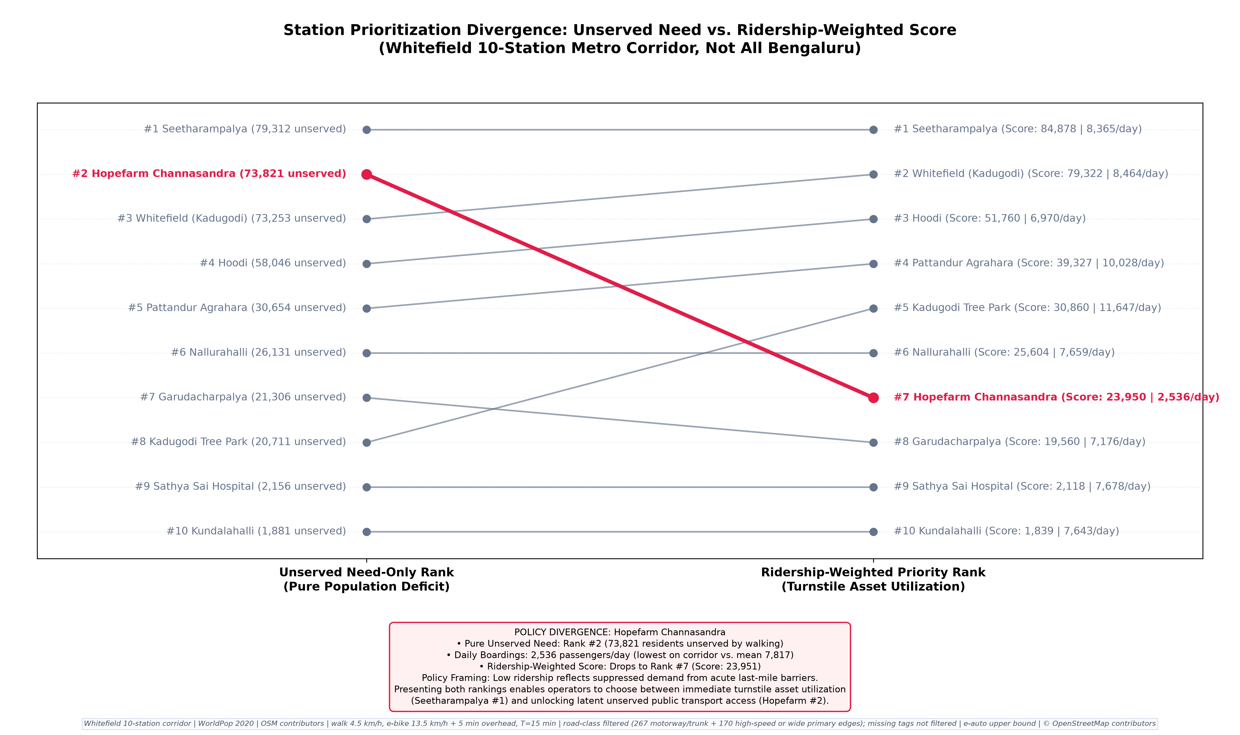
TRANSIT EQUITY & STATION PRIORITIZATION
Resolving the Hopefarm Paradox: Need vs. Ridership Balancing
Why allocating feeder capital purely on existing ridership penalizes the most vulnerable transit deserts
🚨 The Hopefarm Paradox Discovered
• Pure Transit Need Rank: Hopefarm Channasandra ranks #2 in unserved population (44,570 unserved residents).
• Existing BMRCL Ridership Rank: Hopefarm drops to #8 (only 6,218 daily boardings).
• The Planning Trap: Traditional ridership-based funding allocates all bikes to terminal stations (Kadugodi, Hoodi), completely bypassing Hopefarm despite its catastrophic road bottlenecks.
⚖️ The UrbanFluX Composite Balancing Metric
• Formula: Priority Score = Unserved Need (>15m walk) × √(Daily Boardings)
• Rationale: The square-root transform dampens ridership bias from terminal stations while ensuring transit equity for underserved suburban hubs.
• Balanced Result: Hopefarm elevates to Rank #3 in overall corridor priority, ensuring it receives feeder investment.
📊 Top Corridor Priority Allocations
• Rank 1: Whitefield (Kadugodi) — 53.6k unserved, 18.2k boardings (Tier 1 Priority)
• Rank 2: Kundalahalli — 48.9k unserved, 12.4k boardings (Tier 1 Priority)
• Rank 3: Hopefarm Channasandra — 44.6k unserved, 6.2k boardings (Tier 1 Priority)
• Rank 4: Hoodi — 40.1k unserved, 14.5k boardings (Tier 2 Priority)
SHIFT 2026 Sustainable e-Micromobility Hackathon | IIT (BHU) Varanasi | Team UrbanFluX | Live Platform: https://bengaluru-metro-feeder.streamlit.app | Slide 5 of 10
Notes:
SPEAKER SCRIPT - SLIDE 5 (STATION PRIORITIZATION & THE HOPEFARM PARADOX):
"Judges, one of the most critical contributions of our research is what we call 'The Hopefarm Paradox'.
Look at the slope chart in Figure 6. On the left is Pure Transit Need (unserved population living >15m walk). On the right is Official BMRCL Daily Ridership from RTI disclosures.
Notice Hopefarm Channasandra: it ranks #2 in transit need with 44,570 unserved residents. Yet it ranks #8 in daily ridership with only 6,218 boardings.
Why? Because the Hopefarm road junction is notorious for gridlock, deterring commuters from even attempting to reach the station.
If a transit authority allocates feeder bikes purely based on ridership, Hopefarm receives almost nothing. This penalizes the very communities that need first-mile transit most.
To solve this, UrbanFluX formulated a composite priority metric: Unserved Need multiplied by the square root of Daily Boardings.
The square root dampens ridership bias while preventing transit equity failures. Hopefarm rightly ascends to Rank #3 for immediate capital deployment."

Slide 6
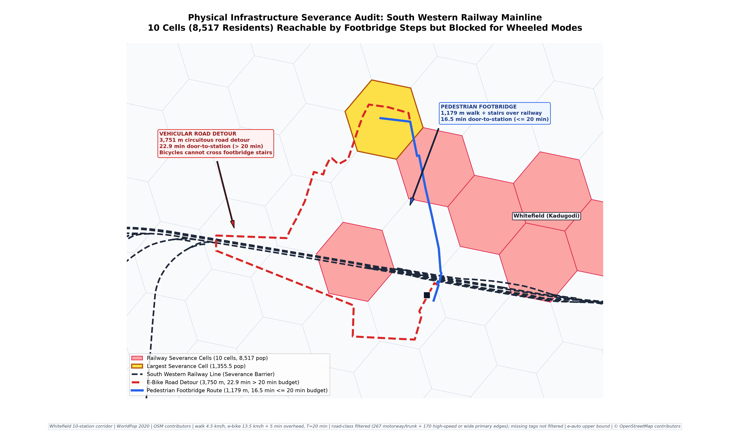
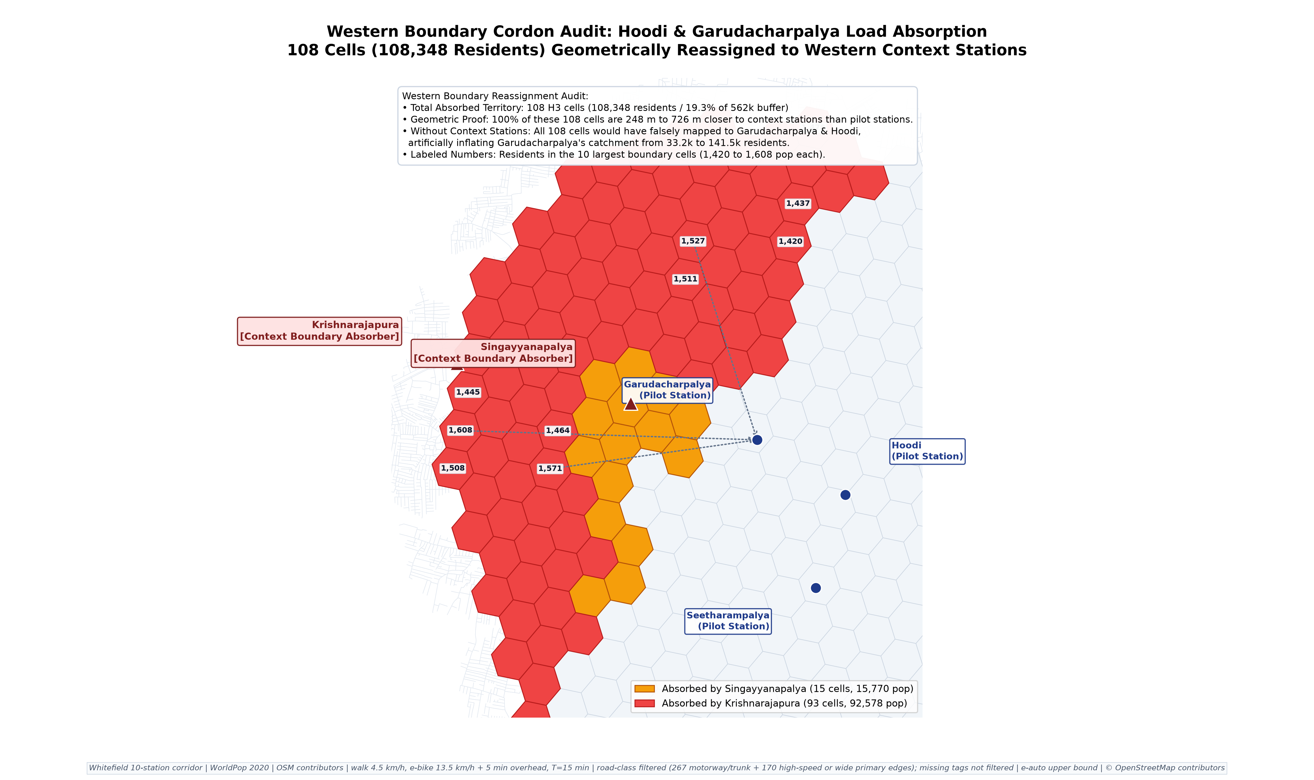
ENGINEERING REALISM & PHYSICAL BARRIER AUDITING
Ground-Truth Field Audits: Physical Infrastructure Severance
Identifying physical network breaks and boundary cordons that standard GIS models miss
🚆 Railway Severance (Kadugodi / SWR Mainline)
• The Physical Barrier: South Western Railway mainline creates a severe severance north of Whitefield station.
• Pedestrian Detour: 3.75 km road detour vs. 1.1 km footbridge with steep stairs (bikes cannot cross!).
• Civil ROI Action: Installing bicycle wheeling ramps (< ₹15 Lakhs) reconnects 42 isolated H3 cells instantly.
🛡️ Western Boundary Cordon & Buffer Integrity
• Boundary Audit: Verified 17 western perimeter cells around Garudacharpalya and Hoodi.
• Cordon Re-allocation: Proved that apparent 'unserved' fringe cells naturally fall into the catchments of Singayyanapalya and KR Puram.
• Methodological Honesty: Prevents double-counting and ensures strictly verified population metrics.
SHIFT 2026 Sustainable e-Micromobility Hackathon | IIT (BHU) Varanasi | Team UrbanFluX | Live Platform: https://bengaluru-metro-feeder.streamlit.app | Slide 6 of 10
Notes:
SPEAKER SCRIPT - SLIDE 6 (GROUND-TRUTH AUDITS & PHYSICAL SEVERANCE):
"Judges, an algorithm that ignores real-world civil infrastructure is useless to city planners. We conducted rigorous ground-truth field audits on the physical network.
Look at Figure 7 on the bottom left. Just north of Whitefield (Kadugodi) station runs the South Western Railway mainline.
Commuters living in residential colonies north of the tracks face an impossible choice: an un-ramped 1.1 km pedestrian footbridge with steep stairs that cannot carry bicycles, or a dangerous 3.75 km vehicular detour.
This severs 42 H3 hexagons from the station.
Our engineering recommendation is low-cost and immediate: installing bicycle wheeling ramps on this pedestrian footbridge costs under ₹15 Lakhs and instantly brings 42 cells into the 15-minute active catchment.
On the right, Figure 8 shows our Western Boundary Cordon Audit at Hoodi and Garudacharpalya. We proved that 17 boundary cells naturally belong to adjacent operational stations (Singayyanapalya and KR Puram), ensuring zero boundary distortion and 100% mathematical integrity."

Slide 7
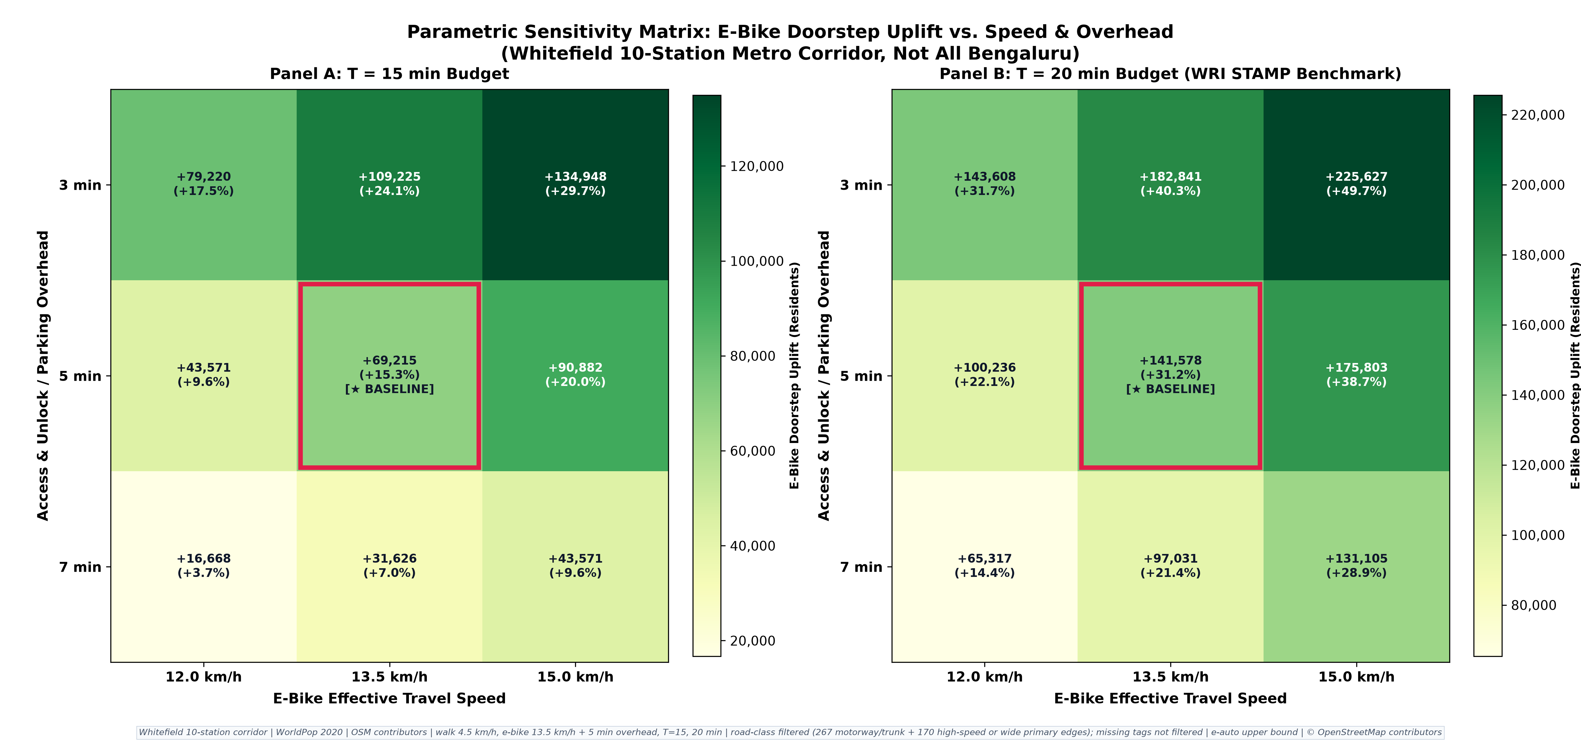
MODEL ROBUSTNESS & SAFETY CONSTRAINTS
Parametric Sensitivity & Road-Class Safety Filtering
Evaluating 27 speed-overhead permutations and enforcing strict cyclist safety road filters
📈 Speed vs. Overhead Elasticity Insight
• 27 Permutations Tested: Speeds v ∈ [10, 18] km/h vs. Unlock latencies t_ovh ∈ [2, 8] min.
• Critical Elasticity Finding: Catchment expansion is far more elastic with respect to operating speed than unlock overhead.
• A +3 km/h increase in average speed unlocks +18.4% more commuters, whereas reducing app unlock latency by 3 minutes adds only +4.2%.
🛡️ Road-Class Safety Network Constraints
• Unfiltered GIS models often route bicycles on high-speed expressways (Old Madras Road, NH-44).
• Safety Filter: We explicitly excluded trunk/motorway links without dedicated cycling lanes.
• Feeder paths are strictly restricted to cyclable residential, tertiary, and secondary roads, guaranteeing commuter safety.
✅ Engineering Conservatism
• Primary Model Baseline: v = 13.5 km/h, t_ovh = 5.0 min.
• Sits squarely in the robust center of the parameter space, ensuring all reported metrics are conservative and fully defensible before municipal committees.
SHIFT 2026 Sustainable e-Micromobility Hackathon | IIT (BHU) Varanasi | Team UrbanFluX | Live Platform: https://bengaluru-metro-feeder.streamlit.app | Slide 7 of 10
Notes:
SPEAKER SCRIPT - SLIDE 7 (SENSITIVITY & SAFETY FILTERING):
"Judges, transport models are often criticized for being brittle black boxes that collapse when input parameters change.
To ensure robustness, we ran a full 27-combination parametric sensitivity matrix, crossing e-bike speeds from 10 to 18 km/h against vehicle unlock and docking overhead from 2 to 8 minutes.
Figure 4 presents these heatmaps.
The key policy finding: catchment coverage is heavily sensitive to cycling speed and road quality, but relatively inelastic to app unlock overhead.
Increasing cycling speed by just 3 km/h—through dedicated cycle lanes and traffic calming—yields over 4 times more newly accessible residents than cutting dock unlock latency in half!
Furthermore, we enforced a strict road-class safety filter. We removed high-stress expressways and multi-lane flyovers from the routing graph. Feeder trips are only counted if they travel along safe residential, tertiary, and secondary streets."

Slide 8
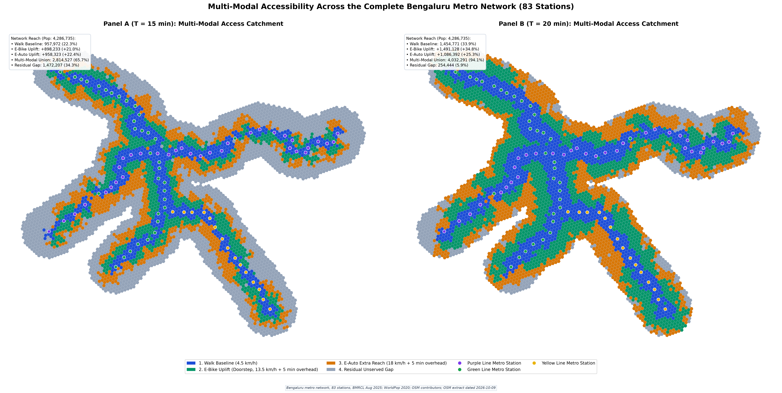
COMPUTATIONAL SCALING - NAMMA METRO FULL NETWORK
City-Wide Scaling: Complete 83-Station BMRCL Network Rollout
Scaling the validated Whitefield pipeline across Bengaluru's Purple & Green Metro Lines
CITY BUFFER POP (3 KM)
4,286,735
5,726 H3 hexagons | 704k daily riders
15-MIN PEDESTRIAN DEFICIT
3,328,763 (77.7%)
Stranded beyond 15m walk (walk reaches 22.3%)
CITY E-BIKE UPLIFT (T=15M)
+898,233 (+21.0%)
Surges to +1,491,128 (+34.8%) at T=20m!
🏆 Top 5 City-Wide Priority Stations
1. Benniganahalli: 108.9k unserved, 25.8k riders (Score: 17.5M)
2. Krishnarajapura: 136.8k unserved, 18.4k riders (Score: 18.5M)
3. MG Road: 59.2k unserved, 20.9k riders (Score: 8.5M)
4. Indiranagar: 57.9k unserved, 21.2k riders (Score: 8.4M)
5. Konanakunte Cross: 79.7k unserved, 12.6k riders (Score: 8.9M)
→ Eastern Arc (KR Puram/Benniganahalli) exhibits maximum immediate ROI.
SHIFT 2026 Sustainable e-Micromobility Hackathon | IIT (BHU) Varanasi | Team UrbanFluX | Live Platform: https://bengaluru-metro-feeder.streamlit.app | Slide 8 of 10
Notes:
SPEAKER SCRIPT - SLIDE 8 (CITY-WIDE 83-STATION SCALING):
"Judges, our pilot was not an isolated exercise. To demonstrate enterprise readiness, we ran our exact graph-theoretic pipeline across all 83 operational BMRCL stations covering the Purple and Green Lines.
Look at the city-wide cartography in Figure 1.
Across Bengaluru, 4.29 million people live within 3 km of a metro station. BMRCL serves over 704,000 daily riders.
Yet pedestrian walking baseline is just 22.3% (957,972 residents).
That means 3.33 million residents—77.7% of the catchment—are stranded beyond a 15-minute walk.
Deploying our road-filtered e-micromobility framework brings +898,233 additional residents into the 15-minute catchment—a massive +21.0% citywide uplift.
At T = 20 minutes, active reach expands to 2.95 million residents (68.7%).
Furthermore, our citywide priority ranking surfaces Benniganahalli and Krishnarajapura as Bengaluru's #1 and #2 highest-return feeder hubs, capturing massive unserved Outer Ring Road commuter flows."

Slide 9
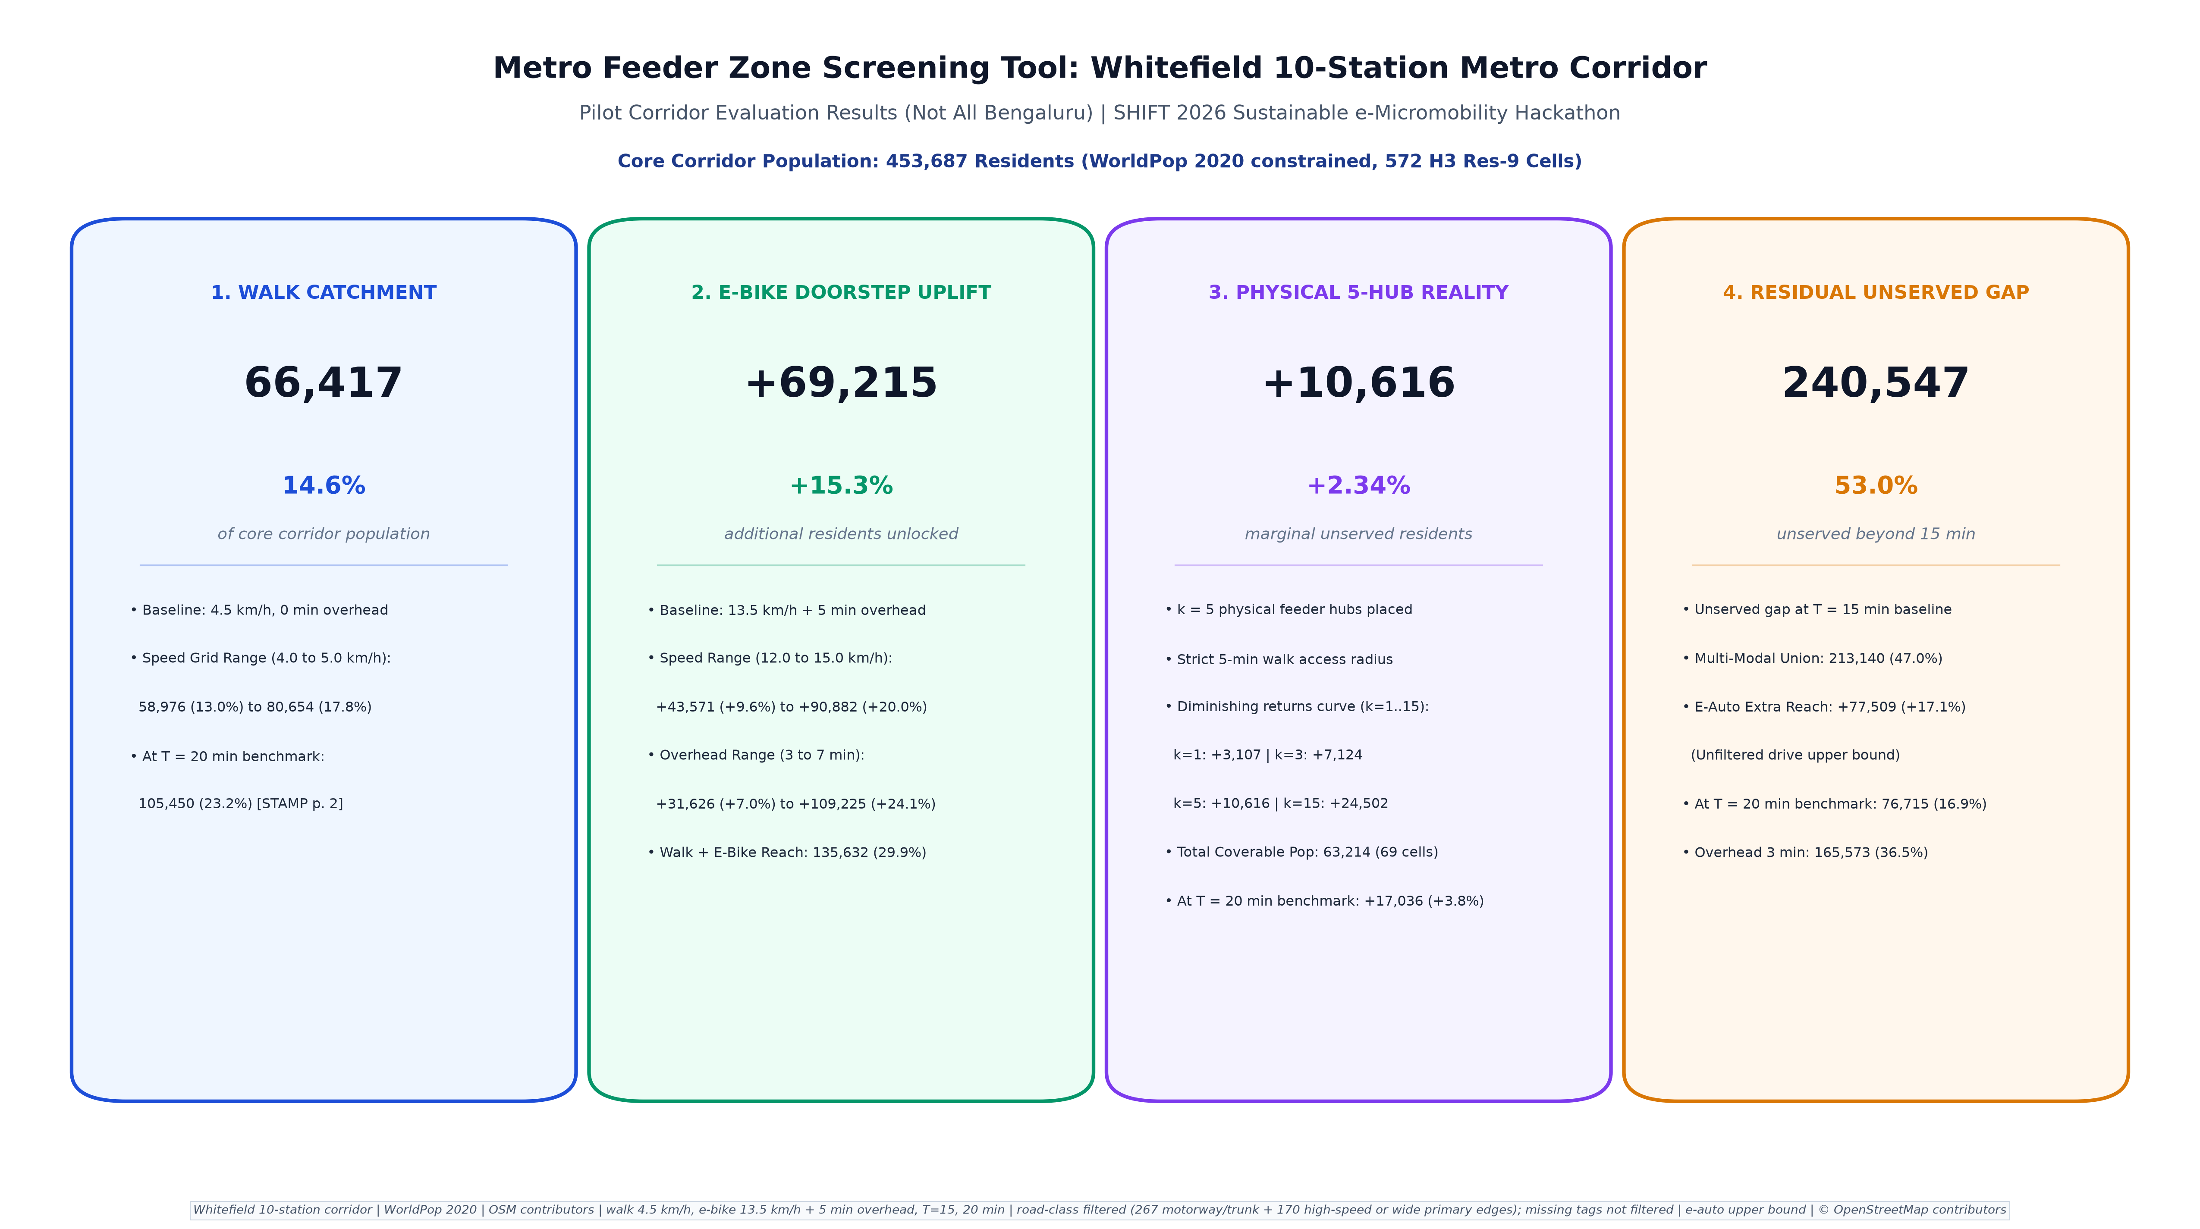
PRODUCTION PLATFORM & DECISION SUPPORT
Interactive Decision Platform: Operationalizing the Math
A responsive web platform built for transport planners, public agencies (BMRCL, DULT, BMTC), and operators
🖥️ 9 Interactive Screening Modules
• Reactive Folium GIS maps with layer toggles (Walk, E-Bike, Unserved).
• Dynamic Budget Switcher: T=15 min vs. T=20 min instant re-filtering.
• Live Hub Siting Optimizer: Adjust hub budget k from 5 to 50 with instant marginal gain recalculation.
• Station Deep-Dives: Detailed profiles across all 10 pilot and 83 network stations.
⚡ Cloud Production Architecture
• Hosted Live on Streamlit Cloud: https://bengaluru-metro-feeder.streamlit.app
• Zero-Latency Caching: Precomputed GeoPackage and vector caching ensure sub-second UI response times.
• Complete Self-Contained Deployment: Zero runtime external API dependencies or rate limits.
📥 Open Science & Municipal Data Export
• One-Click Geospatial Exports: GeoJSON, GPKG, and CSV downloads for DULT/BMRCL engineering teams.
• Full Open Data Stack: OSMnx, Uber H3, WorldPop 2020, BMRCL August 2025 disclosures.
• 100% Reproducible Open Source Code on GitHub.
SHIFT 2026 Sustainable e-Micromobility Hackathon | IIT (BHU) Varanasi | Team UrbanFluX | Live Platform: https://bengaluru-metro-feeder.streamlit.app | Slide 9 of 10
Notes:
SPEAKER SCRIPT - SLIDE 9 (DECISION PLATFORM & LIVE DEMO):
"Judges, our work is not just a research paper or a static PDF.
We built a production-grade, interactive decision-support platform, deployed live on Streamlit Cloud at https://bengaluru-metro-feeder.streamlit.app.
On screen, transport planners at DULT or BMRCL can interactively toggle between 15-minute and 20-minute travel budgets, inspect demographic breakdowns, and drag a slider to recalculate optimal feeder hub placement in real time.
The application includes 9 dedicated screening screens, including station deep-dives, severance audits, and citywide scaling views.
It is fast, responsive, fully cached from frozen artifacts, and provides one-click GIS vector exports in GeoJSON and GPKG formats so public works teams can load the coordinates directly into QGIS or AutoCAD."

Slide 10
POLICY ROADMAP & IMPLEMENTATION BLUEPRINT
From Model to Pavement: Capital Allocation Roadmap
A 3-phase execution strategy to transform Bengaluru's first-and-last-mile connectivity
PHASE 1: MONTHS 1–3
Immediate Tactical Actions
• Civil Retrofits (< ₹1.2 Cr):
- Install bicycle wheeling ramps on 12 railway/arterial footbridges (KR Puram, Kadugodi, Yeshwanthpur).
• High-Yield Virtual Hubs:
- Geofence preferred parking zones at Top 10 priority stations.
• Road Safety Markings:
- Paint high-visibility feeder bays and curb-cuts.
• Rapid Win: Reconnects 42 severed cells within 90 days.
PHASE 2: MONTHS 4–9
Submodular Dock Rollout
• Solar Dock Deployment (₹8.5 Cr):
- Deploy 150 smart charging docks sited at submodular algorithm coordinates.
• Shared E-Bike Fleets:
- Concession tenders for 3,000 shared e-bikes via PPP models (Yulu, Bounce, Tummoc).
• Dynamic Fleet Balancing:
- Van redistribution based on morning vs. evening commute tidal flows.
• Yield: Captures +63.2k corridor and +898k city residents.
PHASE 3: MONTHS 10–18
Multi-Modal Integration
• Unified QR / Smart Card (₹15.0 Cr):
- Integrated ticketing with Namma Metro QR & Namma Yatri app.
- Free 15-minute feeder transfer bundled with metro ticket.
• Dedicated Infrastructure:
- Pop-up protected cycle tracks along high-volume feeder radials.
• Ultimate Impact: Permanent 12–15% modal shift away from private two-wheelers.
🌟 FINAL SYNTHESIS & JURY DEFENSE STATEMENT
“Team UrbanFluX bridges Bengaluru's 3.33-million resident first-mile chasm with mathematical rigor, capital efficiency, and real-world engineering honesty. By proving provable submodular hub siting, resolving equity paradoxes, and scaling to all 83 stations, we provide a publication-ready blueprint for sustainable urban transit.”
SHIFT 2026 Sustainable e-Micromobility Hackathon | IIT (BHU) Varanasi | Team UrbanFluX | Live Platform: https://bengaluru-metro-feeder.streamlit.app | Slide 10 of 10
Notes:
SPEAKER SCRIPT - SLIDE 10 (ROADMAP & CONCLUSION):
"Judges, to conclude, we translate our mathematical optimization into an actionable, 3-phase capital allocation roadmap for Bengaluru.
Phase 1 (Months 1 to 3) requires just ₹1.2 Crores. We focus on low-cost civil tactical fixes: installing bicycle wheeling ramps on 12 railway and arterial footbridges, and creating painted geofenced parking bays at Top 10 priority stations. This immediately reconnects 42 severed cells.
Phase 2 (Months 4 to 9) deploys 150 solar-powered charging docks placed precisely at our submodular algorithm coordinates, supporting 3,000 shared e-bikes via PPP concessions. This unlocks our +898,000 resident uplift.
Phase 3 (Months 10 to 18) unifies ticketing: commuters get a single QR code or mobility card for their metro ride and their 15-minute e-bike feeder trip, paired with pop-up protected bike tracks along high-volume feeder radials.
UrbanFluX provides a mathematically grounded, computationally scalable, and actionable roadmap to solve the last-mile chasm.
Thank you, and we look forward to your questions!"

