Slide 1

Notes:
Slide 1: Title

Slide 2
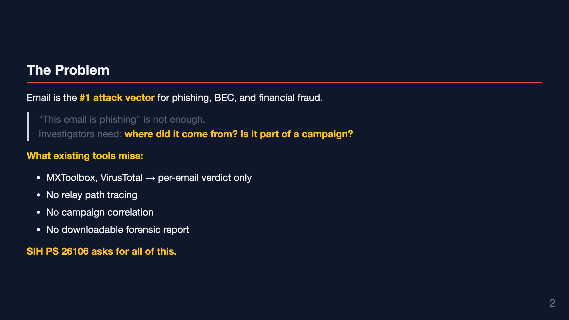
Notes:
Slide 2: The Problem

Slide 3
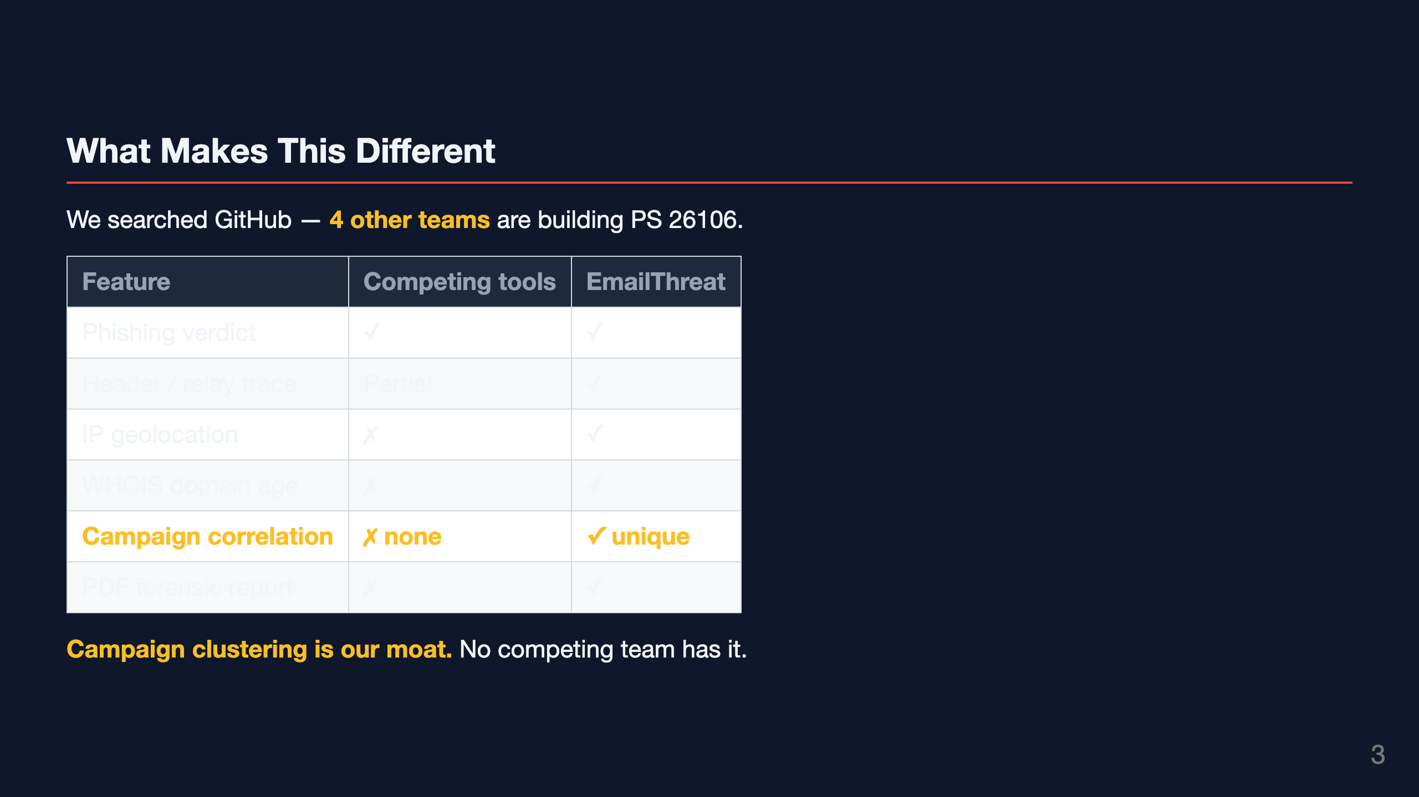
Notes:
Slide 3: Our Differentiator

Slide 4
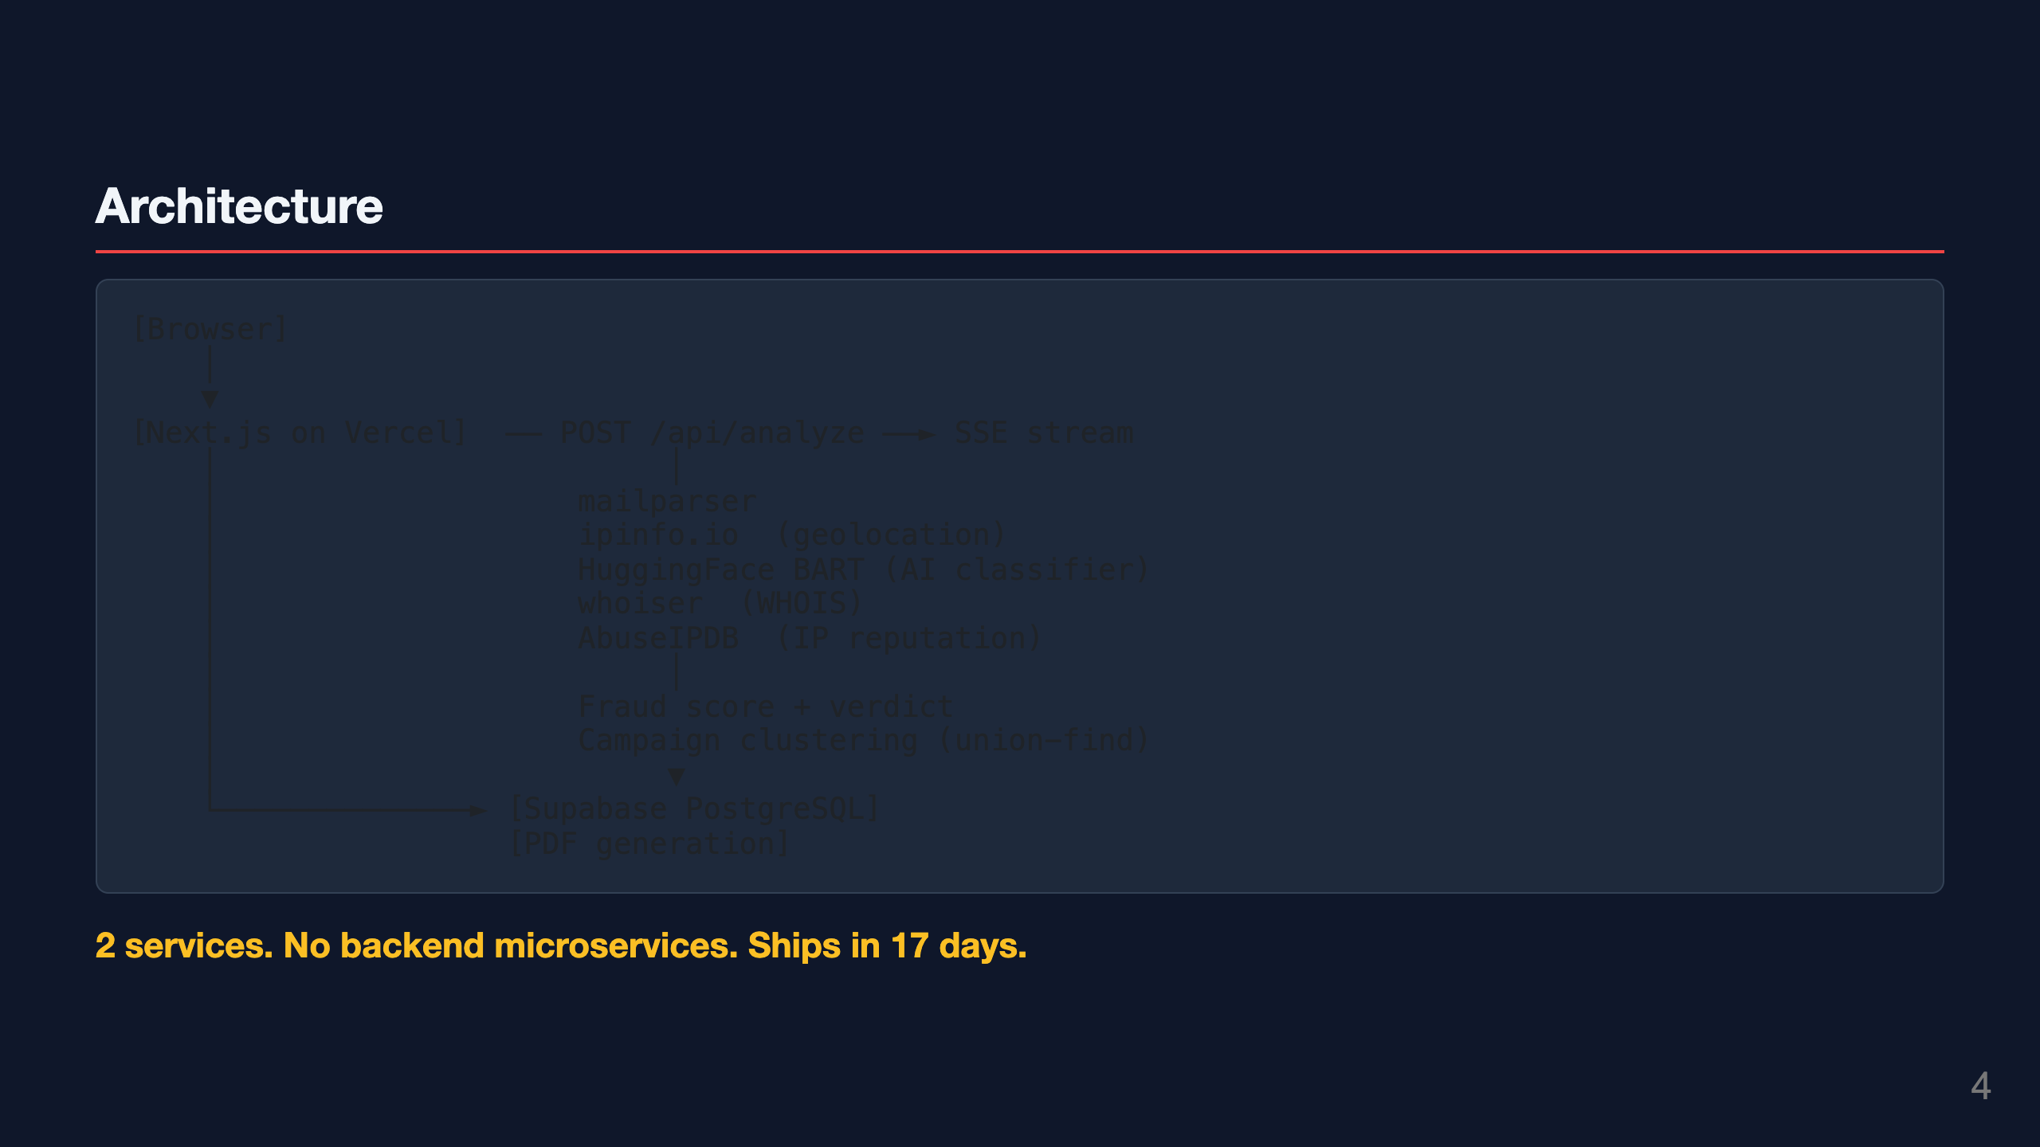
Notes:
Slide 4: How It Works — Architecture

Slide 5
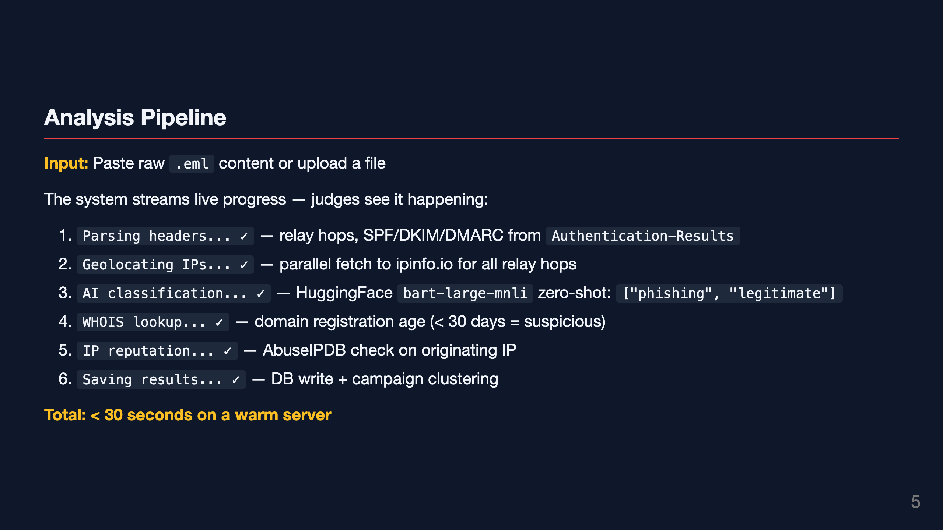
Notes:
Slide 5: The Analysis Pipeline

Slide 6
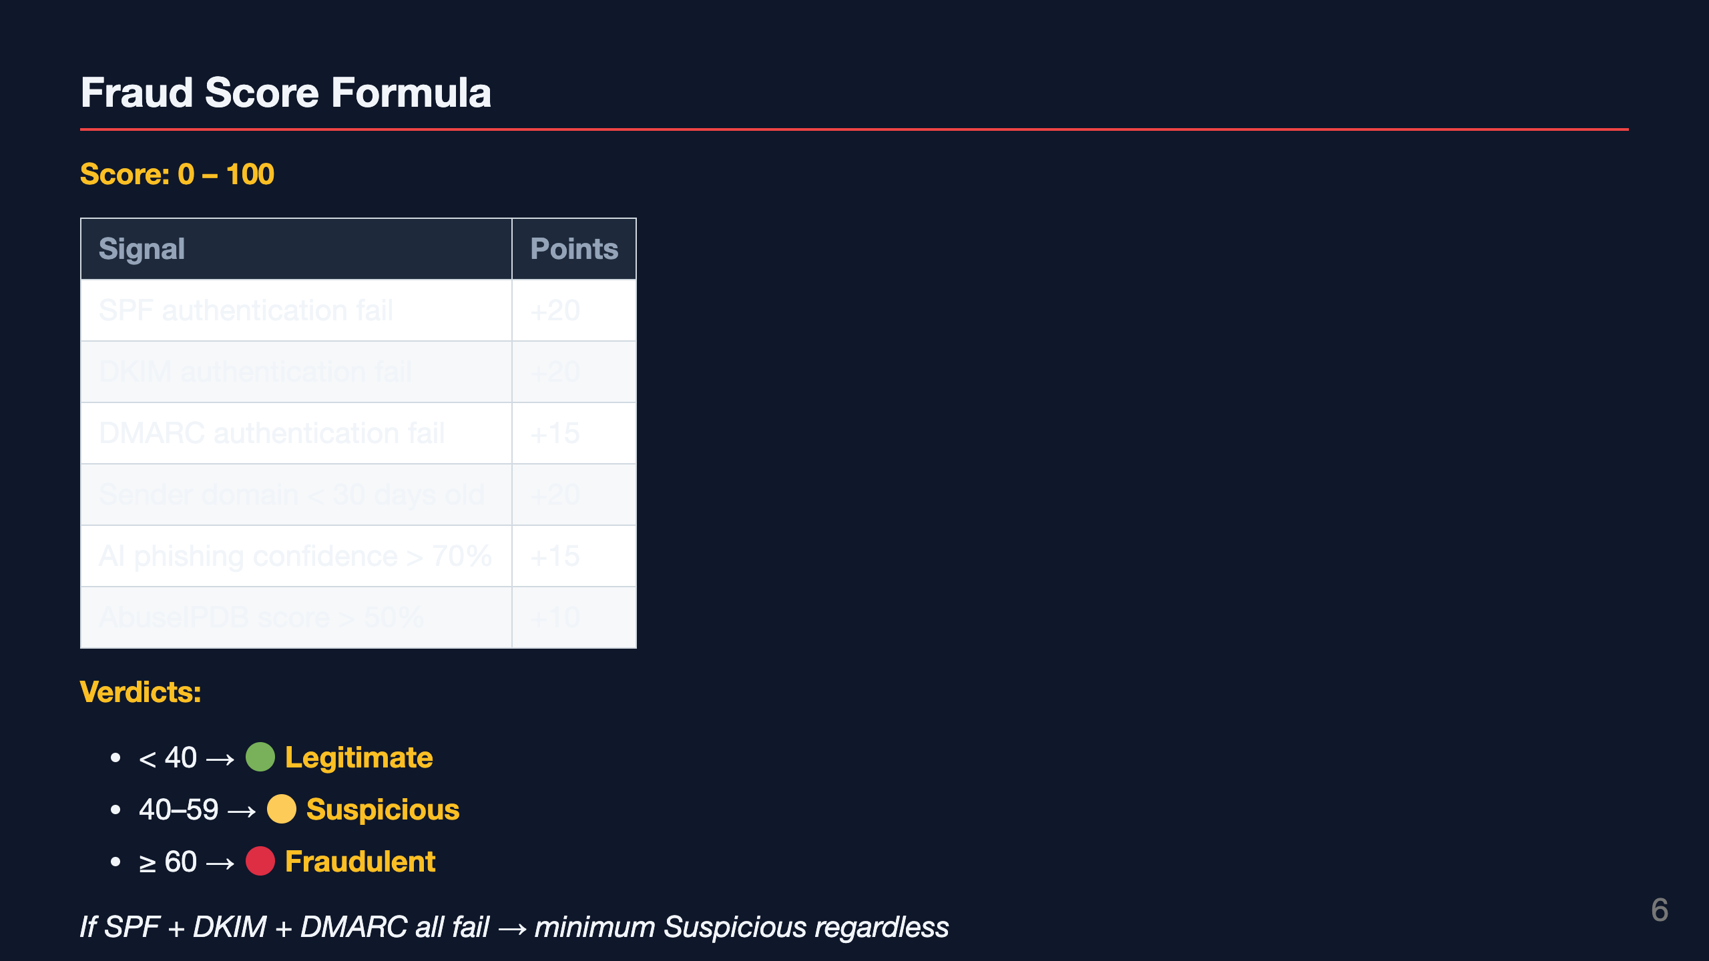
Notes:
Slide 6: Fraud Scoring

Slide 7
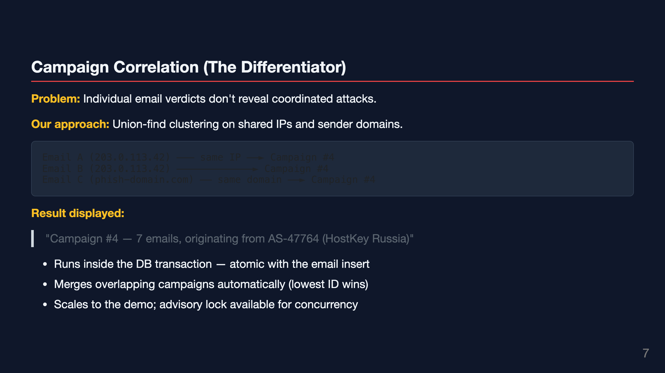
Notes:
Slide 7: Campaign Correlation

Slide 8
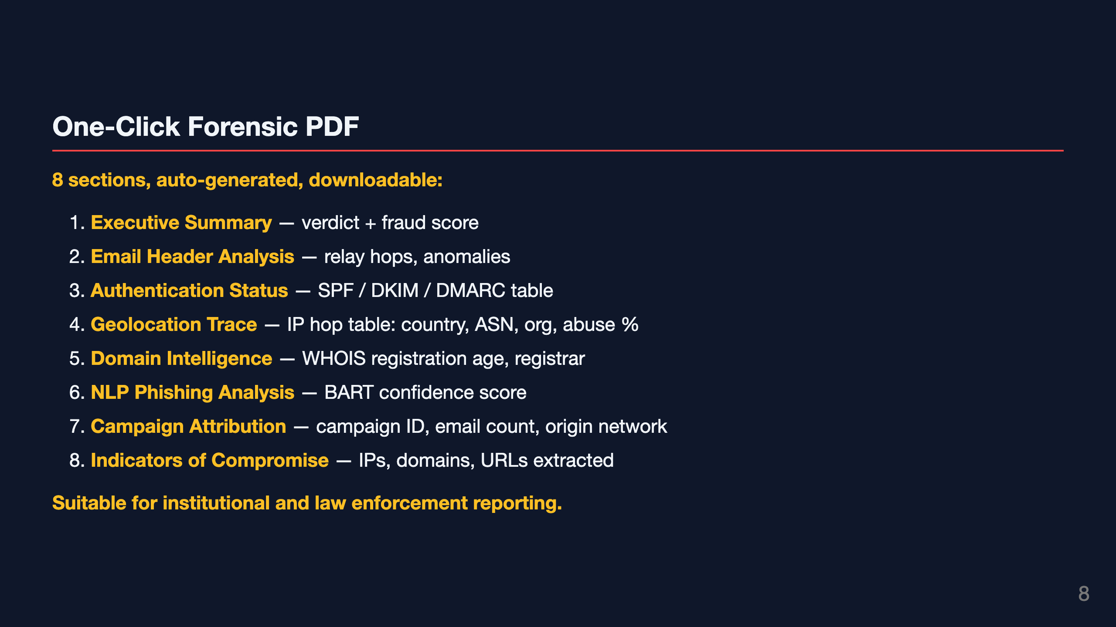
Notes:
Slide 8: The PDF Report

Slide 9
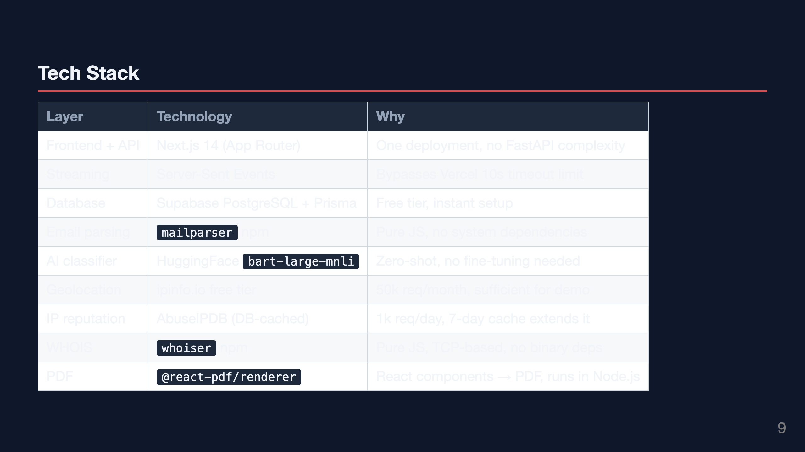
Notes:
Slide 9: Tech Stack

Slide 10
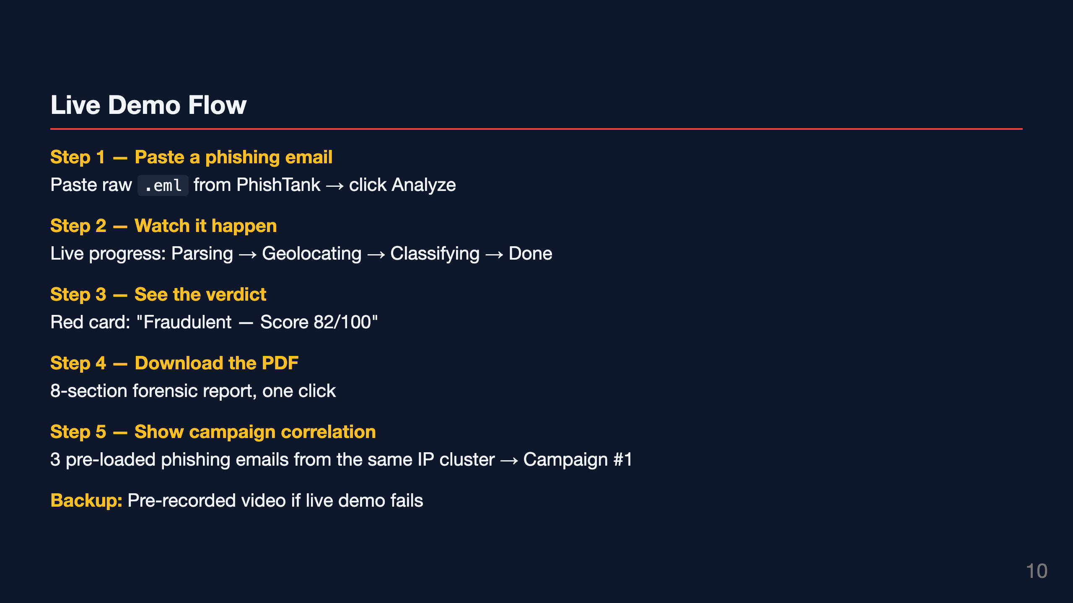
Notes:
Slide 10: Live Demo Flow

Slide 11
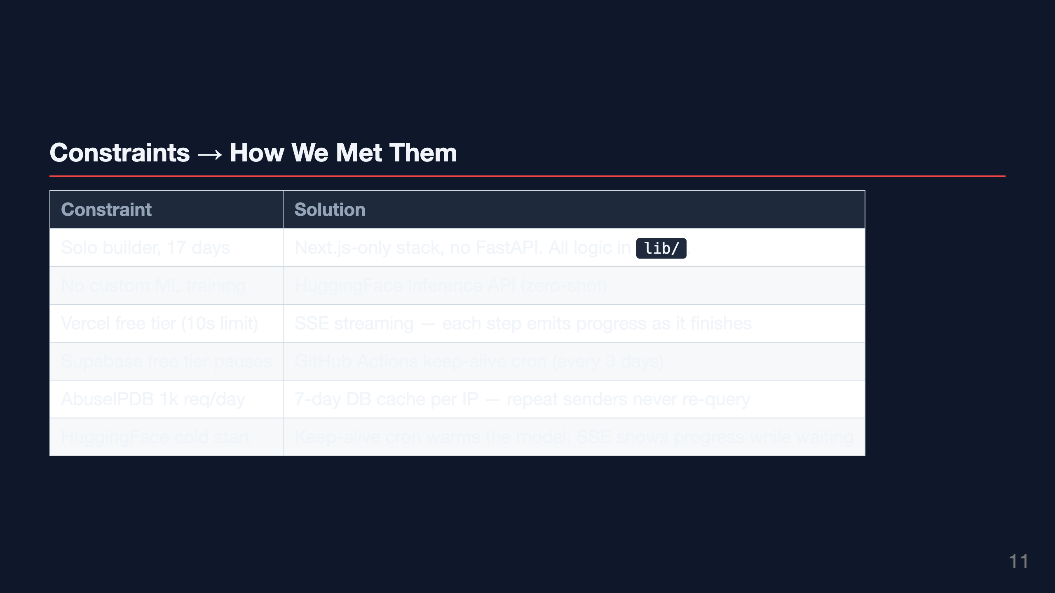
Notes:
Slide 11: Constraints Met

Slide 12
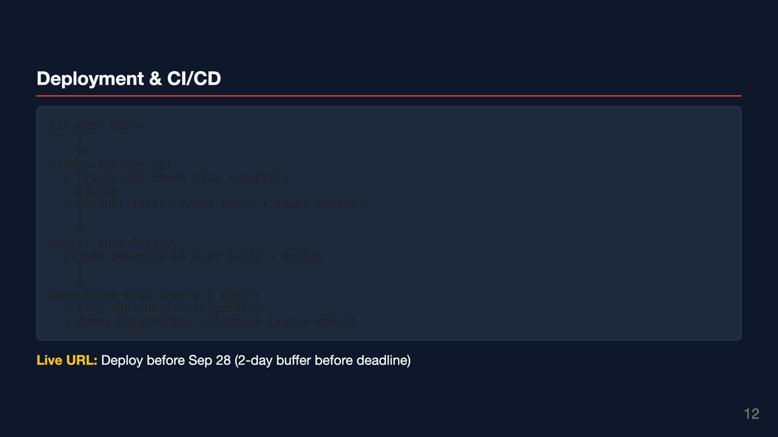
Notes:
Slide 12: Deployment

Slide 13
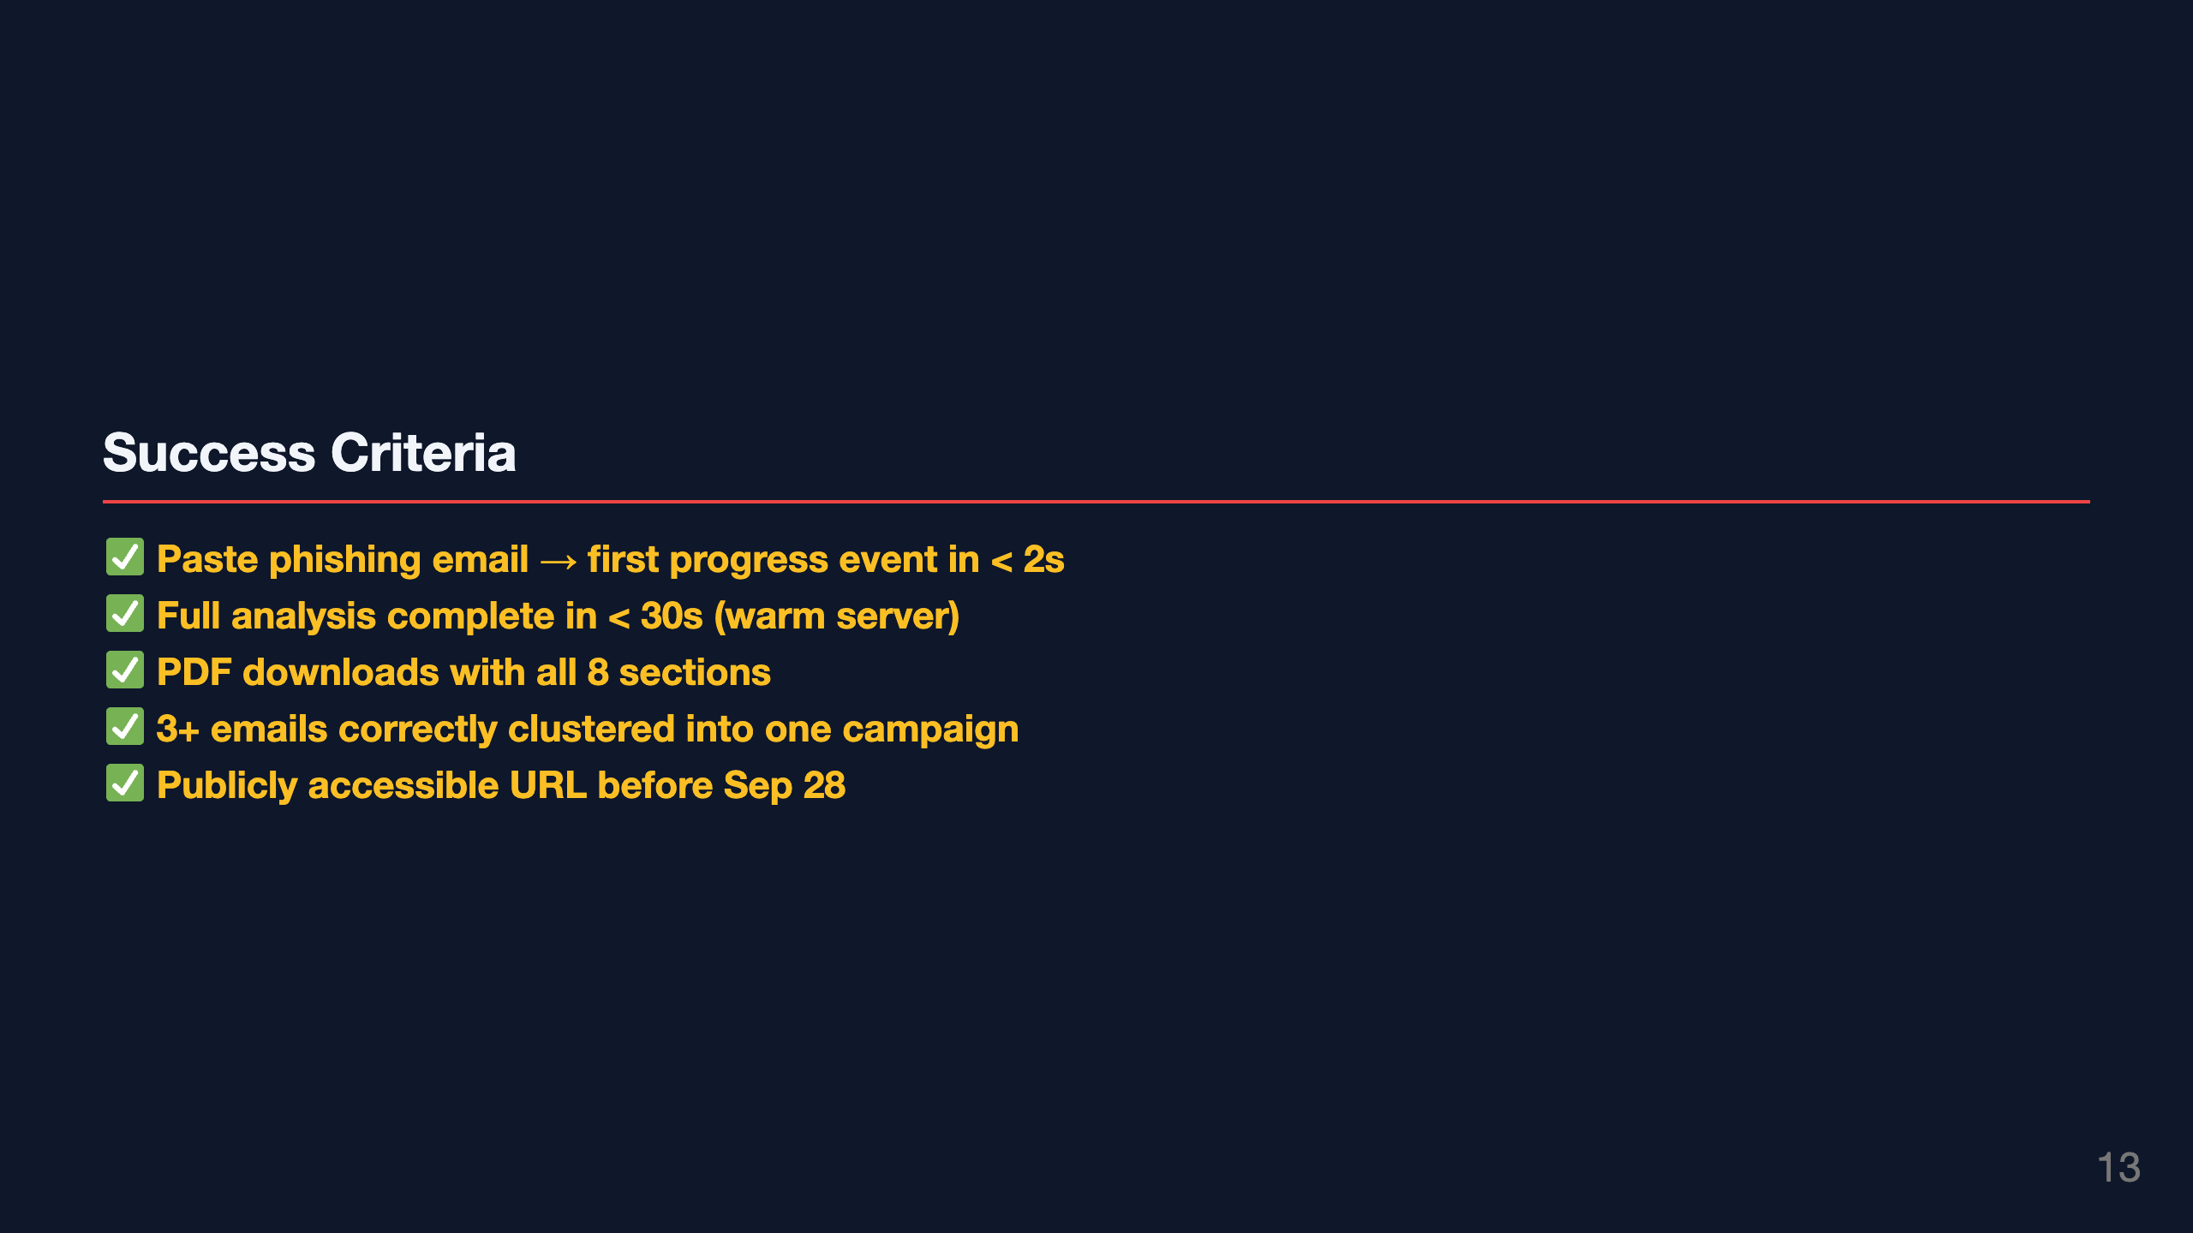
Notes:
Slide 13: Success Criteria

Slide 14
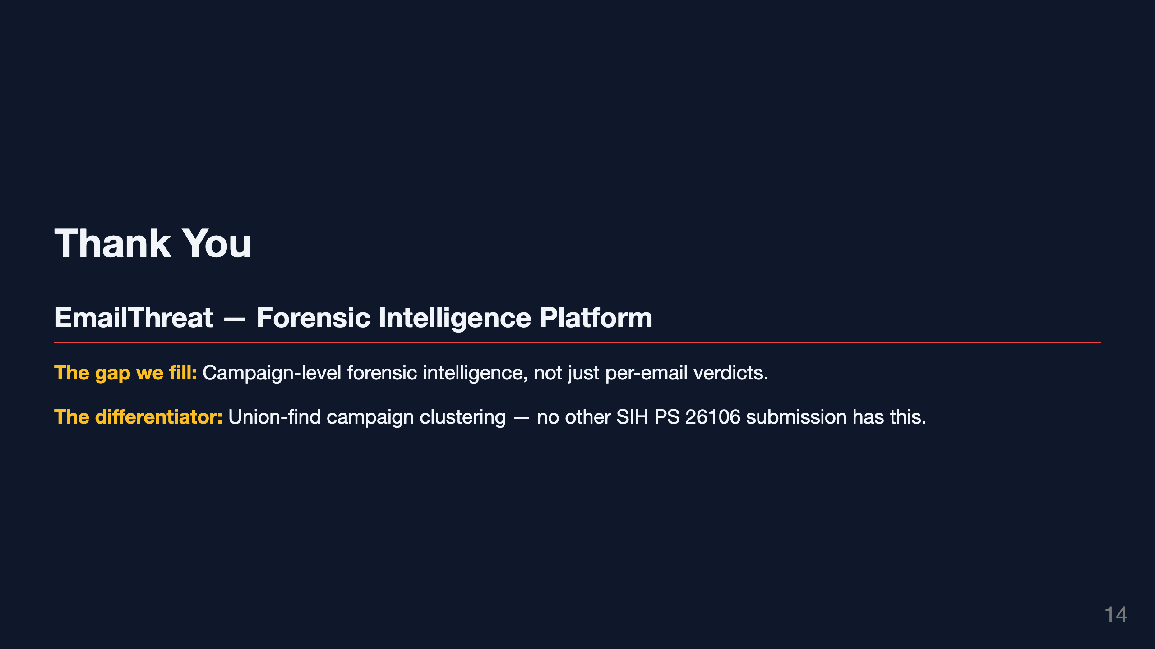
Notes:
Slide 14: Thank You

Slide 15


