Slide 1
Verifying Information Flow Security for Blockchain-based Smart Contracts
Author: Shurong Ge
Supervisor: Lucas Cordeiro

Slide 2


Verifying Information Flow Security for Blockchain-based Smart Contracts
Implementation
Context: Blockchain, Smart Contract
Demo
Verification
Context: Common Security Vulnerabilities
Evaluation
Comparison between different analysis tools

Slide 3
1. Implementation - Context
Blockchain: an open, distributed ledger that can record transactions between two parties efficiently and in a verifiable and permanent way
Smart Contract: a transaction protocol which is automatically execute, control or document legally relevant events and actions according to the terms of a contract or an agreement.
Blockchain enables Smart Contracts by building on its distributed ledger architecture.
A Smart Contract is being executed on a Blockchain

Slide 4

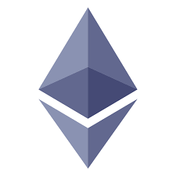

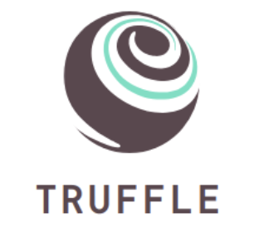

1. Implementation - Demo
Token coin based on the ERC-20 standard
Normal Features: Mint, Supply, Burn, Balance, Transfer...
Interesting Features: Approve, Transfer From and Allowance

Slide 5

2. Verification - Context
The common security Vulnerabilities in Ethereum smart contracts are:
Reentrancy
Integer overflow and underflow
DoS With Block Gas Limit
Weak Sources of Randomness from Chain Attributes

Slide 6
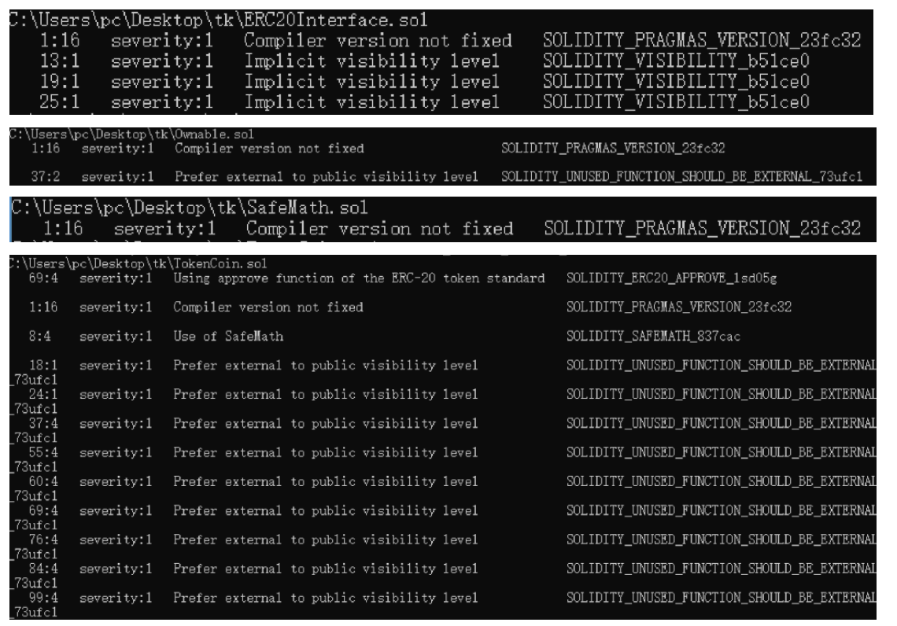
2. Verification - Evaluation
Smartcheck

Slide 7
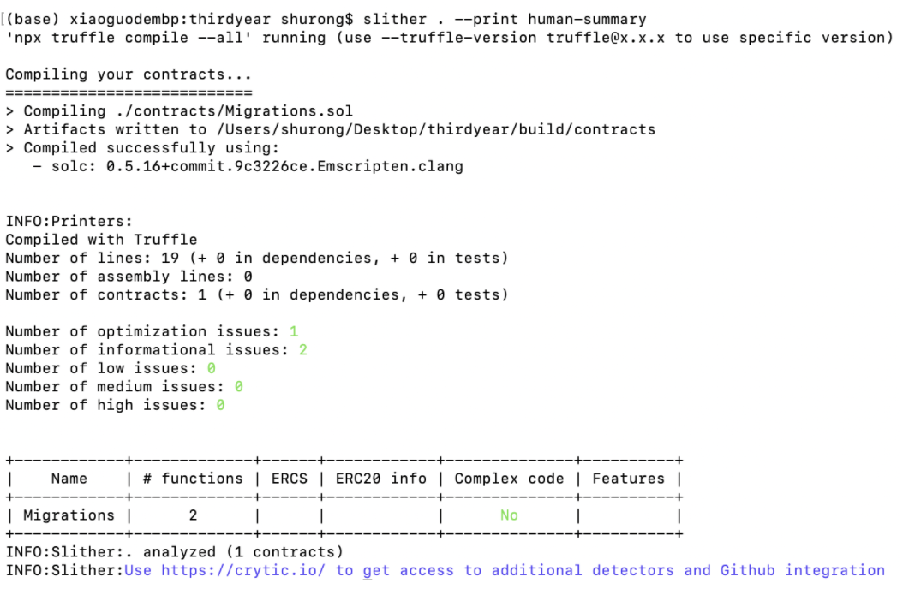
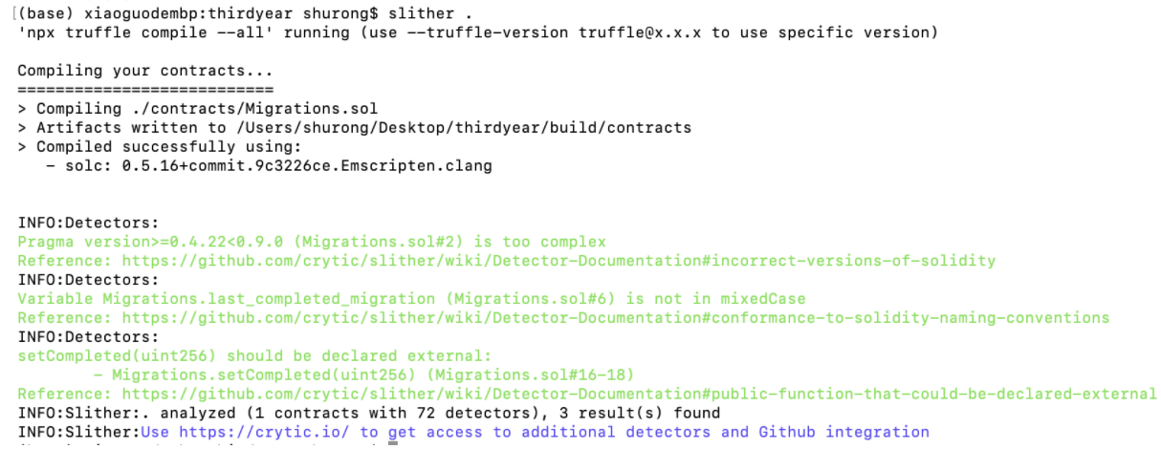
2. Verification - Evaluation
Slither

Slide 8
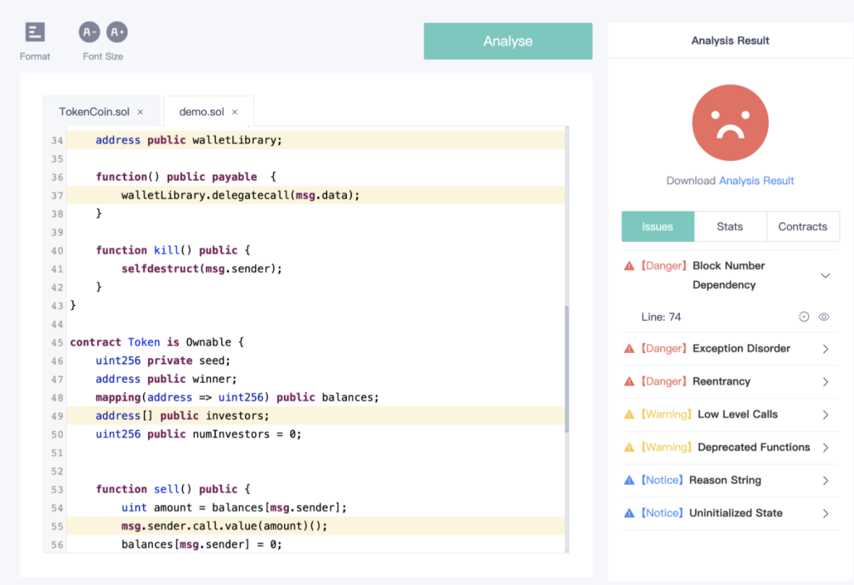
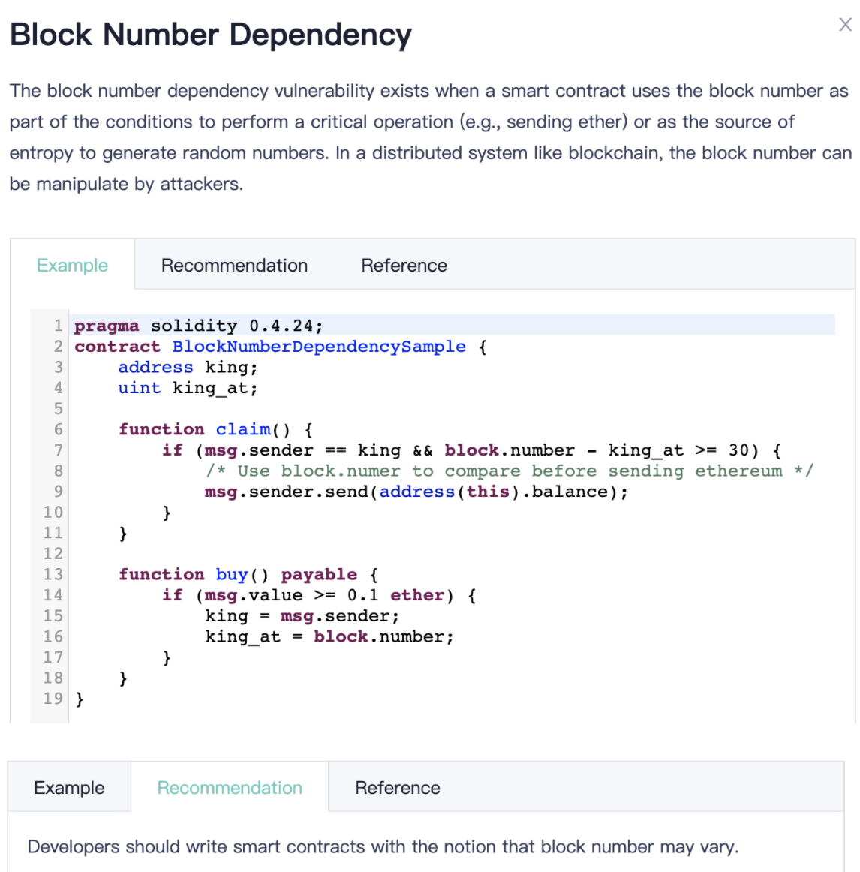
2. Verification - Evaluation
Contract Guard (sFuzz)
note: this part using a problematic smart contract demo instead of my own contract

Slide 9

2. Verification - Comparison
Contract Guard: an efficient fuzzer
Beginner-friendly
Online visual web page
Advice on how to resolve the detected vulnerabilities
However, it is only available for smart contracts with small file sizes, otherwise the analysis time will take so long and the results never display

Slide 10

2. Verification - Comparison
Smartcheck
Checks for vulnerabilities and malpractice
Displaying possible errors in sequence on each line, (the result list is clear)
But, there is no instructions on how to correct errors, and it has some false positives

Slide 11

2. Verification - Comparison
Slither
Able to engaged with Truffle framework
Detect more common problems and give the severity of each problem
Other interesting features such as
Print a human-readable summary of the contracts
Export the call-graph of the contracts to a dot file

Slide 12
Thanks for listening and watching :)

