Slide 1
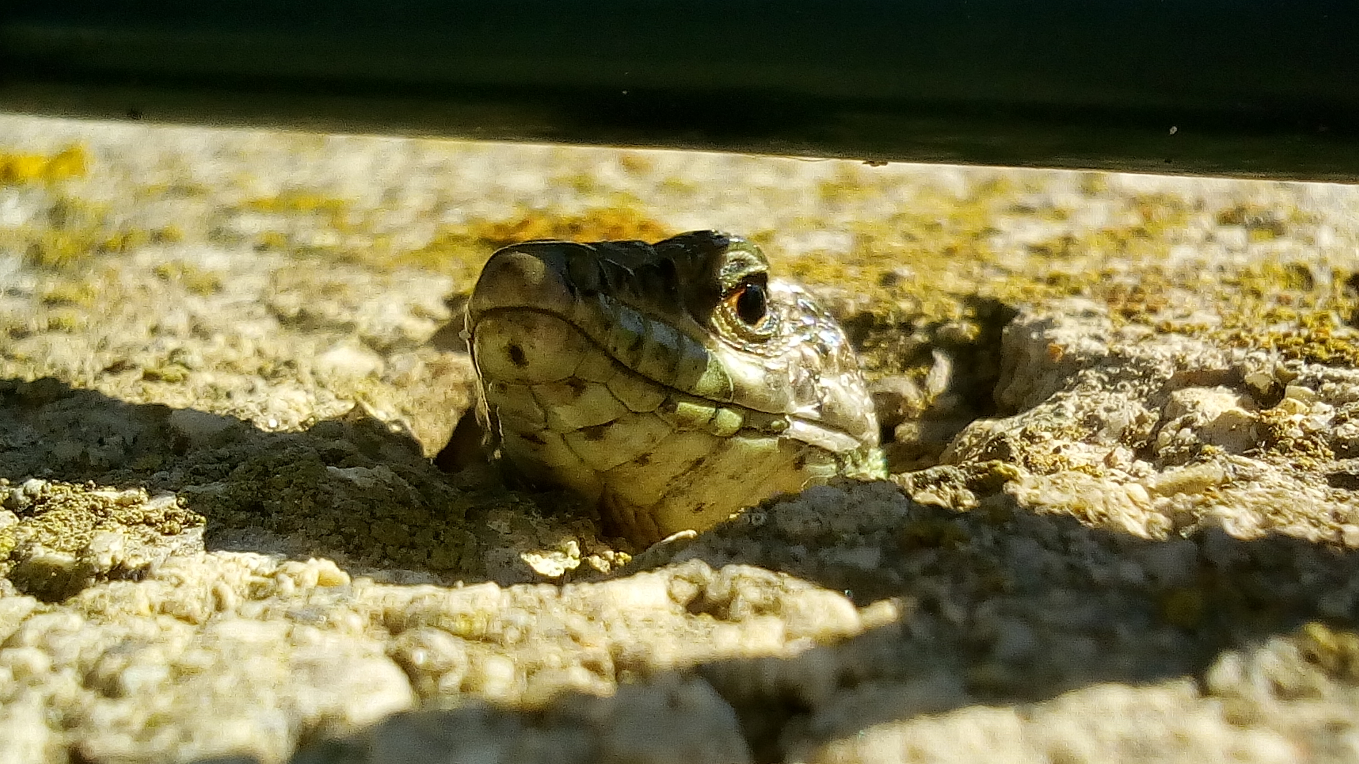
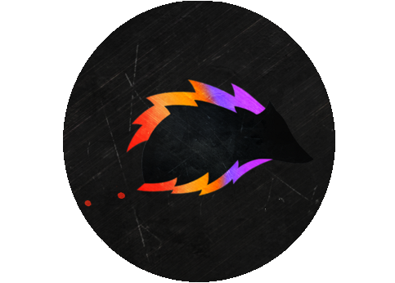
Tiny Life Saver Tools
How to use

Slide 2

1) Welcome to Tiny Life Saver tools. You don't have to press "play" to test the majority of the tools.
See demo scene right here to see the most important tool of this pack
Quickly change timeScale while testing your game !

Slide 3

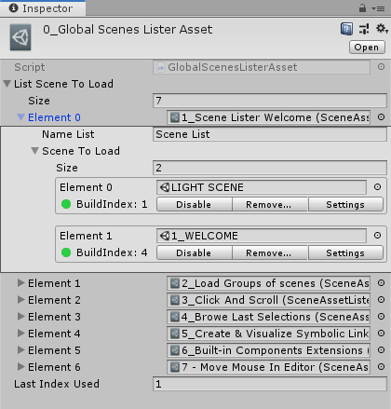
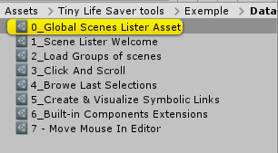
2) Multi Scene Loading, Runtime & Play Mode
This tool allow you to load multiple additive scene together, in play AND in editor quickly. Clic on « Locate » to see the reference asset

Slide 4
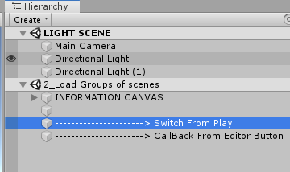
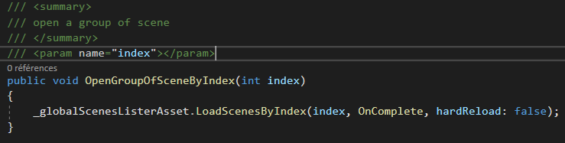

2) Load group of scene from code
You have an exemple in the Group 2: from any script containing a reference of the Global Scene Asset Lister, simply call LoadScenesByIndex()

Slide 5

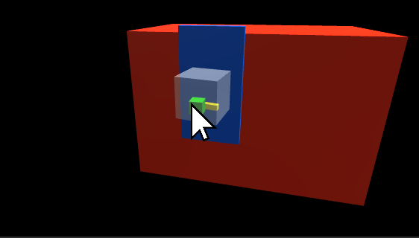
3) Clic & Scroll
Navigation tool: Clic once on a gameObject (in the scene view), and hold CTRL + Scroll Wheel to navigate back & forward

Slide 6

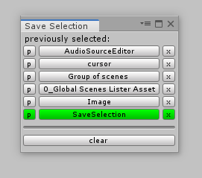


4) Save Last Selection
This tool allow you to quickly browse the previous selected files. It save the selection even after closing unity, and switching scene
PRO TIP: scroll up/Down with the mouse over
Like that ☺

Slide 7

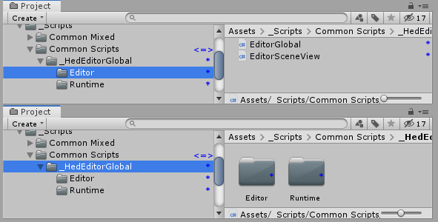
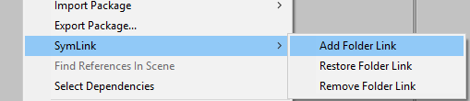
5) Quick Symbolic link pushable in git
This tool allow you to have external files linked to your unity project, and pushable in git !
Simply Right Clic on a folder > SymLink to access the 3 options.
See more: http://www.belfiore.ovh/devlogs/symlink/symlink.php

Slide 8

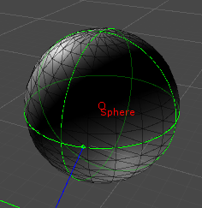
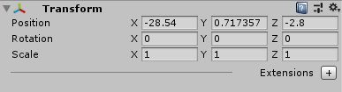
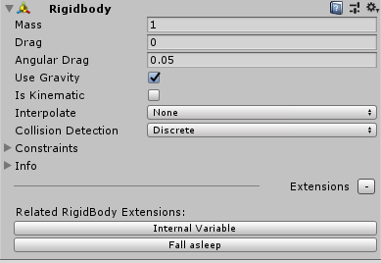
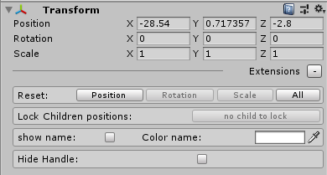
6) Built-in Components extension
I provide you with a simple way to add anything you want to the built-in component of unity ! With a non-intrusive UX.
(see AudioSourceEditor for the most basic exemple)
PRO TIP: tick “Show Name”
To permanently see
The name of the gameObject !
See more:
http://www.belfiore.ovh/devlogs/components-extension/components-extension.php

Slide 9

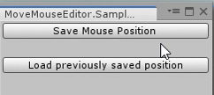
7) Change the mouse position by code in editor (only for tool purpose)
It is often useful in some tools to relocate the mouse position to a given place. This quick article show how to move the cursor of the window's mouse in editor. (only in editor, and for window).
You can:
- Save the mouse position
- Move the mouse to a given x ; y position
- Move the mouse to the previously saved position

