Slide 1
Domain : E-Commerce
Project Name : Olist Store Analysis

Slide 2
Group Members
Project Mentor
Shubham Chaudhari
Rupali Yadav
Harshal Thote
Thimme Gowda
Neeraj Agrawal
Bhushan More
Dipti Sinha
Pushp Raj Rathor

Slide 3

Agenda
01
Introduction.
Implementation of KPIs using MS Power BI.
Implementation of KPIs using Tableau.
Implementation of KPIs using MS Excel.
06
02
05
04
03

Slide 4
Introduction
Olist Store is an E-Commerce platform based in the Brazil that allows small and medium-sized businesses to sell their products online.
Olist provides a marketplace where sellers can list their products and reach a larger customer base,
as well as tools to help manage their online store, track orders, and handle customer support.
The primary goal of this project is to :
Identify insights and trends that can help improve the overall performance business.
Identifying top–performing products and categories.
Analysing customer behaviour and preferences.
Analysing sales and revenue trends over time.
Identifying factors that contribute to customer retention
Developing recommendation for targeted marketing Campaigns and promotions.

Slide 5
KPI’S
Weekday Vs Weekend (order_purchase_timestamp) Payment Statistics
Number of Orders with review score 5 and payment type as credit card.
Average number of days taken for order_delivered_customer_date for pet_shop
Average price and payment values from customers of sao paulo city
Relationship between shipping days (order_delivered_customer_date - order_purchase_timestamp) Vs review scores.

Slide 6
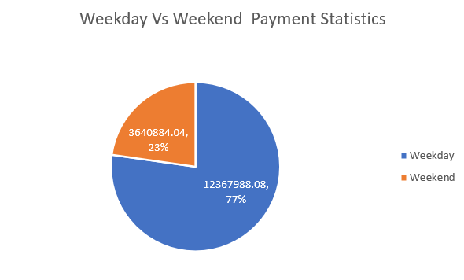
Weekday Vs Weekend Payment Statistics
Weekday total payment is 123.67M.
Weekend total payment is 36.40M.
Weekdays payment statistics is grater than weekend payment statistics which is 77%.
The year 2018 has highest weekdays and weekend total payment value.
This Order purchase timestamp is important piece of data of E-commerce business to tack, as it provides valuable insights into customer behavior, sales trends, and inventory management.

Slide 7
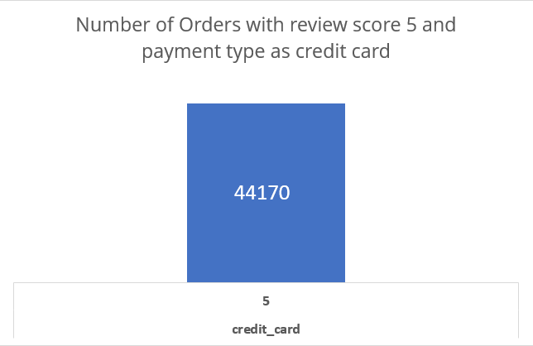
Number of Orders with review score 5 and payment type as credit card.
Number of Orders with review score 5 and payment type as credit card is 44k.
Total number of Orders with review score and with different payment type like debit card, credit card, voucher, boleto is 57k.

Slide 8
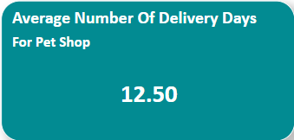
Average number of days taken for order_delivered_customer_date for pet_shop
Average number of days taken for the Delivery for pet shop is 12.50 days

Slide 9
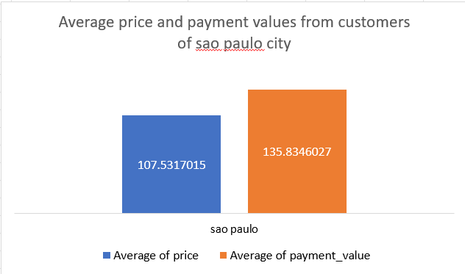
Average price and payment values from customers of sao paulo city
Sao Paulo city is the most populous city in the Brazil and Consider as global city with impressive statistics.
Average of price for Sao Paulo city is 107.53.
Average of payment value for Sao Paulo city is 135.83

Slide 10
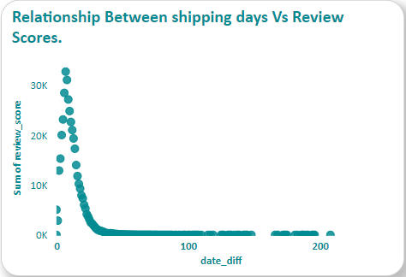
Relationship between shipping days (order_delivered_customer_date - order_purchase_timestamp) Vs review scores.
Here we can see the relationship between Shipping days Vs review scores

Slide 11
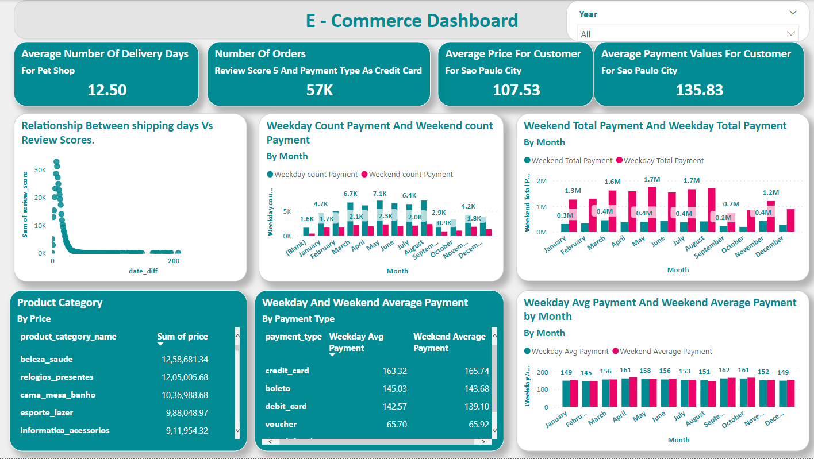
Dashboard

Slide 12
Summary
Weekdays are busier than weekends for payments.
Credit card payments are correlated with higher review scores.
Pet shop has an average shipping time of 12.50 days.
Customers in Sao Paulo have a higher average order value and payment amount than customers in other cities.
Longer shipping time can lead to lower review scores.

Slide 13
Thank You

