Slide 1
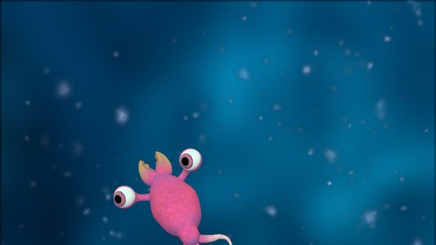
Europis
Game Engine Programming Final Riley B - Solo

Slide 2
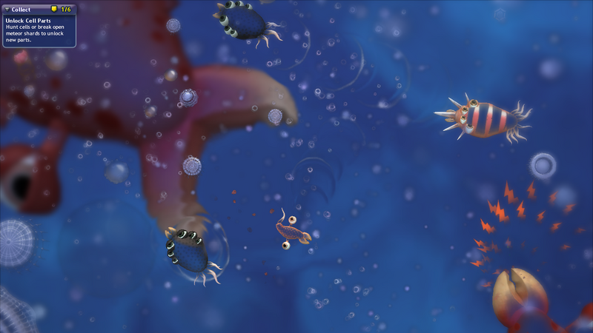
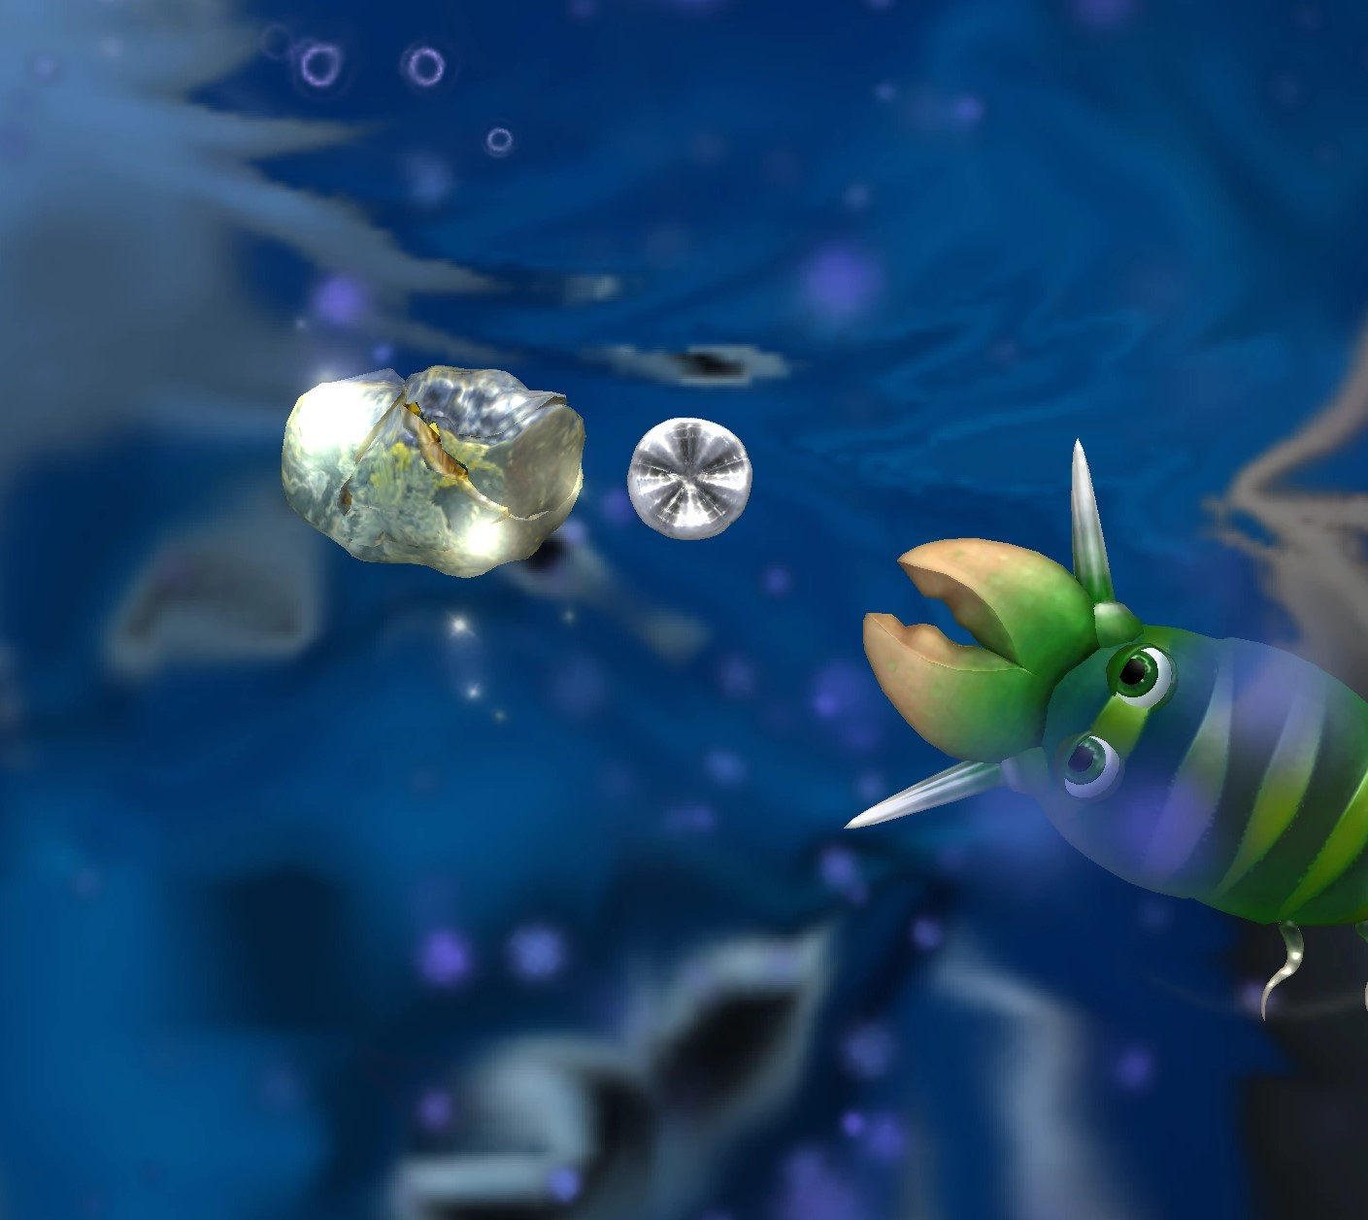
Gameplay
Player is a tiny simple looking creature
They will swim around a 2d environment collecting food to grow and items to evolve / upgrade themselves (simple automatic addons, not an in-depth character creator like Spore)
Evade, hunt and fight other creatures with simple “collision combat” to earn as many points as you can
Rare power-ups or upgrades could be looted from certain enemy types

Slide 3
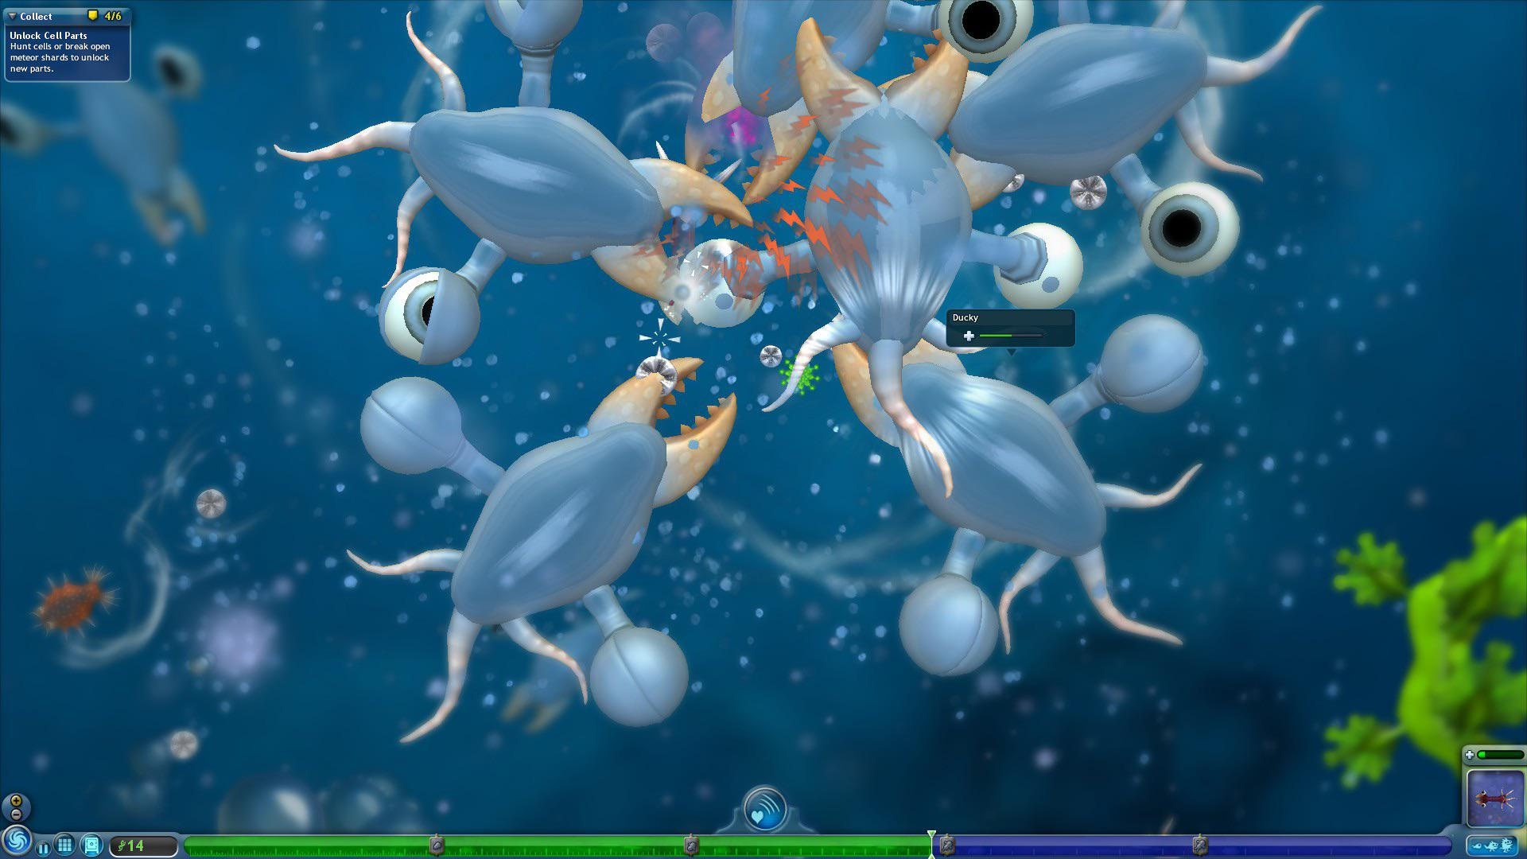
Objective
Last as long as you can, collecting upgrades and making your own build by combining a small number of possible upgrades / abilities (like spikes for collision damage, poison cloud for AOE, or speed boosts for a snatch and grab style)
Game ends when the player runs out of HP and dies

