Slide 1
Intelligent Analysis of Automotive Sensor Faults Using Self-Supervised Learning and Real-Time Simulation
Institute for Software and Systems Engineering
Master Thesis Defense
Presented by: Yahia Amir Yahia Gamal
First Examiner: Dr. Mohammad Abboush
Supervisor: apl. Prof. Dr. Christoph Knieke
TU Clausthal | 03.03.2026

Slide 2
Outline
1. Motivation and Problem Statement
2. Research Questions
3. Related Work: Why This Approach?
4. Proposed Framework (3 Phases)
5. Datasets: A2D2 and HIL
6. Fault Types and Injection Models
7. SimCLR Architecture, Encoder, and Training
8. Anomaly Detection Method
9. Evaluation Results
10. Computing Cost Analysis
11. Conclusion and Future Work

Slide 3
Motivation and Problem Statement
The Problem:
Modern vehicles contain 100+ sensors
Sensor faults compromise safety-critical systems
Supervised methods need labeled fault data
Labeled data is expensive and inherently incomplete
Our Solution:
Learn only from healthy driving data
Self-supervised contrastive learning (Simple Framework for contrastive Learning of Visual Representation)
Detect faults as deviations from normality
Cross-domain: train on real data → test on HIL

Slide 4
Research Questions
RQ1: Can self-supervised contrastive learning on healthy data detect sensor faults?
Test core feasibility: train on A2D2 real driving data, detect faults in HIL simulation data.
RQ2: How does the detection threshold affect precision-recall trade-off?
Evaluate six threshold percentiles (15th–40th) to find optimal operating point.
RQ3: Which fault types and sensors are most/least detectable?
Compare gain, noise, stuck-at faults on accelerator vs. speed sensors.

Slide 5
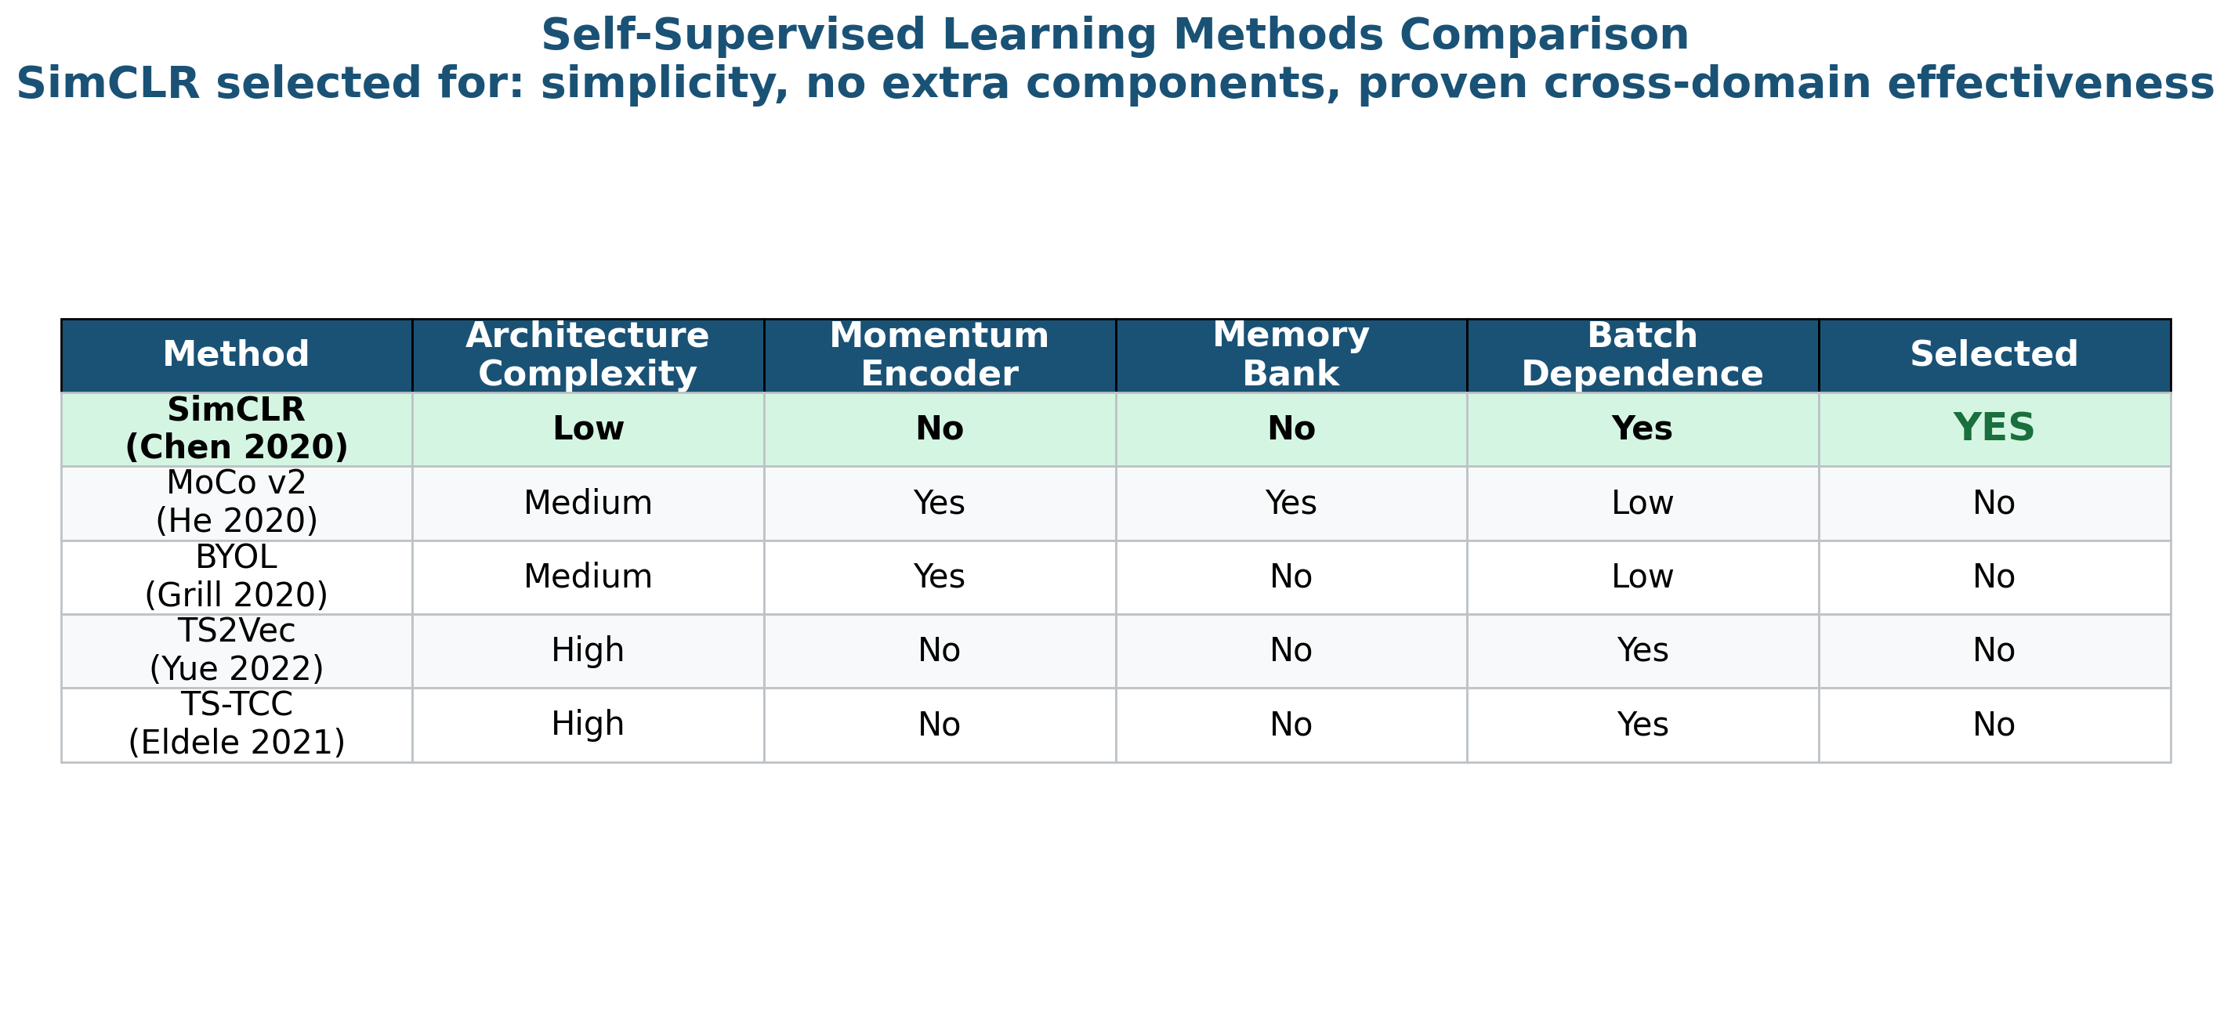
Related Work: Why SimCLR?
Why SimCLR?
Simplest architecture
No momentum encoder (vs. MoCo)
No asymmetric networks (vs. BYOL)
Strong theory: NT-Xent loss
Gap:
SSL fault diagnosis focused on bearings
(Ding et al. 2022, Zhang et al. 2022)
No application to automotive sensors
No cross-domain real → HIL transfer

Slide 6
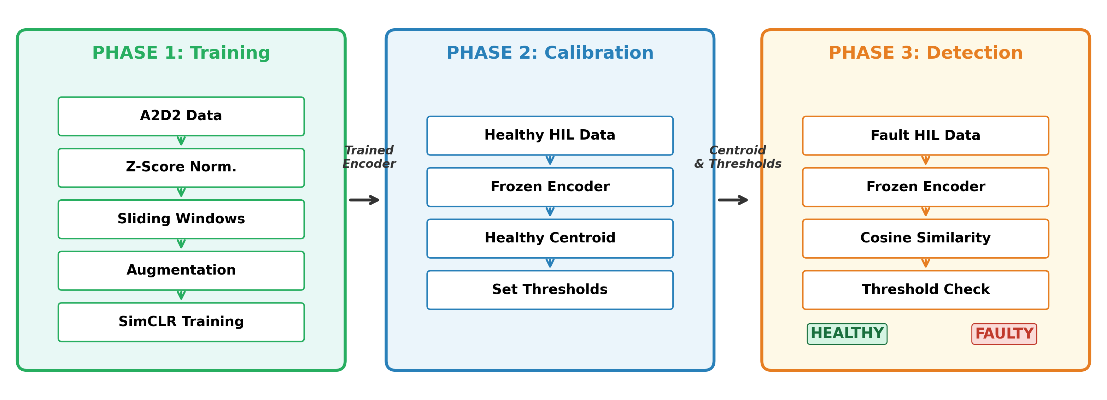
Proposed Framework: Three-Phase Architecture
Phase 1 (green): Train SimCLR encoder on healthy A2D2 data | Phase 2 (blue): Calibrate with healthy HIL data | Phase 3 (orange): Detect faults in HIL test data

Slide 7
Datasets: A2D2 (Training) and HIL (Testing)
A2D2 — Training Data (Phase 1)
Audi real-world driving, Munich
219,064 samples (36.5 min)
Sensors: Accelerator (%), Speed (km/h)
3 recording sessions combined
Only healthy data used for training
A2D2 Statistics:
Acc pedal: μ=6.99%, σ=8.70%, range [0, 52]%
Speed: μ=17.21 km/h, σ=14.78, range [0, 73.36]
HIL — Test Data (Phases 2-3)
dSPACE HIL simulator, TU Clausthal
1 healthy + 6 fault recordings
3 fault types × 2 sensors = 6 scenarios
316 healthy windows
1,911 fault windows

Slide 8
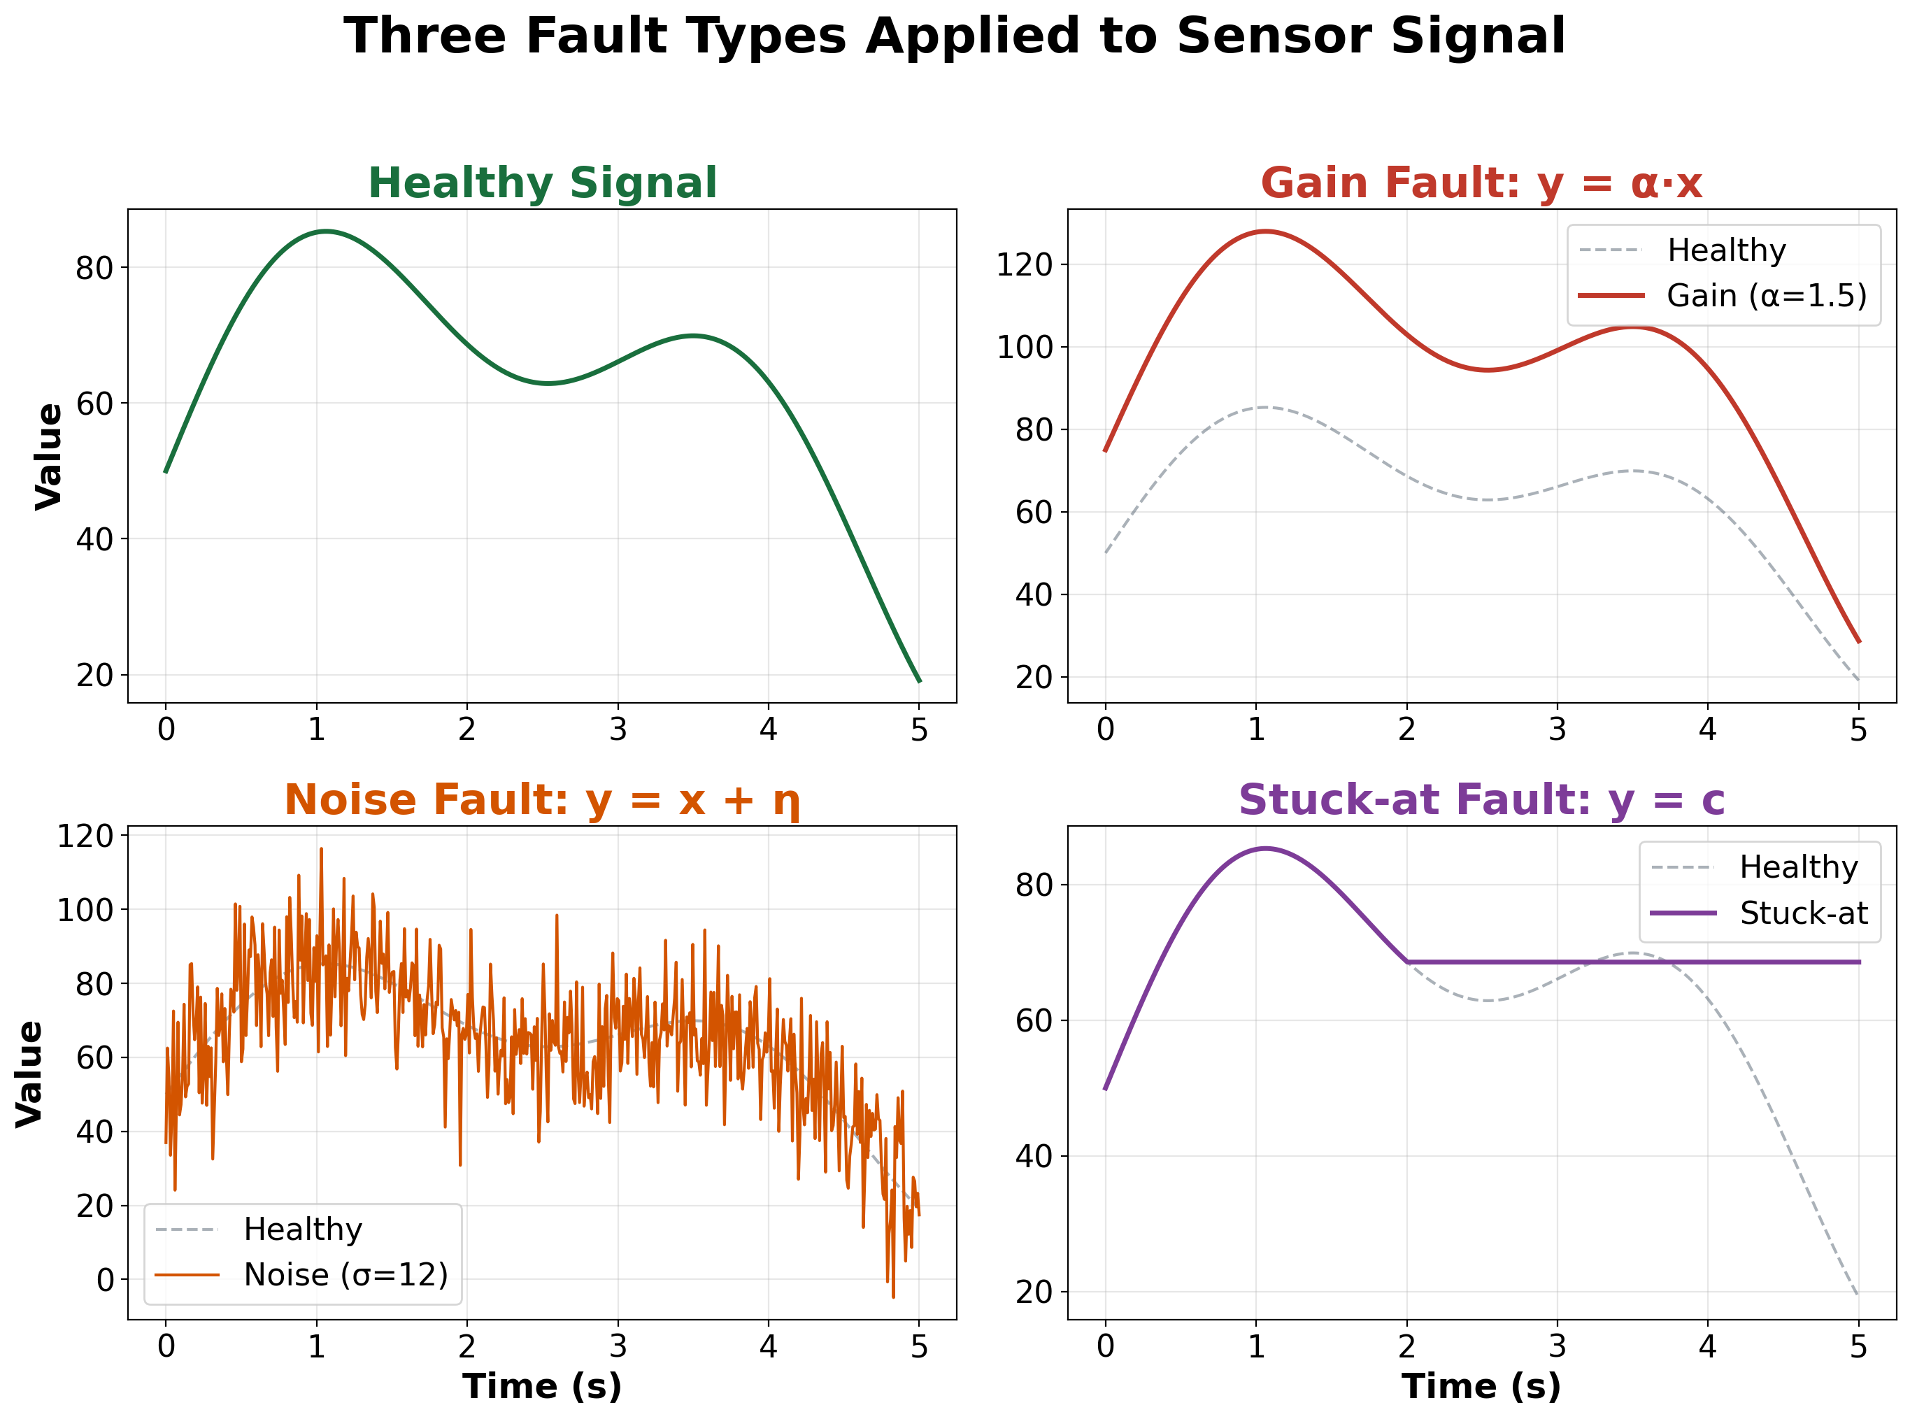
Fault Injection Types
Fault Models:
1. Gain Fault:
y(t) = α · x(t)
Calibration error, amplifier drift
2. Noise Fault:
y(t) = x(t) + η(t), η ~ N(0,σ²)
EMI, loose connections
3. Stuck-at Fault:
y(t) = c (constant)
Hardware failure, frozen sensor

Slide 9
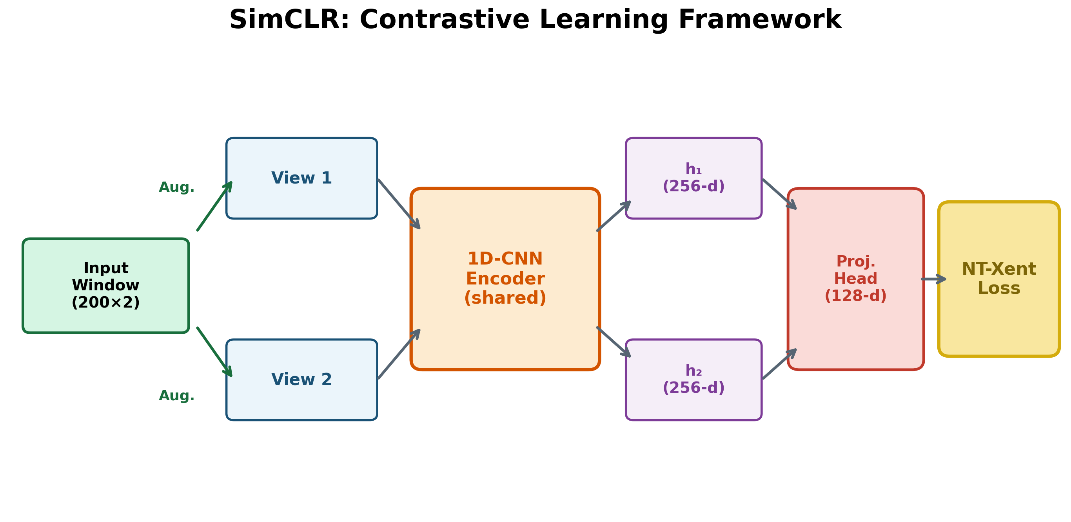
SimCLR: Contrastive Learning Framework

Slide 10
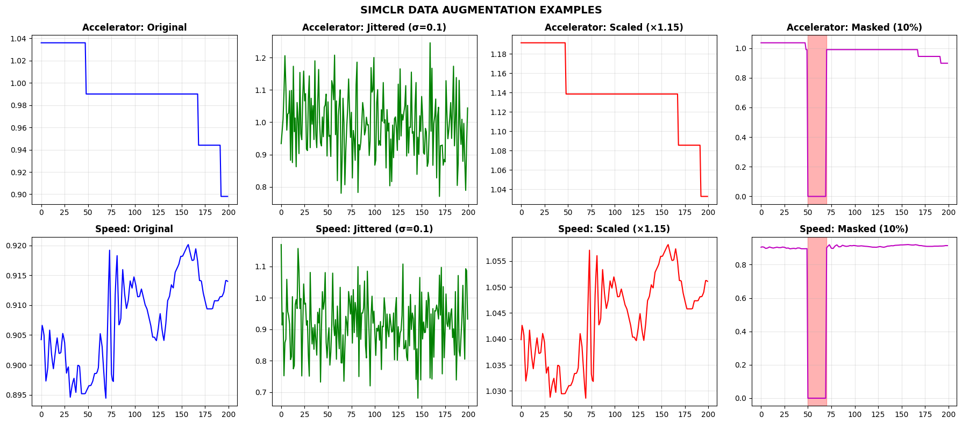
Data Preprocessing and Augmentation
Step | Method | Parameters | Output
Normalization | Z-Score | μ, σ from A2D2 training | Zero mean, unit variance
Segmentation | Sliding Window | W=200, stride=100 (50% overlap) | 2,189 windows
Augmentation | Jitter + Scale + Mask | Applied per window, per epoch | 2 views per window
3 Augmentation Strategies:
Gaussian Jitter (σ = 0.1)
Simulates sensor noise
Amplitude Scaling [0.8, 1.2]
Simulates calibration variance
Temporal Masking (10%)
Forces temporal robustness

Slide 11
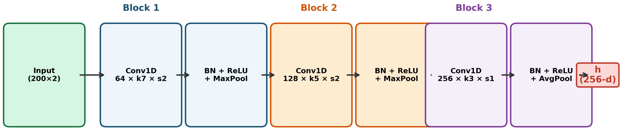
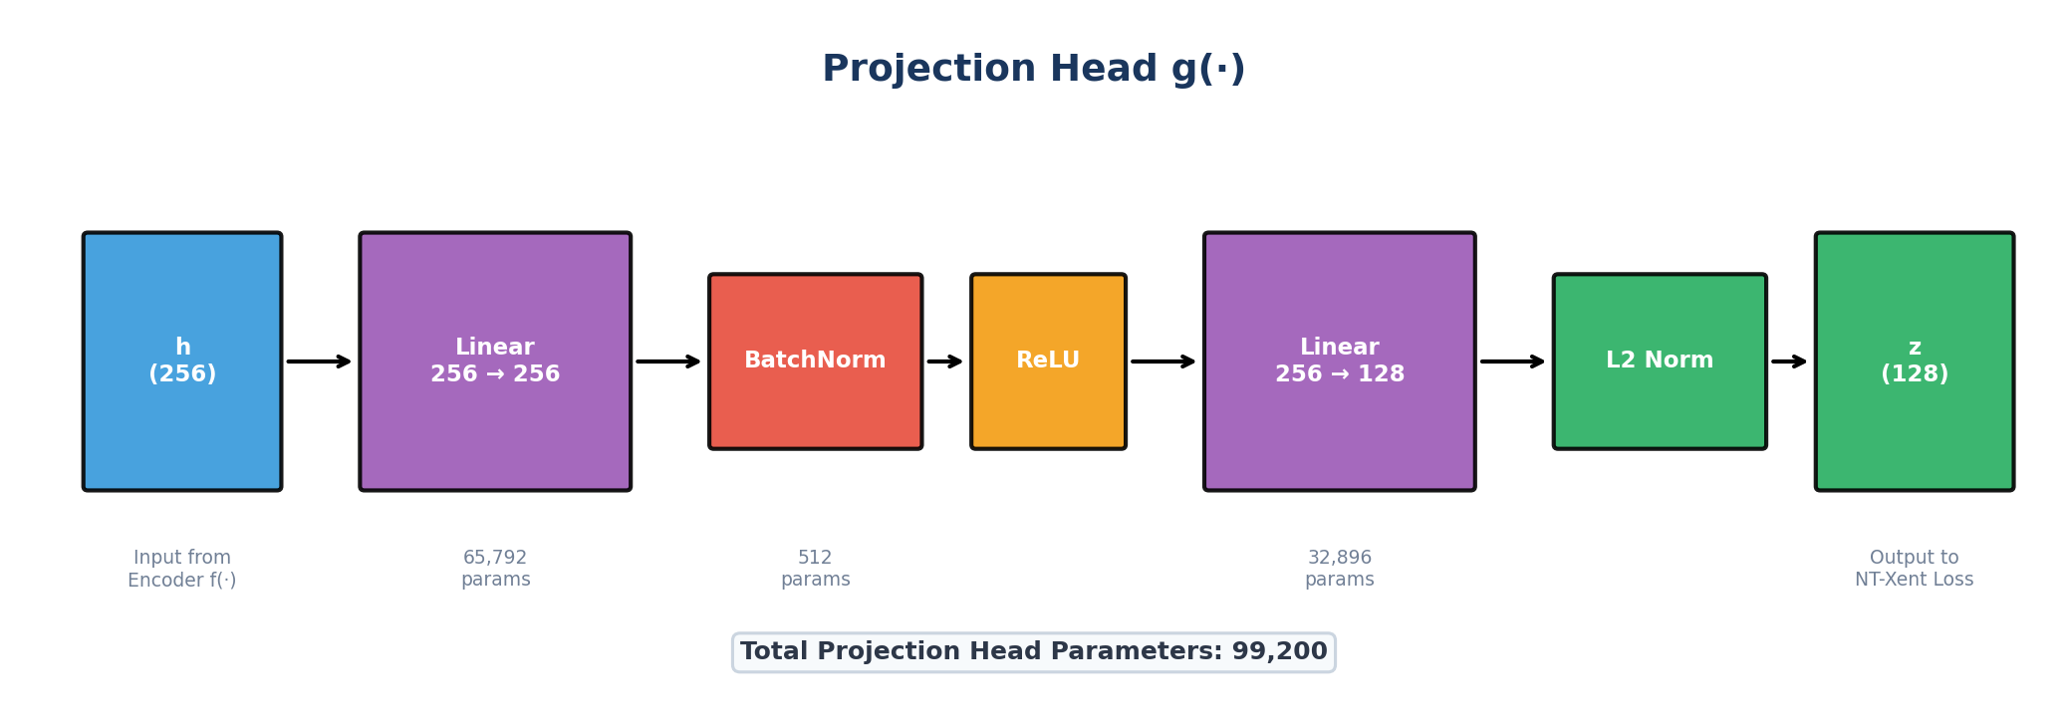
1D-CNN Encoder Architecture and Projection Head g(·)
1D-CNN Encoder Architecture
Projection Head g(·)

Slide 12
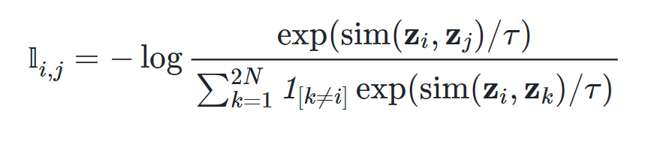
NT-Xent Loss (Contrastive):
Normalize to Unit Length:
z_normalized = z / ||z||
Where ||z|| = sqrt(z₀² + z₁² + z₂² + ... + z₁₂₇²)
Compute Dot Product of two vectors (Similarity):
Dot product : z_a · z_b = a₀×b₀ + a₁×b₁ + a₂×b₂ + ... + a₁₂₇×b₁₂₇
NT-Xent Loss (Contrastive):
(zᵢ, zⱼ) = positive pair (same window)
(zᵢ, zₖ) for k≠i = negative pairs
NT-Xent Loss: ℓi,j , with τ = 0.5

Slide 13
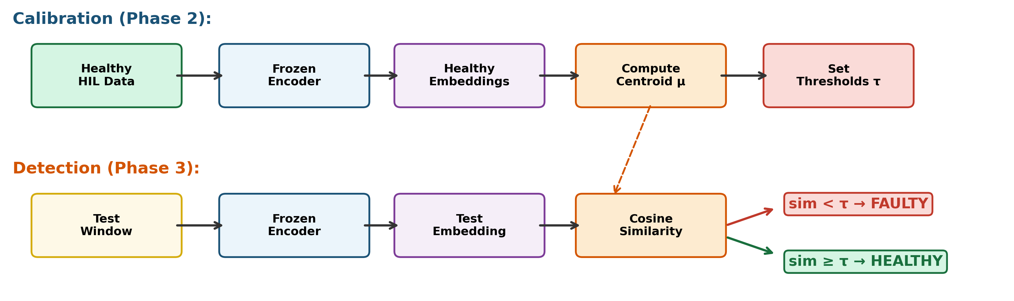
Anomaly Detection Method
Phase 2: Calibration
94 healthy HIL windows
Pass through frozen encoder
Compute healthy centroid: μ = mean(h)
Set thresholds at 6 percentile levels
Phase 3: Detection
Encode each test window → embedding h
Compute cosine similarity → sim(h,µh) = h·µh / ∥h∥∥µh∥
If sim < τ : FAULTY
If sim ≥ τ : HEALTHY

Slide 14
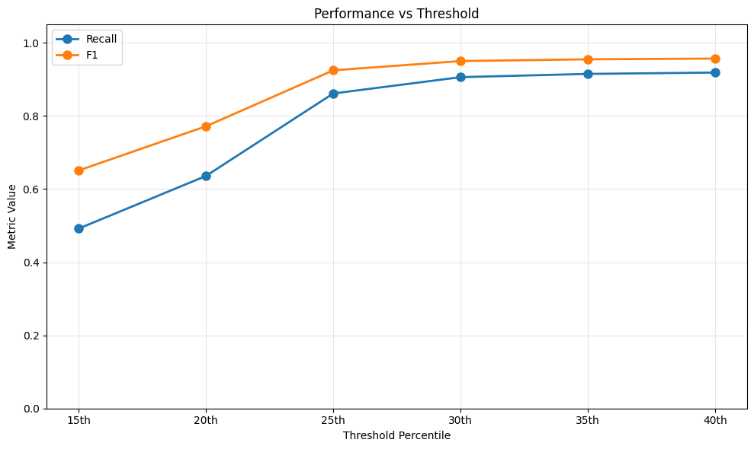
Results: Multi-Threshold Detection Performance
Percentile | Threshold τ | Recall | F1-Score
15th | 0.8901 | 0.4919 | 0.6510
20th | 0.9268 | 0.6359 | 0.7718
25th | 0.9477 | 0.8616 | 0.9250
30th | 0.9742 | 0.9063 | 0.9503
35th | 0.9756 | 0.9152 | 0.9551
40th | 0.9803 | 0.9188 | 0.9571
Key Findings:
Best F1 = 0.9571 at 40th percentile
Recall increases from 49.2% → 91.9%
Steepest improvement between 20th and 25th percentile

Slide 15
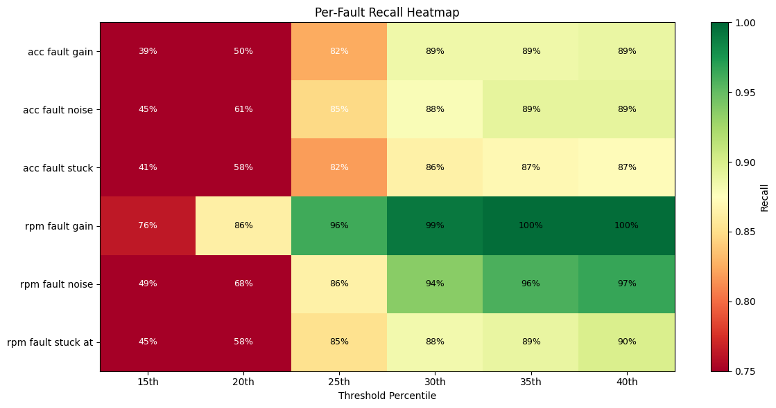
Results: Per-Fault Recall Analysis
Fault Type | Detected | Recall | F1
Acc Gain | 279/314 | 88,9% | 0.9410
Acc Noise | 286/321 | 89,1% | 0.9423
Acc Stuck | 275/315 | 87,3% | 0.9322
Speed Gain | 320/321 | 99.7% | 0.9984
Speed Noise | 304/315 | 96,5% | 0.9822
Speed Stuck | 292/325 | 89,9% | 0.9465
Observations (40th pctl):
Speed gain: 99.7% recall (easiest to detect)
Acc stuck: 87,3% recall (hardest to detect)
Speed signals have lower natural variability
Detectability reflects physical fault severity

Slide 16
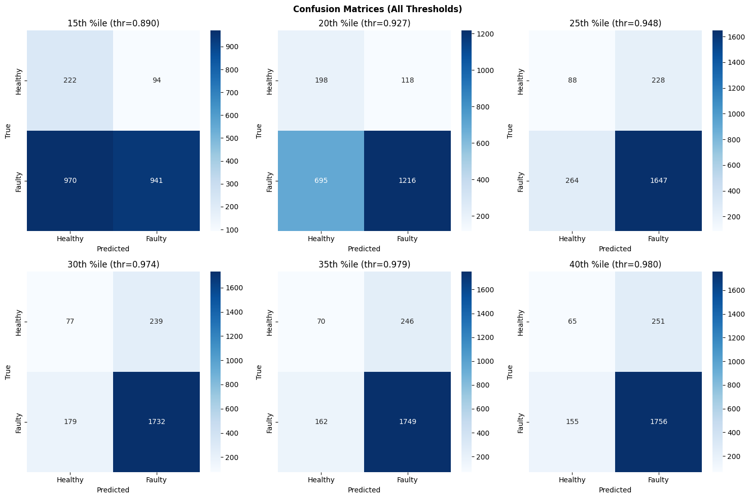
Results: Binary Classification (Healthy vs. Faulty)
Binary Results (40th Percentile):
Accuracy: 81.8%
Precision: 87.5%
Recall: 91.9%
F1-Score: 0.8964
 | Pred Healthy | Pred Faulty
True Healthy | TN = 65 | FP = 251
True Faulty | FN = 155 | TP = 1,756

Slide 17
Conclusion
RQ1: Self-supervised representations from healthy A2D2 data successfully detect sensor faults in HIL data.
Cross-domain transfer works without any labeled fault examples. ✓
RQ2: Recall increases from 49.2% to 91.9% across six thresholds.
Optimal: 40th percentile (F1 = 0.9571). ✓
RQ3: Speed gain = 99.7% recall (easiest). Acc stuck = 87.3% (hardest).
Detectability correlates with physical severity and sensor variability. ✓
Key Contributions:
First application of SimCLR to automotive sensor fault detection
Successful cross-domain transfer: real driving data → HIL simulation
Comprehensive multi-threshold evaluation with 6 fault scenarios
Complete pipeline in ~2.2 minutes on CPU (no GPU required)

Slide 18
Future Work
Short-term Extensions:
Add more sensor channels
(RPM, steering, brake pressure)
Fault localization
Identify which sensor is faulty
Adaptive thresholding
Eliminate manual threshold selection
Test with real vehicle fault data
Long-term Research:
Compare SSL methods
TS2Vec, MoCo, BYOL benchmarking
Explainability (XAI)
Diagnostic insights for faults
Edge deployment
Real-time in-vehicle detection
ISO 26262 ASIL integration
Safety integrity level mapping

Slide 19
Thank You
Questions?
Yahia Amir Yahia Gamal
Institute of Software and Systems Engineering
TU Clausthal | 03.2026

