Slide 1
Institute for Software and Systems Engineering
Intelligent Analysis of Automotive Sensor Faults
Using Self-Supervised Learning and Real-Time Simulation
Master Thesis Defense
Presented by: Yahia Amir Yahia Gamal
First Examiner: apl. Prof. Dr. Christoph Knieke
Second Examiner: Dr. Stefan Wittek
Supervisor: Dr. Mohammad Abboush
TU Clausthal | 2025

Slide 2
Outline
1. Motivation and Problem Statement
2. Research Questions
3. Related Work: Why SimCLR?
4. Proposed Framework (3 Phases)
5. Datasets: A2D2 and HIL
6. Fault Types and Injection Models
7. SimCLR Architecture and 1D-CNN Encoder
8. Anomaly Detection Method
9. Evaluation Results
10. Conclusion and Future Work

Slide 3
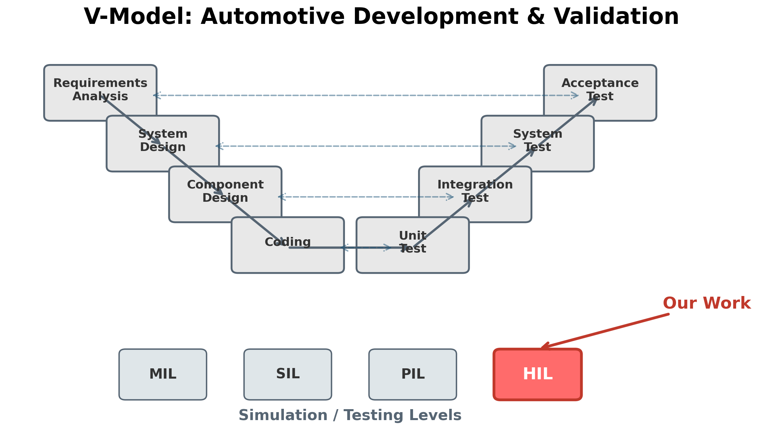
Motivation and Problem Statement
The Problem:
Modern vehicles contain 100+ sensors
Sensor faults compromise safety-critical systems
ISO 26262 requires rigorous validation
Supervised methods need labeled fault data
Labeled data is expensive and inherently incomplete
Our Solution:
Learn only from healthy driving data
Self-supervised contrastive learning (SimCLR)
Detect faults as deviations from normality
Cross-domain: train on real data → test on HIL

Slide 4
Research Questions
RQ1: Can self-supervised contrastive learning on healthy data detect sensor faults?
Test core feasibility: train on A2D2 real driving data, detect faults in HIL simulation data.
RQ2: How does the detection threshold affect precision-recall trade-off?
Evaluate six threshold percentiles (15th–40th) to find optimal operating point.
RQ3: Which fault types and sensors are most/least detectable?
Compare gain, noise, stuck-at faults on accelerator vs. speed sensors.

Slide 5
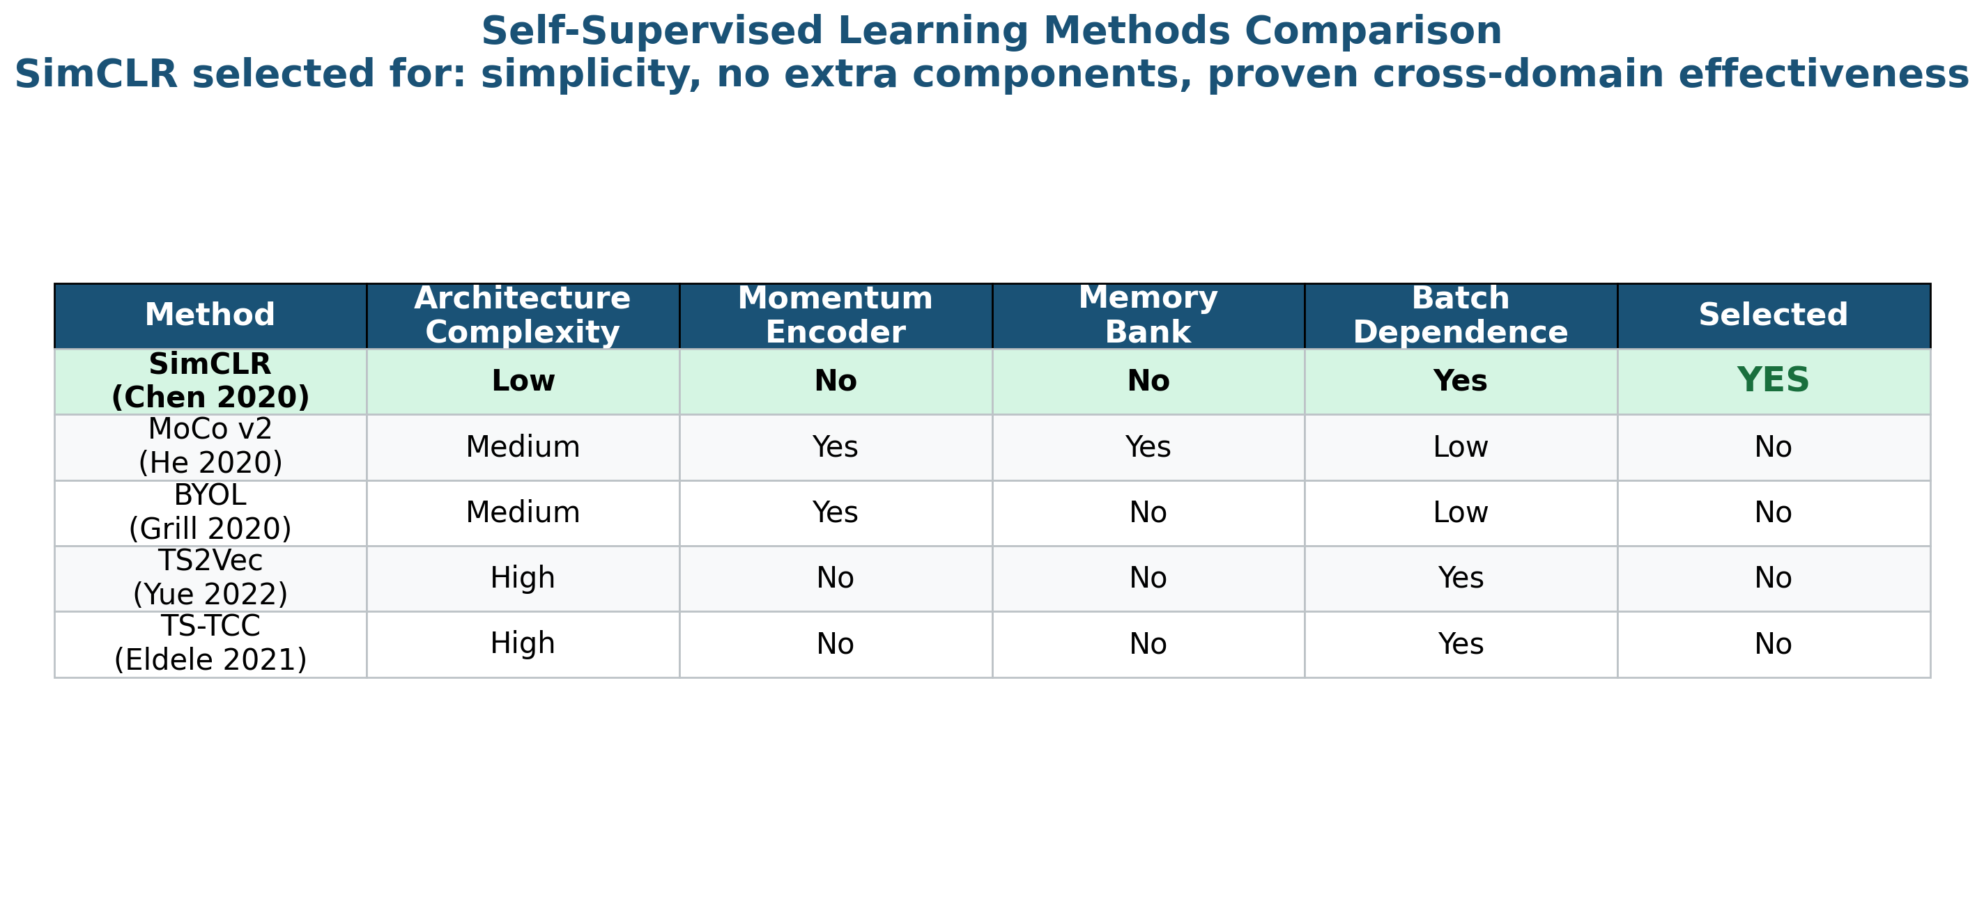
Related Work: Why SimCLR?
Why SimCLR?
Simplest architecture
No momentum encoder (vs. MoCo)
No asymmetric networks (vs. BYOL)
Strong theory: NT-Xent loss
Prior Applications:
Chen et al. (2020): ImageNet
Tang et al. (2022): Bearing faults
Wang et al. (2022): Motor diagnosis
Gap: No automotive sensor
fault detection with SimCLR

Slide 6
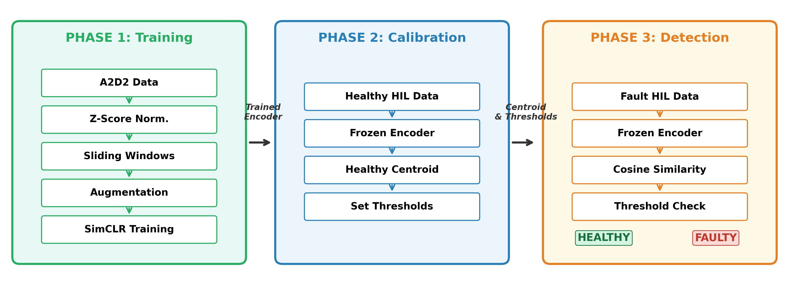
Proposed Framework: Three-Phase Architecture
Phase 1 (green): Train SimCLR encoder on healthy A2D2 data | Phase 2 (blue): Calibrate with 90s healthy HIL data | Phase 3 (orange): Detect faults in HIL test data

Slide 7
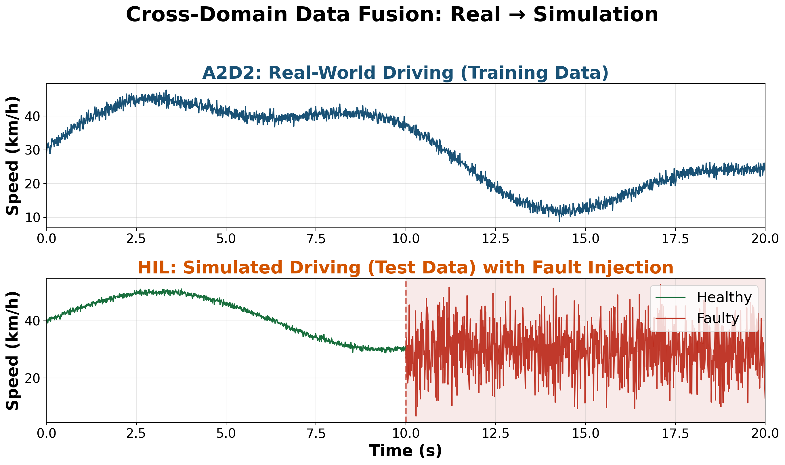
Datasets: A2D2 (Training) and HIL (Testing)
A2D2 — Training Data (Phase 1)
Audi real-world driving, Munich
219,064 samples (36.5 min)
Sensors: Accelerator (%), Speed (km/h)
Speed upsampled 50 Hz → 100 Hz
Only healthy data used for training
HIL — Test Data (Phases 2-3)
dSPACE HIL simulator, TU Clausthal
1 healthy + 6 fault recordings
3 fault types × 2 sensors = 6 scenarios
Calibration: 89 windows (90 sec)
Cross-domain transfer: real → simulation

Slide 8
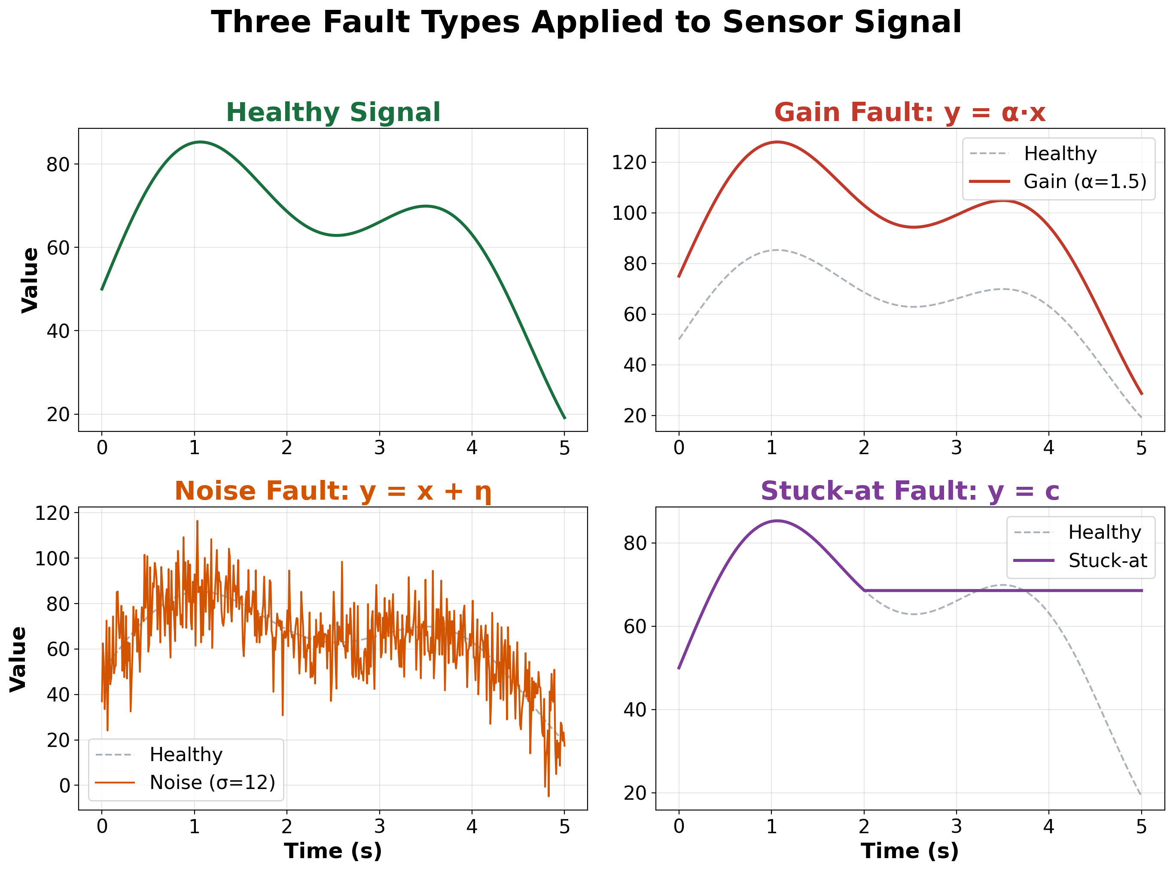
Fault Injection Types
Fault Models:
1. Gain Fault:
y(t) = α · x(t)
Calibration error, amplifier drift
2. Noise Fault:
y(t) = x(t) + η(t), η ~ N(0,σ²)
EMI, loose connections
3. Stuck-at Fault:
y(t) = c (constant)
Hardware failure, frozen sensor

Slide 9
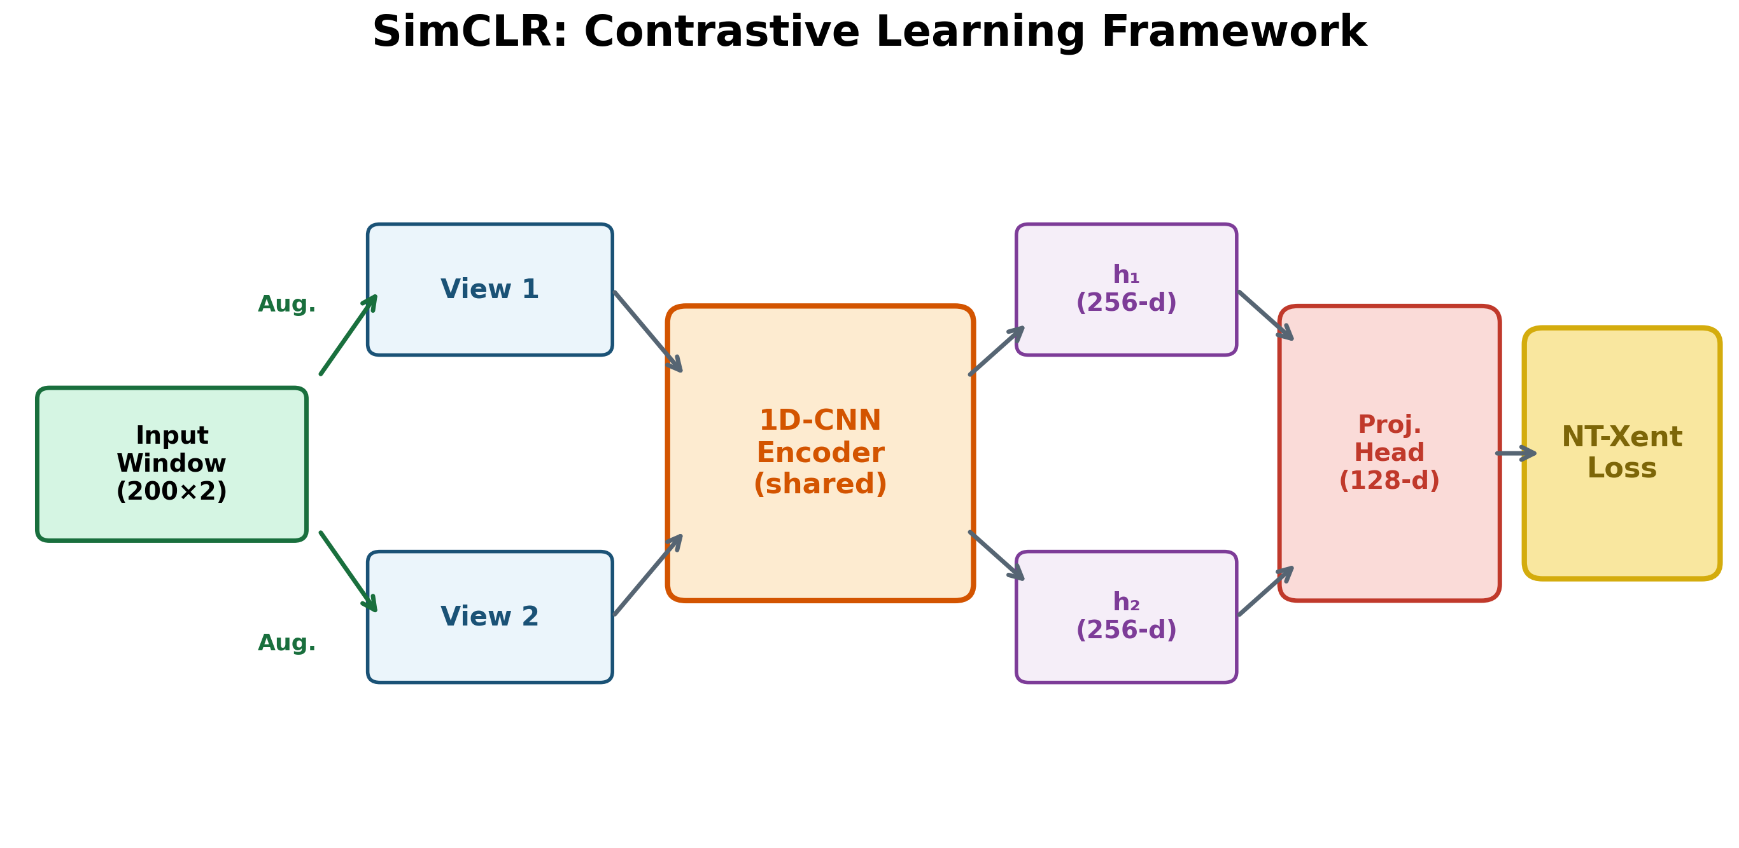
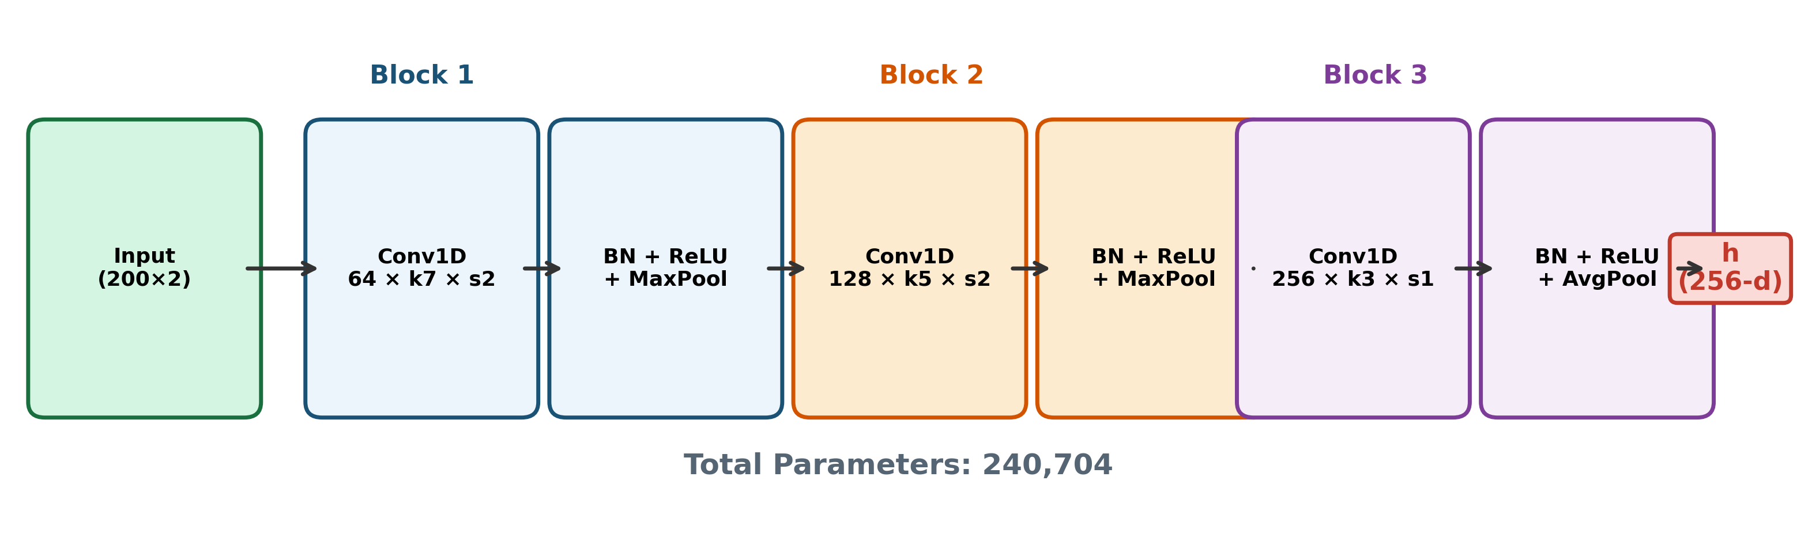
SimCLR Architecture and 1D-CNN Encoder
NT-Xent Loss (Contrastive):
Maximize similarity: positive pair
Minimize similarity: 254 negatives
Training Configuration:
Temperature τ = 0.5
Batch size = 128
Epochs = 50
Windows: 2,189
Total parameters: 240,704

Slide 10
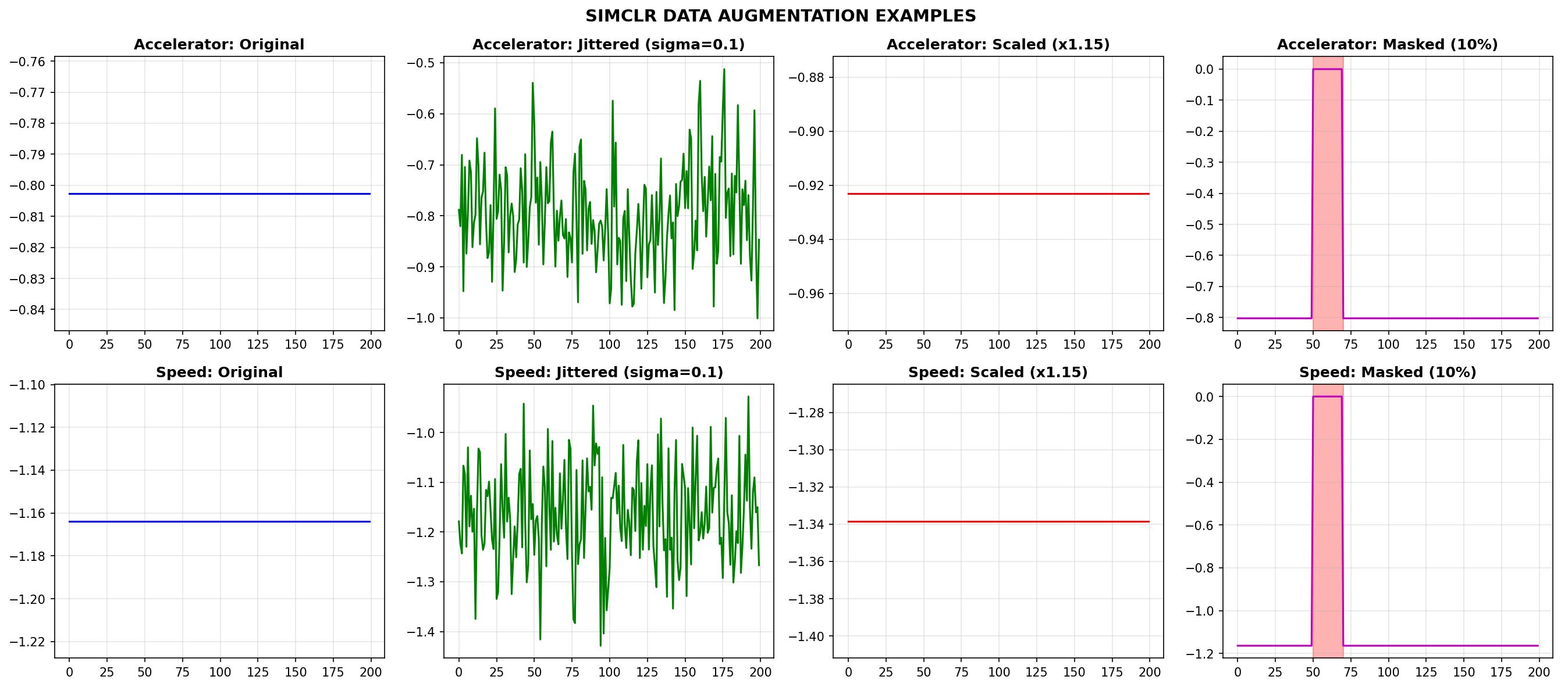
Data Preprocessing and Augmentation
3 Augmentation Strategies:
Gaussian Jitter (σ = 0.1)
Simulates sensor noise
Amplitude Scaling [0.8, 1.2]
Simulates calibration variance
Temporal Masking (10%)
Forces temporal robustness
Preprocessing Pipeline:
Step | Method | Parameters | Output
Normalization | Z-Score | μ, σ from A2D2 training | Zero mean, unit variance
Segmentation | Sliding Window | W=200, stride=100 (50% overlap) | 2,189 windows
Augmentation | Jitter + Scale + Mask | Applied per window, per epoch | 2 views per window

Slide 11
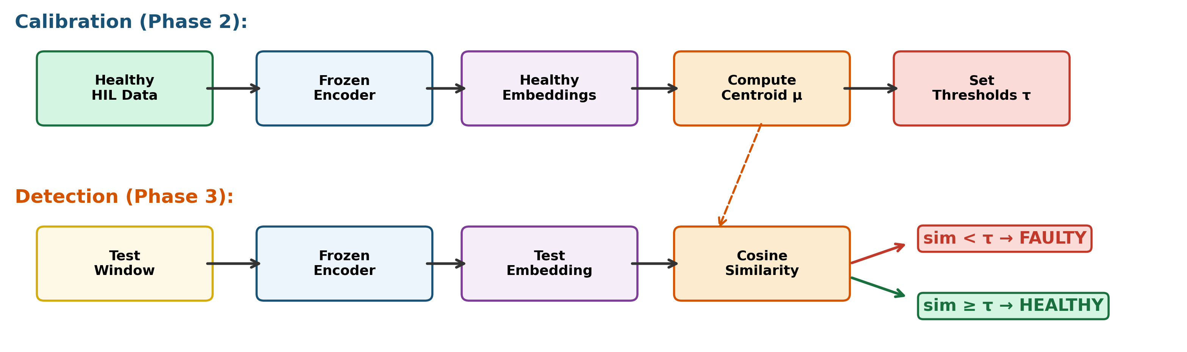
Anomaly Detection Method
Phase 2: Calibration
89 healthy HIL windows (90 s)
Pass through frozen encoder
Compute healthy centroid: μ = mean(h)
Set thresholds at 6 percentile levels
Phase 3: Detection
Encode each test window → embedding h
Compute: sim(h, μ) = cosine similarity
If sim < τ : FAULTY
If sim ≥ τ : HEALTHY

Slide 12
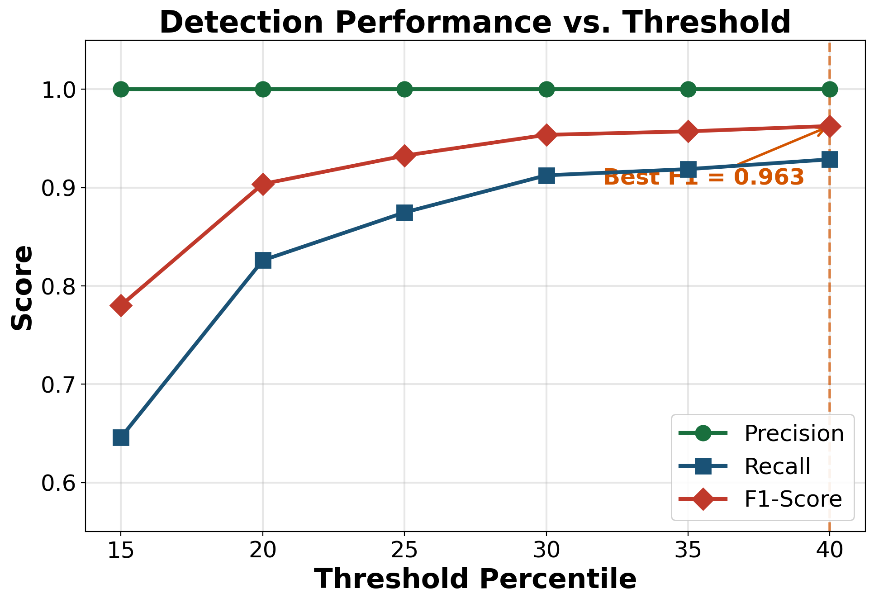
Results: Multi-Threshold Detection Performance
Percentile | Threshold τ | Precision | Recall | F1-Score
15th | 0.889 | 1.000 | 0.646 | 0.780
20th | 0.920 | 1.000 | 0.826 | 0.904
25th | 0.945 | 1.000 | 0.875 | 0.933
30th | 0.967 | 1.000 | 0.913 | 0.954
35th | 0.969 | 1.000 | 0.919 | 0.957
40th | 0.971 | 1.000 | 0.929 | 0.963
Key Findings:
Precision = 1.0 at ALL thresholds
Best F1 = 0.963 at 40th percentile
ROC-AUC = 0.852

Slide 13
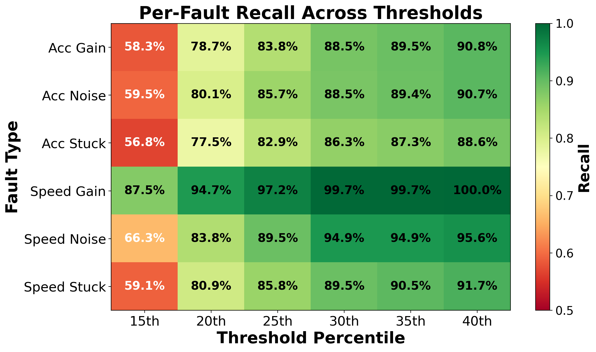
Results: Per-Fault Recall Analysis
Fault Type | Detected | Recall | F1
Acc Gain | 285/314 | 90.8% | 0.952
Acc Noise | 291/321 | 90.7% | 0.951
Acc Stuck | 279/315 | 88.6% | 0.939
Speed Gain | 321/321 | 100.0% | 1.000
Speed Noise | 301/315 | 95.6% | 0.977
Speed Stuck | 298/325 | 91.7% | 0.957
Observations (40th pctl):
Speed gain: 100.0% recall (best)
Acc stuck: 88.6% recall (hardest)
Speed signals have lower natural variability
Detectability reflects physical fault severity

Slide 14
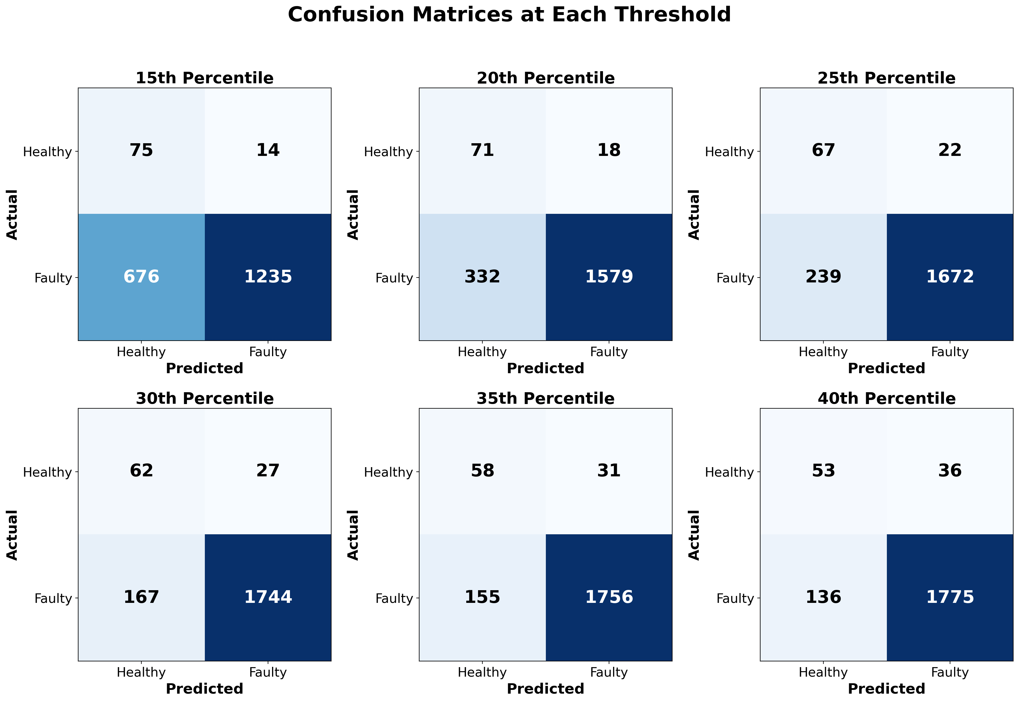
Results: Binary Classification (Healthy vs. Faulty)
Binary Results (40th Percentile):
Accuracy: 91.4%
Precision: 98.0%
Recall: 92.9%
F1-Score: 0.954
 | Pred Healthy | Pred Faulty
True Healthy | TN = 53 | FP = 36
True Faulty | FN = 136 | TP = 1,775
ROC-AUC = 0.852
Significantly above random baseline (0.5)

Slide 15
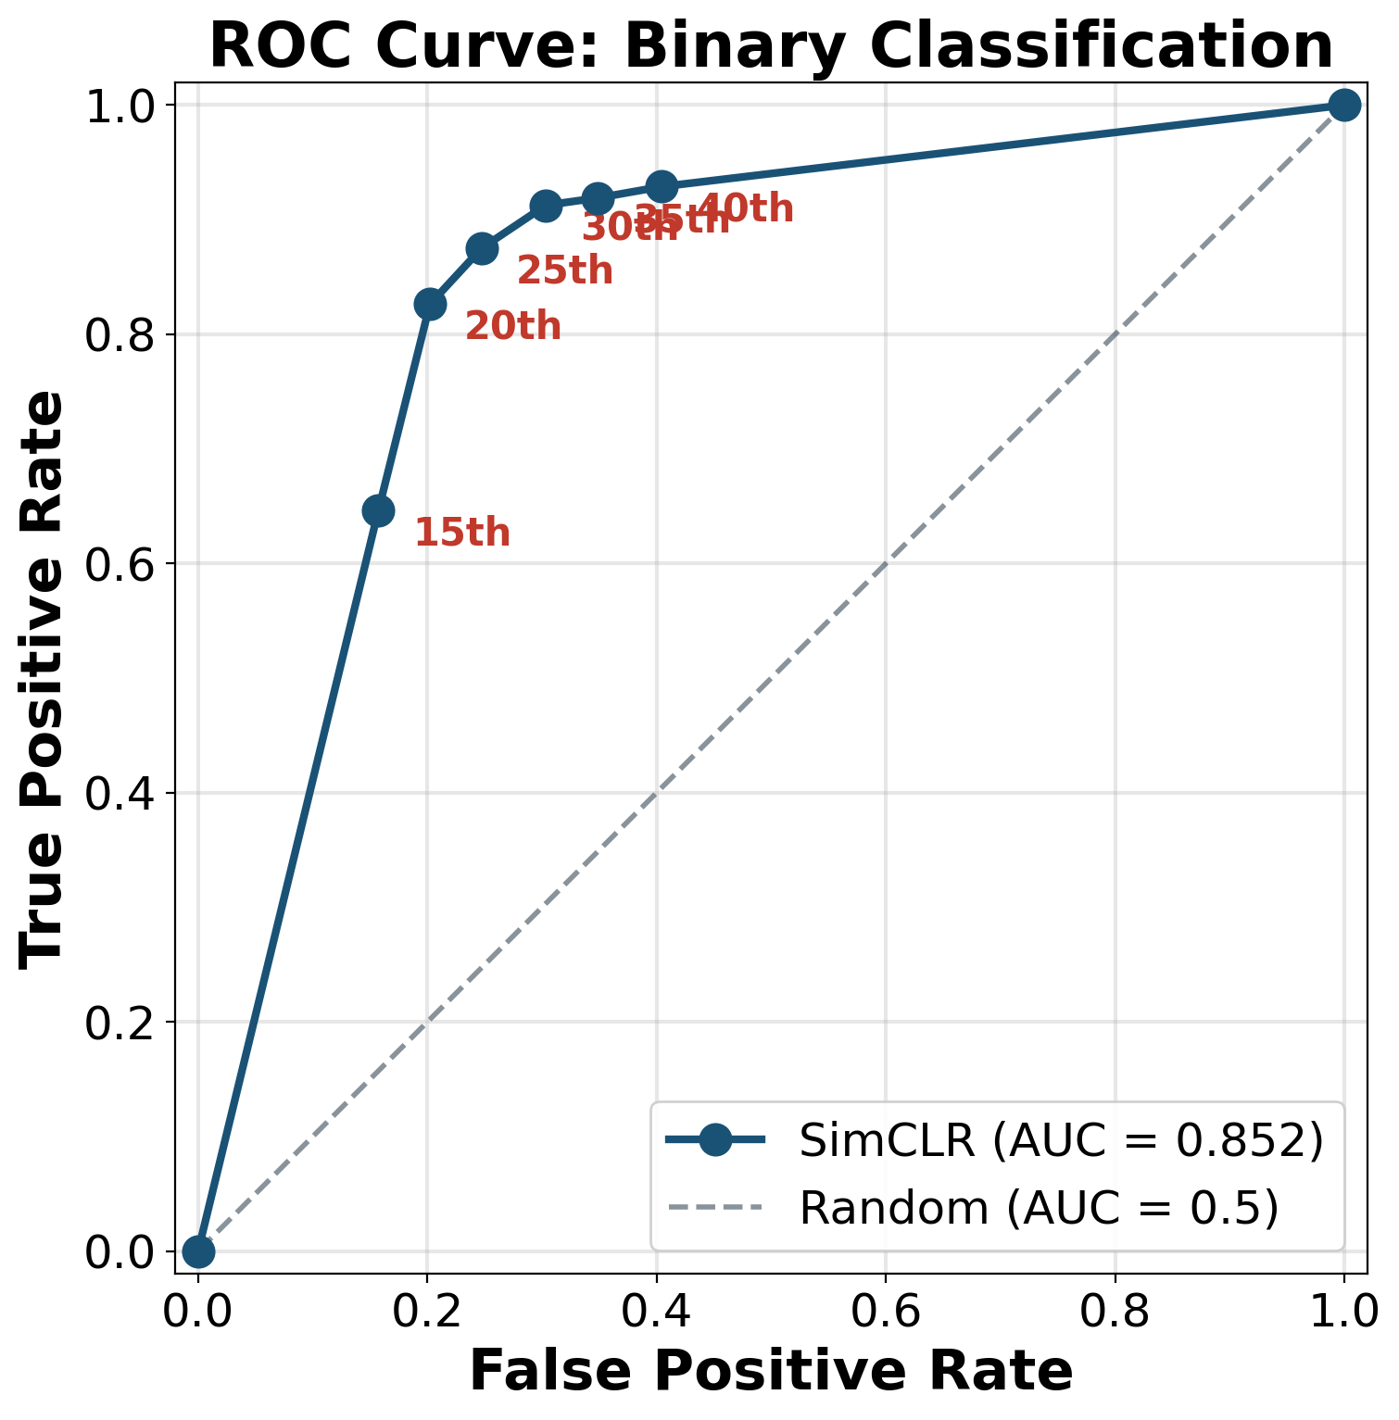
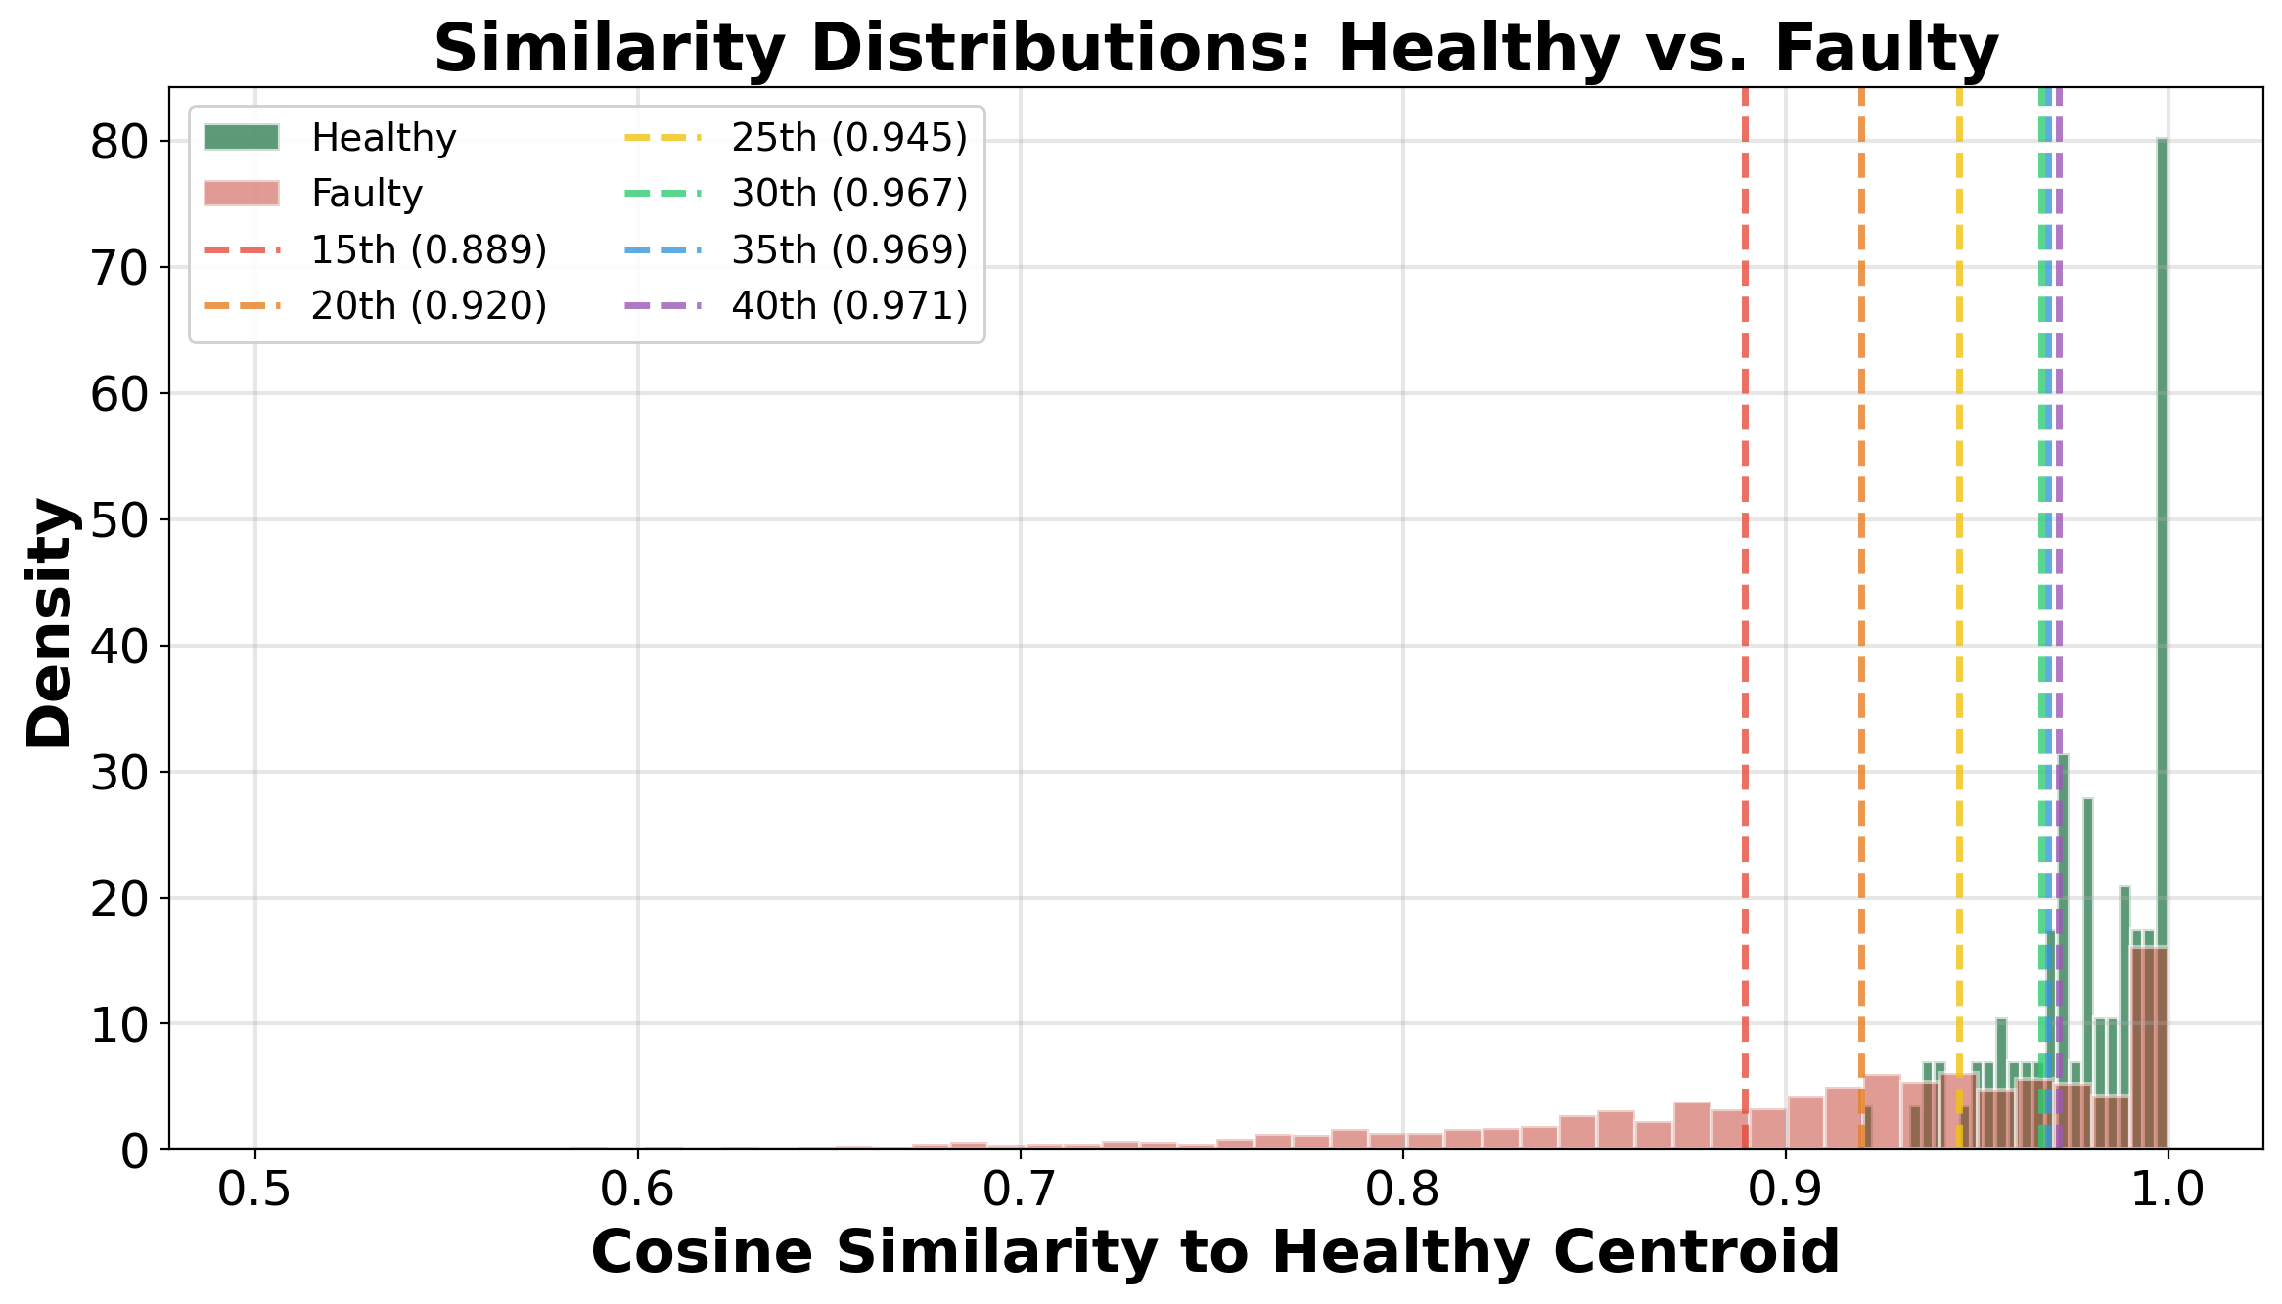
ROC Curves and Similarity Distributions
Clear separation between healthy and faulty distributions
Higher threshold percentile → more recall, slightly more FP

Slide 16
Computing Cost Analysis
Phase | Operation | Time (s) | % of Total
Part 1 | A2D2 data loading | 10.80 | 20.2%
Part 2 | SimCLR training (50 epochs) | 26.56 | 49.7%
Part 2 | Augmentation + other | 10.45 | 19.5%
Part 3 | Embedding extraction | 1.01 | 1.9%
Part 3 | Evaluation + visualization | 4.67 | 8.7%
Total | End-to-end pipeline | 53.49 | 100%
Key Takeaways:
Training: 26.6 s (one-time cost)
Inference: ~0.5 ms per window
Total pipeline: under 1 minute
Suitable for real-time deployment
vs. Supervised approach:
Ghannoum CNN-GRU: 23,000 s (6.4 h)
Our approach: ~860x faster
+ No labeled data required!

Slide 17
Conclusion
RQ1: Self-supervised representations from healthy A2D2 data successfully detect sensor faults in HIL data.
Cross-domain transfer works without any labeled fault examples. ✓
RQ2: Per-fault precision = 1.0 at all thresholds. Recall: 64.6% → 92.9%.
Optimal: 40th percentile (F1 = 0.963). ✓
RQ3: Speed gain = 100.0% recall (easiest). Acc stuck = 88.6% (hardest).
Detectability correlates with physical severity and sensor variability. ✓
Key Contributions:
First application of SimCLR to automotive sensor fault detection
Successful cross-domain transfer: real driving data → HIL simulation
Comprehensive multi-threshold evaluation with 6 fault scenarios
Complete pipeline in under 1 minute on CPU (no GPU required)

Slide 18
Future Work
Short-term Extensions:
Add more sensor channels
(RPM, steering, brake pressure)
Fault localization
Identify which sensor is faulty
Adaptive thresholding
Eliminate manual threshold selection
Test with real vehicle fault data
Long-term Research:
Compare SSL methods
TS2Vec, MoCo, BYOL benchmarking
Explainability (XAI)
Diagnostic insights for faults
Edge deployment
Real-time in-vehicle detection
ISO 26262 ASIL integration
Safety integrity level mapping

Slide 19
Thank You
Questions?
Yahia Amir Yahia Gamal
Institute of Software and Systems Engineering
TU Clausthal | 2025

