Slide 1
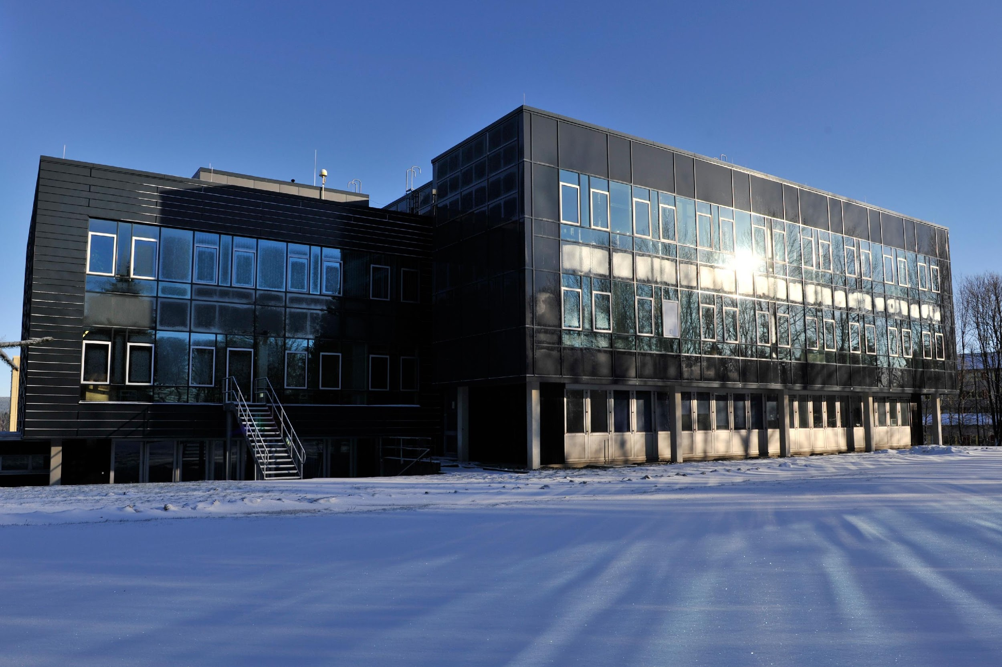
Institute for Software and Systems Engineering
Title
Presented by:

Slide 2
Table of Content

