Slide 1
Unit 4
pointer

Slide 2
Pointer
Pointers in C language is a variable that stores/points the address of another variable.
A Pointer in C is used to allocate memory dynamically i.e. at run time. The pointer variable might be belonging to any of the data type such as int, float, char, double, short etc.
every variable is a memory location and every memory location has its address defined which can be accessed using ampersand (&) operator, which denotes an address in memory.

Slide 3
Operators that are used with Pointers
1. Address of”(&) Operator
The & operator is also known as “Address of” Operator.
printf("Address of var is: %p", &num);
Display the address of a variable using ampersand sign. I have used &Num to access the address of variable num.

Slide 4
2. Value at Address”(*) Operator
We know how to get the address of a variable but how to store that address in some other variable?
Pointer is just like another variable, the main difference is that it stores address of another variable rather than a value.
The * Operator is also known as Value at address operator.
Ex- int *p;

Slide 5
Declaration and initialization of pointer
1. Declaration of pointer::
Syntax : data_type *pointer_name;
Example : int *p; char *p;
Where, * is used to denote that “p” is pointer variable and not a normal variable.
2. Pointer Initialization:: is the process of assigning address of a variable to a pointer variable. Pointer variable can only contain address of a variable of the same data type. In C language address operator & is used to determine the address of a variable.

Slide 6
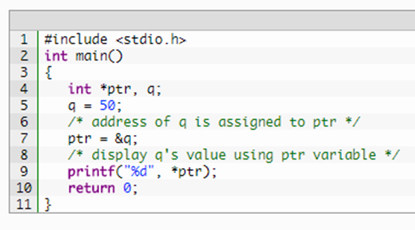
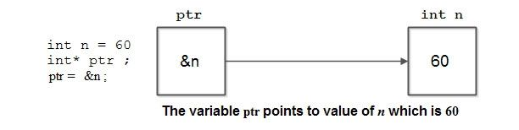
Pointer initialization

Slide 7
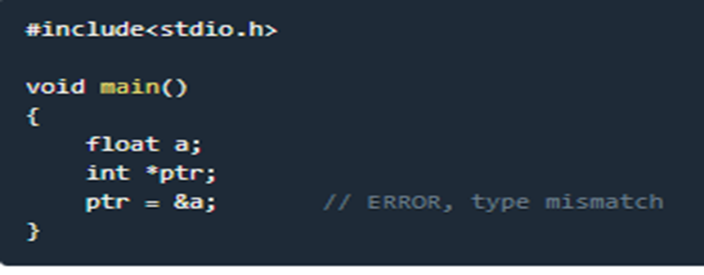
Pointer variable always point to variables of same data type

Slide 8
Types:-
Wild
Null
Dangling
Void/generic

Slide 9
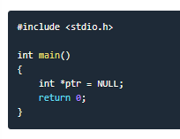
NULL pointer.
if you are not sure about which variable's address to assign to a pointer variable while declaration, it is recommended to assign a NULL value to your pointer variable.
It does not point anywhere.
Int *ptr,
Ptr=0;
Or as in the diagram.
A pointer which is assigned a NULL value is called a NULL pointer.

Slide 10
Points to remember while using pointers:
While declaring/initializing the pointer variable, * indicates that the variable is a pointer.
The address of any variable is given by preceding the variable name with Ampersand &.
The pointer variable stores the address of a variable. The declaration int *a doesn't mean that a is going to contain an integer value. It means that a is going to contain the address of a variable storing integer value.

Slide 11
Generic pointer
When a variable is declared as being a pointer to type void it is known as a generic pointer.
It can be used to point to a avariable of any data type.
Also called void pointer.

Slide 12
Generic/void ptr
int main()
{
int x=10;
char ch=‘a’;
void *gp;
gp=&x;
printf(“Generic pointer points to %d”, *(int *)gp);
gp = &ch;
printf(“Generic pointer points to %d”, *(char *)gp);
getch();
return 0;
}

Slide 13
#INCLUDE<STDIO.H>
#INCLUDE<CONIO.H>
INT MAIN()
{
INT A=10;
INT *B;
PRINTF(“%D”,A);
PRINTF(“%U”,B);
GETCH();
RETURN 0;
}
Wild pointer

Slide 14
Dangling pointer
Dangling pointers arise when an object is deleted or de-allocated, without modifying the value of the pointer, so that the pointer still points to the memory location of the de-allocated memory.
In short pointer pointing to non-existing memory location is called dangling pointer.

Slide 15
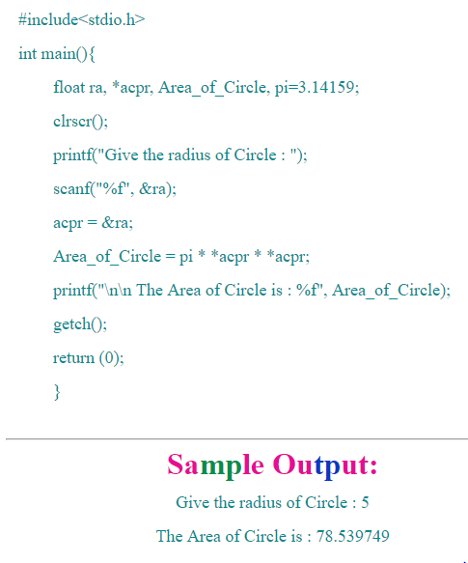
WAP to calculate area of a circle using pointer.

Slide 16
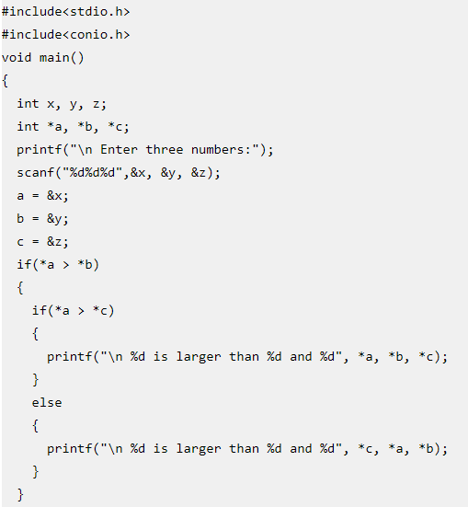
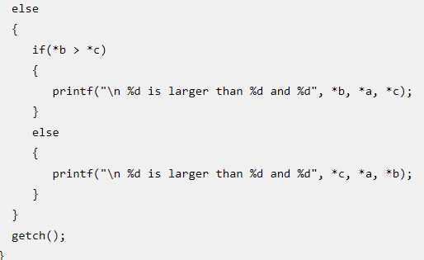
WAP to find greatest among three numbers using pointer.

Slide 17
Array of pointer
Just like we can declare an array of int, float or char et. we can also declare an array of pointers, here is the syntax to do the same.
Syntax: datatype *array_name[size];
Ex- int *a[5];
Here ”a” is an array of 5 integer pointers. It means that this array can hold the address of 5 integer variables,

Slide 18
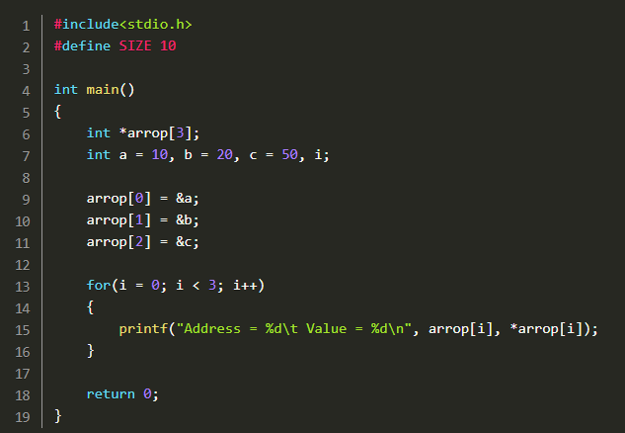
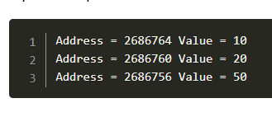

Slide 19
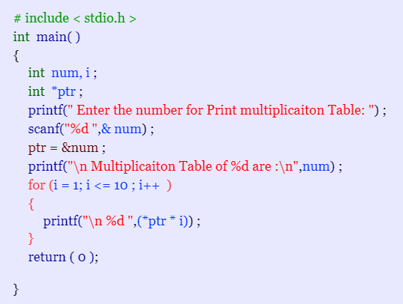
Print table using pointer

Slide 20
Strings
Strings are defined as an array of characters. The difference between a character array and a string is the string is terminated with a special character ‘\0’.
There is an extra terminating character which is the Null character (‘\0’) used to indicate termination of string which differs strings from normal character arrays.

Slide 21
Declaration of strings::
char str_name[size];
str_name is any name given to the string variable and size is used define the length of the string, i.e the number of characters strings will store.

Slide 22
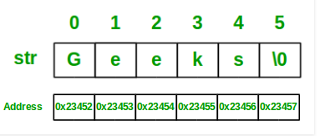
Initializing a String:
char str[] = "GeeksforGeeks";
char str[50] = "GeeksforGeeks";
char str[] = {'G','e','e','k','s','f','o','r','G','e','e','k','s','\0'};
char str[14] = {'G','e','e','k','s','f','o','r','G','e','e','k','s','\0'};

Slide 23
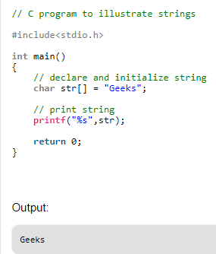
print a string.

Slide 24
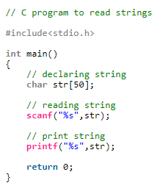
read and write a string

Slide 25
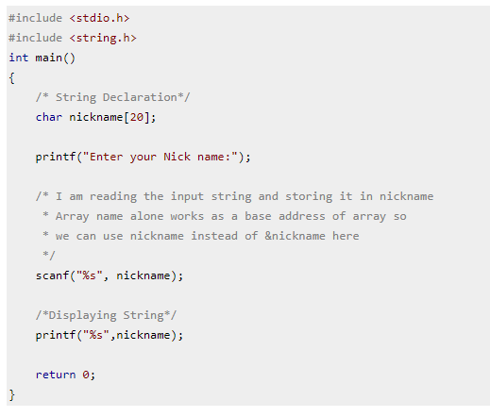
Read & write Strings in C using Printf() and Scanf()

Slide 26
Functions
1. strcpy(s1, s2);
Copies string s2 into string s1.
2. strcat(s1, s2);
Concatenates string s2 onto the end of string s1.
3. strlen(s1);
Returns the length of string s1.
4. strlwr(s1);
Converts string to lowercase.
5. strupr();
Converts string to lowercase

Slide 27
6. strcmp(s1, s2);
Returns 0 if s1 and s2 are the same; less than 0 if s1<s2; greater than 0 if s1>s2.
7. strchr(s1, ch);
Returns a pointer to the first occurrence of character ch in string s1.
8. strstr(s1, s2);
Returns a pointer to the first occurrence of string s2 in string s1.
9. strdup();
Duplicates the string
10. strrev(s1);
Reverses the given string;

Slide 28
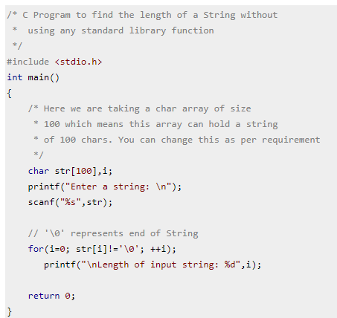
finding length of a String

Slide 29
Array of Strings in C
A string is a 1-D array of characters, so an array of strings is a 2-D array of characters.
A string is an array of characters; so, an array of strings is an array of arrays of characters. Of course, the maximum size is the same for all the strings stored in a two dimensional array.
The first subscript of the array i.e 3 denotes the number of strings in the array and the second subscript denotes the maximum length of the string.

Slide 30
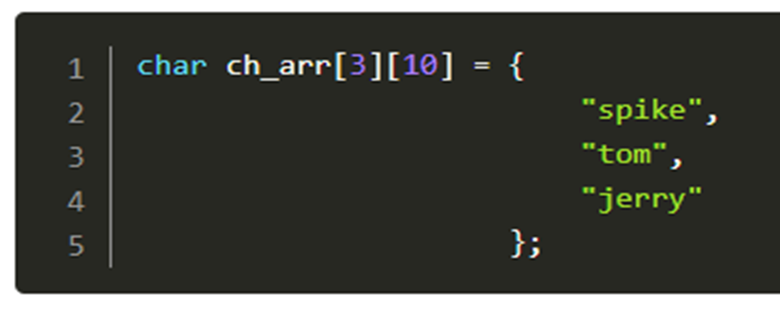
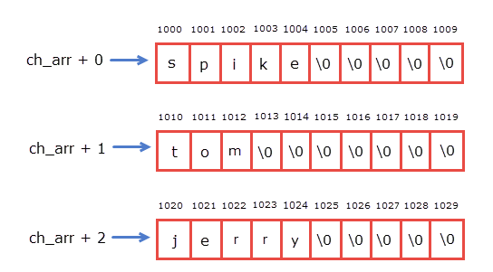

Slide 31
