Slide 1

CSE101-Lec#20
Strings

Slide 2
Outline
Introduction to string
  Declaration
  Initialization
Reading and writing strings
  functions of the standard input/output library (stdio.h)
Processing of strings.
  String Manipulation Functions from the String Handling Library
    Comparing strings
  Determining the length of string

Slide 3

Introduction
Use of C standard library functions for strings and characters:
  Easy string and character processing
  Programs can process characters, strings, lines of text, and blocks of memory
These techniques are used to make
  Word processors
  Page layout software
  Typesetting programs
Quick yak:
Discussion for string usage can be exemplified mentioning
Google Translator!!!

Slide 4
Fundamentals of characters
Characters
  Building blocks of programs
    Every program is a sequence of meaningfully grouped characters
  Character constant
    An int value represented as a character in single quotes
    'z' represents the integer value of z (122 ASCII value).

Slide 5
Fundamentals of strings
Strings
  Array of characters treated as a single unit called string:
    Can include letters, digits and special characters (*, /, $)
  String literal (string constant) - written in double quotes
    “Lovely Professional University."

Slide 6
Fundamentals of strings
Each element of the string is stored in a contiguous memory locations.
Terminated by a null character(‘\0’) which is automatically inserted by the compiler to indicate the end of string.

Slide 7
String Definition
They are defined as
char array_name[size];
e.g. char carname[30];
or char *carname;
It defines an array name and reserves 30 bytes for storing characters and single character consumes 1 bytes each.
Since the last byte is used for storing null character so total number of character specified by the user cannot exceed 29.

Slide 8
String Initialization
String Initialization
  Two ways:
  Define as a character array or a variable of type char *
      char color[] = "blue"; //char array
    Or char color[] = { 'b', 'l', 'u', 'e', '\0' };
      char *colorPtr = "blue"; //pointer variable
  Remember that strings represented as character arrays end with '\0'
    color has 5 elements
b | l | u | e | \0
color

Slide 9
String Input/Output
Inputting strings
  Use scanf.
      scanf("%s", word);
    Copies input into word[]
    Do not need & (because a string is a pointer)
Displaying strings
  Use printf.
      printf("%s", word);

Slide 10
#include <stdio.h>
void main()
{
char carname[20]; //string char array
printf(“Enter the name of your car: ");
scanf("%s", carname);
// to display the input
printf(“\nName of car is %s", carname);
} //end main
Program to read and display string
Enter the name of your car: XUV500
Name of car is XUV500
Output

Slide 11

How?
The last program will print only a single word not the sentences with white spaces?
That is if input is
Lovely Professional University
Output will be:
  Lovely
So how to print:
Lovely Professional University
Ams:-
Gets()
use gets and puts

Slide 12
#include <stdio.h>
void main()
{
char name[100]; //string char array
puts(“\nEnter a string: ”);
gets(name); //to input string with space
printf(“\nString is: ”)
puts(name); //to output const string
}//end main
Program to print strings with white spaces using library functions
Enter a string:
Lovely Professional University
String is:
Lovely Professional University
Output

Slide 13
#include <stdio.h>
void main()
{
char name[]={“Lovely Professional University"}; //string char array
int i=0;
while(name[i]!='\0') //untill null character
{
printf("%c", name[i]);
i++;
}//end while
}//end main
Program to print strings character by character using loop.
Lovely Professional University
Output

Slide 14
String Handling functions/inbuilt string functions
Functions defined in #include<string.h>
String handling library provides many useful functions:
  Strcpy(a,b);
  strcmp(a,b);
  Strlen(a);
  Strlwr(a); strupr(a); strcat(a,b);

Slide 15
strcpy()
strcpy() copies the entire second argument string into first argument.
  strcpy( s1, s2);

Slide 16
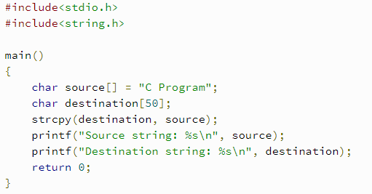
Strcpy()

Slide 17
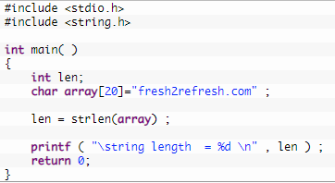
Strlen()

Slide 18
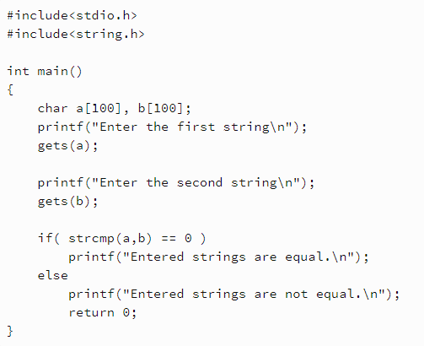
Strcmp()

Slide 19
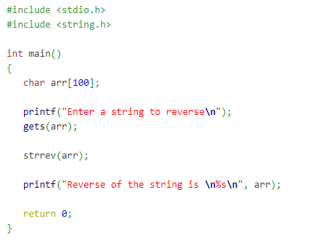
Strrev()

Slide 20
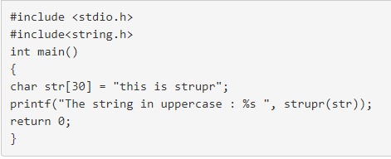
Strupr()

Slide 21
Strlwr()
Same as strupr()

Slide 22
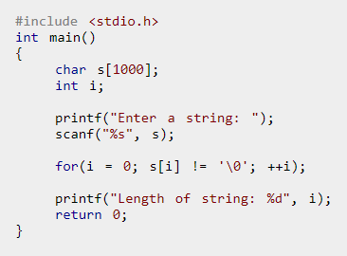
Length of string without using fn

Slide 23


Slide 24
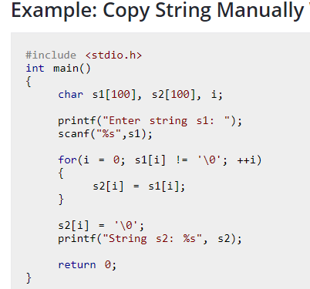
Strcpy()

Slide 25
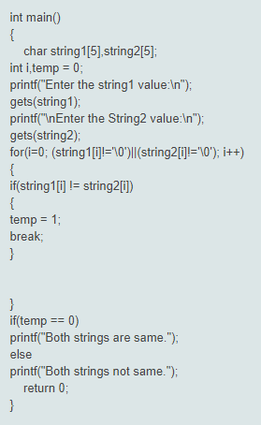
Compare 2 strings without using fn

Slide 26
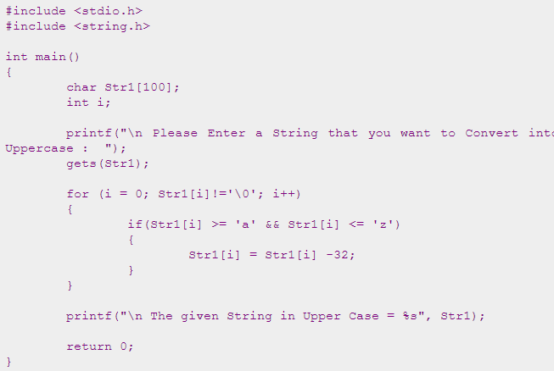
Lower to uppercase

Slide 27
Uppercase to lower
Similar to prevoius

