Slide 1
Transaction
A transaction is a unit of program execution that accesses and possibly updates various data items.
A transaction must see a consistent database.
During transaction execution the database may be inconsistent.
When the transaction is committed, the database must be consistent.
Two main issues to deal with:
  Failures of various kinds, such as hardware failures and system crashes
  Concurrent execution of multiple transactions

Slide 2
ACID Properties
To preserve integrity of data, the database system must ensure:
Atomicity. Either all operations of the transaction are properly reflected in the database or none are.
Consistency. Execution of a transaction in isolation preserves the consistency of the database.
Isolation. Although multiple transactions may execute concurrently, each transaction must be unaware of other concurrently executing transactions. Intermediate transaction results must be hidden from other concurrently executed transactions.
  That is, for every pair of transactions T_{i} and T_{j}, it appears to T_{i} that either T_{j}, finished execution before T_{i} started, or T_{j} started execution after T_{i} finished.
Durability. After a transaction completes successfully, the changes it has made to the database persist, even if there are system failures.

Slide 3
Transaction State
Active, the initial state; the transaction stays in this state while it is executing
Partially committed, after the final statement has been executed.
Failed, after the discovery that normal execution can no longer proceed.
Aborted, after the transaction has been rolled back and the database restored to its state prior to the start of the transaction. Two options after it has been aborted:
  restart the transaction – only if no internal logical error
  kill the transaction
Committed, after successful completion.

Slide 4

Transaction State (Cont.)

Slide 5
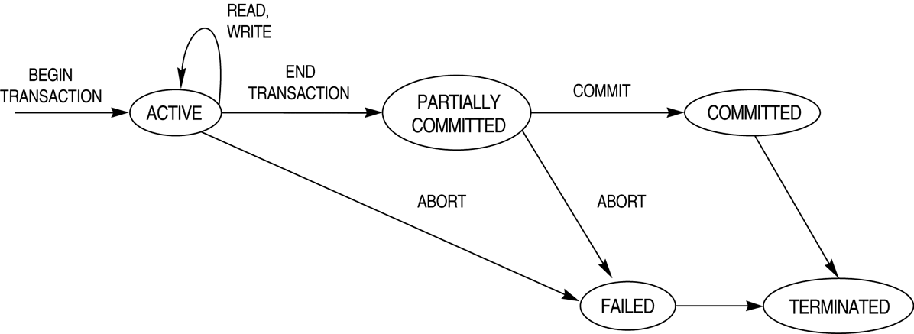

Slide 6
Concurrent Executions
Multiple transactions are allowed to run concurrently in the system. Advantages are:
  increased processor and disk utilization, leading to better transaction throughput: one transaction can be using the CPU while another is reading from or writing to the disk
  reduced average response time for transactions: short transactions need not wait behind long ones.
Concurrency control schemes – mechanisms to achieve isolation, i.e., to control the interaction among the concurrent transactions in order to prevent them from destroying the consistency of the database

Slide 7
Schedules
Schedules – sequences that indicate the chronological order in which instructions of concurrent transactions are executed
  a schedule for a set of transactions must consist of all instructions of those transactions
  must preserve the order in which the instructions appear in each individual transaction.

Slide 8

Example Schedules
Let T₁ transfer $50 from A to B, and T₂ transfer 10% of the balance from A to B. The following is a serial schedule, in which T₁ is followed by T₂.

Slide 9

Example Schedule (Cont.)
Let T₁ and T₂ be the transactions defined previously. The following schedule is not a serial schedule, but it is equivalent to previous Schedule.

Slide 10

Example Schedules (Cont.)
The following concurrent schedule is not equivalent to serial schedule.

Slide 11
Serializability
Basic Assumption – Each transaction preserves database consistency.
Thus serial execution of a set of transactions preserves database consistency.
A (possibly concurrent) schedule is serializable if it is equivalent to a serial schedule. Different forms of schedule equivalence give rise to the notions of:
  1. conflict serializability
  2. view serializability
We ignore operations other than read and write instructions, and we assume that transactions may perform arbitrary computations on data in local buffers in between reads and writes. Our simplified schedules consist of only read and write instructions.

Slide 12
Conflict Serializability
Instructions l_{i} and l_{j} of transactions T_{i} and T_{j} respectively, conflict if and only if there exists some item Q accessed by both l_{i} and l_{j}, and at least one of these instructions wrote Q.
1. l_{i} = read(Q), l_{j} = read(Q). l_{i} and l_{j} don’t conflict.
2. l_{i} = read(Q), l_{j} = write(Q). They conflict.
3. l_{i} = write(Q), l_{j} = read(Q). They conflict
4. l_{i} = write(Q), l_{j} = write(Q). They conflict
Thus, we can say that two operations are conflicting,
1. If they are of different transaction.
2. Refer to same data item.
3. At least one of them is a write operation.

Slide 13
Conflict Serializability (Cont.)
If a schedule S can be transformed into a schedule S´ by a series of swaps of non-conflicting instructions, we say that S and S´ are conflict equivalent.
We say that a schedule S is conflict serializable if it is conflict equivalent to a serial schedule
Example of a schedule that is not conflict serializable:
T₃ T₄
read(Q)
write(Q)
write(Q)
We are unable to swap instructions in the above schedule to obtain either the serial schedule < T₃, T₄ >, or the serial schedule < T₄, T₃ >.

Slide 14

Conflict Serializability (Cont.)
Schedule 3 below can be transformed into Schedule 1, a serial schedule where T₂ follows T₁, by series of swaps of non-conflicting instructions. Therefore Schedule 3 is conflict serializable.

Slide 15
Q1 Consider schedule S:
Schedule S :r1(A),r2(A),w1(A),w2(A),r2(B),w2(B)
Check whether schedule S is conflict equivalent or not?
Q2 ScheduleS:r1(A),r2(A),w1(A),w2(A),r2(B),w2(B)
ScheduleT:r1(A),r2(A),w2(A),w1(A),r2(B),w2(B)
Check whether Schedule S and T are conflict equivalent or not?

Slide 16
Precedence Graph
Consider some schedule of a set of transactions T1, T2, ..., Tn
Precedence graph A direct graph where the vertices are the transactions (names)
We draw an arc from Ti to Tj if the two transactions conflict, and Ti accessed the data item on which the conflict arose earlier
We may label the arc by the item that was accessed.
A schedule is conflict serializable if and only if its precedence graph is acyclic

Slide 17
Directed Graph:
Nodes

Slide 18
Directed Graph:
Edges

Slide 19
Directed Graph:
Cycle

Slide 20
Directed Graph:
Not a cycle

Slide 21
Acyclic Graph: A graph with no cycles

Slide 22
Acyclic Graph:

Slide 23
Testing Conflict Serializability
Construct precedence graph G for given schedule S
S is conflict-serializable iff G is acyclic

Slide 24
Precedence Graph
Precedence graph for schedule S:
  Nodes: Transactions in S
  Edges: Ti → Tj whenever
    S: … ri (X) … wj (X) …
    S: … wi (X) … rj (X) …
    S: … wi(X) … wj (X) …
Note: not necessarily consecutive

Slide 25
View Serializability
Let S and S´ be two schedules with the same set of transactions. S and S´ are view equivalent if the following three conditions are met:
  1. For each data item Q, if transaction T_{i} reads the initial value of Q in schedule S, then transaction T_{i} must, in schedule S´, also read the initial value of Q.
  2. For each data item Q if transaction T_{i} executes read(Q) in schedule S, and that value was produced by transaction T_{j} (if any), then transaction T_{i} must in schedule S´ also read the value of Q that was produced by transaction T_{j} .
  3. For each data item Q, the transaction (if any) that performs the final write(Q) operation in schedule S must perform the final write(Q) operation in schedule S´.
As can be seen, view equivalence is also based purely on reads
and writes alone.

Slide 26
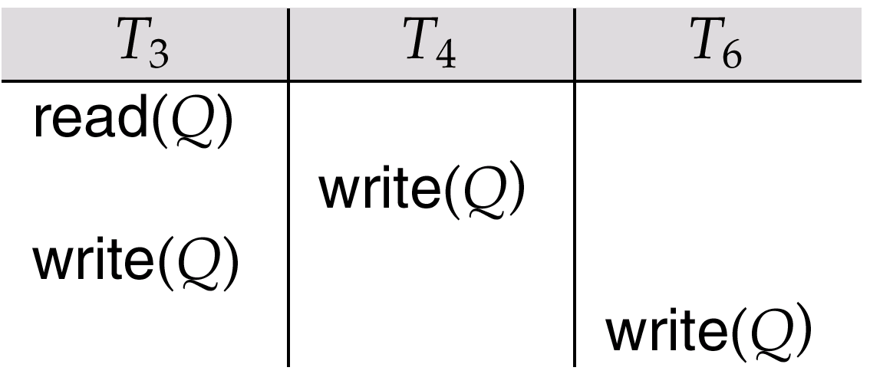
View Serializability (Cont.)
A schedule S is view serializable, if it is view equivalent to a serial schedule.
Every conflict serializable schedule is also view serializable.
A schedule which is view serializable may not be conflict serializable.
Schedule 9 (from text) — a schedule which is view-serializable but not conflict serializable.
Every view serializable schedule that is not conflict
serializable has blind writes.

Slide 27
View Serializability Example
View Serializable Schedule
r2(B) w2(A) r1(A) r3(A) w1(B) w2(B) w3(B)
Serial Schedule
r2(B) w2(A) w2(B) r1(A) w1(B) r3(A) w3(B)

Slide 28
View Serializability Example
View Serializable Schedule
r2(B) w2(A) r1(A) r3(A) w1(B) w2(B) w3(B)
Serial Schedule
r2(B) w2(A) w2(B) r1(A) w1(B) r3(A) w3(B)

Slide 29
View Serializability Example
View Serializable Schedule
r2(B) w2(A) r1(A) r3(A) w1(B) w2(B) w3(B)
Serial Schedule
r2(B) w2(A) w2(B) r1(A) w1(B) r3(A) w3(B)

Slide 30
View Serializability Example
View Serializable Schedule
r2(B) w2(A) r1(A) r3(A) w1(B) w2(B) w3(B)
Serial Schedule
r2(B) w2(A) w2(B) r1(A) w1(B) r3(A) w3(B)

