Slide 1
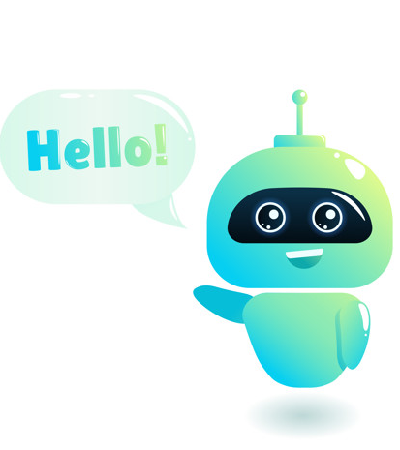
AI Based Chat Bot
C-CAT Assistant
Welcome to the world of living people and artificial intelligence entities called bots!

Slide 2
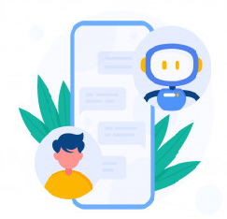
Contents
Introduction
What is Chat Bot ?
How does it work?
Technologies Used
How NLU, NLP, AI helps Chat Bot ?
Benefits
References

Slide 3
Introduction
Chat Bot : A computer program that can talk to humans in natural language!
Uses Artificial Intelligence Markup Language (YAML) to represent knowledge.
Can replace a human for monotonous jobs of answering queries, e.g. E-help desk.

Slide 4
What is Chat Bot?
A Chatter Robot(Chat Bot) is a type of conversational agent, a computer program designed to simulate an intelligent conversation with one or more human users in natural language via auditory or textual methods.
In short , chat-bots are virtual assistant programmed to automatically answer users requests.

Slide 5
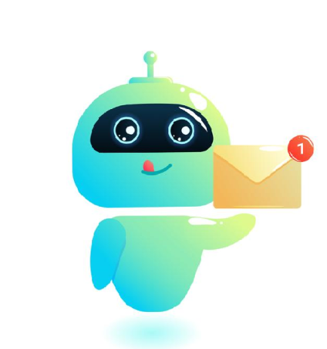
How does it respond
Looks for certain patterns of words in the user's input.
Replies with pre-determined output, if the pattern is matched.
Needs to have an idea of what the user will chat
Has suitable responses defined in the YAML file

Slide 6
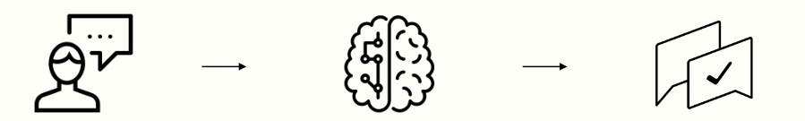
How does it work
User makes a request Request analyzed Real time response
by NLU Conversational strategy
User info taken into account Interactions
(history, preferences...) personalization

Slide 7

Technologies Used :
Rasa
Python
Html/CSS
Bootstrap
JavaScript
My SQL

Slide 8
NLP in Chat Bot
Chat Bots are the most prolific examples of Natural Language Processing systems.
These are computer software which can talk to users in natural language(via written and/or verbal methods).
Adopting the user’s information, such as preference, social role, etc., into conversational models reasonably, while user’s profiles play a significant role in the procedure of conversations by providing the implicit contexts.
Personalized response ranking task , incorporating user profiles into the conversation model.

Slide 9
NLP, NLU,NLG
NLP, or Natural Language Processing is a blanket term used to describe a machine’s determine to ingest what is said to it, break it down, comprehend its meaning, determine appropriate action, and respond back in language the user will understand.
NLU, or Natural Language Understanding is a subset of NLP that deals with the much narrower, but equally important facet of how to best handle unstructured inputs and convert them into a structured form that a machine can understand and act upon.
NLG or Natural Language Generation, simply put, is what happens when computers write language.NLG process turn structured data into test

Slide 10
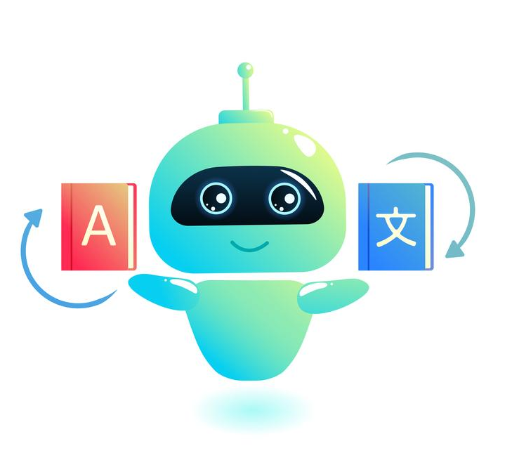
Benefits
User Satisfaction
Immediate answers
Available 24/7
90% correct answers
Personalised answers
Customer autonomy
Innovative customer service

Slide 11
References
https://rasa.com/
https://github.com/RasaHQ
https://www.w3schools.com/

Slide 12
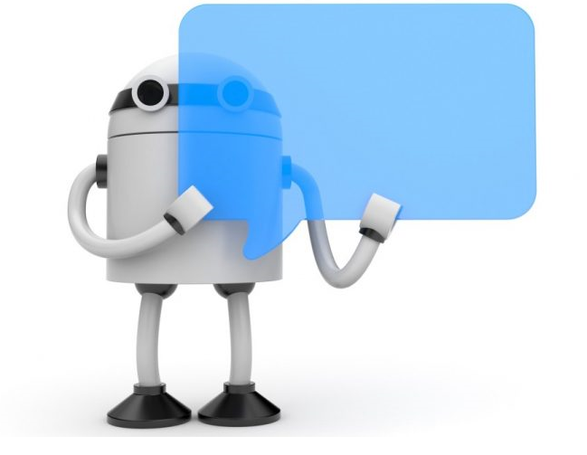
Thank you
Thank You

