Slide 1

DEMO
Presented By : Shubham Kumbhar
Guided By : Suyeb ansari
08/10/18

Slide 2
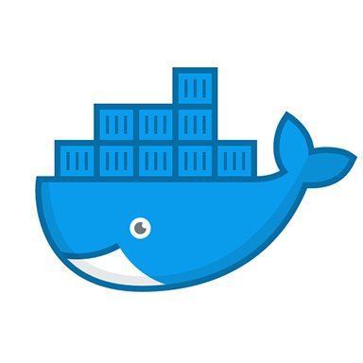

Contents
Introduction to Docker.
What is docker
Docker component
Notes:
‹#›

Slide 3
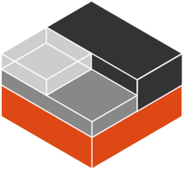
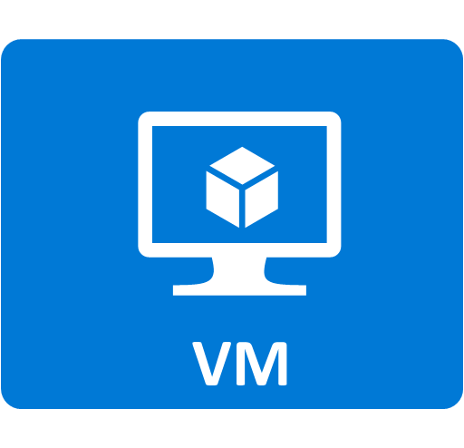
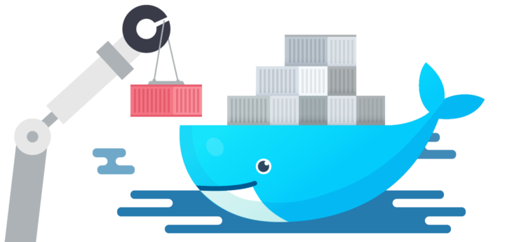
Introduction to Docker
What is linux Container
VM vs Container
What is Docker
Docker Architecture
Image and Container
Manage data in Docker
Network in docker
Notes:
‹#›

Slide 4
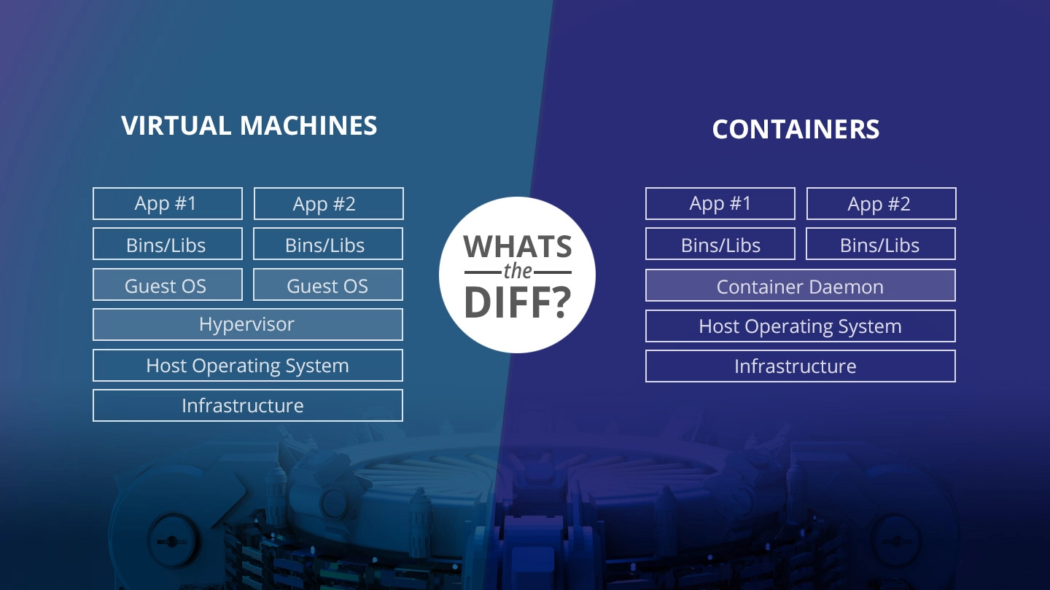
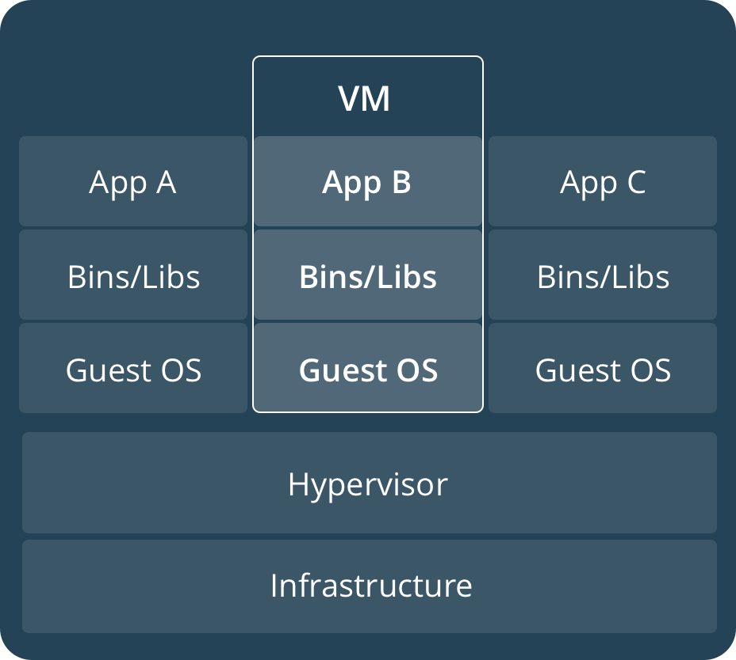
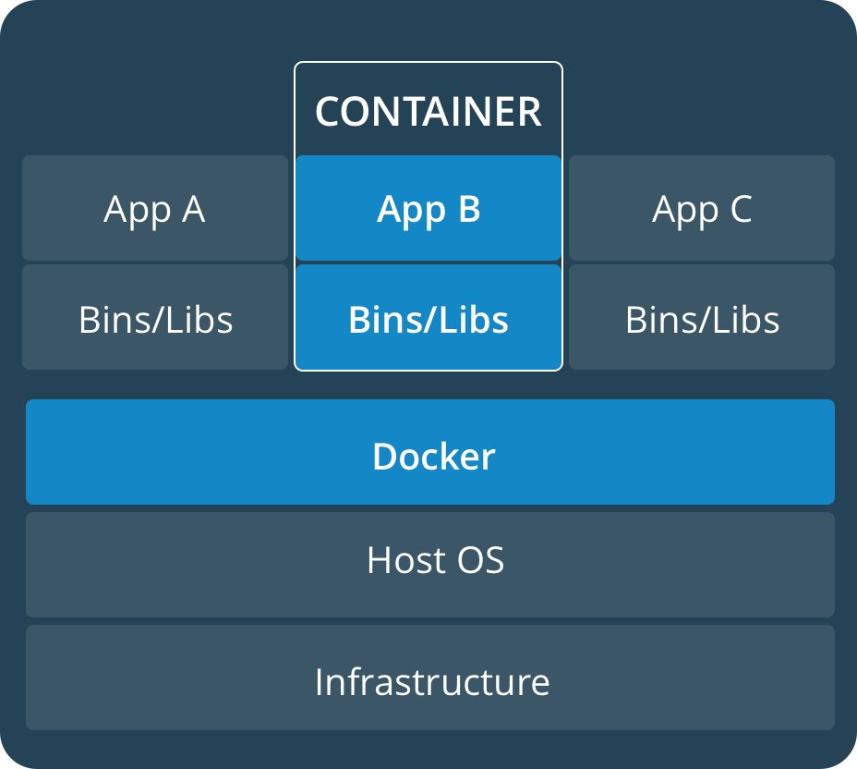
VM vs Container

Slide 5
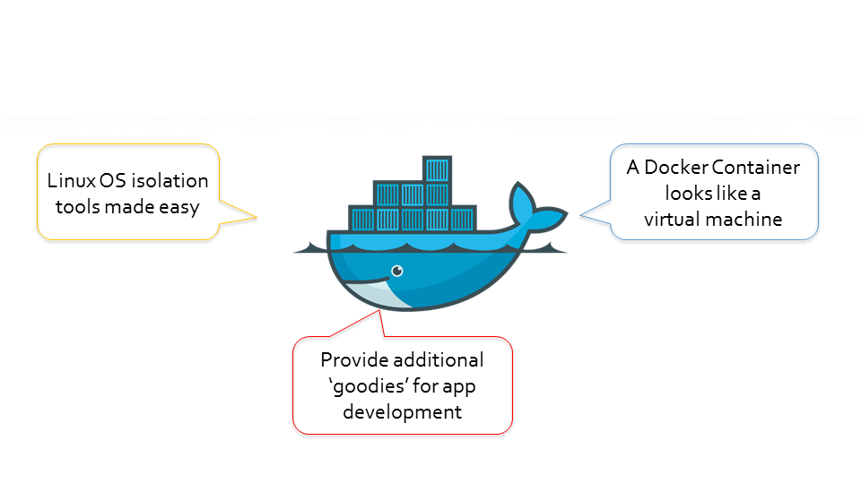
What is Docker
Build, Ship and Run Your Apps Anywhere...
Lightweight
Scalable
Flexible
Portable
Interchangeable
Notes:
‹#›

Slide 6
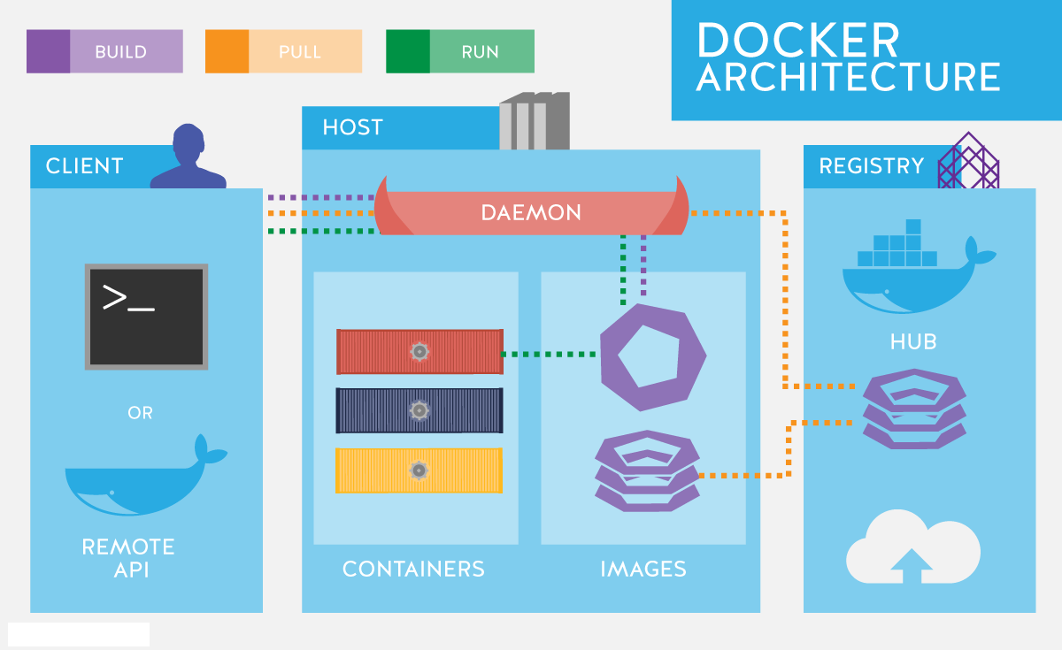
Docker: Architecture
Image
Container
Docker Client
Docker Host
Registry
Docker-compose
Notes:
‹#›

Slide 7
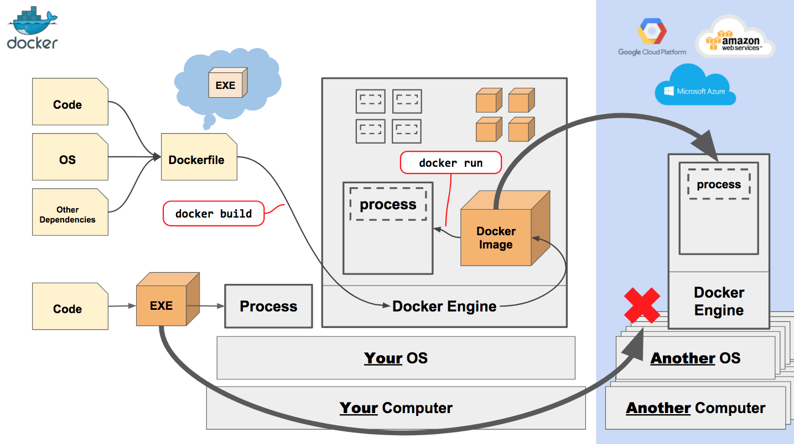
Docker: How it Works
Notes:
‹#›

Slide 8
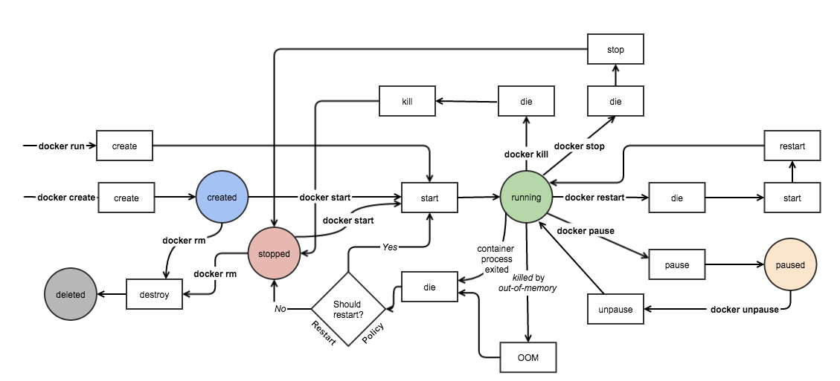
Container Life Cycle

Slide 9
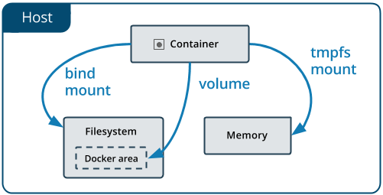
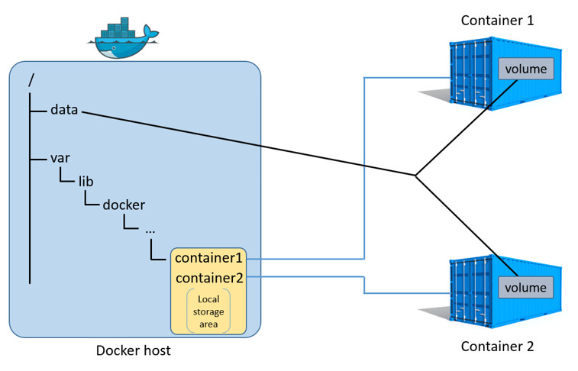
Docker : Storage
Manage data in Docker
Volume
Bind Mounts
tmpfs
Notes:
‹#›

Slide 10
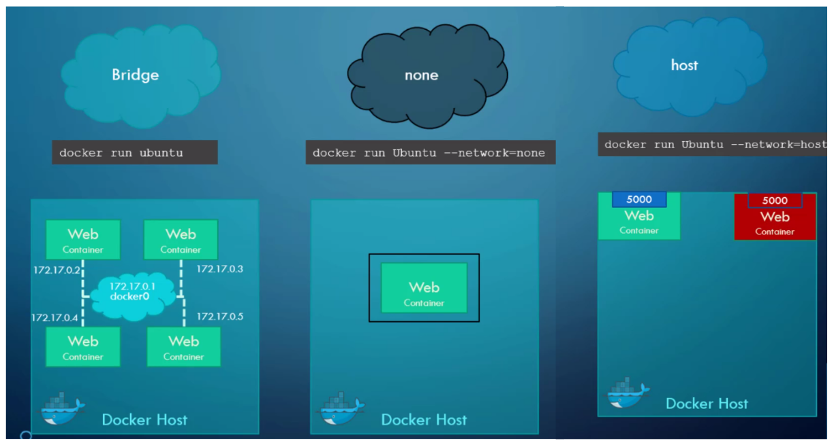
Docker : Networking
Network in Docker
Host
Bridge
Overlay
none
Macvlan
Notes:
‹#›

Slide 11
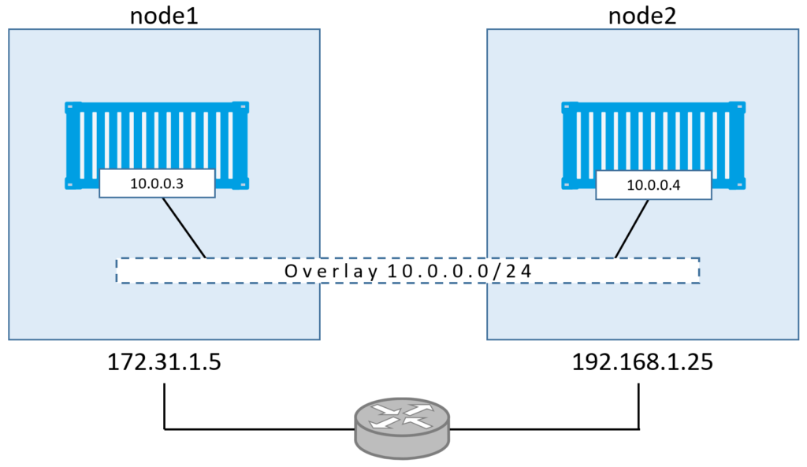
Docker : Networking
Network in Docker
Host
Bridge
Overlay
none
Macvlan
Notes:
‹#›

Slide 12

Question
Notes:
‹#›

Slide 13

Thank You

