Slide 1
DEMO
vRealize Automation
vRealize Orchestrator
Chef
Shubham Kumbhar
^{Guided By: Suyeb Ansari}

Slide 2



Contents
Introduction to vRealize Suite.
vRealize Automation
vRealize Orchestrator
Chef
Notes:
‹#›

Slide 3
Overview of vRealize Automation
What is vRealize Suite?
Components of vRealize Suite.
_{1. vRealize Automation.}
_{2. vRealize Orchestrator.}
_{3. vRealize Log Insight.}
4. vRealize Business for Cloud.
Notes:
‹#›

Slide 4
Introduction to vRealize Automation
Why vRealize Automation
Notes:
‹#›

Slide 5
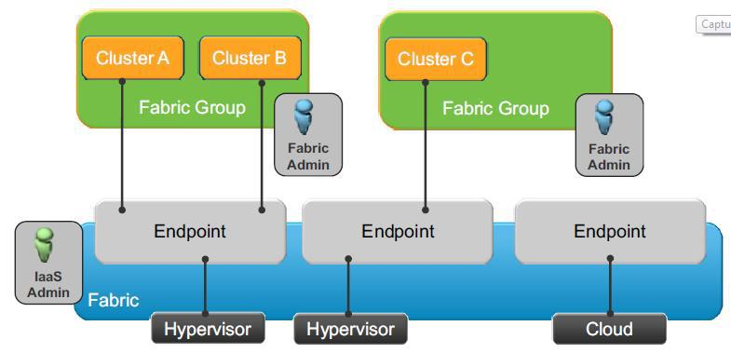
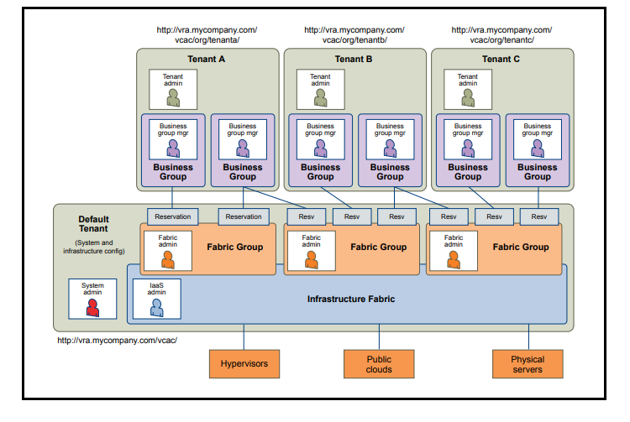
vRealize Automation
Tenants
Endpoints
Fabric Groups
Business Groups
Reservations
Custom Groups

Slide 6
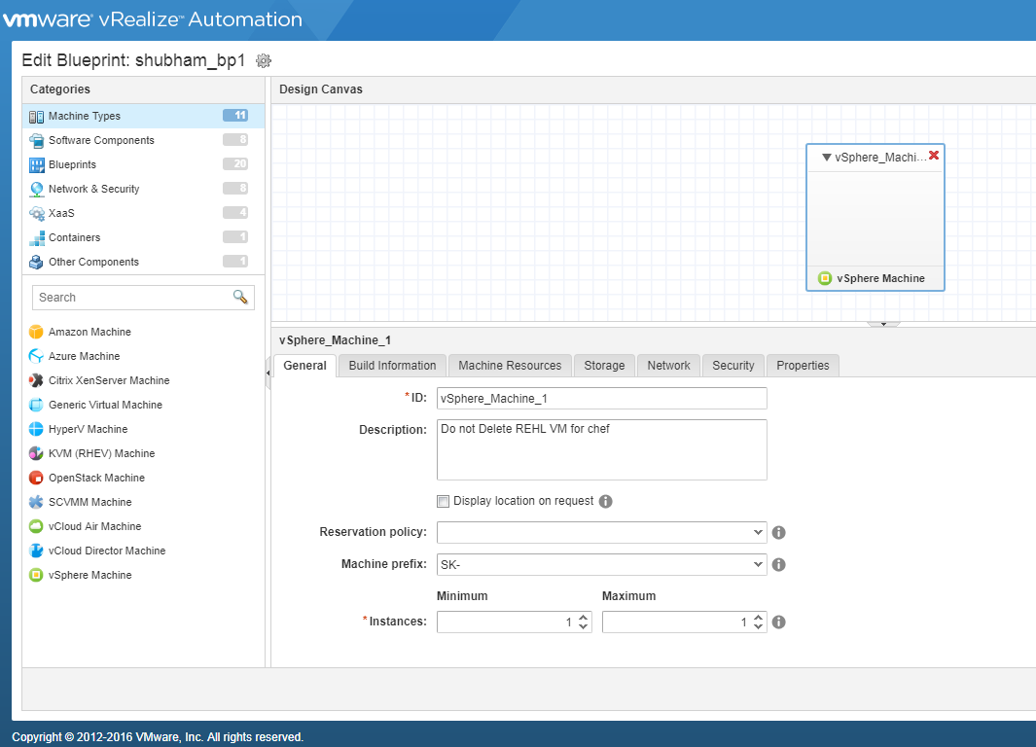
vRealize Automation
Blueprints
Services
Entitlements
Manage Catalog Items
Event Subscriptions
Custom Properties
Software Components
Xaas

Slide 7
vRealize Orchestrator
What is vRO?
Workflows
Actions
Resources
Configurations
Packages
Import/Export

Slide 8
vRA/vRO Assignments
Create Blueprints to deploy Windows and Linux vm.
Implement a vRO workflow to run simple command on VM.
Create Event subscription to run vRO workflow.(vRO workflow should be able to fetch and logs provisioned VM details).
Implement Event Subscription to run a vRO workflow for below events(just print the event type in vRO workflow).
1. POST
2. PRE
3. Running
Create Workflow that will fetch VM details post provision, install chef-client on VM and Run Recipe on VM
Notes:
‹#›

Slide 9
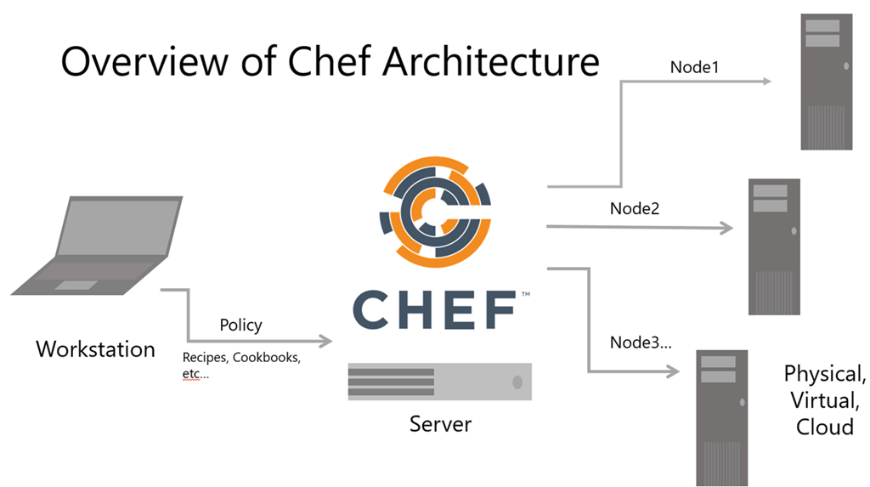
CHEF
What is Chef ?
Chef Architecture.
Chef Server
Chef Workstation
Node
Cookbooks
Recipes
Resources

Slide 10
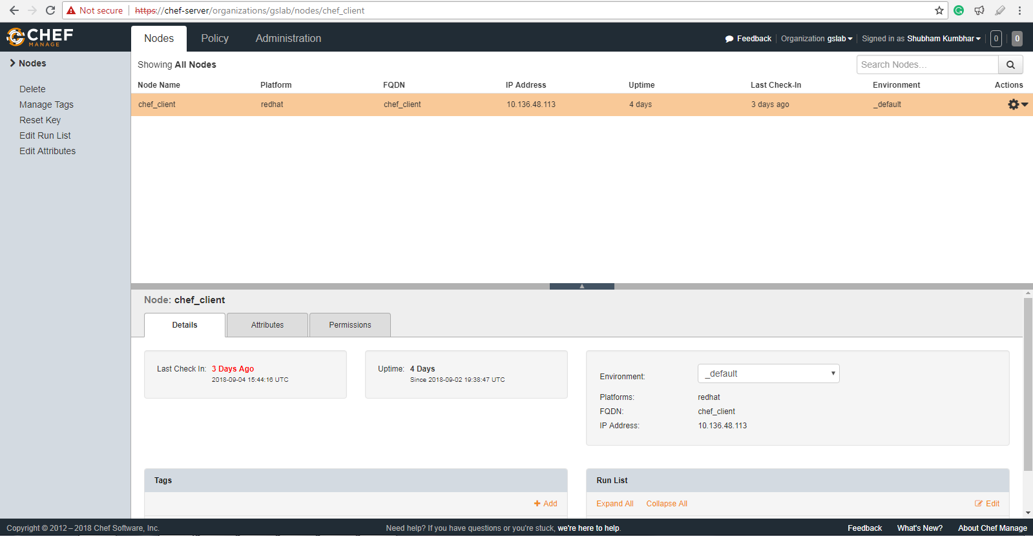
CHEF
Attributes
Data-Bag
Roles
Environment
Knife
Knife bootstrap
Chef-client run
Chef manage

Slide 11
Chef Assignments
1. Create a cookbook for installing apache and modify default html page for apache using template.
2. Create a cookbook for downloading any file from remote url to specific directory.
3. Create a cookbook for installing a package, start its service and capture its status in log file.
4. Create a cookbook which capture node information in log file.
5. Create a cookbook to create a user, set its uid and home directory.
6. Create a cookbook which creates file on node with same content as file located on workstation.

Slide 12


Question

Slide 13
Thank You

