Slide 1
Lekcija 8 – Karakteri i stringovi
Pregled
8.1 Uvod
8.2 Osnovni pojmovi o stringovima i karakterima
8.3 Biblioteka za obradu karaktera
8.4 Funkcije konverzije stringova
8.5 Standardne ulazno-izlazne funkcije
8.6 Manipulacija stringovima (biblioteka <string.h>)
8.7 Funkcije za poređenje stringova
8.8 Funkcije za pretraživanje stringova
8.9 Memorijske funkcije
8.10 Ostale funkcije u biblioteci <string.h>

Slide 2
Ciljevi lekcije
U ovoj lekciji:
  Naučićete kako da koristite biblioteku ctype.
  Koristićete ulazne i izlazne funkcije sa karakterima i stringovima – biblioteka stdio.
  Upotrebljavaćete funkcije za konverziju stringova – biblioteka stdlib.
  Naučićete sve o procesiranju stringova – biblioteka string.
  Shvatićete značaj biblioteka funkcija kao načina za dostizanje ponovne upotrebljivosti softvera (software reusability).

Slide 3
8.1 Uvod
Uvešćemo neke standardne funkcije
  Olakašavaju procesiranje stringova i karaktera
  Programi mogu obrađivati karaktere, stringove, linije teksta i blokove memorije
Ove tehnike se koriste za izradu
  Word procesora
  Softvera za podešavanje izgleda stranica teksta (page layout software)
  Programa za unošenje teksta (typesetting programs)

Slide 4
8.2 Osnovni pojmovi o stringovima i karakterima
Karakteri
  Svi programi su kreirani od karaktera
    Svaki program je niz karaktera grupisanih na određeni način (sa nekim značenjem)
  Konstante karakteri
    int vrijednost predstavljena kao karakter u jednostrukim navodnicima
    'z' predstavlja cjelobrojnju vrijednost za z
Stringovi
  Niz karaktera koji se tretira kao cjelina
    Mogu sadržati slova, cifre i specijalne karaktere (*, /, $)
  String literali (string konstante) – napisani sa dvostrukim navodnicima
    "Hello"
  Stringovi su nizovi karaktera
    String je pokazivač na prvi karakter
    Vrijednost stringa je adresa prvog karaktera

Slide 5
8.2 Osnovni pojmovi o stringovima i karakterima
Definicija stringa
  Definišemo ih kao nizove karaktera ili promjenljive tipa char *
      char color[] = "blue";
      char *colorPtr = "blue";
  Zapamtite da stringovi predstavljaju nizove karaktera koji završavaju sa '\0'
    color ima 5 elemenata
Ulazne operacije sa stringovima
  koristite scanf
      scanf("%s", word);
    Kopira se ulaz u word[]
    Nije potrebno & (jer je string već pokazivač)
  Ne zaboravite prostor u nizu za '\0'

Slide 6
8.3 Biblioteka za obradu karaktera
Biblioteka <ctype.h>
  Sadrži funkcije koje testiraju i manipulišu sa karakterima
  Svaka funkcija ima argument tipa karakter (tj. int) ili EOF (end of file indikator) kao argument
Sledeći slajd sadrži tabelu svih funkcija u <ctype.h>

Slide 7
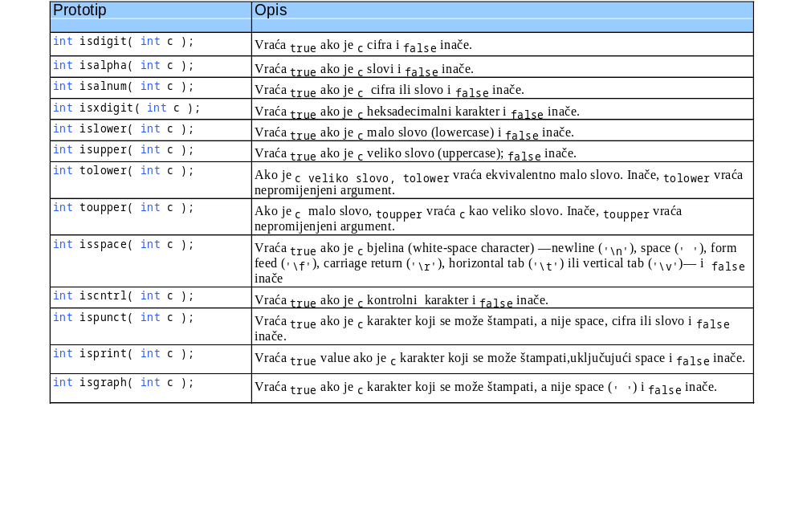
8.3 Biblioteka za obradu karaktera

Slide 8
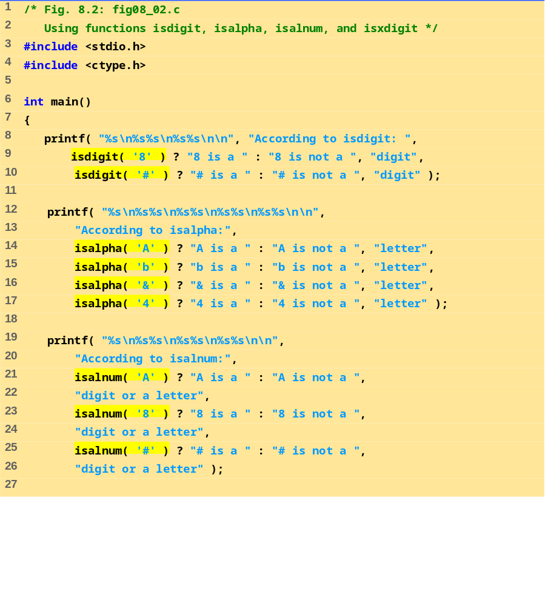
fig08_02.c (Part 1 of 2)

Slide 9
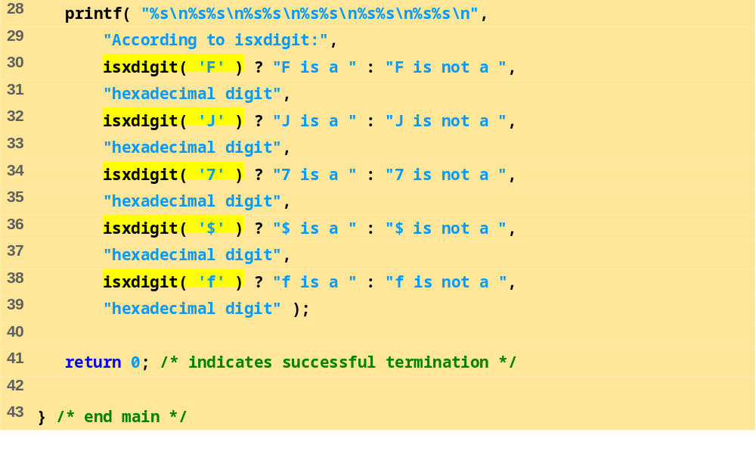
fig08_02.c (Part 2 of 2)

Slide 10
According to isdigit:
8 is a digit
# is not a digit
According to isalpha:
A is a letter
b is a letter
& is not a letter
4 is not a letter
According to isalnum:
A is a digit or a letter
8 is a digit or a letter
# is not a digit or a letter
According to isxdigit:
F is a hexadecimal digit
J is not a hexadecimal digit
7 is a hexadecimal digit
$ is not a hexadecimal digit
f is a hexadecimal digit
Program Output

Slide 11
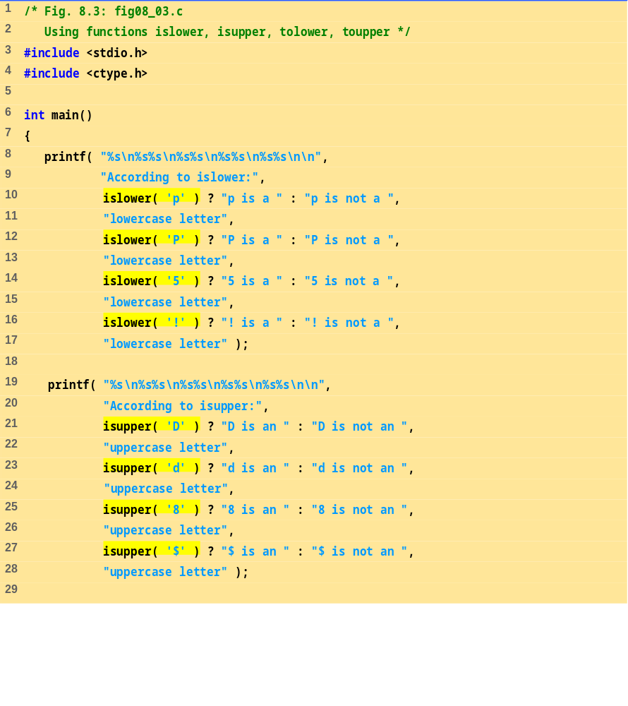
fig08_03.c (Part 1 of 2)

Slide 12
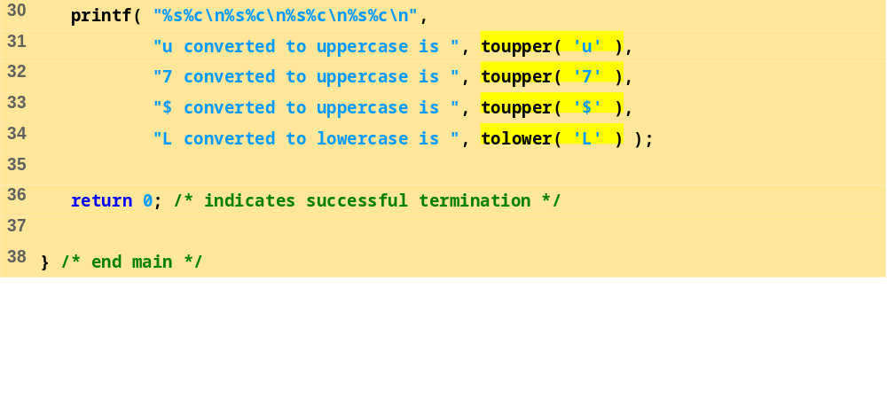
fig08_03.c (Part 2 of 2)
Program Output
According to islower:
p is a lowercase letter
P is not a lowercase letter
5 is not a lowercase letter
! is not a lowercase letter
According to isupper:
D is an uppercase letter
d is not an uppercase letter
8 is not an uppercase letter
$ is not an uppercase letter
u converted to uppercase is U
7 converted to uppercase is 7
$ converted to uppercase is $
L converted to lowercase is l

Slide 13
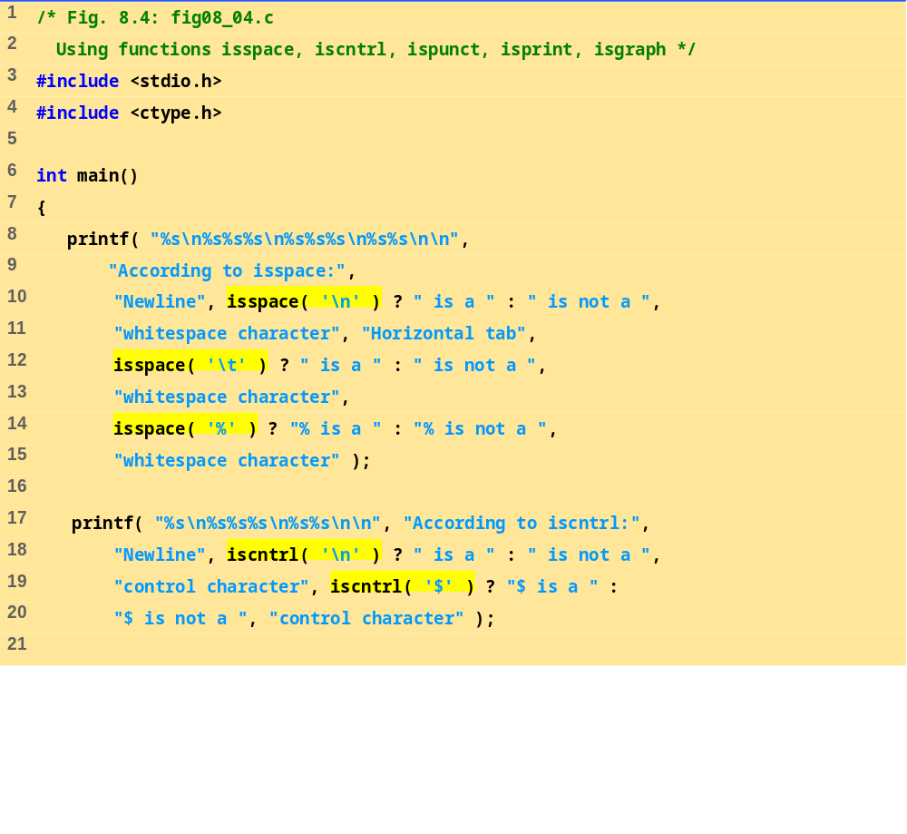
fig08_04.c (Part 1 of 2)

Slide 14
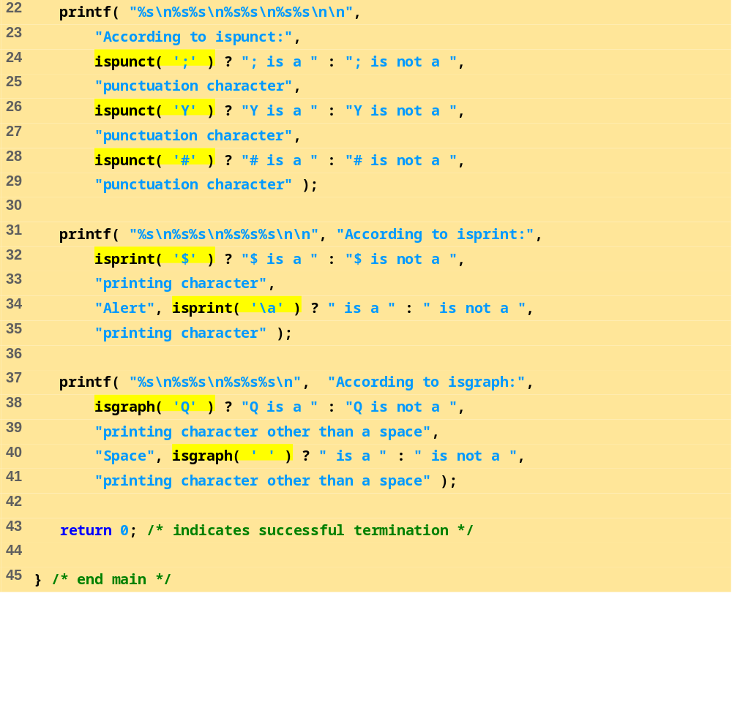
fig08_04.c (Part 2 of 2)

Slide 15
According to isspace:
Newline is a whitespace character
Horizontal tab is a whitespace character
% is not a whitespace character
According to iscntrl:
Newline is a control character
$ is not a control character
According to ispunct:
; is a punctuation character
Y is not a punctuation character
# is a punctuation character
According to isprint:
$ is a printing character
Alert is not a printing character
According to isgraph:
Q is a printing character other than a space
Space is not a printing character other than a space
Program Output

Slide 16
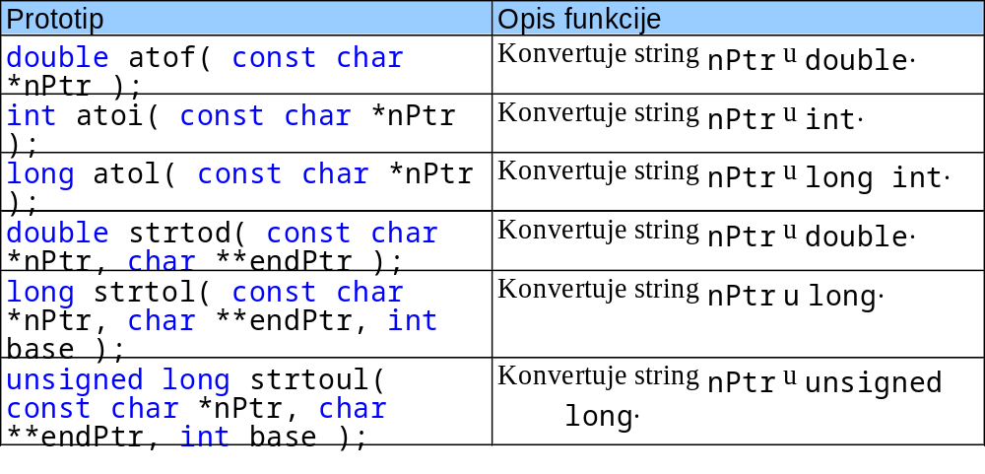
8.4 Funkcije za konverziju stringova
Funckije za konverziju
  U biblioteci <stdlib.h> (opšte pomoćne funkcije)
Konvertuju stringove cifara u cijele i realne (floating-point) vrijednosti

Slide 17
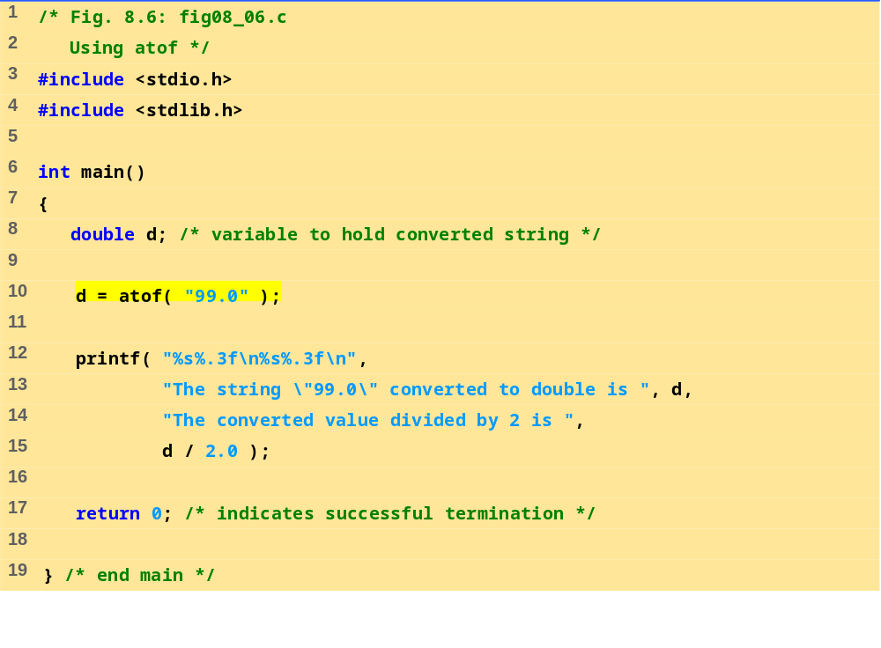
fig 08_06.c
Program Output
The string "99.0" converted to double is 99.000
The converted value divided by 2 is 49.500

Slide 18
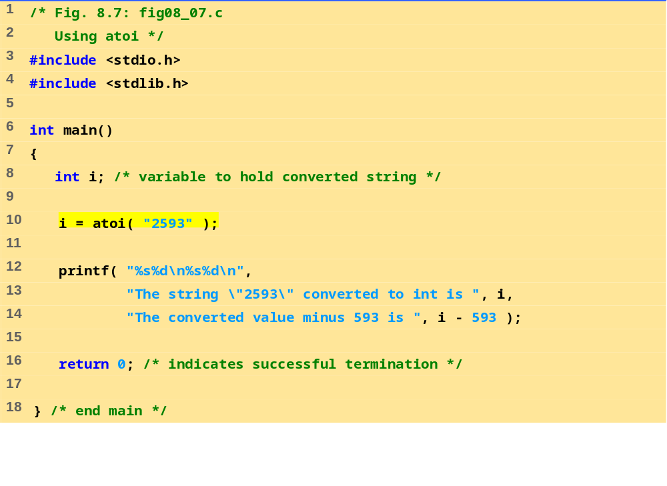
fig08_07.c
Program Output
The string "2593" converted to int is 2593
The converted value minus 593 is 2000

Slide 19
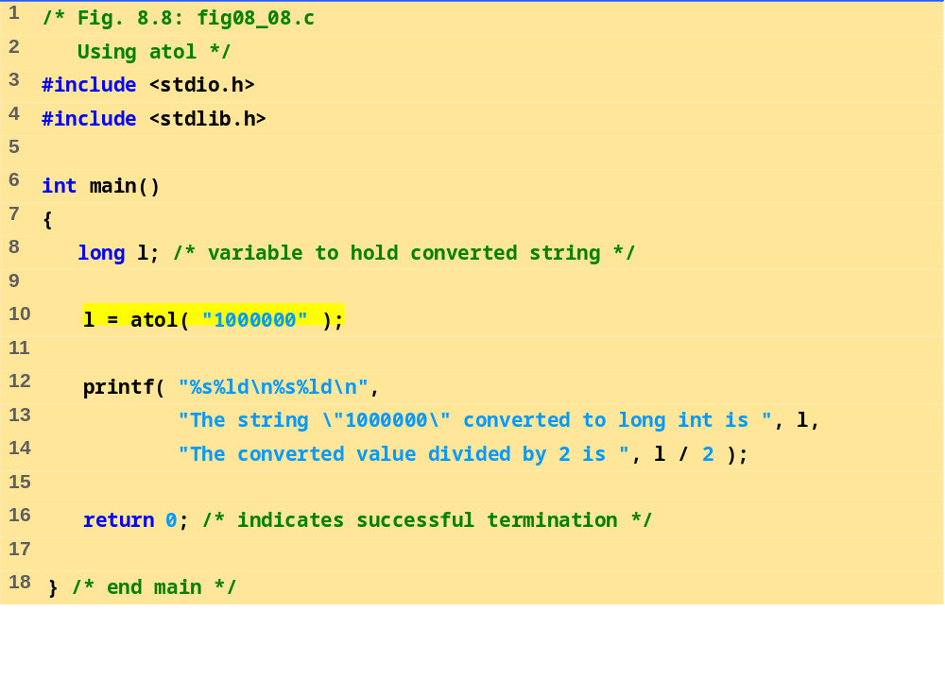
fig08_08.c
Program Output
The string "1000000" converted to long int is 1000000
The converted value divided by 2 is 500000

Slide 20
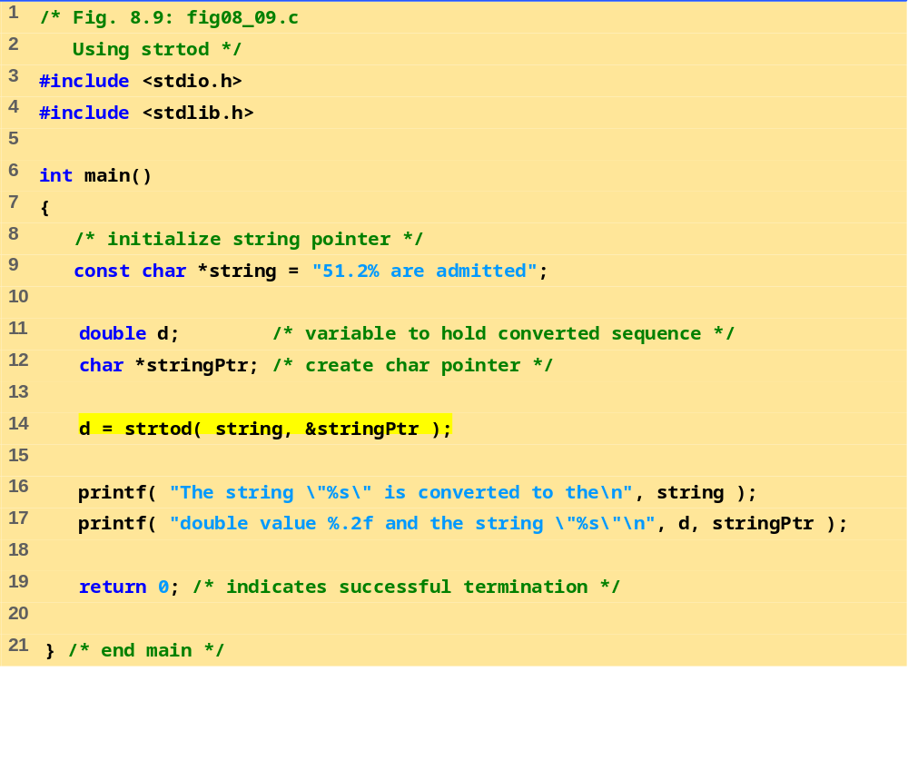
fig08_09.c
Program Output
The string "51.2% are admitted" is converted to the
double value 51.20 and the string "% are admitted"

Slide 21
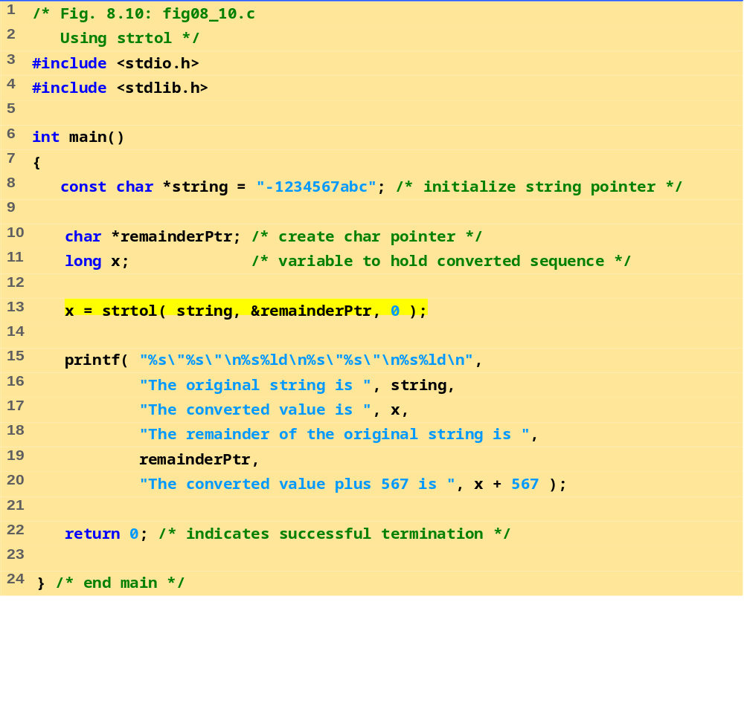
fig08_10.c
Program Output
The original string is "-1234567abc"
The converted value is -1234567
The remainder of the original string is "abc"
The converted value plus 567 is -1234000

Slide 22
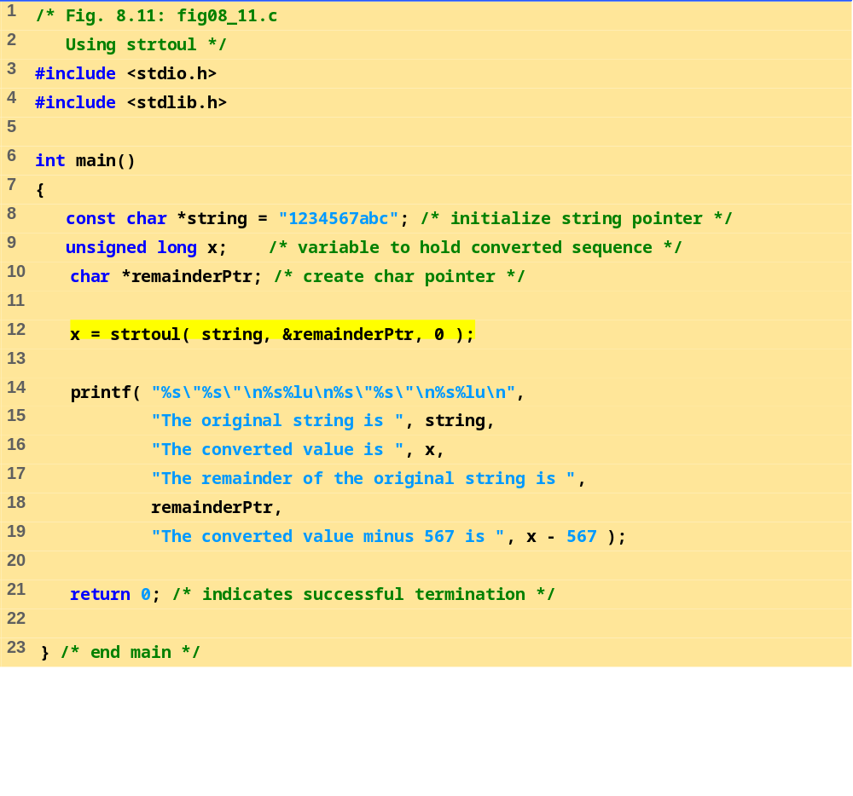
fig08_11.c
Program Output
The original string is "1234567abc"
The converted value is 1234567
The remainder of the original string is "abc"
The converted value minus 567 is 1234000

Slide 23
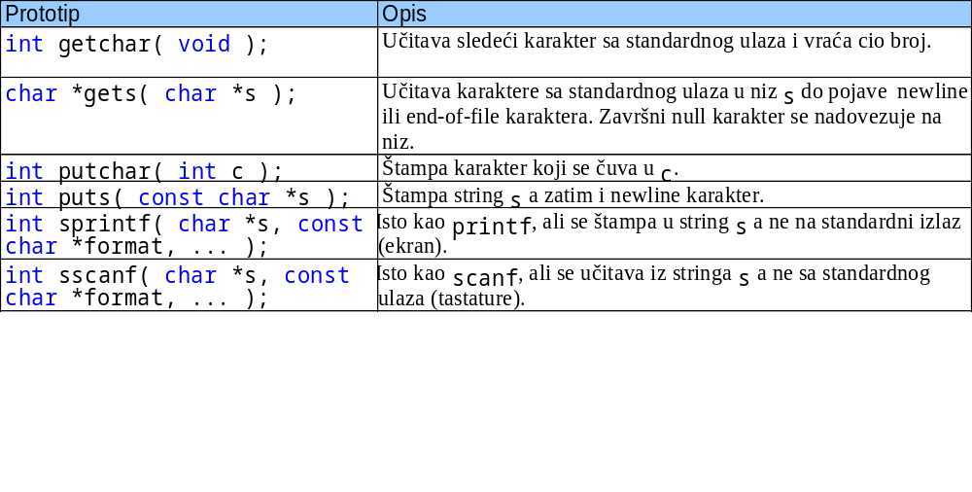
8.5 Standardne ulazno-izlazne funkcije
Funkcije u <stdio.h>
Za manipulisanje karakterima i stringovima

Slide 24
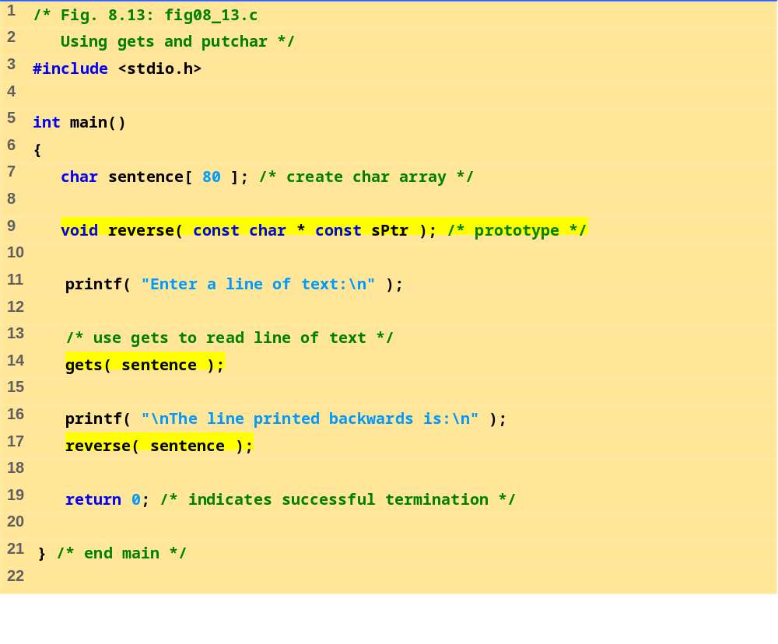
fig08_13.c (Part 1 of 2)

Slide 25
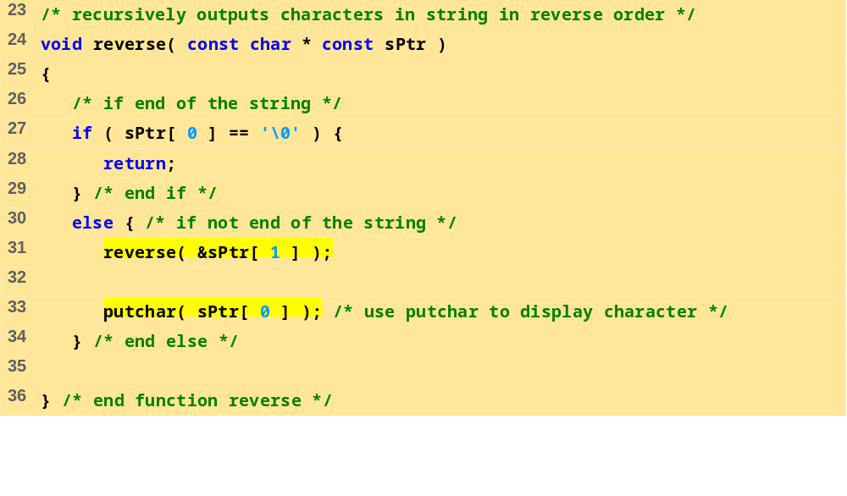
fig08_13.c (Part 1 of 2)
Program Output
Enter a line of text:
Characters and Strings
The line printed backwards is:
sgnirtS dna sretcarahC
Enter a line of text:
able was I ere I saw elba
The line printed backwards is:
able was I ere I saw elba

Slide 26
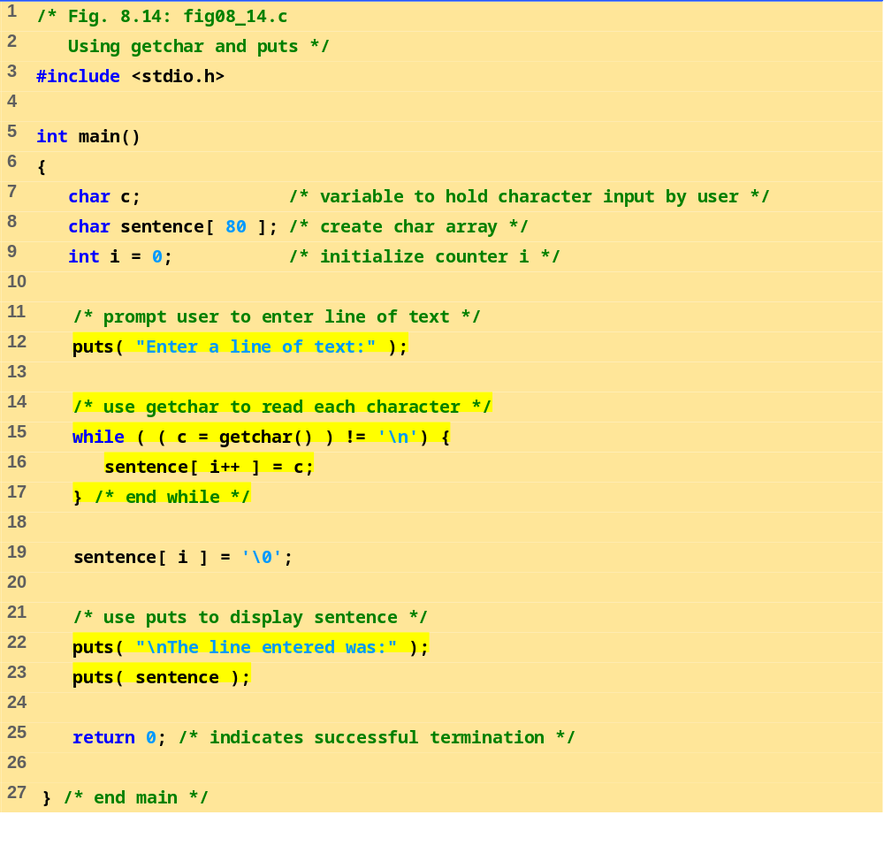
fig8_14.c

Slide 27
Enter a line of text:
This is a test.
The line entered was:
This is a test.
Program Output

Slide 28
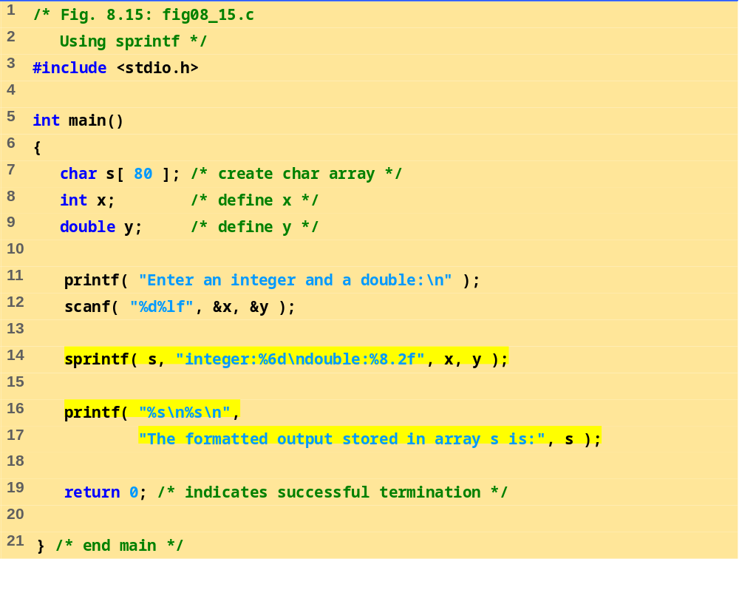
fig08_15.c
Program Output
Enter an integer and a double:
298 87.375
The formatted output stored in array s is:
integer: 298
double: 87.38

Slide 29
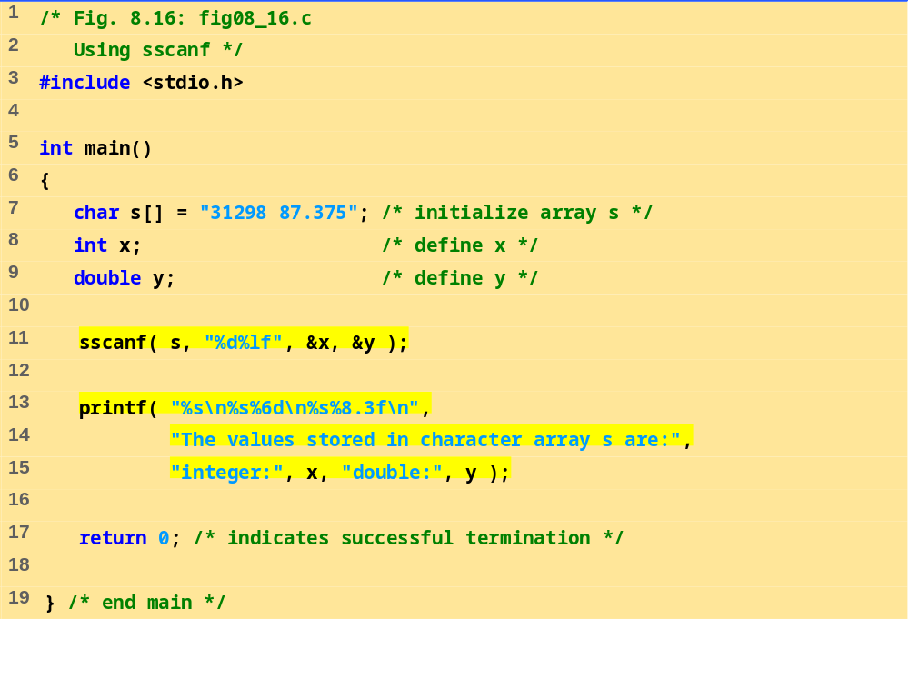
fig08_16.c
Program Output
The values stored in character array s are:
integer: 31298
double: 87.375

Slide 30
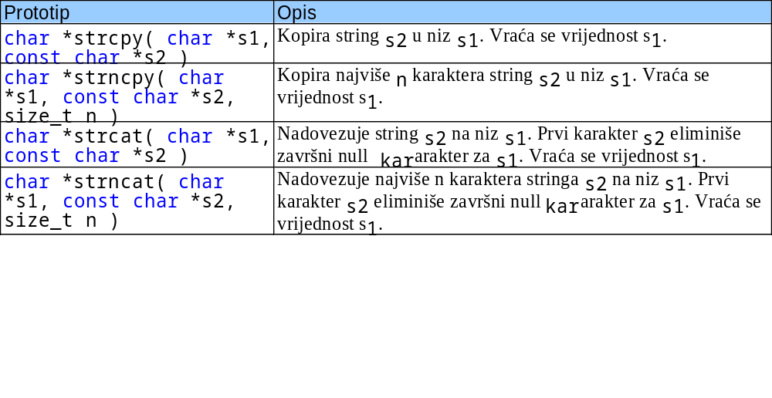
8.6 Manipulacija stringovima
Funkcije biblioteke <string.h> imaju ulogu da
  Manipulišu stringovima
  Pretražuju stringove
  Tokenizuju stringove
  Odrede dužinu stringa

Slide 31
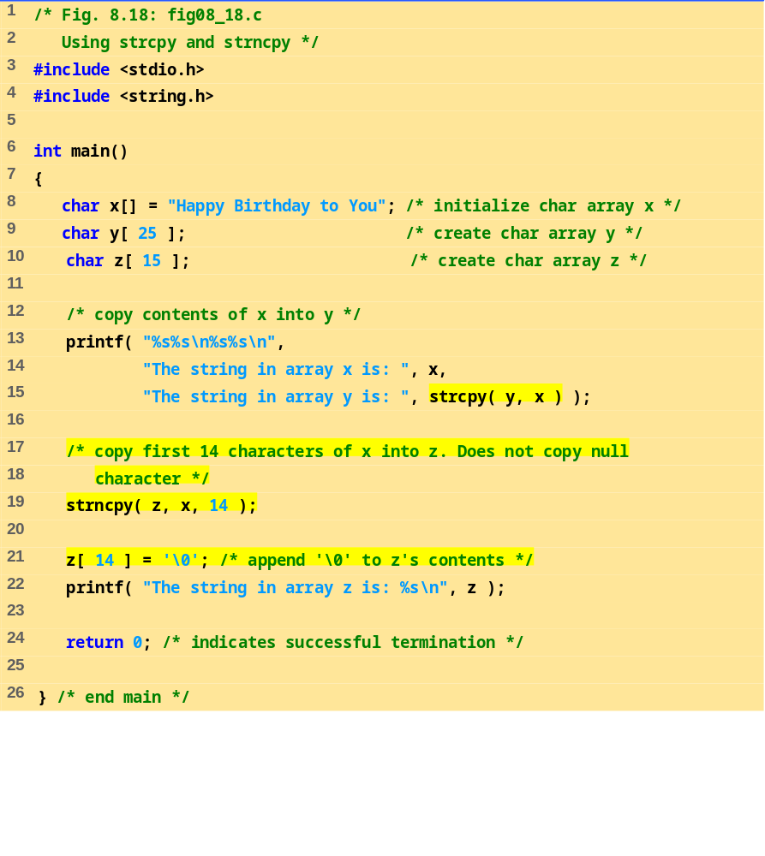
fig08_18.c
Program Output
The string in array x is: Happy Birthday to You
The string in array y is: Happy Birthday to You
The string in array z is: Happy Birthday

Slide 32
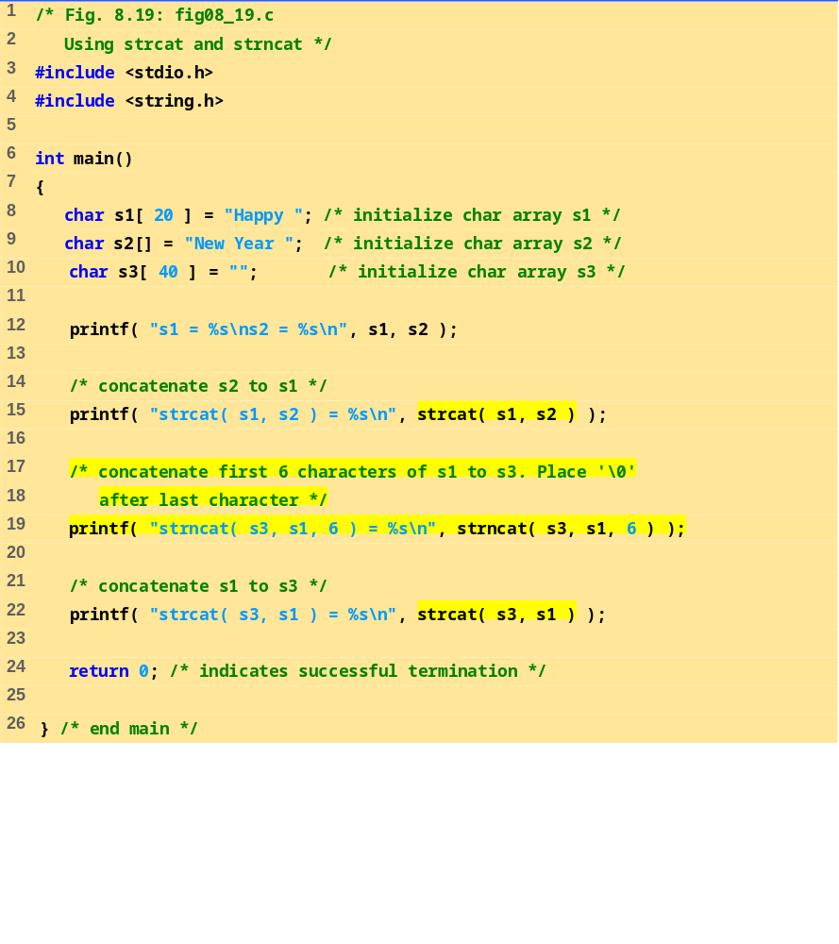
fig08_19.c

Slide 33
s1 = Happy
s2 = New Year
strcat( s1, s2 ) = Happy New Year
strncat( s3, s1, 6 ) = Happy
strcat( s3, s1 ) = Happy Happy New Year
Program Output

Slide 34
8.7 Funkcije za poređenje stringova
Upoređivanje stringova
  Kompjuter upoređuje numeričke ASCII kodove karaktera u stringu
  Pronaći u literaturi listu ASCII kodova
int strcmp( const char *s1, const char *s2 );
  Upoređuje string s1 sa stringom s2
  Vraća negativan broj ako je s1 < s2, nulu ako je s1 == s2 ili pozitivan broj ako je s1 > s2
int strncmp( const char *s1, const char *s2, size_t n );
  Upoređuje najviše n karaktera stringa s1 sa stringom s2
  Vraća iste vrijednosti kao i strcmp

Slide 35
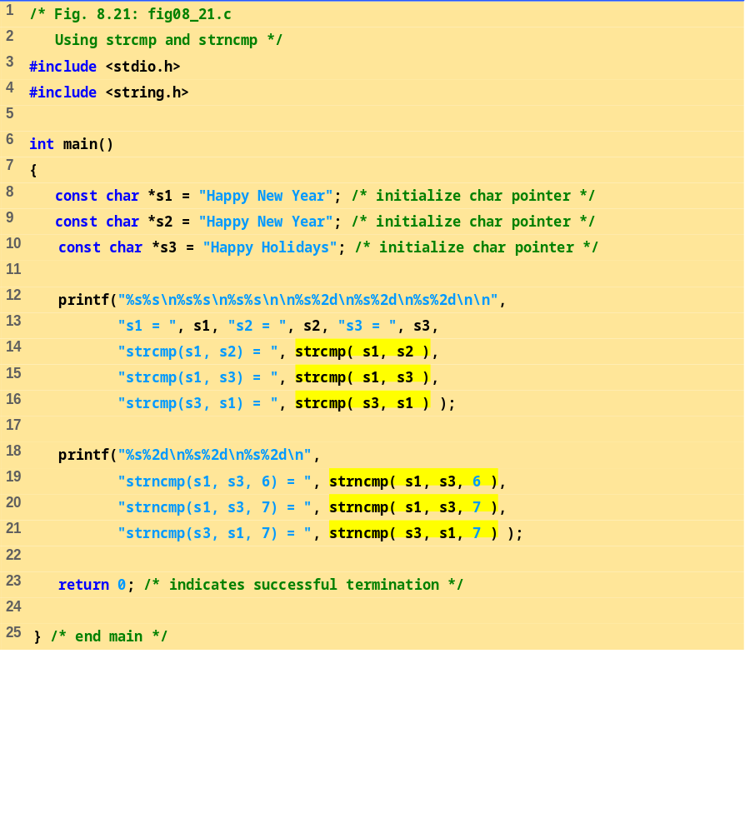
fig08_21.c

Slide 36
s1 = Happy New Year
s2 = Happy New Year
s3 = Happy Holidays
strcmp(s1, s2) = 0
strcmp(s1, s3) = 1
strcmp(s3, s1) = -1
strncmp(s1, s3, 6) = 0
strncmp(s1, s3, 7) = 1
strncmp(s3, s1, 7) = -1
Program Output

Slide 37
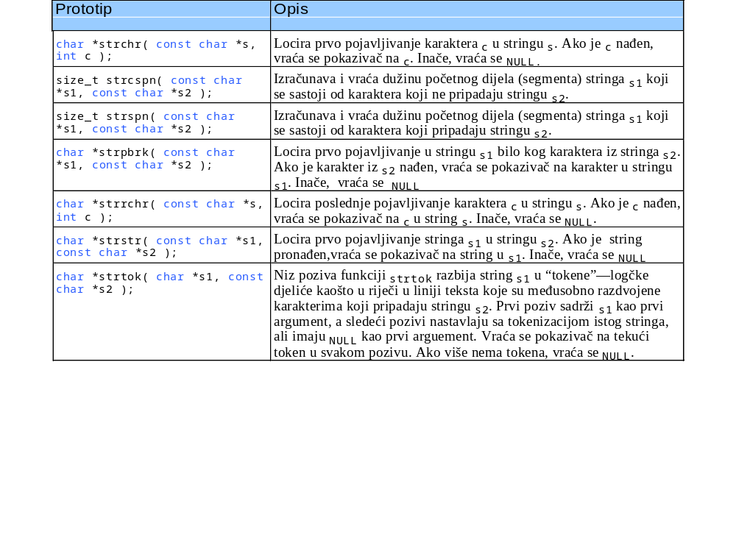
8.8 Funkcije za pretraživanje stringova

Slide 38
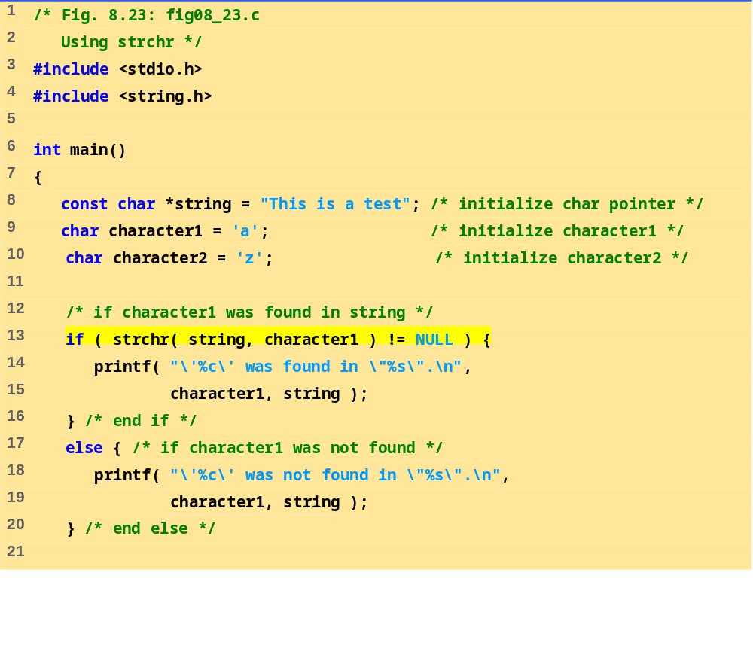
fig08_23.c (Part 1 of 2)

Slide 39
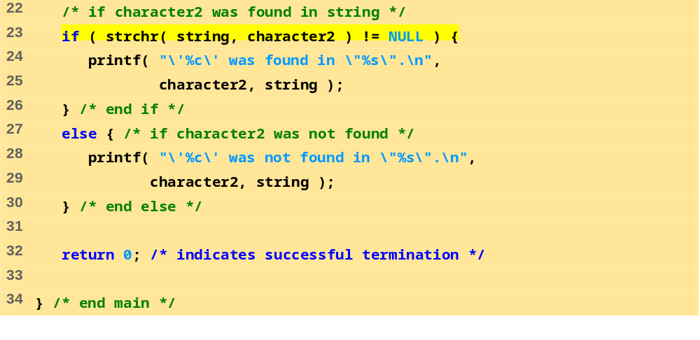
fig08_23.c (Part 2 of 2)
Program Output
'a' was found in "This is a test".
'z' was not found in "This is a test".

Slide 40
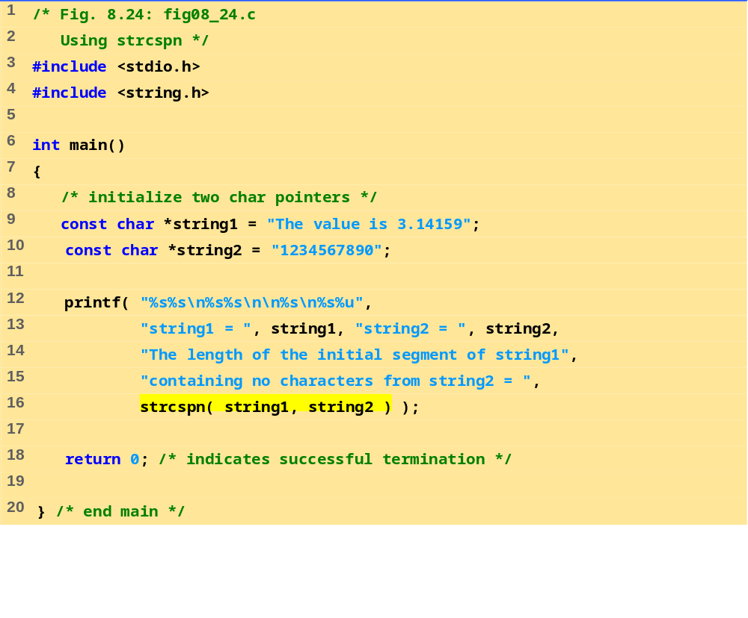
fig08_24.c
Program Output
string1 = The value is 3.14159
string2 = 1234567890
The length of the initial segment of string1
containing no characters from string2 = 13

Slide 41
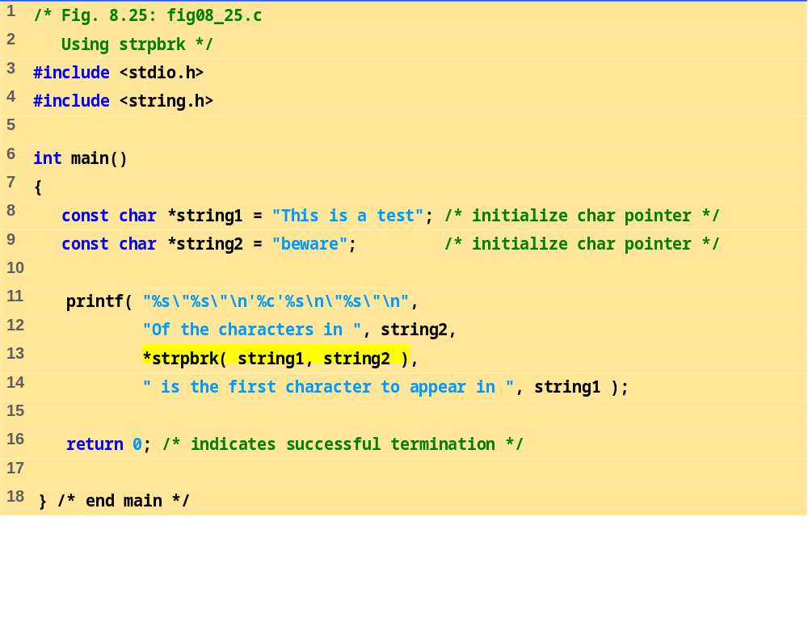
fig08_25.c
Program Output
Of the characters in "beware"
'a' is the first character to appear in
"This is a test"

Slide 42
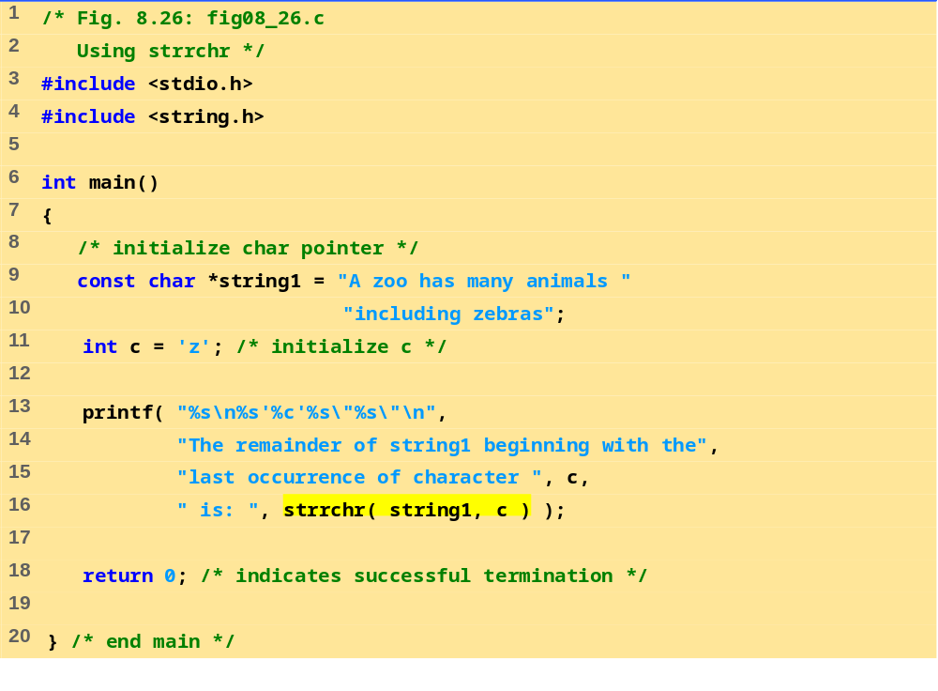
fig08_26.c
Program Output
The remainder of string1 beginning with the
last occurrence of character 'z' is: "zebras"

Slide 43
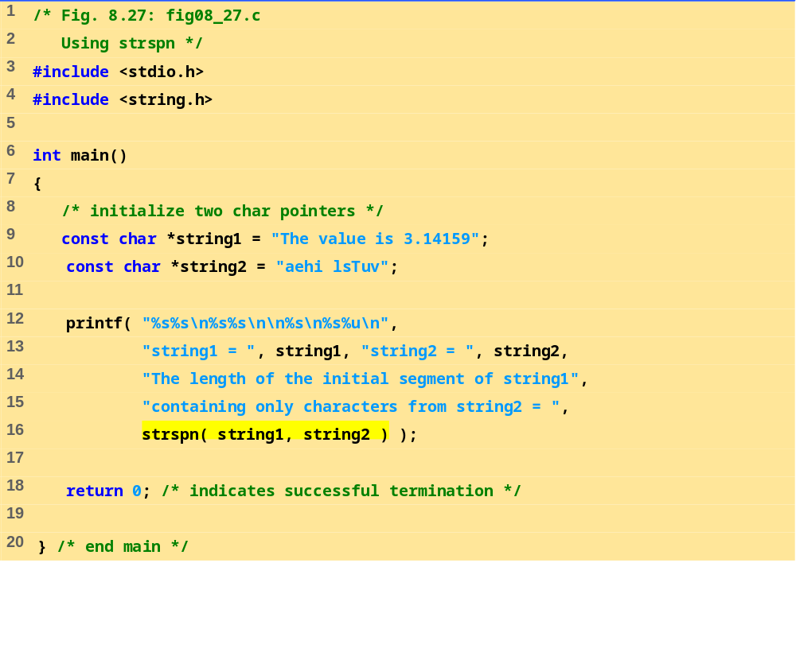
fig08_27.c
Program Output
string1 = The value is 3.14159
string2 = aehi lsTuv
The length of the initial segment of string1
containing only characters from string2 = 13

Slide 44
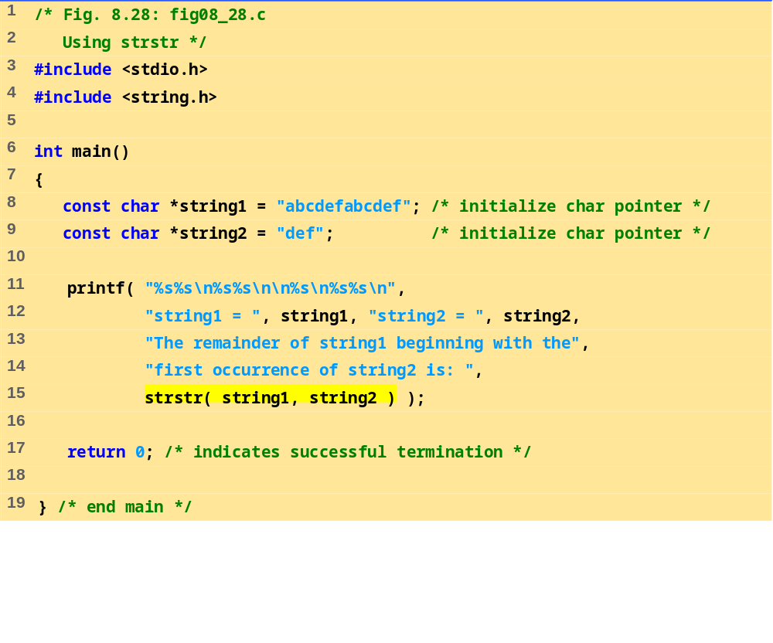
fig08_28.c
Program Output
string1 = abcdefabcdef
string2 = def
The remainder of string1 beginning with the
first occurrence of string2 is: defabcdef

Slide 45
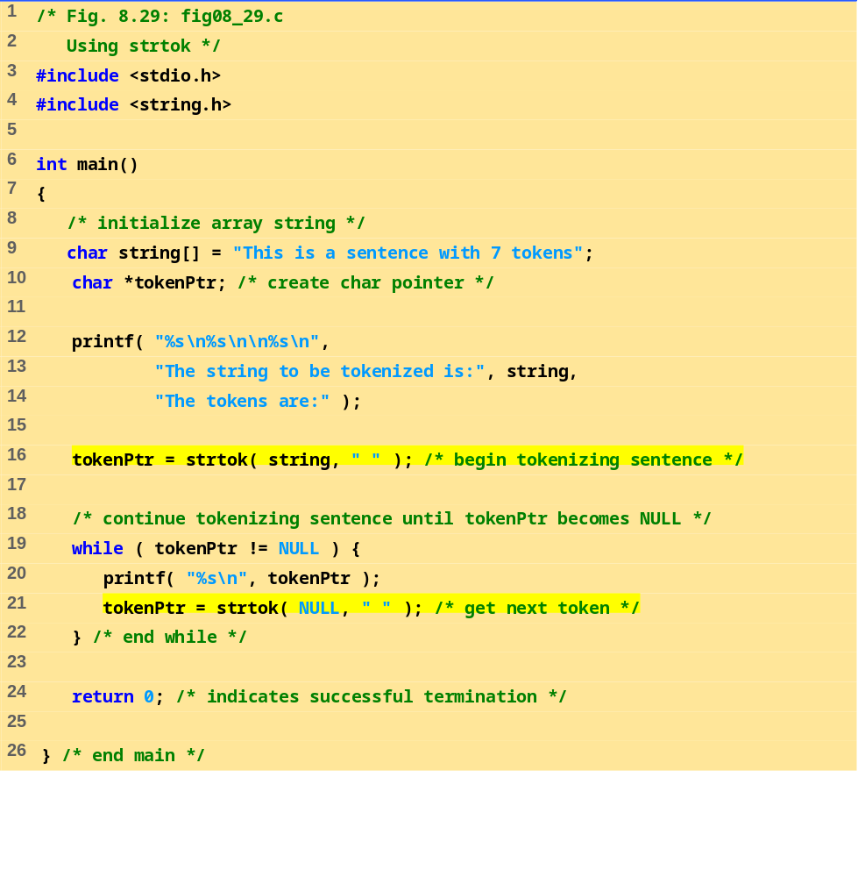
fig08_29.c

Slide 46
The string to be tokenized is:
This is a sentence with 7 tokens
The tokens are:
This
is
a
sentence
with
7
tokens
Program Output

Slide 47
8.9 Memorijske funkcije
Memorijske funkcije
  U biblioteci <stdlib.h>
  Manipulišu, upoređuju i pretražuju blokove memorije
  Mogu manipulisati sa bilo kakvim blokom podatka

Slide 48
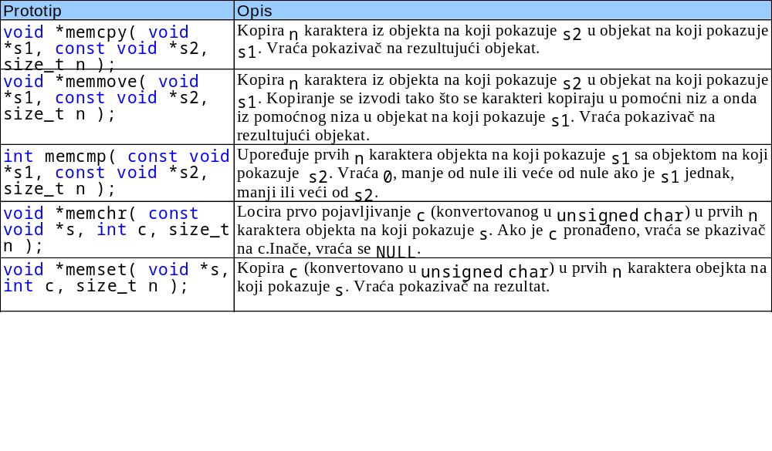
8.9 Memorijske funkcije

Slide 49
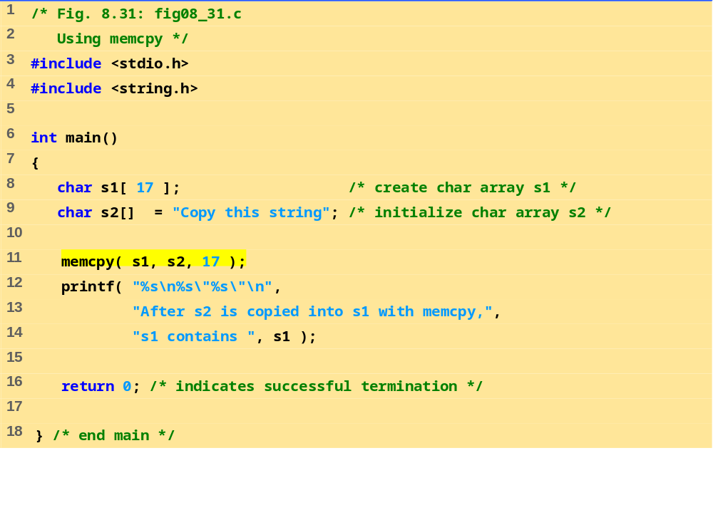
fig08_31.c
Program Output
After s2 is copied into s1 with memcpy,
s1 contains "Copy this string"

Slide 50
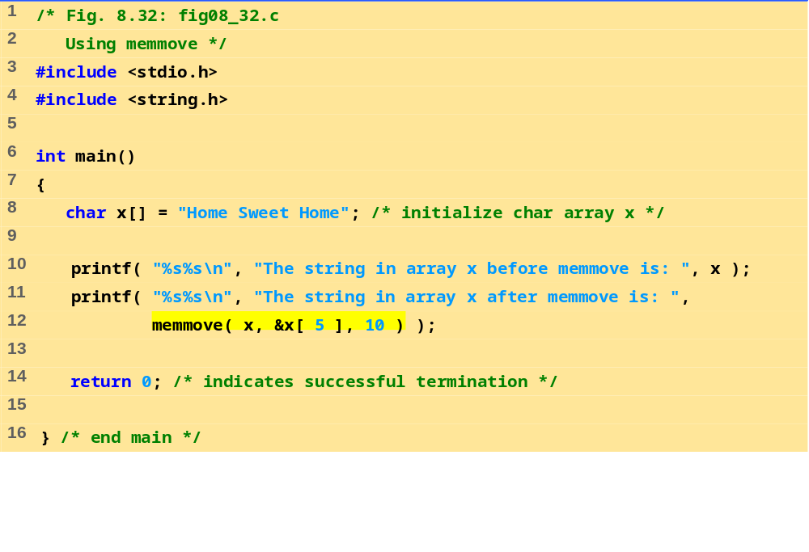
fig08_32.c
Program Output
The string in array x before memmove is: Home Sweet Home
The string in array x after memmove is: Sweet Home Home

Slide 51
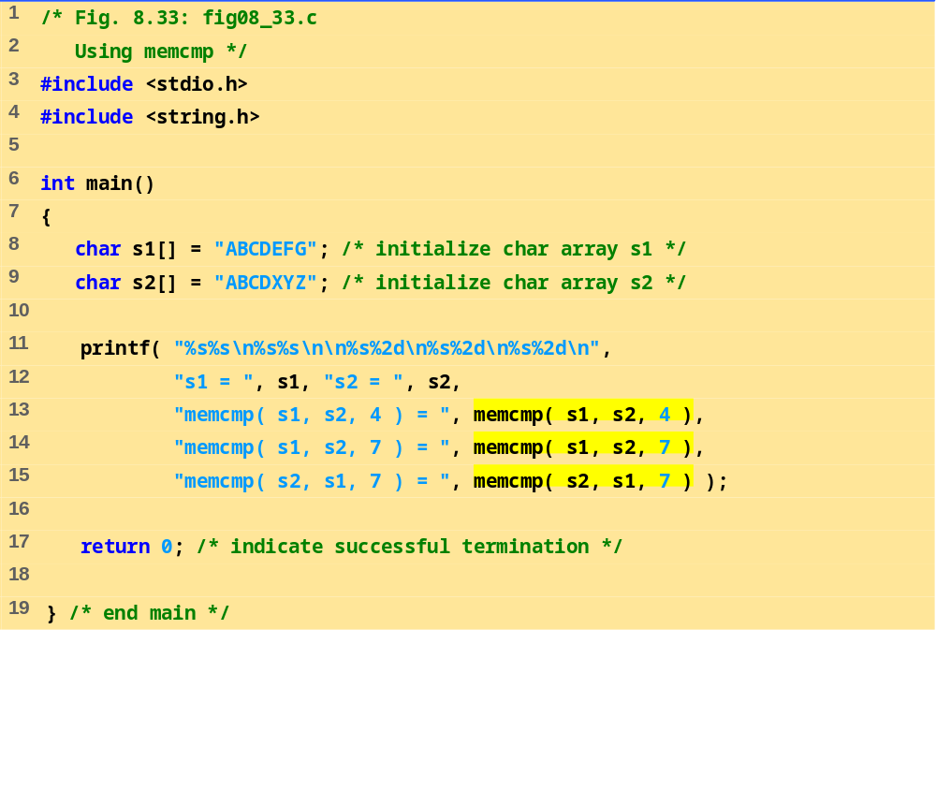
fig08_33.c
Program Output
s1 = ABCDEFG
s2 = ABCDXYZ
memcmp( s1, s2, 4 ) = 0
memcmp( s1, s2, 7 ) = -1
memcmp( s2, s1, 7 ) = 1

Slide 52
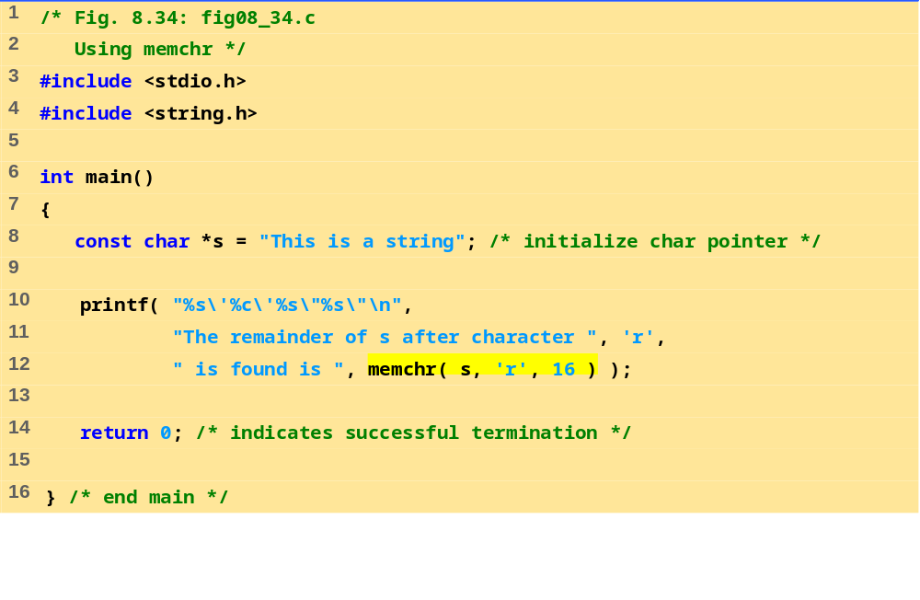
Fig8_34.c
Program Output
The remainder of s after character 'r' is found is "ring“

Slide 53
8.10 Ostale funkcije u biblioteci
char *strerror( int errornum );
  Kreira sistemski-zavisne greške bazirane na errornum
  Vraća pokazivač na string
  Dobijanje tekstualnog opisa greške na osnovu koda greške
size_t strlen( const char *s );
  Vraća broj karaktera (bez NULL) u stringu s

Slide 54
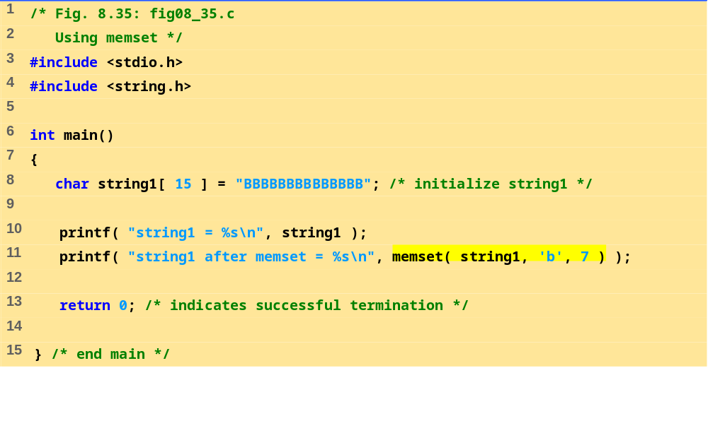
fig08_35.c
Program Output
string1 = BBBBBBBBBBBBBB
string1 after memset = bbbbbbbBBBBBBB

Slide 55
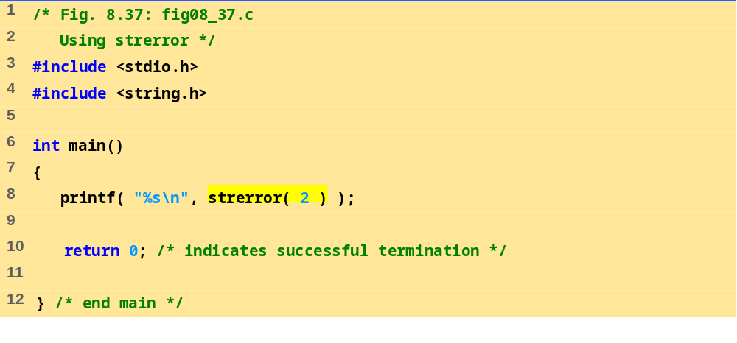
fig08_37.c
Program Output
No such file or directory

Slide 56
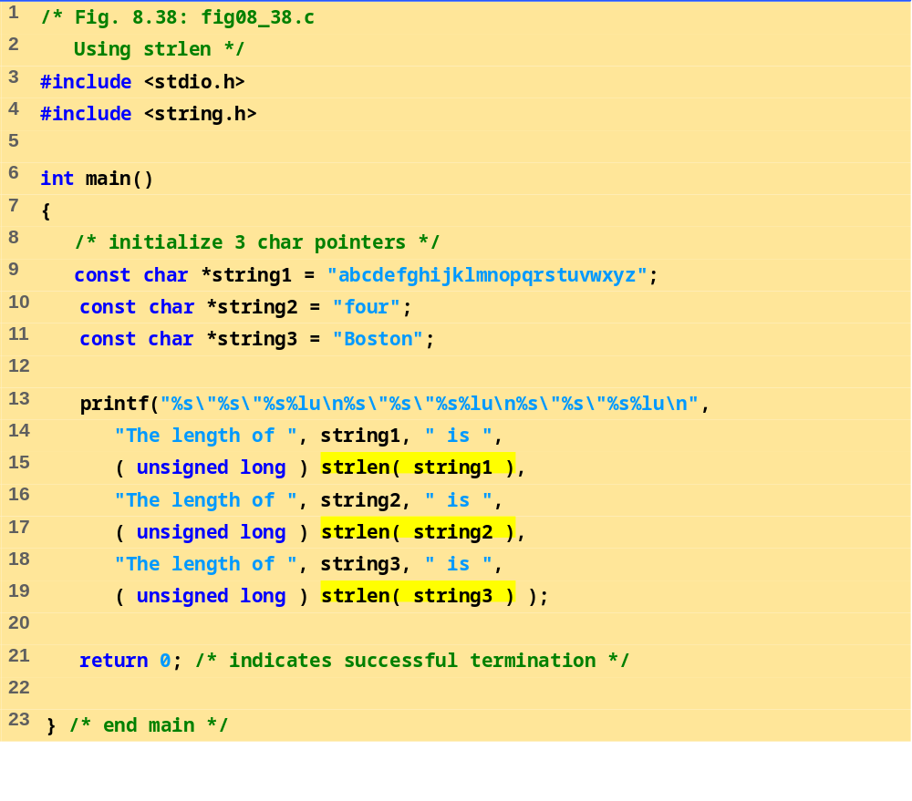
fig08_38.c
Program Output
The length of "abcdefghijklmnopqrstuvwxyz" is 26
The length of "four" is 4
The length of "Boston" is 6

