Slide 1
Indicator of the Month MACD (Moving Average Convergence/Divergence)
04-SEP-2021
Vipin Kumar

Slide 2
What is the MACD?
Oscillator composed of Moving Averages
Provides a mathematical filter to price action
Indicates Momentum
Three parts of a MACD
Fast line
Composed of the difference between two EMA’s
Signal Line (slow line)
An EMA of the Fast line
Histogram
Represents the difference between the Fast line and Signal line

Slide 3
How is the MACD used?
Crossovers
Buy when fast line crosses above signal line
Sell when fast line crosses below signal line
Divergence
Height of histogram moves contrary to price action
Only Trade WITH the Trend!

Slide 4
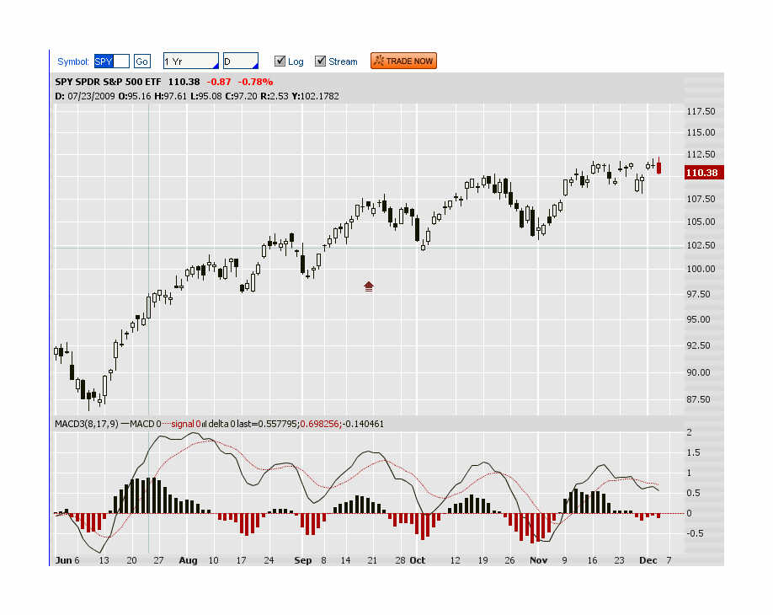
MACD Crossover Example
Slow Line
Fast Line
Histogram

Slide 5
MACD Crossover Example
Sell
Sell
Sell
Sell
Sell
Buy
Buy
Buy
Buy
Buy

Slide 6
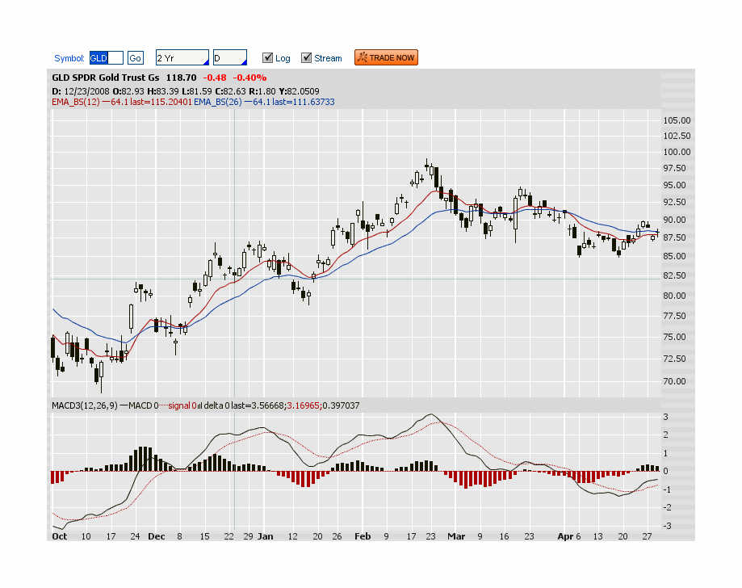
MACD Divergence Example
Increasing Price
Decreasing Histogram Height

Slide 7
MACD Divergence Example
Bearish Movement forecasted
By Divergence

Slide 8
MACD Settings
EMA Calculation
Calculated by applying a percentage of current period closing price to a percentage of the previous period moving average value.
Emphasis is on most recent price action
E = Percent of current closing price
P = Periods used in EMA calculation
E = 2 P = 2 - 1
P + 1 E

Slide 9
MACD Settings
TOS
MACD (12,26,9)
Corresponds to MACD(15%, 7.5%, 20%)
Prophet Charts
MACD(8, 17, 9)
Corresponds to MACD(22%, 11%, 20%)
Fast Line
Signal Line

Slide 10
MACD Pros/Cons
Subject to strengths and weaknesses of any indicator built on Moving Averages
Strengths
Filters the “noise” of price action to indicate momentum
Best in trending markets
Weaknesses
Lots of False signals
Does poorly in sideways/choppy markets
Indicator “lags” price action—opportunities can be missed

Slide 11
How I use the MACD
Use it as a confirming indicator
Primary signals come from
Candles
Volume
Support & Resistance
Trendlines
Pivot Points
Use with other indicators to get “agreement”
Stochastics
RSI
CCI
Bollinger Bands
Get confirmation of momentum with longer timeframe MACD
Improves odds of follow-through

