Slide 1

My weather MVC
By: Joseph LePage

Slide 2
The Solution
First, I created three models to represent the three different endpoints within the API.
Then, I created three views to format the weather data for display.
Next, I adjusted the home controller. I needed three methods to get the desired weather information.
Lastly, I adjusted the base address within the MVC project and the addresses within the home controller so my project would consume the correct API.
In addition to completing the application’s functionality. I was also able to add some CSS and even a picture to the site.

Slide 3
Challenges
Connecting the MVC to the API.
I had trouble figuring out what the base address should be
I also struggled with the addresses within the methods I added in the home controller
With help from the internet, the professor, and fellow students in the form of a zoom call. We were able to nail down what those addresses should look like.
Adding CSS to the MVC
It seemed anything I tried to change would not change anything. (it was a chrome problem).
Adding a them to the project.
I also added an image which proved to be tricky.
The solution to my image problem was to create a folder within the wwwroot file called images and save it there.

Slide 4

Victories
Getting the MVC project connected to the API.
When the endpoints all functioned properly.
Adding some CSS.
Adding a picture.

Slide 5
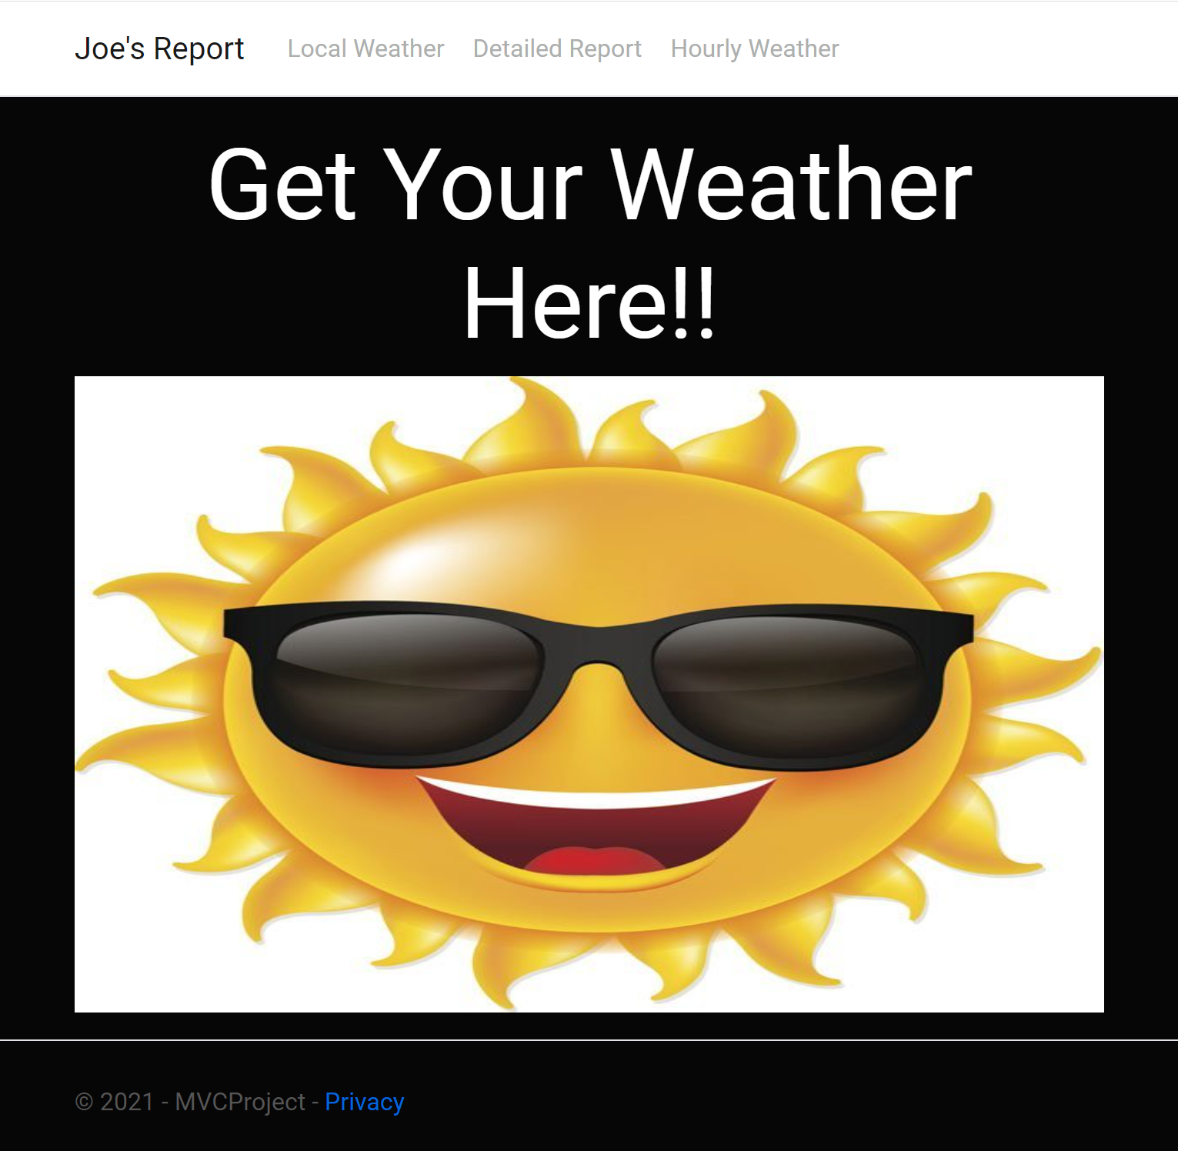
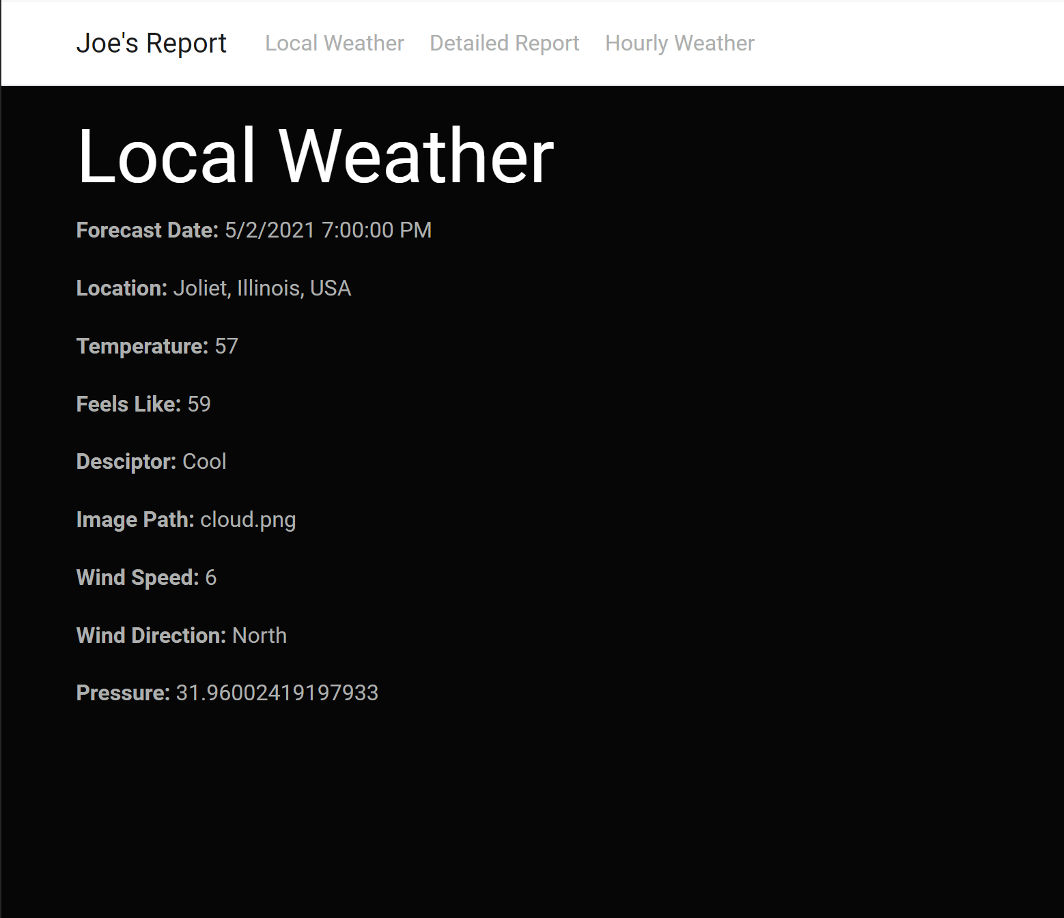

Slide 6
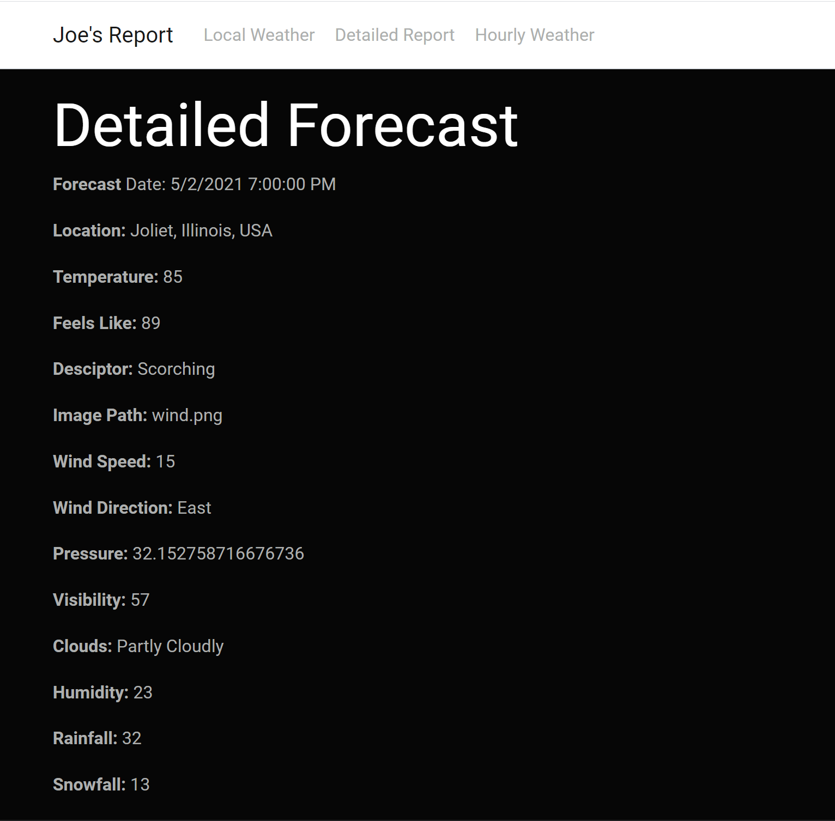
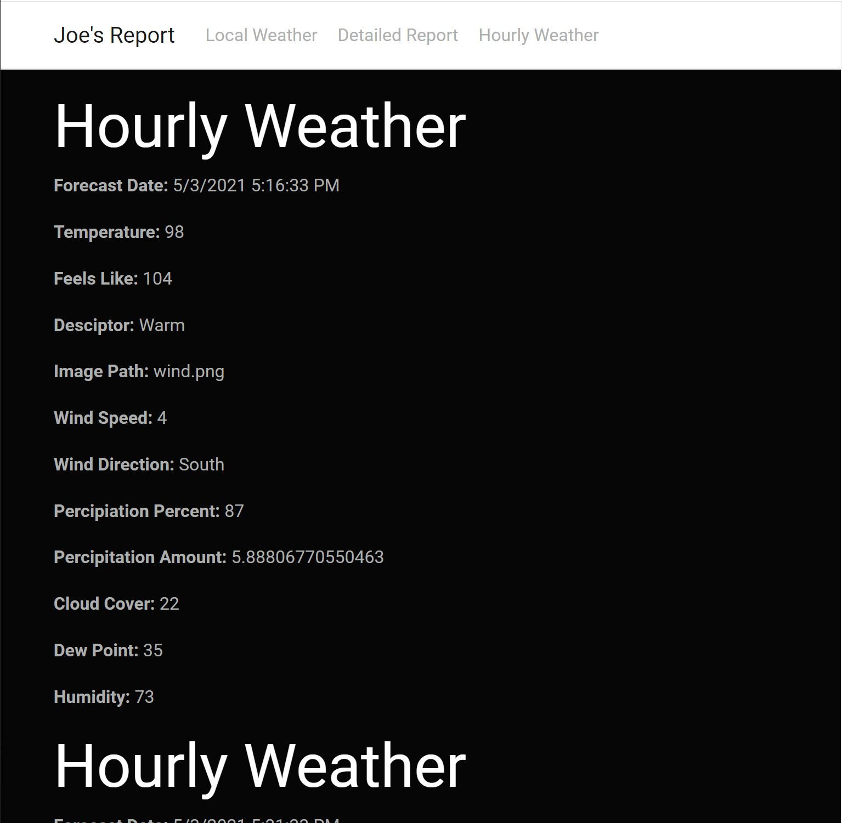

Slide 7
Thoughts on the Class
Evolution:
I thought the class started in the same format as many of the other coding classes at St. Francis do. I was already familiar with most of the material at the beginning of the class.
It started to become challenging when we began to discuss .net programming with APIs and MVCs.
I thought the most challenging part of the course was the final project.
Compared to other languages I’ve learned at USF
I thought the coolest part of this class was learning to code something other than a console application.
I also feel that since this class was a hybrid, I gained skills working and collaborating remotely.

Slide 8
Thank you

