Slide 1

Teradata 2019 Data Challenge
Yousef Alobaid
Abdulaziz Alfallaj
Majed Almarri

Slide 2
Overview
This project is a quest to answer one of the business questions Hire Heroes USA has provided to support their business processes in making crucial conclusions and recommendations about their business operations. Our main mission as a team includes a variety of challenges and tasks to be tackled in order for Hire Heroes USA to meet their business expectations and goals. This mainly includes cautiously analyzing the sets of data given to draw unquestionable conclusions.

Slide 3
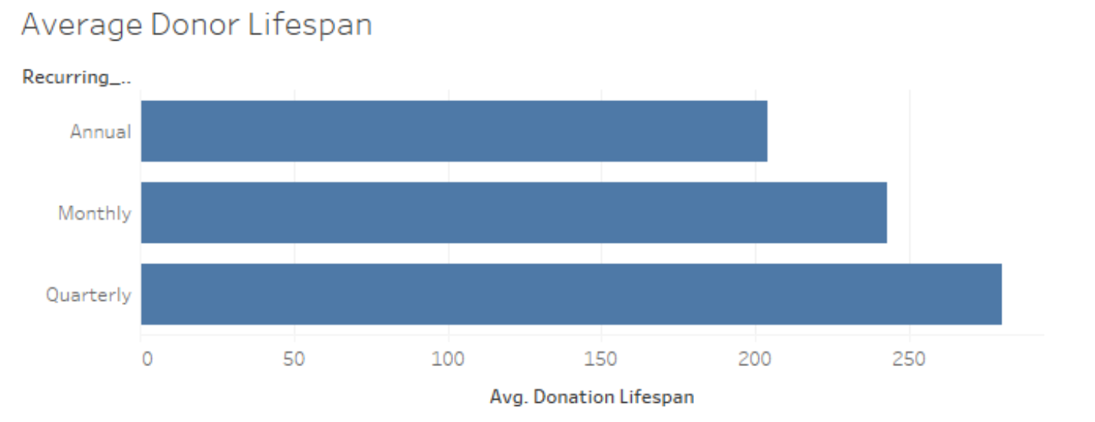
Do we have an average lifespan of a monthly donor?

Slide 4
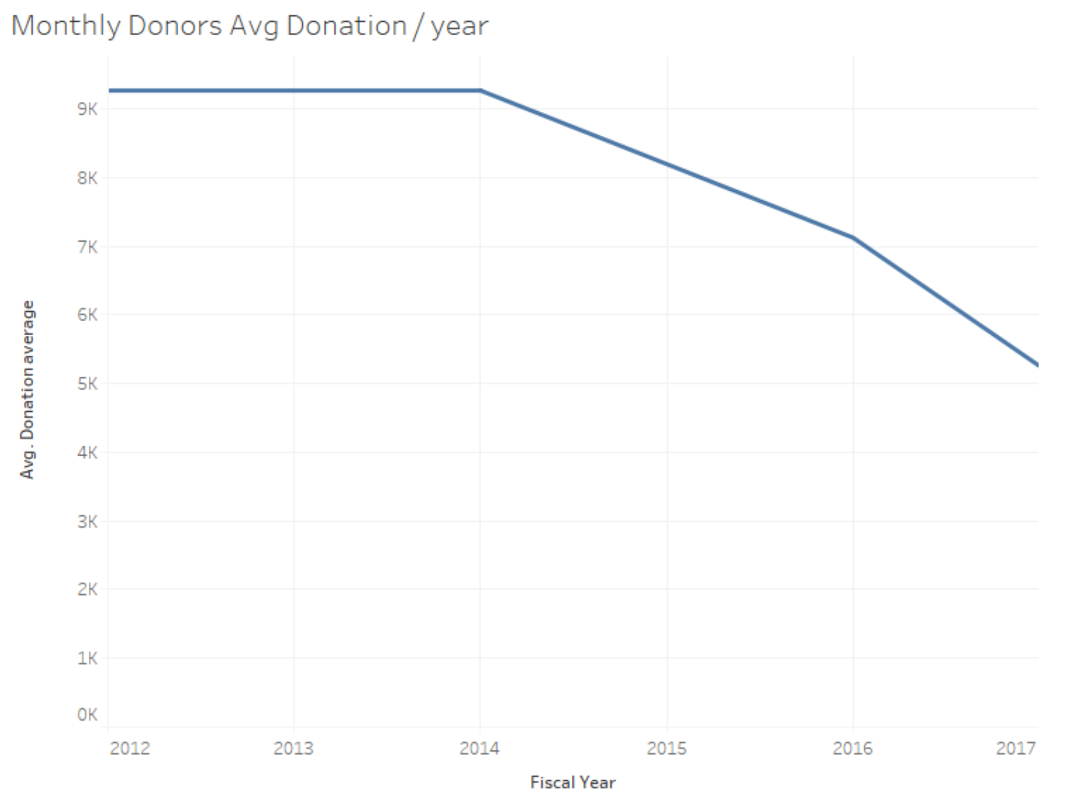
Do our monthly donors give for a year and then lapse, or do they give over the course of a few years?

Slide 5
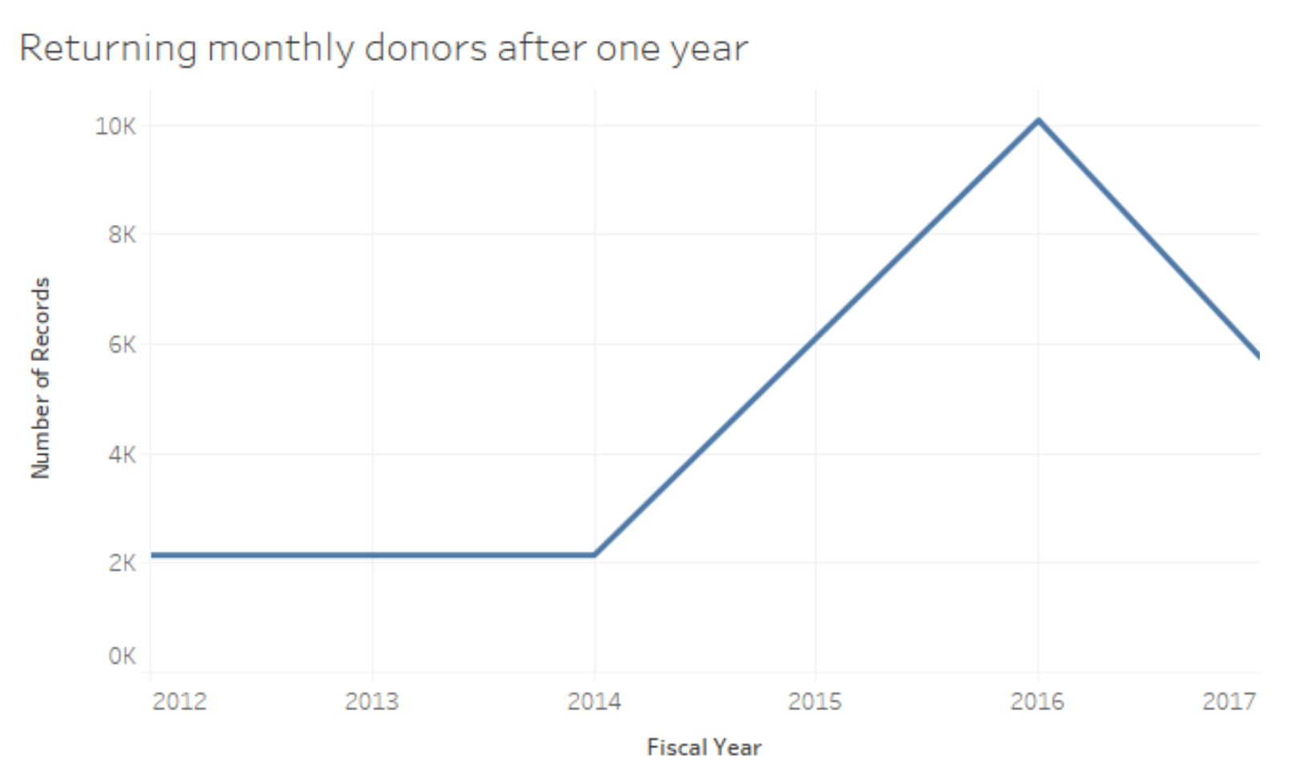
Do our monthly donors who give more than one year increase their gift amount year over year?

