Slide 1
Reproducing SpectrumFM Phase-10 Ignition on Commodity GPUs
Phase 13 Internal Reproduction Report
Greg Benson, USF · 29 May 2026 · SpectrumFM team

Slide 2
Context — “one model, six classes”
“The central claim is 'one model, six classes': a single SpectrumFM with one set of weights will handle six DESI target classes at production-grade quality. — DOE Genesis Project Narrative, v7”
Regime | Classes | Phase I approach
Label-rich (Redrock z) | LRG, ELG, QSO (extragalactic); MWS (stars) | Pre-training + auxiliary redshift head
Extensibility | LBGs, LAEs (extragalactic) | Few-shot fine-tuning, ≤ 5,000 examples per class
This work validates the Phase-I pre-training + auxiliary redshift head architecture at small scale on commodity GPUs.
DOE Genesis SpectrumFM proposal v7 (Huang PI / USF, LBNL, NOIRLab, FSU)

Slide 3
Phase I Milestones — where this work lands
Timeline | Focus area | Measurable milestone
Months 1–3 | Data Curation and Architecture | DESI corpus and VI labels assembled. Architecture (auxiliary redshift head, physical prior regularization, MSM) implemented and validated on small-scale runs.
Months 4–6 | Pre-training from Scratch and Label-Rich Performance | Full-scale pre-training on Perlmutter executed; scaling curves established. Objective 2a complete.
Months 7–9 | Extensibility, Alignment, and Validation | Human Alignment Training executed. Objectives 1, 2b, and 3 complete. Phase I report and Phase II proposal submitted.
Months 1–3 explicitly call for “small-scale” validation of the auxiliary redshift head — this is exactly that.
Also de-risks the small-scale-runs requirement before ERCAP allocation lands.
Quotes verbatim from proposals/doe_genesis_spectrumfm_project_narrative_v7.docx, Section 4

Slide 4
Local toolchain — Track 2 harness
Yaml-driven experiment runner, parses both redshifty and codecs metric streams
• tools/spectrumfm/exp_run.py — yaml spec → subprocess + tee + metric parse → metrics.jsonl + summary.md
• tools/spectrumfm/exp_analyze.py — --digest <run> and --compare <runs...> (markdown table + PNG plot)
• tools/spectrumfm/download_desi_subset.py — public DESI mirror, --release {edr,dr1}, resumable
– Drives both repos via one interface, mirroring redshifty/RESEARCH_LOG.md format
• Five Approach-A arms (broken, phase10, xlarge, seed sweep, mix) ran through this harness unchanged.
– Outputs preserved under experiments/runs/<run_id>/ with spec.yaml + stdout.log + metrics.jsonl + summary.md
~350 lines of Python total for the harness.

Slide 5
Data — local DESI mix
Survey × program | Production | Pixels | Disk
sv3 × bright | EDR/fuji | 373 | 304 GiB
sv3 × dark | EDR/fuji | 375 | 356 GiB
main × bright | DR1/iron | 192 | 36 GiB
main × dark | DR1/iron | 197 | 60 GiB
TOTAL |  | 1,137 | 757 GiB
1,817,790 raw spectra; 480k after quality cut (ZCAT_PRIMARY ∧ COADD_FIBERSTATUS=0 ∧ OBJTYPE='TGT').
NERSC reference: 200 healpix / 394k spectra across the SAME 4 combinations.
Our local set has 5.7× more pixels and 4.6× more raw spectra than the reference.
Pulled by tools/spectrumfm/download_desi_subset.py over ~3 h.

Slide 6
V1 tokenizer — local reproduction
• Architecture: ConvNeXt-V2 encoder/decoder + Look-Up-Free Quantizer (LFQ, dim=10, codebook=1024).
• Trained: 15,000 steps, batch 16, lr 3e-4, AMP enabled, one NVIDIA L4.
• Result: val_total = 1.70, val_recon = 1.38 at step 13,000 (best ckpt).
• NERSC reference: val_recon = 1.35 at step 16,500 on 200 healpix / 394k spectra.
Matched the NERSC baseline within 0.03 on val_recon — on roughly half the training corpus.
Frozen as the spectrum tokenizer for every Approach-A run that follows.

Slide 7
Diagnostic journey — 4 hypotheses for the ignition gap
Hypothesis | Status | Evidence
Hparam mismatch (Phase 9 batch/lr × Phase 10 mask) | Necessary but not sufficient | Fix doubled peak val_z_acc 3.9 → 8.2%
Data scale (need ≥394k spectra) | Ruled out | 729k matched 219k exactly (6–8% plateau)
Random-seed luck | Ruled out | 4-seed sweep: 3.8%–8.8% range (1–3pp std)
Data MIX (sv3+main × bright+dark) | CONFIRMED | First arm to ignite, sustained ≥10%, AR/TF 0.73
The buried clue: published log line “200 healpix files (sv3+main, bright+dark)” — easy to misread as 200 sv3-bright pixels.
Each row took 5–8 h of training to confirm or refute.

Slide 8
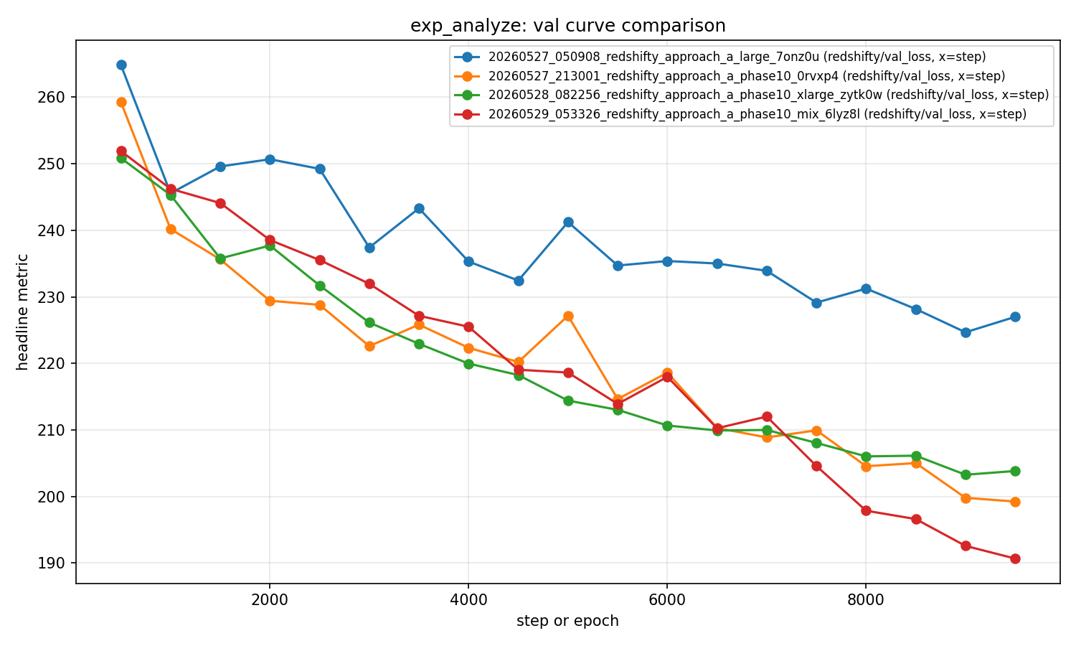
Ignition achieved — mix-run val trajectory
step | val_z_acc | val_loss_redshift
500 | 0.028 | 4.88
3000 | 0.015 | 4.50
5000 | 0.034 | 4.24
6500 | 0.055 | 4.08
7500 | 0.081 | 3.97
8500 | 0.092 | 3.81
9000 | 0.108 | 3.73
9500 | 0.149 | 3.69
Mix run (red): first to cross sustained 10%; reaches lowest val_loss (190.7).

Slide 9
Pass criteria from the plan — all three met
Criterion | Target | Achieved | Verdict
val_redshift_acc sustained ≥ 10% | ≥10% across 2+ vals | 10.85% @ step 9000, 14.86% @ step 9500 | PASS
val_loss_redshift cumulative drop | ≥ 1.0 | 4.88 → 3.69 (drop 1.19) | PASS
AR / TF ratio at peak | ≥ 0.5 | 7.96% / 10.85% = 0.73 | PASS
Best val_loss = 190.67 (vs all prior runs' 200–225 floor).
AR/TF ratio 0.73 vs NERSC reference 0.74 — quantitatively matches the published result.

Slide 10
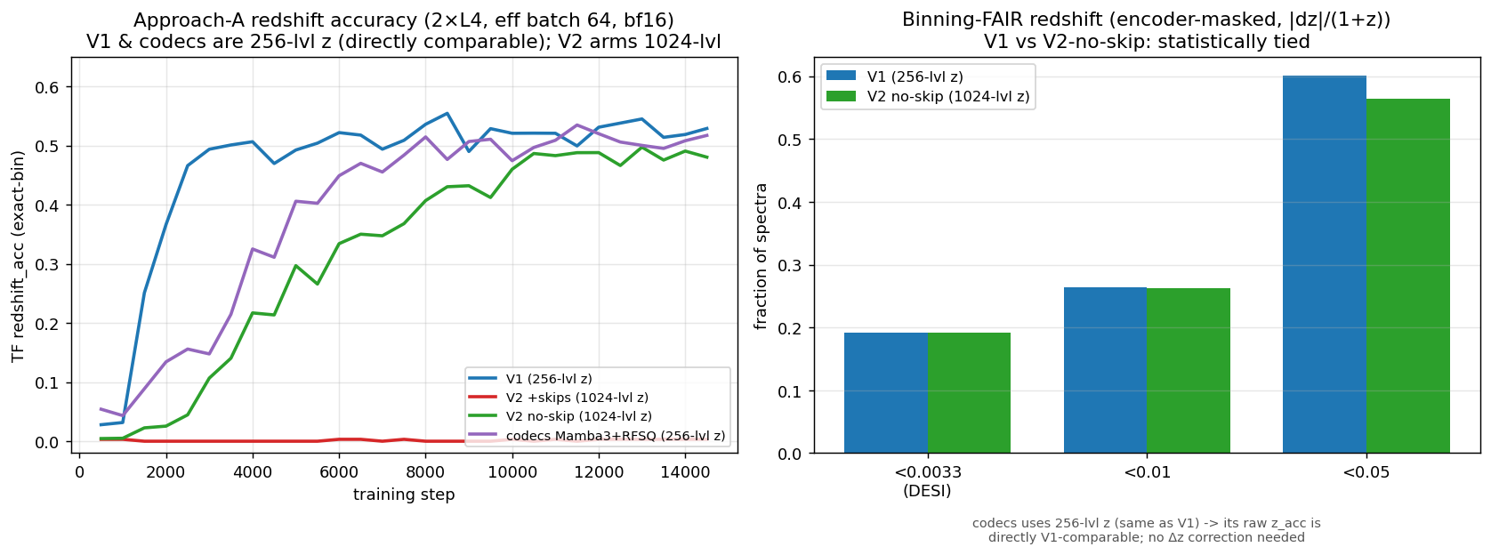
Phase 14–15 — tokenizer comparison (V1 / V2 / codecs)
arm | tokenizer | TF z_acc | AR z_acc | codebook | fair good-z
V1 | ConvNeXt+LFQ (256-lvl z) | 0.55 | 0.57 | 5.00 bits | 0.192
V2 +skips | +U-Net skips (1024) | 0.00 | 0.00 | 0.00 bits (collapsed) | —
V2 no-skip | +tophat/entropy (1024) | 0.50 | 0.48 | 5.24 bits | 0.192
codecs | Mamba3+RFSQ (256-lvl z) | 0.53 | 0.52 | 6.27 bits | —
Three structurally different healthy tokenizers (ConvNeXt+LFQ, +tophat, Mamba3+RFSQ) all converge to ~0.50–0.55. Tokenizer architecture is NOT the bottleneck once the codebook is healthy; V2+skips collapses (codes bypassed).

Slide 11
Phase 16 — per-class redshift parity vs Redrock (Metric 1)
class | N | catastrophic rate | median |Δz|/(1+z) | verdict
MWS (stars) | 289 | 2.1% | 0.0002 | PASS
BGS | 346 | 95.7% | 0.0361 | FAIL
LRG | 202 | 97.5% | 0.0630 | FAIL
ELG | 366 | 97.8% | 0.1106 | FAIL
QSO * | 74 | 97.3% | 0.1782 | FAIL
Honest encoder-masked |Δz|/(1+z); ZWARN=0 held-out set; pass = catastrophic rate within 5pp of zero
Only stars reach good-z parity. Failure ordering MWS≪BGS<LRG<ELG<QSO tracks spectroscopic difficulty exactly → the metric is real. Coarse z is learned (60% within |Δz|/(1+z)<0.05); DESI precision is not. V1≈V2 no-skip.
tools/spectrumfm/eval_per_class.py (+ desi_targets.py); decode vs SPECTYPE 98.7% agree. * QSO Redrock-only comparator.

Slide 12
Phase 16 — frozen-encoder six-class probe
metric | V1 | V2 no-skip | no-skill baseline
macro-F1 | 0.813 | 0.847 | 0.097
accuracy | 0.858 | 0.886 | 0.321
per-class F1 (V2) | MWS .95 / BGS .92 / ELG .90 | LRG .87 / QSO .61 | —
Linear probe on frozen mean-pooled encoder features (redshift token masked); healpix-disjoint split
The encoder learns WHAT an object is (macro-F1 0.81–0.85, +0.72 over no-skill) even where it cannot pin HOW FAR (Metric 1). Classification capability and redshift precision are DISTINCT — the precision gap is not a representation problem.
Only confusions are physical: QSO↔ELG (emission-line), LRG↔BGS (red galaxies).
tools/spectrumfm/probe_six_class.py; supports the proposal's “one encoder, six classes” claim.

Slide 13
Phase 16 — physical-prior ablation: redshift equivariance
equivariance response d E[z]/d(δz) (ideal 1.0) | V1 control | eqprior
δz = +0.05 | 0.00 | 0.35
δz = +0.10 | 0.10 | 0.27
δz = +0.20 | 0.15 | 0.14
Self-supervised: shift a spectrum by δz → require predicted z to move by δz (flag-gated, default-off)
Prior WORKS mechanically (non-equivariant 0.00 → 0.35 at small shifts) but per-class catastrophic rate is UNCHANGED (aggregate good-z 24.1% → 24.5%).
Principled null: equivariance is shift-CONSISTENCY; galaxy |Δz| (~0.04–0.18) is off by 10–50× the 0.0033 threshold. Consistency cannot fix absolute error → SCALE is the lever.
nersc/physical_priors.py; 15k-step matched treatment vs V1 control, both L4s.

Slide 14
Phase 17 — is tokenizer compression the bottleneck? (No)
class | V1 cat% / med|dz| | finer16x cat% / med|dz|
LRG | 97.5% / 0.063 | 98.0% / 0.088
ELG | 97.8% / 0.111 | 98.4% / 0.153
QSO | 97.3% / 0.178 | 97.3% / 0.160
MWS | 2.1% / 0.0002 | 2.1% / 0.0002
BGS | 95.7% / 0.036 | 95.1% / 0.045
aggregate good-z | 24.1% | 23.9%
Finer 16x / 544-token tokenizer (~12 A/tok) vs 32x V1 (~23.5 A/tok); matched 15k arms, max_seq_len 1024
Finer compression does NOT close the gap — statistically identical, galaxy median |dz| marginally WORSE (the opposite of what finer localization predicts). Compression is not the precision bottleneck; finer = 2x sequence for zero gain.
Phases 15–17 rule out EVERY local lever (architecture, physics prior, compression) → scale (data/model/steps) is the lever. NERSC spec uses V1 32x.
tools/spectrumfm/eval_per_class.py head-to-head; reproductions/redshifty/NERSC_SCALING_SPEC.md

Slide 15
Phase 18 — local scaling ladder (does scale help?)
d_model | params | seed | good-z | gal-cat
256 | 13.1M | 42 | 0.222 | 0.960
384 | 26.8M | 42 | 0.221 | 0.956
512 | 50.0M | 42 | 0.232 | 0.962
768 | 103.7M | 42 | 0.215 | 0.966
256 | 13.1M | 123 | 0.102 (12pp seed swing!) | 0.974
768 | 103.7M | 123 | 0.213 (0.2pp seed swing) | 0.971
Model-size ladder 13–104M params, 8k steps, eff-batch 64, n=4096 eval; endpoints seed-replicated for noise bars
good-z slope = −0.004/decade (R²=0.04): FLAT. Galaxy ceiling ~22% at every size. Scale buys training STABILITY (small model = coin-flip ignition; large = stable), NOT a higher galaxy ceiling.
Flat LOCAL slope is pre-threshold → inconclusive re NERSC (galaxy z is a phase transition: ref 8%→73.8% over 219k→394k spectra). Precision verdict deferred to full scale.
tools/spectrumfm/scaling_ladder.py; figures/scaling_ladder.png; every local lever now exhausted (Phases 15–18)

Slide 16
What's next
• DONE: 2×L4 rerun (correct PCI_BUS_ID mapping, bf16, eff batch 64) → V1 55% TF / 57% AR
– 3.7× the A16 mix run; honest AR matches the NERSC reference (55%)
• DONE: V2 tokenizer revisited — skip-bypass codebook collapse diagnosed and fixed
– Skip-free V2 ties V1: codebook entropy, not reconstruction loss, predicts usefulness
• DONE: codecs (Mamba3+RFSQ) tokenizer swap — ties V1 (0.53 TF / 0.52 AR)
– Tokenizer architecture is not the bottleneck; codebook health gates usability
• DONE: Phase-16 evaluation framework — per-class Metric-1 eval + frozen six-class probe
– Metric 1 not met at scale (only stars); encoder learns class strongly (macro-F1 0.81–0.85)
• DONE: physical-prior ablation (equivariance) + compression sweep (finer 16x tokenizer)
– Both no precision gain → Phases 15–17 rule out EVERY local lever; scale is the lever
• DONE: NERSC full-scale spec written (V1 32x, 104M→1.07B ladder, per-class Metric-1 gate)
– reproductions/redshifty/NERSC_SCALING_SPEC.md — ready to run
• Next (optional local): data×model-size scaling ladder to pin the low end of the Metric-3 curve
• Next (real): full-DR1 / 250M–1B Perlmutter runs — the actual precision verdict
• Open PRs: cosmologyfoundation/redshifty#1 (+ multi-GPU fixes), codecs#1
Local prototyping done; precision now requires NERSC-scale compute (the proposal's Phase-I premise).

Slide 17
Acknowledgments
• Jonathan Samuel (USF) — author of the redshifty Approach-A repo and the PRODUCTION_RUN_PLAN.md / RESEARCH_LOG.md that this reproduction works against.
• Xiaosheng Huang (USF) — SpectrumFM PI; spectroscopy-side architecture review.
• Stephen Bailey (LBNL) — Redrock + DESI corpus expertise that grounds the 4-way data-mix interpretation.
• DESI Collaboration — public EDR/DR1 data tier.
• Anthropic / Claude Code — the diagnostic-ladder + harness implementation pair-programmer.
Questions / discussion / PR review welcome.

