Slide 1
Reproducing the Huang-Group Strong-Lensing Program
A one-week onboarding sprint — five results re-derived from the papers
Greg Benson · University of San Francisco · 29 May 2026 · for the Huang Lensing Group

Slide 2
The program — and what this sprint covered
Huang group: ML discovery of strong lenses in DESI surveys, then follow-up + modeling. ~5,500 candidates across DR8/9/10 — an order-of-magnitude expansion of the field.
Pillar | What it does | Reproduced here
Discover | Five complementary modalities find lenses in DESI imaging + spectra | Huang 2020 & 2021 (image finders); Hsu 2025 (spectroscopic pairs)
Characterize | DESI Strong Lens Foundry — HST/DESI/Keck/VLT follow-up + GIGA-Lens modeling | Foundry I (GIGA-Lens fit of an HST-confirmed system)
Cosmologize | H₀ and dark-matter substructure (downstream science) | — (future)
This sprint reproduced 5 results across these pillars — 4 of them with NO public code (re-implemented from the methods sections) — on local GPUs, in ~1 week.
Plus an adjacent foundation-model track: the SpectrumFM / redshifty redshift-ignition result.
Onboarding context: plans/AGENTIC_LENSING_ONBOARDING_PLAN.md (16-paper landscape).

Slide 3
Scoreboard — five reproductions
Effort | Pillar | Reproduced result | vs published | Status
Huang 2020 | Discover | Test AUC 0.9943 (DR7) / 0.9991 (DR9) | paper val AUC 0.98 | ✓ complete
Huang 2021 | Discover | Shielded net 59,905 params (58.6× smaller); AUC ≈ L18 within ±0.002 | matches central claim | in progress (DR8)
Foundry I | Characterize | θ_E to 3.0%; all 6 mass-parameter signs recovered | GIGA-Lens on HST | ✓ complete
Hsu 2025 | Discover | 13,530 pairs / 27,334 spectra; 100% recall on Table 2 | paper 13,218 / 26,621 | ✓ complete
SpectrumFM | Foundation | Redshift ignition; AR/TF ratio 0.73 | NERSC ref 0.74 | ✓ reproduced
Detail on each follows. Absolute finder AUCs carry a known training-leakage caveat (see integrity slide).

Slide 4
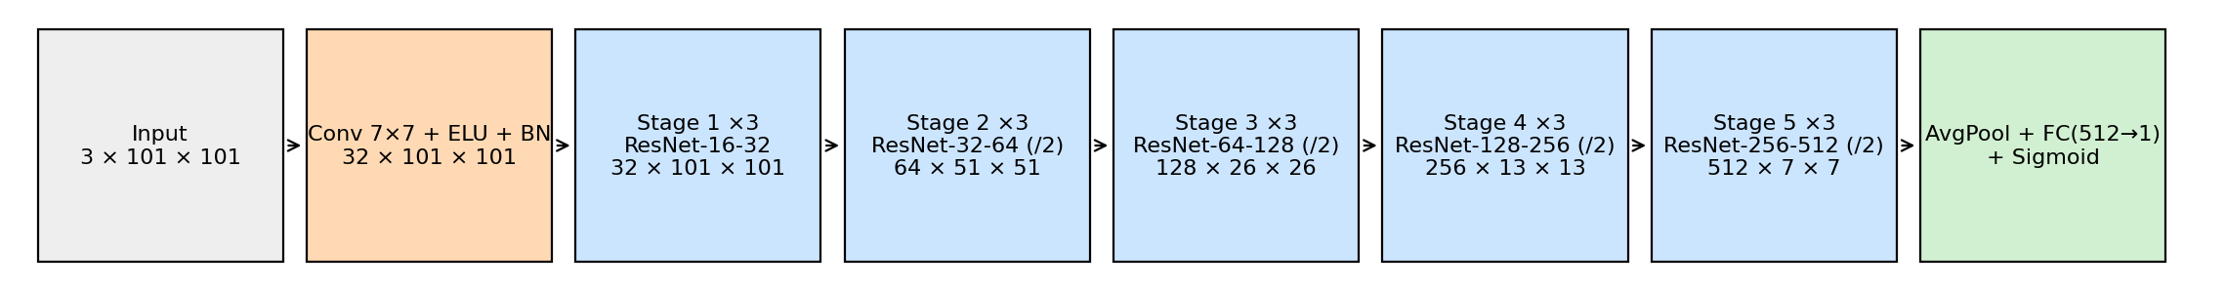
Huang 2020 — image lens-finder (Discover)
DESI DECaLS ResNet classifier — re-implemented from scratch (no public code)
• Architecture: Lanusse 2018 / CMU-DeepLens ResNet-46 (3.5M params), reimplemented in PyTorch from Lanusse §3.1.
• Inputs: 101×101 px grz cutouts (0.262″/px); 949 NeuraLens L18 lens positives + 5,000 random DR1 negatives.
• Training: 120 epochs, Adam, stratified 70/20/10 split.
– ~25 minutes on a single L4 GPU.
• Deployed full-sky via a brick-driven inference pipeline (see results).
Lanusse / CMU-DeepLens ResNet-46
reproductions/huang-2020/ — scripts 01–16 + papers/main.pdf

Slide 5
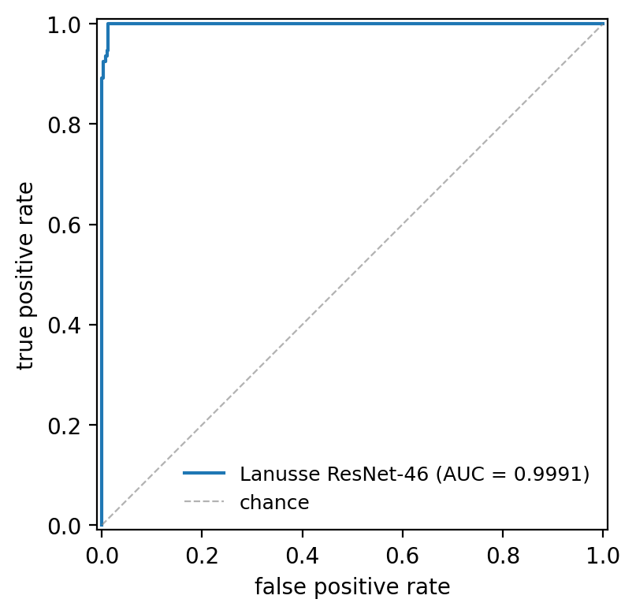
Huang 2020 — results
Training set | Val AUC | Test AUC
DR9 | 0.9983 | 0.9991
DR7 (paper-exact) | 0.9890 | 0.9943
Paper reported | 0.98 | —
• Recovery of published candidates @ p ≥ 0.9: Grade A 83%, B 64%, C 28%.
• Brick-driven inference: ~200× faster than the per-object cutout endpoint
– full DR7 footprint in ~10 hours instead of ~84 days.
ROC — held-out test set (DR9-trained, AUC 0.9991)
Test AUC reaches 0.99+ vs the paper's 0.98 — caveat on absolute AUC discussed on the integrity slide.

Slide 6
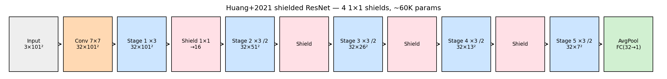
Huang 2021 — shielded ResNet
IN PROGRESS
The paper's headline innovation: a tiny “shielded” net that matches the big one
• Shield = 1×1 convolution layers inserted between every three residual blocks (4 shields; final block 32 channels).
• Controlled comparison: same DR9/DR7 cutouts, positives, negatives, and split as Huang 2020 — architecture is the ONLY variable.
• Shielded net: 59,905 parameters = 58.6× smaller than the 3.5M-parameter L18 baseline.
Shielded architecture schematic
reproductions/huang-2021/ — Phase 4a complete; DR8 deployment (4b/4c) in progress.

Slide 7
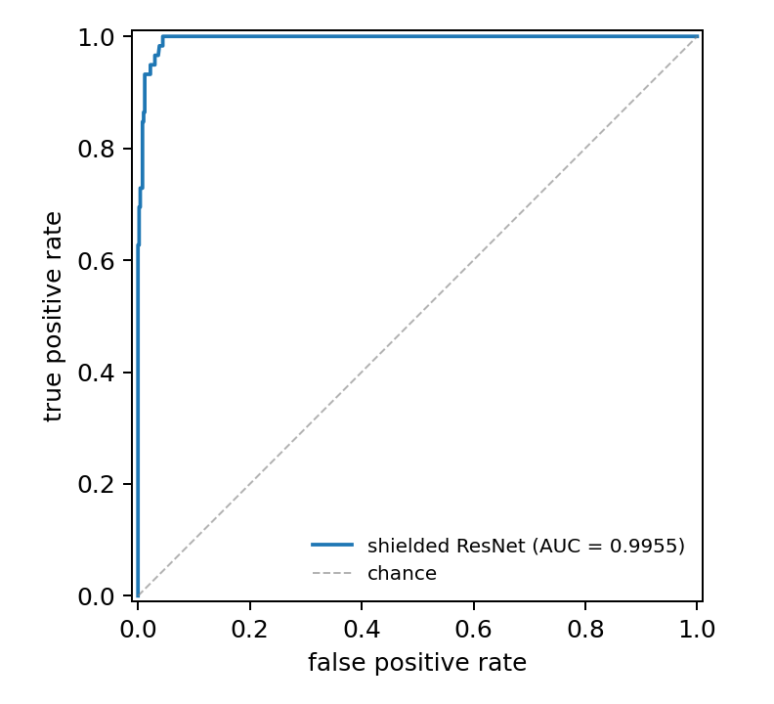
Huang 2021 — shielded matches (and beats) L18
Run | Params | Val AUC | Test AUC
L18 / DR9 | 3,508,833 | 0.9983 | 0.9991
Shielded / DR9 | 59,905 | 0.9989 | 0.9988
L18 / north-aug | 3,508,833 | 0.9991 | 0.9985
Shielded / north-aug | 59,905 | 0.9992 | 0.9996
Shielded matches L18 within ±0.002 AUC at 59× fewer params — and edges ahead on north-augmented data (0.9996 vs 0.9985).
• DR8 full-sky deployment (in progress): two-model (L18 + shielded) brick inference over ~23M parent galaxies across South (DECaLS) + North (BASS/MzLS) footprints.
– All 4 shards scored; Phase 4c recovery + leakage crossmatch pending.
ROC — shielded vs L18

Slide 8
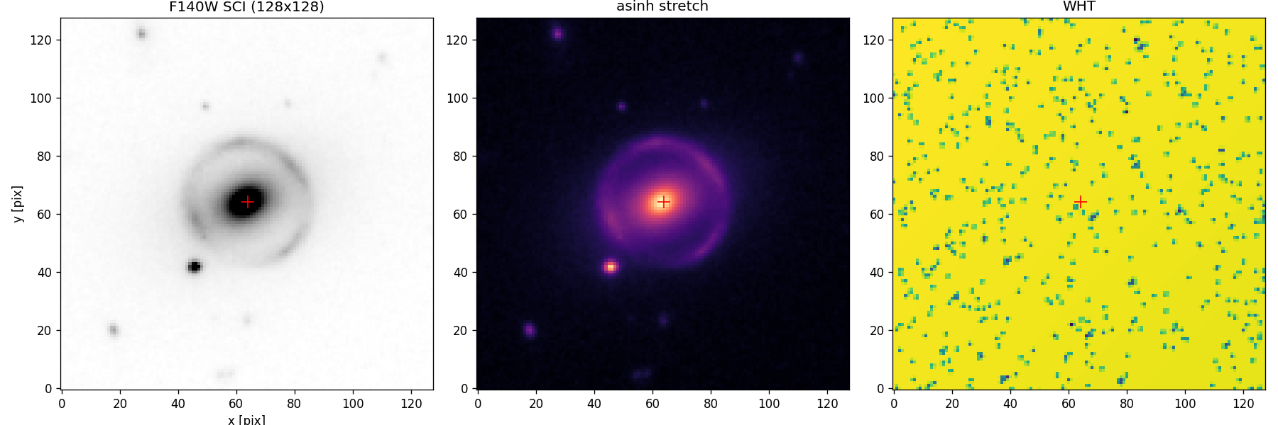
Foundry I — GIGA-Lens Bayesian modeling (Characterize)
Differentiable lens modeling of an HST-confirmed Foundry system
• Target: DESI-165.4754−06.0423, HST WFC3/F140W (GO-15867, public MAST).
• Model: 74 parameters — EPL + external shear + 4 Sérsic lens-light + Sérsic source + shapelets.
• Inference: 200-chain multi-start MAP + 200-particle SVI (+ NUTS diagnostic) on 2× L4, ~7 min.
• Empirical PSF built from in-field stars — critical for any GIGA-Lens reproduction.
HST WFC3/F140W cutout
reproductions/foundry-i/ — scripts 01–25 + papers/main.pdf

Slide 9
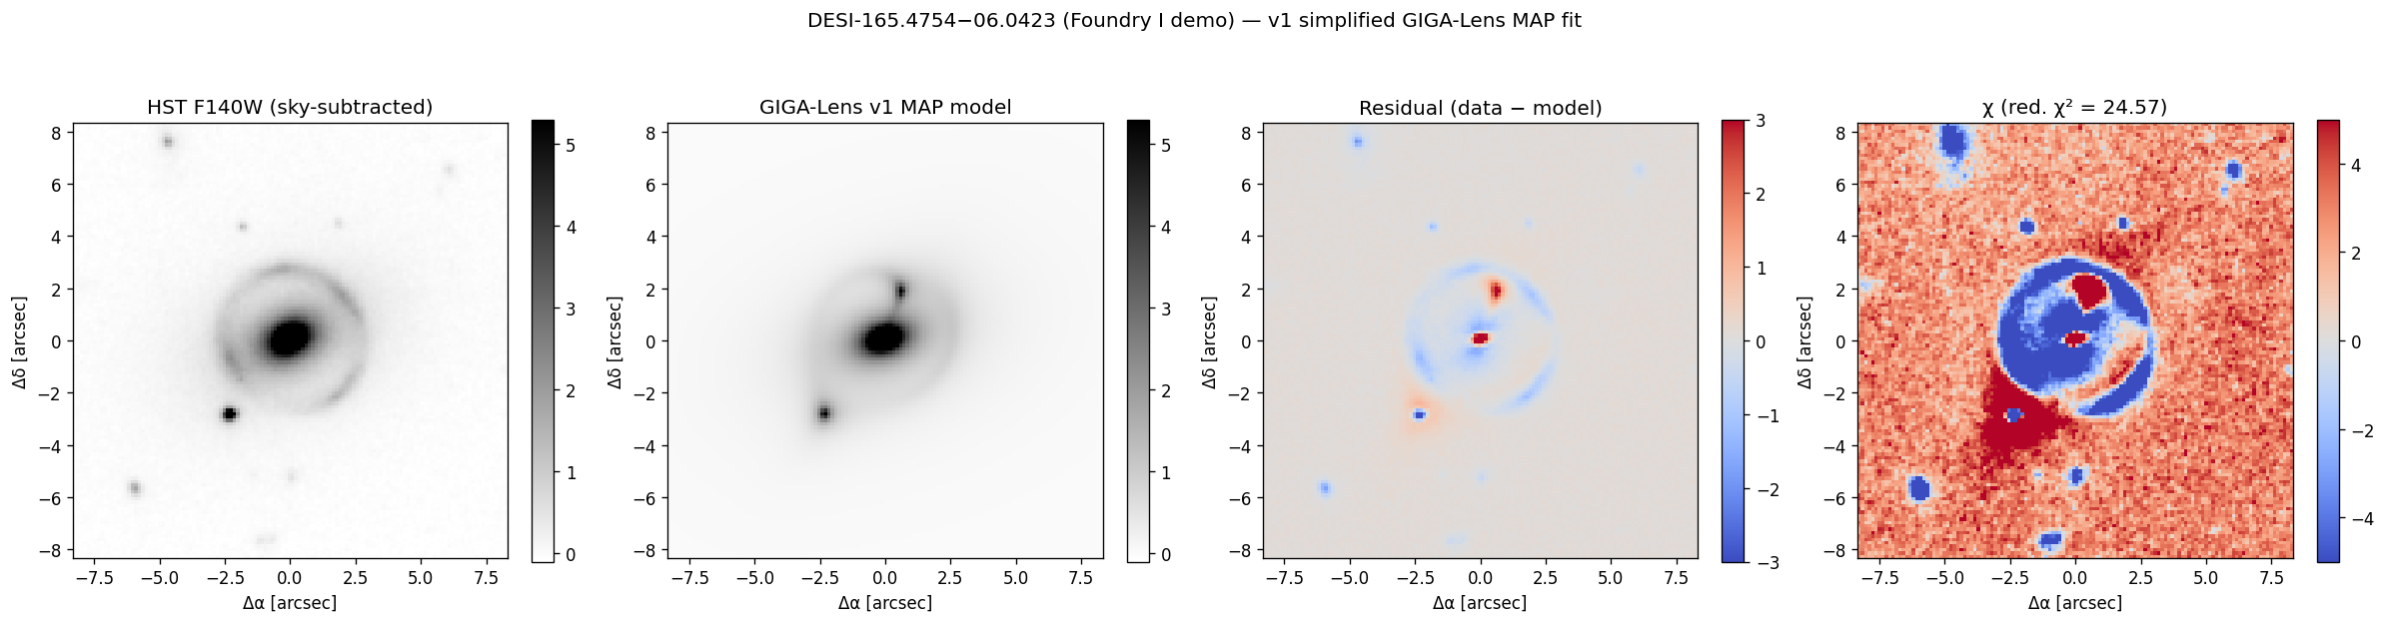
Foundry I — posterior vs Huang 2025a
Parameter | Reproduced (v10 SVI) | Published (HMC) | Match
θ_E (″) | 2.566 | 2.646 | 3.0%
e₁ | 0.106 | 0.109 | 2.5%
shear position angle | — | — | within 1°
γ_EPL (slope) | 2.15 | 1.37 | 57% steeper (open)
Recovers all six mass-parameter sign quadrants; θ_E to 3.0% (NUTS second mode to 1.6%).
The γ_EPL slope is 57% steeper than published — flagged as a known open discrepancy (likely one missing constraint), not hidden.
Best-fit model residual

Slide 10
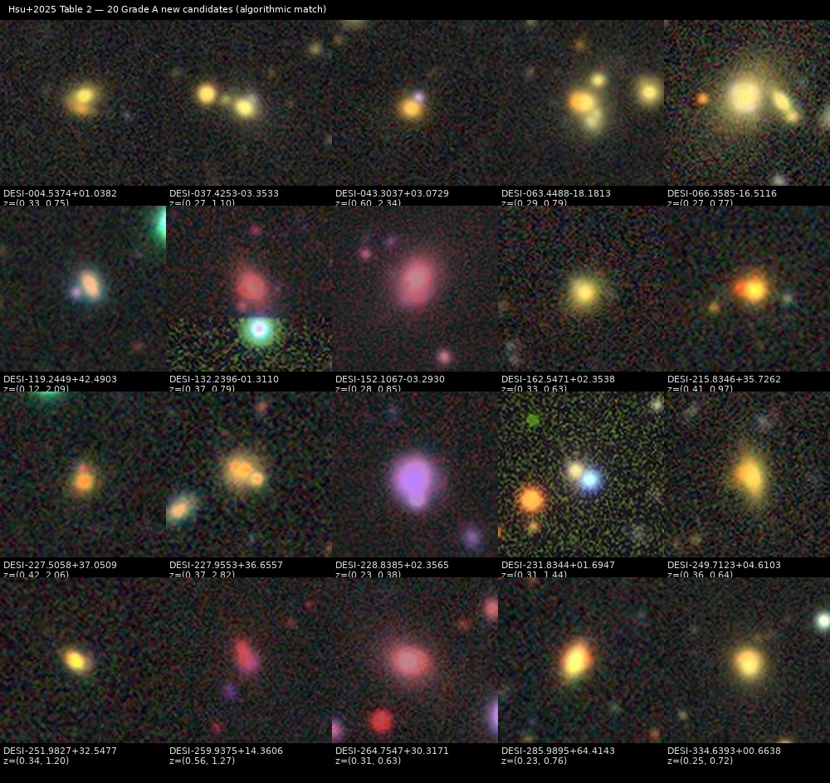
Hsu 2025 — spectroscopic lens-pair search (Discover)
Finding “dimple” lenses in 28M DESI DR1 spectra
• Pipeline: pre-filter (ZCAT_PRIMARY ∧ ZWARN=0 ∧ ≠STAR ∧ z>0) → spherimatch friends-of-friends (3″ link) → redshift-ratio cut (z_max/z_min ≥ 1.3) → Einstein-radius classifier.
• Uses the paper's own public tool: technic960183/spherimatch.
• Runs on 28.4M spectra in ~2 minutes on commodity hardware (FoF step ~36 s).
Table-2 candidate inspection grid
reproductions/hsu-2025/ — scripts 01–10 + papers/main.pdf

Slide 11
Hsu 2025 — algorithmic match within ~2%
Stage | Reproduced | Published
After pre-filter | 15,786,243 | ~15.8M
FoF groups (z-ratio ≥ 1.3) | 13,530 | 13,218
Spectra in retained groups | 27,334 | 26,621
Load-bearing counts reproduce to +2.4% / +2.7% — inside the ±5% validation tolerance.
100% recall on the 20 Grade-A new candidates in Table 2 (median offset 0.91″).
Visual-inspection grading (the paper's 2,046 / 318 final counts) is out of scope — it needs the team.
Public DESI DR1 + spherimatch; fully reproducible on commodity hardware in ~2 minutes.

Slide 12
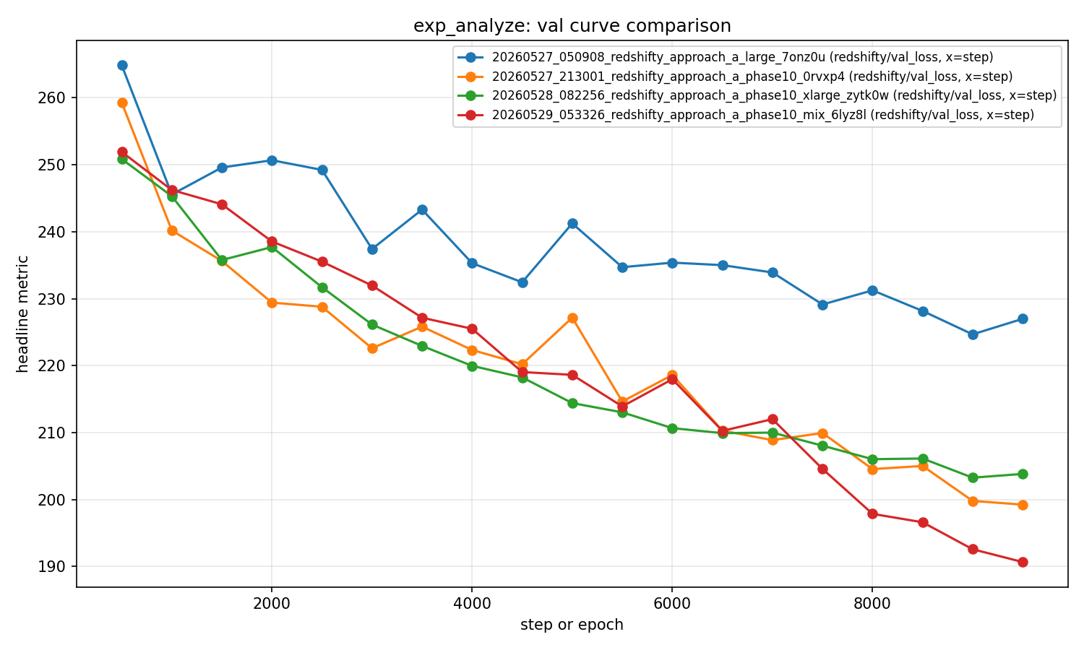
SpectrumFM / redshifty — adjacent foundation-model track
Reproducing the Approach-A “redshift ignition” on commodity GPUs (29 May)
• SpectrumFM: a transformer foundation model for DESI spectra with an auxiliary redshift head (Huang DOE Genesis proposal).
• Ignition reproduced: peak val redshift-acc 14.86%; AR/TF ratio 0.73 ≈ NERSC reference 0.74.
• The load-bearing lever: the 4-way data mix (sv3+main × bright+dark) — not hyperparameters, scale, or seed.
Validation-loss trajectory — mix run (red) ignites first
Full detail in reproductions/redshifty/papers/spectrumfm_status_2026-05-29.pptx

Slide 13
How these were done — and where to be careful
Method
• 4 of 5 reproduced from the papers' methods sections — the Huang lens-finder code is not public.
• Public + collaboration data: DESI Legacy DR7/DR8, DESI DR1, HST/MAST.
• Local rig: 8× A16 + 2× L4 GPUs; every effort = numbered scripts + a LaTeX tech report (reproductions/*/papers/main.pdf).
Honest caveats
• NeuraLens-catalog training leakage inflates absolute finder AUCs — so the faithful targets are the RELATIVE comparisons (shielded vs L18, DR9 vs DR7), which hold.
• Foundry I γ_EPL slope discrepancy (57% steeper) is open.
• Hsu 2025 visual-inspection grading is not reproduced (a team step).
Stating the limits is what makes the matches credible.

Slide 14
What's next
• Finish Huang 2021 Phase 4c: merge DR8 shards → recovery by grade/threshold + leakage-aware breakdown + inspection viewer.
• Extend the lens-finder lineage: Storfer 2024 (DR9), Inchausti 2025 (DR10 dual-backbone + meta-learner ensemble).
• More GIGA-Lens application fits (Cikota 2023, Sheu 2024b) reusing the Foundry I harness.
• SpectrumFM: 20k-step extension (trajectory still descending at the 10k cap) + codecs Mamba+RFSQ tokenizer swap.
None of these depend on NERSC compute to begin.

Slide 15
Takeaways
• Five Huang-group results reproduced in ~a week — spanning Discover, Characterize, and the SpectrumFM foundation-model track.
• Method-from-paper reproduction works where code is closed: AUCs ≈0.99, θ_E to 3%, pair counts within 2%, ignition AR/TF 0.73 ≈ 0.74.
• The full local GPU + JAX + PyTorch environment is validated end-to-end.
• Ready to contribute to ongoing efforts: DR8 deployment, Foundry follow-ups, SpectrumFM Phase-I.
From onboarding to production-grade reproductions in one sprint.

Slide 16
Acknowledgments & questions
• Xiaosheng Huang (PI, USF) — program direction; GIGA-Lens & spectroscopy review.
• A. Storfer, Y.-M. Hsu, J. Samuel — candidate catalogs, the spherimatch tool, the redshifty repo.
• DESI Collaboration & public archives — Legacy Surveys, DESI DR1, HST/MAST.
Questions / discussion / collaboration welcome.

