Slide 1
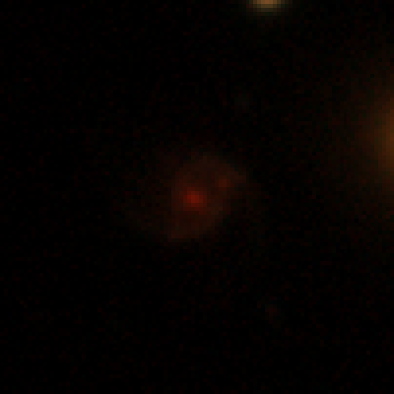
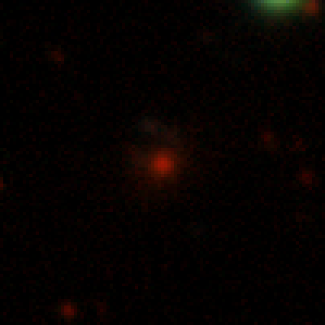
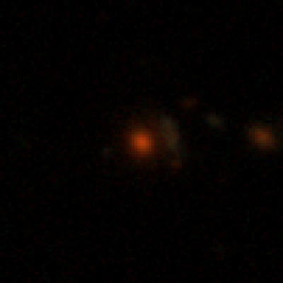
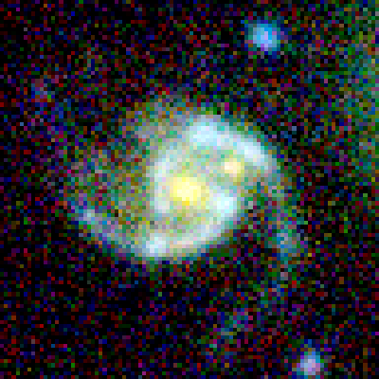
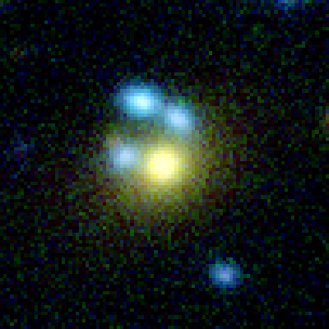
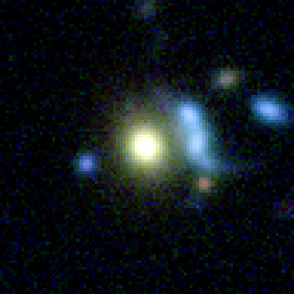
ClaudeNet v4 and the DR11-South Sweep
What we improved, what the sweep discovered, and how confident we are
Greg Benson, USF CS · 9 July 2026 · progress update
The three genuinely new lens systems from the DR11-south campaign — DESI grz (top) and HSC grizy (bottom)
s_327526_9059
s_340971_2860
s_325163_2981
53,809,040 galaxies swept · 3 confirmed new systems · 134,078 v4 candidates pending vetting
Notes:
Progress update for the group, 9 July 2026.
Cutouts are the three genuinely-new systems from the v3blend8 DR11-south campaign after LensJudge + HSC PDR3 tier-2 vetting: s_327526_9059, s_340971_2860, s_325163_2981. Top row DESI grz (0.262"/px), bottom row HSC grizy (0.168"/px). Source: reproductions/dr11-campaign/papers/main.tex, Table tab:confirmed and Appendix app:gallery.
Frame the talk with the one-liner: the recall gains are large and confidence-interval'd; the discovery yield is small and resolution-bounded.

Slide 2
Bottom line
• The Huang lineage's ceiling was never architecture: a 194k-param shielded ResNet matches a 20.5M-param EfficientNetV2-S within ±0.003 AUC, and the published meta-learner collapsed to a simple average.
• ClaudeNet's four real levers, in the order each exposed the next: diversity (v1) → honest deployment-scale negatives (v2) → contaminant awareness (v3) → release-native adaptation (v4).
• v4 = v3's contaminant-aware members + two additive, release-portable levers: a calibrated-mean stage-1 selector (free) and a DR11-native warm-start fine-tune (one short GPU pass).
• It is the best-recall configuration ever measured on DR11-south: Inchausti grade-A 0.54 → 0.87, Storfer grade-A (hard) 0.32 → 0.825.
• But: the v3 DR10 sweep produced zero net-new lenses; the v3 DR11 campaign produced three after HSC vetting; and v4's 134,078 new candidates are not yet vetted at all.
• On the one independent, unbiased test — Euclid grade-A-vs-C AUC — all four model generations tie within one standard error.
Recall went up a lot, and we can prove it. Discovery went up a little, and only where higher-resolution pixels exist.
Notes:
Bottom line up front. Hold the two halves apart all talk: recall is measured and confidence-interval'd; discovery is small and bounded by pixel resolution, not by the model.
Numbers: 0.54 -> 0.87 Inchausti grade-A is dr11-campaign-v4/papers/main.tex Table 2. The 3 new systems are dr11-campaign/papers/main.tex (post-hoc literature crosscheck of 8 distinct new-class systems left 3 genuinely new).
Provenance: v4 numbers are transcribed from reproductions/claudenet/papers/v4_section.tex and reproductions/dr11-campaign-v4/papers/main.tex. The v4 result artifacts (resweep_v4_summary.json, dr11_finetune_gate.json, survivors_dr11s_v4.parquet) live on Perlmutter scratch, not in this repo.

Slide 3
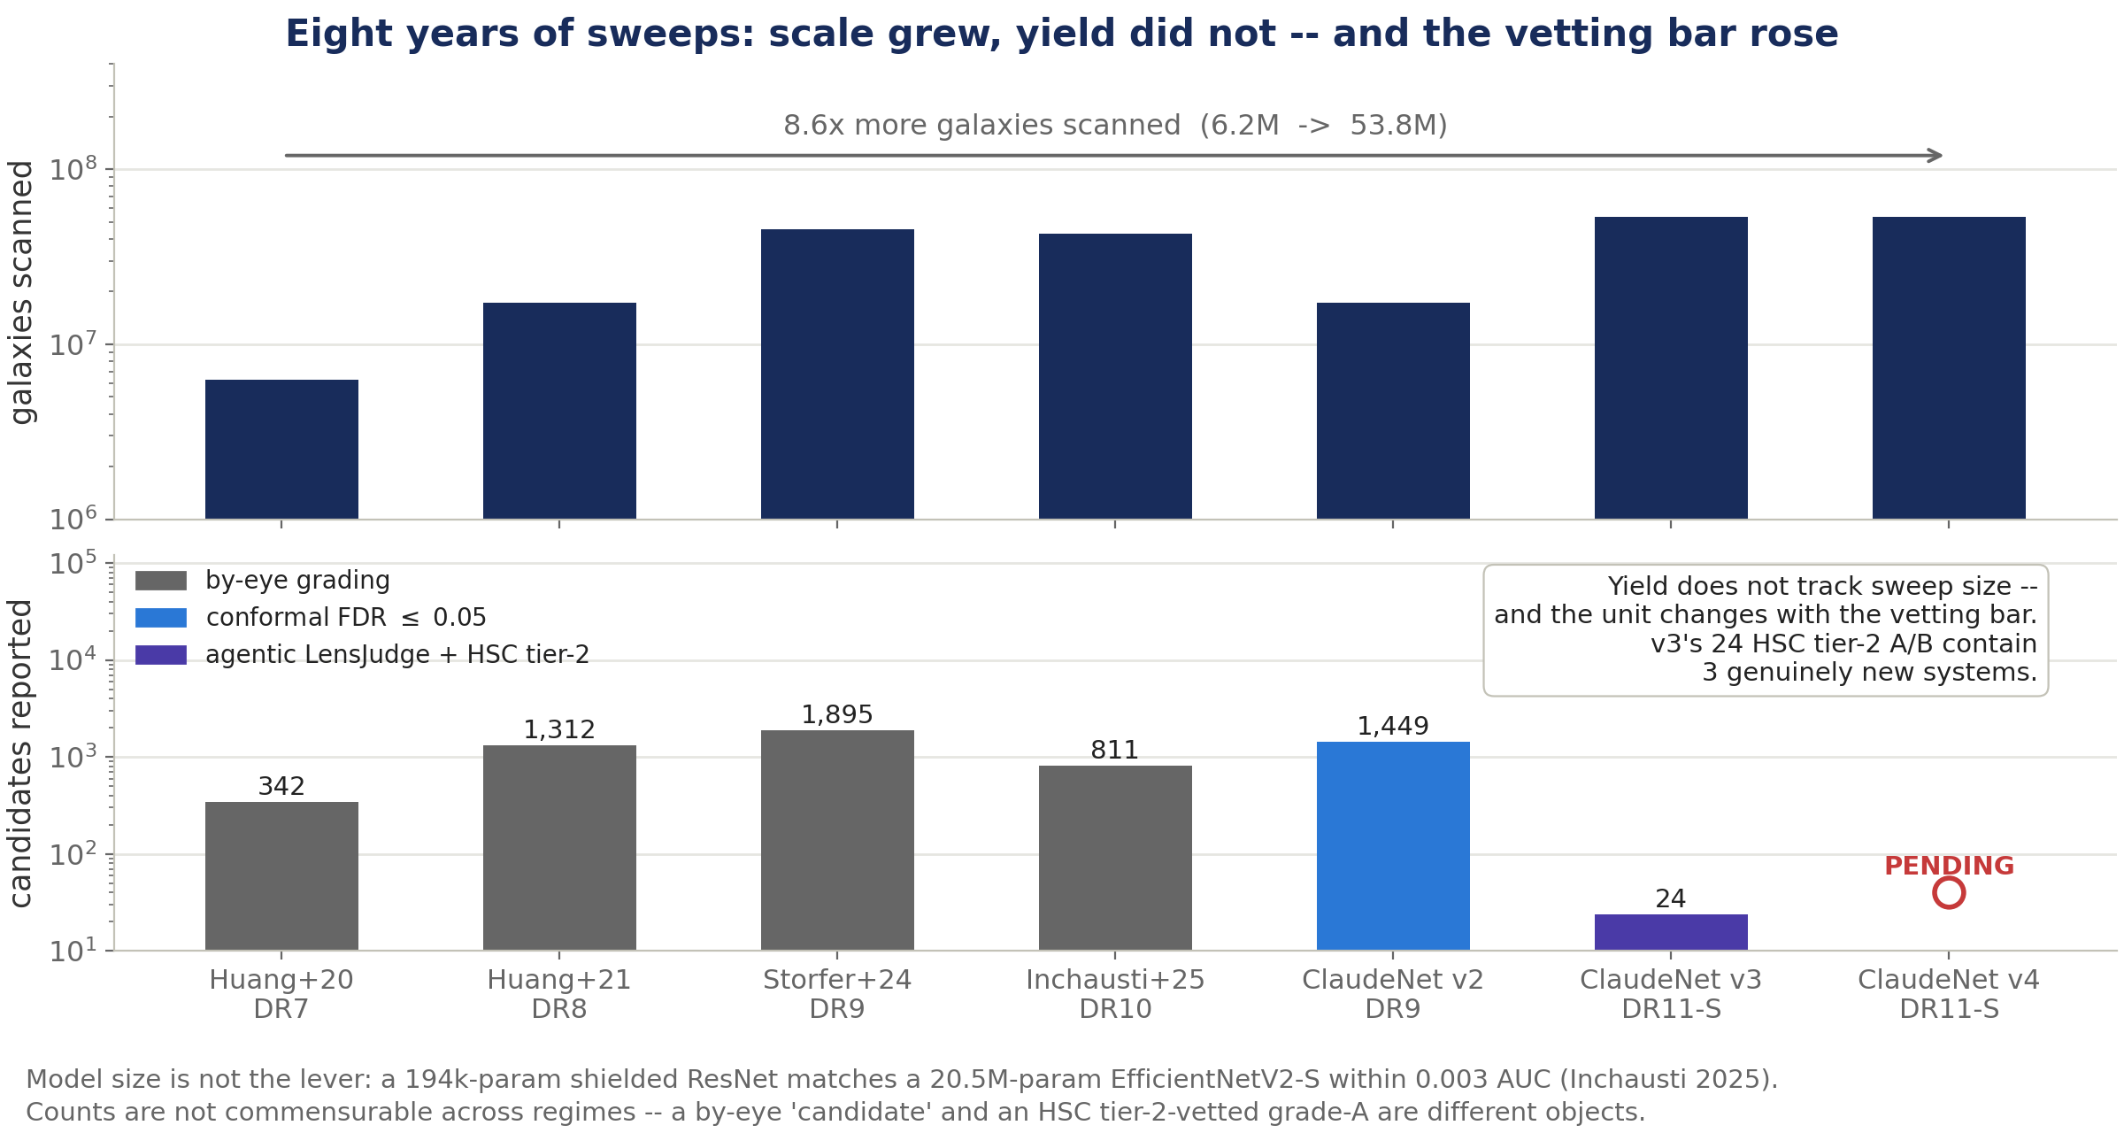
Where we started: the Huang lineage and its sweeps
Eight years, 8.6× more galaxies scanned, and candidate yield did not follow — while the vetting bar rose from by-eye grading to HSC tier-2 confirmation.
Notes:
The baselines we are positioning against.
Huang+2020: Lanusse-2018 CMU DeepLens ResNet-46, 3,508,833 params; DECaLS DR7, 6,242,507 galaxies; 342 candidates (60A/106B/176C).
Huang+2021: 'shielded' ResNet, 59,905 params (58.6x reduction), deployed as a 2-model ensemble; DR8 ~14,000 deg^2, 17,290,814 parent; 1,312 candidates (216A/199B/897C), 1,210 new.
Storfer+2024: same shielded ResNet at 1,961 training lenses; DR9 ~19,000 deg^2, 45.26M cutouts; 1,895 candidates, 1,512 new.
Inchausti+2025: shielded ResNet (194,501) + EfficientNetV2-S (20,543,145) + FWLS meta (1,201); DR10 ~14,000 deg^2, ~43M cutouts; 811 new candidates.
All four vetted by by-eye visual grading. The chart's second panel is deliberately not commensurable across regimes -- say so out loud.
Sources: reproductions/{huang-2020,huang-2021,inchausti-2025}/README.md.

Slide 4
The negative result that started ClaudeNet
Reproduced, controlled comparison — architecture is not the bottleneck
model | params (reproduced) | test AUC | role
shielded ResNet | 194,501 | 0.9984 | base model 1
EfficientNetV2-S | 20,543,145 | 0.9987 | base model 2
FWLS meta-learner | 1,201 | 0.9989 | stacked combiner
simple average | — | 0.9989 | the meta-learner's actual behaviour
• A 194k-param ResNet ties a 20.5M-param EfficientNet to within ±0.003 AUC — 105× the parameters, no gain.
• The combiner had nothing to exploit: both bases saw byte-identical data, so their errors are correlated at ~1.0.
• Honest Stage-D baseline to beat (recovery @ matched FPR): meta @1% = 0.908 Storfer / 0.968 Inchausti; @0.1% = 0.755 / 0.845.
Bigger backbones and a learned combiner bought nothing, because every model saw the same data and made the same mistakes. The levers are elsewhere: diversity, negatives, contaminants, domain.
Notes:
The negative result that started ClaudeNet. Reproduced controlled AUC from reproductions/inchausti-2025/ (their Fig 6): ResNet 0.9984, EffNet 0.9987, meta 0.9989 -- and the simple average is also 0.9989.
The meta-learner is a 1,201-param FWLS MLP: Linear(2->300)->ReLU->Linear(300->1) on [p_shielded, p_effnet]. It collapsed to averaging because both base models were trained on byte-identical data, so their errors correlate at ~1.0 and a combiner has nothing to exploit.
Stage-D honest baseline (matched-FPR recovery): meta @1% FPR = 0.908 Storfer / 0.968 Inchausti; @0.1% = 0.755 / 0.845. Inchausti's own finding: the negative:positive ratio, not architecture or AUC, sets usability at a real operating point.

Slide 5
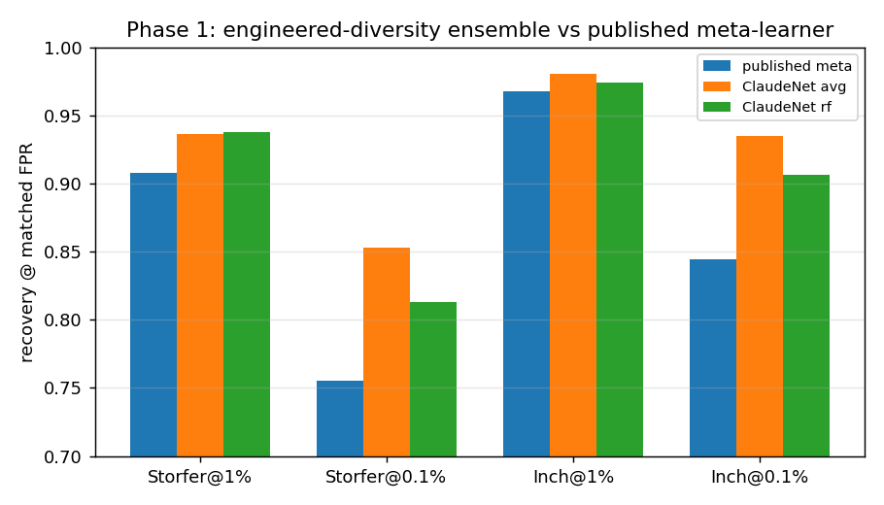
The metric that makes every number here comparable
Recovery @ matched false-positive rate — the exact arithmetic of inchausti-2025/22_fpr_operating_point.py, reused verbatim
• AUC saturates near 1.0 and hides the tail; a sweep lives entirely in the tail.
• A 45M-cutout sweep at 1% FPR means ~450,000 false positives. Real scans run near 0.01% FPR.
• So we report recovery at 1%, 0.1% and 0.01% FPR against held-out Storfer and Inchausti graded lenses.
• Same held-out catalogs throughout — and from v4 on, they are excluded from training as both positives and negatives.
One number, one operating point: recovery at matched FPR. Everything that follows is apples-to-apples against the reproduced baseline.
Notes:
The metric. Recovery @ matched false-positive rate, using arithmetic copied verbatim from reproductions/inchausti-2025/22_fpr_operating_point.py into claudenet/_ensemble.py, so every number in this deck is directly comparable to the reproduced baseline.
Why not AUC: AUC saturates near 1.0 (all four models above sit at 0.998-0.999) and averages over the whole ROC. A real sweep operates at a fixed, tiny FPR where only the tail matters. A 45M-cutout sweep at 1% FPR yields ~450k false positives; scans run near 0.01%.
Figure: claudenet/papers/figures/flagship_operating_point.png.

Slide 6
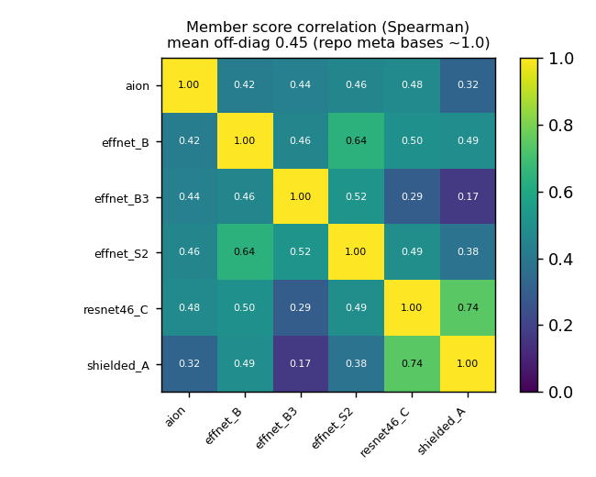
v1 — diversity, not combiner cleverness, is the lever
• Five decorrelated members (EfficientNetV2-S ×2, EfficientNet-B3, an AION-1 frozen-embedding probe, shielded-194k ResNet, Lanusse ResNet-46).
• Member score correlation: Pearson ~0.31 / Spearman ~0.45, against the lineage's collapsed ~1.0.
• Beat the published meta-learner on 4/4 matched-FPR cells — with a naive average, no clever combiner:
– Storfer @1% 0.908→0.938, @0.1% 0.755→0.853
– Inchausti @1% 0.968→0.980, @0.1% 0.845→0.935
• Also shipped: certified-FDR conformal selection, and deep-ensemble triage (selective error 0.022 → 0.0002 at 50% coverage).
• Honest caveat: the 0.1% threshold was pinned by ~6–7 of only ~6,500 held-out negatives — roughly ±10 pp of noise, no confidence interval.
With decorrelated members even a plain average beats the published correlated-base meta-learner — and the gap is widest at the strict thresholds that control purity.
Notes:
ClaudeNet v1. Five to six deliberately decorrelated members: EfficientNetV2-S x2, EfficientNet-B3, an AION-1 frozen-embedding MLP probe, the shielded-194k ResNet, and the Lanusse ResNet-46. Each isotonic-calibrated, then combined.
Member score correlation fell from the lineage's ~1.0 to Pearson ~0.31 / Spearman ~0.45. Beat the published meta on 4/4 matched-FPR cells.
Other v1 phases: conformal selection certified FDR control; deep-ensemble triage cut selective error 0.022 -> 0.0002 at 50% coverage; test-time D4 pooling added +0.041 mean. Domain adaptation was a negative result: the north/south gap is real (north@1% 0.688 vs south 0.874) but naive MMD at lambda=1 hurt both domains by ~0.06.
Caveat to state: v1's 0.1% threshold was pinned by only ~6-7 of ~6,500 held-out negatives -- about +/-10pp of noise, no CI. v2 fixes exactly this.
Figure: claudenet/papers/figures/diversity_heatmap.png.

Slide 7
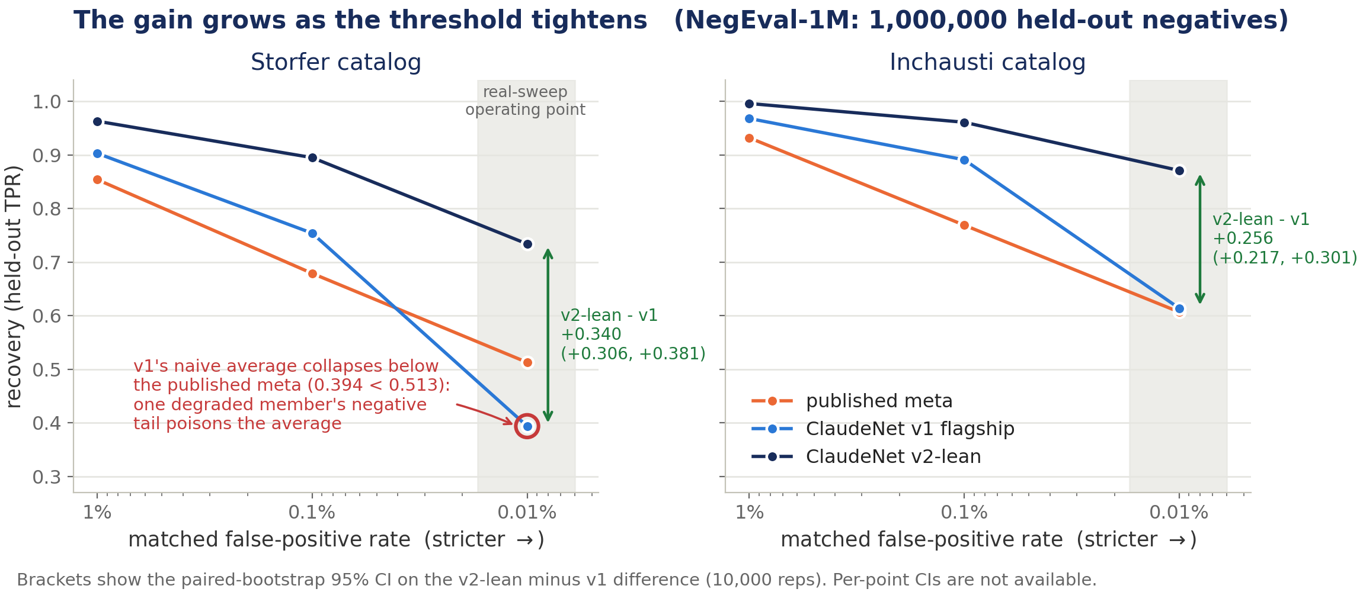
v2 — an honest eval, and deployment-scale negatives
NegEval-1M: 1,000,000 held-out negatives, so the 0.01% FPR operating point can be measured at all
The gain grows monotonically as the threshold tightens — +0.34 Storfer / +0.26 Inchausti at 0.01% FPR — which is exactly the regime a 10⁷-galaxy sweep runs in.
Notes:
ClaudeNet v2, the Perlmutter scale-up. NegEval-1M replaced the ~6,500 held-out negatives with 1,000,000, so the 0.01% FPR point could be measured for the first time. Deployment-scale hard-negative mining over a 1M pool shipped in round 1 (+0.157 Inchausti @0.1%); round 2 over-mined and was rejected.
Two things FAILED their gate and were dropped -- worth saying out loud:
- the AION native-griz upgrade (0.535 < 0.647): the synthetic-i 'degradation' WAS the diversity mechanism (Pearson vs CNN 0.13 degraded vs ~0.65 native).
- distillation to a single student: 5.3x faster but -0.111 recovery.
v2-lean roster: effnet_B, effnet_B3_hard, effnet_S2_hard, resnet46_C_hard, zoobot_N. Table tab:v2lean, paired bootstrap 10,000 reps.
Note the v1 collapse at 0.01% Storfer (0.394, below the meta's 0.513): the degraded-AION member's negative tail poisons the average. The RF combiner was robust there. This is why v2 dropped AION from the roster.

Slide 8
v2's reality check — the score moved, the discoveries did not
• Full DR9 sweep: 17,290,814 parent galaxies → 29,892 survivors → group-conformal at FDR ≤ 0.05 selects 1,449 (813 new, 737 new-and-unseen).
• Known-lens recall into survivors: 47.5% in-coverage. The pipeline works.
• Then vetting: of 601 genuinely-new conformal-selected candidates, zero were graded A/B by either independent vetter.
• The rejects were overwhelmingly luminous red galaxies with companions, rings, or blends — objects that look like lenses at 0.262″/px.
Diagnosis: the binding constraint is lens-vs-mimic separation and vetting resolution — not architecture, and not AUC.
This is the pivot that produced v3 (contaminant-aware training) and v4 (release-native adaptation).
A better score produced not one new confirmed lens. The wall is telling real lenses from convincing look-alikes — and, ultimately, pixel resolution.
Notes:
The pivot. v2's DR9 sweep: 17,290,814 parent galaxies -> 29,892 survivors -> group-conformal at FDR<=0.05 selects 1,449 (813 new, 737 new-and-unseen). Known-lens recall 47.5% in-coverage.
Then the campaign result: of 601 genuinely-new group-conformal candidates, ZERO were graded A/B by either independent vetter. The only five graded >=B were already-catalogued lenses. Rejects were overwhelmingly luminous red galaxies with companions, rings, or blends.
That is the diagnosis that produced v3 and v4: the binding constraint is lens-vs-mimic separation and vetting resolution, not architecture and not AUC. Source: claudenet/papers/v3_section.tex (motivation), README.md phase 160.

Slide 9
v3 — contaminant-aware training on a typed mimic bank
Score the models against lens mimics, not random galaxies, and the flattering numbers disappear
held-out DR10 mimic-eval | v2-lean | v3blend8
mimic-FPR 0.05 (Storfer) | 0.713 | 0.793 | the contaminant metric
mimic-FPR 0.01 (Storfer) | 0.460 | 0.699 | +0.24 at the strict point
random-FPR 0.01 (Storfer) | 0.967 | 0.935 | the deliberate cost
random-FPR 0.01 (Inchausti) | 0.998 | 0.979 | the deliberate cost
• Mimic bank: 148,034 CNN-high DR10 non-lens survivors, morphology-typed via Tractor, 98.3% non-lens purity (118,901 train / 29,724 frozen held-out).
• The v2 recipe is held byte-identical; only the negative content changes — half the displaced negatives become typed mimics ("b50").
• Ship roster v3blend8 keeps both the v2-hard and the v3-b50 version of each swappable member — 8 members, near-Pareto on both metrics.
• Broad-mimic recovery (DR10-eval): 0.598 original CNN → 0.790 v3blend8 → 0.885 with the v3 head re-ranker (deployed only as a φ=0.05 stage-2 re-rank).
Training against typed mimics roughly halves the hard-contaminant miss rate, at a small and deliberate cost on the easy random-FPR metric.
Notes:
ClaudeNet v3, contaminant-aware. New metric: recovery @ matched MIMIC-FPR. v2-lean, which recovers 96-100% of held-out lenses at random-FPR, recovers only 0.168 Storfer / 0.307 Inchausti at mimic-FPR 0.05 -- the random-FPR metric was flattering.
Mimic bank: 148,034 CNN-high DR10 non-lens survivors, morphology-typed via Tractor, 98.3% non-lens purity by a 120-row agentic gate; 118,901 training rows + a frozen 29,724-row held-out mimic-eval.
Recipe: hold the v2 'hard' recipe byte-identical and swap only the negative CONTENT -- a fraction f of displaced negatives become typed mimics. f=0.5 ('b50') wins; f=0.7 over-specialises.
Ship roster v3blend8 = 8 members, keeping BOTH the v2-hard and v3-b50 versions of each swappable member: effnet_B, zoobot_N, effnet_S2_{hard,b50}, effnet_B3_{hard,b50}, resnet46_C_{hard,b50}. Source: v3_section.tex tab_a2, a6_ensemble_refit.json.

Slide 10
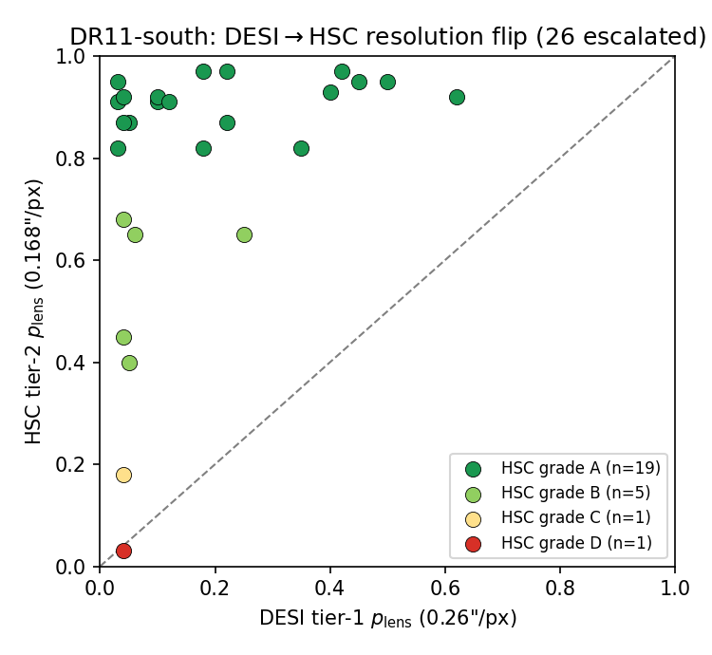
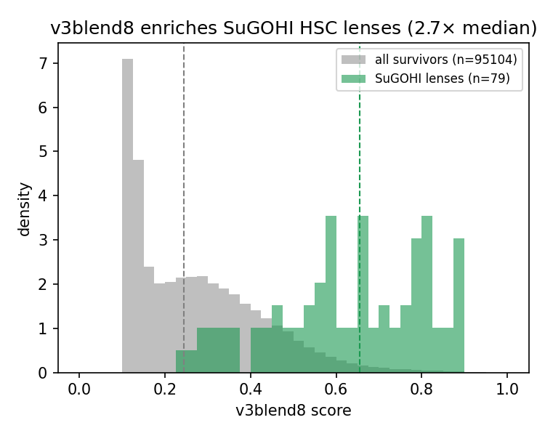
The v3 DR11-south campaign — swept, vetted, and counted honestly
53,809,040 galaxies → 95,104 union survivors → top-500 new → LensJudge v3 cascade → HSC PDR3 tier-2 at 0.168″/px ($40.38)
• 500 graded → 350 escalated → 26 reached HSC tier-2
• HSC tier-2 grade-A/B: 24 (19 A, 5 B)
• of those 24: 0 in DESI finder catalogs, 15 are SuGOHI lenses
• 9 new-class detections = 8 distinct systems
• post-hoc literature crosscheck: 5 of 8 already published
• ⇒ 3 genuinely new systems
• (+ 39 genuinely new among 108 DESI-resolution-only A/B)
A full 53.8M-galaxy sweep plus HSC vetting yielded exactly three genuinely new lenses. The model recovers known systems well; net-new discovery is bounded by resolution.
Left: the DESI→HSC resolution flip on the 26 HSC-covered candidates. Right: v3blend8 enriches independent SuGOHI lenses to 2.7× the survivor-median score.
Notes:
The v3blend8 DR11-south as-run campaign -- COMPLETE and HSC-vetted. This is the confirmed catalogue of record.
53,809,040 DR11-south galaxies swept; per-member 1e-4 union -> 95,104 survivors. Conformal certified ZERO at this scale (power-limited, not a null result).
Top-300 = 102 known + 198 new; discovery set = the top-500 new.
LensJudge v3 cascade + HSC PDR3 tier-2 (0.168"/px, ~1,300 deg^2 ~= 20x Euclid Q1). Total cost $40.38.
Cascade: 500 graded -> 350 escalated -> 26 reached HSC tier-2; tier-1 grades A/B/C/D = 27/76/125/272; HSC tier-2 grade-A/B = 24 (19 A, 5 B).
SuGOHI: 79 SuGOHI HSC committee lenses recovered into survivors at 2.7x the survivor-median score; 15 of the 24 tier-2 A/B are SuGOHI lenses.
Net-new accounting: of the 24, zero are in DESI finder catalogs, 15 are SuGOHI, 9 (8 distinct systems) are new-class. A post-hoc literature crosscheck found 5 of the 8 previously published -> 3 GENUINELY NEW.
Also: 108 DESI-resolution-only A/B (17A/91B), of which 39 genuinely new.
Source: reproductions/dr11-campaign/papers/main.tex, tab:cascade, tab:confirmed.

Slide 11
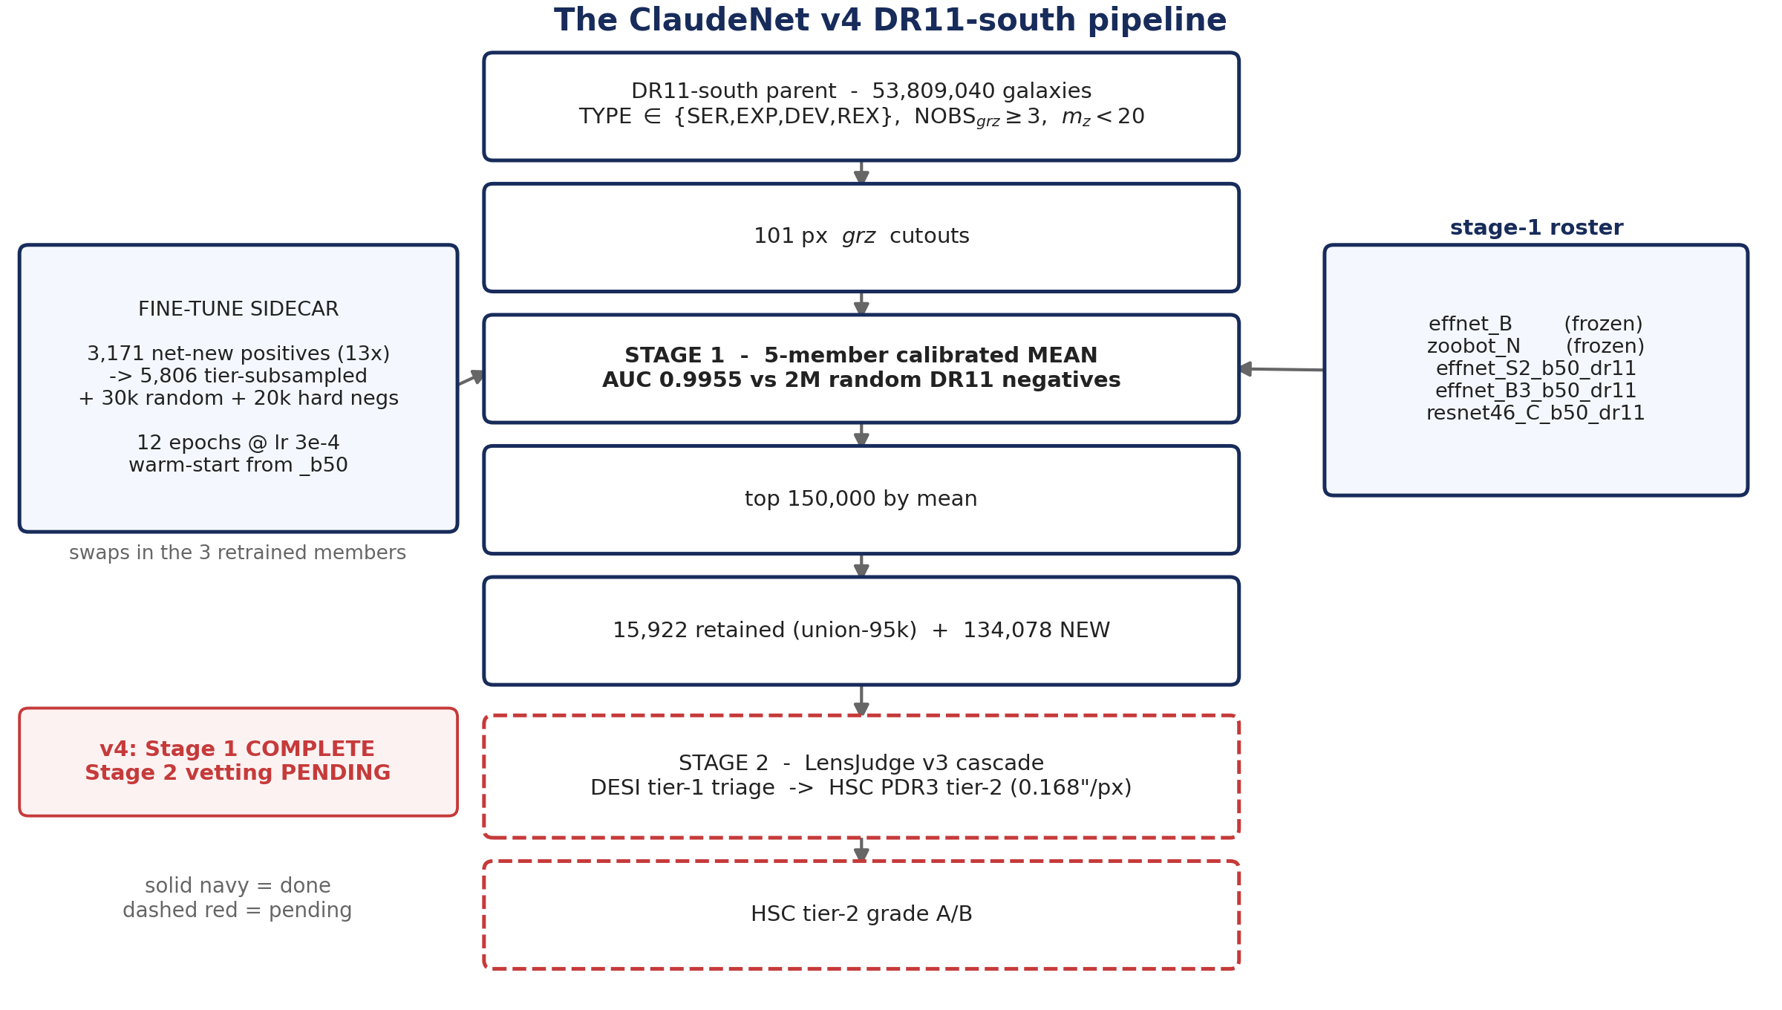
ClaudeNet v4 — two additive, release-portable levers
Trigger: on DR11-south, v3blend8's grade-A recall at the per-member 10⁻⁴ operating point appeared to fall 62% → 41% vs DR10
• v4 is additive — it keeps v3's contaminant-aware members.
• Lever 1 — calibrated-mean stage-1 selector.
– Free. No retraining. Removes DR9→DR11 threshold drift entirely.
• Lever 2 — release-native warm-start fine-tune.
– One short GPU pass on a 13×-expanded DR11-native positive pool.
• Both levers are the recipe that transfers to the higher-resolution surveys that are the program's endpoint.
v4 doesn't replace v3 — it fixes the selection rule and adapts the weights to the actual data release.
Notes:
ClaudeNet v4. Trigger: deploying v3blend8 on DR11-south showed known-lens grade-A recall at the per-member 1e-4 operating point falling 62% -> 41% relative to DR10.
v4 is ADDITIVE. It keeps v3's contaminant-aware members and stacks two release-portable levers:
(1) a combiner change -- free, no retraining;
(2) a release-native warm-start fine-tune -- one short GPU pass.
Both levers are exactly the recipe that transfers to the higher-resolution surveys that are the program's endpoint: re-harvest the native-resolution positive pool, mine native hard negatives, warm-start fine-tune, select by mean.
Provenance: v4 numbers are transcribed from reproductions/claudenet/papers/v4_section.tex and reproductions/dr11-campaign-v4/papers/main.tex. The v4 result artifacts (resweep_v4_summary.json, dr11_finetune_gate.json, survivors_dr11s_v4.parquet) live on Perlmutter scratch, not in this repo.

Slide 12
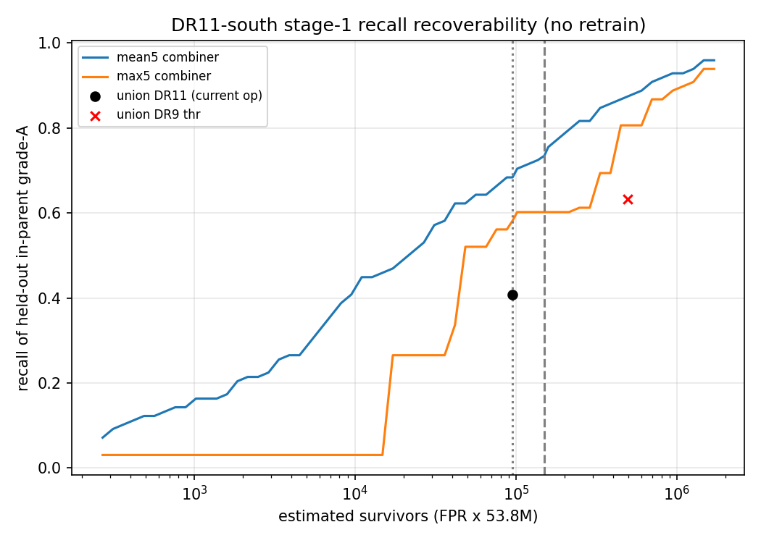
v4 Lever 1 — the recall collapse was the combiner, not the model
• The union over per-member 10⁻⁴ thresholds degrades on deeper DR11 imaging: thresholds tighten, resnet46_C saturates (0.81 → 1.00), and the union ends up dominated by single-member spikes.
• Threshold-free AUC of in-parent held-out grade-A vs 2M random DR11 negatives: 0.9955 for the five-member calibrated mean. The model ranks DR11 lenses fine.
• The calibrated mean carries no per-release threshold recalibration — it removes the DR9→DR11 drift entirely, and is now the default stage-1 selector.
Denominator discipline — three readings, three denominators:
reading | value | denominator
union @10⁻⁴, all grade-A | 41% (37/90) | all 90 grade-A
union @10⁻⁴, searchable | 54% (37/69) | in-parent, in-footprint
calibrated mean @95k | 75% | in-parent
calibrated mean @150k | 0.80 (Inch.-A) | position-crossmatch, held out
Swapping the union for a calibrated mean recovers the recall for free — no retraining. The 62%→41% "collapse" was a selection rule, not a broken model.
Notes:
Lever 1. The apparent recall collapse is an OPERATING-POINT artifact, not a model failure.
Mechanism: the stage-1 selector was a per-member 1e-4 UNION. On the deeper DR11 imaging the per-member thresholds tighten and resnet46_C saturates (its 1e-4 threshold moved 0.81 -> 1.00), so the union is dominated by single-member spikes.
Three facts show the model is intact:
(i) 21/90 grade-A lie outside the searched footprint or are cut by the parent selection, so searchable recall is already 54%, not 41%;
(ii) threshold-free AUC of in-parent held-out grade-A vs 2M random DR11 negatives = 0.9955 for the five-member calibrated mean;
(iii) swapping union for the calibrated mean at the SAME survivor budget recovers grade-A recall 54% -> 75%.
DENOMINATOR DISCIPLINE -- say this if asked. Those percentages use different denominators. The authoritative three-configuration comparison is Table 2 of dr11-campaign-v4/papers/main.tex (position-crossmatch, training-excluded), which is what slide 14 plots. The plotted curve here uses its own 'held-out in-parent grade-A' denominator and reads ~0.69 at 95k. Do not mix them on one axis.
Figure: dr11-campaign-v4/papers/figures/recall_recoverability.png.

Slide 13
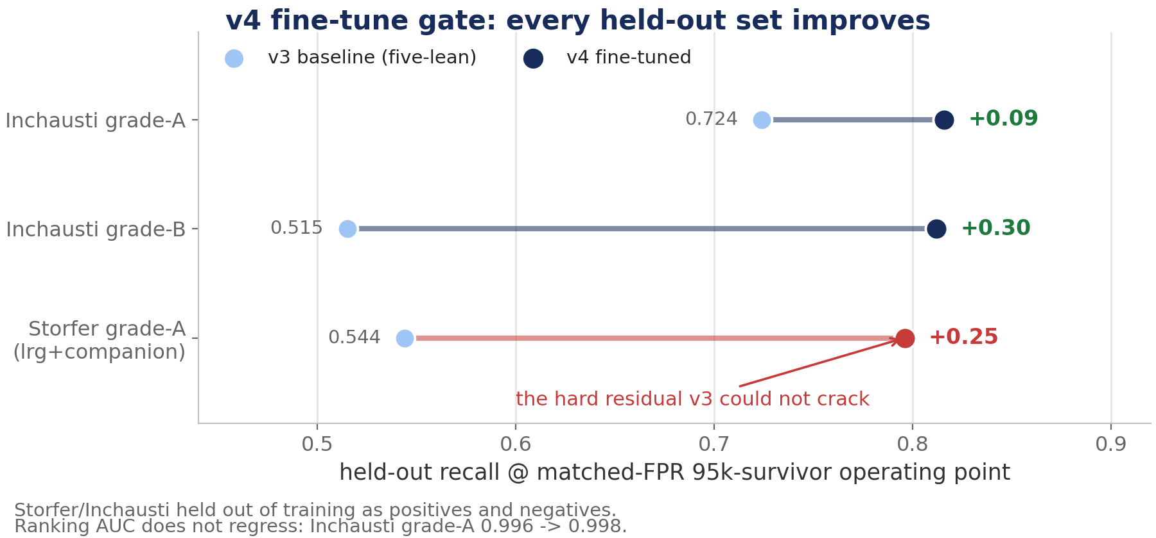
v4 Lever 2 — a release-native warm-start fine-tune
• v1–v3 trained on 1,961 DR9-pixel lenses. We re-harvested the DR11-south confirmed-lens literature (VizieR/DES/KiDS/HSC, SLACS/BELLS, lensed quasars, SIMBAD, Euclid-Q1 A/B), deduped at 5″ and tiered by confidence: 3,171 net-new high-confidence positives — a ~13× expansion.
• Cutouts re-extracted DR11-native (griz, 101 px), tier-subsampled to 5,806; paired with 30k random + 20k hard DR11 negatives (PU-guarded at 10″, and candidate-region-skimmed so real unconfirmed lenses can't poison the negatives).
• Three swappable members warm-started from _b50 and fine-tuned 12 epochs @ lr 3×10⁻⁴; effnet_B and zoobot_N stay frozen as random-FPR / diversity anchors.
• Storfer and Inchausti held out as both positives and negatives ⇒ the gate measures generalisation, not memorisation.
One short DR11-native fine-tune cracks the lrg+companion hard residual v3 could not touch (0.544 → 0.796), with no AUC regression.
Notes:
Lever 2. Release-native warm-start fine-tune.
The v1-v3 positive set was capped at 1,961 DR9-pixel lenses. We re-harvested the confirmed-lens literature for the DR11-south footprint: VizieR/DES/KiDS/HSC catalogs, SLACS/BELLS spectroscopic lenses, lensed-quasar compilations, a bulk SIMBAD object-type pull, and the Euclid-Q1 grade-A/B set. Deduplicated at 5 arcsec, tiered by confidence -> 3,171 net-new high-confidence (gold+silver) positives, a ~13x expansion.
Cutouts re-extracted DR11-south-native (griz, 101px), tier-subsampled to 5,806, paired with 30k random + 20k hard DR11 negatives. The hard negatives are CNN-high mimics from the mean-ranked survivor pool, PU-guarded at 10 arcsec and candidate-region-skimmed (skip the top 2,000, take the next 20,000) so real unconfirmed lenses do not poison the negative class.
The three swappable members are warm-started from their _b50 checkpoints and fine-tuned 12 epochs at lr=3e-4. effnet_B and zoobot_N stay FROZEN as the random-FPR / diversity anchors.
Storfer and Inchausti are held out throughout, as positives AND as negatives, so the gate measures generalisation and not memorisation.
Gate table = v4_section.tex Table tab:v4gate. AUC does not regress: 0.996->0.998.
Provenance: v4 numbers are transcribed from reproductions/claudenet/papers/v4_section.tex and reproductions/dr11-campaign-v4/papers/main.tex. The v4 result artifacts (resweep_v4_summary.json, dr11_finetune_gate.json, survivors_dr11s_v4.parquet) live on Perlmutter scratch, not in this repo.

Slide 14
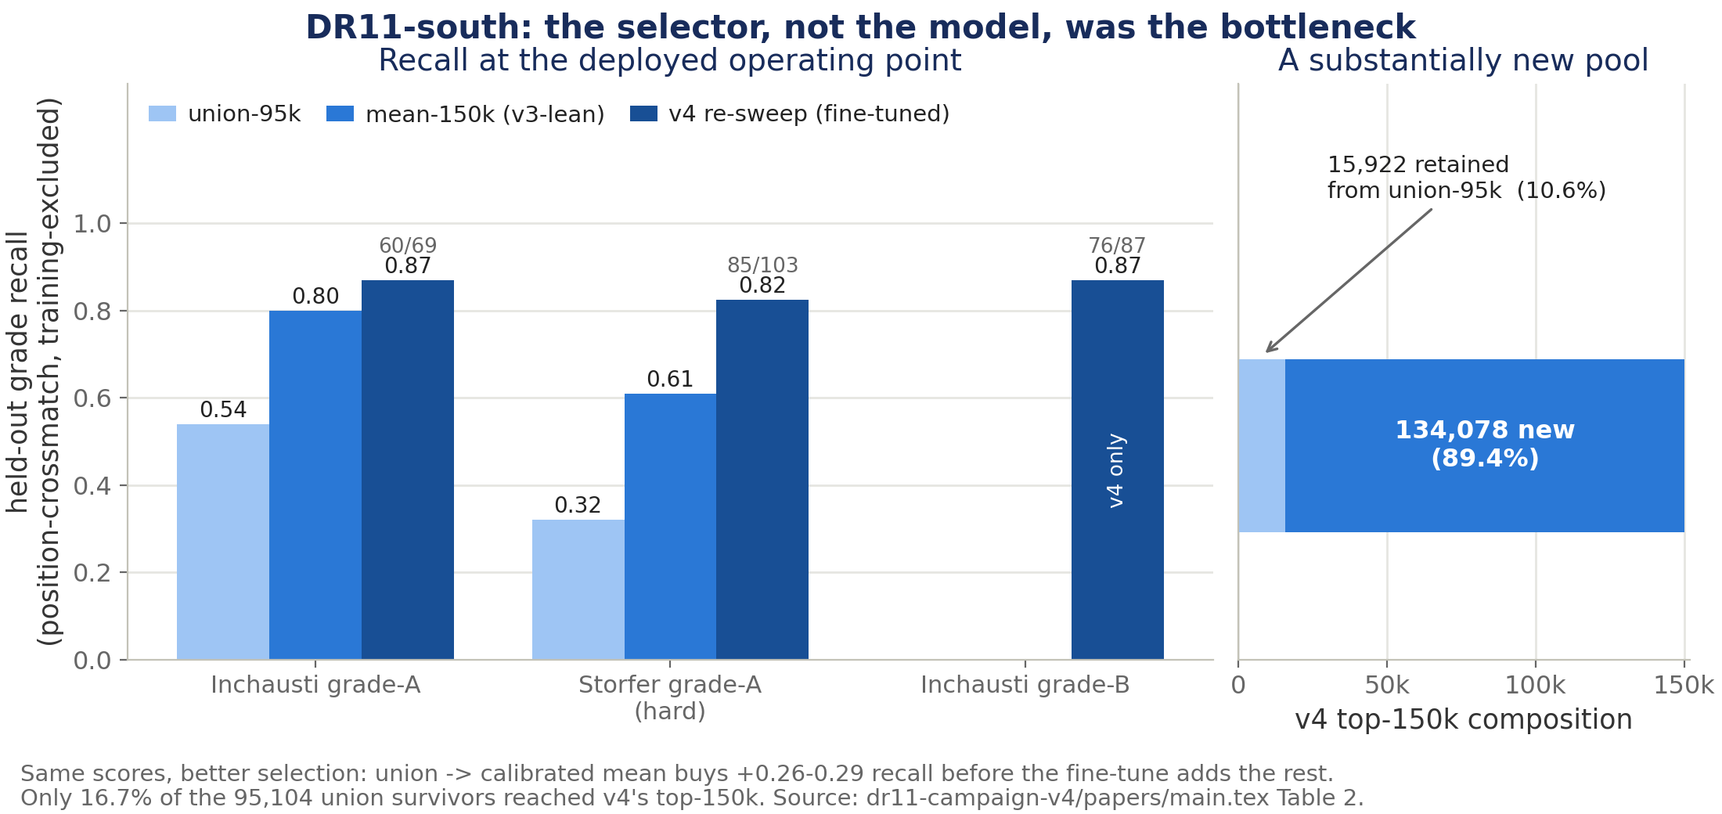
v4 — the full re-sweep and the candidate set
All 53,809,040 DR11-south galaxies re-scored with the fine-tuned ensemble (original parent cutouts reused); top 150k by mean
Status: the v4 candidate set is recall-richer but PENDING VETTING. The completed, HSC-vetted catalogue remains the v3blend8 as-run set.
Best recall of any configuration by a wide margin — and 89% of the top-150k is territory the union sweep never surfaced.
Notes:
The full v4 re-sweep. All 5.38e7 = 53,809,040 DR11-south galaxies re-scored with the fine-tuned ensemble, reusing the original parent cutouts (no re-extraction). Combiner = mean of [effnet_B, zoobot_N, and the three _b50_dr11 members]. Select the top 150k by mean.
Held-out recall, position-crossmatch, Storfer/Inchausti training-excluded -- the best of any configuration (dr11-campaign-v4/papers/main.tex Table 2):
Inchausti grade-A: union-95k 0.54 | mean-150k 0.80 | v4 0.87 (60/69)
Inchausti grade-B: v4 0.87 (76/87)
Storfer grade-A (hard): union-95k 0.32 | mean-150k 0.61 | v4 0.825 (85/103)
The full re-sweep recovers out-of-pool lenses that a survivor-only re-rank cannot: the v4 top-150k retains only 15,922 of the union-95k survivors and ADDS 134,078.
STATUS: this candidate set is recall-richer but PENDING VETTING. The completed, HSC-vetted catalogue is still the v3blend8 as-run set. Sections 4-5 of the dr11-campaign-v4 report (candidate catalogue + LensJudge HSC vetting, conclusion) are a scaffold, marked TODO.
If asked why mean-150k beats union-95k by so much: it is not only the extra 55k budget -- the union is dominated by single-member spikes, see slide 12.
Provenance: v4 numbers are transcribed from reproductions/claudenet/papers/v4_section.tex and reproductions/dr11-campaign-v4/papers/main.tex. The v4 result artifacts (resweep_v4_summary.json, dr11_finetune_gate.json, survivors_dr11s_v4.parquet) live on Perlmutter scratch, not in this repo.

Slide 15
What the DR11 sweep discovered — and the tension to hold
Recall / recovery — large, CI'd, established
Discovery — small, resolution-bounded
• v2-lean over v1 @0.01% FPR (paired bootstrap, 10,000 reps, 1M negatives):
– Storfer +0.340 [+0.306, +0.381]
– Inchausti +0.256 [+0.217, +0.301]
• v4 re-sweep, held out and training-excluded:
– Inchausti grade-A 0.54 → 0.87
– Storfer grade-A (hard) 0.32 → 0.825
• v4 fine-tune gate passes on all three held-out sets, AUC 0.996 → 0.998.
• Every one of these is a measured, interval-bearing number.
• v3 DR10 sweep: zero net-new lenses. The four "new" grade-A survivors are all previously published — Huang+2020 DESI-038.2078−03.3906, CSWA 1 (the Cosmic Horseshoe), DES J0352−3825, AGEL J221912−434835.
• v3's headline 49 cross-validated A/B are recoveries of published Euclid-Q1 lenses, not discoveries.
• v3 DR11 campaign: 3 genuinely new systems after HSC tier-2 vetting.
• v4: 134,078 new candidates, none vetted yet.
• "No net-new lens is established from DECaLS pixels alone." The resolution lever converts overlap candidates; it does not manufacture discoveries.
We got dramatically better at ranking lenses and only marginally better at confirming new ones — because the two are limited by different things: the combiner and the weights vs. the pixel scale.
Notes:
The central tension. Keep the two columns rigidly apart.
LEFT (established): v2-lean over v1 at 0.01% FPR: Storfer +0.340 [+0.306,+0.381], Inchausti +0.256 [+0.217,+0.301], paired bootstrap 10,000 reps over 1M negatives. v4 re-sweep: Inchausti-A 0.54->0.87, Storfer-A 0.32->0.825.
RIGHT (bounded): the v3 DR10 sweep produced ZERO net-new lenses -- the four 'new' grade-A survivors are all previously published (Huang+2020 DESI-038.2078-03.3906; CSWA 1, the Cosmic Horseshoe; DES J0352-3825; AGEL J221912-434835). v3's headline 49 cross-validated A/B are RECOVERIES of published Euclid-Q1 lenses, not discoveries. The DR11 campaign yielded 3 genuinely new after HSC vetting.
Why: 'no net-new lens is established from DECaLS pixels alone.' The resolution lever CONVERTS overlap candidates; it does not manufacture discoveries.
The nuance to land: v4's improvements are real and large on the metric we can measure. They have NOT yet been shown to convert into new confirmed lenses.

Slide 16
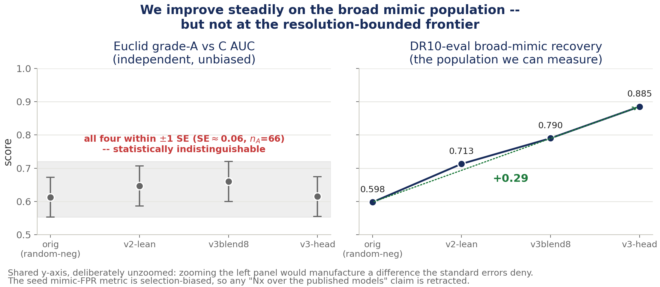
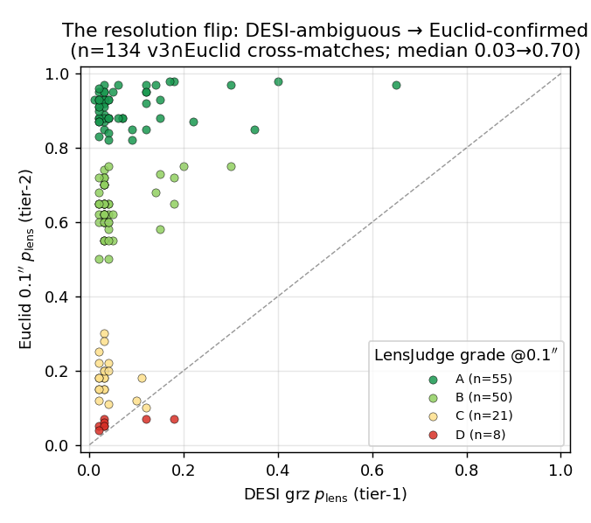
How confident are we? (I) The hardest test says the models tie
• Retracted: the seed mimic-FPR metric is selection-biased — the seed bank is precisely what the v2/v3 ensemble scored high — so any "N× over the original published models" claim read off it is invalid. We do not make it.
• Still solid: broad-mimic recovery 0.598 → 0.885 across the four generations (right panel), and the LensJudge escalation flip (median p_lens 0.03 → 0.70 at 0.1″ on 134 real objects, ~90% agreement with Euclid experts on grade-A).
On the one truly independent test, all four generations tie within a standard error. Resolution breaks the lens-vs-mimic tie; models don't.
Notes:
Confidence, part I. The hardest, most independent test says the models tie.
Independent Euclid grade-A-vs-C AUC (claudenet/data/v3/model_progression.json, v3_section.tex tab_progression):
orig (effnet_B, random-neg) 0.613 | v2-lean 0.647 | v3blend8 0.660 | v3-head 0.615. SE ~= 0.06, n_A = 66.
All four sit within about one standard error -- statistically indistinguishable at the hardest distinction (real lens vs convincing mimic at Euclid resolution).
RETRACTED: the seed mimic-FPR metric is selection-biased -- the seed bank IS what the v2/v3 ensemble scored high -- so any 'Nx over the original published models' claim read off it is invalid, and we do not make it.
What IS solid: v3 clearly beats the original CNN on the broad mimic population (DR10-eval recovery 0.598 -> 0.885); and LensJudge escalation flips median p_lens from 0.03 to 0.70 at 0.1 arcsec on 134 real objects, with ~90% agreement with Euclid experts on grade-A.
Conclusion: the discovery frontier is resolution-bounded for every model. Architecture and training gains do not resolve the lens-vs-mimic tie at Euclid resolution.

Slide 17
How confident are we? (II) Solid vs pending
Tense discipline: what is measured, what is vetted, what is merely promising
claim | evidence | interval | vetted? | status
v2-lean ≫ v1 ≫ published meta at matched FPR | NegEval-1M, 1M negatives | paired bootstrap 95% CI | n/a | SOLID
v4 fine-tune gate: +0.09 / +0.30 / +0.25 | held-out, training-excluded | no CI reported | n/a | SOLID
v4 re-sweep recall 0.87 / 0.825 | position-crossmatch, held out | no CI reported | n/a | SOLID
3 genuinely new lens systems | LensJudge + HSC tier-2 + literature | — | yes | CONFIRMED
v4's 134,078 new candidates | stage-1 mean only | — | no | PENDING
"N× better than the published models" | seed mimic-FPR (selection-biased) | — | — | RETRACTED
conformal-certified selection at DR11 scale | group-conformal BH | power floor reached | — | CERTIFIES NOTHING
The recall gains are established and v3's confirmed lenses are real. v4's new pool is promising but unvetted — so we make no discovery claim for it today.
Notes:
Confidence, part II. A ledger. Be precise about tense.
SOLID and interval-bearing: the matched-FPR recovery gains (v2 paired bootstrap over 1M negatives; v4 gate and re-sweep on held-out, training-excluded catalogs).
SOLID and vetted: 3 genuinely new lenses + 39 new DESI-resolution-only A/B from the v3 DR11 campaign, HSC tier-2 confirmed.
PENDING: the whole v4 candidate set. 134,078 new candidates, zero vetted.
RETRACTED: the seed mimic-FPR 'Nx' claim.
POWER-LIMITED: conformal selection certifies nothing at DR11 scale -- a surfaced power floor, not a null result.
And the provenance point, if it comes up: the v4 result artifacts live on Perlmutter scratch, not in the repo. Every v4 number in this deck is transcribed from v4_section.tex and dr11-campaign-v4/papers/main.tex. The v1/v2/v3 numbers are backed by tracked JSON under claudenet/data/.

Slide 18
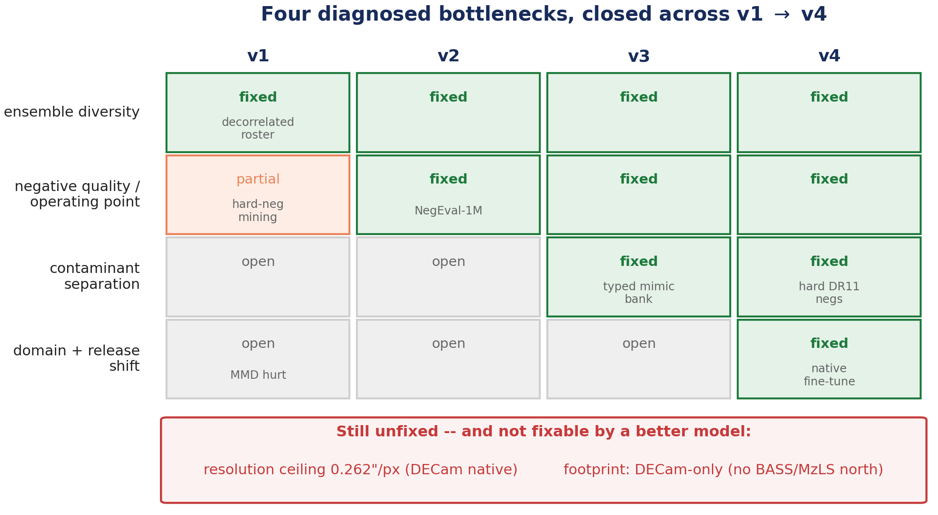
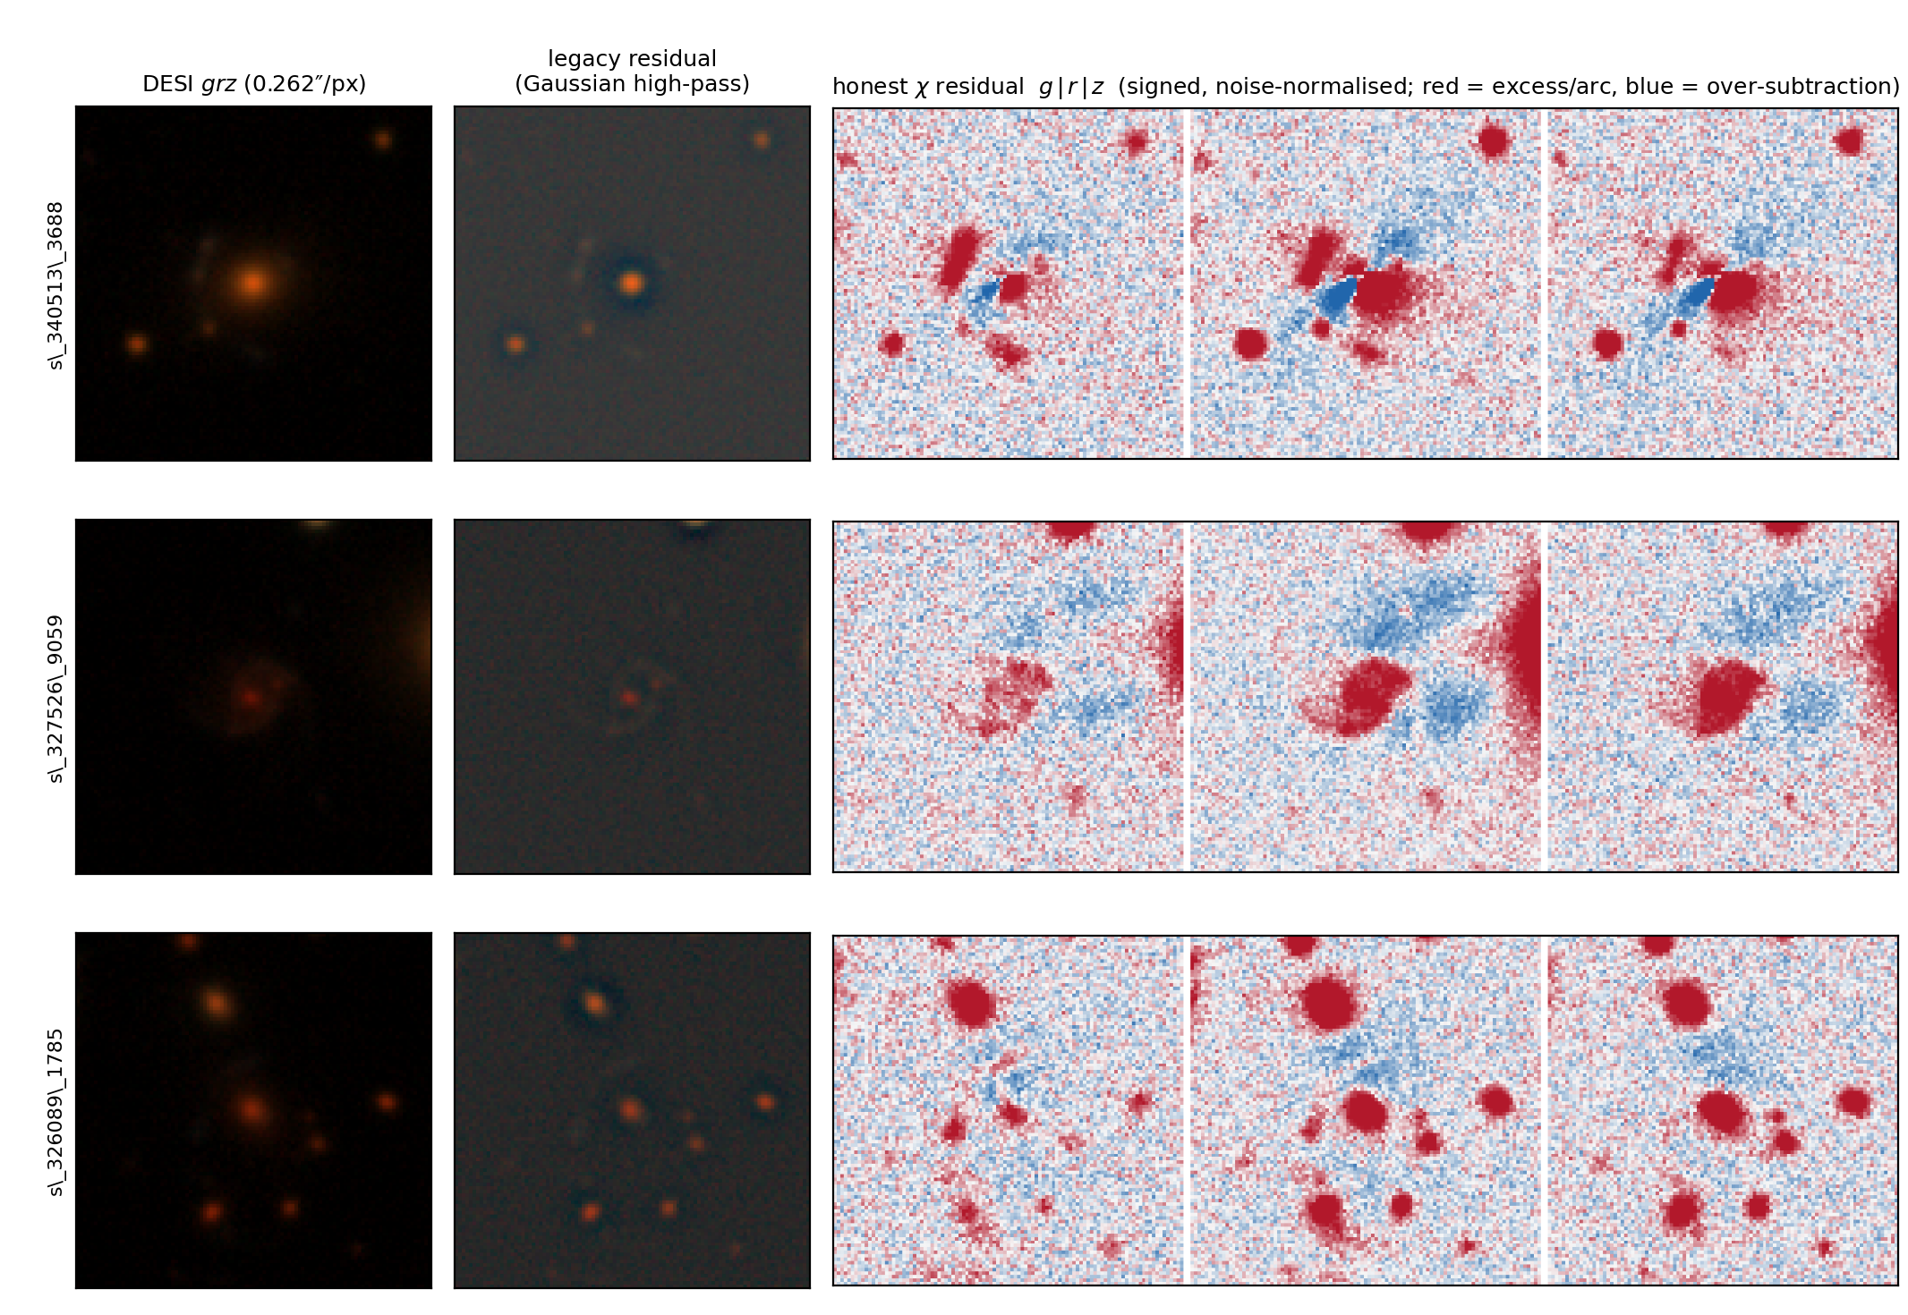
Honest scope — what ClaudeNet fixed, and what it cannot
• v4 remains DECam-specific: the BASS/MzLS north still under-scores systematically (v3's DR11-north top-30 contained zero Euclid A/B).
• The 0.262″/px ceiling is unchanged, and ~40% of Euclid grade-A/B lenses are not even in the DESI parent — too faint or too small for any DESI model.
• Robustness holds: replacing the legacy residual with a signed χ=(data−model)/σ runs ~2× hotter at tier-1 (raw A/B 90→135), but the HSC tier-2 gate absorbs it (24→27) and all 9 new-class systems survive.
Two structural limits remain — the northern instrument and the DECam pixel scale — and neither is fixed by a better model.
Notes:
Honest scope. Two structural limits remain, and neither is fixed by a better model.
1. v4 remains DECam-specific. The northern footprint (BASS/MzLS) still under-scores systematically -- the v3 DR11-north sweep had zero Euclid-A/B in its top-30. It needs north-native retraining.
2. The DECaLS 0.262"/px resolution ceiling is unchanged. Higher-resolution vetting remains the decisive net-new-discovery lever. About 40% of Euclid grade-A/B lenses are not even in the DESI parent -- too faint or too small. No model can cross that.
Robustness we did check: the legacy Gaussian high-pass residual was replaced by a signed chi = (data - model)/sigma, and the entire 500-candidate cascade was re-run in a paired design. The new residual runs ~2x hotter at tier-1 (raw A/B 90 -> 135) but the HSC tier-2 gate absorbs it (tier-2 A/B 24 -> 27). All 9 new-class systems survive. Conclusions unchanged.
Figures: fig7 (this deck) and dr11-campaign/papers/figures/residual_robustness.png.

Slide 19
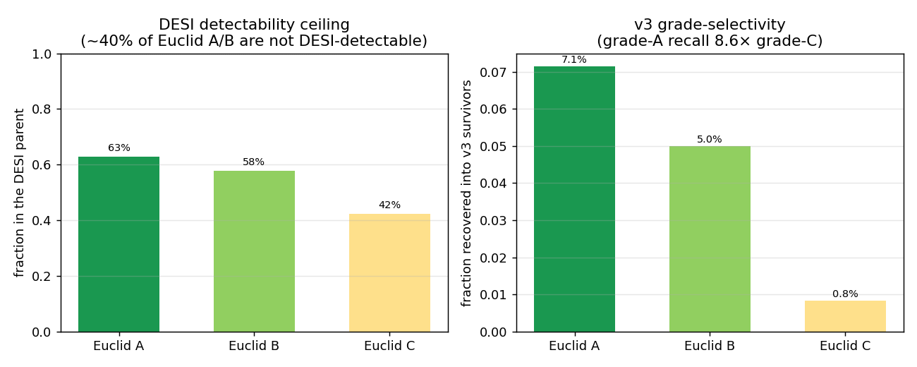
Future work — the levers, in priority order
1. Euclid pre-screening — the decisive discovery lever. v4 pre-screens DESI; Euclid confirms at 0.1″.
– Q1's ~63 deg² over three Deep Fields overlaps only ~0.5% of a DESI-south sweep — which is exactly why net-new yield is bounded there. Euclid DR1 (wide-area) inverts this.
– Ready action: a targeted sweep restricted to the Euclid-overlap sky, where every candidate is escalatable.
2. BASS/MzLS-north retraining — mine a north-native mimic bank and retrain. The recipe is instrument-agnostic; only the negatives change. ~3× the addressable footprint.
3. i-band / foundation-model revival for small θ_E — re-test the deferred AION/i-band lever under the narrower lens-vs-mimic task, not the random-FPR task where it failed in v2.
4. A pixel-level lens-vs-mimic head — the logistic head on member scores overfits the strict tail and doesn't generalise to Euclid; train a small CNN on pixels as a post-conformal re-ranker.
5. The active-learning loop — LensJudge exports confident-D rejections (true mimics, not resolution-flips) as fresh typed hard negatives: mine → grade → retrain.
The next real discoveries come from where we vet, not from what we train. Euclid-overlap sweeps and north-native retraining are the two highest-leverage moves.
Notes:
Future work, verbatim priorities from claudenet/papers/future_work.tex.
1. Euclid pre-screening -- the decisive discovery lever. v3/v4 pre-screen DESI; Euclid confirms at 0.1 arcsec. Q1's ~63 deg^2 over three Deep Fields overlaps only ~0.5% of a DESI-south sweep, which is exactly why net-new yield there is bounded. Euclid DR1 (wide-area) inverts this. The ready action is a targeted sweep restricted to the Euclid-overlap sky, where every candidate is escalatable.
2. BASS/MzLS-north retraining. Mine a north-native lens-mimic bank and retrain the members -- the recipe is instrument-agnostic, only the negatives change. Roughly triples the addressable footprint.
3. i-band / foundation-model revival for small theta_E. Re-test the deferred AION/i-band lever under the NARROWER lens-vs-mimic task, not the random-FPR task where it failed in v2. Targets the red-lens/red-companion degeneracy.
4. A pixel-level lens-vs-mimic head. The learned logistic head on member scores overfits the strict tail and does not generalise to Euclid; train a small CNN head directly on pixels (positives=lenses, negatives=the typed mimic bank) as a post-conformal re-ranker.
5. The active-learning loop. LensJudge exports confident-D rejections -- true mimics, NOT objects that flipped to A/B at higher resolution -- as fresh typed hard negatives, closing a mine->grade->retrain loop.
6. A full DR11-south candidate catalogue: realised, that is v4.

Slide 20
Next step, and what to deploy
Immediate
• Run the LensJudge v3 HSC tier-2 cascade on the v4 NEW shortlist (134,078 candidates). This fills sections 4–5 of the dr11-campaign-v4 report, which are still a TODO scaffold.
• It is the one action that could convert v4's measured recall gain into an actual vetted yield. Reference cost: the v3 campaign vetted 500 candidates for $40.38.
Deployment recommendation
• DR11-south: ship v4 — the release-native fine-tuned ensemble with the calibrated-mean stage-1 selector.
• DR10-south and the Euclid cross-validation: retain v3blend8.
• In all cases combine with the score mean, not the learned head — it does not generalise past φ = 0.05 — and vet with the LensJudge cascade.
• This keeps v2-lean's lens recall, adds v3's contaminant rejection and v4's release-native gain on the hard residual, and routes the resolution-breaking confirmation to exactly the candidates with higher-resolution coverage.
Ship v4 with the mean selector for DR11-south now; vet its 134k new candidates next. That is the step that could turn a recall gain into new lenses.
Notes:
The immediate next step and the deployment recommendation.
IMMEDIATE: run the LensJudge v3 HSC tier-2 cascade on the v4 NEW shortlist (134,078 new candidates). That fills in sections 4-5 of the dr11-campaign-v4 report, which are currently a TODO scaffold, and it is the one action that could convert v4's measured recall gain into an actual vetted yield. The v3 campaign cost $40.38 for 500 candidates, so budget accordingly for the shortlist.
DEPLOYMENT (future_work.tex): for DR11-south ship v4 -- the release-native fine-tuned ensemble with the calibrated-mean stage-1 selector. Retain v3blend8 for DR10-south and the Euclid cross-validation. In all cases use the score MEAN, not the learned head (it does not generalise past phi=0.05), plus the LensJudge cascade for vetting.
What this buys: keeps v2-lean's lens recall, adds v3's contaminant-rejection edge, adds v4's release-native gain on the hard residual, and routes the resolution-breaking confirmation to exactly the candidates that have higher-resolution coverage.

Slide 21
Summary
• The lineage's ceiling was never architecture — a 194k ResNet ties a 20.5M EfficientNet, and the published meta-learner was a simple average in disguise.
• ClaudeNet's levers, in the order each exposed the next: diversity (v1) → honest deployment-scale negatives (v2) → contaminant awareness (v3) → release-native adaptation (v4).
• v4 = v3's members + a calibrated-mean selector (free) + a DR11-native fine-tune (one GPU pass). Best recall of any configuration: Inchausti grade-A 0.54 → 0.87.
• The honest split: recall gains are large and CI'd; net-new discovery is three confirmed systems from the v3 DR11 campaign, and v4's 134,078 new candidates remain unvetted.
• On the one independent test, all four generations tie within one standard error. The frontier is resolution-bounded.
3 confirmed · 134,078 pending — the three genuinely new systems (DESI grz, HSC grizy)
s_327526_9059
s_340971_2860
s_325163_2981
We built a demonstrably better lens-ranker — and drew a clean line between what that proves (recall) and what it does not yet prove (discovery). The path forward is resolution, not architecture.
Notes:
Summary. Land the two-part claim cleanly and stop.
We built a demonstrably better lens-ranker, and we drew a clean line between what that proves (recall) and what it does not yet prove (discovery).
The path forward is resolution, not architecture.
Cutouts: the same three genuinely new systems as the title slide (s_327526_9059, s_340971_2860, s_325163_2981), DESI grz over HSC grizy.

