Slide 1
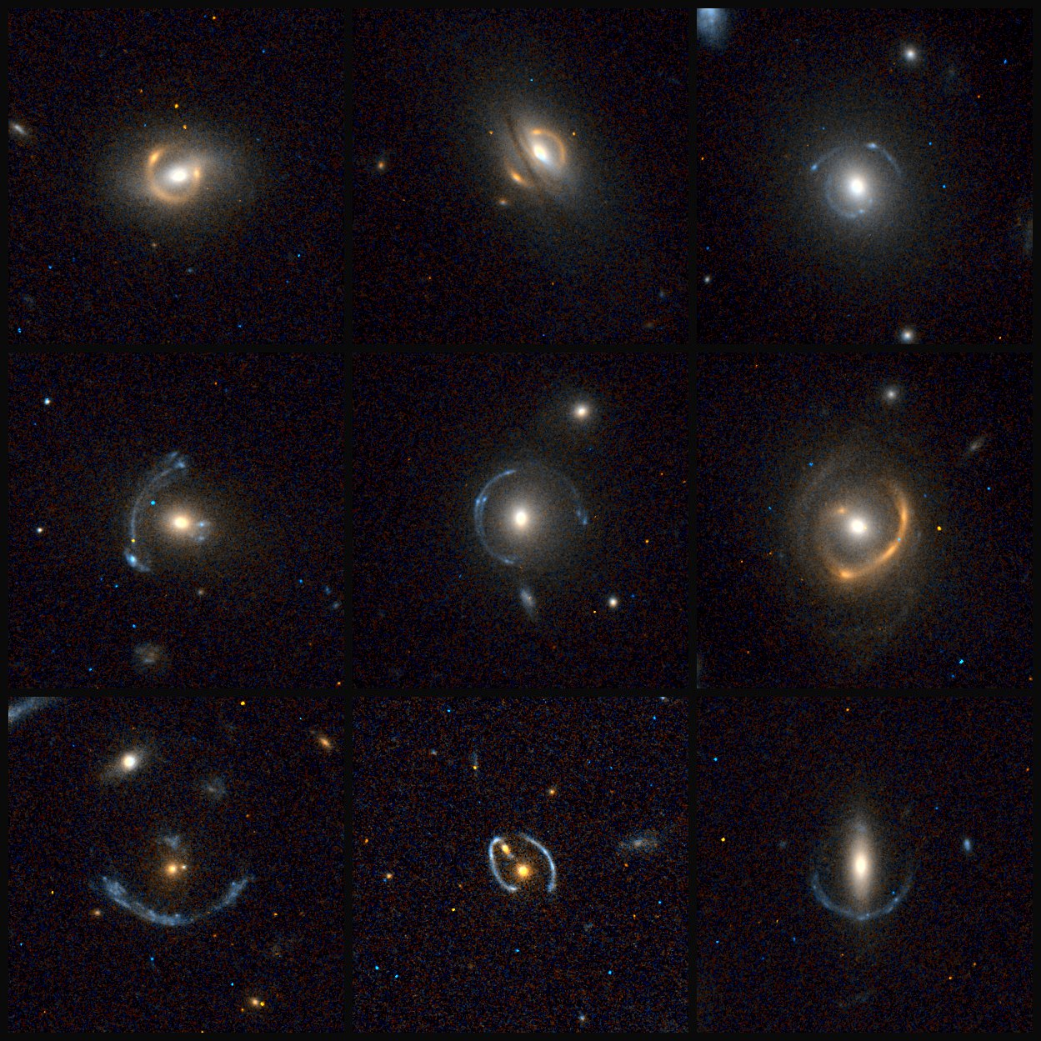
Nine strong-lens candidates — original cutouts in png
For final product see slide 9
Notes:
91, 89, 68,
74, 60, 41,
30, 24, 40

Slide 2
PROMPT 0, 1
“Tell me what you see in these 9 images. And gives me a description of what you see that supports your judgement.” “Do it this way: add arrows with different colors in the each figure, and then in your description refer to the arrows by color for each feature that you have identified.”

Slide 3
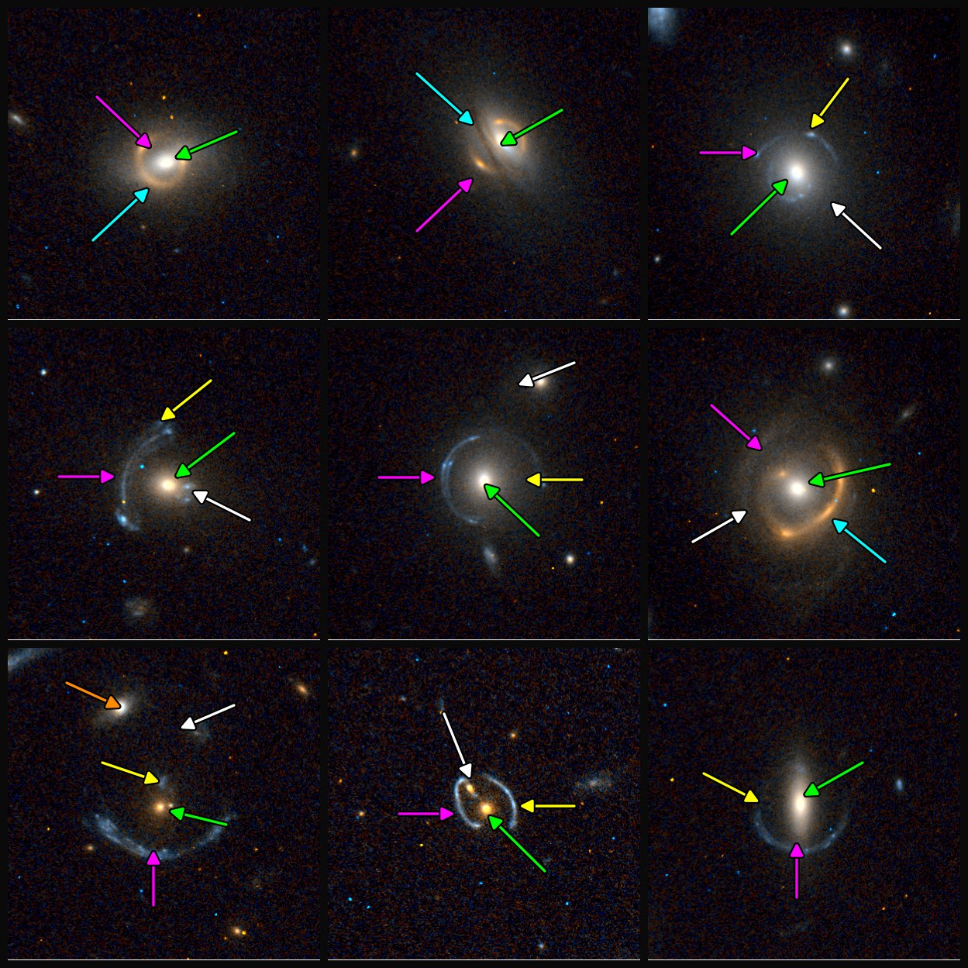
Step 1 — Colored arrows mark the identified features

Slide 4
PROMPT 2
“Now, for each image, add a circle around all objects that are not related to the lensing system -- whether these are field galaxies (dashed circle) or stars (dotted circle). The size of the circle for each marked object should be the size of a mask that needs to be applied during lens modeling.”

Slide 5
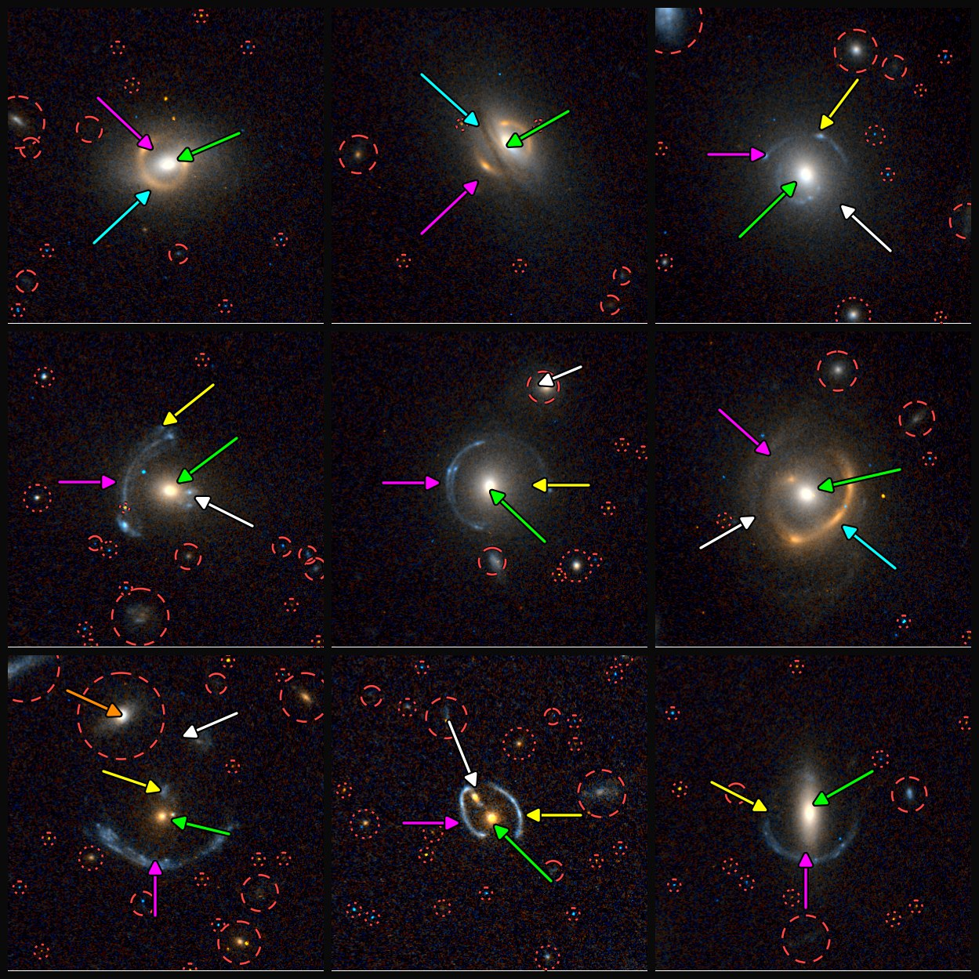
Step 2 — Mask circles: dashed = field galaxy, dotted = star

Slide 6
PROMPT 3
“1. Assume the cutout is 16" across, estimate the Einstein radius for each system.
2. For the arrows, add legend on the each panel to indicate what each arrow points at.”

Slide 7
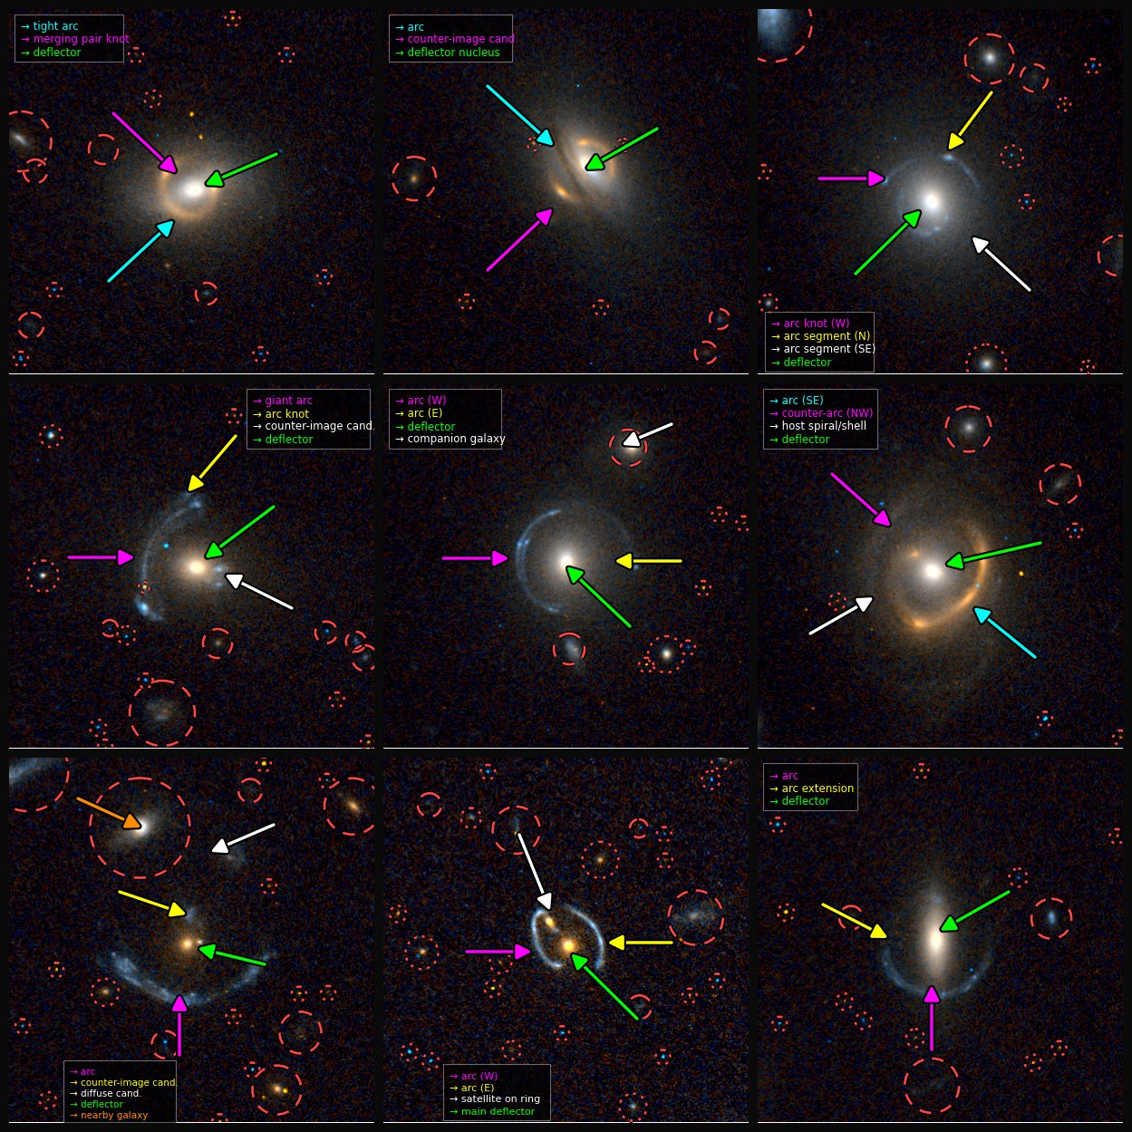
Step 3 — Arrow legends added; θE estimated (16″ cutouts)

Slide 8
PROMPT 4, 5, 6
“mark the estimated Einstein radius on each panel”
“draw the einstein ringe in gray dotted circles”
“make the dots making up the einstein rings even smaller -- half their current size -- and the separation between the dots 3 times the radius of each dot.”

Slide 9
Step 6 — Fine-dot Einstein rings:

Slide 10
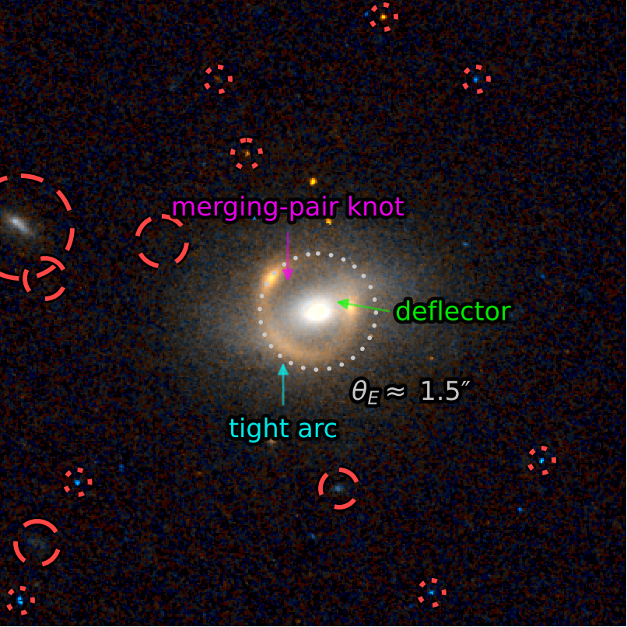
System 1 — 91
θE ≈ 1.5″ (geometric) · annotation

Slide 11
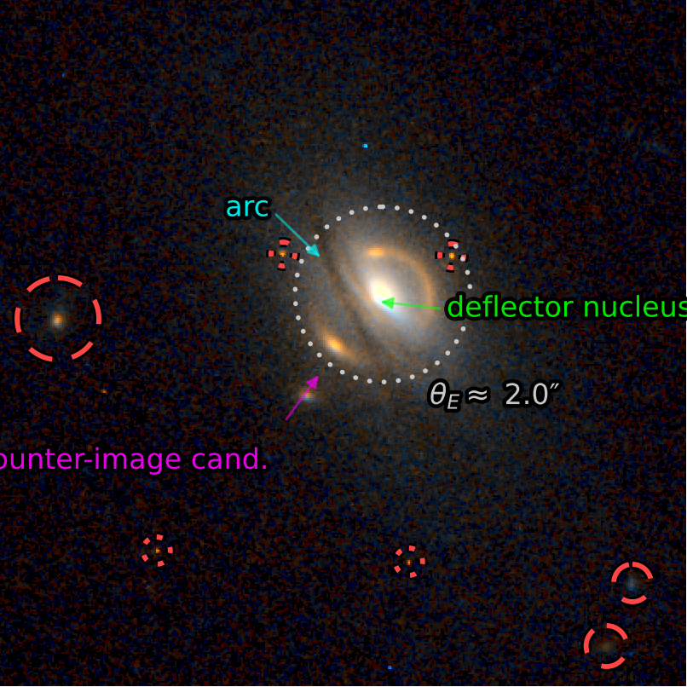
System 2 — 89
θE ≈ 2.0″ (geometric) · annotation

Slide 12
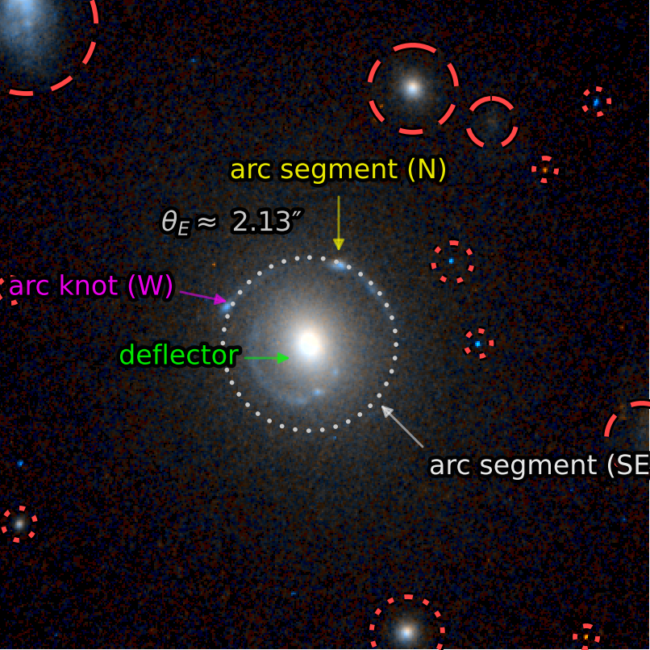
System 3 — 68
θE ≈ 2.13″ · annotation

Slide 13
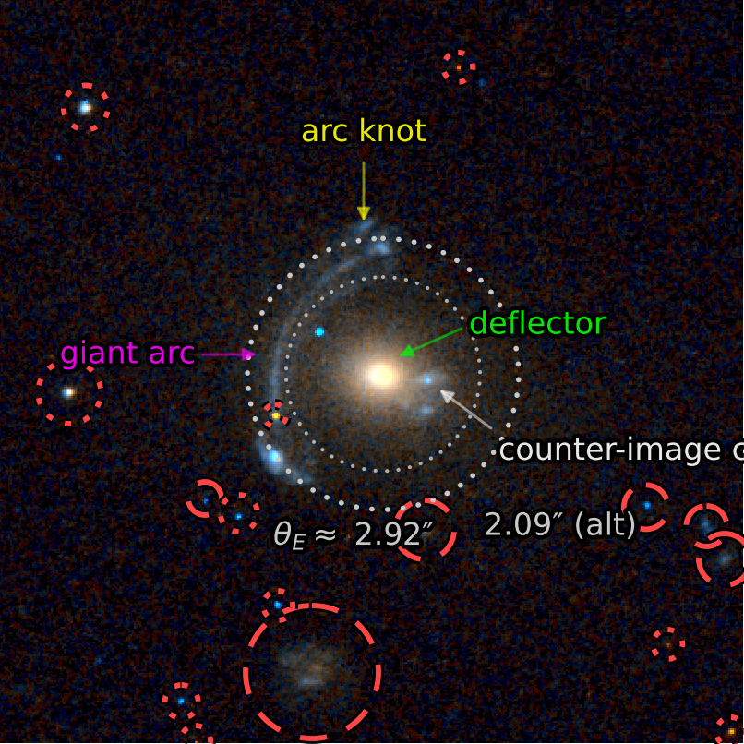
System 4 — 74
θE ≈ 2.92″ (alt 2.09″) · annotation

Slide 14
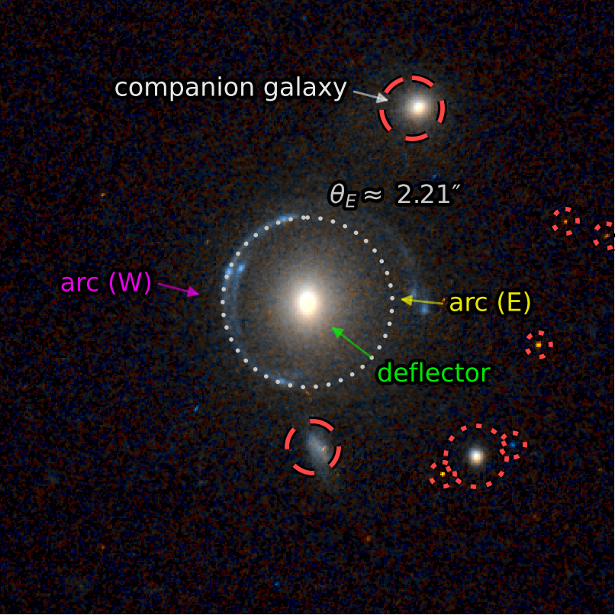
System 5 — 60
θE ≈ 2.21″ · annotation

Slide 15
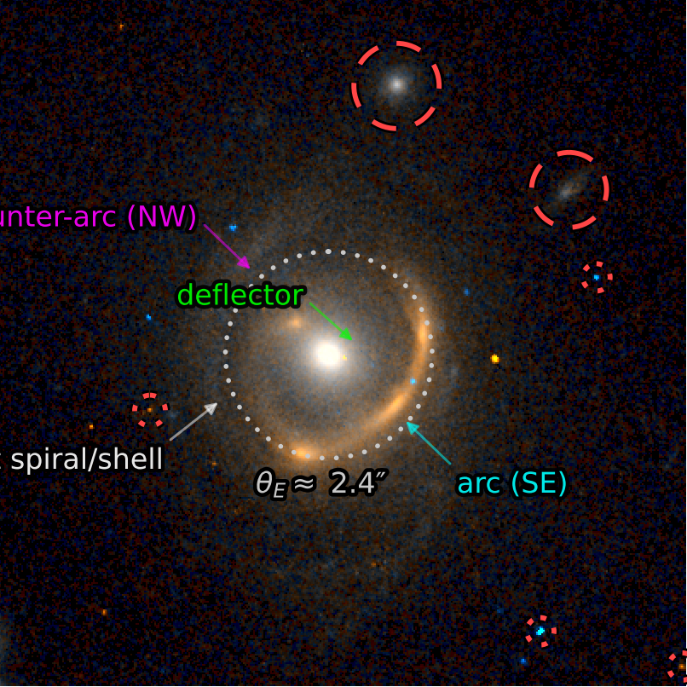
System 6 — 41
θE ≈ 2.4″ (geometric) · annotation

Slide 16
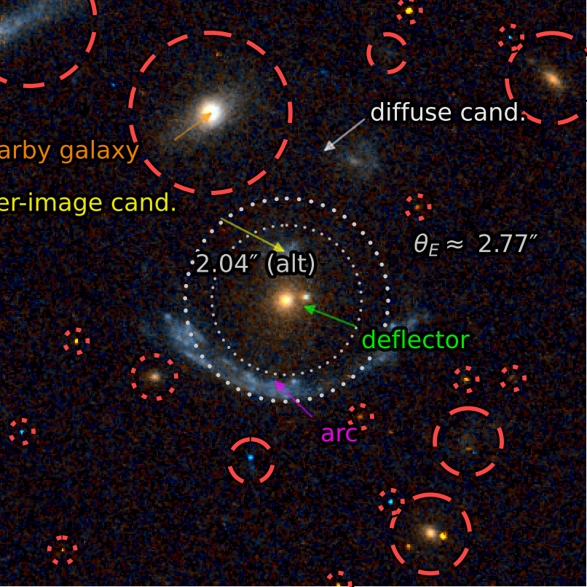
System 7 — 30
θE ≈ 2.77″ (alt 2.04″) · annotation

Slide 17
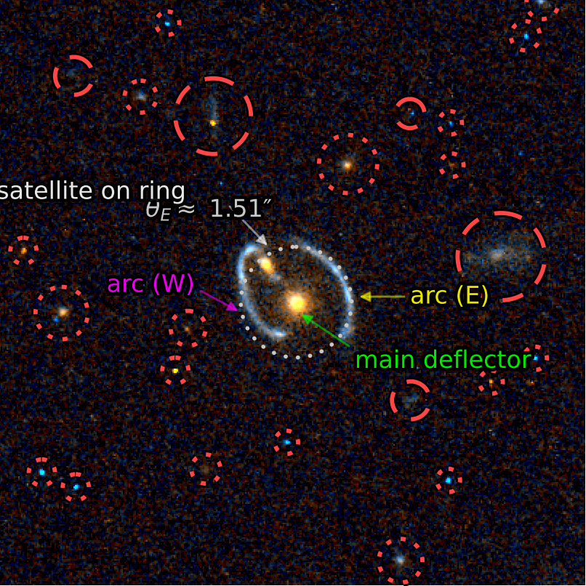
System 8 — 24
θE ≈ 1.51″ · annotation

Slide 18
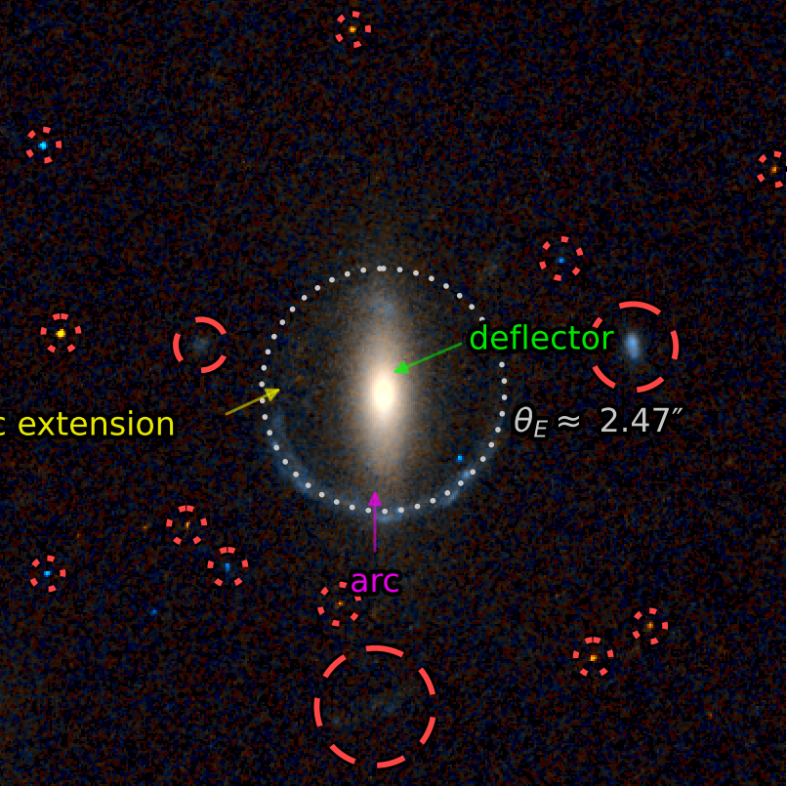
System 9 — 40
θE ≈ 2.47″ · annotation

