Slide 1
AstroMark
A symbolic notation and metadata format for annotating astronomical images
Research, proposals and recommendations · 3 September 2026 · Nothing here is adopted — this is for the team to choose from
1

Slide 2
What was asked, and what is here
formats/AstroMark/research/
– The ask. A concise but descriptive notation, useful to humans and to models, for marking features in telescope images. Lenses first, astronomy generally later.
Three specific questions: should it be accessible without colour? can the symbols be thin but readable? can marks be resized for emphasis?
– The work. 66 formats surveyed across 8 domains. Four visual notations designed, prototyped and measured. Six metadata architectures encoded and compared. A draft spec for the recommendation.
– The evidence. Working code, deterministic from a seed: a synthetic reference scene, a prototype renderer, colour-vision simulation, a measurement harness, and worked examples on real JWST data.
– The status. Recommendations, not decisions. Where the evidence is thin, the slides say so.
2

Slide 3
The recommendation, in one table
 | Pick | Why
Notation | N1 Terminator alphabet, with N4 prototyped beside it | N1 keeps the arrow and costs least; N4 is the only one that fixes the named defect
Container | P1 evolved bespoke | the cheapest decision — converters are 57–161 lines
Identity | prefixed terms in one vocabulary file | this is where every actual problem is
Model surfaces | read the line form, write JSON | the only arrangement satisfying both the schema rule and the token budget
Portrayal | out of the record | so no field can carry meaning by appearance
Accessibility | hard constraint, tested | role by shape, polarity by texture
Do first | build the vocabulary file | the only artifact every proposal shares
Detail in 07-recommendation.md
3

Slide 4
PART ONE
The problem
What the current format is, and what is actually wrong with it
4

Slide 5
Four things were competing for one name
This is why the naming conversation went in circles
– The app — hand, model and voice annotation. Named: LensMark.
– The symbolic notation — what the marks mean. Unnamed.
– The metadata format — vector JSON, provenance, render contract. Unnamed.
– The standard as a whole — what gets published and adopted. Unnamed.
– Naming the fourth separately is what unlocks the rest: a general core with domain profiles, so the lens work becomes astromark/lens/1.0 rather than the whole thing, and LensMark keeps its name as the reference implementation.
naming-study.md
5

Slide 6
What the current record looks like
lensmark/1.0 — 11,184 characters per deck on average, across 19 real decks
{
"schema_version": "lensmark/1.0",
"image": { "sha256": …, "cutout_arcsec": 16.0, "pixel_scale_arcsec": 0.0397, … },
"system": { "grade": "A", "theta_e": { "value_arcsec": 1.45, "method": "geometric" },
"verdict": "likely_lens", "description": "free text …" },
"style_defaults": { … the whole style table, copied into every file … },
"items": [
{ "type": "arrow", "tail": [.40,.30], "head": [.46,.40],
"label": "arc", "color": "cyan" },
{ "type": "mask_circle", "center": [.80,.20], "radius_arcsec": 0.9,
"kind": "galaxy", "color": "mask_red" },
{ "type": "einstein_ring", "center_ref": "…", "theta_e_arcsec": 1.45 }
]
}
Geometry is normalized [u, v]; sizes are arcsec; the render is already deterministic and pinned by nine golden hashes. The bones are good.
6

Slide 7
Nine structural problems — and what each one really is
Audited against the codebase, not inferred
Symptom | What it actually is
Enums defined in six uncoordinated places | term identity, unowned
θ_E stored twice and unlinked | identity of a *measured quantity*
theta_e.method a free string despite three named rules | a term with no vocabulary
green = deflector; colours reserved by item type | a term smuggled into portrayal
prose refers to arrows *by colour* | a term with no referenceable id
the style table copied into every data file | portrayal had no identity, so it was inlined
no role field — semantics in a 40-char label | a term hidden in free text
no polarity | a missing term
no polygon, no secondary ring, no source grouping | missing terms, and a missing grouping term
04-metadata-proposals.md §0
7

Slide 8
NINE FOR NINE
They are all vocabulary-identity problems.
Not one would have been prevented by GeoJSON, by Web Annotation, or by tables. So: choose the container for cheapness. Put the rigour in the vocabulary.
8

Slide 9
The sharpest instance
How the current system decides what is a lens galaxy
# lensmark/validate.py:75 — and again, independently, in frontend/src/geometry.ts
def _is_deflector(label):
return bool(label) and "deflector" in label.lower()
# so this label renders GREEN — the colour that means lens mass:
"spiral arm, NOT a deflector"
The semantics of the standard ride on substring-matching an optional 40-character string, in two languages, with no shared definition.
9

Slide 10
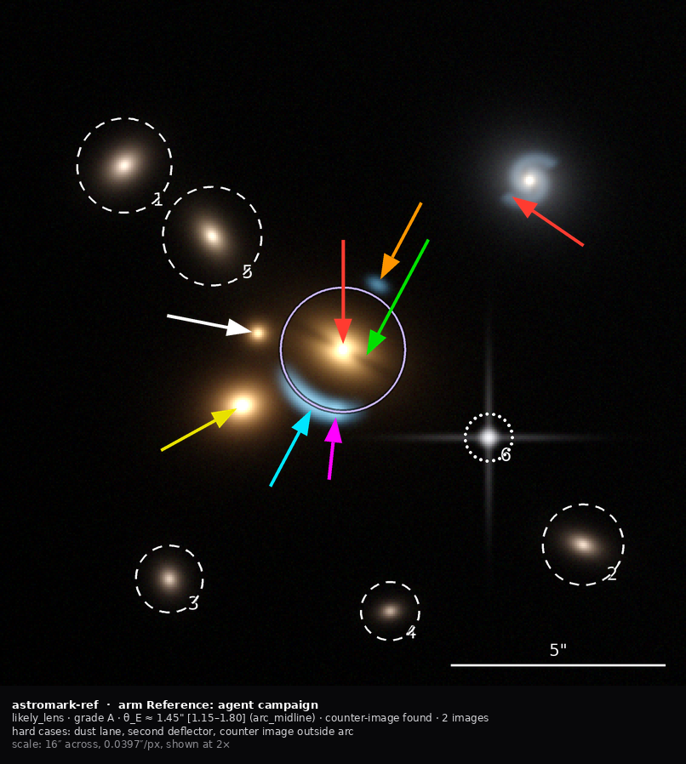
What the best annotations so far look like
The agent campaign the room preferred — reproduced here at its own constants
Why it was liked, and where it stops
Measured strengths. 1.2–2.3% ink inside the image. Arrows never overlap the feature. Line style separates the measured ring from galaxy and star masks. Every mask numbered and keyed to a table. The key sits below the image.
Measured weaknesses.
The colour key is only partly consistent: red and green are locked, four colours are opportunistic, and cyan flips between “unrelated field object” and “lensed feature” *within the same nine-panel set*.
Uncertainty is text only — a question mark, “would-be”, a parenthetical range.
Negative evidence has no visual channel at all. Flipping through nine panels, you cannot tell which one is the non-lens from the marks.
03-notation-proposals.md
10

Slide 11
PART TWO
How other fields solved this
66 formats across 8 domains. Medicine solved this thirty years ago; astronomy largely has not.
11

Slide 12
The survey
01-prior-art/
66
formats examined, primary sources where reachable
8
domains: radiology, medical vocabularies, computer vision, web and geospatial, astronomy overlays, astronomy metadata, notation theory, accessibility
9
mechanisms independently arrived at by 6–10 domains
8
well-designed standards that died anyway
12

Slide 13
Radiology's foundational move: a term is never a string
DICOM PS3.3 §8.3
# DICOM coded entry — three mandatory fields plus an optional version
Code Value (0008,0100) the opaque, stable identity
Coding Scheme Designator(0008,0102) which vocabulary it came from
Code Meaning (0008,0104) the human-readable string
# and the rule that makes it work, from PS3.3 §8.3, normative:
"the Value of Code Meaning shall NEVER be used as a key, index or
decision value ... Code Meaning is a purely annotative, descriptive
Attribute." ... "This does not imply that Code Meaning can be
filled with arbitrary free text."
LensMark's 40-character substring-matched label is precisely the anti-pattern that sentence exists to forbid.
13

Slide 14
What else radiology settled
DICOM SR, GSPS, RT Structure Sets, SEG
– Portrayal is a separate object. A Presentation State is its own instance that *references* images; the pixels are never modified. Standardised in 1999.
Meaning rides on a graphic layer, and every layer carries a greyscale value and a CIELab colour. Redundant achromatic encoding is in the data model, not bolted on.
– The measurement is primary; the geometry is inferred from it. The shape is a witness, not a second copy — which is exactly the fix for θ_E stored twice.
– Presence is three-valued and coded: present, absent, undetermined. AIM used a boolean and the standard records why that was wrong: a boolean cannot say “undetermined”.
– Generation method is three-valued: automatic, semiautomatic, manual. The middle value is the one everyone omits and everyone needs — a model-proposed arc that a human nudged is neither.
– Two identities per mark: this mark, and the physical thing it is of. Grouping then becomes emergent rather than structural.
01-prior-art/medical-imaging.md
14

Slide 15
THE CAUTIONARY TALE
NCI's AIM got the central abstraction exactly right, and died.
It invented the markup-versus-annotation split in 2008 — the same architecture this project arrived at independently. Its reference repository is archived; the last substantive commit was 29 April 2014. Three verifiable reasons: it put lineColor and lineThickness on its own geometry class, violating its own thesis in its own schema; 58 of its 124 types were relationship classes with names like ImagingObservationEntityIsIdentifiedByTwoDimensionGeometricShapeEntityStatement; and it imported ISO datatype machinery because it looked rigorous.
This is why the recommendation takes AIM's identity and leaves AIM's ceremony
15

Slide 16
Graded assessment: BI-RADS has the answer to the grade problem
The most actionable unclaimed idea in the survey
– BI-RADS defines its scale as a three-column table: ordinal category · numeric probability band · the specific next observation that would settle it — plus a published expected prevalence per grade.
– PI-RADS goes further and DERIVES the grade from coded component scores by a published lookup table. The evidence is stored; the verdict is computed.
– For a project whose goal is consistent grading between annotators, the derived model makes disagreement locatable: two graders who differ on the verdict but agree on the evidence have a different problem from two who differ on the evidence.
– Grades A–D are currently used with only the borderline class defined on the record. This is the direct answer, and it is unclaimed.
01-prior-art/vocabularies-and-grading.md
16

Slide 17
Astronomy: DS9 got it wrong and right in the same application
The record/portrayal separation, demonstrated by the same authors who got it wrong
# a line from DS9's own reference test file —
# 38 characters of geometry, 106 characters of portrayal:
circle(202.48643,47.208449,3.964") # color=pink width=3 font="times 10"
text={Circle} tag={foo} tag={foo bar} This is a Comment
# the DS9 CATALOG TOOL, same program, stores no colour per row —
# it stores a rule evaluated against the data's own columns:
condition [string equal $Class SNR] -> shape diamond, colour red
size $Jmag/2.
Root cause: a region file is a serialization of what is ON THE SCREEN, not a record of what is true — so colour, window state and a decorative version string all belong in it, and the image reference does not. And JS9 shows the cost: it grew a boolean query language over colour, which freezes the palette forever.
17

Slide 18
THE NEAREST NEIGHBOUR
Space Warps encoded “not a lens” as the absence of markers.
In a strong-lensing citizen-science project at scale — the closest possible neighbour to this work — a volunteer placing no marks *was* the rejection. The reasoning behind a negative was never recorded, only its outcome. That is the same gap the workshop identified in the current annotations, reached independently. It is the strongest argument for making negative evidence a first-class mark.
18

Slide 19
Nine convergences
Mechanisms unrelated domains arrived at independently
Mechanism | Domains
A term is an opaque code; the display string is documentation | 7
Record and portrayal are separate, separately versioned artifacts | 10
Geometry and meaning are two objects joined by a stable id | 10
Never join by ordinal index | —
Absence is not one thing; a missing key is never enough | 8
A measurement lives in exactly one place; geometry is derived | 8
Deprecate additively, never delete; make the retirement link typed | 6
Generate every downstream artifact from one source file | 7
Colour is never the only carrier; the achromatic rendering is authored | 7
The rich canonical form needs a flat companion or it does not get written | 7
The last one is independent confirmation of the read/write asymmetry — in four of those seven, the flat companion is what actually shipped
19

Slide 20
PART THREE
The three questions you asked
Accessibility · thin but readable · resize for emphasis
20

Slide 21
QUESTION ONE — ACCESSIBILITY
Yes — and it changes the notation, not just the palette.
Role is carried by glyph SHAPE. Polarity by stroke TEXTURE. Colour reinforces and never carries alone (WCAG 2.2 SC 1.4.1). Two consequences fall out rather than being imposed: size cannot carry emphasis, because size is already spoken for by measurement; and colour cannot carry polarity — which is where the room had independently arrived.
21

Slide 22
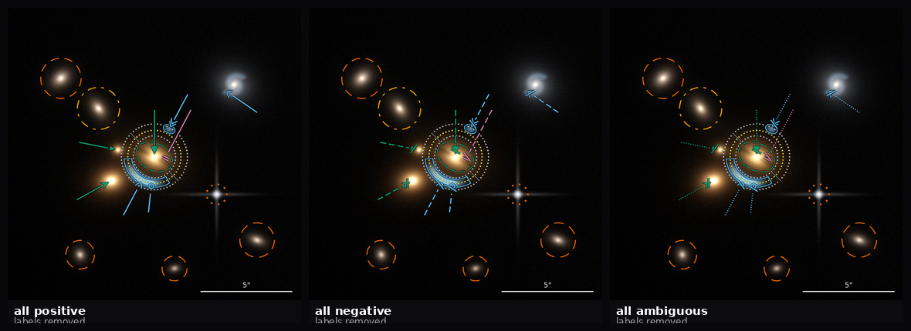
Accessibility as a test, not an aspiration
The same document rendered three times — all positive, all negative, all ambiguous — with every label removed
If this sheet were ambiguous, the polarity channel would have failed.
05-accessibility-design.md · examples/cvd.py
22

Slide 23
The gate, and its result
For every pair below the ΔE floor, assert that a non-colour channel differs
136
pairs of marks that can share a panel, checked under normal vision, deuteranopia, protanopia, tritanopia and greyscale
123
of them — 90% — are NOT reliably separable by colour under some vision condition
0
are separated by colour alone. Every one differs in shape, texture or orientation.
The floor is calibrated, not guessed: pure red against pure green still measures ΔE2000 = 12.9 under deuteranopia — almost all of it lightness — so a floor at 12 would wave through the canonical confusion. It is set at 15.
23

Slide 24
QUESTION TWO — THIN BUT READABLE
The problem was misdiagnosed. It was never mainly stroke width.
24

Slide 25
Where the ink actually goes
Measured on the real renders
 | ink over the panel | of which, the on-image legend plate
LensMark today, deck-01 | 7.7% | 4.6%
deck-04 | 10.8% | 6.6%
deck-08 | 9.7% | 5.3%
deck-07 (legend off) | 9.0% | 0%
The campaign the room liked | 1.2–2.3% | 0% — its key sits *below* the image
The legend plate is roughly half the total ink, and in most decks more than every arrow, circle, ring and label combined. Note deck-07: thirty items, no plate, and still lighter than the eleven-item decks that have one.
25

Slide 26
THE RULE THAT FOLLOWS
No ink inside the image rectangle that is not about a specific location in it.
This settles the apparent contradiction in the record. “Labels go on the object” and “the legend obscured the image” are both true and are about different things: identification belongs on the object, the key belongs below. The notation key is printed once per SHEET, not once per panel. One principled exception: the scale bar, because a length comparison needs physical adjacency to the pixels being compared.
26

Slide 27
QUESTION THREE — RESIZE FOR EMPHASIS
Emphasise the stroke, never the path.
The obstacle is that some marks encode a measurement in their size — the ring radius IS θ_E. So every drawn scalar is tagged METRIC or PRESENTATIONAL, and emphasis scales only the presentational ones. A ring at key gets heavier, closer-spaced dots and a stronger casing — it visibly shouts — while its radius does not move by one pixel.
27

Slide 28
The partition
Three ordinal levels: muted · normal · key
PRESENTATIONAL — emphasis scales these | METRIC — emphasis never touches these
stroke width, glyph size, label size and face | circle radius (mask, θ_E, bounds)
casing width, dot radius and spacing | polygon vertices
layer alpha, shaft length, tail position | pointer head position
Exactly three, and that is a bound rather than a preference: at 3:1 contrast the achievable lightness levels between black and white are 0.000, 0.100 and 0.400 — a fourth would need 1.30, which does not exist.
28

Slide 29
Three design decisions inside the emphasis mechanic
– An ordinal enum, not a float. A float invites 1.37 and makes cross-panel comparison meaningless.
– The attention mark is corner brackets, not a halo ring. This notation has already spent circles on measurement; a new circle around a feature reads as another measured radius. A square never does.
– A guard rail: dot radius capped at 0.08 × radius, because oversized dots bias the radius a reader measures off the ink. A small circle therefore cannot be emphasised past a point — which is correct.
– Per-layer alpha, never per-stroke, or two overlapping muted strokes double-composite and darken — an order-dependent defect that is painful to reproduce.
– Two golden assertions come with it: absent emphasis must render byte-identical to normal, and the radius recovered from the ink must be identical across all three levels to 0.1%. That second one is what catches a multiplier leaking into a metric path.
29

Slide 30
PART FOUR
Four notations, prototyped and measured
One neutral content file, compiled to each — so the sheets compare notations rather than annotators
30

Slide 31
The four organising principles
All four inherit one substrate, so the comparison has a single variable
 | Principle | The idea worth having
N1 | Terminator alphabet — keep the pointer, move the weight into the shape at the business end | families as the thumbnail layer: filled = mass, open = light, bar = obstruction
N2 | Bertin ledger — assign each visual variable to exactly one semantic dimension; the table IS the spec | orientation derived from the physics: tangential tick = lensed light, radial = mass
N3 | Station model — one composite badge per object, one fixation | polarity for one stroke; a source index, which nothing today can express
N4 | Evidence graph — annotate the argument, not the objects; the primitive is a link | the source chord; a struck chord makes the non-lens visible at thumbnail size
31

Slide 32
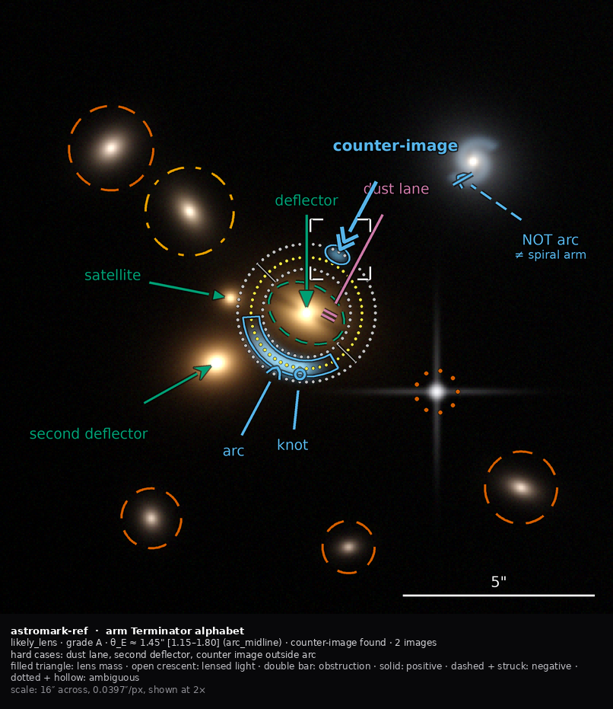
N1 · Terminator alphabet
ink 3.65% · ink per statement 0.183 · occlusion 11.06% · 20 statements expressed
Keep the pointer — the one mark the room has consistently endorsed — and move the semantics into the shape at the business end. Lens mass is a filled silhouette, lensed light an open curve, obstruction a bar.
Polarity is the shaft texture, reinforced on negatives by a strike through the terminator: two channels, because negative is the rarest and most consequential mark.
Does well: highest role resolution of the four; evolutionary, so the cheapest to adopt; the terminator sits where the eye already goes.
Breaks: below ~9 px the individual shapes collapse and only the three FAMILIES survive, so the families must be designed as the thumbnail layer.
Same twenty marks in every arm, compiled from one neutral content file
32

Slide 33

N2 · Bertin ledger
ink 3.17% · ink per statement 0.159 · occlusion 11.24% · 20 statements expressed
Do not start from a shape catalogue. Assign each of Bertin's seven visual variables to exactly one semantic dimension, forbid any dimension a second, and let the marks fall out. The assignment table IS the specification.
Tick ORIENTATION is derived from the physics: tangential means lensed light, which really is tangentially stretched; radial means mass.
Does well: orientation survives downscaling better than shape — 235 px against 300 — so it is the most thumbnail-robust; and the mark is mnemonic for an astronomer.
Breaks: orientation is undefined at the deflector itself, where the radius vector is degenerate. The prototype handles it explicitly; the spec must too.
Same twenty marks in every arm, compiled from one neutral content file
33

Slide 34
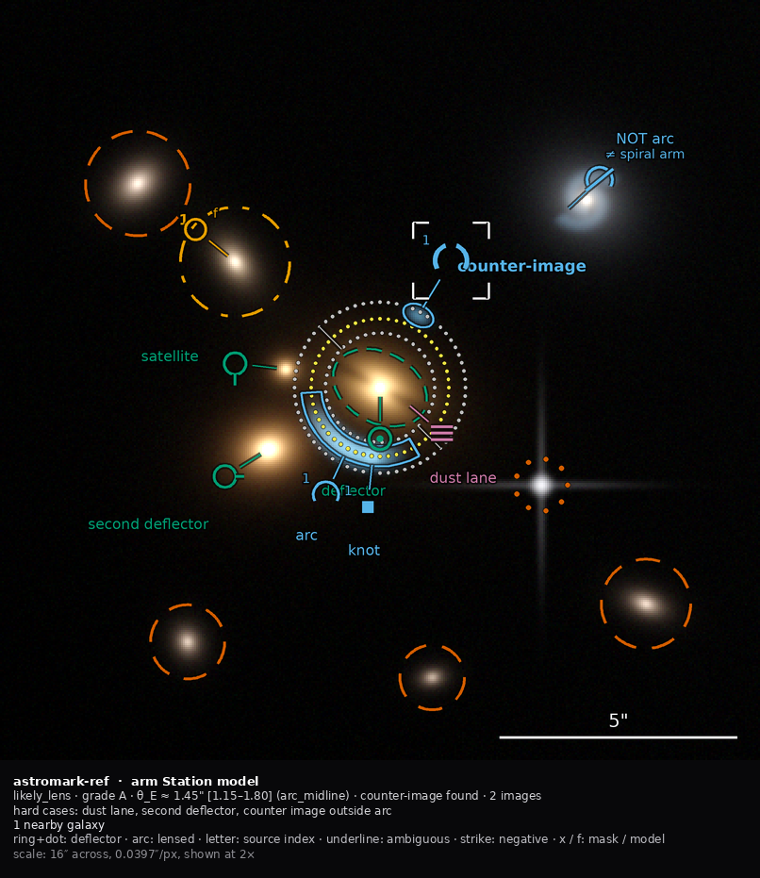
N3 · Station model
ink 3.36% · ink per statement 0.168 · occlusion 11.67% · 20 statements expressed
Modelled on the WMO surface station plot: one compact badge per object, joined to it by a hairline stem, with slots for role, polarity, source index and treatment. One fixation per object instead of three.
Polarity costs a single stroke — an underline for ambiguous, a strike for negative — which is what makes the whole approach cheap.
Does well: lowest ink per object; carries SOURCE MEMBERSHIP, which nothing in the current system can express at all, for two characters.
Breaks: it demands literacy. An unbriefed astronomer cannot read the badge, which is in direct tension with the room's preference for plain labels on the object.
Same twenty marks in every arm, compiled from one neutral content file
34

Slide 35
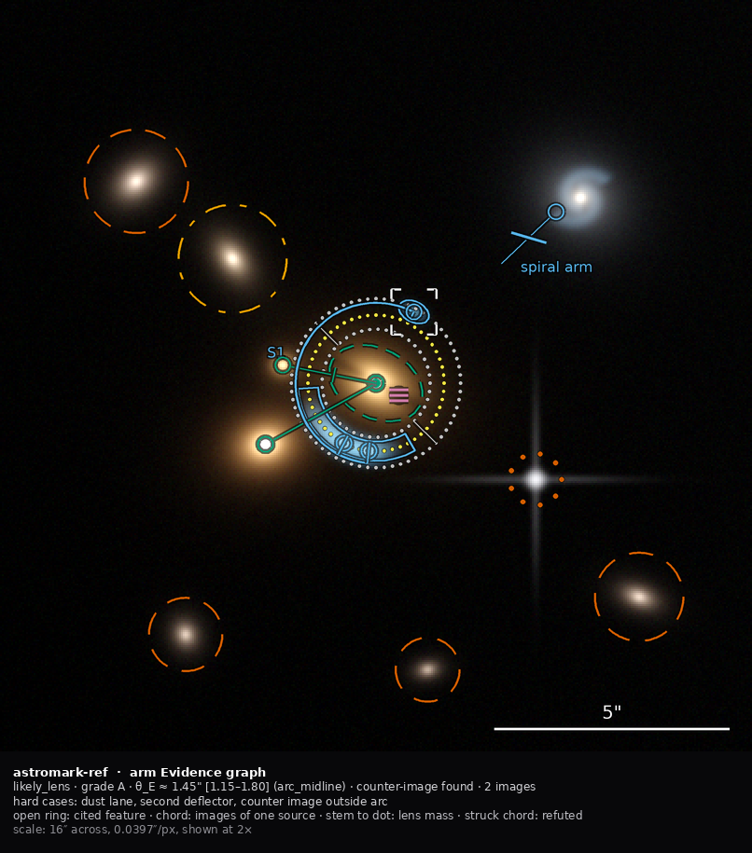
N4 · Evidence graph
ink 2.66% · ink per statement 0.133 · occlusion 11.43% · 20 statements expressed
Annotate the ARGUMENT, not the objects. A strong-lens claim is the assertion that these blobs are images of one source behind that mass — so draw that, and let the objects be implied by their participation in it.
An anchor is the only mark that touches a feature. A source chord — a hairline arc concentric with the ring — says “these are images of one source, tangential, at this radius” in one stroke. Stems to a filled dot say “this is mass”.
Does well: the only proposal where negative evidence is a first-class visual object. A positive panel has an unbroken chord; a negative panel's chord is struck. Lowest ink.
Breaks: poor role resolution — it separates the four families and nothing finer — and it is the most unfamiliar, so it has the highest explanation cost.
Same twenty marks in every arm, compiled from one neutral content file
35

Slide 36
Measured
Read the ink-per-statement column: raw ink penalises an arm for saying more
arm | statements | ink % | ink / statement | occlusion %
N4 | 20 | 2.66% | 0.133 | 11.43%
N2 | 20 | 3.17% | 0.159 | 11.24%
N3 | 20 | 3.36% | 0.168 | 11.67%
N1 | 20 | 3.65% | 0.183 | 11.06%
R-CAMPAIGN | 15 | 2.09% | 0.139 | 6.16%
R-CURRENT | 15 | 6.33% | 0.422 | 12.77%
The two reference arms CANNOT express bound rings, segmentation polygons, treatment, polarity or source grouping — five of the twenty statements. They look thinner for free. Normalised, today's notation costs 3.2× more ink per unit of meaning than the best candidate.
36

Slide 37
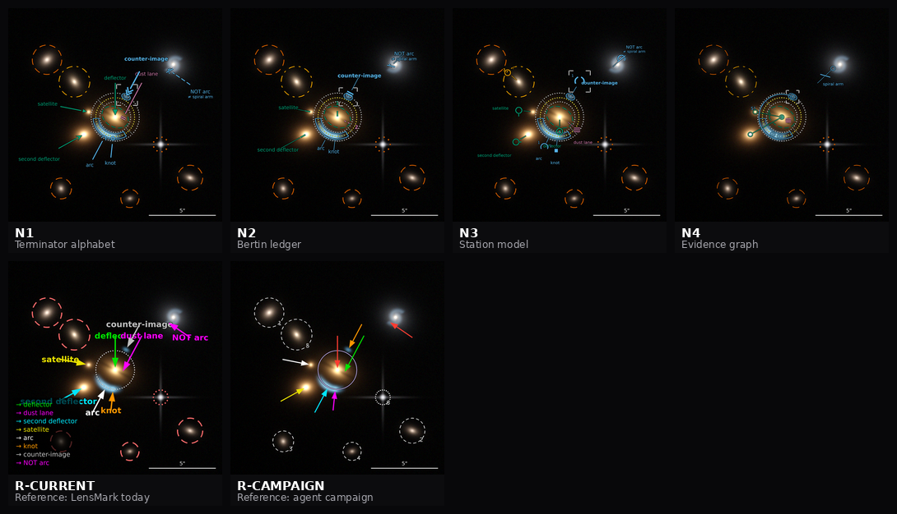
What survives at thumbnail size
260 px per panel — an ordinary nine-panel contact sheet
At this size text is unreadable in EVERY arm. Only the visual channel remains — which is the empirical case for putting polarity in texture and role in shape.
Measured thresholds: stroke texture survives to 167 px · orientation to 235 px · glyph shape to 300 px · text needs 367 px
37

Slide 38
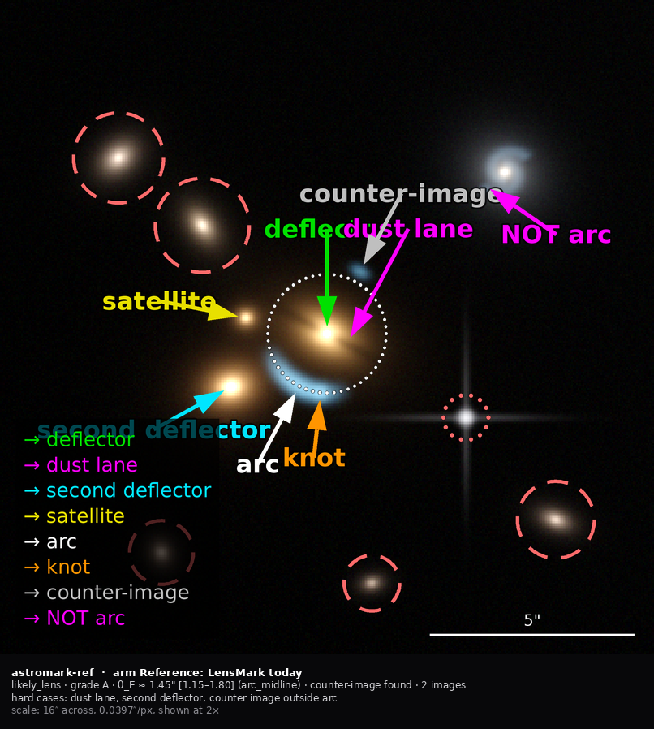
Today, and a candidate, on the same scene
Same twenty marks where expressible; same base pixels
LensMark today — 6.3% ink, 0.42 per statement. The legend plate is the single largest consumer of ink, and five statements cannot be made at all.
N1 — 3.7% ink, 0.18 per statement, expressing five MORE things: bound rings, segmentation, treatment, polarity and source grouping.
The prototype reference arm validates against reality: it measures 6.3% against 6.4–10.8% for the real renders
38

Slide 39
PART FIVE
Six metadata architectures
All six encoded in full, saying the same thing about the same image
39

Slide 40
The option space
 | Shape | Verdict
P1 | Evolved bespoke — typed items, orthogonal semantic fields, portrayal hoisted out | recommended container — smallest diff, humans already read it
P2 | GeoJSON FeatureCollection | fails: no circle primitive, and 9 of 20 marks are circles whose radius IS the datum. Also the largest encoding
P3 | W3C Web Annotation (JSON-LD) | fails the flat-schema gate; its native review model is worth stealing conceptually
P4 | Markup/annotation split with coded concepts (DICOM SR, AIM) | architecturally best; 9.4× the cost — take the identity, leave the ceremony
P5 | Dual surface: canonical JSON plus a compact line notation | orthogonal to the rest — adopt as the model-read surface
P6 | Relational / columnar (FITS BINTABLE, VOTable, Parquet) | the right export, not the record
DS9-extended and RDF/OWL were considered and rejected as primaries, with what to steal from each recorded
40

Slide 41
THE AXIS THAT DECIDES
Choose the container for cheapness. Choose the vocabulary machinery for rigour.
Converters between containers are 57–161 lines each — this is the cheapest decision in the whole design, and it will absorb the most argument. What killed the current format was not a wrong choice; it was EROSION. Nothing prevented drift. So the axis that matters is the one where a mechanism can be installed.
41

Slide 42
The mechanism
08-draft-spec/generate.py — and --check is the gate that keeps it true
# one vocabulary file -> every other surface, generated
astromark-vocab-lens-1.0.json 80 terms, 10 schemes
|
+--> astromark-core-1.0.schema.json flat, closed, 0 $ref
+--> generated/vocab_literals.py pydantic Literals
+--> generated/vocab.ts TypeScript unions
+--> generated/vocabulary.md the docs tables
$ python generate.py --check
all 4 generated artifacts are current
# adding a role touches ONE file. Today it touches six.
42

Slide 43
What each encoding costs
The same annotation — 20 marks, 12 roles, both polarities — in every candidate
encoding | characters | × smallest | 50-example payload
P5 model-READ | 2,091 | 1.0× | ~30k
P6 relational | 8,089 | 3.9× | ~116k
P1 evolved bespoke | 14,362 | 6.9× | ~205k
P3 W3C Web Annotation | 17,777 | 8.5× | ~254k
P4 markup/annotation split | 19,678 | 9.4× | ~281k
P2 GeoJSON-shaped | 19,762 | 9.5× | ~282k
Character counts are EXACT. Token figures are derived at 3.5 chars/token, not measured: no Claude tokenizer offline. The ratios are what the decision turns on.
43

Slide 44
THE ASYMMETRY THAT RESOLVES IT
Models READ the compact line form and WRITE the JSON form.
Reading is where the volume is — fifty examples, every one costing tokens. Writing is where correctness matters — one document, schema-enforced, repairable. Nothing else in the option space satisfies both the flat-closed-schema requirement and the token budget. And four standards bodies got here first: in four of the seven domains that ship a flat companion to a rich canonical form, the flat companion is what actually gets written.
44

Slide 45
The whole annotation, in the line form
2.1 kB against 14.4 kB for the JSON — and readable
#astromark lens/1.0 frame=norm,tl,+x-right,+y-down size=arcsec
#system likely_lens grade=A p=0.92 cimg=found n=2 hard=dust_lane,second_deflector
#source S1 images=2 config=double thE=1.45"
defl + 0.500,0.350 -> 0.500,0.510
dust + 0.624,0.349 -> 0.530,0.526
defl2 + 0.235,0.657 -> 0.353,0.591
sat + 0.244,0.460 -> 0.376,0.486
arc + 0.394,0.709 -> 0.458,0.590 S1 ; rev=wrong_position 0.31"
cimg + 0.614,0.296 -> 0.550,0.415 S1 emph=key
arc - 0.851,0.358 -> 0.739,0.282 alt=spiral_arm
ring + @m-defl r=1.45" S1 [1.15,1.8] method=arc_midline
gal + 0.181,0.241 r=1.1" treat=mask
Read the highlighted line: “there is an arc-shaped feature here, it argues AGAINST lensing, and the reason is that it is a spiral arm.” The current format cannot say that at all, in any number of characters.
45

Slide 46
Four gates — fail one and the candidate is out
Predicted casualties, recorded before the gates are run: P3 on G1, P2 on G2
 | Gate | Test
G1 | flat, closed structured-output schema | 0 $ref, additionalProperties:false everywhere, honoured by a live call
G2 | round-trip fidelity | convert 19 real decks out and back; must re-render byte-identical to the golden hashes
G3 | embargo separability | strip_free_text provable by a closed key allow-list, not a type-sniffing walk
G4 | expressiveness | all 22 fixture statements expressible; the 16 P0 statements first-class
No weighted sum. Report the matrix and decide by dominance; where nothing dominates, name the trade in a sentence and take it to the room as a decision.
46

Slide 47
PART SIX
Worked examples on real JWST data
Three candidates from the public NIRCam archive search — chosen because each one strains a different part of the format
47

Slide 48
Why these three, and what makes them honest
jwst-strong-lens-search/top100_clean/ — 100 cutouts, a 41-column table
– The source is the one-shot search of the public JWST NIRCam archive: 4.48 deg², 5,391 targets, ten candidates surviving adversarial verification. No embargo.
– Every mark is derived from a recorded measurement, not placed by eye. Arc positions come from blind_arc_radius_arcsec and blind_arc_pa_deg; the ring from blind_theta_E_arcsec and its stated method; counter-images from coordinates written into the verifier's own note.
– rank 1 · J3440482-522486 — a published lens, SL2S J02176-0513. Arc AND counter-image, θ_E by half-separation. The clean positive case.
– rank 2 · J15199556+2122210 — a single tangential arc with NO counter-image found after searching. Exercises not_found as distinct from not_searched, and the single-giant-arc exception.
– rank 3 · J34707505-219476 — a knot chain plus a blue blob antipodal to it whose radius EXCEEDS the arc radius. The verifier explicitly declined half-separation for that reason.
48

Slide 49
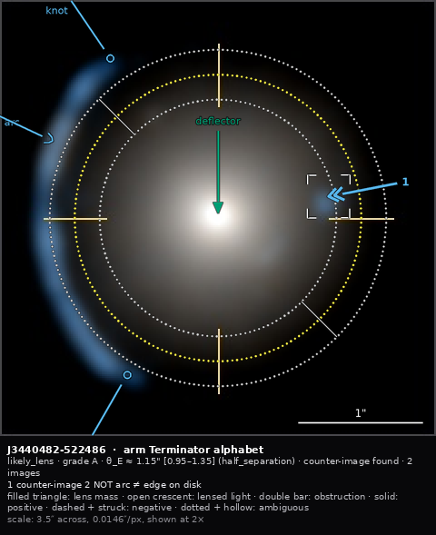
rank 1 — a published lens
SL2S J02176-0513 · grade A, 3 of 3 verifiers · θ_E 1.15″ by half-separation
The clean case: a blue tangential crescent east of a red elliptical, concave toward it, with a compact blue counter-image nearly opposite.
The counter-image carries emphasis: key — hence the corner brackets. They are a SQUARE deliberately: a ring would read as another measured radius.
Its label had nowhere to go this close to the edge, so it demoted to the index 1 and the text moved to the caption band. That is the designed failure — crowding degrades predictably instead of overlapping.
The mark at upper right is negative polarity: dashed shaft, struck terminator, NOT arc ≠ edge-on disk. That is the verifier's own correction — the NE streak runs radially, not tangentially, so it is a field galaxy rather than a second arc.
The current format could record none of that.
Panel: colour 3.5″ zoom · north up, east left
49

Slide 50
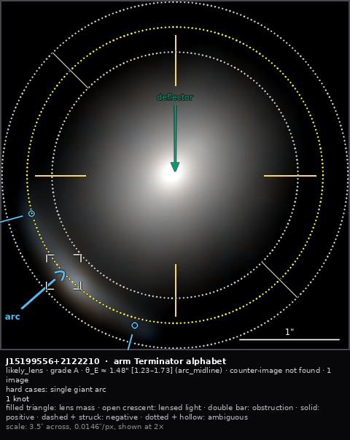
rank 2 — searched, and not found
grade A · θ_E 1.48″ by arc midline · counter-image NOT FOUND
A thin tangential arc east through south-southeast, bluer than the host, surviving in the deflector-subtracted panel.
The caption reads counter-image not found, and that is a different statement from “not searched”. The verifier looked at every stretch and none was visible.
This is the three-valued absence that DICOM, RadElement, WMO and Galaxy Zoo all arrived at independently — and it matters here, because θ_E rests on the arc radius alone and could be high if the source is offset.
Hard case: single giant arc.
The bound rings bracket the ridge measurement, 1.23–1.73″
50

Slide 51
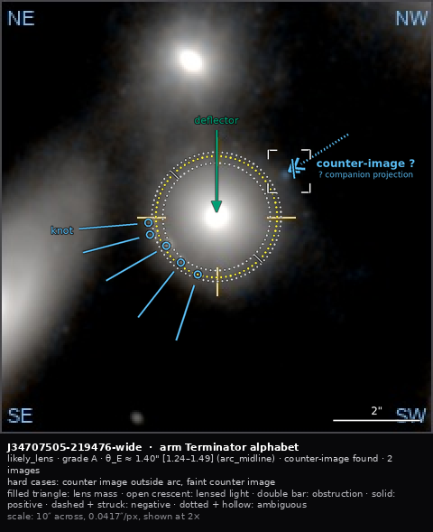
rank 3 — the counter-image is farther out than the arc
grade A · five knots at r 1.24–1.49″ · a blue blob antipodal at r 1.88″
The blob is antipodal to the chain and the same colour as the knots — a plausible counter-image. But its radius EXCEEDS the arc radius, which is the reverse of the usual configuration.
So it is marked ambiguous: dotted shaft, hollow struck terminator, counter-image ? ≠ companion projection. The record shows the feature AND its alternative reading rather than choosing silently.
And the ring records that half-separation was declined: method: arc_midline, θ_E 1.40″. Had the blob been accepted, θ_E would be nearer 1.6″. A coded method makes that decision recoverable.
Lensing permits a counter-image farther out than the arc. Radius is never by itself a ground for rejection.
Rendered on the 10″ field, because — see next slide
51

Slide 52
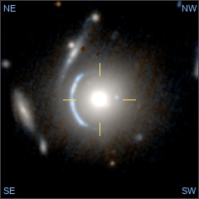
Six renderings of one sky
The figure the verifiers actually saw is six panels: three stretches of the 10″ field, three of the 3.5″ zoom
Why variants is a requirement, not a convenience
The rank-3 counter-image at r = 1.88″ falls OUTSIDE the 3.5″ zoom. The same annotation is simply unrenderable there.
That is the clearest possible demonstration that a mark's coordinates are meaningless without a declared frame — and that the two field-of-view groups do NOT share one.
The current format has one image per record. It cannot say “these six renderings are of one sky”, cannot say which panel the marks were placed on, and cannot carry a per-panel scale.
This is requirement R33, made concrete by real data rather than argued for.
examples/jwst/variants-*.json
52

Slide 53
PART SEVEN
Recommendation
And what remains undecided
53

Slide 54
Six changes worth making whichever proposal wins
Notation-independent
– 1. The 2× canonical render. Forced by arithmetic: at native size the bound-ring dots, θ_E dots and leader hairlines all fall below the ~1.25-pixel aliasing floor.
– 2. Tag every drawn scalar METRIC or PRESENTATIONAL. This is the whole answer to resize-for-emphasis.
– 3. The emphasis enum, with layered compositing.
– 4. Keep-out geometry in the label solver — using each circle's ANNULUS, not its bounding box. Roughly a twenty-line change and the largest single legibility win available.
– 5. Demotion-to-index, so crowding degrades deterministically instead of producing overlap.
– 6. The caption band, and remove the on-image legend plate from the contract.
– Only the sign inventory is a bet. These six are not — they are independently valuable and they are in dependency order.
54

Slide 55
Migration from lensmark/1.0
Executed, not asserted: examples/migrate_lensmark.py converts a real deck
today | becomes | lossless?
schema_version | schema + profile | yes
items[].label | role inferred + label for display | lossy where free text — a human pass over 19 decks
items[].color | dropped; derived from role via the style document | intentionally lossy
mask_circle.kind | role + treatment | yes
theta_e.alt_arcsec | lower_arcsec or upper_arcsec by comparison | yes — and it fixes the two decks carrying (alt) rings
einstein_ring.theta_e_arcsec | geometry only; the measurement lives once | yes — removes the duplicate
style_defaults inlined | style_ref by id and hash | yes
— | polarity, alternative, source, hard_case, counter_image, bound, polygons | new — nothing to migrate
On deck-08, all four arrow labels mapped lexically; four SYSTEM-level fields need a human — counter_image, n_images, hard_case, sources. Those are not conversion failures; they are the things lensmark/1.0 had no way to record.
55

Slide 56
What the prior art changed, rather than confirmed
Five findings that altered the design
– Presence and polarity are two axes, not one. RadElement separates present / absent / indeterminate / unknown from the term. Our polarity conflates “is this really there?” with “does it bear on the claim?” — which is why a dust lane sits awkwardly. Better than adding a fourth polarity value.
– Borrow the object classes; do not mint them. The IVOA object-type vocabulary already publishes grav-lens and lensed-image as URIs. Our vocabulary should cover what is specific to ANNOTATION and reference the rest.
– Generation method is three-valued — automatic, semiautomatic, manual — and that middle value is exactly the propose-then-correct workflow this project runs.
– The grade problem has a worked answer in BI-RADS and PI-RADS.
– Two hard numbers for the render rules: exactly three lightness levels exist at 3:1 contrast, and two textures must differ in period by a full octave.
56

Slide 57
What is verified, and what is not
– Measured and reproducible: ink, occlusion, stroke contrast, encoding sizes in characters, the colour gate, schema flatness, the reference annotation validating, generator staleness, and the embargo check — 0 banned-lexicon hits across 19 documents, all three model-facing spec files completely clean.
– Derived, not measured: token counts. No Claude tokenizer offline; character ratios are exact and are what the decision turns on.
– Not tested: whether image plus coordinate metadata teaches a model better than an annotated PNG. This is the hypothesis on the record, the format is partly designed around it, and it should run BEFORE the format freezes. It is cheap now that every encoding exists.
– Judgement, declared as such: N1 versus N4. The measurements rule out the status quo; they do not choose between two good candidates.
57

Slide 58
Six decisions for the review
A draft vocabulary already exists: 80 terms, 10 schemes, generating a flat closed schema the reference annotation validates against today
– 1. Notation: N1 now, N4, or N1 with N4's source chord grafted in?
– 2. Container: accept P1 plus prefixed-term identity, or spend the argument on the container?
– 3. Do the six notation-independent changes land regardless? *(I would say yes.)*
– 4. Is the read/write asymmetry acceptable, given it means two surfaces and a round-trip test in CI?
– 5. Should presence and polarity become two separate axes?
– 6. Who runs the few-shot experiment, and does the freeze wait for it?
– Start with the vocabulary file either way. It is the only artifact every proposal shares, the only one whose absence caused every problem in the audit — and it is the part that is not in dispute.
58

Slide 59
One warning worth carrying into the room.
DICOM's Presentation State has been the right overlay answer since 1999, is supported by every PACS, and lost in practice to burning annotations into a flattened image — because that was easier. A correct design does not win by being correct. If AstroMark's overlay path is harder than exporting a PNG with the marks drawn on it, people will export the PNG.
59

