Slide 1
Reproducing SpectrumFM Phase-10 Ignition on Commodity GPUs
Phase 13 Internal Reproduction Report
Greg Benson, USF · 29 May 2026 · SpectrumFM team

Slide 2
Context — “one model, six classes”
“The central claim is 'one model, six classes': a single SpectrumFM with one set of weights will handle six DESI target classes at production-grade quality. — DOE Genesis Project Narrative, v7”
Regime | Classes | Phase I approach
Label-rich (Redrock z) | LRG, ELG, QSO (extragalactic); MWS (stars) | Pre-training + auxiliary redshift head
Extensibility | LBGs, LAEs (extragalactic) | Few-shot fine-tuning, ≤ 5,000 examples per class
This work validates the Phase-I pre-training + auxiliary redshift head architecture at small scale on commodity GPUs.
DOE Genesis SpectrumFM proposal v7 (Huang PI / USF, LBNL, NOIRLab, FSU)

Slide 3
Phase I Milestones — where this work lands
Timeline | Focus area | Measurable milestone
Months 1–3 | Data Curation and Architecture | DESI corpus and VI labels assembled. Architecture (auxiliary redshift head, physical prior regularization, MSM) implemented and validated on small-scale runs.
Months 4–6 | Pre-training from Scratch and Label-Rich Performance | Full-scale pre-training on Perlmutter executed; scaling curves established. Objective 2a complete.
Months 7–9 | Extensibility, Alignment, and Validation | Human Alignment Training executed. Objectives 1, 2b, and 3 complete. Phase I report and Phase II proposal submitted.
Months 1–3 explicitly call for “small-scale” validation of the auxiliary redshift head — this is exactly that.
Also de-risks the small-scale-runs requirement before ERCAP allocation lands.
Quotes verbatim from proposals/doe_genesis_spectrumfm_project_narrative_v7.docx, Section 4

Slide 4
Local toolchain — Track 2 harness
Yaml-driven experiment runner, parses both redshifty and codecs metric streams
• tools/spectrumfm/exp_run.py — yaml spec → subprocess + tee + metric parse → metrics.jsonl + summary.md
• tools/spectrumfm/exp_analyze.py — --digest <run> and --compare <runs...> (markdown table + PNG plot)
• tools/spectrumfm/download_desi_subset.py — public DESI mirror, --release {edr,dr1}, resumable
– Drives both repos via one interface, mirroring redshifty/RESEARCH_LOG.md format
• Five Approach-A arms (broken, phase10, xlarge, seed sweep, mix) ran through this harness unchanged.
– Outputs preserved under experiments/runs/<run_id>/ with spec.yaml + stdout.log + metrics.jsonl + summary.md
~350 lines of Python total for the harness.

Slide 5
Data — local DESI mix
Survey × program | Production | Pixels | Disk
sv3 × bright | EDR/fuji | 373 | 304 GiB
sv3 × dark | EDR/fuji | 375 | 356 GiB
main × bright | DR1/iron | 192 | 36 GiB
main × dark | DR1/iron | 197 | 60 GiB
TOTAL |  | 1,137 | 757 GiB
1,817,790 raw spectra; 480k after quality cut (ZCAT_PRIMARY ∧ COADD_FIBERSTATUS=0 ∧ OBJTYPE='TGT').
NERSC reference: 200 healpix / 394k spectra across the SAME 4 combinations.
Our local set has 5.7× more pixels and 4.6× more raw spectra than the reference.
Pulled by tools/spectrumfm/download_desi_subset.py over ~3 h.

Slide 6
V1 tokenizer — local reproduction
• Architecture: ConvNeXt-V2 encoder/decoder + Look-Up-Free Quantizer (LFQ, dim=10, codebook=1024).
• Trained: 15,000 steps, batch 16, lr 3e-4, AMP enabled, one NVIDIA L4.
• Result: val_total = 1.70, val_recon = 1.38 at step 13,000 (best ckpt).
• NERSC reference: val_recon = 1.35 at step 16,500 on 200 healpix / 394k spectra.
Matched the NERSC baseline within 0.03 on val_recon — on roughly half the training corpus.
Frozen as the spectrum tokenizer for every Approach-A run that follows.

Slide 7
Diagnostic journey — 4 hypotheses for the ignition gap
Hypothesis | Status | Evidence
Hparam mismatch (Phase 9 batch/lr × Phase 10 mask) | Necessary but not sufficient | Fix doubled peak val_z_acc 3.9 → 8.2%
Data scale (need ≥394k spectra) | Ruled out | 729k matched 219k exactly (6–8% plateau)
Random-seed luck | Ruled out | 4-seed sweep: 3.8%–8.8% range (1–3pp std)
Data MIX (sv3+main × bright+dark) | CONFIRMED | First arm to ignite, sustained ≥10%, AR/TF 0.73
The buried clue: published log line “200 healpix files (sv3+main, bright+dark)” — easy to misread as 200 sv3-bright pixels.
Each row took 5–8 h of training to confirm or refute.

Slide 8
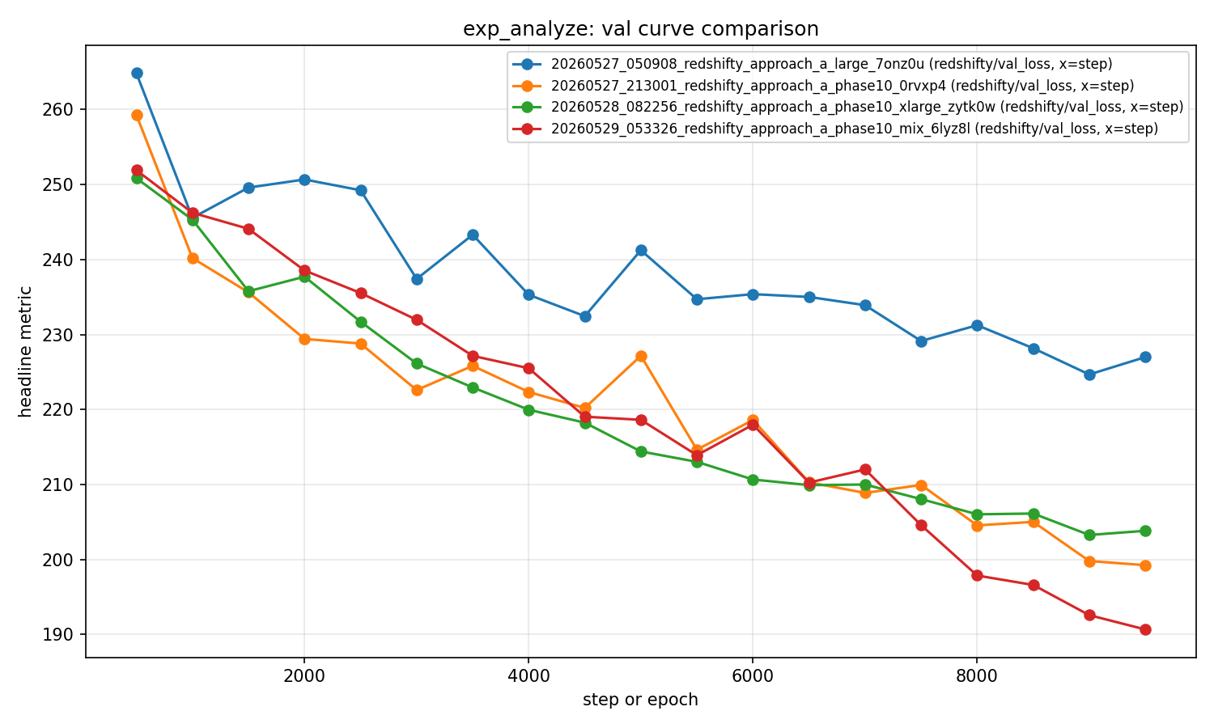
Ignition achieved — mix-run val trajectory
step | val_z_acc | val_loss_redshift
500 | 0.028 | 4.88
3000 | 0.015 | 4.50
5000 | 0.034 | 4.24
6500 | 0.055 | 4.08
7500 | 0.081 | 3.97
8500 | 0.092 | 3.81
9000 | 0.108 | 3.73
9500 | 0.149 | 3.69
Mix run (red): first to cross sustained 10%; reaches lowest val_loss (190.7).

Slide 9
Pass criteria from the plan — all three met
Criterion | Target | Achieved | Verdict
val_redshift_acc sustained ≥ 10% | ≥10% across 2+ vals | 10.85% @ step 9000, 14.86% @ step 9500 | PASS
val_loss_redshift cumulative drop | ≥ 1.0 | 4.88 → 3.69 (drop 1.19) | PASS
AR / TF ratio at peak | ≥ 0.5 | 7.96% / 10.85% = 0.73 | PASS
Best val_loss = 190.67 (vs all prior runs' 200–225 floor).
AR/TF ratio 0.73 vs NERSC reference 0.74 — quantitatively matches the published result.

Slide 10
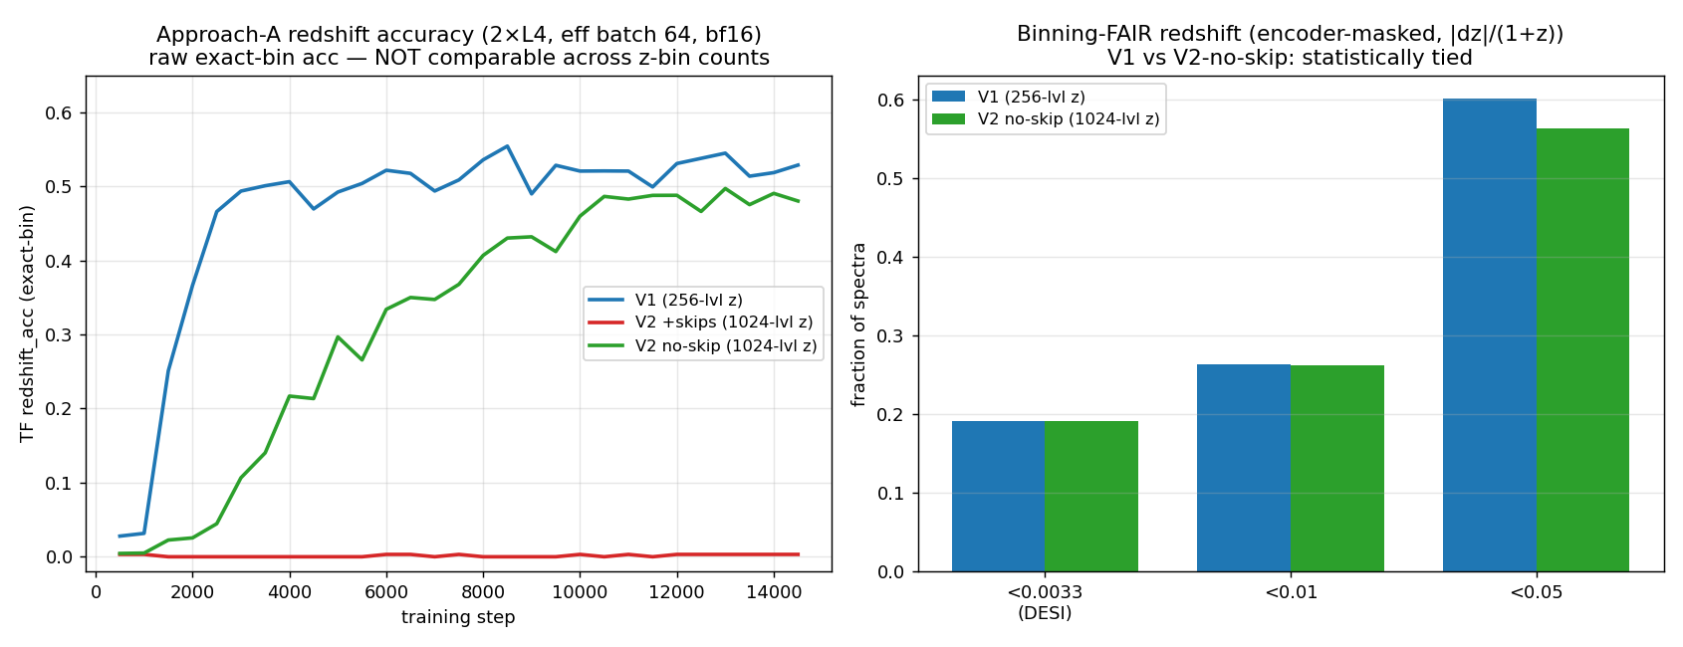
Phase 14 — 2×L4 rerun + V2 tokenizer revisit
arm | TF z_acc | AR z_acc | codebook entropy | fair good-z (<0.0033)
V1 (256-lvl z) | 0.55 | 0.57 | 5.00 bits (163 codes) | 0.192
V2 + skips (1024-lvl z) | 0.00 | 0.00 | 0.00 bits (1 code) | —
V2 no-skip (1024-lvl z) | 0.50 | 0.48 | 5.24 bits (113 codes) | 0.192
V1 reaches 3.7× the A16 mix run. V2's U-Net skips bypass the quantizer → codebook collapses (1 code) → 0% redshift; skip-free V2 ties V1. Reconstruction quality ≠ tokenizer quality.

Slide 11
What's next
• DONE: 2×L4 rerun (correct PCI_BUS_ID mapping, bf16, eff batch 64) → V1 55% TF / 57% AR
– 3.7× the A16 mix run; honest AR matches the NERSC reference (55%)
• DONE: V2 tokenizer revisited — skip-bypass codebook collapse diagnosed and fixed
– Skip-free V2 ties V1: codebook entropy, not reconstruction loss, predicts usefulness
• Next: codecs (Mamba3+RFSQ) tokenizer swap — head-to-head vs the local V1 baseline
– The Phase-I architectural claim the proposal targets for Months 1–3
• Next: scale steps/data toward the NERSC 73.8% peak (local config plateaus ~55%)
• Open PRs: cosmologyfoundation/redshifty#1 (+ multi-GPU fixes), codecs#1
None of the next items depend on NERSC compute.

Slide 12
Acknowledgments
• Jonathan Samuel (USF) — author of the redshifty Approach-A repo and the PRODUCTION_RUN_PLAN.md / RESEARCH_LOG.md that this reproduction works against.
• Xiaosheng Huang (USF) — SpectrumFM PI; spectroscopy-side architecture review.
• Stephen Bailey (LBNL) — Redrock + DESI corpus expertise that grounds the 4-way data-mix interpretation.
• DESI Collaboration — public EDR/DR1 data tier.
• Anthropic / Claude Code — the diagnostic-ladder + harness implementation pair-programmer.
Questions / discussion / PR review welcome.

