Slide 1
Linux shell tutorial

Slide 2
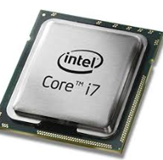
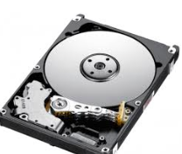
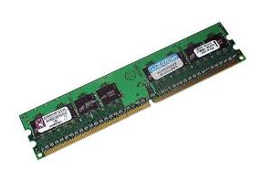

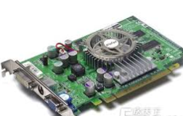
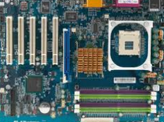
Computer structure
Brain
CPU
Disk
Memory
Lone-term memory
Short-term memory
Graphics
card
Main board
Notes:
Using the analogy of brain behaviour to explain how computers will

Slide 3
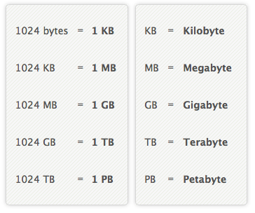

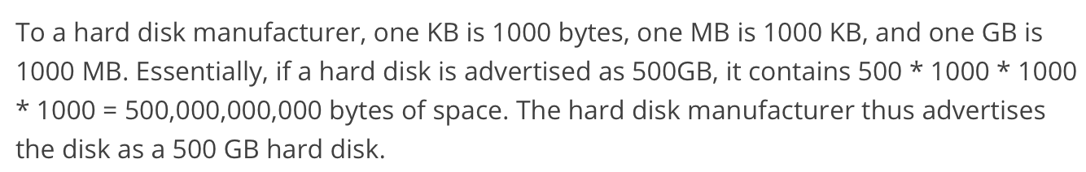
Understanding file sizes
An alphanumeric character (e.g. a letter or number such as 'A', 'B' or '7') is stored as 1 byte. For example, to store the letter 'R' uses 1 byte, which is stored by the computer as 8 bits, '01010010'.
1KB = 1024Bytes = 2^10 Bytes
1Bytes = 8 bits
Notes:
Binary translation
500,000,000,000/1024/1024/1024 is the real amount.

Slide 4

CPU speed
The “CPU speed” determines how many calculations it can perform in one second of time.
3.0 GHz = 3.0*10⁹ times calculations
“Word size” refers to the number of bits processed by a computer's CPU in one go (these days, typically 32 bits or 64 bits).

Slide 5
Memory size
CPU
Disk
Memory

Slide 6
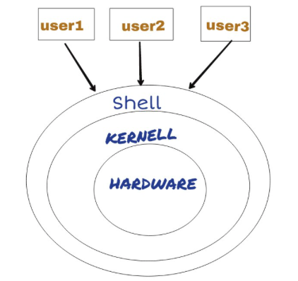
What is Shells
A Shell provides you with an interface to the Linux system. It gathers input from you and executes programs based on that input. When a program finishes executing, it displays that program's output.
Shell is an environment in which we can run our commands, programs, and shell scripts. There are different flavors of a shell, just as there are different flavors of operating systems. Each flavor of shell has its own set of recognized commands and functions.
Here, we use Bash Shell

Slide 7


Log on Liunx server
Type
ssh User_Name@sc.rc.usf.edu
SSH client program that enables secure connection to the SSH server on a remote machine.
SSH server id
2. After password inputting
means a normal user, some unix systems end the prompt with % which means same thing.
# means a root user
User name
SSH server
Name
Home (Login)
directory

Slide 8
Command grammar of linux
Command [-options] parameter1 parameter2
# Multiple options should be separated by space
# Some times may use ‘--’
For example ‘-h’, or ‘--help’
Example
Command
Parameter
Option

Slide 9








User and group
Linux was designed to allow more than one user to have access to the system at the same time. In order for this multiuser design to work properly, there needs to be a method to protect users from each other. This is where permissions come in to play.
Teacher (Root)
Others
David (User)
Leo (User)
Group 1
Group 2
Lily (User)
Ruby (User)
Sofia (User)
Angela (User)

Slide 10
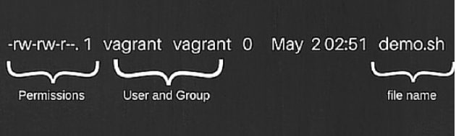
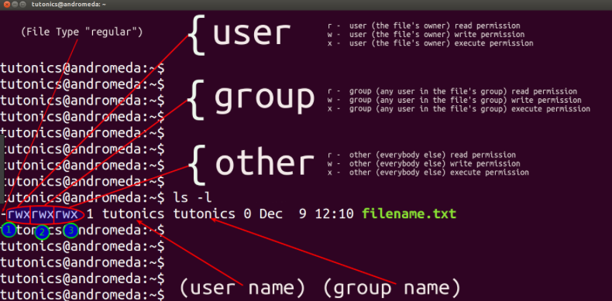

Slide 11

Name of
the group
owning the
file
Name of
the owner
File
Size
the time of last data modification
File name
r, Read
w, Write
x, eXecute
Type of the file
Permissions
for owner of
the file
Permissions
for group
owning
The file
Other members

Slide 12





Calendar
Some simple commands
Date
Cal [[month] year]
Calculater
Type ‘quit’ out
Notes:
余数 reminder

Slide 13
Download a file
Creating a new directory
mkdir <foldername>
File from GSE77565
Copy the address on ‘FTP’

Slide 14
Extract files using ‘gzip’
-d --decompress –uncompress.
Decompress.
-h --help
Display a help screen and quit.
-v –verbose (For compressing)
Verbose. Display the name and percentage reduction for each file compressed or decompressed.

Slide 15
Linux Shortcuts and Commands:
<Tab>
(In a text terminal) Autocomplete the command if there is only one option, or else show all the available options.
Example:

Slide 16


[Tab] !!!!!!!!
Tab completion is an extremely helpful feature in nearly any command-line environment
For example, if we have a long, complex file name beginning with the letters ‘GSE’, we’d just have to type GSE and press Tab to automatically complete it. If we had multiple file names beginning with GSE, we’d just need to type a bit more of the file’s name before pressing Tab again.
[Tab]
[Tab]
Tab completion can even be used to automatically complete options for some commands.

Slide 17
Linux Shortcuts and Commands:
<Ctrl>c
Kill the current process (mostly in the text mode for small applications).
<Ctrl>d
Log out from the current terminal.
<Ctrl>E or End:
Go to the end of the line.
<Ctrl>A
Go to the beginning of the line

Slide 18
Man page
‘man’ provide extensive documentation about commands and other aspects of the system, including configuration files, system calls, library routines and the kernel (i.e., the core of the operating system).

Slide 19
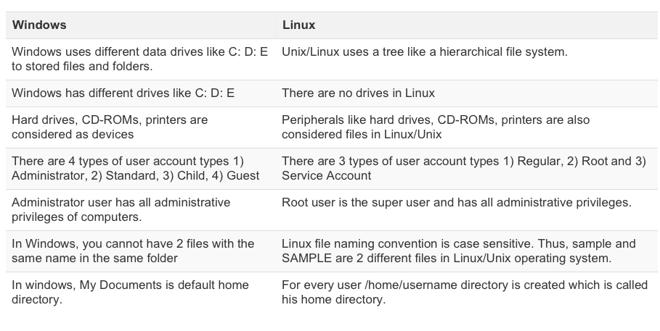
Windows Vs. Linux: Key Differences

Slide 20
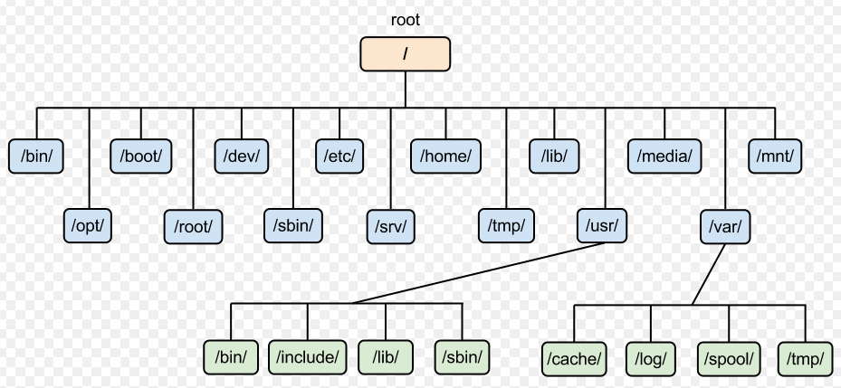
Windows Vs. Linux: File Differences

Slide 21
C
D
The mount command calls the mount system call to prepare and graft a special device or the remote node (rhost:path) on to the file system tree at the point node.

Slide 22
Absolute Path
What is an absolute path?
An absolute path is defined as the specifying the location of a file or directory from the root directory(/). In other words we can say absolute path is a complete path from start of actual filesystem from / directory.
Root path: ‘/’ (Slash)
Checking your current directory with ‘pwd’

Slide 23


Changing path
cd
Changing to root path
Changing to home path

Slide 24
Absolute Path vs. Relative Path
What is the relative path?
Relative path is defined as path related to the present working directory(pwd). Suppose I am located in /var/log and I want to change directory to /var/log/kernel. I can use relative path concept to change directory to kernel
. (a link to itself)
.. (a link to its parent directory)
Current path: ‘./’ (Dot slash)
Parent path: ‘../’(Two dots Slash)

Slide 25

Practicing
List all the files under ‘/’
Change the folder to ‘genomeTrain’

Slide 26
Extract files using ‘gzip’
-d --decompress –uncompress.
Decompress.
-h --help
Display a help screen and quit.
-v –verbose (For compressing)
Verbose. Display the name and percentage reduction for each file compressed or decompressed.

Slide 27
Reading file
Head command will obviously on the contrary to tail, it will print the first 10 (-n) lines of the file.
head -n <number of lines> /path/to/file
Tail command will obviously on the contrary to head, it will print the last 10 (-n) lines of the file.
tail -n <number_of_lines> /path/to/file

Slide 28
Reading file
cat is one of the most frequently used commands on Linux operating systems. It has three related functions with regard to text files: displaying them, combining copies of them and creating new ones.
cat file1
the standard output of cat is redirected using the output redirection operator (which is represented by a rightward pointing angular bracket) to file2:
cat file1 > file2
Redirected the output to another file

Slide 29
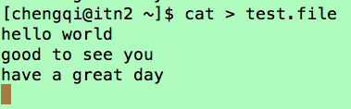

Writing text to file by cat
Type <Ctrl>d
Type <Ctrl>d
> redirects output to a file, overwriting the file.
>> redirects output to a file appending the redirected output at the end.

Slide 30
Reading file
less does not have to read the entire input file before starting, so with large input files it starts up faster than text editors like vim

Slide 31
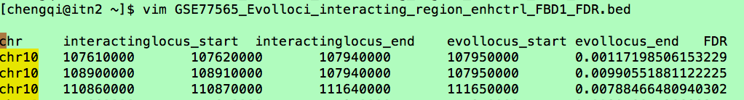
File editor (Vim)
Open a file:
Command mode:
Insert model
Type ‘:’
Type ‘i’
Type ‘set nu’, check the number ID
Type ‘q’, outside the file
Type ‘w’ Save the file
Type ‘wq’ Save and out the file
Type ‘q!’ Ignore changes and quit. No changes from last write will be saved.
Type ‘Esc’ Out of the command model
Cursor Movement model
To the end of the file ‘G’ Copy the line ‘nyy’
To the top of the file ‘gg’ Paste the line ‘p’
To the specific line ‘nG’ Delete the line ‘ndd’

Slide 32
Create and remove directory
mkdir is a utility for creating a directory.
rmdir is a utility for deleting empty directories.

Slide 33
Create and remove directory
mv = renames a file or moves it from one directory to another directory
cp = copies files from one location to another
rm : deletes a file without confirmation (by default)

Slide 34
Practicing
Create a file named as ‘test.txt’
Type ‘Hello world’ in test.txt
Move ‘test.txt’ to the folder genomicTrain

Slide 35
Bash shell
Commend history
All history information is saved under ~/.bash_history
[Tab]

Slide 36
Environmental variables
Environmental variables are variables that are defined for the current shell and are inherited by any child shells or processes. Environmental variables are used to pass information into processes that are spawned from the shell.
Shell variables are variables that are contained exclusively within the shell in which they were set or defined. They are often used to keep track of ephemeral data, like the current working directory.
a list of all of our environmental variables

Slide 37
$PATH
Like ls, cd, mkdir, rm, and others are just small programs that usually live inside a directory on your computer called /usr/bin
When you type a command into your Linux shell, it doesn't look in every directory to see if there's a program by that name, just the ones you specify.
Sometimes, you may wish to install programs into other locations on your computer, but be able to execute them easily without specifying their exact location. You can do this easily by adding a directory to your $PATH
Check $PATH
Add more directory to $PATH
Notes:
/ try this C++ program, to show them what’s $PATH
# include <iostream>
int main ()
{
std::cout << "hello world" << std::endl;
}

Slide 38
~/.bash_profile
~/.bash_login
~/.profile
When you log on to the linux, the system reads one of these files and set environment.
[Tab]

Slide 39
Redirection and pipe
STDOUT
STDIN
Program
STDERR
> redirects output to a file, overwriting the file.
>> redirects output to a file appending the redirected output at the end.
STDOUT
STDIN
File
Program
STDERR

Slide 40
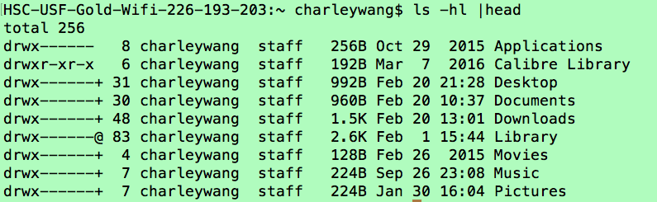
Redirection and pipe
STDOUT
STDIN
Program
STDIN
Program
STDERR
| sending data from one program to another.

