Slide 1
Introduction to RNA-Seq Pre-Analysis
Justin Gibbons, PhD

Slide 2
RNA-seq
RNA-seq measures the average expression level for each gene or transcript
Advantages
Detect novel genes or isoforms including:
mRNAs
microRNAs
Small interfering RNAs
Long non-coding RNAs
Transcriptomics without an annotated genome
Relative expression levels are accurate
Disadvantages
Differential expression detection biased towards highly expressed genes
Gene-specific biases (GC-content)
Absolute expression levels are not accurate
Notes:
The power of RNA-seq is you get transcript expression and sequence information

Slide 3
RNA-seq strategy
Notes:
cDNA uses random primers to make cDNA. Total RNA makes cDNA from everything

Slide 4
Quality control
Sequence quality: Predicted accuracy of base calls
Duplicate reads: Contamination, PCR error, or poor library quality
GC content: Contamination, PCR error, or poor library quality
Overrepresented k-mers: Contamination, PCR error, or poor library quality
Adapter contamination: Library prep adaptors sequenced
Reproducibility: How similar are replicates?

Slide 5
Dealing with poor quality sequences
Strategies
Trimming—remove bad bases from the reads
Filtering—remove bad reads from library
Programs
Trimmomatic
Trim Galore
For trimming parameter recommendations:
MacManes, M., On the optimal trimming of high-throughput mRNA sequence data. Frontiers in Genetics, 2014. 5(13)

Slide 6
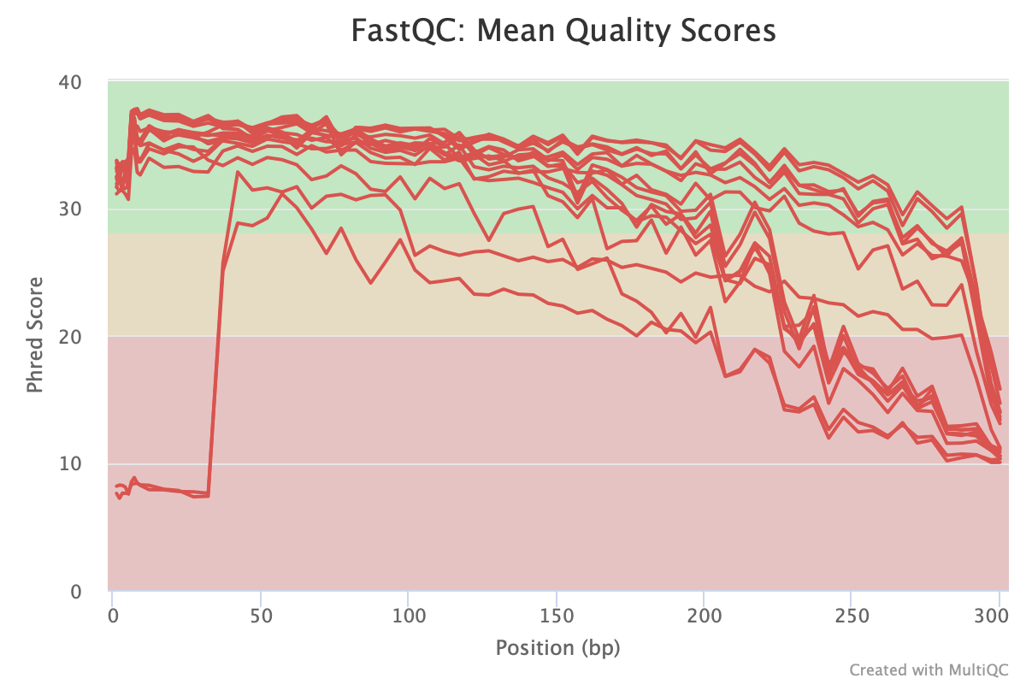
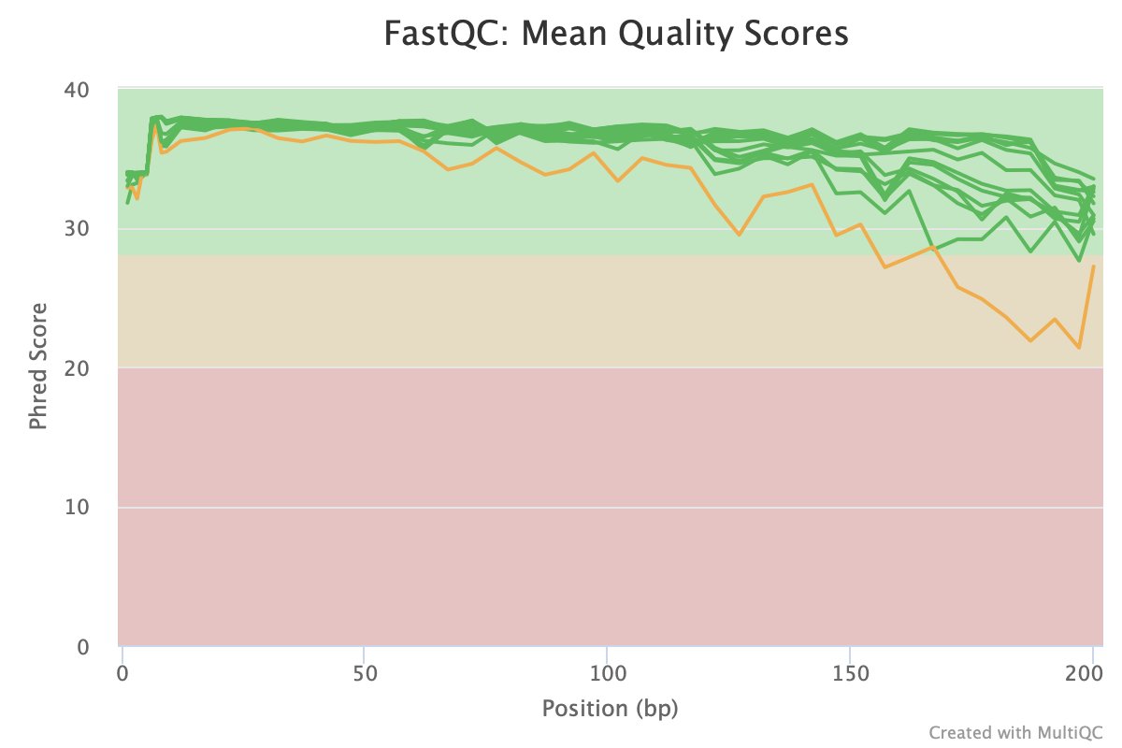
Sequence Quality
Before filtering
After filtering
Notes:
The x-axis is the position along the reads and the y-axis is the mean Phred score in a sample at the given position. The Phred score is a measure of the probability of a base-call error with higher Phred scores indicating a lower probability of error. If the Phred score falls below 30 you should consider trimming the reads.

Slide 7
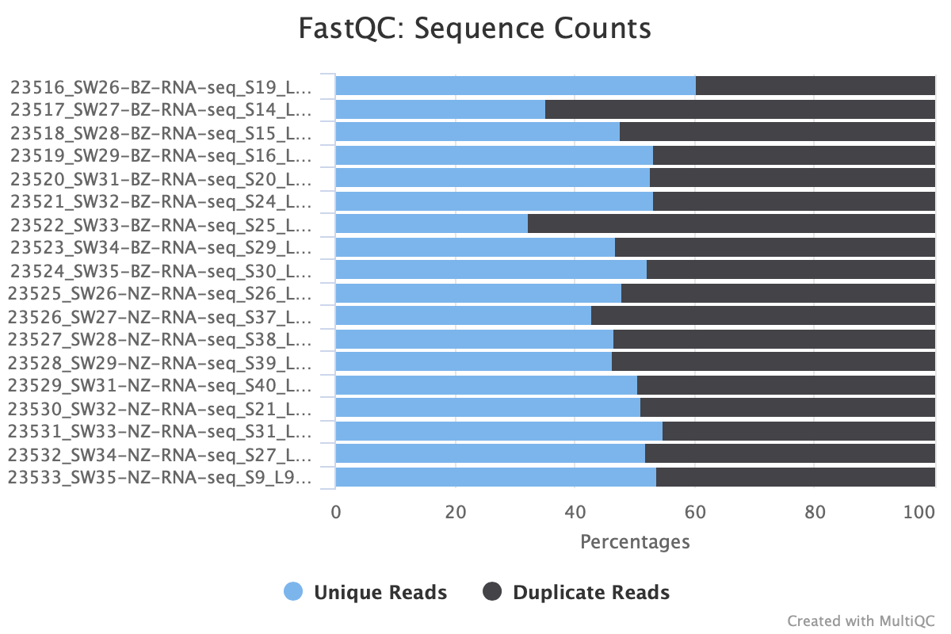
Sequence duplication
Notes:
Most duplicate reads are legitimate biological signal. Problematic levels of duplicates are typically caused by low amount of starting RNA leading to an unrepresentative RNA population (https://doi.org/10.1186/s12864-018-4933-1).
Unless a unique molecular identifier (UMI) is attached to the reads during library prep there is no way to distinguish legitimate duplicates from experimental error. In either case there is no way to computationally correct for excess duplicate levels since it results in a complete loss of information about the original composition of the sample.
There is no hard cut off for an acceptable amount of duplicated reads. If you have many replicates it is possible to identify which samples are outliers with respect to the percentage of duplicate reads. Samples with larger than average percentage of duplicate reads will often also have biased GC content and over-represented k-mers.

Slide 8
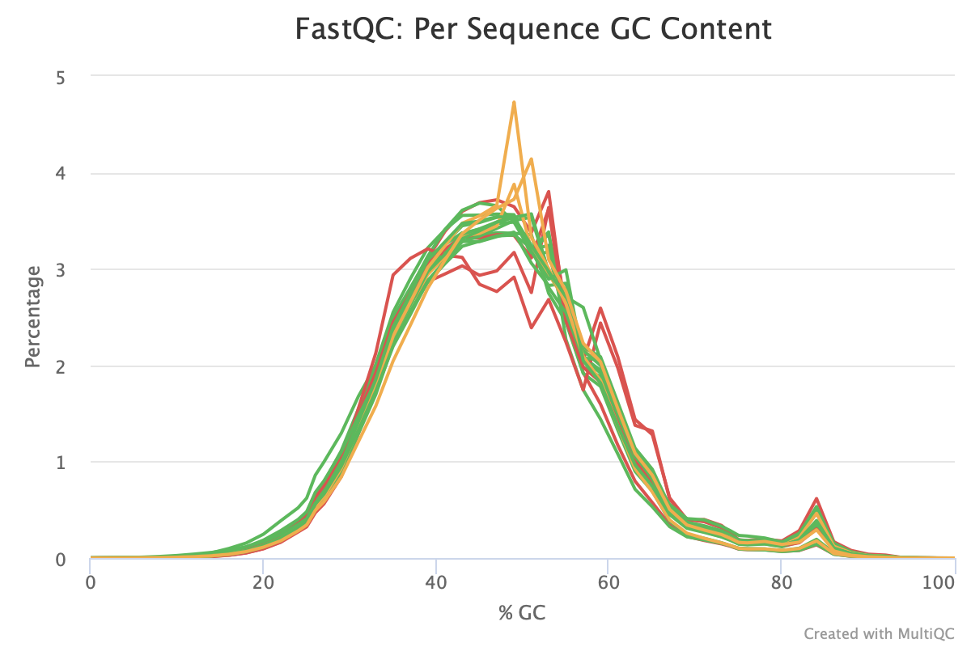
GC content
Notes:
GC indicating possible contamination or PCR error

Slide 9
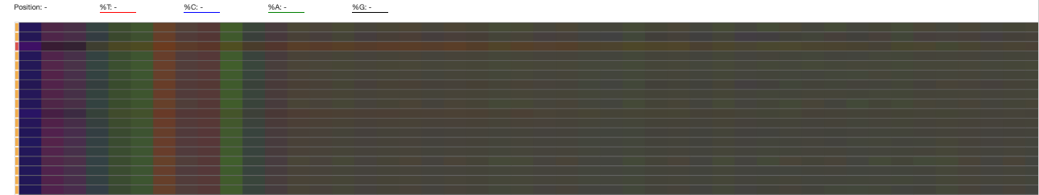
Overrepresented k-mers
Notes:
This is not an acutal k-mer plot. This slows nucleotide percentage by position. Kmer plots are difficult to aggregate and interpret for multiple samples, but this plot will give you a good sense of whether or not there are over-represented kmers in your samples. The colors represent the balance between the 4 bases and should produce a muddy brown color. It’s normal to see bias at the beginning of the sequences.

Slide 10
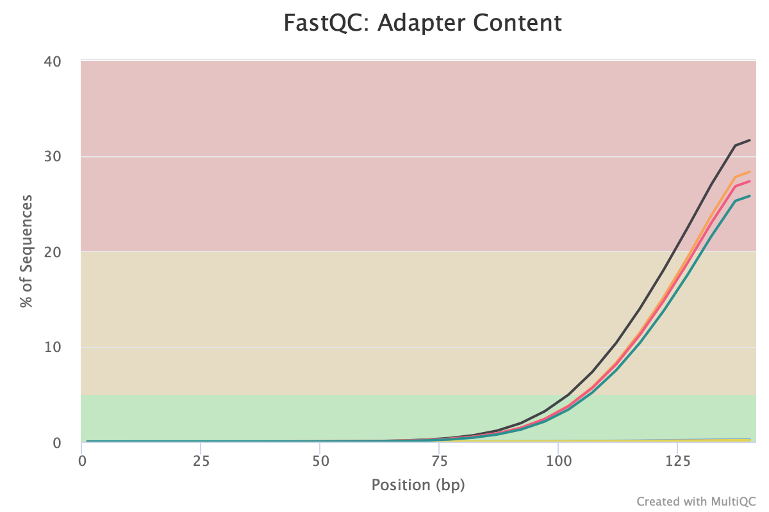
Adapter contamination
Notes:
Sometimes the library adapter sequences get sequenced and these should be trimmed off.
Adapter contamination is no longer a common issue since adapters are typically automatically removed when the FASTQ files are created. This was not allows the case so if you are using reads from a previously published study they will commonly still have the adaptors attached.

Slide 11
Reproducibility
How similar are replicates to each other?
Check with sample ordination
This is done after you get gene expression estimates

Slide 12
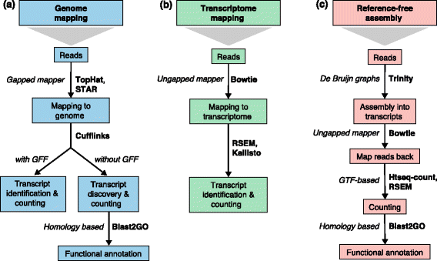
RNA-seq Gene Identification Strategies
Conesa 2016
Notes:
Using a reference improves results
Mapping to transcriptome won’t allow the identification of new transcripts.

Slide 13
Sequence Alignment
Reference sequence
Unmapped reads

Slide 14
Sequence Alignment
Reference sequence
Mapped Reads

Slide 15
Gene Expression
Reference sequence
Mapped Reads
Gene | Read Count
Red | 7
Blue | 11
Purple | 13

Slide 16
Multimapping
Reads map to more than one location
Caused by duplications and transposable elements
Leads to either under or overcounting
Can effect differential expression analysis
Computational strategies:
Ignore them
Count once for each alignment
Randomly assign
Split amongst all alignments
Assign to region with most unique reads
Read coverage based method
Expectation maximization approaches
Multi-map groups
Best methodology is still an open question
Deschamps-Francoeur et al 2020
Robert and Watson 2015

Slide 17
Transcript Identification
Reference sequence
Mapped reads
Predicted transcripts

Slide 18
Strandedness
Transcription can occur from either of the DNA strands
Library preparation library either lose or preserve stand origin information
Benefits of preserving strand information:
More accurate gene expression measurements (especially in dense genomes)
Identification of anti-sense transcriptional regulation,
Assist with transcript assembly
Preserving Strandedness is not required for differential expression analysis if there is a reference genome
If Strandedness is preserved need to include how the reads are related to the original transcript (Determined by library prep protocol)
If original strand degraded: RF (Reverse, Forward)
If original strand preserved: FR (Forward, Reverse)
Parkhomchuck et al 2009, Levin et al 2011
Notes:
Parameters by library prep: https://chipster.csc.fi/manual/library-type-summary.html
In libraries where the original RNA strand is degraded read 2 is from the original RNA and so the directionality is RF (Reverse, Forward)
In libraries where the original RNA strand is preserved read 1 is from the original RNA and so the directionality is preserved (FR—Forward, Reverse)
Video that explains sequencing process: https://www.youtube.com/watch?v=fCd6B5HRaZ8

Slide 19
Small RNAs
Import regulatory elements:
Embryo development
Cell differentiation
Growth and proliferation
Apoptosis and cell death
Library preparation protocols different from mRNA protocols
Library preparation protocol greatly influences sample composition
Differential expression measurements still accurate
Dard-Dascot et al 2018

Slide 20
What we will be going over today
Checking sequencing data quality
Sequence alignment to a reference genome
Obtaining gene expression estimates
Predicting transcript structure

