Slide 1
Metagenomics demo
Anujit Sarkar
Postdoctoral scholar, COPH, CON
USF Genomics Program
July 26, 2021

Slide 2
Main steps in metagenomic analyses
Gather raw data (we will provide demo shotgun metagenomics fastq files)
Evaluate data quality
Adapter trimming and data quality filtering
Fastqc
Trimmomatic
Build database for classification (RefSeq), get taxonomic profiles, convert to tables
Convert sam to bam, extract unmapped reads, sort bam files, convert bam to fastq
Host genome removal (Download host genome, build database, map all reads against database)
Kaiju
Samtools
Bowtie2
Assemble genomes from unmapped fastq files
Quality assessment of assembled genomes, get contig details, N50, graphs
Build database from assembled genomes, indexing assemblies, get assembly stats
Megahit
Metaquast
Bowtie2, samtools
Predict open reading frames from assembly
Evaluate bins for completeness and contamination but assessing single copy genes
Binning contigs into separate taxonomic identities to get ‘Metagenome assembled genomes (MAGs)’
Prodigal
CheckM
MetaBAT

Slide 3
Main steps in metagenomic analyses
0
1
2
Gather raw data (we will provide demo shotgun metagenomics fastq files)
Evaluate data quality
Adapter trimming and data quality filtering
Fastqc
Trimmomatic
4
3
3
Build database for classification (RefSeq), get taxonomic profiles, convert to tables
Convert sam to bam, extract unmapped reads, sort bam files, convert bam to fastq
Host genome removal (Download host genome, build database, map all reads against database)
Kaiju
Samtools
Bowtie2
5
5
6
Assemble genomes from unmapped fastq files
Quality assessment of assembled genomes, get contig details, N50, graphs
Build database from assembled genomes, indexing assemblies, get assembly stats
Megahit
Metaquast
Bowtie2, samtools
9
8
7
Predict open reading frames from assembly
Evaluate bins for completeness and contamination but assessing single copy genes
Binning contigs into separate taxonomic identities to get ‘Metagenome assembled genomes (MAGs)’
Prodigal
CheckM
MetaBAT

Slide 4
Step 0 : Explore the resources
Explore the raw data
Explore the local.env file
Explore the databases
Change the ‘outdir’

Slide 5
Step 1 : Evaluate data quality
Purpose: Evaluate metagenomics data quality for quality control purposes and identify over-represented sequences
Input: Raw demultiplexed fastq files
Requirements: Fastqc
Output: Reports on various parameters regarding data quality

Slide 6
Step 2 : Adapter trimming and data quality filtering
Purpose: Trim down the adapters and remove bad quality reads
Input: Raw demultiplexed fastq files
Requirements: Trimmomatic
Output: Nice and clean fastq files with very fewer sequencing errors

Slide 7
Step 3 : Host genome removal
Purpose: To discard the sequences which belongs to the host
Input: Clean fastq files
Requirements: Bowtie2, Samtools
Output: Microbiome component separated and saved as fastq
Note: The fastq files for each sample are not in paired-end mode here
Bowtie2
samtools
All sequences
Human component mapping to reference genome
Remaining component comprise of only microbiome

Slide 8
Step 4 : Get microbial taxonomic profiles
Purpose: Get highest level classification of each sequence
Input: Microbiome component as fastq
Requirements: Kaiju
Output: Microbial classification tables for each sample

Slide 9
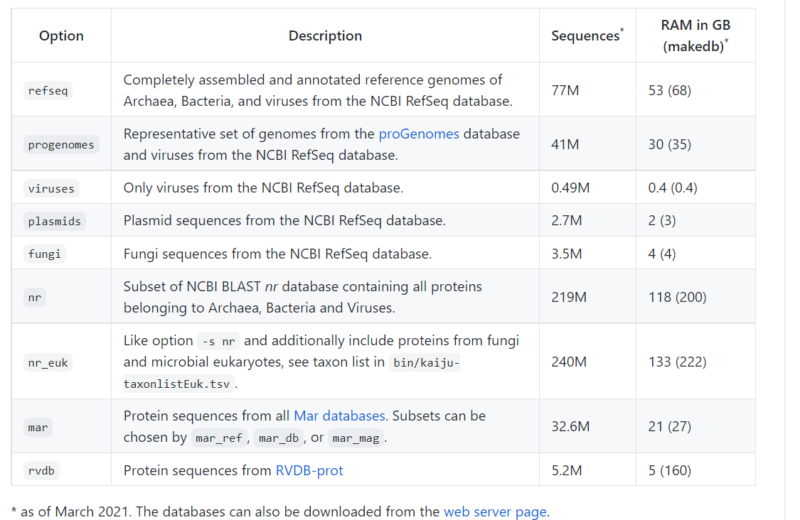
Step 4 : Kaiju databases

Slide 10
Step 5 : Assemble genomes from microbiome data
Purpose: To stitch the sequences together to get contigs
Input: Microbiome component as fastq
Requirements: Megahit. Metaquast
Output: Assembled genomes, details of contigs assembly

Slide 11
Step 5 : Assemble genomes from microbiome data
AGTTCGAGCACTGGA
ACTGGAACTGGATGG
AGTTC
ACTGG
GTTCG
CTGGA
TGGAA
TTCGA
AGTTCGAGCACTGGAACTGGATGG
GGAAC
TCGAG
GAACT
CGAGC
AACTG
GAGCA
ACTGG
AGCAC
CTGGA
GCACT
TGGAT
CACTG
GGATG
ACTGG
GATGG
CTGGA

Slide 12
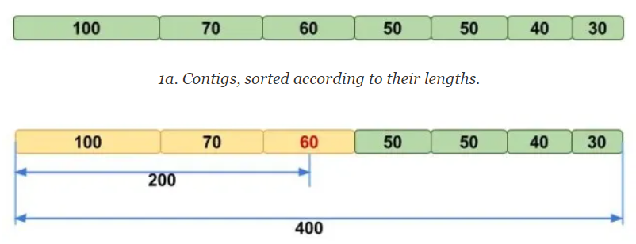
Step 5 : Check assembly quality
Explore combined reference
N50 assembly

Slide 13
Step 6 : Segregate fastq file and create a database of your assembly
Purpose: Separate forward and reverse fastq
Create an indexed database of your assembly for future use
Input: Microbiome component as fastq, final assembled contigs (fasta)
Requirements: Bowtie2, Samtools
Output: Separate forward and reverse fastq for each sample, database indexes from assembly

Slide 14
Step 7 : Metagenomic binning of your assembly
Purpose: Reconstruct single genomes from assemblies obtained from metagenomic sequencing
Input: Final assembled contigs (fasta)
Requirements: MetaBat
Output: For each sample, a folder will be created containing corresponding bins

Slide 15
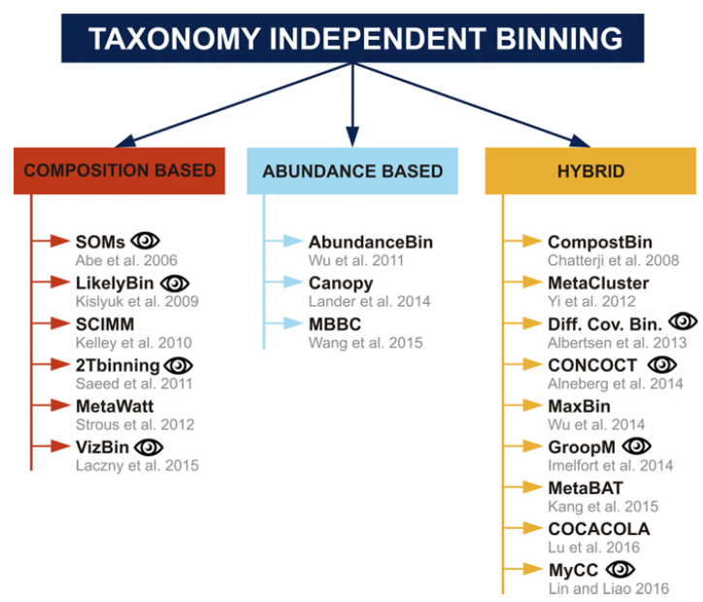
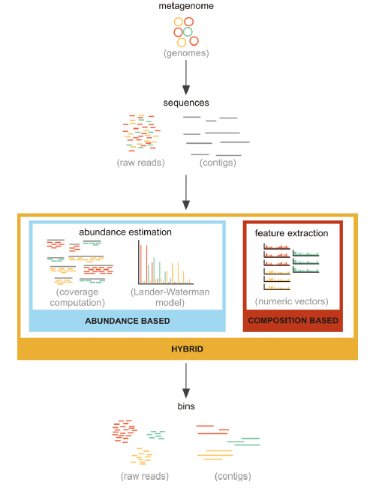
Step 7: Binning strategies
Bioinformatics strategies for taxonomy independent binning and visualization of sequences in shotgun metagenomics - PubMed (nih.gov)

Slide 16
Step 8: Check bin quality
Purpose: To check the quality of bins obtained in previous steps
Input: Bins obtained in previous step
Requirements: CheckM
Output: For each sample, completeness and contamination of genome will be obtained

Slide 17
Step 9: ORF prediction
Purpose: To predict genes and amino acids from MAGs
Input: final contigs fasta file from Metabat
Requirements: Prodigal
Output: Details of amino acids, gene coordinates and nucleotides

