Slide 1

Statistical Considerations for Microbiome Studies
Dr. Ryan McMinds
20210407
Influenced by previous iterations by Dr. Ming Ji

Slide 2

No free lunch
Garbage in, garbage out!
Big data and machine learning can’t solve everything
Design of experiment is more critical than the stats used in the end
Always take more samples than you think you need

Slide 3
Patterns vs. Processes
Separating very similar patterns can help determine processes that created them
Statistics can only help describe and distinguish those patterns
Statistical tests make assumptions about processes using a model. ‘Non-parametric’ tests are no exception.
Some assumptions will always be wrong. It is your job to understand and communicate how potential violations would influence your interpretation

Slide 4
Discrete Compositionality
Most high-throughput sequencing studies result in counts that can be interpreted as relative abundances
Relative abundances of different variables from a single sample are not independent
Many standard methods transform these data in a way that reduces the interdependency and helps approximate residual normality
It is fundamentally impossible to do such transformations without making strong assumptions, which are almost always violated in microbiome studies
Best to do statistical tests on the rawest-possible data (as long as those tests are designed for such data)

Slide 5
Big Data
Unfortunately, the size of these datasets often makes the ideal statistical analysis from ‘raw’ data impractical
In the extreme, you would directly analyze the machine pixel intensity data, with error models that acknowledge specific processes that happen during sequencing
Many terabytes of data requiring insane number of parameters – absolutely not possible. You have to pool information.
Pixels get summarized as base calls, sequential base calls get pooled into sequences, index sequences are used to group sequences from each sample, similar sequences in each sample are pooled during QC and ‘denoising’ or taxonomic summarization...
Many methods exist for analysis at that point; pooled counts. But sometimes this dataset is still too large to answer some questions

Slide 6
Distance matrices
UniFrac
Jaccard
Bray-Curtis
None are ‘the best’ – they all emphasize different patterns
Common practice to do ‘multivariate stats’ using matrices of distances between samples
Instead of a matrix of 200 samples X 60,000 ASVs (12 million observations?), you can work with a 200 X 200 symmetric matrix (max 19,800 DOF)
Many choices. Incorporate abundance or just use presence/absence, partially pool information from phylogenetically related taxa or not...
STRONG. VERY STRONG. SUPER STRONG ASSUMPTIONS
I often struggle to take these analyses seriously for drawing robust conclusions. But extremely useful for summary statistics, guiding and generating hypotheses, and producing figures
Permanova
Permdisp
Anosim :(

Slide 7
Baby Bear and Goldilocks
Let your question guide your stats
Would it be important to identify differential abundance of a single ASV, with high power? Use the rawest possible data, and if necessary, compromise by heavier filtering or pooling of unrelated sequences
Do strain-level differences not matter as much as macro-ecological patterns? Start with distance-matrix based stats, and see if there are specific patterns of interest that could be modeled with more precise methods
No such thing as a standard workflow

Slide 8
Differential abundance
Lots of tools designed for RNASeq data and co-opted for microbiomes (e.g. DESeq2)
Statistical model assumes:
Most taxa have relatively constant abundance (often violated in microbiome studies)
No true absences (zeros are due to extremely low abundance; good for RNASeq, much less good for microbiomes. Zero inflation can be important and interesting!)
Error follows negative binomial distribution. Not a bad assumption, but somewhat inflexible (can’t incorporate residual correlation)
Taxa of similar abundance have similar residual variance (this one can get us in trouble – possible to have significant differences with just two samples! Potential for false positives)
Often most practical option. Just be aware of these and other assumptions!
ALL tools looking at individual taxa will suffer from the Curse of Dimensionality.
Multiple-comparison adjustments like Bonferroni corrections are necessary for frequentist tests!
Increase power (and computational efficiency!) through extra filtering or pooling (but be aware of potential introduction of biases!)

Slide 9
Sample sizes
Necessary sample numbers vary a lot, depending on:
Diversity of microbiome
Variability of microbiome
Strain-level specificity required
Number of variables, interaction effects, interest in dispersion effects
Hard to make general recommendations, but tools exist.
R package powmic
Domain experts like us and your friends

Slide 10
Always think twice
These are complicated experiments. Errors can creep in at a lot of steps. Consider the possibilities when doing stats and making conclusions!
Contamination
Cross contamination
Negative controls aren’t negative
Wrong barcodes (can happen during sequencing and be read-specific)
Chimeras!
Inaccurate (even biased) OTU clustering / ASV denoising
Samples stored or prepped differently
Multiple sequencing runs, different or same quality scores
Host sequences in theoretically microbial data
Different samples’ host sequences can be different
Correlation is not causation. Manipulative experiments or else and especially...

Slide 11
Your interpretation
Is your interpretation.
Stats alone never give a definite answer
No need to be a nihilist, just be honest in your discussion and results

Slide 12
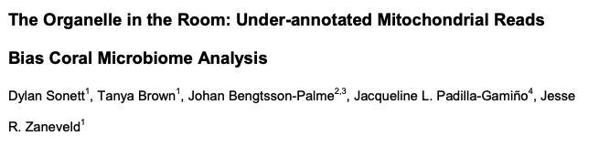
Pattern vs. Process Example: Where’s the host

Slide 13
Where’s the host
A ‘standard’ pipeline might wind up comparing communities of bacteria in corals from two different reefs, using Permanova
There’s a significant difference! Write that paper showing how coral microbiomes are geographically variable

Slide 14
Where’s the host
Unfortunately, our interpretation is at odds with a violated assumption
We assumed that our ‘16S’ dataset only included bacterial sequences. But for some reason, the 12S gene of coral hosts is also amplified by our primers!
In fact, the permanova results completely disappear when these 12S ASVs are removed. There was a host genetic difference between the sites, not a difference in microbiomes!

Slide 15
Where’s the host
Host contamination doesn’t seem to be as much of a problem for human studies, but the lesson stands: our interpretation of statistical results is drastically affected by our (often very misplaced) assumptions about our data
In this case, a ‘multivariate test’, often interpreted as meaning something about the microbiome ‘as a whole’, is driven almost entirely by a small number of variables. The multivariate test in this case shouldn’t influence our conclusions beyond those drawn with differential abundance analysis. And yet...

Slide 16
Where’s the host
Different ‘16S’ primers have different biases. Some might catch fungal 12S, some might be biased against Archaea, almost all miss a huge diversity of bacteria in the ‘Candidate Phylum Radiation’ (CPR).
Think about your conclusions with this in mind! Any single statistical analysis in this field is highly suspect until the interpretations can be supported by very different methodologies. Weird artifacts can be common.

Slide 17

Pattern vs. Process Example: Anna Karenina

Slide 18
Example: Anna Karenina
Pattern: Permdisp says groups have different dispersion (AKA heteroskedasticity or differences in residual variance)
Anna Karenina effect? What does that mean?
AKP effect can result from multiple processes, each of which can produce slightly different sub-patterns

Slide 19
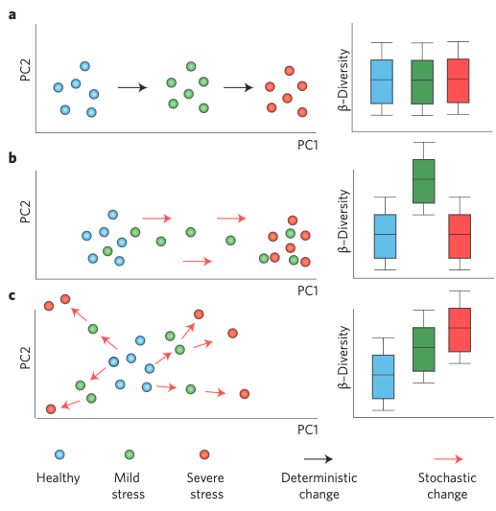
Example: Anna Karenina
Assumptions:
1. Samples fall into
discrete categories
2. Categories are 100%
accurately coded
3. Normally distributed
residual variance
4...
5...
6...
...
Missing/miscoded
variable?
“True AKP effect”?
Common
Permdisp assumption?

Slide 20
Talk to me about custom Bayesian statistical models
555-know-your-assumptions.com
(that’s fake but I am starting up a blog at merdemicrobes.com)

