Slide 1
Setting up Hyper-V 2012 Replication on Workgroup Servers
Documentation:
Hyper-V 2012 Replication on Workgroup Servers.docx
Available at:
https://github.com/usgin/Workshops/archive/master.zip
Eastern Regional Workshop

Slide 2
Hyper-V is a Windows Server Role that can be installed on Windows Server 2012 platforms
Purpose: allow any hub or node in NGDS to have a mirror image of a server at another location, updated every 15 minutes
Prerequisites:
A minimum of two Windows Server 2012 Hyper-V host servers
One host server will act as the primary server, of which copies will be made
Another host server will act as a replica server used to receive replica copies of virtual machines from the primary host server

Slide 3
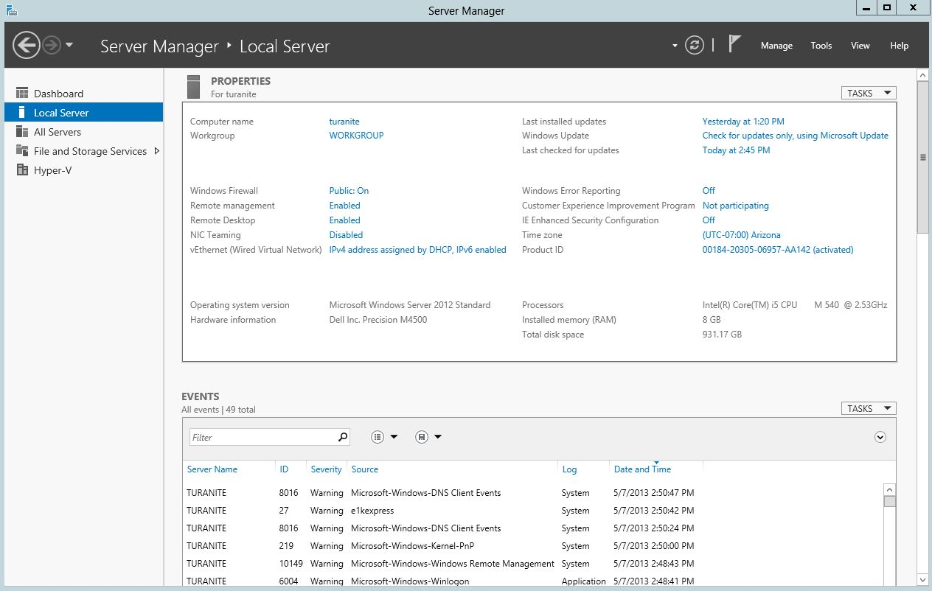
Install
Using Add Roles and Features Wizard

Slide 4
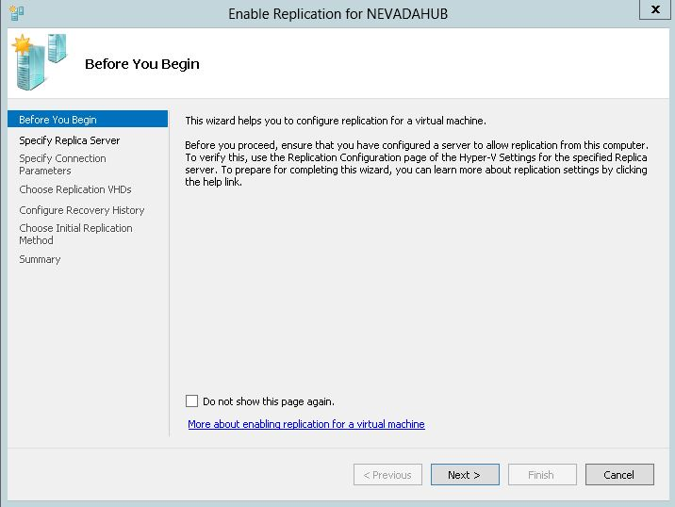
Enable Replication
Using the Enable Replication Wizard

Slide 5
With Hyper-V, replicate a server for any hub or node in NDGS and prevent catastrophe!
For Hyper-V demo video, visit http://blogs.technet.com/b/haroldwong/archive/2012/09/05/it-camps-on-demand-windows-server-2012-demo-hyper-v-replica.aspx

Slide 6
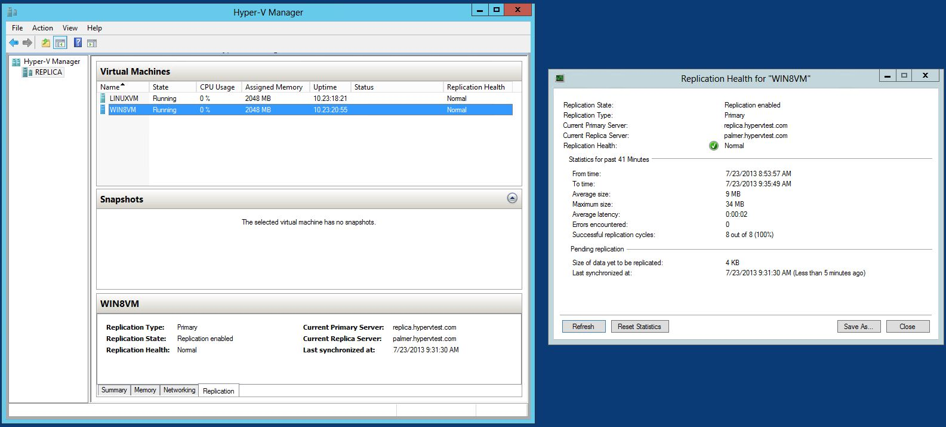
Primary Server during Replication

Slide 7
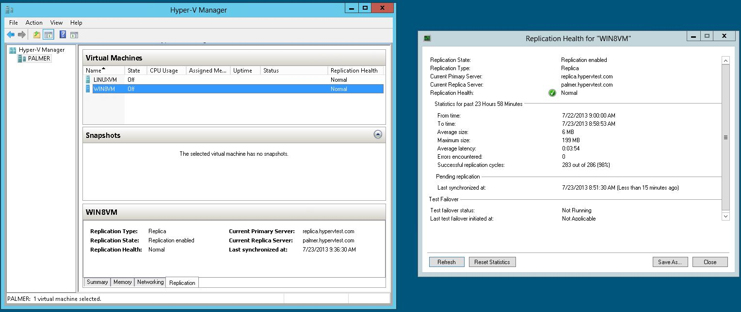
Replica Server during Replication

