Slide 1
Demystifying interoperability
The National Geothermal Data System:
Implementation of the U.S. Geoscience Information Network
Stephen M Richard
Ron Palmer
Christy Caudill
Janel Day
Grand Sierra Resort and Casino, Reno, NV
May 14, 2013

Slide 2

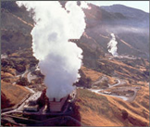
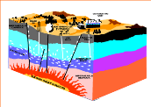
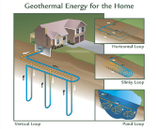
USGIN: Purpose
Make data resources of State and Federal geological surveys accessible online in a distributed network by
using common standards and protocols
working with data providers to implement these services.

Slide 3
What defines the network
Specifications
People and software using them
Information Exchanges
Service Protocol – how message are sent to ask for and get data
Content models – what information is available
Interchange formats – how the information is encoded (e.g. HTML, xml, json, txt, xls)

Slide 4
Why
Is interoperability worth the pain

Slide 5
Make things easier
Make life easier for the customer
They don’t have to do figure out new data structures
Create bigger market for applications
App works with different data providers
Facilitate machine processing
Make metadata easier
Don’t have to document data structure-it’s already done.
Simplify data maintenance

Slide 6
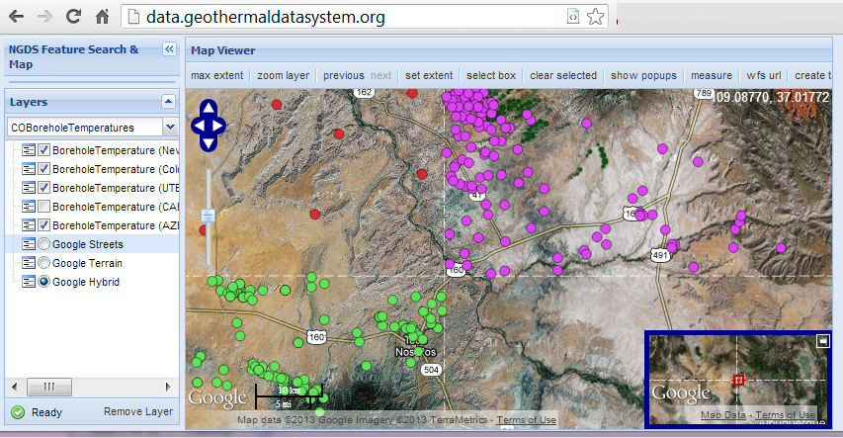
Example: NGDS Borehole temperatures

Slide 7
Linked Data
Use identifiers that can be dereferenced on the WWW
Enable navigation between related resources
Leverage web archecture
GitHub\USGIN\Workshops\WesternRegionalWorkshopWMS_URIDemo.mxd

Slide 8
NGDS Sustainability
Stephen Richard and NGDS team
Reno, NV May 14, 2013

Slide 9
Outline
What needs to be sustained
Costs
Business models

Slide 10


Paradigm Shift
From: Paper publications as the product
To: Information via web services as the product

Slide 11
State surveys as data providers
We all have web servers and web sites
Run data services
Have to integrate web usage metrics into agency performance assessment

Slide 12
What needs to be maintained
Web server:
Physical server: maintain hardware, update system software, security
Cloud server: update system software, security
Hosting service:
Data:
Correct errors
Update with new data
Upgrade as software evolves

Slide 13
What’s it cost… People
costs calculated for AZGS, include ERE, vacation, holiday, sick…
supervisor | 1 hr/wk | $ 3,120.00
Technician | 8hrs/mo, every year a big job = +40hr/yr | $ 6,800.00
Content manager | 4 weeks/yr; new content and updates come in bursts | $ 5,280.00
 | Annual Total: | $15,200.00

Slide 14
What’s it cost: Computers
Estimated cost per year; these will vary widely…
electricity, cooling, space | $ 800.00
internet | $ 100.00
software, guess academic site license kind of pricing | $ 1,000.00
Servers, storage (budget on basis of VMs running in a local host, with a storage-area network); base on AZGS calculation with HP server running ~20 VMs, 5 year lifetime. | $500.00 /yr per VM; est. $1200 /yr
subtotal computer $3,100.00

Slide 15
Grand Total:
$18,300.00 per year
% personnel 83%
% equipment 17%
Account for lifetime of hardware
Include funds for personnel to monitor and update

Slide 16
Business models:
Build into operating costs
Sponsors
Advertising
Subscriptions
… We need to invent

