Slide 1
Excel to NGDS Services
Transforming data into interoperable web-accessible and widely-available web services
Example workflow using ArcMap v10.0, Microsoft Access, and ArcServer

Slide 2
Data Processing Demo Agenda
Ensure use of correct schema
Create URIs
Run ExceltoNGDSServices python tool
Review feature class in Access
Create ArcMap project (with metadata)
Demo service deployment (more metadata)
Service validation
Create repository page (and more metadata)

Slide 3
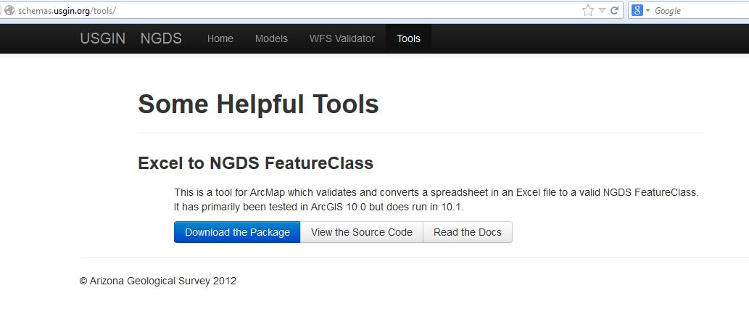
Download ExceltoNDGSServices tool at http://schemas.usgin.org/tools/

Slide 4
Section 1: Data QA/QC in Excel
Check for Reasonable Data
Create Meaningful Labels
Ensure that the Excel file is in the correct schema: http://schemas.usgin.org/models/

Slide 5
Section 2: Create URIs
URIs – a core part of a USGIN-styled system
Each record in a dataset has a globally unique identifier; hence each record can be seen as a unique object
Important to reduce dupilication and determine associations between resources
An extra layer is added onto this idea in NGDS, where the URIs actually redirect to something in a browser
An implemented rewrite rule enables URIs to dereference an online resource or representation of each individual record of the data service. Examples:
http://resources.usgin.org/uri-gin/isgs/well/API:120010005200/
http://resources.usgin.org/uri-gin/isgs/welllog_tif/120010010800_ies/
Notes:
I was reading about a company who provides Guidance for Unique Object Identifiers (OIDs) for health care systems, where each document associated with a patient has this identifier and can be found by the system with no other information (such as name or SSN).

Slide 6
Section 2: Create URIs
Create URIs in Excel workbook
Begin with a unique identifier for each record in the dataset
Check the assigned name authorities and tokens
https://github.com/usgin/uriredirect/wiki/
NGDS-Name-Authorities-and-Tokens
Concatenate:
the redirect URL ‘http://resources.usgin.org/uri-gin/’
naming authority for the data provider (i.e., azgs, cadoggr, nhgs)
token, specific to the dataset (i.e., bhtemp, welllog, welltest)
unique identifier for each record
Notes:
Within NGDS, there will be only one Well Headers service represented by a given institution or state, so having the name authority with a token makes the URI unique from other Well Header datasets. The identifier makes it unique within the dataset.

Slide 7
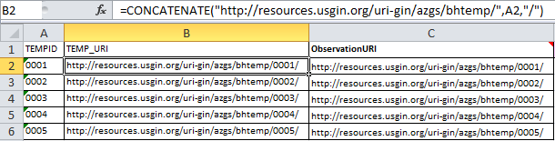
Concatenate
the redirect URL http://resources.usgin.org/uri-gin/
naming authority for the data provider azgs
token, specific to the dataset bhtemp
unique identifier for each record found in column A
Email URIredirection@usgin.org for URI redirection implementation (see documentation)

Slide 8
Section 3: Run the Excel to NGDS Service Tool
Save the entire folder ‘ExcelToNGDSServiceTool-master’ to your local C:\Users\[user]\Documents\ArcGIS\
Open ArcMap, and the Catalog window (within ArcMap)
Navigate in Catalog to your Home directory, then choose the Documents\ArcGIS folder\ExcelToNGDSServiceTool
Open the Toolbox ‘ExcelToNGDSService’
Double-click the script ‘Excel to Service’
Drag the Excel file reviewed in Sections 1 and 2 into the Excel file box, or browse to select it
Select the sheet containing the data (if multiple tabs exist in your Excel workbook)
Select the appropriate schema
Enter the Service Name, ideally in the format: State Prefix + Service (see Appendix B in documentation)

Slide 9
What will the tool do?
Validates Excel file against chosen schema (XSD)
Checks required fields for data
Calculates values for missing data in required fields
string = Missing
date = 1900-01-01T00:00
double = -999
Corrects data types, as necessary
Ensures SRS is EPSG:4326, or will reproject
Ensures URIs are unique and in correct format
Creates georeferenced Feature Class in Personal Geodatabase

Slide 10
Why create the tool?
Simplicity!
Automates schema (XML, XSD) comparison
Helps to ensure validation of eventual service
Greatly increased efficency of service data processing
Example of reason for interoperability
with standardization, many such applications can be built on top of data structure not only for processing, but for data analyzing/comparing/distributing for end users

Slide 11
Section 4: Fix Errors Indicated by Tool
Closely read the output provided by the tool – failures are provided by row, so they can be fixed immediatley in Excel file without searching the data
Even if file valiates, acknowledge changes made to the data by the tool
If tool cannot reproject to EPSG:4326, go to documentation Appendix E to do so manually

Slide 12
Section 5A: Finish Creating the Feature Class using Access
Open Access database
move Shape field to last in field order
(as is specified by the schema)
Fill in RelatedResources field, if necessary

Slide 13
Section 5B: Finish Creating the Feature Class using ArcCatalog
Export Feature Class as XML document and Import to new File Geodatabase Feature Class
Open ArcCatalog
Right-click Feature Class; choose Export then
XML Workspace Document
Select “Schema Only”
Specify an output location and filename for the .xml file
Open XML document in editor (XML Explorer / Notepad++), then move Shape field. Save.
Right click a target File Geodatabase; choose Import then XML Workspace Document…
Right-click new Feature Class; choose Load then Load Data, loading the original Feature Class

Slide 14
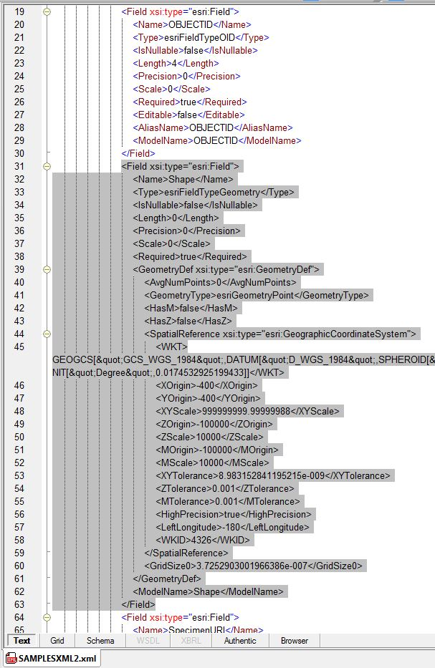
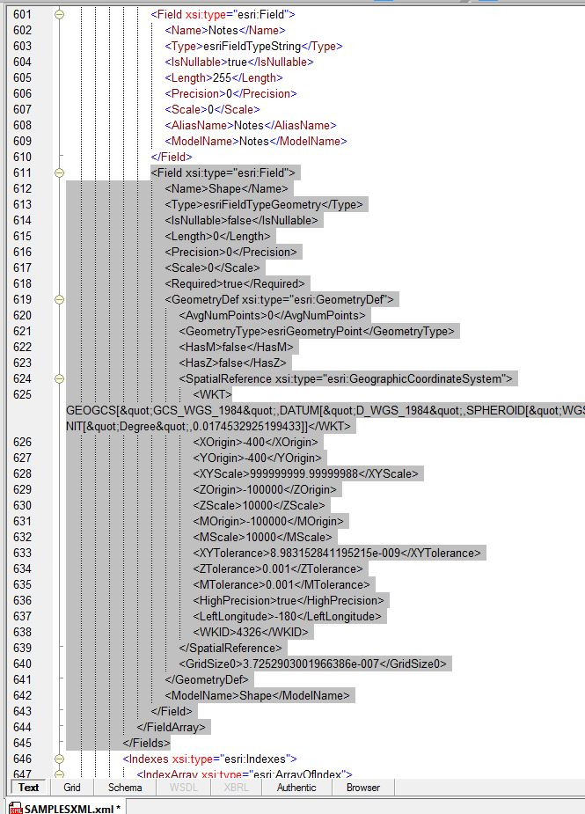
Move From
Move To

Slide 15
Section 6.1B: Create ArcMap Project (.mxd)
Open ArcMap
Add Feature Class
Right-click layer, choose Properties
Symbology, choose Import (http://repository.stategeothermaldata.org/repository/resource/98ddf901b9782a25982e01af3b068fdc/)
General: fill in metadata
Fill in metadata for Data Frame
Fill in metadata for Map Document
Notes:
Once you’ve deployed the service, this will end up on the service rest page (if deploying with ArcServer). Go to AZ’s AKActiveFaults rest page

Slide 16
ArcServer Deployment Demo: Load Data and Publish Services
Postgres “staging” and
PostGIS “production” databases
Ideally, a staging database is used for data table edits. Data tables from which live services are pulled should be static and password protected.
PostGIS databases are used for service deployment due to GeoServer requirements and open-source software developer preferences

Slide 17
ArcServer Deployment Demo: Load Data and Publish Services
Copy the Feature Class and paste into the “staging” database
Right-click the Feature Class,
choose Add Global IDs
Right-click the Feature Class
choose Register As Versioned
Create Replica - “pushes” the dataset from staging to production database
Create a new service on production server using new Map Project and Feature Class

Slide 18
Section 7: Validating Services
WMS (Web Map Service) validation requires visual confirmation in a GIS program
Navigate to the service rest page for the WMS GetCapabilities URL; copy everything left of the “?”
Open ArcCatalog, navigate to GIS Servers
Choose ‘Add WMS Server’
Paste in the URL and click ‘Get Layers’
Drag the added layer into ArcMap.
Ensure that the WMS draws with correct symbology. Choose the Identify tool and select a feature; click on a URI to test the redirects.
Notes:
Also use Arc online ********Have everyone navigate to a home page and validate for themselves

Slide 19
Section 7: Validating Services
Schema Validation using WFS GetFeature or GetCapabilities request
Copy the WFS GetCapability link
Paste into validation tool http://schemas.usgin.org/validate/wfs
Choose appropriate schema and version
Notes:
Also use Jessica’s tool ********Have everyone navigate to a home page and validate for themselves

Slide 20
Section 8: Create New Repository Resource
Creating a new resource in the NGDS repository that represents this data service exposes it to the catalog where it becomes searchable within the system. This also creates metadata for the service. This step is necessary to fulfill the Tier 3 USGIN requirements.
Go to http://repository.stategeothermaldata.org/repository/
to Create a New Resource

Slide 21
Section 8: Create New Repository Resource
Upload the Excel file, database file, or shapefile that represents this service
Add links for ESRI, OGC:WFS, and OGC:WMS services
Add Author and Distributor information
Add Keywords
Add Description
Add to Collections on screen left. Collections are categorizations of metadata, where state, organization, and data type are specified.

Slide 22
Section 6.2: Load Data and Publish services using GeoServer
For workshop purposes, the following assumes data table already exists in a PostGIS database
From OpenGeo Suite Dashboard, click Start and choose GeoServer to open the GeoServer interface.
Under Data, click Workspaces.
The workspace specifies a namespace, so each data type will need its own separate workspace.
Under Stores, click Add new Store. The Store will house the connection parameters to the data table in PostGIS database.
Under Layers, click Add a new resource.
From the drop-down list, choose the workspace:Store you’ve just created.
Navigate to data table in PostGIS database.

Slide 23
Publish services using GeoServer, cont.
Data table created using ArcMap? SRID will have to be manually specified by creating a New SQL View of the new layer
Under Layers, click Add a new resource and choose the workspace:Store you created previously
Choose ‘Configure new SQL view...’
SQL statement = select * from azthermalsprings, click “Refresh”
Indicate “4326” in shape field
Save the new layer, named EXACTLY as the layer name is specified in the schema

Slide 24
Create app-schema configuration for GeoServer service
Download the app-schema extension and place the jar files in the WEB-INF/lib directory
Create a “mapping file” and place in GeoServer workspaces/[layer]/[store] directory, example: http://repository.stategeothermaldata.org/resources/documents/App-Schema-Mapping-Files/HeatFlow.xml
Edit datastore.xml file, example: http://repository.stategeothermaldata.org/resources/documents/App-Schema-Mapping-Files/datastore.xml

Slide 25
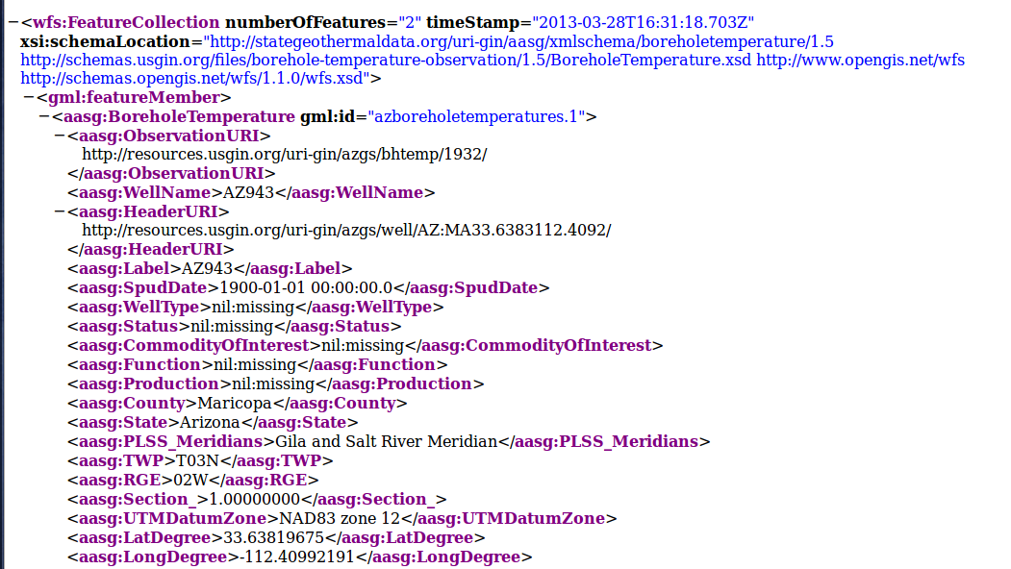
Using GeoServer Application Schemas, a WFS GetFeature request actually references the online schema (XSD) making for a schema-valid WFS –
capabilities for which ArcMap falls short

Slide 26
Appendix E: Project and Transform Data
In ArcCatalog, open ArcToolbox
Choose: Data Management Tools, Projections and Transformations, Feature, Project
Input = Feature Class with other SRS
Ouput = new Feature Class with specification SRS
Output Coordinate System: GCS_WGS_1984

Slide 27
Appendix E: Calculate New Coordinates
In ArcCatalog, open ArcToolbox
Choose: Data Management Tools, Field, Calculate Field
Input = new Feature Class
Calculate LatDegree field; Type !shape.firstpoint.Y! in Expression field and choose Python_9.3 for Expression Type
Calculate LongDegree field; Type !shape.firstpoint.X! in Expression field and choose Python_9.3 for Expression Type
Choose Calculate Fields again
Input = same Feature Class
Calculate SRS field; Type “WGS84” in Expression field and VB for Expression Type

Slide 28
Excel to Geodatabase without Script
Create a New – File Geodatabase in ArcCatalog
right click, Import - Table (Single)
choose Excel data file
Right click on new table
choose Create Feature Class, select From XY Table...
save in same geodatabase as “File and Personal Geodatabase Feature Class”
Create another new Feature Class from Template tab of content model
Import Excel Template tab; http://schemas.usgin.org/models/
ensure data types are correct as specified by schema
Append the data Feature Class to the Template Feature Class
map fields from one to another

Slide 29
Section 7: Validating Services
Schema Validation using WFS GetFeature request
Navigate to the service rest page for the WFS GetCapabilities URL and edit the URL as shown:
http://services.azgs.az.gov/ArcGIS/services/aasggeothermal/AZActiveFaults/MapServer/WFSServer?request=GetCapabilities&service=WFS
http://services.azgs.az.gov/ArcGIS/services/aasggeothermal/AZActiveFaults/MapServer/WFSServer?request=GetFeature&service=WFS&TypeName=ActiveFault&MaxFeatures=2

Slide 30
Schema Validation, cont.
Open XML Explorer. Paste in this URL.
Save the .xml
Open in Notepad++ to edit
Open http://schemas.usgin.org/models/ and save the schema (.xsd) to the same directory
In Notepad++ edit the second URL of the .xml to read the name of the saved .xsd
Save the document with the exact same name and in the same file location as the .xsd
Re-open in XML Explorer to validate

