Slide 1
Maps and data:
Intro to making NGDS resources
Topics to Cover
Tiers of USGIN data delivery
How can my institutions current efforts (e.g., web applications, publications) be a part of the NGDS?
What is an information exchange format? What’s in workbooks?
Where to access templates/content models
How can I put my existing database into an information exchange format?
Data review process—what makes a good dataset?

Slide 2
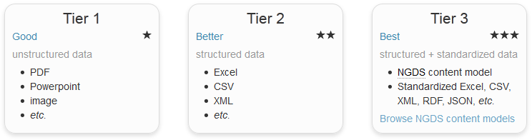
Tiers of NDGS data delivery
Web Mapping Applications
Online Digital Maps
Online Datasets
Online Maps with Structured Data
Core Samples Database
Publications Database
Web Services (WMS/WFS)
Web Services in interchange format (WMS/WFS)
Databases in ‘Metadata’ information exchange format

Slide 3
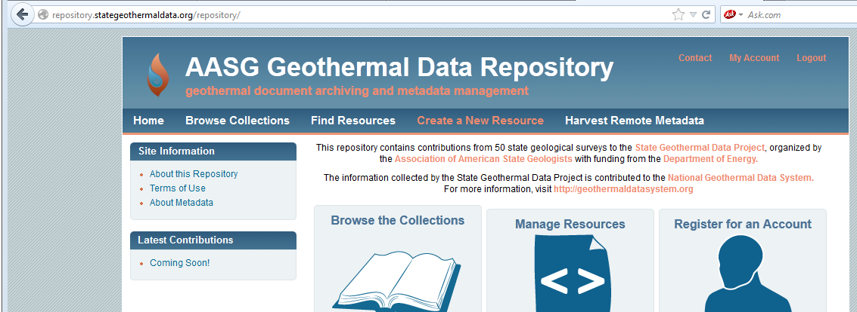
Web applications and services
Tier 1 and 2 online web applications, web services, and databases can be a part of NGDS
Metadata A metadata record for the resource must be created as part of the upload process and this metadata will be harvested into the USGIN Catalog
Provide links to enable searches on your data Make your data accessible along with 5 million data points and 18,000 documents

Slide 4
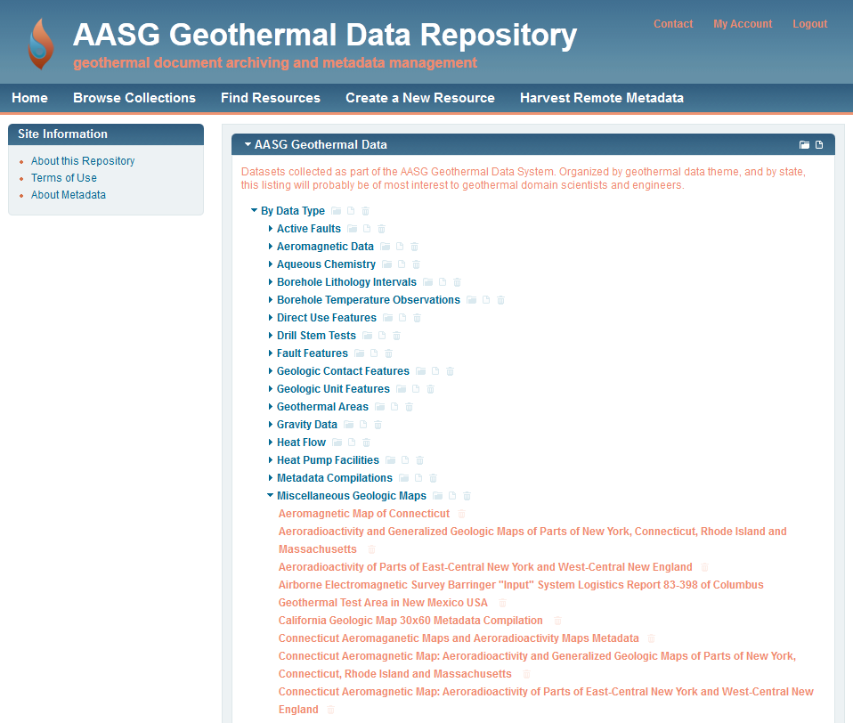
Data Services in NGDS interchange formats
(Tier 3)
Online Geologic Maps as PDFs (Tier 1) and WMS (Tier 2)

Slide 5
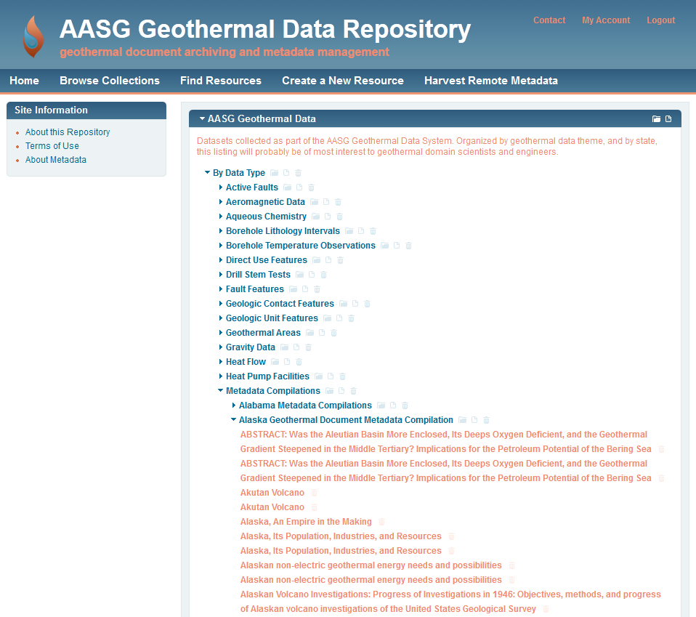
Data Services in NGDS interchange formats
(Tier 3)
Online Geologic Maps as PDFs (Tier 1) and WMS (Tier 2)
Publications and other databases in Metadata information exchange format
(Tier 3)
http://repository.stategeothermaldata.org/repository/
Notes:
LIVE DEMO

Slide 6
USGIN Metadata Standards
ISO19139 Metadata standards (and ISO19115 / ISO19119 standards for data web services)
Allows formal, structured data with controlled vocabularies for effective searcing of catalog
(all documents and data services)
Meeting minimum standards, made easy:
Information Exchange Formats
Metadata Content Model
Services Content Models (30+)
Built-in mandatory fields in repository form
Notes:
ISO 19115 The base ISO metadata international standard for the description of geographic information and services; ISO 19139 is XML implementation of that.

Slide 7
Information exchange format – includes a content model (Excel workbook) which provides a “template” to make it easier for researchers to submit their data with structure (allowing for interoperability as specified by a schema)
Content Models (Excel workbooks) contain tabs:
to map the existing database into template
to assist mapping with field definitions, terms, instructions
about the content model itself, data type that is appropriate

Slide 8
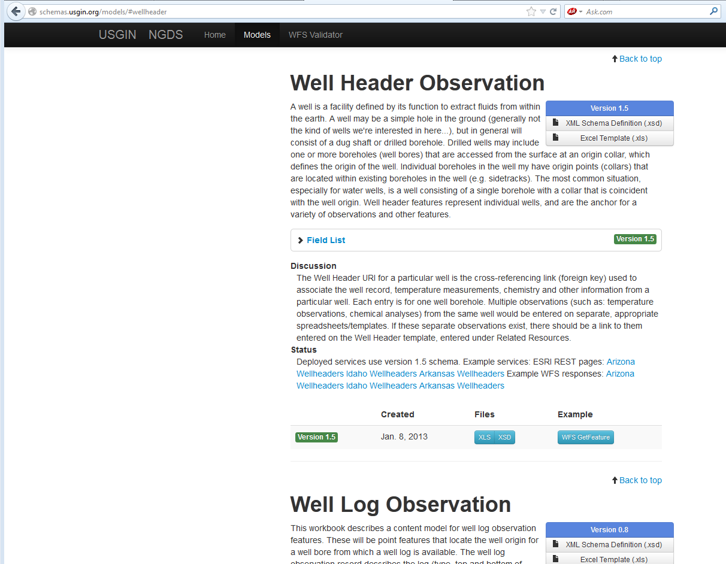
Access content models at: http://schemas.usgin.org/models/

Slide 9
Maps and data:
Intro to making NGDS resources
Topics to Cover
Tiers of USGIN data delivery
How can my institutions current efforts (e.g., web applications, publications) be a part of the NGDS?
What is an interchange format? What’s in workbooks?
Where to access templates/content models
How can I put my existing database into an information exchange format?
Data review process—what makes a good dataset?

Slide 10
Entering Data into Content Models
Open Excel workbook ‘Template’ tab. Copy and paste your records into the spreadsheet, field by field
Using shapefiles or geodatabase, Join with Excel ‘Template’ tab in ArcMap
Microsoft Access can be useful to Map Fields of personal geodatabase to Excel ‘Template’ tab, concatenate data in fields, consolidate more easily
ArcSDE database to Feature Class, using SQL views that match the interchange format http://lab.usgin.org/groups/arcgis-server-and-ogc-services/sde-trickery-and-awesomeness-data-transformations-behind-scene
Note: Your data may not correspond with the fields in a given content model on a one-for-one basis; if not, then a degree of ‘schema mapping’ is required

Slide 11
Maps and data:
Intro to making NGDS resources
Topics to Cover
Tiers of USGIN data delivery
How can my institutions current efforts (e.g., web applications, publications) be a part of the NGDS?
What is an interchange format? What’s in workbooks?
Where to access templates/content models
How can I put my existing database into an information exchange format?
Data review process—what makes a good dataset?

Slide 12
“Good” Data
Information exchange (i.e., Excel workbook, schema) allows data to become a part of an interoperable, widely-available approach to data dissemination, therefore “good” data:
quality data; substantial QA/QC
fulfill the requirements of the schema
adhere to data types (text or number) specifications
all required fields having data
adhere to the fields as listed in the workbook and schema

Slide 13
“Good” Data
adhere to data types (text or number) specifications
date format = yyyy-mm-dd:T\hh
all required fields having data; If missing:
string = Missing
date = 1/1/1900T00:00
double = -999
adhere to the fields as listed in the workbook and schema
check for reasonable data
create meaningful labels

Slide 14
Overview of Data Processing
Database to Excel
Get into Information Exchange Format
Excel to Access or ArcMap
Get into Feature Class
ArcMap or GeoServer
Publish as Web Services

