Slide 1

Information Exchanges for NGDS
Workshop on NGDS Content Model development
NGDS Design and Development Team
Stephen Richard, presenting
Geothermal Resource Council 37th annual meeting Las Vegas, Nevada 2013

Slide 2
Outline
Approach to Data
How are content models constructed
Work on content model examples
Fractures, Geothermal reservoir, Fluid characterization, Cost information, Power plant, Direct use facility

Slide 3
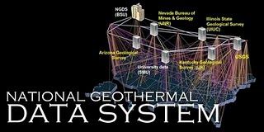
Overview
NGDS is a data system, not a database
System is unified by:
Catalog and standardized metadata
Data access protocols and interchange formats

Slide 4
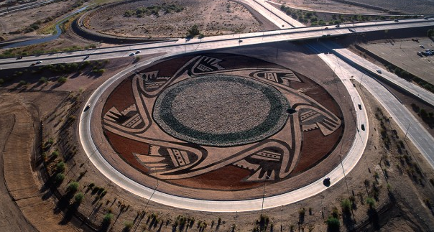
Design Considerations
Content model is for an interchange format
Goal is to simplify the data user’s work
Prefer a ‘granular’ approach – simple, narrowly scoped models
Reuse property elements from existing models
Standardize units

Slide 5
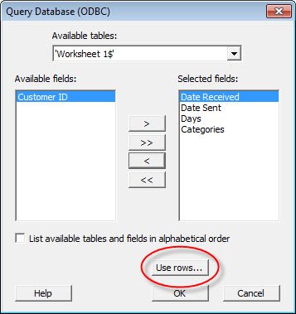

Design considerations
Anything that needs to be used for querying, filtering, analyzing needs to be included in the model
Links to other information via URI– use web architecture

Slide 6
Content Models (Tier 3)
Active Fault/Quaternary Fault
Aqueous Chemistry
Borehole Temperature Observation Feature
Direct Use Feature
Fault Feature
Fluid Flux Injection and Disposal
Geologic Contact Feature
Geologic Unit Feature
Geothermal Area
Geothermal Fluid Production
Geothermal Power Plant
Heat Flow
Heat Pump Facility
Lithology Interval Log Feature
Metadata
Physical Sample
Powell Cummings Geothermometry
Power Plant Production
Radiogenic Heat Production
Seismic Event Hypocenter
Thermal Conductivity
Thermal/Hot Spring Feature
Volcanic Vents
Well Fluid Production
Well Header
Well Log Observation
Well Test Observations
Notes:
6

Slide 7
New content model
First determine if there is an existing content model that meets your requirements
http://schemas.usgin.org
If not…
Determine what is the scope of the model (what kind of entity)
Determine the information that needs to be exchanged about the entity
Look at existing data to see what information is actually available

Slide 8
Constructing a model
What is the model about
Is it a Feature or an observation
What will the model be used for
Are there essential properties
What kind of data do people have
Construct field list
Add standard fields
Add domain specific fields; each field should define data type, obligation, and the scope.

Slide 9
Features, Observations, Records
Feature: describes a geolocated entity of interest,
e.g. facility, borehole, fault, thermal spring, volcanic vent
Has location, label and symbol for map display
Observation: describes the result of an event in which property value for an entity is determined
Chemical analysis, strike and dip measure, earthquake hypocenterr
Has feature of interest, sampling feature, procedure

Slide 10
Standard fields for Data Items
ItemURI – unique, web-resolvable identifier for data item
ItemType – what kind of thing is described (Well type, facility type, fault type)
Source – text statement describing origin of the information
RelatedItem – links to related data items
ItemName – text name unique to the data item in the dataset, for people
ItemDescription – free text describing the item

Slide 11
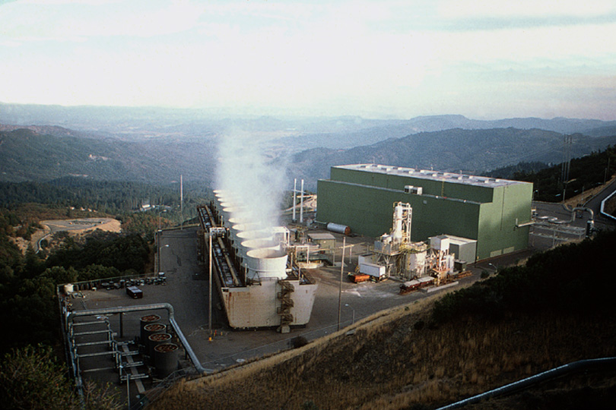
Thank You
The Geysers

Slide 13
NGDS Community Participation
New information exchanges
Geothermal Resource Council 37th annual meeting Las Vegas, Nevada 2013

Slide 14

How to participate
Register resources in catalog
Design and document new content models
Build applications

Slide 15
Register resource in catalog
Engage with node operator
List of nodes accessible via geothermaldata.org web site
Discuss requirements with node; do files need to be uploaded…
Use Form interface to create metadata for resource
Upload files to node if necessary

Slide 16
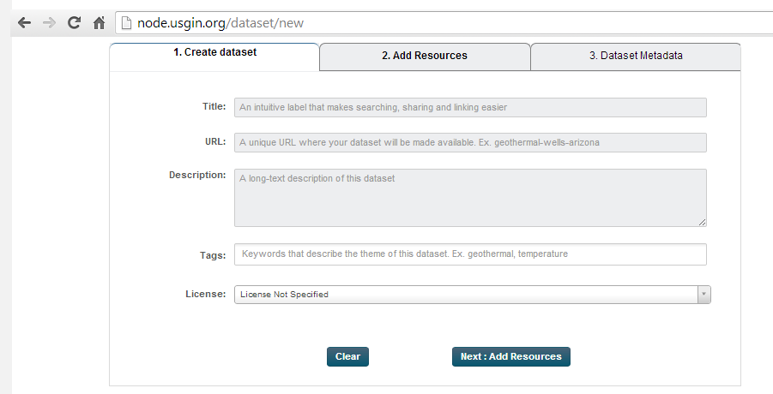
Register a dataset form

Slide 17
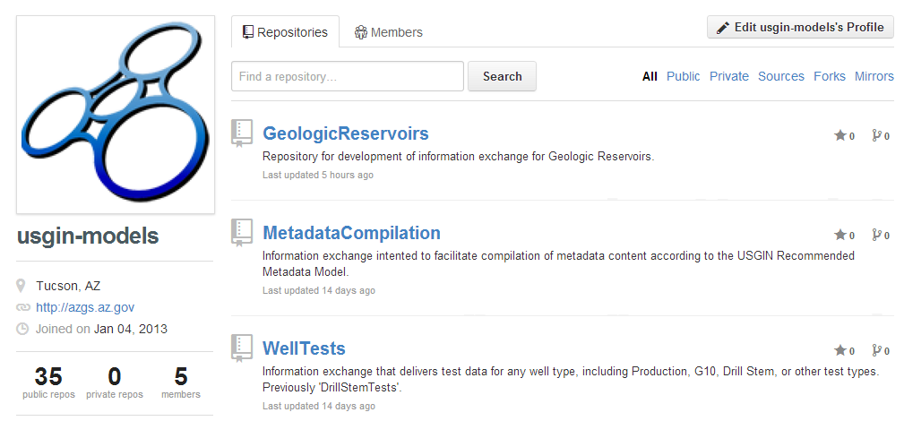
New content model
Models are developed by community process using GitHub
Create new repository on GitHub
Get workbook template
https://github.com/usgin-models

Slide 18
New content model process
Form workgroup
Person that proposes model is ‘shepherd’
Gets volunteers for workgroup (>3, with domain and information modeling expertise)
Workgroup develops draft model
Broadcast to community with request for reviews
Respond to comments (GitHub issues)
Nominate for adoption
Review by schemas.usgin.org steward, any discussion from community
Adoption is formalized when model is made available on schemas.usgin.org

Slide 19
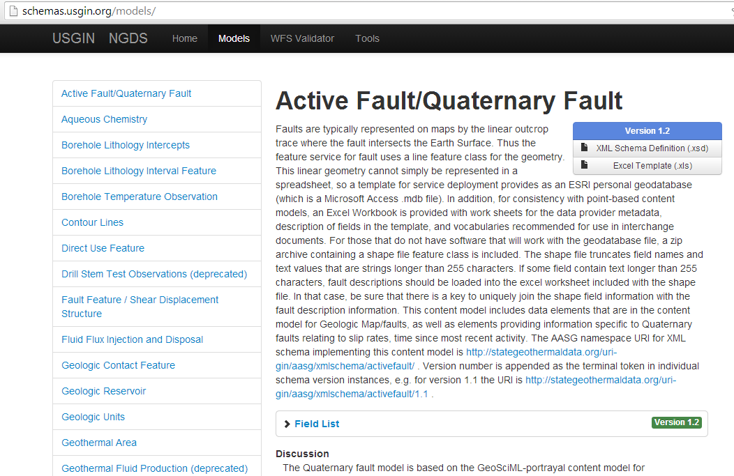
Content Model Repository

Slide 20
Build application
Any application that utilizes data or metadata from NGDS services is an NGDS client
E.g. Geothermal Prospector, USGS The National Map Viewer, ArcGIS, Quantum GIS, IRENA web mapper…

Slide 21
Why should I?
Visibility of data product
Catalog can include data products that are not free
Public scrutiny to increase trust
Mandated
Government open data
NSF data management plans
DOE contract requirements
Increase market for software that utilizes standardized data
Separation of concerns (data publication/stewardship vs. data acquisition/analysis)

Slide 22

Onward to information nirvana

