Slide 1
Terminology development to support geoscience information interoperability CGI Geoscience Terminology Working Group
Regrets from Steve Richard

Slide 2
Outline
CGI Geoscience Terminology Work Group
Objectives
History
Approach to vocabularies
Implementation of vocabularies
Notes:
Charge for WG:
Develop, review, adopt, publish, and steward vocabularies and associated documentation for use in geoscience information systems. Develop liaisons with other semantic interoperability groups to ensure cross-domain interoperability. Special emphasis should made to involve participants and integrate concepts and requirements from regional communities outside North America, Europe and Australia.

Slide 3
Background
1972 IUGS/ICSTI Working group
1988 Multilingual Thesaurus of Geosciences first printed edition
1995 second printed edition paperback
2003 Multilingual Thesaurus Working Group
multilingual core vocabulary developing and expanding the Multilingual Thesaurus of Geosciences
Notes:
ICSTI International Council for Scientific and Technical Information: WG formed 1972, resulted 1988 publication of printed Multilingual Thesaurus of Geosciences.
The thesaurus was printed again in 1995. The Multilingual Thesaurus contains 5823 key terms mapped into the languages of the thesaurus. Publisher is “Information Today”, but the book is not findable on their website (http://www.infotoday.com/). Copright status of the Thesaurus is unclear.
Multilingual Thesaurus Working Group was formed in 2003 with the goal of developing a multilingual core vocabulary to elaborate and expand the Multilingual Thesaurus of Geosciences

Slide 4
Background
2007 Concept Definition Task Group, CGI Interoperability Working Group
develop concept vocabularies for populating GeoSciML interchange documents
2012 Geoscience Terminology Work Group
Notes:
Work on GeoSciML, an XML markup language for geoscience information interchange, started in 2002. In 2007 the need for controlled vocabularies to populate interchange documents led to formation of the Concept Definition Task Group.
In 2012 the CGI council formally merged activities of the Multilingual Thesaurus Working Group and Concept Definition Task Group to form the Geoscience Terminology Working Group.

Slide 5
Workgroup mission
Unite CDTG and MLT work
Develop and steward vocabularies for use in geoscience information systems
Liaison with semantic interoperability groups in related communities
Notes:
Mission is basically to
Continue development of web-accessible vocabularies for geoscience information interchange.
Work on multilingual terms for concepts in vocabularies
Work to integrate CGI vocabularies with other Linked data communties.

Slide 6
Work group members 2013
Kristine Asch (BGR)
Stefan Bergman (SGU)
Florence Cagnard ( BRGM)
Daniel Cassard (BRGM)
Carlo Cipolloni (ISPRA)
Simon Cox (CSIRO)
Mike Craig (GA)
Rachel E Heaven (BGS)
Chris Jenkins (U.Colo.)
John Laxton (BGS)
Marshall X Ma (RPI)
Timothy McCormick (BGS)
Matevž Novak (geo-zs)
Zié Ouattara (GIRAF)
Mark Rattenbury (GNS)
Oliver Raymond (GA)
Stephen Richard (AzGS)
Frands Schjøth (GEUS)
Shaozhong Shi (NUIM)
Clinton Smyth (Georef. Online)
Viktor Snezhko (VSEGEI)
Sieng Sotham (Cambodia)
Francis Talla Takam (GSC)
Harvey Thorleifson (MnGS)
Jouni Vuollo (GTK)
Brandon Whitehead (U. Auk, NZ)
Notes:
https://groups.google.com/forum/?fromgroups#!forum/gtwg
Membership is open, but participation is expected.

Slide 7
Approach
Develop vocabularies for geoscience concepts and property values
Provide concept labels for different language communities
Make vocabularies accessible using web technology for use in information applications
Notes:
The WG approach is to first scope the vocabulary to some particular category or property value that is specified using terminology, for example grain-size, or rock-type. Next the properties that distinguish divisions within the vocabulary must be identified. For example grain-size terms might be based on average or maximum observed grain size; lithology is complex, based on texture/fabric, mineralogy, and typically some genetic interpretation.
Finally, the range of possible values within the scope of the vocabulary must be subdivided and terms assigned to each interval. For example fine-grained, medium-grained, coarse-grained. Sometimes the vocabulary is hierarchical, with broader terms encompassing narrower terms. For example ‘granitic rock’ as a broad concept, with subdivisions like ‘granite’, ‘granodiorite’, ‘diorite’.
The vocabulary defines concepts—these are currently expressed in English-language text definitions.
Labels for the concept in different languages are then assigned.
Vocabularies are published through a vocabulary service hosted by CSIRO using SISSVoc, and made available as
SKOS/RDF, HTML and TXT at resource.geosciml.org (http://resource.geosciml.org/static/vocabulary/cgi/201211/)

Slide 8
Purpose of Vocabularies
Communicate information to user
Interoperability:
Users don’t have to spend a lot of effort figuring out data schema and vocabulary
Enable software interactions based on registered resources and reusable patterns

Slide 9
Concept schemes: the foundation
Collection of concepts with definitions
Rules for definitions depend on applications
For people (glossary, text)
For machines: formal logic (‘ontology’, OWL)
Notes:
Vocabulary is a collection of concepts, defined within a particular concept space. The concepts are currently specified with english language definitions.
Rules for definitions depend on applications
For people (glossary, text)
For machines: formal logic (‘ontology’, OWL)

Slide 10
Interfaces to concepts
Meaning is ultimately represented by some kind of token (symbol)
People use words (sand, arena, песок, رمل)
Machines need formal structures:
URI to identify
Computable representations like OWL
Notes:
Concepts are accessed through various ‘interfaces’ (used in a really generic sense)
For people, the interface is language, and the words in a particular language. Depending on the language and community of users in that language, the word might or might not connote precisely the same concept, but is generally close enough to get the sense across.
Machines need formal structures to represent concepts for any kind of computational comparison/utilization of the vocabularies. URI’s identify concepts, and representations like SKOS or more complex OWL schema are used to convey semantic relationships.

Slide 11
Concept
People
Machines
Term
URI
Labels, Languages
Encoding, Dereferencing
Definition text
Rules, axioms, assertions
Pragmatics– context, connotation
Links
Notes:
People interchange concepts using words, understood through definitions; these may be transmitted in text, photographs, examination of the same ‘prototype’… Understanding is strongly influences by the pragmatics of language, which still eludes computational capabilities in many respects.
Machines use URI’s– string tokens – and the technology of the WWW to ‘dereference’ the identifier to some useful represnetation.

Slide 12
Application: Registries
Associate URI and concept representation
Dereference URI to useful representation
Views constructed from content in a data store
Representations useful in different contexts:
skos/rdf/owl – good for computers
html – good for people
Pictures, other information encoding schemes…
Vocabulary metadata for discovery
Notes:
Functionality depends on the availability of web-accessible registries that can provide machine or human-actionable representations for the concepts. These are the key to semantic interoperability– actual understanding of content in information interchange documents.
HTTP URI’s can be dereferenced using existing web technology, to provide various kinds of representations.
‘meta-registry’ are necessary to discover the existence of web-published (‘linked data’) vocabularies.

Slide 13
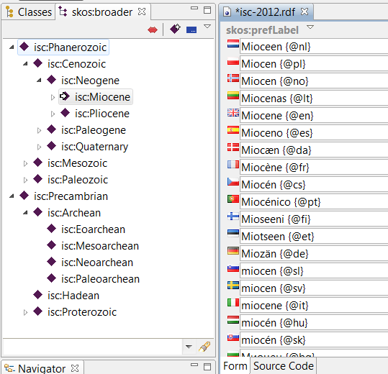
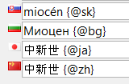
Languages
Time scale has most languages
Other vocabularies only have English
Notes:
Ideally the identifiers can be used to obtain labels in different languages, which could then be used to automate translation of technical documents.

Slide 14
GTWG Process
Requirement for vocabulary identified
Work team formed
Draft vocabulary
Definition of scope and concept space
List of concepts with English-language label, text definitions, and links to broader term
Review and comment
GTWG vote on adoption
Web publication
Notes:
Requirement for vocabulary identified
Work team formed
Draft vocabulary
Definition of scope and concept space
List of concepts with English-language label, text definitions, and links to broader term
Review and comment
GTWG vote on adoption
Web publication
Work is conducted using GTWG google Group and Google Drive. Anyone is welcome (invited, urged!) to participate

Slide 15
Current Status
30 vocabularies accessible through http://resource.geosciml.org
11 vocabularies approved, mostly for Earth Resources, in preparation for web release
30 other vocabularies are used by GeoSciML v3
Alteration and bedding description, borehole related categories, other categories related to Earth resources
These are in various stages of development. Your help is needed!
Language localization needed for vocabularies
URI syntax uses English-language terms for greater transparency
http://resource.geosciml.org/classifier/cgi/lithology/basic_igneous_rock
Notes:
The group met face to face for the first time in St. Petersburg, Russia in June, 2013. A working procedure was established for proposing, developing, reviewing and adopting vocabularies. The group decided to use Google Group and a Google Drive for online collaboration.
New vocabularies are currently under discussion. Check out the GTWG google drive at
https://drive.google.com/?usp=chrome_app#folders/0B-5zXOYZ_JMIcDlCMDZPOU5GMzg

Slide 16
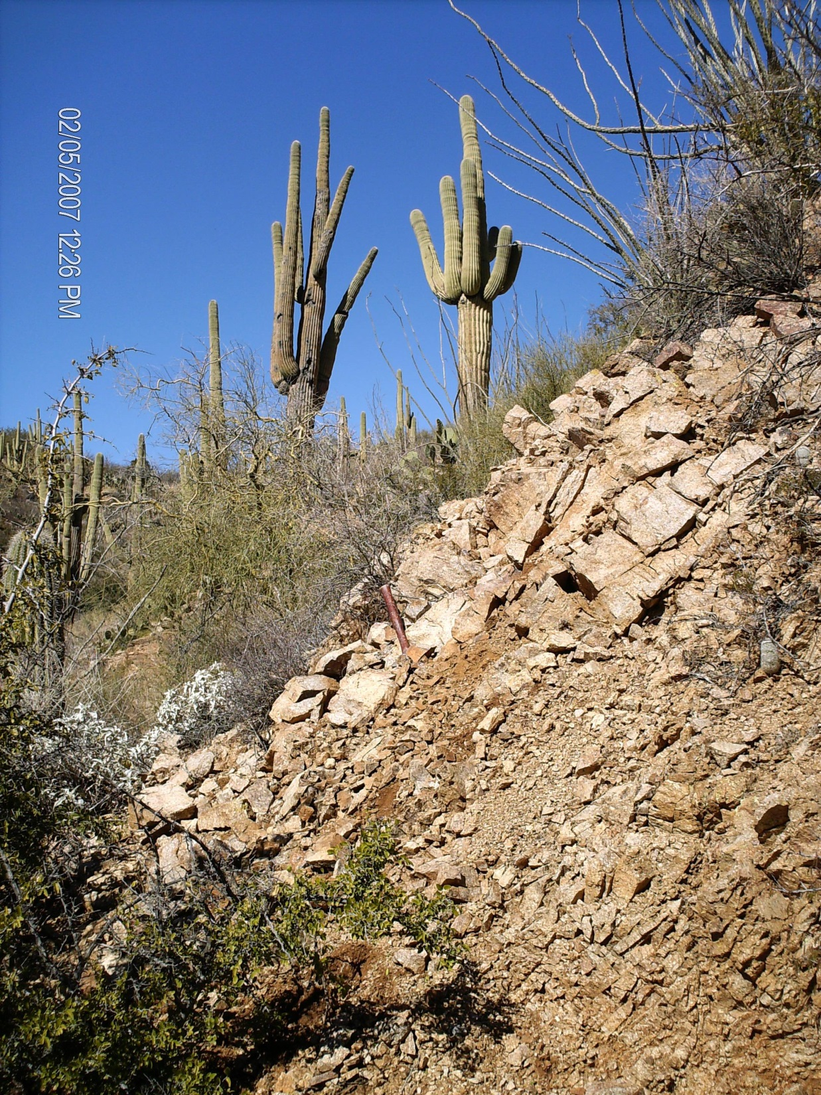
The End
Notes:
Random picture. Put in one that you like!

