Slide 1
Setting up Hyper-V 2012 Replication on Workgroup Servers
Documentation:
Hyper-V 2012 Replication on Workgroup Servers.docx
Available at:
https://github.com/usgin/Workshops/archive/master.zip
Eastern Regional Workshop

Slide 2
Hyper-V is a Windows Server Role that can be installed on Windows Server 2012 platforms
Purpose: allow any hub or node in NGDS to have complete and immediate server replication (acting as a back-up in emergency) at a partner hub or node
Prerequisites:
A minimum of two Windows Server 2012 Hyper-V host servers
One host server will act as the primary server, of which copies will be made
Another host server will act as a replica server used to receive replica copies of virtual machines from the primary host server

Slide 3
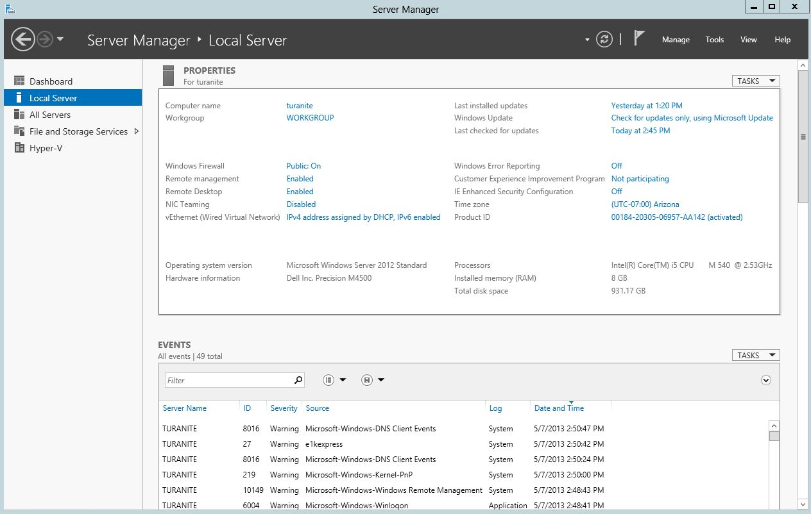
Install
To install the Windows 2012 Hyper-V role, open the Windows Server 2012 Server Manager
Add Roles and Features to a Local Server

Slide 4
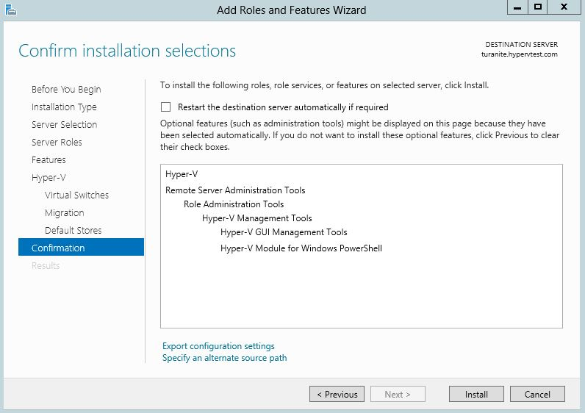
Continue the Add Roles and Features Wizard
The last step in the Wizard is the Confirmation page; click Install to begin installation process

Slide 5
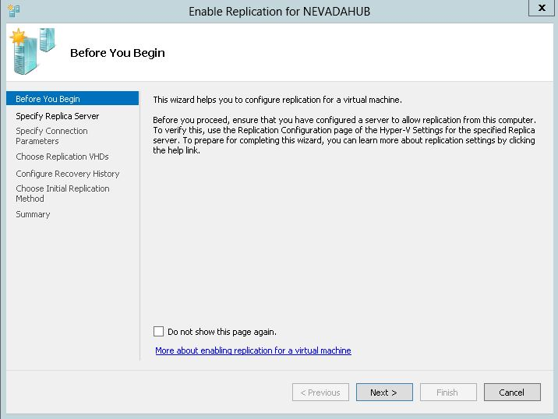
Enable Replication
In Hyper-V Manager, right-click the virtual machine that you wish to replicate; click Enable Replication to start the Enable Replication Wizard
Figure 18: Before You Begin

Slide 6
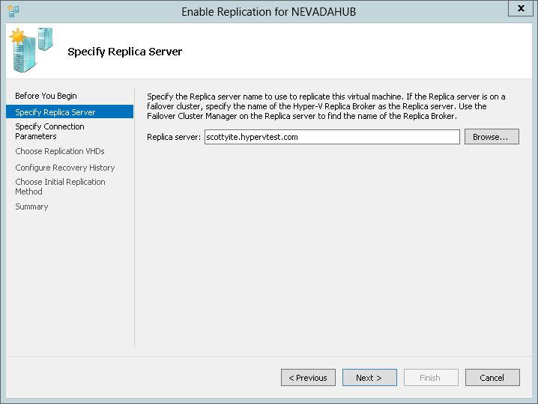
Enter host name and connection parameters of server to replicate
Figure 19: Specify Replica Server

Slide 7
Continue the wizard, following the documentation for guidance.
You are now ready to replicate a server for any hub or node in NDGS and prevent catastrophe!
For Hyper-V demo video, visit http://blogs.technet.com/b/haroldwong/archive/2012/09/05/it-camps-on-demand-windows-server-2012-demo-hyper-v-replica.aspx

