Slide 1
NGDS Repository
Register your resources with NGDS

Slide 2
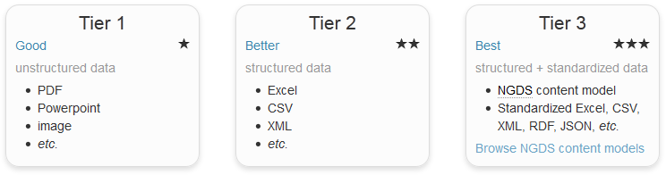
Tiers of NDGS data delivery
Web Mapping Applications
Online Digital Maps
Online Datasets
Online Maps with Structured Data
Core Samples Database
Publications Database
Web Services (WMS/WFS)
Web Services in interchange format (WMS/WFS)
Databases in ‘Metadata’ information exchange format

Slide 3
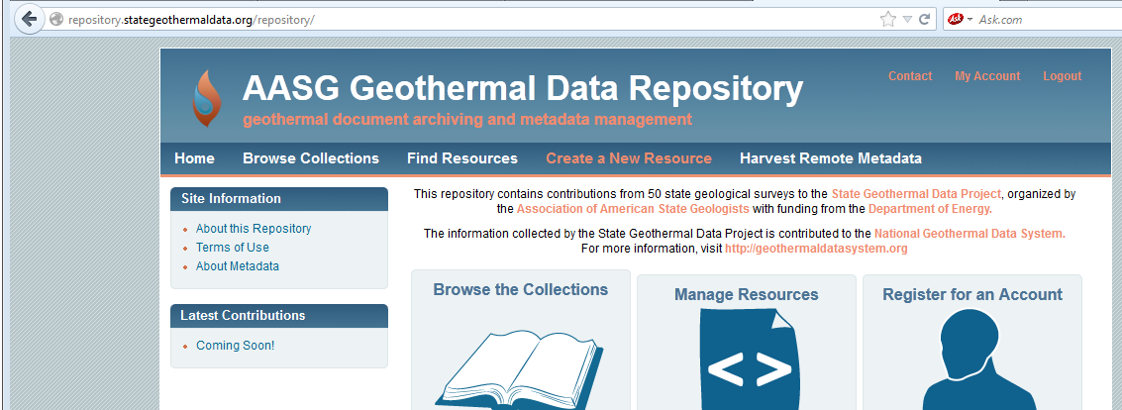
Web applications and services
Tier 1 and 2 online web applications, web services, and databases can be a part of NGDS
Metadata A metadata record for the resource must be created as part of the upload process and this metadata will be harvested into the USGIN Catalog
Provide links to enable searches on your data Make your data accessible along with 5 million data points and 18,000 documents

Slide 4
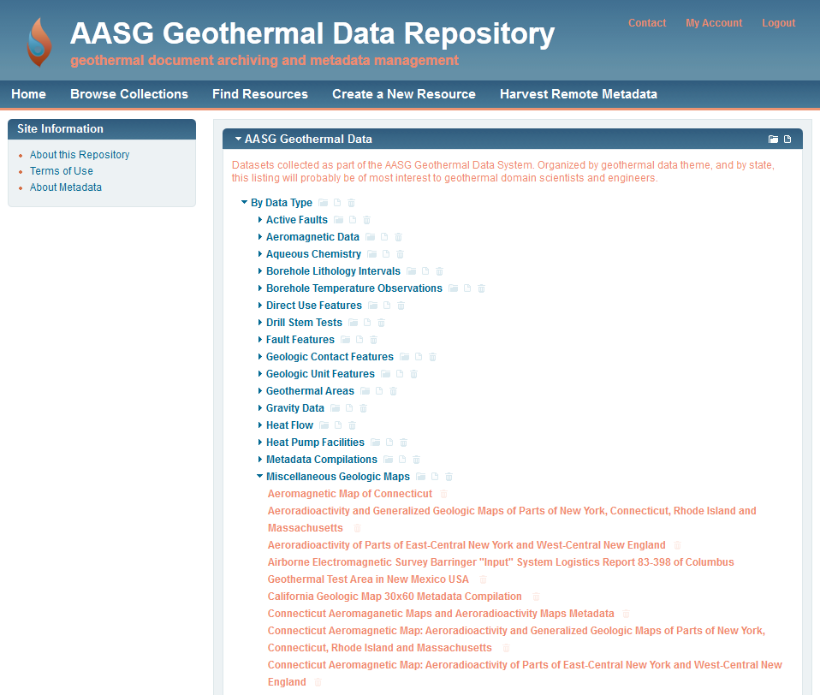
Data Services in NGDS interchange formats
(Tier 3)
Online Geologic Maps as PDFs (Tier 1) and WMS (Tier 2)

Slide 5
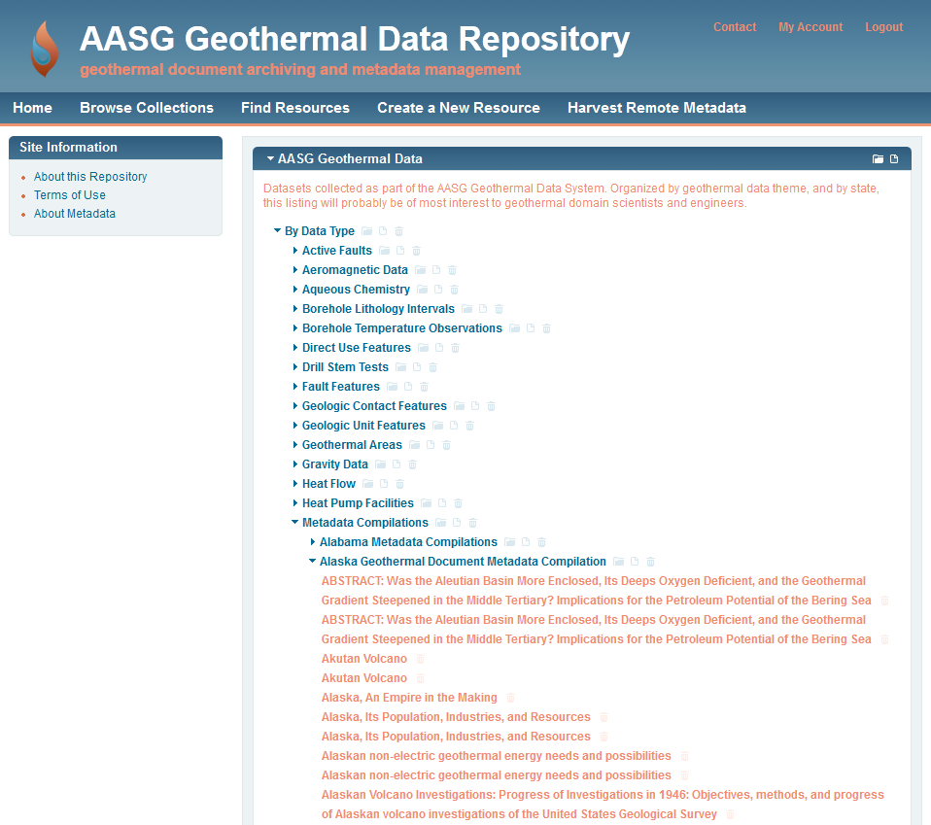
Data Services in NGDS interchange formats
(Tier 3)
Online Geologic Maps as PDFs (Tier 1) and WMS (Tier 2)
Publications and other databases in Metadata information exchange format
(Tier 3)
http://repository.stategeothermaldata.org/repository/
Notes:
LIVE DEMO

Slide 6
USGIN Metadata Standards
ISO19139 Metadata standards (and ISO19115 / ISO19119 standards for data web services)
Allows formal, structured data with controlled vocabularies for effective searcing of catalog
(all documents and data services)
Meeting minimum standards, made easy:
Built-in mandatory fields in repository form
Information Exchange Formats
Metadata Content Model
Services Content Models (30+)
Notes:
ISO 19115 The base ISO metadata international standard for the description of geographic information and services; ISO 19139 is XML implementation of that.

Slide 7
Create New Resource
Creating a new resource in the NGDS repository that represents data or web services exposes it to the catalog where it becomes searchable within the system, while creating metadata for the resource or service.
This step is necessary to fulfill the Tier 3 USGIN requirements.
Go to http://repository.stategeothermaldata.org/repository/
to Create a New Resource

Slide 8
Create New Resource
Upload the Excel file, database file, or shapefile that represents this service
Add links for ESRI, OGC:WFS, and OGC:WMS services
Add Author and Distributor information
Add Keywords
Add Description
Add to Collections on screen left. Collections are categorizations of metadata, where state, organization, and data type are specified.

Slide 9
You have now registered your resources with NGDS!

