Slide 1
NGDS Web Services
Transform your data into the most readily and widely accessible format

Slide 2
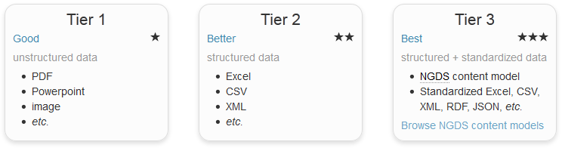
Tiers of NDGS data delivery
Web Mapping Applications
Online Digital Maps
Online Datasets
Online Maps with Structured Data
Core Samples Database
Publications Database
Web Services (WMS/WFS)
Web Services in interchange format (WMS/WFS)
Databases in ‘Metadata’ information exchange format

Slide 3
USGIN Metadata Standards
ISO19139 Metadata standards (and ISO19115 / ISO19119 standards for data web services)
Allows formal, structured data with controlled vocabularies for effective searcing of catalog
(all documents and data services)
Meeting minimum standards, made easy:
Information Exchange Formats
Web Services Content Models (30+)
Notes:
ISO 19115 The base ISO metadata international standard for the description of geographic information and services; ISO 19139 is XML implementation of that.

Slide 4
Information exchange format – includes a content model (Excel workbook) which provides a “template” to make it easier for researchers to submit their data with structure (allowing for interoperability as specified by a schema)
Content Models (Excel workbooks) contain tabs:
to map the existing database into template
to assist mapping with field definitions, terms, instructions
about the content model itself, data type that is appropriate

Slide 5
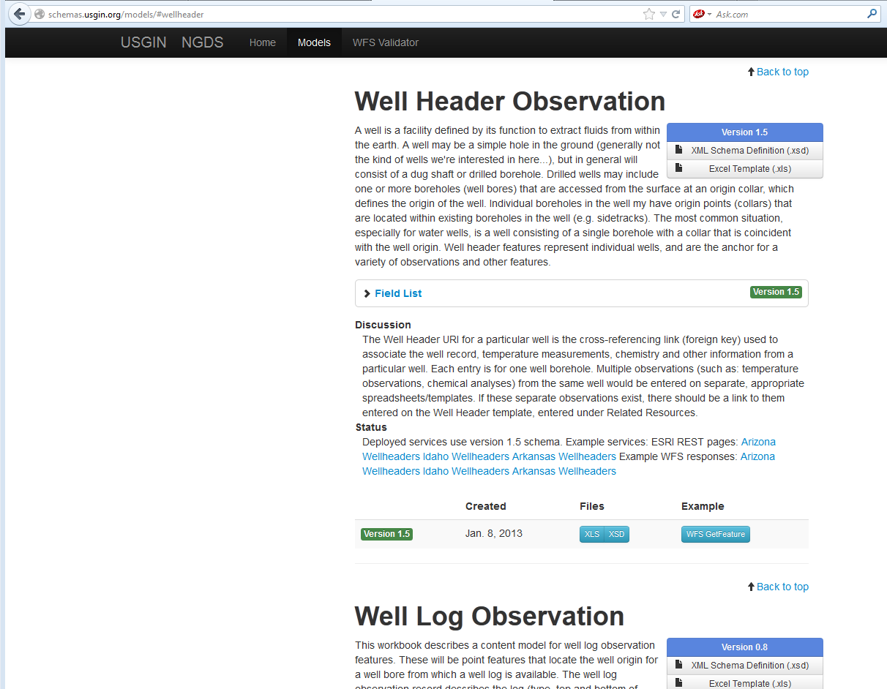
Access content models at: http://schemas.usgin.org/models/

Slide 6
Entering Data into Content Models
Open Excel workbook ‘Template’ tab. Copy and paste your records into the spreadsheet, field by field
Using shapefiles or geodatabase, Join with Excel ‘Template’ tab in ArcMap
Microsoft Access can be useful to Map Fields of personal geodatabase to Excel ‘Template’ tab, concatenate data in fields, consolidate more easily
ArcSDE database to Feature Class, using SQL views that match the interchange format http://lab.usgin.org/groups/arcgis-server-and-ogc-services/sde-trickery-and-awesomeness-data-transformations-behind-scene
Note: Your data may not correspond with the fields in a given content model on a one-for-one basis; if not, then a degree of ‘schema mapping’ is required

Slide 7
Overview of Data Processing – ArcMap Server or GeoServer
Database to Excel
Get into Information Exchange Format
Excel to PostGIS
Get into Feature Class data table
ArcMap or GeoServer
Publish as Web Services

Slide 8
Let’s Talk URIs
URIs – a core part of a USGIN-styled system
Each record in a dataset has a globally unique identifier; hence each record can be seen as a unique object
Important to reduce dupilication and determine associations between resources
An extra layer is added onto this idea in NGDS, where the URIs actually redirect to something in a browser
An implemented rewrite rule enables URIs to dereference an online resource or representation of each individual record of the data service. Examples:
http://resources.usgin.org/uri-gin/isgs/well/API:120010005200/
http://resources.usgin.org/uri-gin/isgs/welllog_tif/120010010800_ies/
Notes:
I was reading about a company who provides Guidance for Unique Object Identifiers (OIDs) for health care systems, where each document associated with a patient has this identifier and can be found by the system with no other information (such as name or SSN).

Slide 9
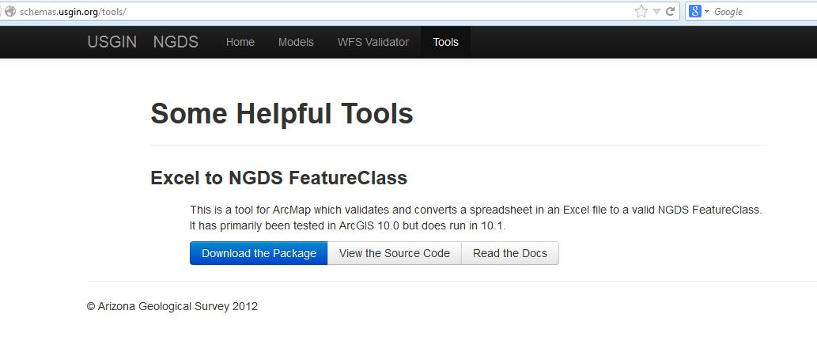
Download ExceltoNDGSServices tool at http://schemas.usgin.org/tools/

Slide 10
What will the tool do?
Validates Excel file against chosen schema (XSD)
Checks required fields for data
Calculates values for missing data in required fields
Corrects data types, as necessary
Ensures SRS is EPSG:4326, or will reproject
Ensures URIs are unique and in correct format
Creates georeferenced Feature Class in Personal Geodatabase
data table ready for PostGIS database

Slide 11
If using ArcMap Server, create MXD
Open ArcMap
Add Feature Class
Right-click layer, choose Properties
Symbology, choose Import (http://repository.stategeothermaldata.org/repository/resource/98ddf901b9782a25982e01af3b068fdc/)
General: fill in metadata
Fill in metadata for Data Frame, Map Document
Connect to data table in PostGIS database
Notes:
Once you’ve deployed the service, this will end up on the service rest page (if deploying with ArcServer). Go to AZ’s AKActiveFaults rest page

Slide 12
Load Data and Publish Services
Load Feature Class/data table into
PostGIS database
ArcMap Server – publish a new service
GeoServer – create new workspace, data store (connecting to PostGIS data table), and new layer

Slide 13
If using GeoServer, create app-schema
Download the app-schema extension and place the jar files in the WEB-INF/lib directory
Create a “mapping file” and place in GeoServer workspaces/[layer]/[store] directory, example: http://repository.stategeothermaldata.org/resources/documents/App-Schema-Mapping-Files/HeatFlow.xml
Edit datastore.xml file, example: http://repository.stategeothermaldata.org/resources/documents/App-Schema-Mapping-Files/datastore.xml

Slide 14
Validating Web Services
Schema Validation using WFS GetCapabilities
Copy the WFS GetCapability link
Paste into validation tool http://schemas.usgin.org/validate/wfs
Choose appropriate schema and version
Notes:
Also use Jessica’s tool ********Have everyone navigate to a home page and validate for themselves

Slide 15
You now have a Tier 3 data service!
Please see the NDGSRepsitory presentation for registering your service with NGDS

