Slide 1

Why
Is interoperability worth the pain

Slide 2
Make things easier
Make life easier for the customer
They don’t have to do figure out new data structures
Make metadata easier
Don’t have to document data structure-it’s already done.
Create bigger market for applications

Slide 3
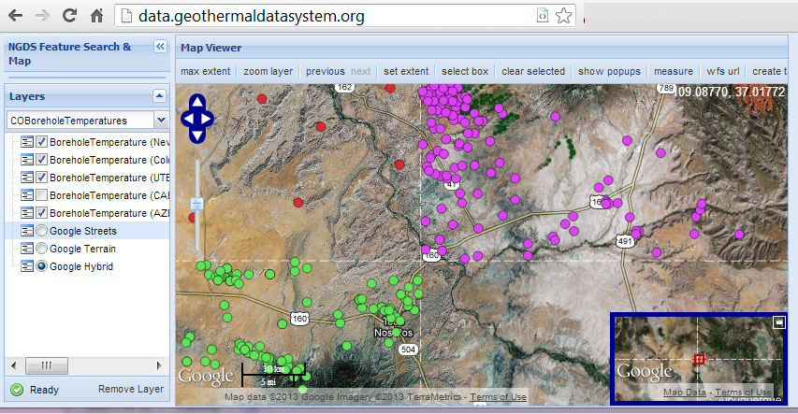
Example: NGDS Borehole temperatures

Slide 4
Linked Data
Use identifiers that can be dereferenced on the WWW
Enable navigation between related resources
GitHub\USGIN\Workshops\WesternRegionalWorkshopWMS_URIDemo.mxd

Slide 5
NGDS Sustainability
Stephen Richard and NGDS team
Reno, NV May 14, 2013

Slide 6
Outline
What needs to be sustained
Costs
Business models

Slide 7


Paradigm Shift
From: Paper publications as the product
To: Information via web services as the product

Slide 8
State surveys as data providers
We all have web servers and web sites
Run data services
Have to integrate web usage metrics into agency performance assessment

Slide 9
What needs to be maintained
Web server:
Physical server
Cloud server
Hosting service
Datasets:
Correct errors
Update with new data
Upgrade as software evolves

Slide 10
What’s it cost… People
costs calculated for AZGS, include ERE, vacation, holiday, sick…
supervisor | 1 hr/wk | $ 3,120.00
Technician | 8hrs/mo, every year a big job = +40hr/yr | $ 6,800.00
Content manager | 4 weeks/yr; new content and updates come in bursts | $ 5,280.00
 |  | $15,200.00

Slide 11
What’s it cost: Computers
Estimated cost per year; these will vary widely…
electricity, cooling, space | $ 800.00
internet | $ 100.00
software, guess academic site license kind of pricing | $ 1,000.00
Servers, storage (budget on basis of VMs running in a local host, with a storage-area network); base on AZGS calculation with HP server running ~20 VMs, 5 year lifetime. | $500.00 /yr per VM; est. $1200 /yr
subtotal computer $3,100.00

Slide 12
Grand Total:
$18,300.00 per year
% personnel 83%
% equipment 17%
Account for lifetime of hardware
Include funds for personnel to monitor and update

Slide 13
Business models:
Build into operating costs
Sponsors
Advertising
Subscriptions
…

